Slide 1
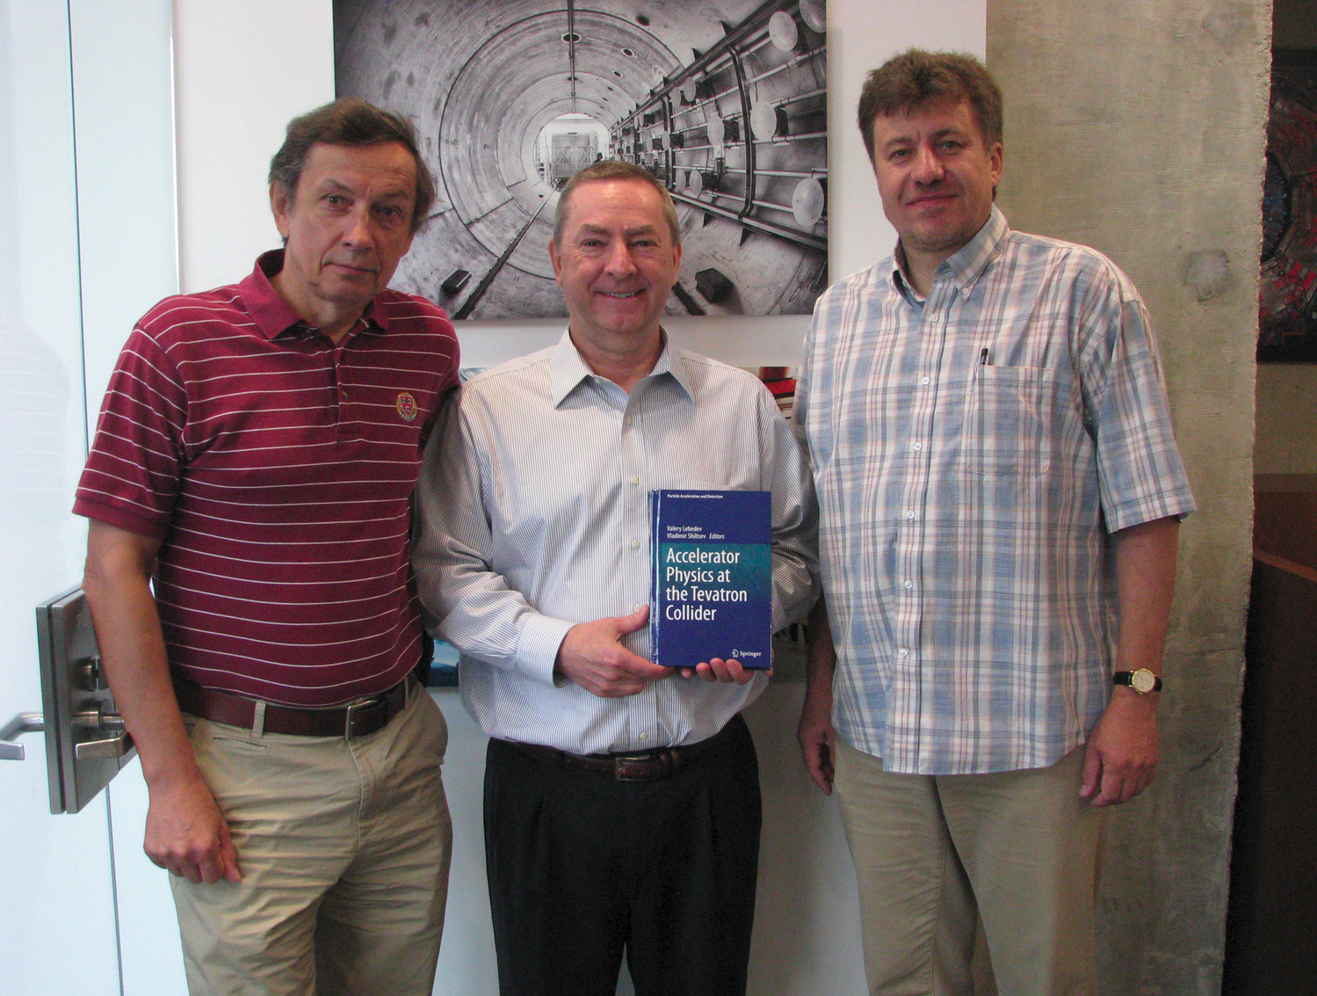
Farewell to Valery
Vladimir Shiltsev
Fermilab
19 November 2021

Slide 2
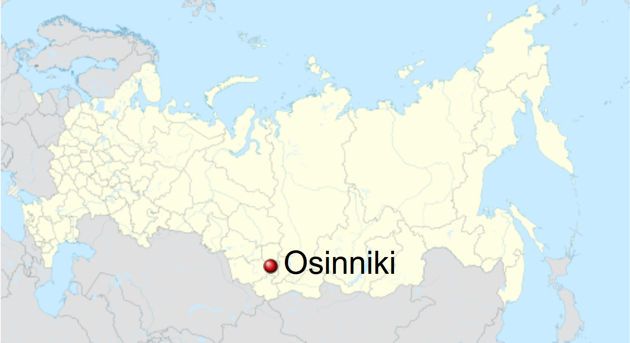
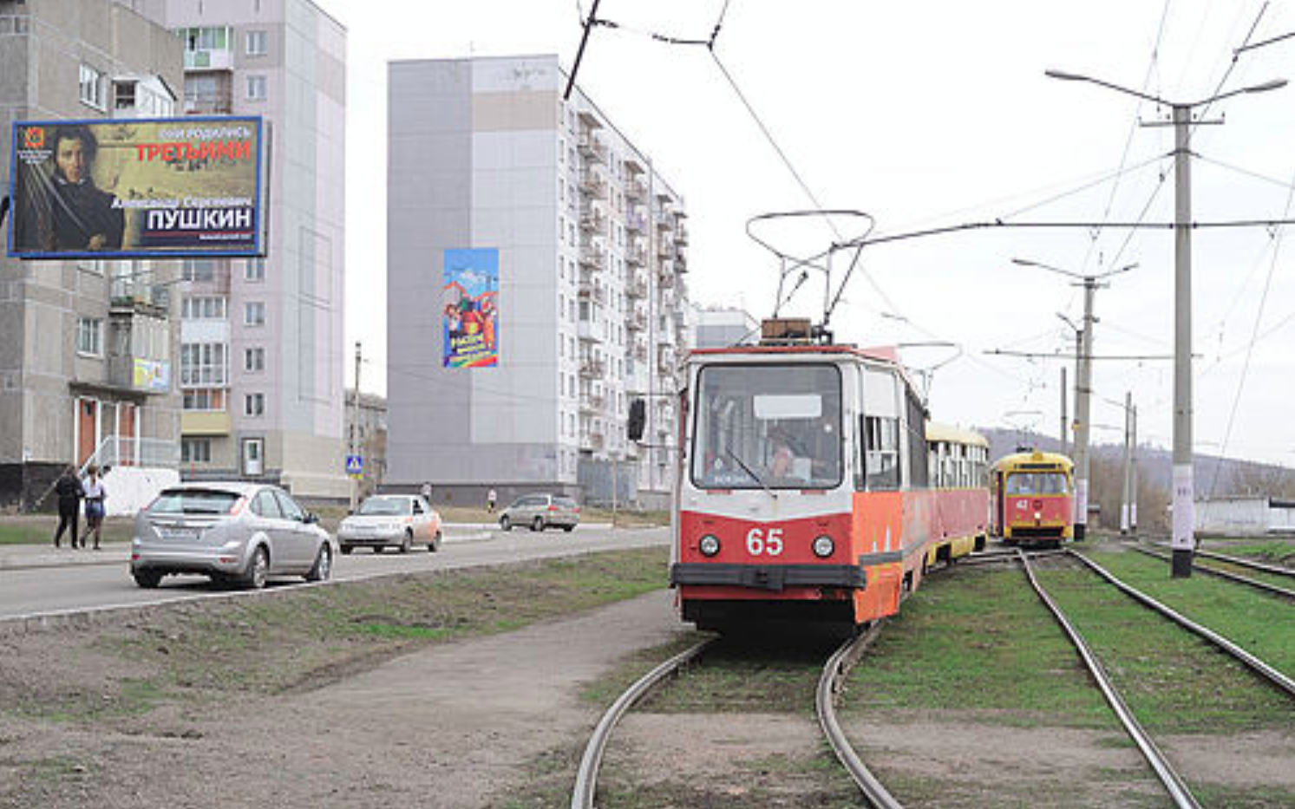
Before Fermilab: Osinniki → Novosibirsk State

Slide 3
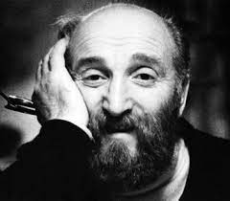
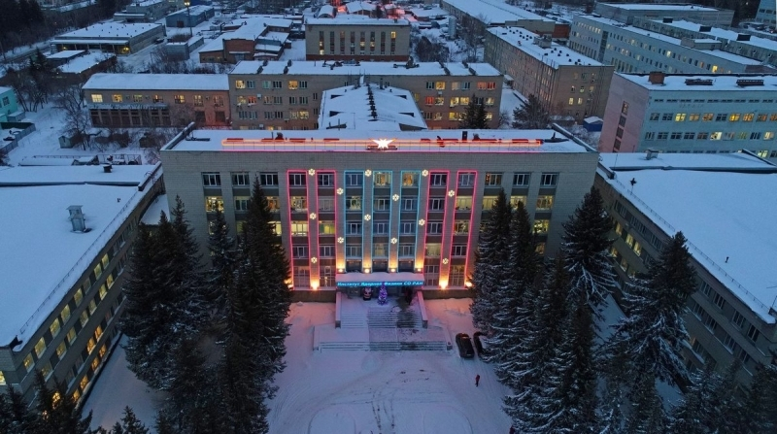
Novosibirsk State University → Budker INP
NSU (1958- )
Budker (1918-1977)
Valery is an active member
of the NSU alumni association
Budker Institute of Nuclear Physics (1958- )

Slide 4
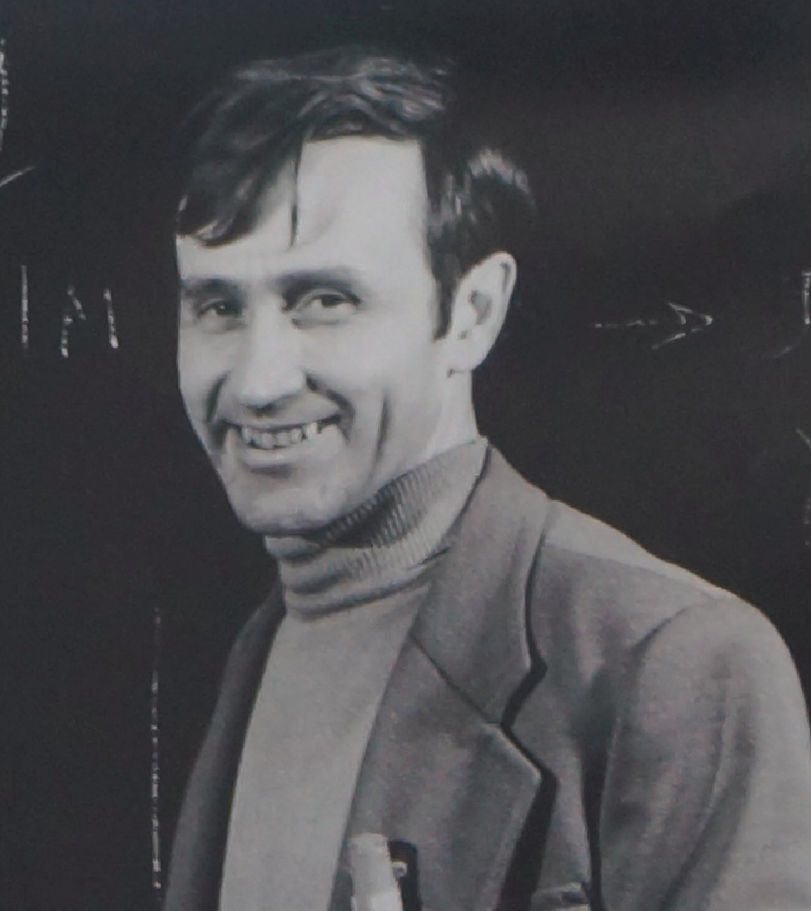
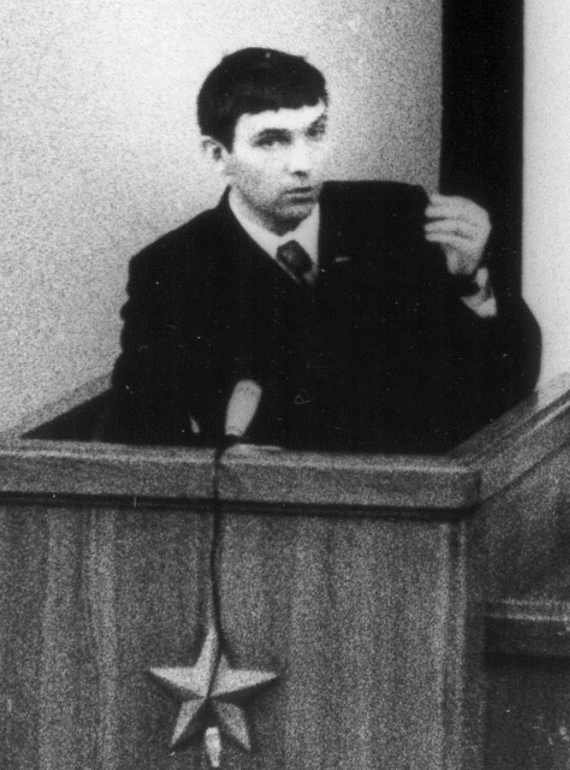
Colleagues (among many others)
Vasily Parkhomchuk
Igor Meshkov
Alexander Skrinsky

Slide 5
Valery : “Hero of the Tevatron” (twice!)
Dec 2003 : 4-6 mm IR magnet moves (with N.Gelfand and M.Syphers)
May 2004 : β* from 48 cm → 35 cm lifetime (w. J.Annala)

Slide 6
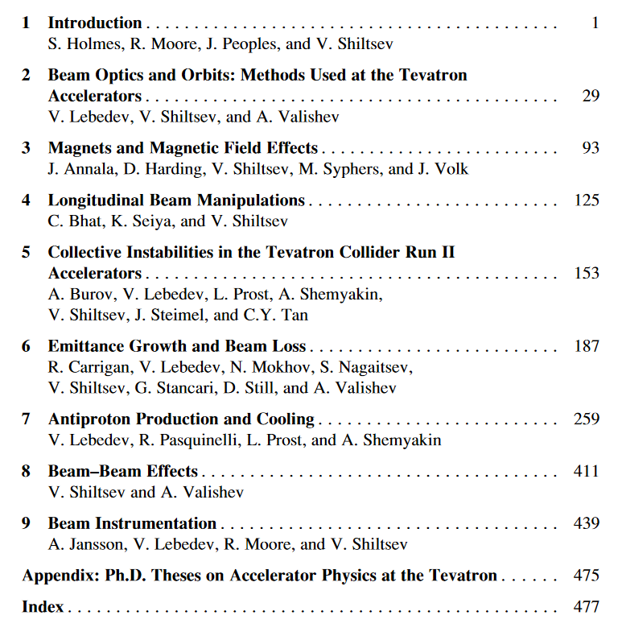
“Handbook of Collider Physics”
“This book will serve as a wonderful and unique reference for many decades to come. The authors and editors are to be congratulated for their effort to compile and preserve the accelerator knowledge of the Tevatron … . I recommend this book highly to accelerator professionals around the world. Reading it should be all but compulsory for anyone wishing to improve the performance of an existing frontier machine, or design the next generation of highest-energy colliders…”
Frank Zimmermann, CERNCourier, cerncourier.com, November, 2014
> 7,200 downloads

Slide 7
Superconducting Super Collider
20+20=40 TeV cme proton-proton collider
87.1 kilometers circumference, near Dallas, TX
* cancelled in 1993 due to budget problems

Slide 8
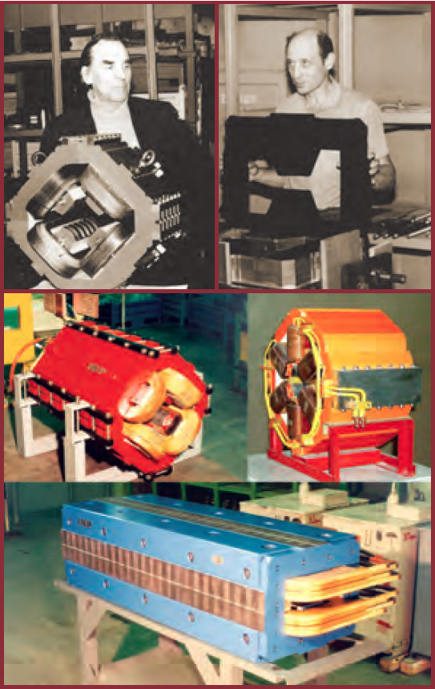
BINP Contributions to SCC
… many, including:
LEB (low energy booster) magnets, energy storage, RF cavities, etc
Linac 600 MeV
LEB 0.6-12 GeV, 10 Hz, 0.57 km
MEB 12-200 GeV, 3s, 4.12 km
HEB 0.2-2 TeV, 60 s, 10.8 km
SSC 2 – 20 TeV, 87.12 km
Photo-desorption studies
Emittance growth and ground motion studies

Slide 9
Initial Thoughts
Valery, Parkhomchuk, Skrinsky & me BINP-91-120
External dipole kicks → filamentation and beam emittance growth
Feedback can suppress it if it is fast enough
Beam-beam determines the tune spread → how fast FB system should be
Later, Gennady Stupakov joined us at the SSC Lab & analysis of slow ground motion SSCL-495; Part. Accel. 44 (1993):147

Slide 10
Valery’s Studies
Emittance growth
eg at the SSC f_0=0.96 kHz
FB suppression
need gain faster than
Tune spread set by beam-beam interaction

Slide 11
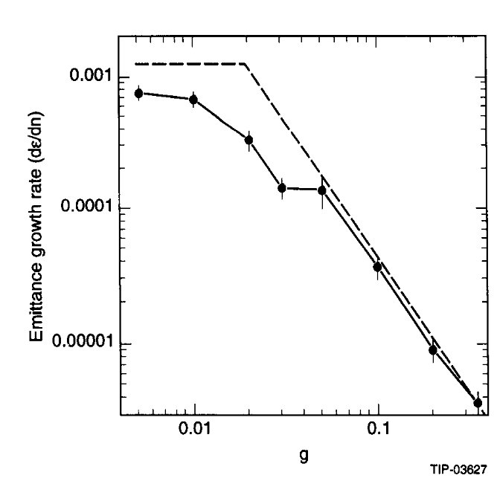
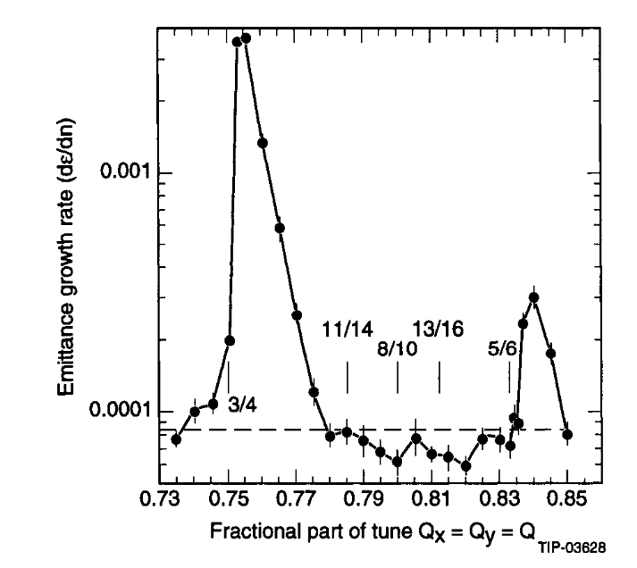
Valery’s Simulations
Emittance growth
depends on PSD, FB gain and beam-beam parameter approx. as predicated
Of course, tune-dependent
avoid resonances
Effect due to coherent beam-beam (modest)
Effect due to beam-beam separation and parasitic collisions (may be considerable)
Important: measure “real” PSD

Slide 12
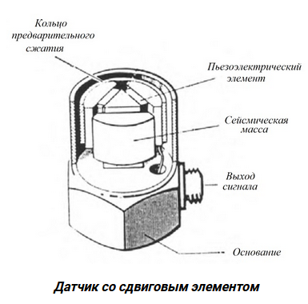
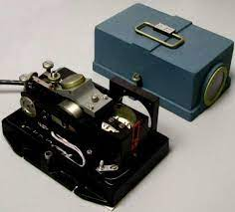
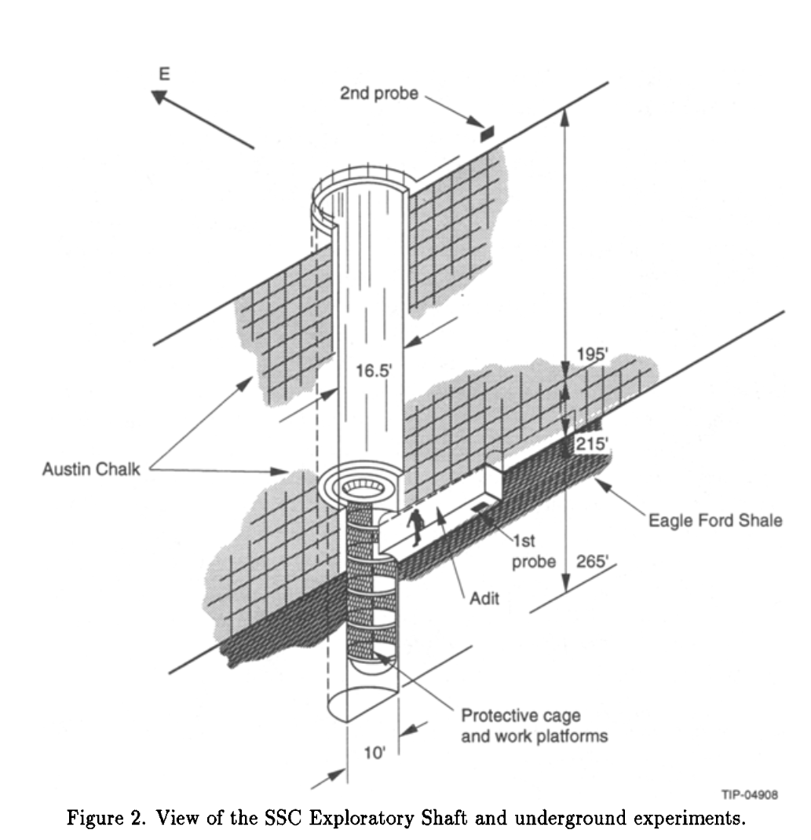
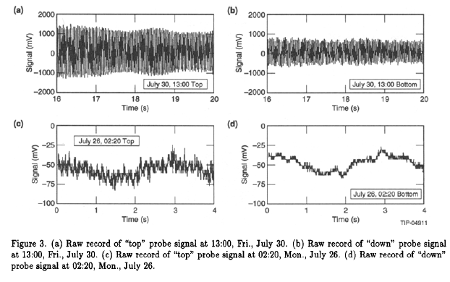
My contribution: seismometers and measurements
Seismometers SM-3KV
0.1 Hz -few 100’s Hz
Piezo-accelerometers
TA-2 200 Hz – few kHz
Alignment data ~months

Slide 13
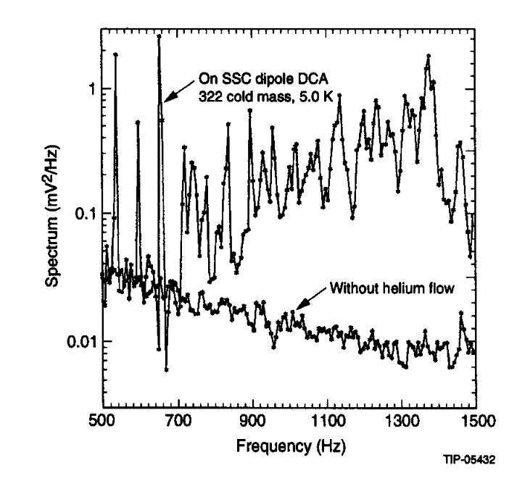
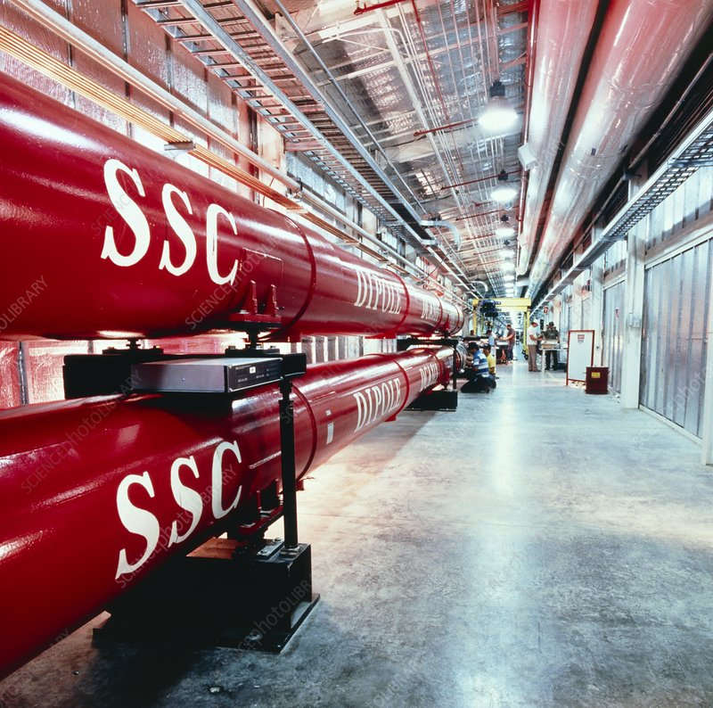
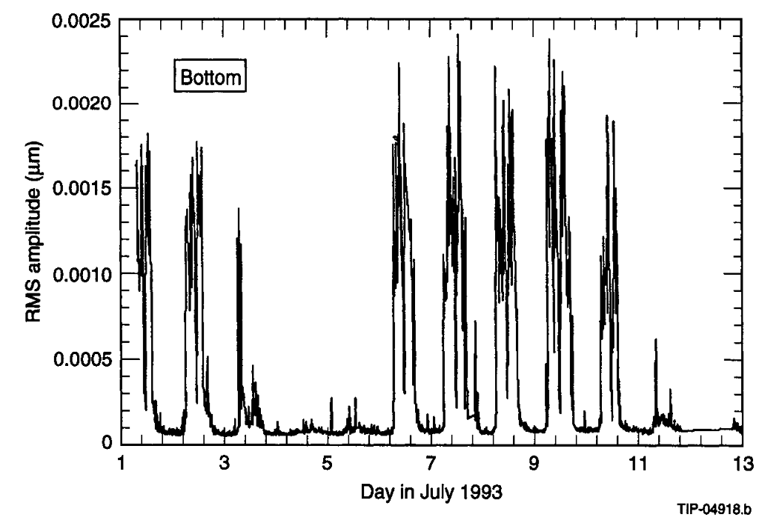
Results: “up” vs “down”, “quiet” vs “noisy”
+ measured vibration of cold mass to estimate “frozen field” dB/B fluctuations
inside dipole aperture

Slide 14
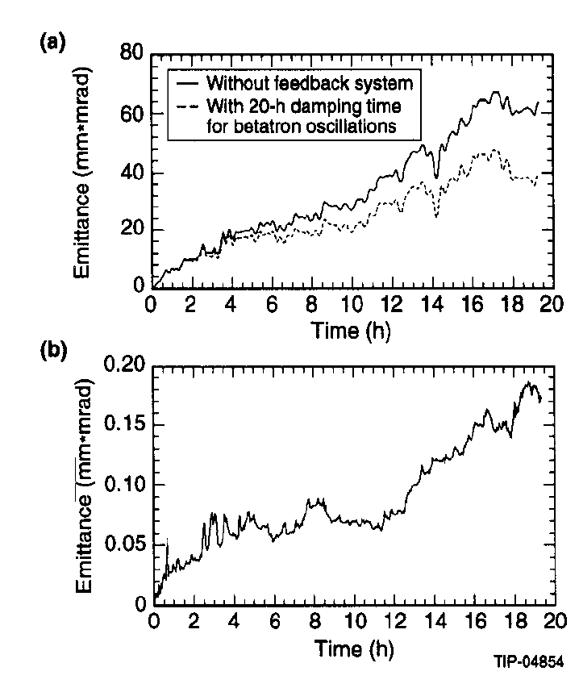
Results (2):
a) Emittance growth will be barely to-lerable under quiet conditions 1π/day
b) Emittance growth will be huge
under noisy conditions → need “low noise” FB system with g=0.05

Slide 15
Results (3):
c) (expected) slow ground motion
with ATL coefficient
will be tolerable with strong enough orbit correction system

Slide 16
References:
Emittance growth due to noise and its suppression with the feedback system in large hadron colliders
V. A. Lebedev
AIP Conference Proceedings 326, 396 (1995
Ground motion measurements at the SSC
Vladimir Shiltsev
AIP Conference Proceedings 326, 560 (1995);

Slide 17
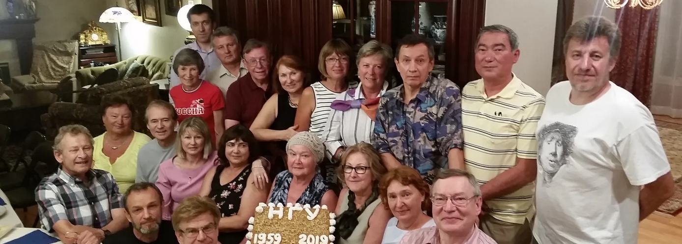
Dear Valery: a) we’ll miss you! b) stay in touch!

