Slide 1
Valeri’s Journey in Beam Optics
Alexander Valishev
V.Lebedev’s Retirement Symposium
19 November 2021

Slide 2
Preface
“A man must accomplish three things: build a house, plant a tree and raise a son”
Accelerator physicist version:
“Any accomplished accelerator scientist must
Write the best beam dynamics/optics code
Invent the best parametrization of coupled betatron motion”

Slide 3
Otherwise, how do we explain this
Transport
MAD
Dragt-Finn
MaryLie
SAD
COSY-Infinity
MADX
ORBIT
TRACK
OPAL
Synergia
IMPACT
PTC
RING
WARP
Elegant
OPAL
DIMAD
SixDSim
…
OptiM

Slide 4
Parametrizing betatron motion is a bit more involved but still…
D.A. Edwards and L.C. Teng, Parametrization of linear coupled motion in periodic systems, IEEE Trans. Nucl. Sci. 20 (1973) 885
V. Litvinenko and E. Perevedentsev, Calculating beam parameters in a storage ring with arbitrary coupling, In Proc. of All-Union Accelerator Particle Conference, Dubna, 1978, p. 254
I. Borchardt, E. Karantzoulis, H. Mais and G. Ripken, Calculation of Beam Envelopes in Storage Rings and Transport Systems in the Presence of Transverse Space Charge Effects and Coupling, DESY 87-161, 1987
D. Sagan and D. Rubin, Linear analysis of coupled lattices, Phys. Rev. ST Accel. Beams 2 (1999) 074001
V. Lebedev and S. Bogacz, Betatron motion with coupling of horizontal and vertical degrees of freedom, (2010) JINST 5 P10010

Slide 5
Beam optics is tightly coupled with performance
Optics is the foundation of every machine, especially a collider like Tevatron
Beam transport from injector to the collider without loss of intensity or degradation of emittance
Emittance growth due to injection oscillations
Emittance growth caused by betatron and dispersion mismatch
Emittance growth due to x/y coupling
Focusing on the antiproton production target
Beam circulation in the ring
Peak luminosity
Beam size at the IP
Luminosity integral
Beam lifetime
Emittance blowup

Slide 6
Systematic approach to optics control is critical for success of large facilities
Solid theoretical understanding of key phenomena
That is why treatment of betatron coupling is important
Data analysis methods
Good beam diagnostics instruments
From beam E/M signals to measured quantities
Effective methods and software tools
Accurate lattice model
Software integration with control system
Convenient GUI
Thoughtful approach to implementation and use
The ever-present time crunch
Preexisting conditions

Slide 7
The problem of coupled betatron motion
For linear optics, the particle phase space coordinates can be transported through the sequence of lattice elements by matrix manipulations
E. Courant and H. Snyder (Annals Phys. 3 (1958) 1) came up with an elegant parametrization for transport maps in 1-D case
For 2-D case, the definitions of parameters are not unique, and computations may break in systems with strong coupling
Eigenvectors and the matrix of second moments are unique, however analysis of systems and visualization are aided by parametrization
The ‘best parametrization’ will be implemented in useful software
V. Lebedev and S. Bogacz, (2010) JINST 5 P10010 contains 26 pages of formulae that have been coded in OptiM and proved operational usefulness for strongly coupled lattices
CEBAF, most of Fermilab machines: transport lines, Booster, Accumulator, Debuncher, Recycler, Tevatron, e-Cool, IOTA

Slide 8
OptiM

Slide 9
OptiM
First version 1998 (?)
Windows 32-bit code
Linux version 2004
Active development by Valeri until 2014
2014 onwards: a major rewrite by Jean-Francois Ostiguy
Qt - Windows, Linux, MacOS
Many new features
Own lattice format
Own scripting language
Advanced GUI
Operational models of
Rings: Booster, Accumulator, Debuncher, Recycler, Tevatron, IOTA
Lines: Fermilab transport lines, e-Cool, ILC

Slide 10
Putting it all together for Tevatron
BPM signal analysis
Orbit Response Analysis
Orbit response data collection application in Fermilab ACNET system (P163)
Data fitting/analysis (manual) – resulted in greatly improved machine understanding: improved beam transfer, reduction of beta-function (+15% luminosity)
Valeri initiated the implementation of LOCO algorithm for machines of Fermilab complex (2004-2006). V. Sajaev (ANL), V.Nagaslaev, M.Xiao, A.Petrenko, A.Valishev
Further improvement of performance: e.g. ultimately reached beta-function of 28 cm (+10% in luminosity)
Beam lifetime improved through second-order chromaticity correction

Slide 11
When good is not good enough
LOCO is a very good tool, but the speed of data collection at hadron machines like Tevatron is low (2+ hours)
LHC relies on AC dipole measurements for optics reconstruction, however the case of coupled modes presents some challenges
Valeri initiated research on using independent component analysis of kicked-beam turn-by-turn signal

Slide 12
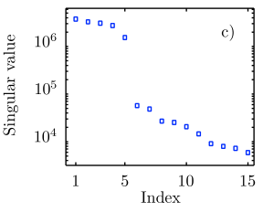
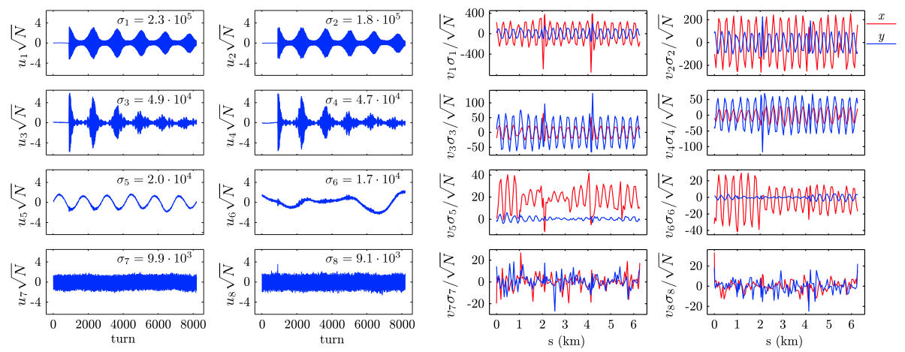
Model-independent analysis

Slide 13
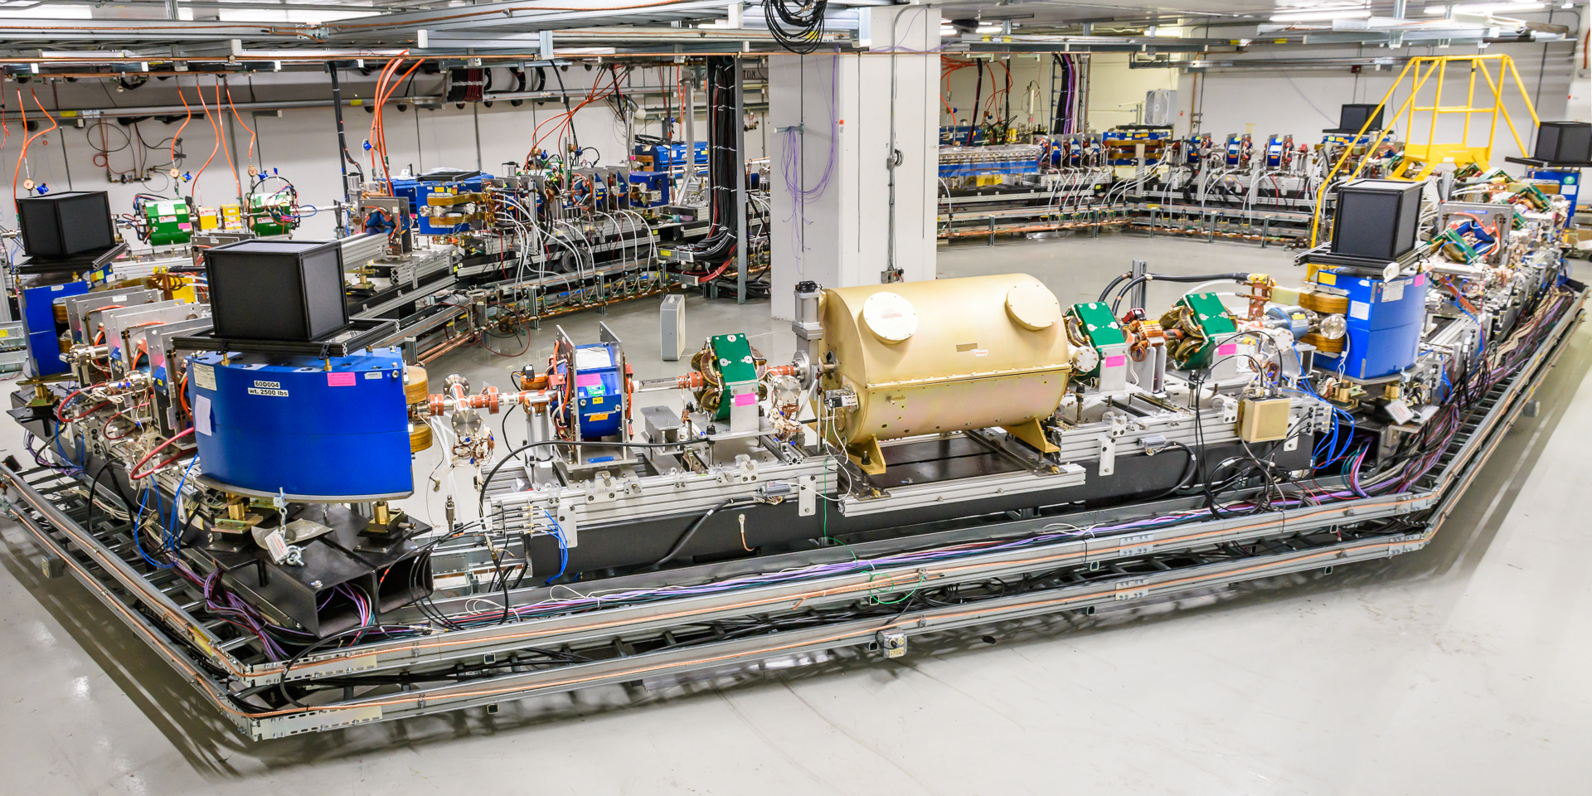
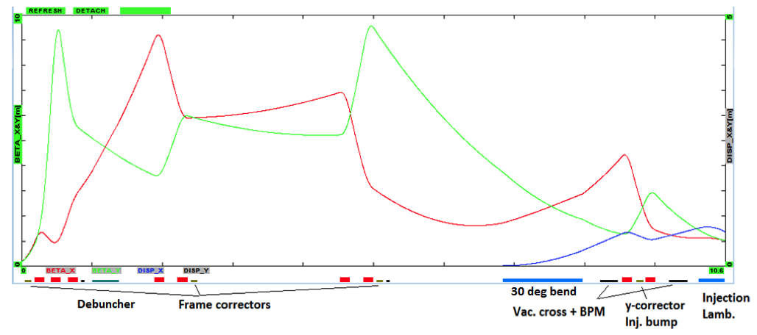
From large to small – Tevatron to IOTA
photo G.Stancari

Slide 14
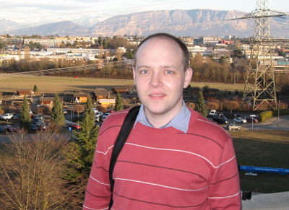
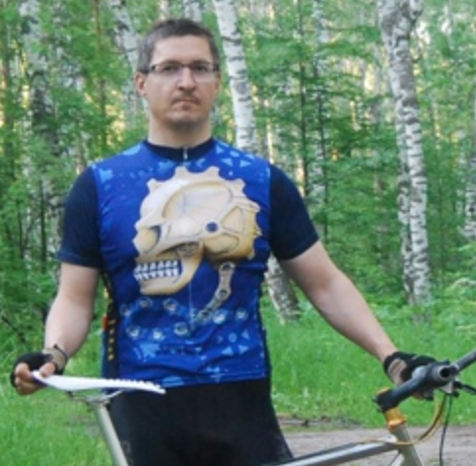
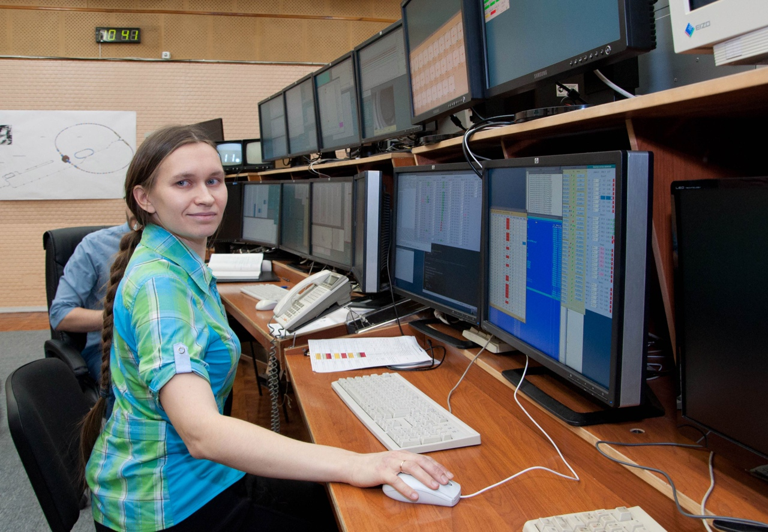
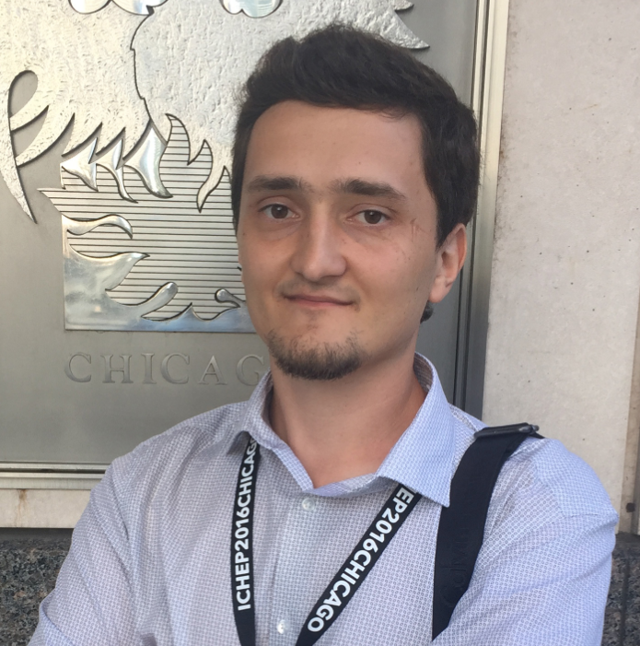
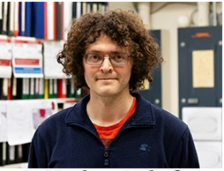
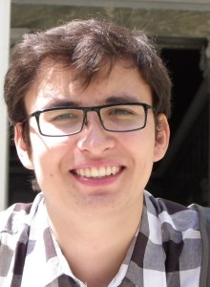
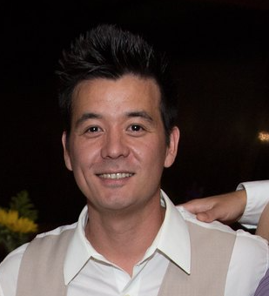
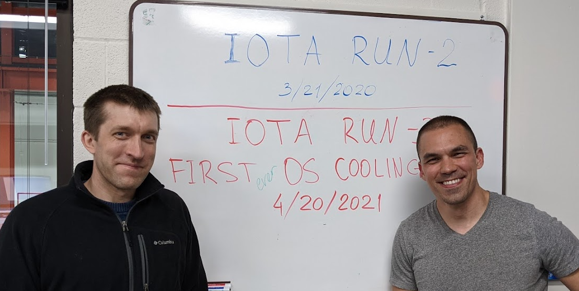
Valeri’s mentoring

Slide 15
We wish you fair seas and a following wind!

