Slide 1
MQXFA11/07b Coil Reception Electrical QC Measurements Coils 134, 135, 218, 219, 222, 223,
MQXFA11/07b Coil Selection Review
Bob Memmo, Dan Cheng
Nov 12, 2021
LBNL

Slide 2
Overview
QXFA Coil 220 had already been reviewed for MQXFA10 (see MQXFA10 Coil Selection Review Report in https://indico.fnal.gov/event/50739/)
But this coil will not be used at this time
Coils reported on will be
MQXFA11: 134, 135, 219, 222, 223
MQXFA07b replacement coil: 218
LBNL EQC Acceptance Data availability
Only a subset of data is available at date of review; measurements are still being taken
Four coils’ impulse tests will be complete later today, with two additional coils’ data to be made available next week
Will be summarized in following slides
Now includes acceptance values reviewed by V. Marinozzi

Slide 3
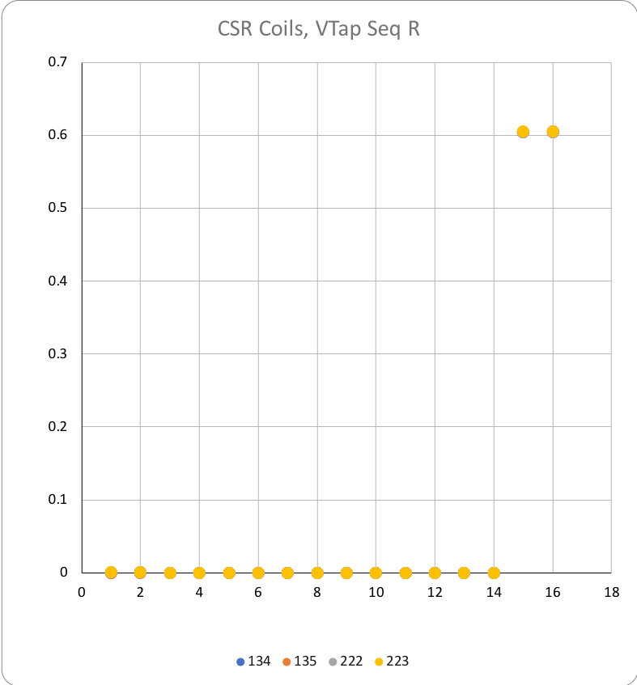
Coil Data
 |  |  | 134 | 135 | 222 | 223 | 219 | 218
See DocDB #956 / SU-1010-1903
RLQ
 | R | (mΩ) | 605 | 604 | 605 | 606
 | L_{s} (mH) | 20 Hz | 10.01 | 9.99 | 10.01 | 10.04
 |  | 100 Hz | 6.42 | 6.42 | 6.42 | 6.42
 |  | 1 kHz | 5.81 | 5.82 | 5.83 | 5.83
 | Q | 20 Hz | 1.29 | 1.29 | 1.29 | 1.29
 |  | 100 Hz | 5.5 | 5.55 | 5.56 | 5.55
 |  | 1 kHz | 8.55 | 8.54 | 8.49 | 8.62
QH R (Ω)
 | NT | A01 | N/A | N/A | N/A | N/A
 | T | A02 | N/A | N/A | N/A | N/A
 | T-P | B01 | 2.3 | 2.1 | 2.4 | 2.3
 | NT-P | B02 | 2.3 | 2.1 | 2.3 | 2.3
 | T-M | B03 | 2.2 | 2.1 | 2.4 | 2.3
 | NT-M | B04 | 2.2 | 2.1 | 2.5 | 2.3
VT R (mΩ) Individual coils
@1 Amp |  | A1 | 0.00026 | 0.00024 | 0.00033 | 0.00032
 |  | A2 | 0.00031 | 0.00030 | 0.00039 | 0.00037
 |  | A3
 |  | A4
 |  | A5
 |  | A6
 |  | A7
 |  | A8
 |  | B8
 |  | B7
 |  | B6
 |  | B5
 |  | B4
 |  | B3
 |  | B2 | 0.60400 | 0.60400 | 0.60420 | 0.60550
 |  | B1 | 0.60500 | 0.60400 | 0.60430 | 0.60560
HIPOT |  |  | OK | OK | OK | OK
IMPULSE |  |  | OK | OK | OK | OK
These two coils will be measured shortly
All coils are Series coils, with limited voltage taps

Slide 4
Hipot and Impulse tests
Hipot tests passed for coils 134,135, 222, 223
See Coil EQC data workbook on Indico Page
Coils 218 and 219 will follow
Impulse tests 2000V data will be shown here
When data is available in EQC data workbook

Slide 5
Summary
Coil acceptance EQC tests are not yet complete
Tests that were completed passed with all values within acceptance values
No issues observed yet
Complement of EQC data to be made available next week
This presentation will be updated and all data uploaded

Slide 6
Appendix

