Slide 1
Test procedures
I. Xiotidis
HPgTPC Electronics meeting
Date: 2/11/21

Slide 2
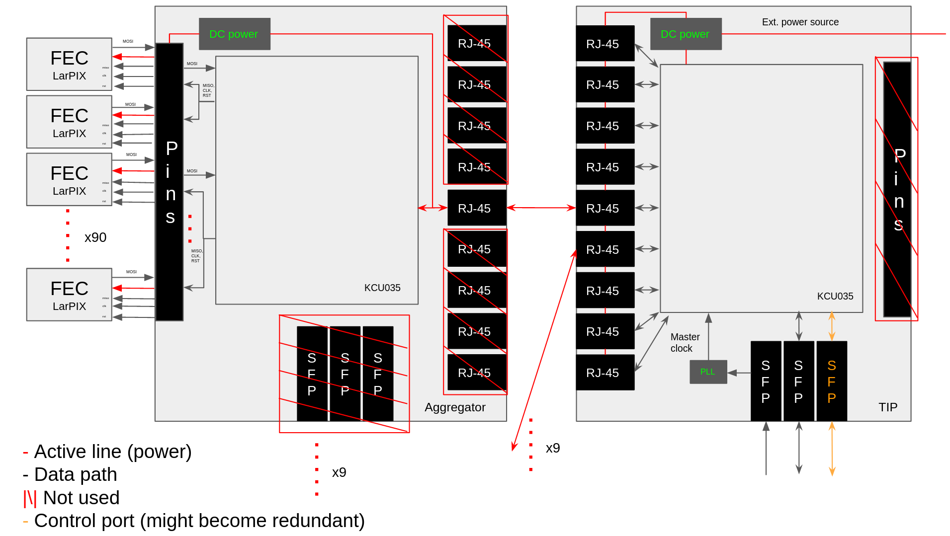
Board layout
Two type of tests available:
Hardware component tests (serial links, power distribution, etc.)
Firmware component tests

Slide 3
Hardware tests overview
We can test various hardware compoents with the two available test boards in the lab
Power board (made by Duncan): Allows to power 4 RX/TX lines with DC voltage over RJ45
Xilinx evaluation card (Commercial): Hosts same FPGA family and transceiver type as the final boards
Any objection to move test set-up from FC7 to the eval. card?
Proposed hw tests:
The TIP <-> AGGR link contains a number of components:
GTH transceivers from Xilinx
Ethernet cable (long distance) + DC signal
Vessel feedthrough
Custom serial transceiver circuit (e.g. bias network, ESD diodes, etc.)
AGGR<-> FEC links from FPGA fabric (HP/HR banks)
Paired in groups of two for configuration and reset
Rate much smaller than serial links
Do we want to test the FEC communication links?
We cannot use Eval card out of the box
Extra adapter is required
Eye scans with oscilloscope (performed from Johan in the past)
Any other component we can test?

Slide 4
Testing signal integrity on serial transceivers
Current hardware allows 4xGTH transceiver tests via the FMC connector
Power can be provided externally with DC power supply
FMC extender card allows setup to be tested in the magnetic field (what is the status for that?)
4-5x ethernet cables available to be tested
1x feedthrough for high pressure
What tests are available (@1Gbps):
Tune the GTH transceivers with sweap scans to derive base configuration
4x parameters with all combinations can be changed (Swing, Pre/Post cursor, RX termination)
Equalization network (LPM-short distance vs DFE-long distance)
Cable standard (CAT5/6) and length + feedthrough
Cable + DC power
Test impedance elements (currently air-cored inductors)
Anything else?

Slide 5
Current scan status
Transceiver parameters:
* Line rate: 1Gbps
* Pre/Post cursor: 0dB
* TX Swing: 0.995 V
* RX Term: ?
Scan with DFE
Scan with LPM
Wrote ROOT based macro to automated scan procedure to avoid Vivado

Slide 6
Firmware tests
Current focus on TIP firmware implementation in kcu105 card
In case FPGA parts are late can we use this as back-up TIP?
What about aggregators?
Firmware can be separated in three high level blocks:
Each component can be tested with evaluation card initially
Almost same boxes for Aggregator (what about the LArPIX?)
I/F logic
(TIP->network)
(TIP<-AGGR)
Aggregation
Logic
Control
+
Monitoring

Slide 7
Interfacing block
Contains all required I/Fs decoders for data processing
Block break down:
SiTCP: TCP core from beebeans
Interfaces network with processing logic
Current status: Implementation to kcu105 completed -> ping operation works but ~20% of packages are lost (under investigation)
Testing:
Send data to fifo and read back
Saturate link to measure throughput (p2p connection)
Anything else?
Aurora
Slow Control I/F
SiTCP
SiTCP

Slide 8
Interfacing block
Contains all required I/Fs decoders for data processing
Block break down:
Aurora 8b/10b core: Standard IP-block from Xilinx (well documented)
Interfaces Aggregators with processing logic
Current status: Configured via Vivado GUI, include In-System IBERT core
IBERT core (resources permitted) will remain also in final design to allow online integrity tests for link quality
Testing:
After transceiver configuration derived from hardware tests repeat same eye scans with data from FIFOs
Not much internal stuff to be checked
Aurora
Slow Control I/F
SiTCP
SiTCP

Slide 9
Interfacing block
Contains all required I/Fs decoders for data processing
Block break down:
Slow control I/F: Masters for board configuration interfaces (SPI,I2C,etc.)
Interfaces with control/monitoring logic
Current status: Not much developed, implementations of I2C/SPI/PMbus masters are available and will be used
Testing:
Once hardware components available tests master behaviour with data from the con/mon path
Anything else?
Aurora
Slow Control I/F
SiTCP
SiTCP

Slide 10
Aggregation logic
Preliminary layout
Main data path block:
Retrieves data from 9x Aurora links
8-bit@62.5MHz
Buffering with spy buffers:
RAM+FIFO (possibly): FiFo will buffer the data to enter the aggregation logic block, RAM will keep copy to be accesed from control/monitoring interface
Aggregation logic: TBD
Higher clock frequency
Buffering with normal buffer (don’t think we need data copy)
Transmitts to 1x ETH link
8-bit@125MHz
AGGR link
SpyBuffer
Aggregation
Logic
Buffer
ETH
link
x9
AGGR link
SpyBuffer

Slide 11
Aggregation logic
Preliminary layout
Current status: Identified spy buffer from past ATLAS project
Will ask around also if CMS has something similar (more support within the group)
Testing:
Initially one aggregator will be assumed to setup proper handshaking
Interface with control/monitoring logic to identify needed information
Duplicate for 2x aggregators (design needed for test beam)
AGGR link
SpyBuffer
Aggregation
Logic
Buffer
ETH
link
x9
AGGR link
SpyBuffer

Slide 12
Control/Monitoring logic
Block required for configuring the system and monitor the status
Current status: Haven’t thought much about implementation yet
Setup meeting with Alex T. to discuss data formatting for DAQ I/F
Testing: TBD

Slide 13
Summary
Hardware tests:
Check signal integrity of all Aggregator2TIP links in as close as possible conditions
Identify maximum cable length
DC voltage limit
Critical components
Missing still LArPIX timeline
Rate is much smaller than Aurora link, do we want to test the connector?
Firmware tests:
SiTCP evaluation in progress with first loopback tests over TCP
Aurora links evaluated once hardware tests define baseline configuration for GTH
Aggregation logic requires a bit more thinking for details
Con/Mon: Not much developed but about to take up
Am I missing anything?

