Slide 1
g-2 Lens Testing Plan
Beam Team Meeting
January 24, 2012
D. Still

Slide 2
Lens Testing Plan
Since key to Plan B is confidence in pulsing lens, What to test.
Condition current lens.
Attempt 12Hz test at low currents
Attempt g-2 pulse scenario. ( Modify test supply?)

Slide 3
Lens Testing & Power Supply Needs
(T. Leveling)

Slide 4
From reference paper: “Liquid Lithium Lens Pulse Power Supply System for Fermilab Antiproton Source”
GM2-doc-242-v1

Slide 5
From reference paper: “Liquid Lithium Lens Pulse Power Supply System for Fermilab Antiproton Source”
GM2-doc-242-v1

Slide 6
Liquid Lithium Lens Pulse Power Supply System for Fermilab Antiproton Source
GM2-doc-242-v1

Slide 7
Pulsed Devices Power Supply Modifications
Demand Charge System
AVERAGE FREQUENCY: 18 Hz PEAK CURRENT: 24 kAmp Burst rate: 80 Hz
13.8kV to 480v 3Ø transformer and accessories. |  |  | ($80k) | - if needed for isolation
50kW power supply ($0.65/w) |  | $35,000
AC utilities (Breaker, safety sw., etc.) |  | $2,500
3 mH 800A inductor (960 J, $3.5/J) |  | $3,500
Holding supply 1.5 kV 250 mA (375W) |  | $1,000
Isolation diode D2 and D3 |  | $1,000
4.5mF capacitor bank (2.5kJ, $1.2/J) |  | $3,000
Recovery diode D3 |  | $1,000
Recovery Inductor 2.5-3 uH |  | $5,000
SCR Switch array |  | $5,000
Transmission line
Current sensors (Pearson) |  | $2,000
Controls |  | $5,000
Water cooling (materials, valves, sensors, etc.) |  | $3,000
 | TOTAL | $67,000
LABOR (=M&S)?
CONTINGENCY (35%)?
Charge Transfer Method
(K.Bourkland/D. Wolff)

Slide 8
g-2 Pulse Train at the Target (12Hz mode)
Begin cycle
End cycle
Lens pulse length 490 µsec
Bunch length
of 1 pulse
120 nsec
100Hz
30Hz
Pulse separation
Train propagation
800 msec
10 msec
90 msec
~
~
1
2
3
4
5
6
7
8
9
10
11
12
13
14
15
16
Pulse #
Cycle length
1.33 sec

Slide 9
Protons on Target
 | FNAL g-2 12hz w/ Nova | FNAL g-2 18hz | BNL g-2 | FNAL-AP0
Intensity (1 booster batch 4 recycler bunches) | 4 Tp | 4 Tp | 60 Tp | 5 Tp
Total POT for 1 cycle | 16 Tp | 24 Tp | 60 Tp | 8 Tp
# pulses | 16 | 24 | 12 | 1
Train separation (sec) | 1.33 | 1.33 | 3 | 2.4
Pulse separation (msec) | 10 | 10 | - | -
Beam energy at target (Gev) | 8.9 | 8.9 | 24 | 120
Selected particle | Π⁺ | Π⁺ | Π⁺ | Pbar
Selected Beam energy (Gev) | 3.1 | 3.1 | 3.1 | 8.9
Production (per proton) | Π⁺ .87 E-5* | Π⁺ .87 E-5 | Π⁺ 2.75 E-5 | pbar 4.0 E-5
POT/year ( full 3.16E7 sec/per year) | 3.8 E20 | 5.7 E20 | 6.32 E20 | 6.5 E19
Beam power at Target (kW) | 17.2 | 25.7 | 77 | 64
Beam size at target σ (round beam (mm)) | .55 (scaled from 120Gev) | .55 | - | .15
(* Number for Π+ production taken from C. Yoshikawa GM2-doc-#-133 for air)

Slide 10
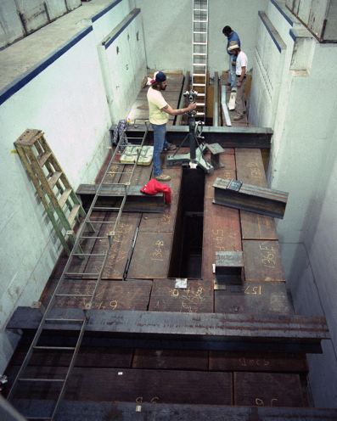
g-2 Target Enclosure
Beam line to Debuncher
(Looking from the side)
g-2 target building
(AP0)
Beam line from Recycler
Beam line to Debuncher
Desired to keep the enclosure in tact.
25 years of running beam
There are radiation concerns to modify
Beam Dump
(Looking from the top)

Slide 11
The Lithium Lens
Lithium Lens Parameters | Pbar | G-2 12Hz | G-2 18Hz | G-2 Test Station
Peak Current | 62 kA | 22.6 kA | 22.6 kA | .5 kA
Pulse width | 400 nsec | 400 nsec | 400 nsec | 400 nsec
Gradient | 670 T/m | 670 T/m | 670 T/m | 670 T/m
Rep rate | .5 Hz | 12 Hz | 18 Hz | 12 Hz/ .5 Hz
Coil Resistance | 95 µΩ | 95 µΩ | 95 µΩ | 95 µΩ
Resistive Heating | 4 KW | 11.6 kW | 17.4 kW | 570 W /24 W
Beam Heating | 2 kW | +25% | +25% | +25%
Total Heating | 6 kW | 14.5 kW | 21.8 kW | 713 / 30W
Cooling system removal capacity | 11 kW | +32% | +100% | -6% / .3%
Scaling to the initial 18Hz rep rate at 25kW beam energy on the target
produced at total heat load of 20kW which was 2X more that cooling system.
This was one the of biggest concerns with Plan B.

