Slide 1
GARD Accelerator and Beam Physics
&
GARD test facilities
Two talks in one
John power
Argonne National Lab
2021 AF1 community meeting
November 22, 2021

Slide 2

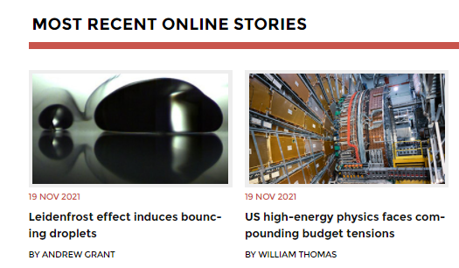
US high-energy physics faces compounding budget tensions
US Accelerator Science requires support to remain competitive.
Physics Today article (https://physicstoday.scitation.org/do/10.1063/PT.6.2.20211119a/full/ )
  Despite officials’ desire to strengthen support for core research and accelerator and detector R&D, much of DOE’s high-energy physics program funding has been spent on large projects, including the LBNF/DUNE neutrino experiment.
John Power (ANL)

Slide 3
GARD Accelerator and Beam Physics
The ABP Roadmap
GARD ABP Roadmap task force.
Chairs: S. Nagaitsev (Fermilab/UChicago) & Z. Huang (SLAC/Stanford)
Organizing committee: J. Power (ANL), J.-L. Vay (LBNL), L. Spentzouris (IIT), P. Piot (NIU/ANL) J. Rosenzweig (UCLA)
John Power for S. Nagaitsev

Slide 4
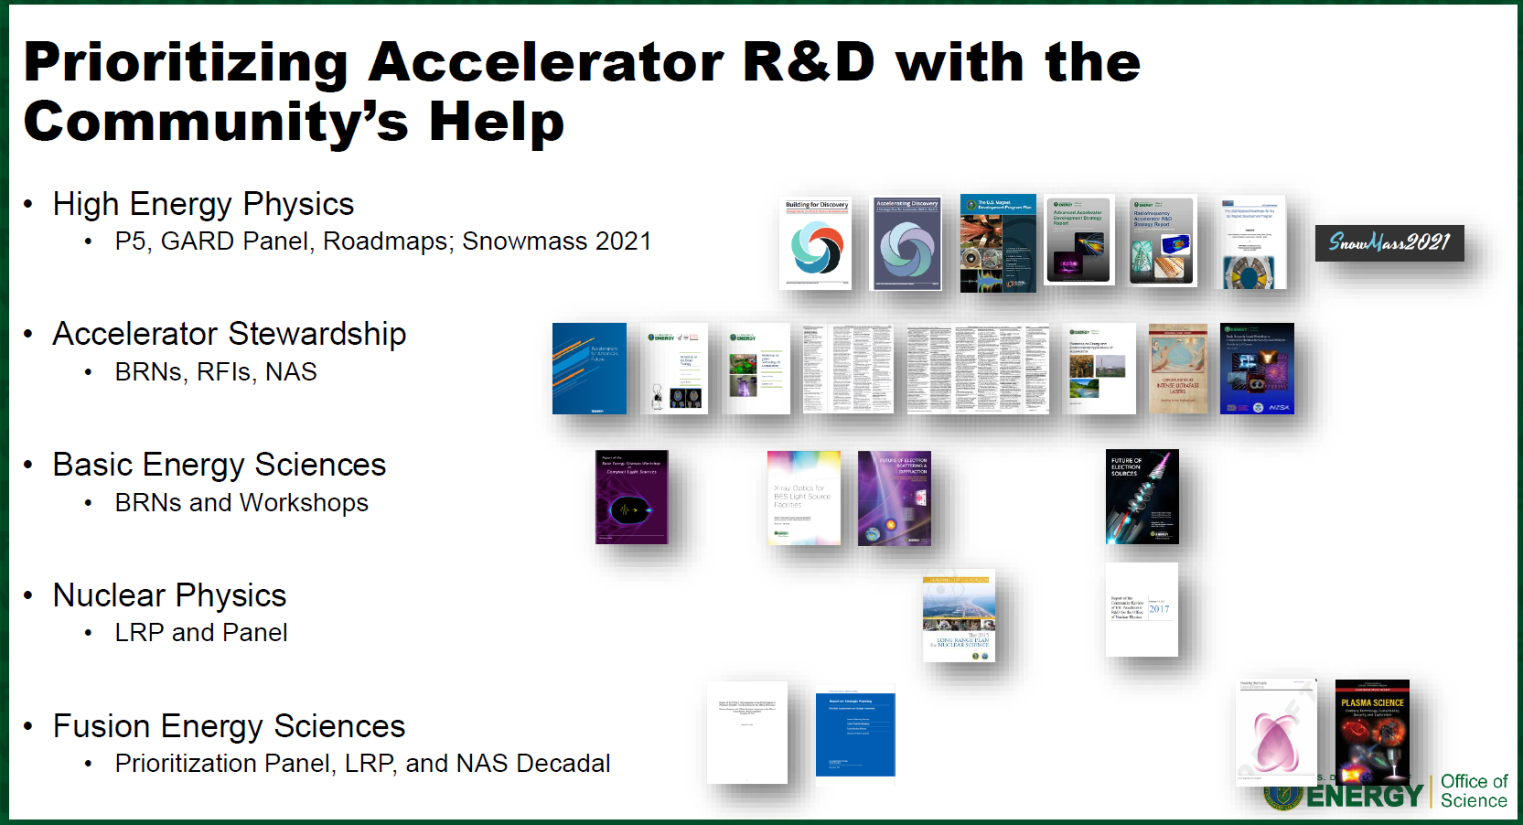
Accelerator Science across the DOE
See Eric Colby’s talk at https://aacseminarseries.lbl.gov/program/oral-program
John Power (ANL)

Slide 5
Accelerator Science across the US
NSF Center for Bright Beams
  CBB's overarching research goal is to increase the intensity ("brightness") of beams … by two orders of magnitude while decreasing the cost of key accelerator technologies.
  collaborative research with national laboratories and companies
  research into instruments that advance the frontiers of knowledge in life sciences, materials science, condensed matter physics, particle physics, and nuclear physics.
DOE General Accelerator Research and Development (GARD)
  The GARD program in the Department of Energy Office of High Energy Physics (HEP) provides most of the funds for accelerator R&D in the U.S. …. GARD supports medium- and long-term accelerator R&D, and the facilities to support that R&D.
  DOE GARD as a whole is to address “Technology Gaps” for HEP.
Proposal driven accelerator science.
  We are to bring to DOE/NSF proposals for research and they respond (with guidance, requirements, and/or funding)
  Accelerator scientists (like all scientists) should be continuously proposing new ideas and experiments
  ABP proposals should address both “Knowledge gaps” and “Technology gaps” in Accelerator and Beam Physics.
John Power (ANL)

Slide 6
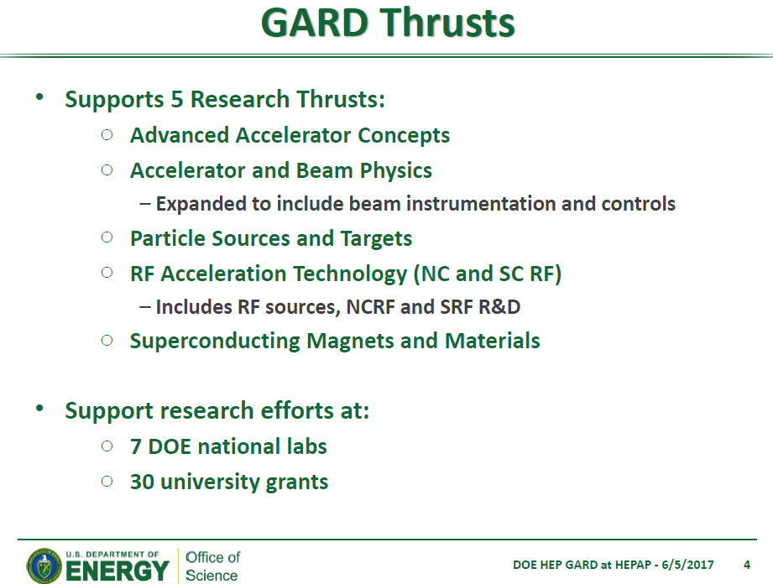
6 Programmatic Thrust
(AF6)
ABP
(AF1)
(AF7)
Test Facility Operations
The GARD thrusts support research efforts at DOE national labs and universities
John Power (ANL)

Slide 7
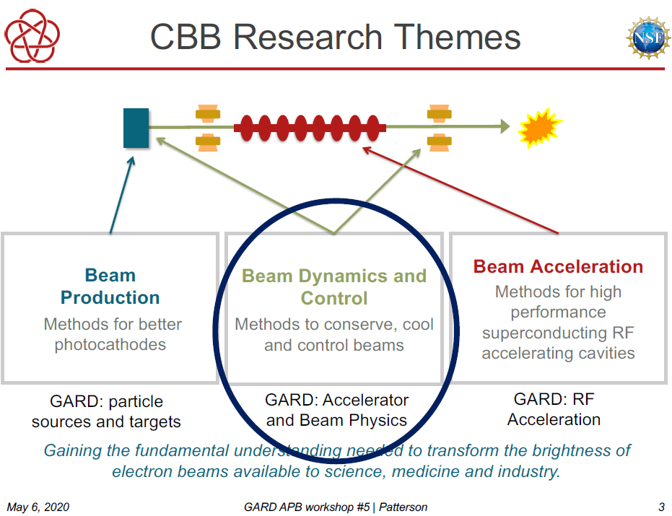
NSF-funded Center for Bright Beams (CBB)
NSF-CBB
3 research themes
=
DOE-GARD
5 thrusts
Notes:
NSF-DOE overlap

Slide 8
The 2014 P5 report called for an accelerator R&D roadmap
ABP Roadmap
2019 HEPAP presentation by J. Rosenzweig about GARD’s execution of the 2014 P5 plan: https://science.osti.gov/hep/hepap/Meetings/201911

Slide 9
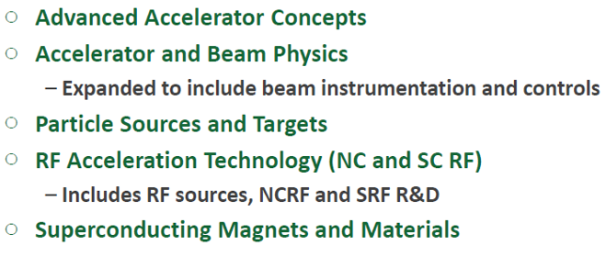
GARD reports and GARD roadmaps
HEP Reports
  2014 P5 report (https://www.usparticlephysics.org/)
  2015 GARD Accelerator subpanel report (https://science.osti.gov/~/media/hep/hepap/pdf/Reports/Accelerator_RD_Subpanel_Report.pdf)
GARD Roadmaps (3 of 5 completed)
  AAC roadmap (https://science.osti.gov/~/media/hep/pdf/accelerator-rd-stewardship/Advanced_Accelerator_Development_Strategy_Report.pdf)
  RF roadmap (https://science.osti.gov/~/media/hep/pdf/Reports/DOE_HEP_GARD_RF_Research_Roadmap_Report.pdf)
  HF magnet roadmap (https://science.osti.gov/~/media/hep/pdf/Reports/MagnetDevelopmentProgramPlan.pdf)
  High-power targets (coming soon)
  ABP (coming soon)
GARD Research Thrusts

Slide 10
Barriers that stand in our way
Technology barriers
  Technology roadmaps exist for all areas of GARD.
Physics barriers (or challenges to be overcome)
  In Sep 2018, we formed an ABP working group to understand these physics challenges and to formulate a strategic roadmap for the US
Accelerator and Beam Physics (ABP) working group members
  S. Nagaitsev (Fermilab/UChicago), Z. Huang (SLAC/Stanford), J. Power (ANL),
  J.-L. Vay (LBNL), P. Piot (NIU/ANL), L. Spentzouris (IIT), and J. Rosenzweig (UCLA)

Slide 11
ABP community-driven roadmap … progress
ABP working group meetings started ~Sept 2018
Preparatory workshops:
  Develop community-driven physics aspirations for accelerator and beam physics
  information-gathering at workshops
    Dec 2019 at LBNL: https://conferences.lbl.gov/event/279/
    Apr – June 2020 (Zoom): https://indico.fnal.gov/event/22709/
  Preparatory Workshops considered:
    Single-particle dynamics, including nonlinearities, and spin dynamics.
    High-brightness beam generation, transport, manipulation and cooling.
    Mitigation and control of collective phenomena: instabilities, space charge, beam-beam, etc
    Advanced accelerator instrumentation and controls.
    Modeling and simulation tools; fundamental theory and applied math.
    Early conceptual integration and optimization, maturity evaluation
    Connections to other GARD roadmaps; synergies with non-HEP programs

Slide 12
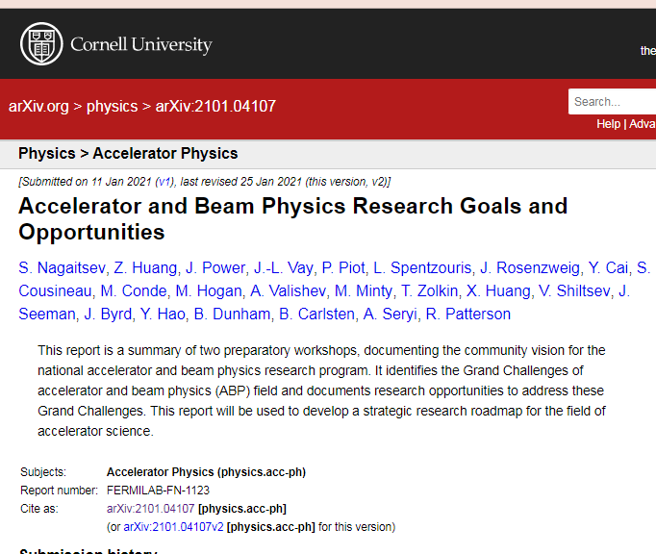
ABP community-driven roadmap
ABP Workshop Report (2021)
ABP Preparatory Workshops Report (2021 January)
  Accelerator and Beam Physics Research Goals and Opportunities (https://arxiv.org/abs/2101.04107)
  Authors: S. Nagaitsev, Z. Huang, J. Power, J.-L. Vay, P. Piot, L. Spentzouris, J. Rosenzweig, Y. Cai, S. Cousineau, M. Conde, M. Hogan, A. Valishev, M. Minty, T. Zolkin, X. Huang, V. Shiltsev, J. Seeman, J. Byrd, Y. Hao, B. Dunham, B. Carlsten, A. Seryi, R. Patterson
ABP Roadmap Workshop in-person meeting (Apr 2022)
  ~3 days

Slide 13
Accelerator and beam physics
ABP definition
  Accelerator and beam physics is the science of the motion, generation, acceleration, manipulation, prediction, observation and use of charged particle beams. The Accelerator and Beam Physics (ABP) thrust focuses on fundamental long-term accelerator and beam physics research and development.
ABP vision statement:
  The ABP thrust explores and develops the science of accelerators and beams to make future accelerators better, cheaper, safer, and more reliable. Particle accelerators can be used to better understand our universe and to aid in solving societal challenges.
Link to Workshop Report: https://arxiv.org/abs/2101.04107

Slide 14
GARD ABP mission statement
timeless
The primary scientific mission of the ABP thrust is to address and resolve the Accelerator and Beam Physics Grand Challenges
Grand challenge #1 (beam intensity): How do we increase beam intensities by orders of magnitude?
Grand challenge #2 (beam quality): How do we increase beam phase-space density by orders of magnitude, towards quantum degeneracy limit?
Grand challenge #3 (beam control): How do we control the beam distribution down to the level of individual particles?
Grand Challenge #4 (beam prediction): How do we develop predictive “virtual particle accelerators”?
Link to Workshop Report: https://arxiv.org/abs/2101.04107

Slide 15
ABP-LOI: Research needed to address the above Grand Challenges
Single-particle dynamics and nonlinear phenomena; polarized-beams dynamics
  This impacts GC 1 and 2 and benefits from addressing GC 3 and 4.
Collective effects (space-charge, beam-beam, and self-interaction via radiative fields, coherent synchrotron radiation, e.g.) and mitigation
  This impacts GC 1 and 2, and benefits from addressing GC 3 and 4.
Beam instabilities, control, and mitigation; short- and long-range wakefields
  This impacts GC 1 and 2, and benefits from addressing GC 3 and 4.
High-brightness / low-emittance beam generation, and high peak-current, ultrashort bunches
  This impacts GC 2, and benefits from addressing GC 3 and 4.
Beam quality preservation and advanced beam manipulations; beam cooling and radiation effects in beam dynamics
  This impacts GC 2, and benefits from addressing GC 3 and 4.
Advanced accelerator instrumentation and controls
  This impacts GC 3.
High-performance computing algorithms, modeling and simulation tools
  This impacts GC 4.
Fundamental accelerator theory and applied math
  This impacts all Grand Challenges.
Machine learning and artificial intelligence
  This impacts GC 3 and 4 in the short term and GC 1 and 2 in the long term.
Early conceptual integration, optimization, and maturity evaluation of accelerator concepts
  This focuses on science and technology gaps and bridges between various GARD thrusts.
https://www.snowmass21.org/docs/files/summaries/AF/SNOWMASS21-AF1_AF7_S_Nagaitsev-056.pdf

Slide 16
ABP-LOI: Resources needed to address the above Grand Challenges
Test facilities
Currently, there are several ABP research facilities, such as FACET (SLAC), AWA (ANL), ATF (BNL),
BTF (ORNL), IOTA/FAST (FNAL) and facilities at universities. Such facilities are invaluable for
advancing new accelerator concepts and technologies. It is critical to maintain and enhance support for
these accelerator test facilities to keep them productive for ABP.
Education and training
It is critical to maintain support for the existing cross-cutting educational mechanisms in the field of
accelerator science and technology (e.g. USPAS). Maintaining the workforce remains a challenge; and
meeting it requires the availability of specialized courses and facilities suitable for hands-on training, as
well as university-based research opportunities.
Integration of computational and ML tools across facilities
Effective coordination, maintenance and standardization of computational and ML tool development
should be encouraged. Dedicated support of this would critically benefit accelerator and beam physics
modeling across facilities.
https://www.snowmass21.org/docs/files/summaries/AF/SNOWMASS21-AF1_AF7_S_Nagaitsev-056.pdf

Slide 17
GARD test Facilities
ANL-AWA
BNL-ATF
FNAL-FAST/IOTA
LBNL-BELLA
SLAC-FACT

Slide 18
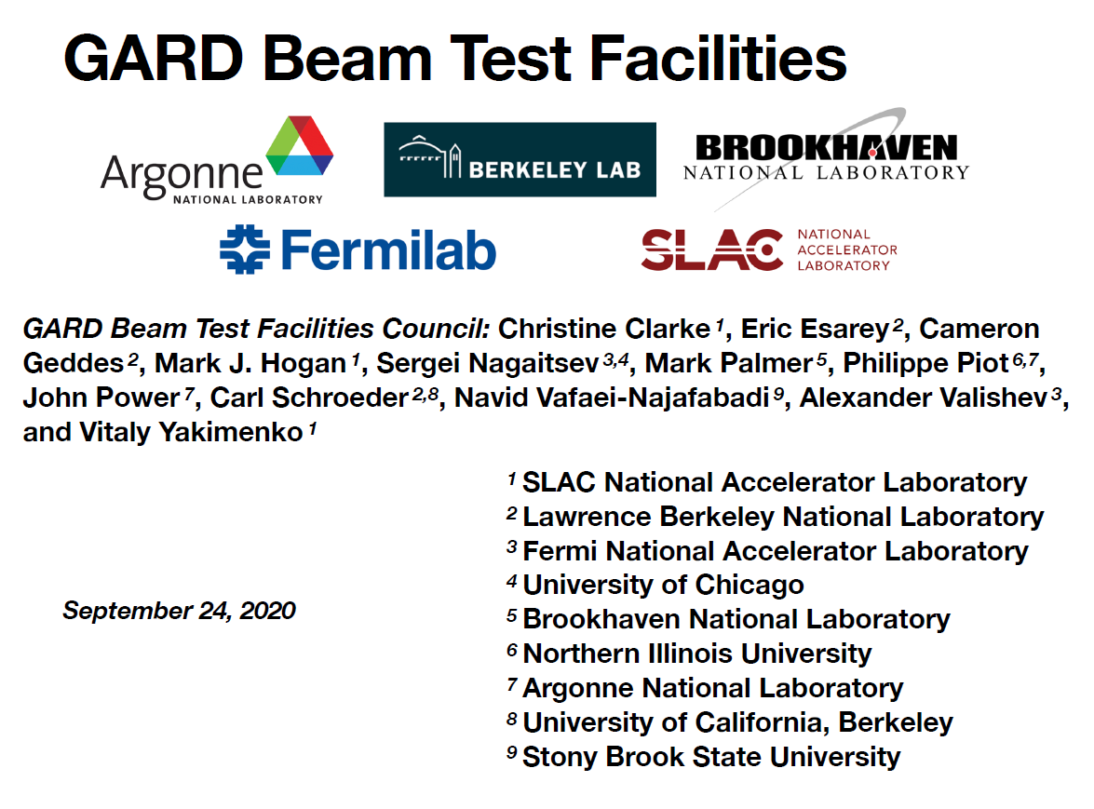

Slide 19
Five beam test facilities, supported by GARD in support of SC mission:
5 GARD DOE-HEP Facilities
Accelerator Test Facility (ATF*), BNL
Argonne Wakefield Accelerator (AWA), ANL
Berkeley Laboratory Laser Accelerator Center (BELLA), LBL
Facility for Advanced Accelerator Experimental Tests II (FACET-II), SLAC
Fermilab Accelerator Science and Technology facility (FAST), FNAL
Mission: Provide access to a suite of complementary and diverse capabilities for a broad community of scientists representing universities, industry and National laboratories.
  Advance accelerator technologies for the next generation of SC research facilities
  Basic research in accelerator and beam physics
  Education and training for future scientists and engineers
*ATF has been funded by GARD prior to 2013 and Accelerator Stewardship after 2013. It will move to SC-24.2 (ARDAP) in FY21.

Slide 20
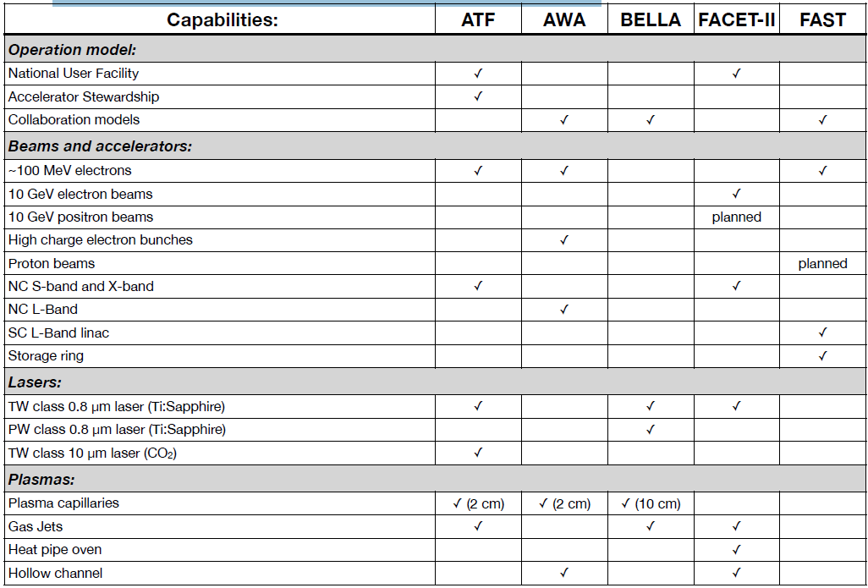
GARD Facility capabilities
Complementary and diverse

Slide 21
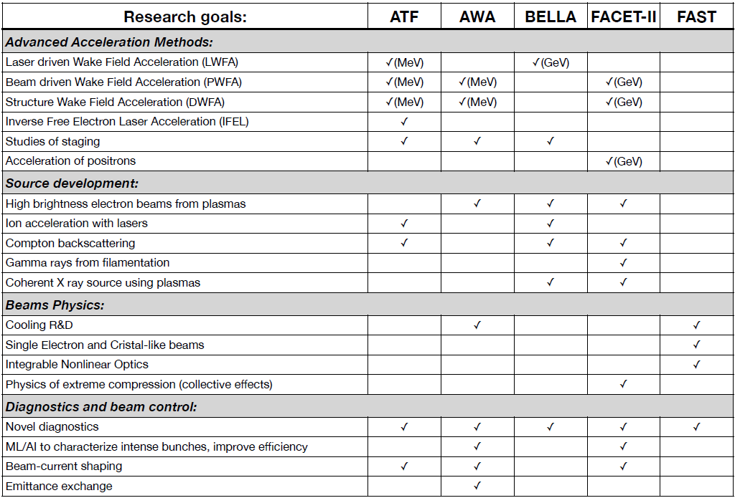
GARD Facility capabilities
Complementary and diverse

Slide 22
Evolution of supported capabilities
Roadmaps for Advanced Concepts were developed following the previous P5 and are outlined in the 2016 DOE Advanced Accelerator Development Strategy Report
These roadmaps highlight the key R&D challenges in an order of phased complexity in line with the expected availability of experimental facilities
An effort to re-examine priorities, developing updated roadmaps for R&D and identifying needs for demonstration and beam test facilities is expected following upcoming P5
As advanced acceleration techniques continue to mature, as first applications will be brought online and as concepts move to the conceptual and technical design level
The capabilities at each facility were developed with the focus on specific aspects of the HEP mission. Upgrade plans will be developed and coordinated to address needs of the community

Slide 23
GARD summary
ABP and Test facilties
Stakeholders
scinence

Slide 24
GARD ABP and Test facility
Developing accelerator technologies to enable the next generation of SC-HEP science facilities​
GARD ABP Roadmap
Identified Research to address the above Grand Challenges
Test facilities
Education and training
Integration of computational and ML tools across facilities
GARD Test Facilities
Research facilities needed to address the 5 GARD Thrusts (AF1, AF6, AF7)
Basic research in accelerator R&D and beam physics (AF1).
Education and training for future scientists and engineers. ​(AF1)
Worldwide competitiveness at stake (Eupraxia proposed <$600M Euro, 100M likely approved? )

Slide 25
HEP GARD partnership
Stakeholders and partners
(the other) HEP GARD Thrusts
  Advanced Accelerator Concepts
  Particle Sources and Targets
  RF Accelerator Technology (NC and SRF)
  SC Magnets and Materials
Domestic:
  SC-DOE: Accelerator Stewardship, BES, NP, FES
  NSF: CBB
  National Laboratories (FNAL, SLAC, LBNL, ANL, BNL, Jlab, LANL, …)
  Universities (Cornell, UCLA, NIU, Stanford, IIT, U. Chicago, MSU, …)
  Industrial (SBIR companies)
International
Scientific disciplines ranging from life sciences, materials science, condensed matter physics, particle physics, and nuclear physics.

