Slide 1



Belle II input to RF3: Fundamental physics in small experiments (g-2)
Based on “Opportunities for precision QCD physics in hadronization at Belle II -- a snowmass whitepaper” (2204.02280 [hep-ex])
)
Anselm Vossen
Research supported by the

Slide 2
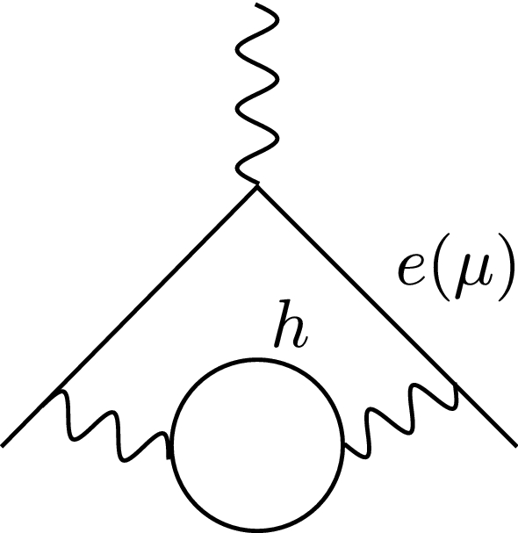
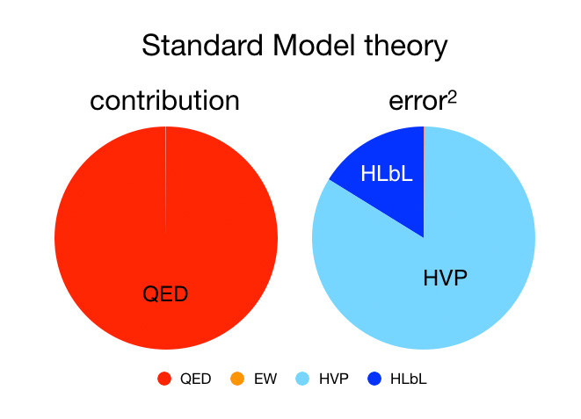
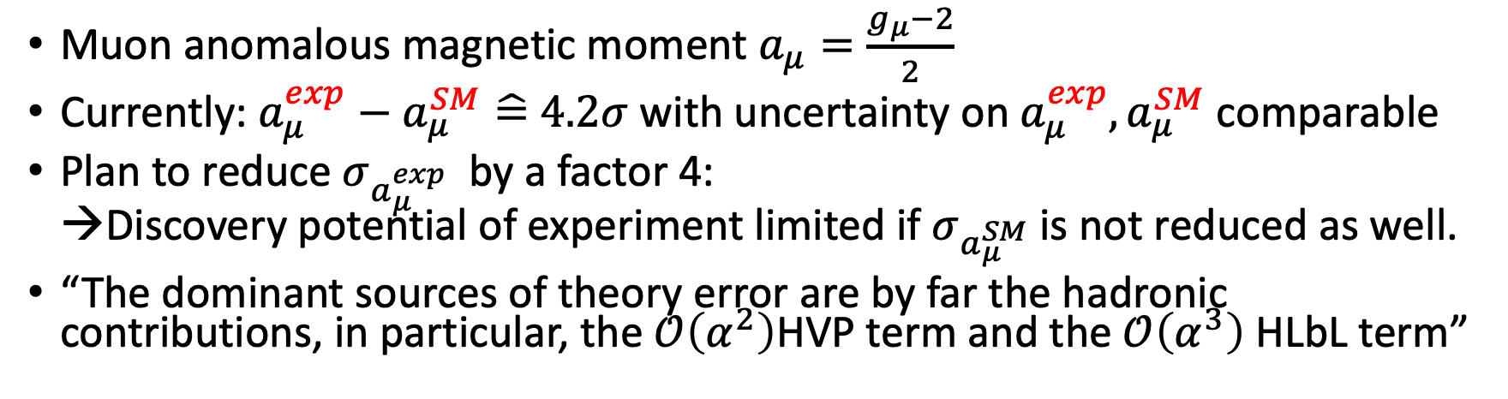

Motivation: Belle II needed to reduce uncertainty on $a_{μ}$
Muon anomalous magnetic moment $a_{μ}=\frac{g_{μ}−2}{2}$
Currently: $a_{μ}^{exp}−a_{μ}^{SM}\hat{=}$ $4.2σ$ with uncertainty on $a_{μ}^{exp},a_{μ}^{SM}$ comparable
Plan to reduce $σ_{a_{μ}^{exp}}$ by a factor 4:
→Discovery potential of experiment limited if $σ_{a_{μ}^{SM}}$is not reduced as well.
“The dominant sources of theory error are by far the hadronic contributions, in particular, the $𝒪\left(α^{2}\right)$HVP term and the $𝒪\left(α^{3}\right)$HLbL term”

Slide 3
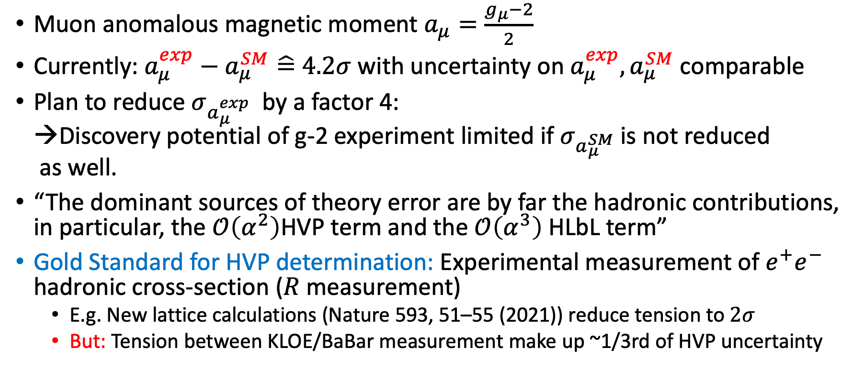
Motivation: Belle II needed to reduce uncertainty on $a_{μ}$
Muon anomalous magnetic moment $a_{μ}=\frac{g_{μ}−2}{2}$
Currently: $a_{μ}^{exp}−a_{μ}^{SM}\hat{=}$ $4.2σ$ with uncertainty on $a_{μ}^{exp},a_{μ}^{SM}$ comparable
Plan to reduce $σ_{a_{μ}^{exp}}$ by a factor 4:
→Discovery potential of g-2 experiment limited if $σ_{a_{μ}^{SM}}$is not reduced
as well.
“The dominant sources of theory error are by far the hadronic contributions, in particular, the $𝒪\left(α^{2}\right)$HVP term and the $𝒪\left(α^{3}\right)$HLbL term”
Gold Standard for HVP determination: Experimental measurement of $e^{+}e^{−}$ hadronic cross-section ($R$measurement)
  E.g. New lattice calculations (Nature 593, 51–55 (2021)) reduce tension to $2σ$
  But: Tension between KLOE/BaBar measurement make up ~1/3rd of HVP uncertainty

Slide 4
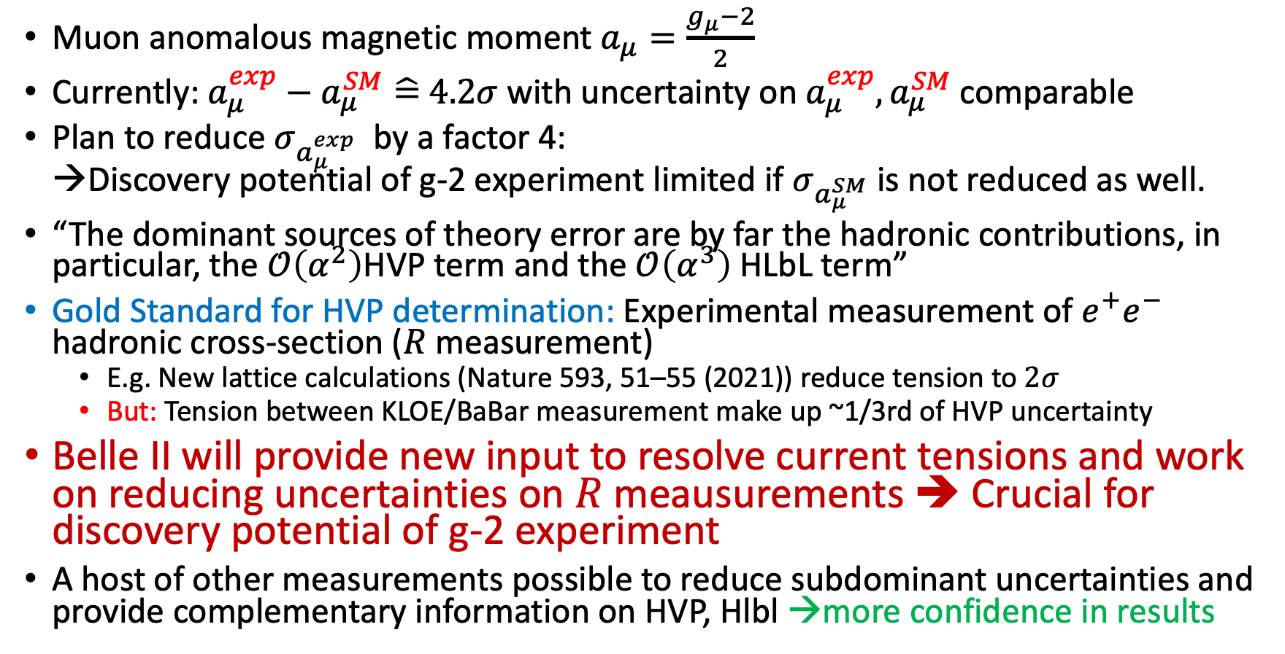

Motivation: Belle II needed to reduce uncertainty on $a_{μ}$
Muon anomalous magnetic moment $a_{μ}=\frac{g_{μ}−2}{2}$
Currently: $a_{μ}^{exp}−a_{μ}^{SM}\hat{=}$ $4.2σ$ with uncertainty on $a_{μ}^{exp},a_{μ}^{SM}$ comparable
Plan to reduce $σ_{a_{μ}^{exp}}$ by a factor 4:
→Discovery potential of g-2 experiment limited if $σ_{a_{μ}^{SM}}$is not reduced as well.
“The dominant sources of theory error are by far the hadronic contributions, in particular, the $𝒪\left(α^{2}\right)$HVP term and the $𝒪\left(α^{3}\right)$HLbL term”
Gold Standard for HVP determination: Experimental measurement of $e^{+}e^{−}$ hadronic cross-section ($R$measurement)
  E.g. New lattice calculations (Nature 593, 51–55 (2021)) reduce tension to $2σ$
  But: Tension between KLOE/BaBar measurement make up ~1/3rd of HVP uncertainty
Belle II will provide new input to resolve current tensions and work on reducing uncertainties on $R$meausurements ➔ Crucial for discovery potential of g-2 experiment
A host of other measurements possible to reduce subdominant uncertainties and provide complementary information on HVP, Hlbl →more confidence in results

Slide 5
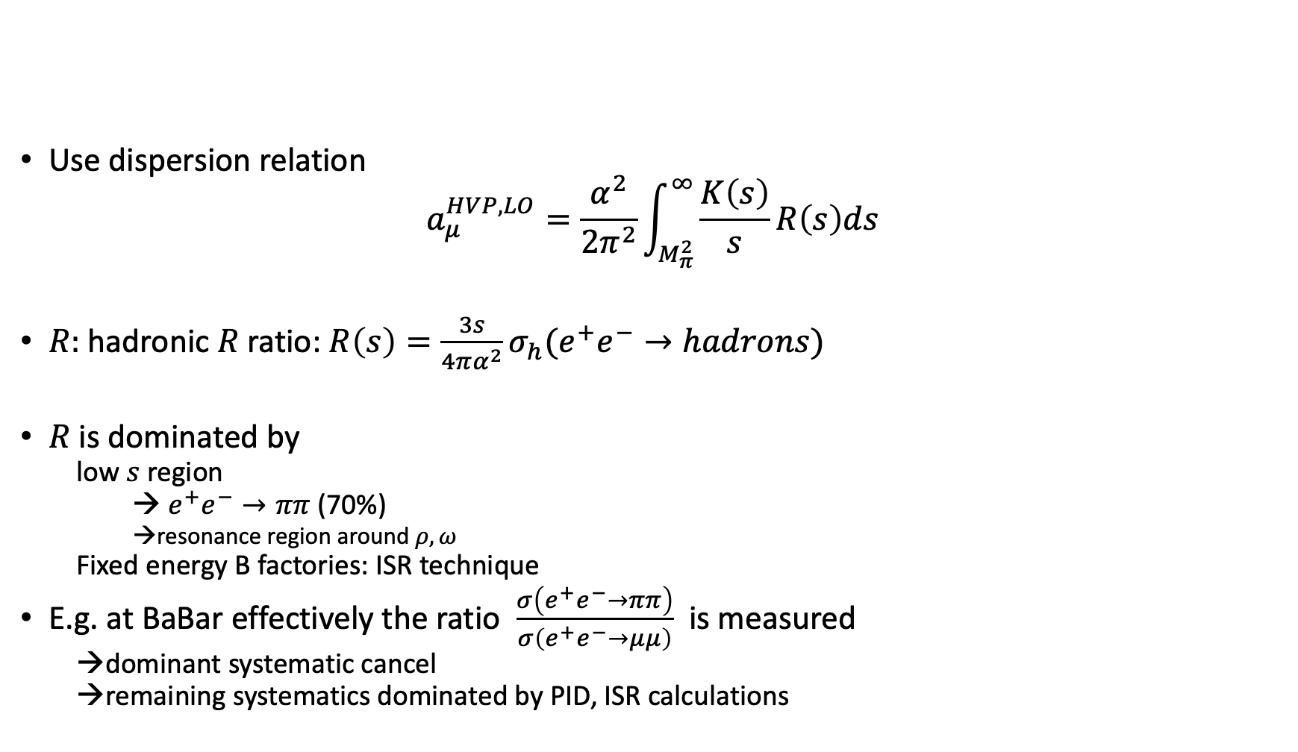

How to measure HVP in $e^{+}e^{−}$
Use dispersion relation
$$a_{μ}^{HVP,LO}=\frac{α^{2}}{2π^{2}}\int_{M_{π}^{2}}^{∞}{\frac{K\left(s\right)}{s}R\left(s\right)ds}$$
$R:$ hadronic $R$ratio: $R\left(s\right)=\frac{3s}{4πα^{2}}σ_{h}(e^{+}e^{−}→hadrons)$
$R$is dominated by
  low $s$region
  → $e^{+}e^{−}→ππ$ (70%)
    →resonance region around $ρ, ω$
  Fixed energy B factories: ISR technique
E.g. at BaBar effectively the ratio $\frac{σ\left(e^{+}e^{−}→ππ\right)}{σ\left(e^{+}e^{−}→μμ\right)}$ is measured
  →dominant systematic cancel
  →remaining systematics dominated by PID, ISR calculations

Slide 6
Tension in existing KLOE/BaBar measurements
Need to be resolved !
Figures from JHEP 03, 173
(2018), arXiv:1711.03085 [hep-ex]

Slide 7
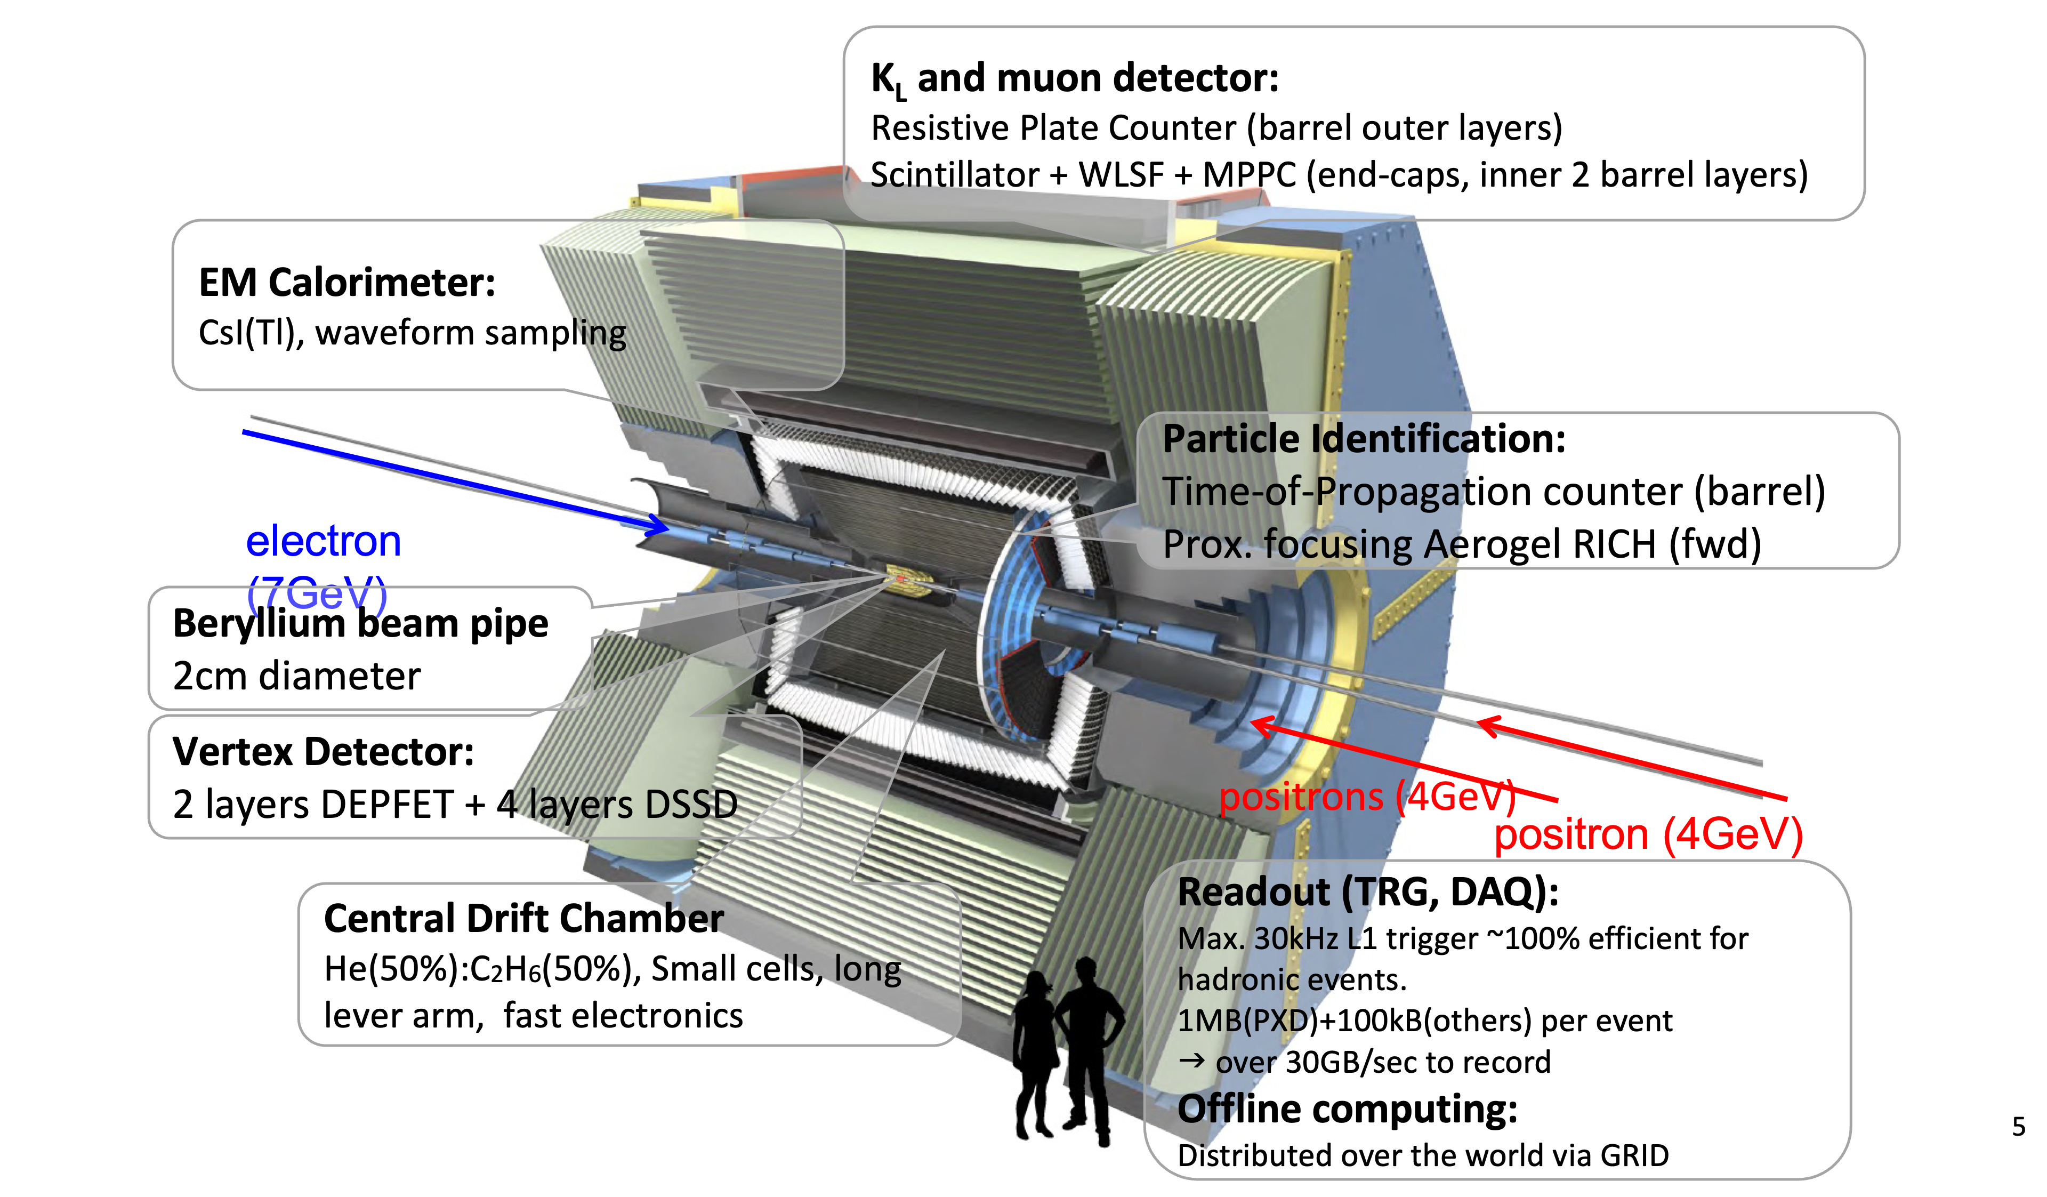
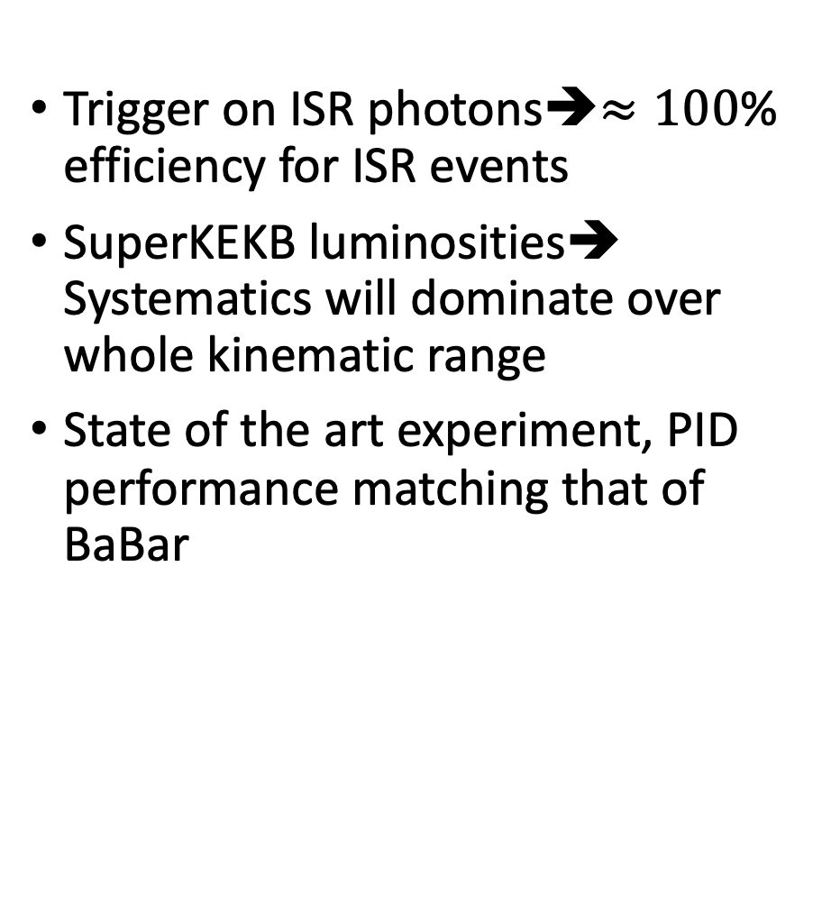
Belle II outlook for $σ\left(e^{+}e^{−}→π^{+}π^{−}\left(γ\right)\right)$ measurement
Trigger on ISR photons➔$≈100$% efficiency for ISR events
SuperKEKB luminosities➔ Systematics will dominate over whole kinematic range
State of the art experiment, PID performance matching that of BaBar

Slide 8
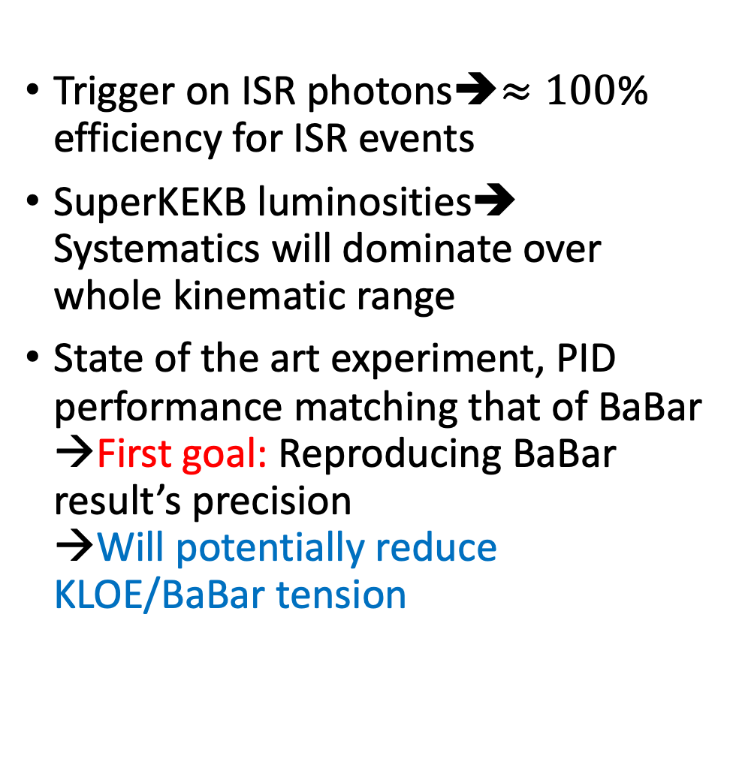
Belle II outlook for $σ\left(e^{+}e^{−}→π^{+}π^{−}\left(γ\right)\right)$ measurement
Trigger on ISR photons➔$≈100$% efficiency for ISR events
SuperKEKB luminosities➔ Systematics will dominate over whole kinematic range
State of the art experiment, PID performance matching that of BaBar →First goal: Reproducing BaBar result’s precision
→Will potentially reduce KLOE/BaBar tension

Slide 9
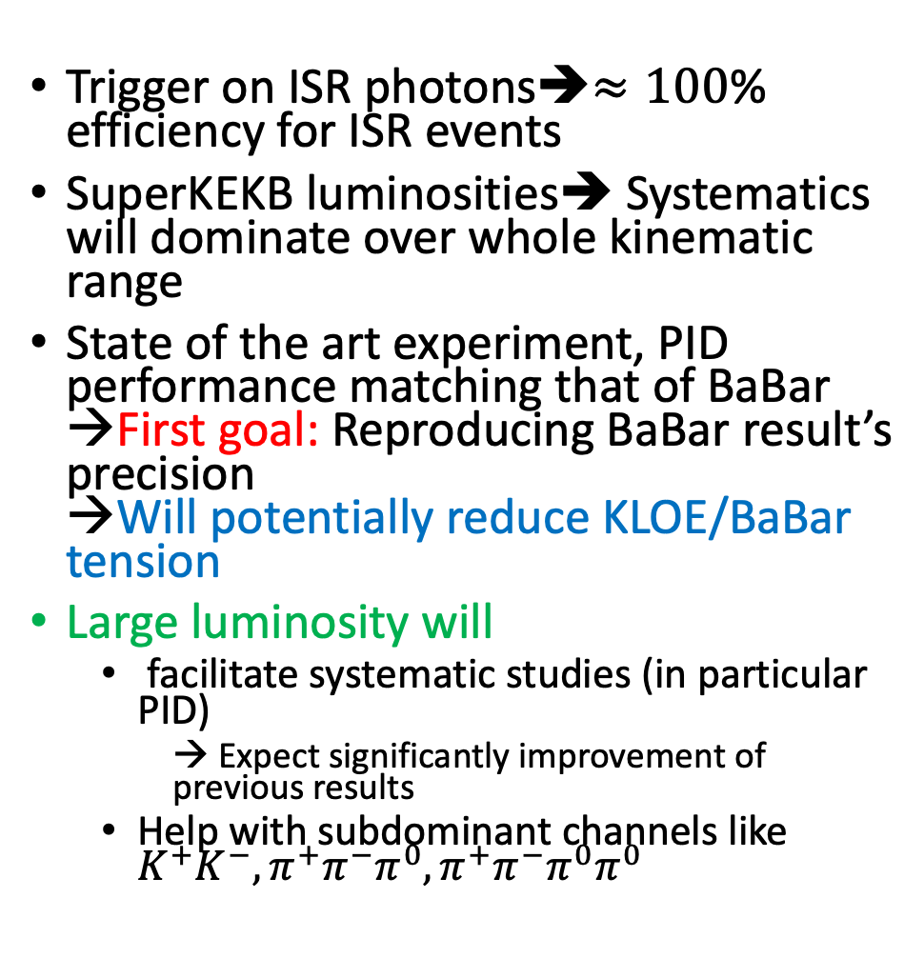
Belle II outlook for $σ\left(e^{+}e^{−}→π^{+}π^{−}\left(γ\right)\right)$ measurement
Trigger on ISR photons➔$≈100$% efficiency for ISR events
SuperKEKB luminosities➔ Systematics will dominate over whole kinematic range
State of the art experiment, PID performance matching that of BaBar →First goal: Reproducing BaBar result’s precision
→Will potentially reduce KLOE/BaBar tension
Large luminosity will
  facilitate systematic studies (in particular PID)
    → Expect significantly improvement of previous results
  Help with subdominant channels like $K^{+}K^{−}, π^{+}π^{−}π^{0}, π^{+}π^{−}π^{0}π^{0}$

Slide 10
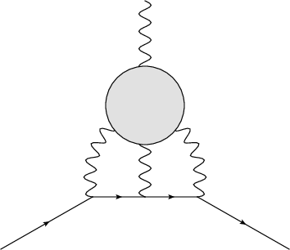
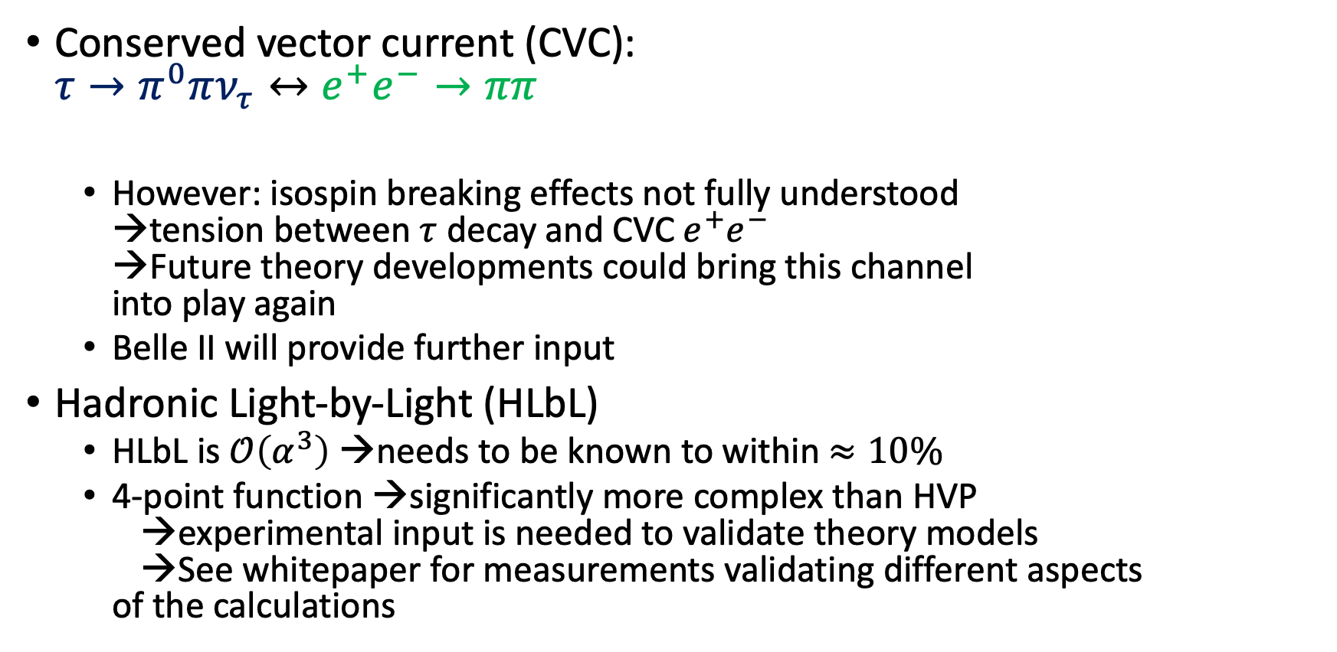
Additional Measurements related to g-2
Conserved vector current (CVC):
$τ→π^{0}πν_{τ}↔e^{+}e^{−}→ππ$
  However: isospin breaking effects not fully understood
  →tension between $τ$ decay and CVC $e^{+}e^{−}$
  →Future theory developments could bring this channel
  into play again
  Belle II will provide further input
Hadronic Light-by-Light (HLbL)
  HLbL is $𝒪\left(α^{3}\right)$ →needs to be known to within $≈10\%$
  4-point function →significantly more complex than HVP
  →experimental input is needed to validate theory models
  →See whitepaper for measurements validating different aspects
  of the calculations

Slide 11
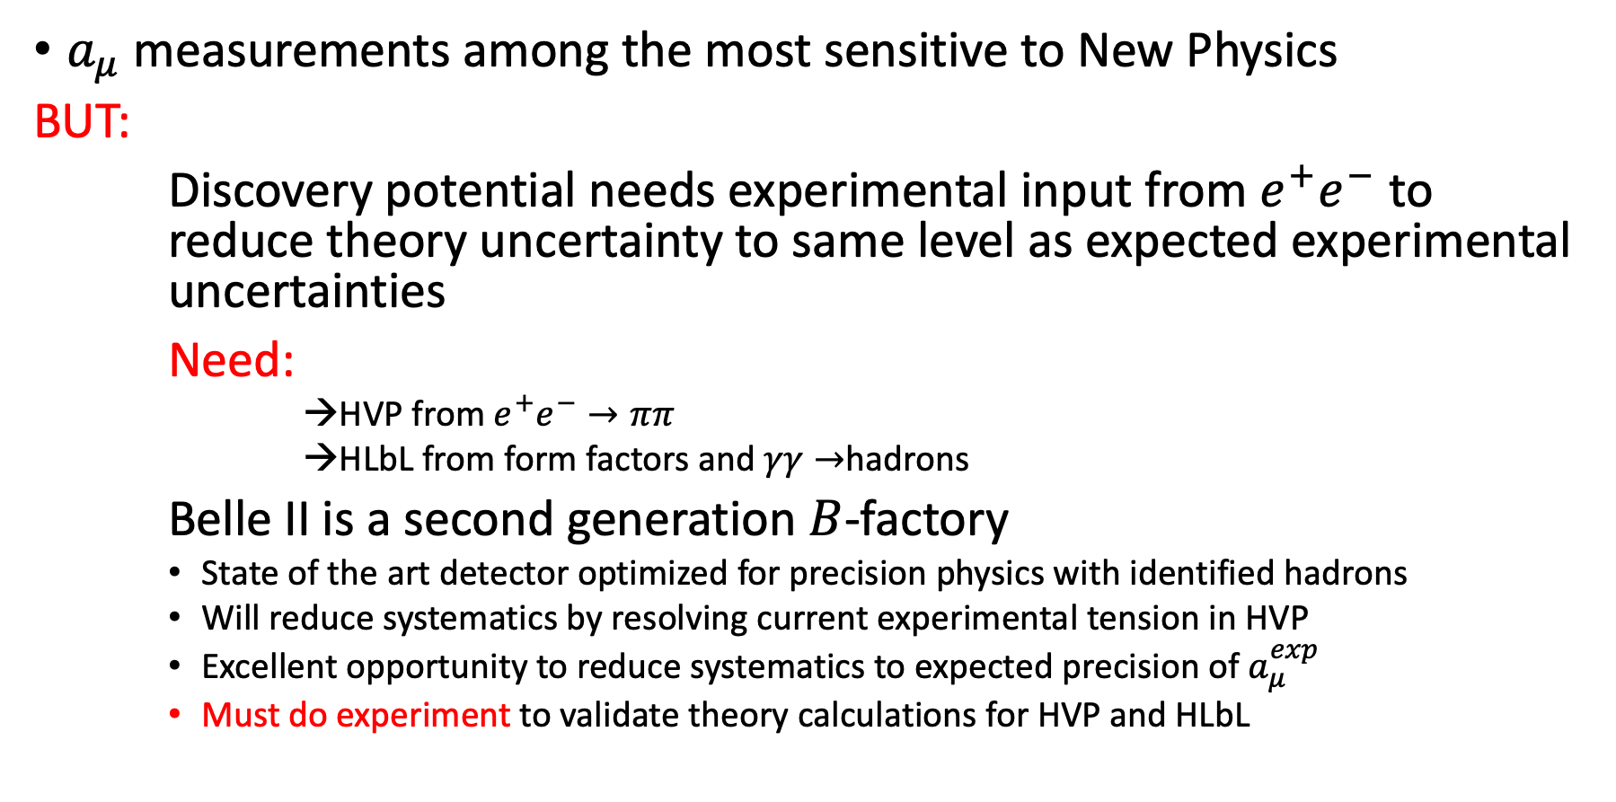
Summary and Take away message
$a_{μ}$measurements among the most sensitive to New Physics
BUT:
Discovery potential needs experimental input from $e^{+}e^{−}$ to reduce theory uncertainty to same level as expected experimental uncertainties
Need:
    →HVP from $e^{+}e^{−}→ππ$
    →HLbL from form factors and $γγ→$hadrons
Belle II is a second generation $B$-factory
    State of the art detector optimized for precision physics with identified hadrons
    Will reduce systematics by resolving current experimental tension in HVP
    Excellent opportunity to reduce systematics to expected precision of $a_{μ}^{exp}$
    Must do experiment to validate theory calculations for HVP and HLbL
Details in “Opportunities for precision QCD physics in hadronization at Belle II -- a snowmass whitepaper” (2204.02280 [hep-ex])
)

