Slide 1
Seattle Snowmass 2022
S.-C. Hsu
G. Watts

Slide 2
Basics Setup
Website: http://seattlesnowmass2021.net/
Anyone can contribute changes by submitting a PR to https://github.com/gordonwatts/seattlesnowmass2021
Dates are fixed: July 17-26 (10 Days)
Planning for ~700 people
Flexibility to increase that up to ~1000
Finance not well understood yet, but probably down to 500
We are aiming for $800 per person for 9.5 days before any grants or sponsorship
Private, modern dorm rooms (with private shower) close to campus, about $120 per night.
Broad Goals:
Community Consensus
Cross-group Collaboration
Paper prep
Preparing the story for the P5 hand off

Slide 3
700 People in One Place At One Time
This can’t be a (giant) zoom meeting, but in person
(plenary status reports bad?)

Slide 4
What we have decided now(ish):
Reuse the shape of the 2013 meeting:
First day and last 1.5 days were plenaries
Mornings were scheduled “formal” parallel sessions. Between 10-15 each morning
Afternoons were panel sessions and colloquia, and lots of time for informal get togethers and meetings
the reason people traveled
rather than just listened on vidyo!
Scatter through out were other things – like out reach, etc.
Link to Snowmass 2013: https://indico.fnal.gov/event/6890/

Slide 5
What does it make sense to fill now?
(taken from 2013)
First day of plenaries
Expectation setting, getting everyone on the same page.
Morning Parallel Sessions
Frontiers, and sub-frontier working groups have reports and formal discussions.
Status updates on whitepapers and important contributions.
Afternoons
Small number of colloquia on ‘important questions’ – a way to bring people onto the same page
Panel Discussions – open questions, things requiring more feedback from the community, presentations of plans that require feedback from the community
Last 1.5 day
Frontier Reports
“why particle physics matters”
Invited representatives from other regions (Europe, Japan, etc.)
Intro by the P5 committee
Closeout

Slide 6
Day One (Sunday)
Three hours of plenaries, with a coffee break (9-noon), including introductions (2 hours for us?)
Two hours of plenaries, with a coffee break after lunch (1:30-3:30)
2 hours plenaries or 2 big talks…
Lunch is 1.5 hours, box lunch, eat around anywhere, trying to get a café to sit at (Hopefully not raining!)
First chance for real “social-working” ad-hoc interactions

Slide 7
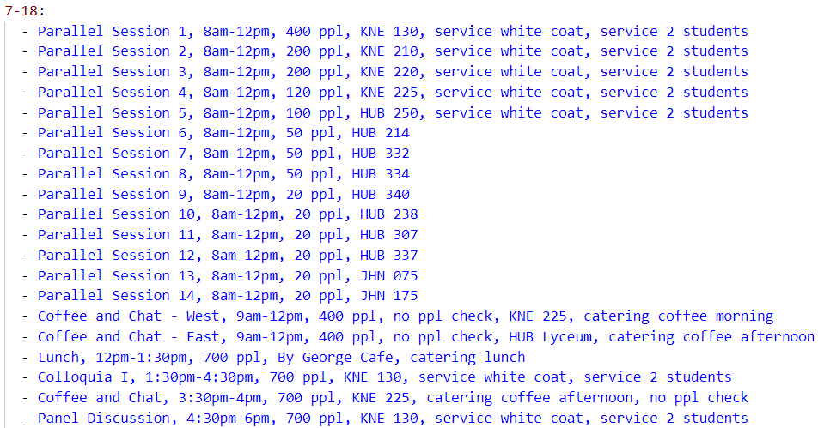
Day Two (Monday)-Day 7 (Saturday)
14 parallel sessions, 4 hours, with coffee break
Lunch is on your own
Larger (but not 100%) talks, panels, etc. (5.5 hours, with coffee break)

Slide 8
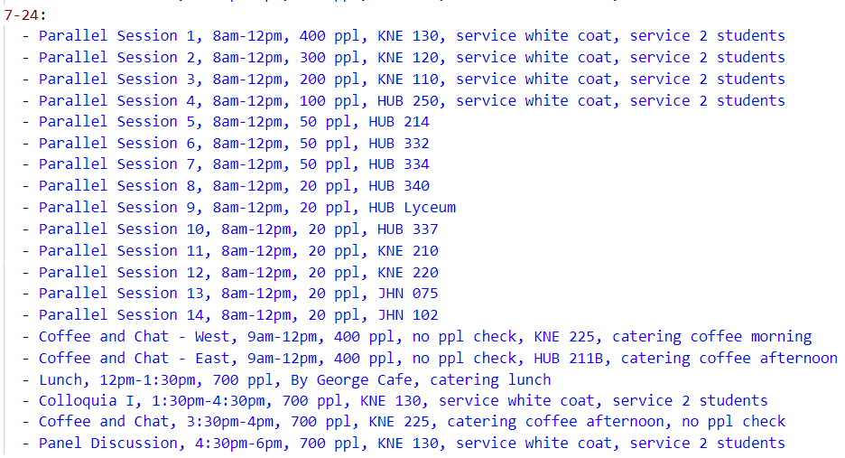
Day 8 (Sunday)
Rooms reserved for regular meeting
But suggest only really needed overflow uses this day to give everyone a bit of a break and meeting time and go off an explore time, etc., before the final two days

Slide 9
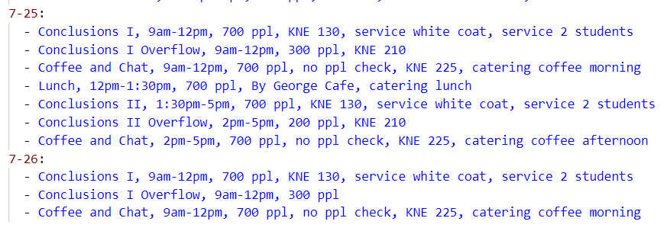
Day 9 (Monday) – Day 10 (Tuesday)
Three hours of plenaries, with a coffee break (9-noon)
Box Lunch
Three hours of plenaries, with a coffee break after lunch (1:30pm-5pm)
Three hours of plenaries, with a coffee break (9-noon)
A room open with coffee, tables the whole day
(Trying to get this for more than just the last two days)

Slide 10
Other Meetings & Events at same time as Snowmass
Have some folks with access to training money
Possibly bring students by paying for most of their costs (but not 100%)
Then they can hang around for snowmass pretty cheaply
There is an Ann Nelson memorial workshop just before Snowmass starts
We do not think there will be overlap on Sunday of our start
Other meetings are fine – let us know – we will have to work on financing, but in general small rooms for an afternoon aren’t expensive

Slide 11
LOC Current Tasks
We are currently drafting the DOE grant application
We are restarting regular meetings of the LOC
There are a public lectures, physics slam, etc., that we need to get coordinated

