Slide 1
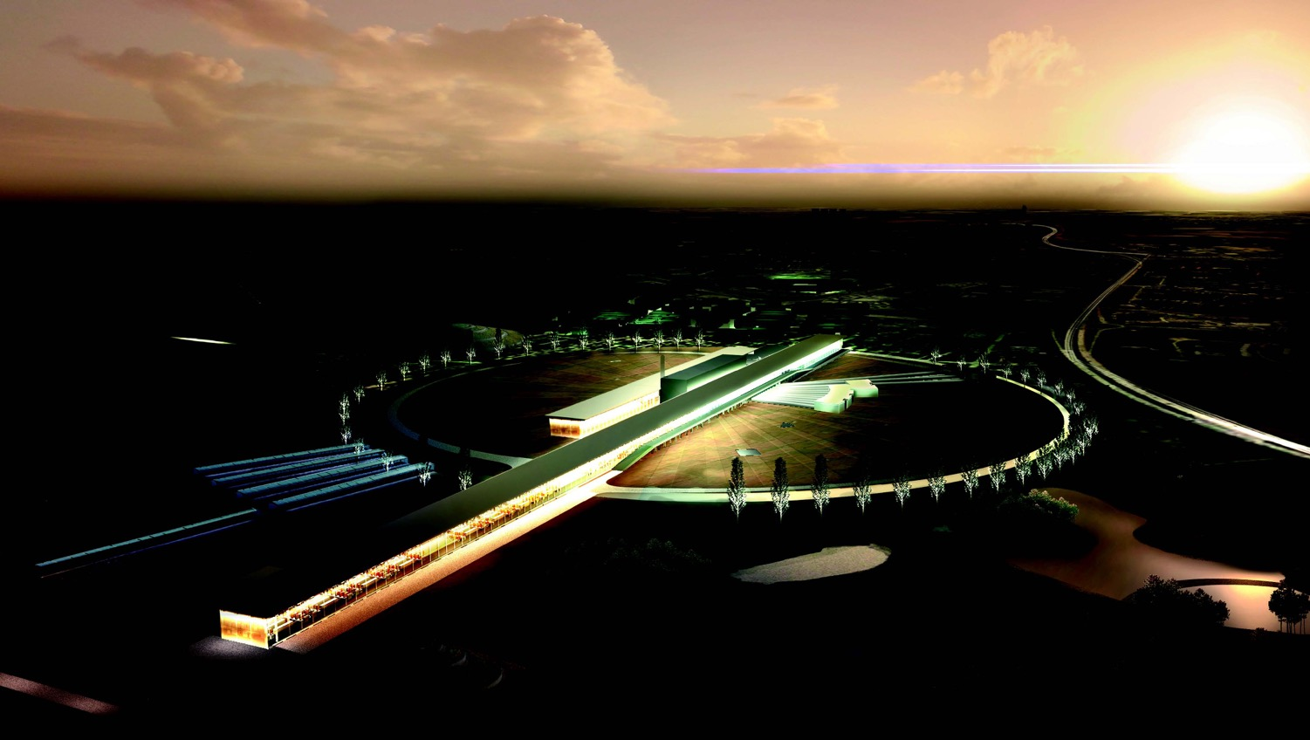


Neutrino CP Violation with the European Spallation Source neutrino Super Beam
Marcos Dracos
IPHC-Strasbourg

Slide 2
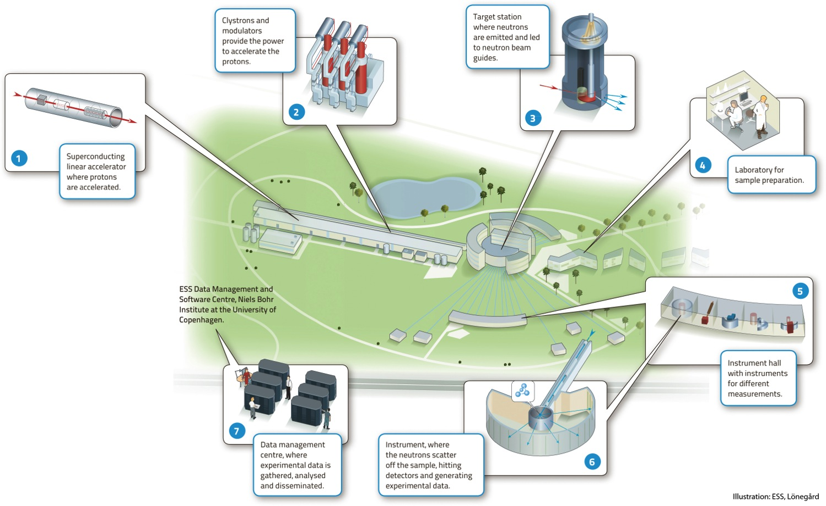

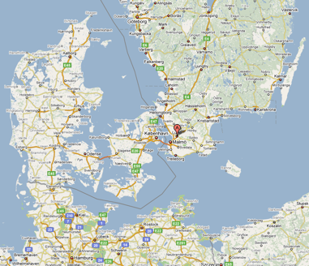
European Spallation Source
Neutron facility
(equivalent to SNS in the USA)
under construction phase
(~1.85 B€ facility)

Slide 3
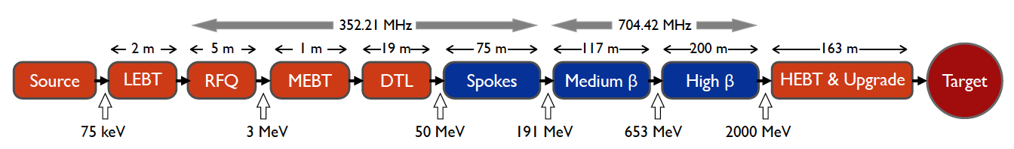
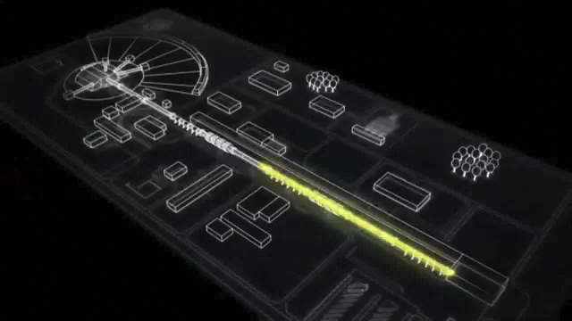
ESS proton linac
empty space for energy upgrades
The ESS will be a copious source of spallation neutrons.
5 MW average beam power.
125 MW peak power.
14 Hz repetition rate (2.86 ms pulse duration, 10¹⁵ protons).
Duty cycle 4%.
2.0 GeV protons
  up to 3.5 GeV with linac upgrades
>2.7x10²³ p.o.t/year.
8
x10¹⁴
ESS 5 MW
2015 design
7
λ = 1.5 Å
6
5
Brightness (n/cm²/s/sr/Å)
4
3
ESS 5 MW
2012 design (TDR)
2
UK TS2
32 kW
SNS
1-2 MW
JPARC
0.3-1 MW
1
UK TS1
128 kW
ILL 57 MW
0
time (ms)
1
2
3
4

Slide 4
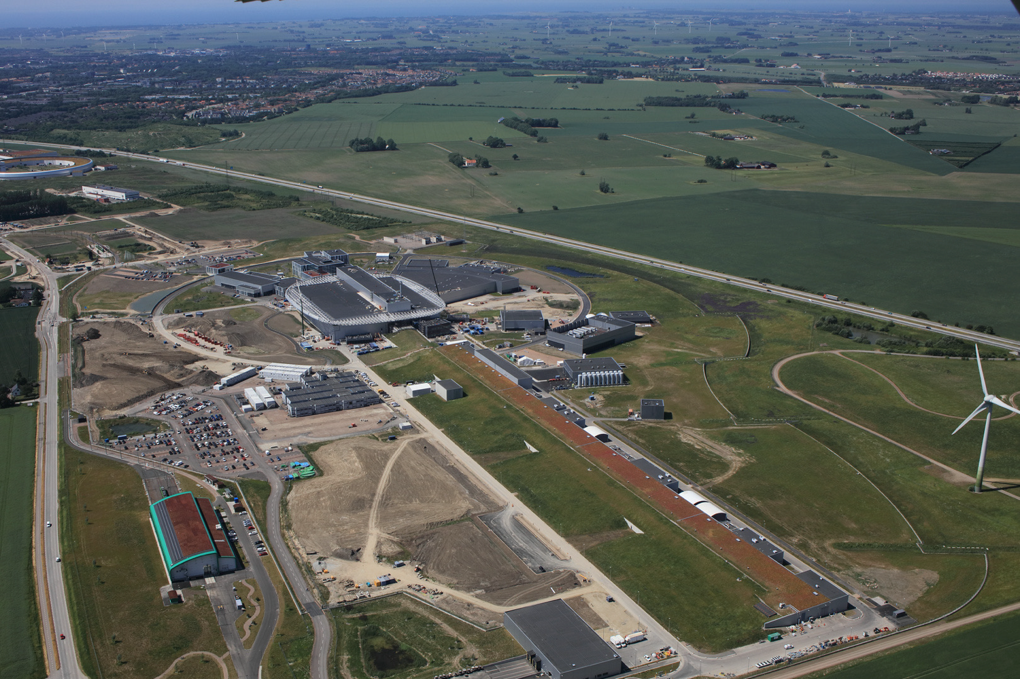

European Spallation Source
July 2021
target
instruments
utility buildings
linac
European Research Infrastructure Consortium (ERIC) since 2015
Beam commissioning end 2022

Slide 5
European Spallation Source as Neutrino Facility for CP violation observation
(2nd Oscillation maximum)
ν_{μ}→ν_{e}

Slide 6
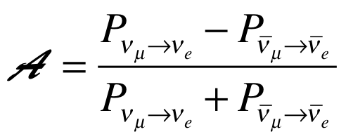
Oscillation probability
(neutrino beams)
"atmospheric"
"interference"
"solar"
matter effect
for antimatter: δ_{CP} →-δ_{CP} and a→-a
fake matter/antimatter asymetry due to matter effect
δ_{CP} dependence,
sizable matter effect for long baselines
Matter-antimatter asymmetry

Slide 7
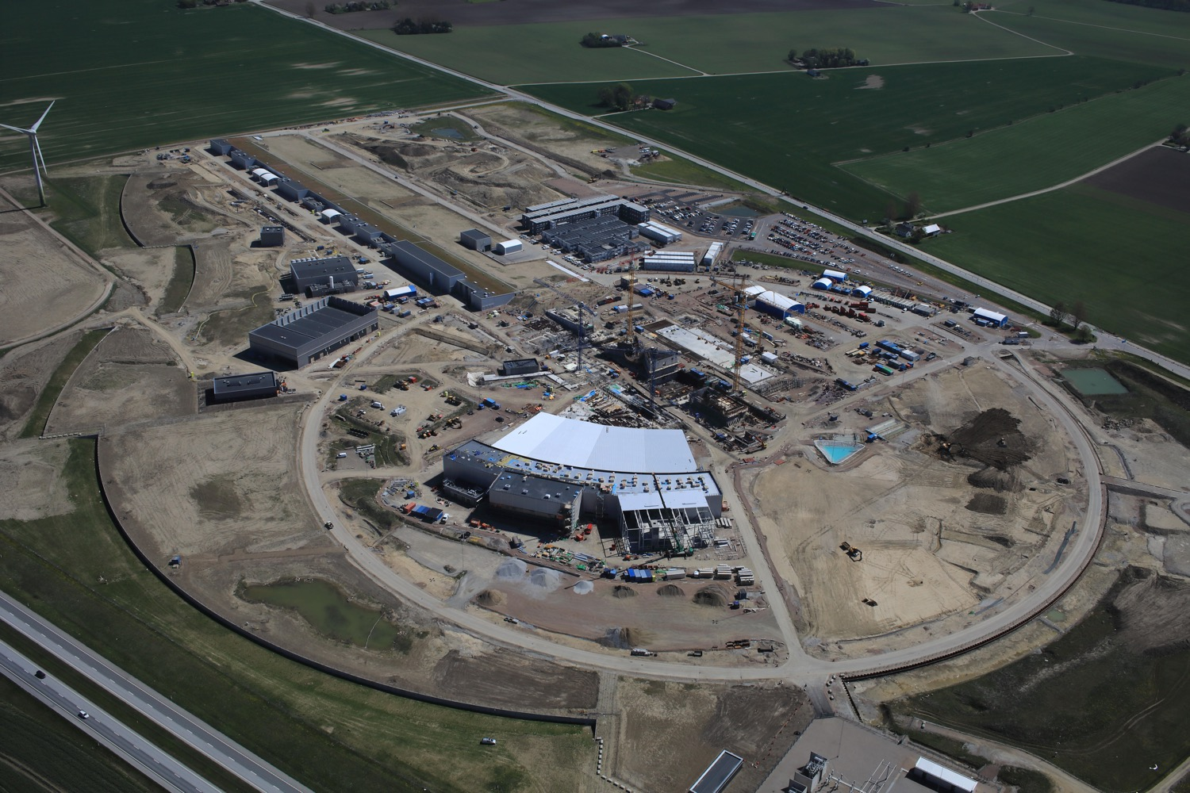
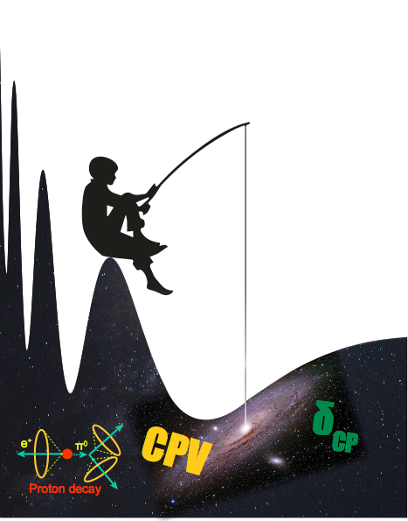
Use all this ESS linac power to go to the second oscillation maximum
but why?

Slide 8
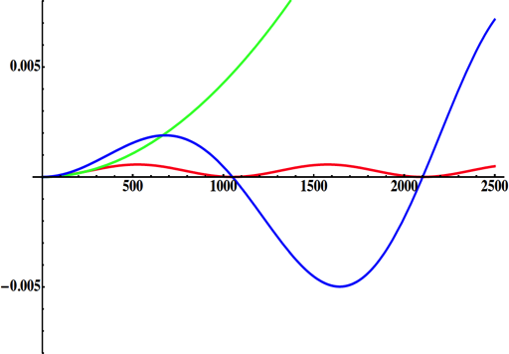
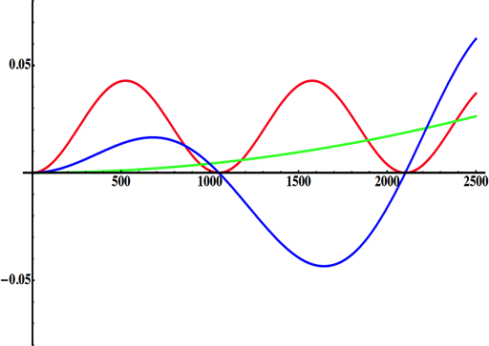
Neutrino Oscillations with "large" θ₁₃
(before 2012)
(after 2012)
solar
atmospheric
for "large" θ₁₃ 1st oscillation maximum is dominated by atmospheric term
for small θ₁₃ 1st oscillation maximum is better
atmospheric
solar
L/E
L/E
CP interference
(arXiv:1110.4583)
θ₁₃=1º
CP interference
θ₁₃=8.8º
1st oscillation max.: A=0.3sinδ_{CP}
2nd oscillation max.: A=0.75sinδ_{CP}
(see arXiv:1310.5992 and arXiv:0710.0554)
more sensitivity at 2nd oscillation max.
less sensitive to systematic errors

Slide 9
Production of a neutrino beam
What can we do with:
5 MW power
2 GeV energy
14 Hz repetition rate
10¹⁵ protons/pulse
>2.7x10²³ protons/year
proton beam
decay tunnel
p
hadrons
physics
π
ν
⨂B
target
hadronic collector
(focusing)
Detector
conventional neutrino (super) beam

Slide 10
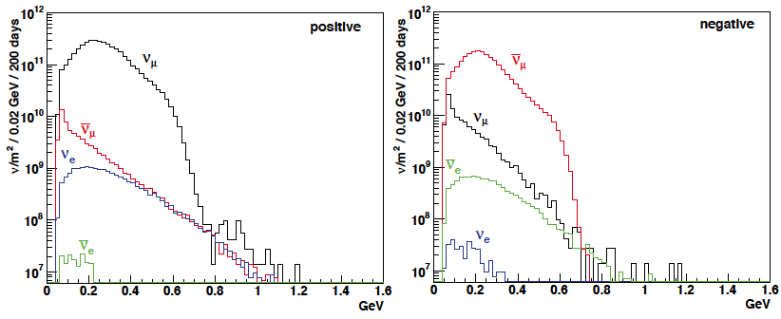
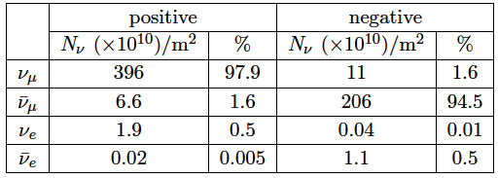
ESSνSB ν energy distribution
neutrinos
anti-neutrinos
almost pure ν_{μ} beam
small ν_{e} contamination which could be used to measure ν_{e} cross-sections in a near detector
at 100 km from the target, per year (in absence of oscillations)
(Nucl. Phys. B 885 (2014) 127)

Slide 11
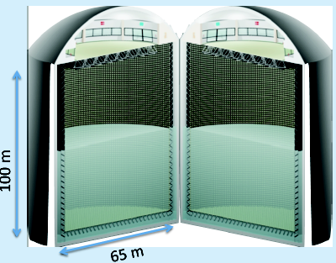
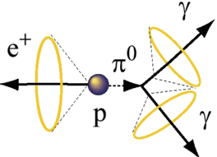
Can we go to the 2nd oscillation maximum using our proton beam?
Yes, if we place our far detector at around 500 km from the neutrino source.
MEMPHYS like Cherenkov detector
(MEgaton Mass PHYSics studied by LAGUNA)
(arXiv: hep-ex/0607026)
Neutrino Oscillations
Proton decay
Astroparticles
Understand the gravitational collapsing: galactic SN ν
  Supernovae "relics"
Solar Neutrinos
Atmospheric Neutrinos
500 kt fiducial volume (~20xSuperK)
Readout: ~240k 8” PMTs
30% optical coverage
New 20" PMTs with higher QE and cheaper (see JUNO), the detection efficiency will improve the detector performance keeping the price constant, not yet taken into account.

Slide 12
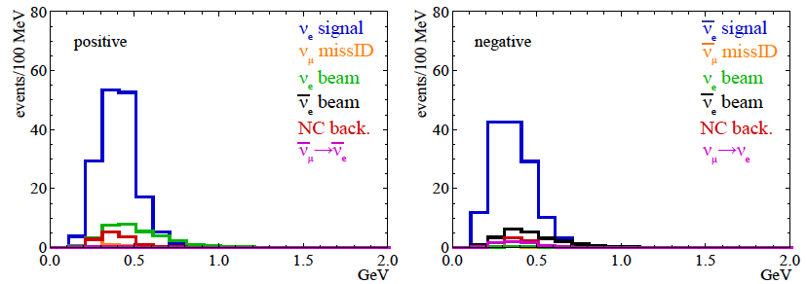
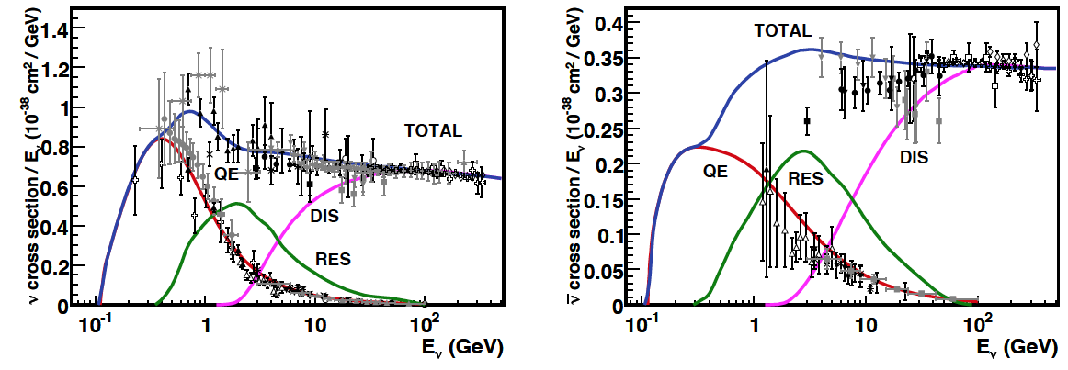
Neutrinos in the far detector
540 km (2 GeV), 10 years
neutrinos
anti-neutrinos
δ_{CP}=0
2 years
8 years
Below ν_{τ} production, almost only QE events, not suffering too much by π⁰ background.

Slide 13
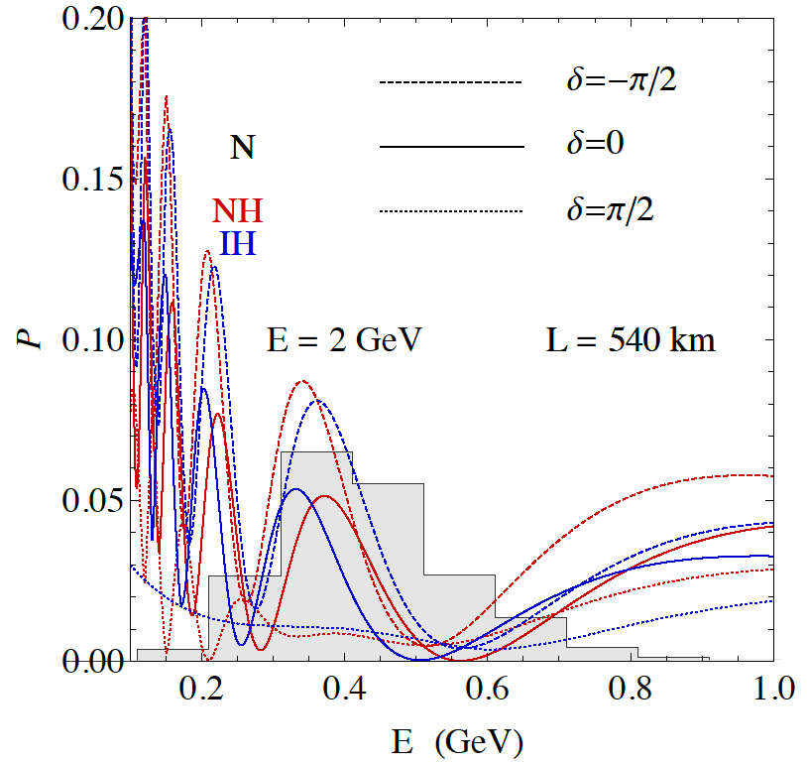
2nd Oscillation max. coverage
2nd oscillation max.
well covered by the ESS neutrino spectrum
1st oscillation max.
full coverage of the 2nd oscillation max.

Slide 14



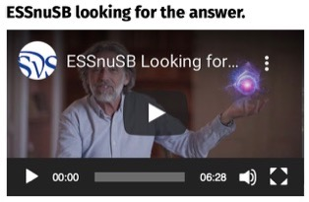
ESSνSB Consortium
COST Action EuroNuNet (CA15139): 2016-2020
  https://euronunet.in2p3.fr
  video for scientists: https://www.youtube.com/watch?v=PwzNzLQh-Dw
EU-H2020 Design Study ESSνSB: 2018-2022 (3 months extension due to COVID19)
  https://essnusb.eu
  video for general public: https://www.youtube.com/watch?v=qAnvft0nAlg

Slide 15
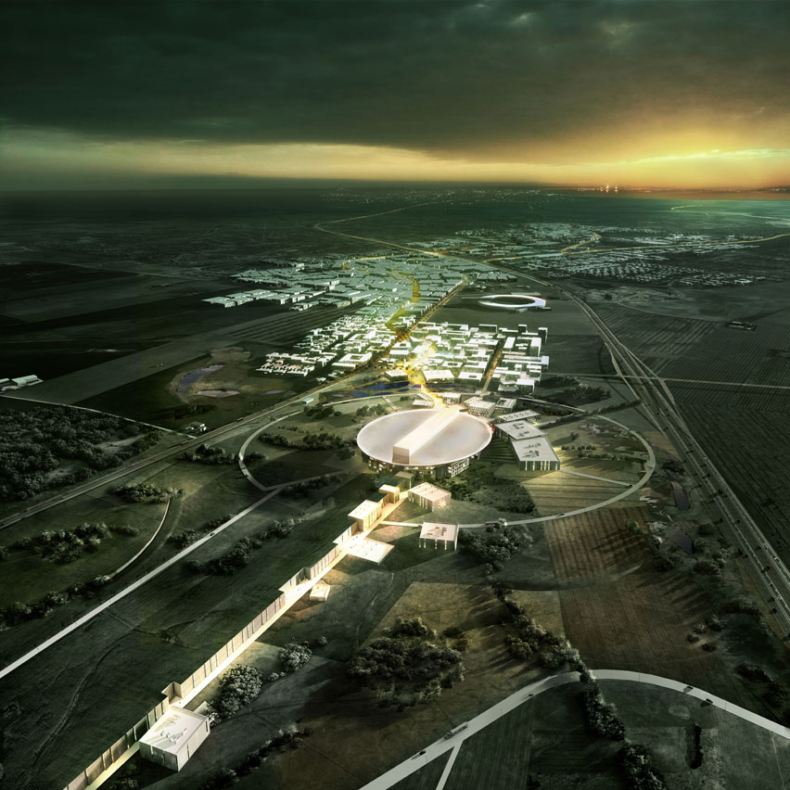
ESS modifications to produce a neutrino Super Beam
European Spallation Source Linac

Slide 16
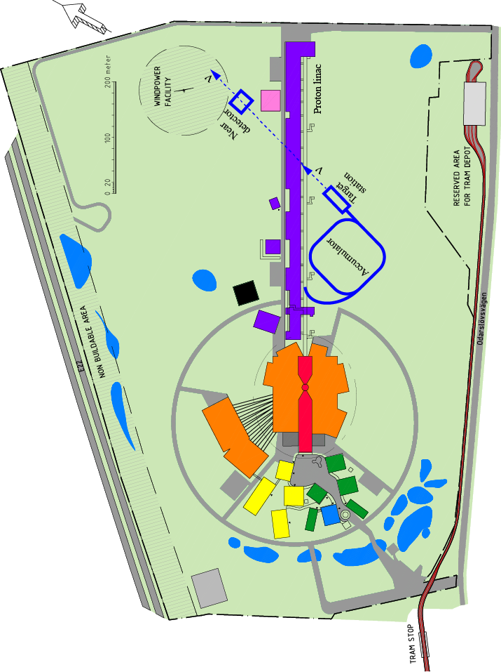
How to add a neutrino facility?
The neutron program must not be affected and if possible synergetic modifications.
Linac modifications: double the rate (14 Hz → 28 Hz), from 4% duty cycle to 8%.
Accumulator (C~400 m) needed to compress to few μs the 2.86 ms proton pulses, affordable by the magnetic horn (350 kA, power consumption, Joule effect)
  H⁻ source (instead of protons),
  space charge problems to be solved.
~300 MeV neutrinos.
Target station.
Underground detector.
Short pulses (~μs) will also allow DAR and Coherent Scattering experiments (as those proposed for SNS) using the neutron target.

Slide 17
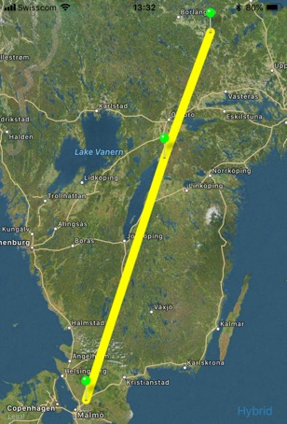
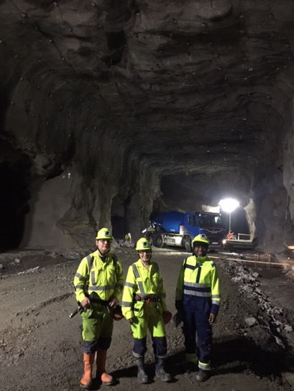
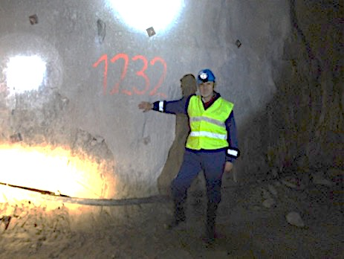
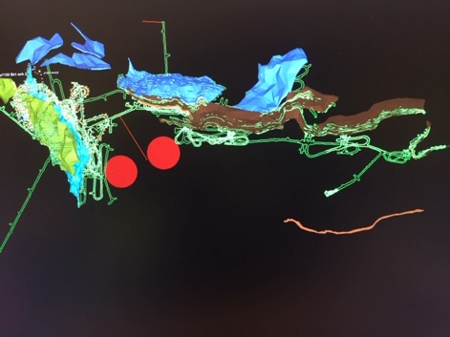
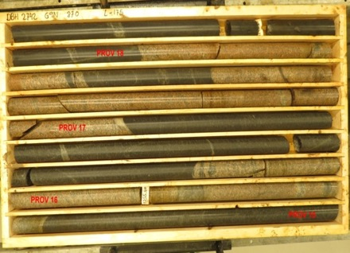
Candidate active mines
Garpenberg mine
  Distance from ESS Lund 540 km
  Depth 1200 m
  Truck access tunnel
Zinkgruvan mine
  Distance from ESS Lund 360 km
  Depth 1500 m
  Truck access tunnel
Garpenberg
(540 km)
Zinkgruvan
Zinkgruvan
(360 km)
Lund
possible location of MEMPHYS in
Zinkgruvan mine
Garpenberg
Granite drill cores

Slide 18
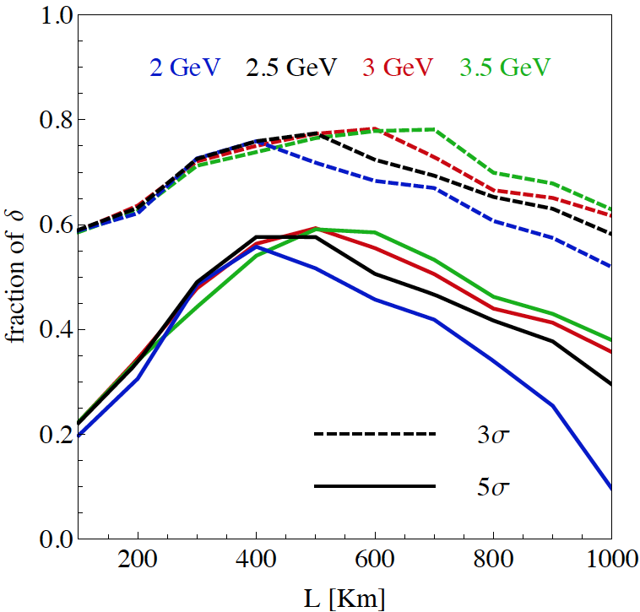
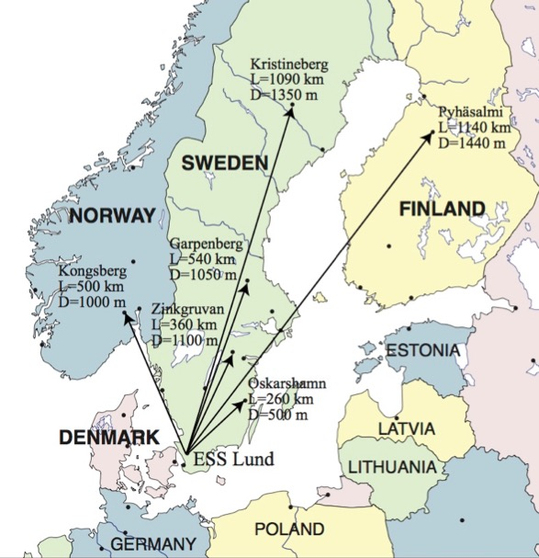
Which baseline?
CPV (Nucl. Phys. B 885 (2014) 127)
Garpenberg
Zinkgruvan
~60% δ_{CP} coverage at 5 σ C.L.
>75% δ_{CP} coverage at 3 σ C.L.
systematic errors: 5%/10% (signal/backg.)
Candidate active mines

Slide 19
Physics Performance
(CPV discovery)
540 km
little dependence on mass hierarchy,
δ_{CP} coverage at 5 σ C.L. up to 60%,
δ_{CP} accuracy down to 6° at 0° and 180° (absence of CPV for these two values),
not yet optimized facility,
5/10% systematic errors on signal/background.

Slide 20
Physics Performance
(accuracy)
5/5 yrs
δ_{CP} accuracy down to 6° at 0° and 180°
12° accuracy at δ_{CP}= -90° and 10° at δ_{CP}= 90°
5/10% systematic errors on signal/background.

Slide 21
The Linac modifications and operation
H⁻ source options
Into linac
P
_{H}⁻
_{H}⁻
_{H}⁻
_{H}⁻
P
_{H}⁻
_{H}⁻
_{H}⁻
_{H}⁻
14 Hz
100 µs
0.65 ms
Into ring
H⁻
H⁻
H⁻
H⁻
H⁻
H⁻
H⁻
H⁻
14 Hz
~1.4 kHz
~1 µs
~0.75 ms
Into horn
_{H}⁻
_{H}⁻
_{H}⁻
_{H}⁻
_{H}⁻
_{H}⁻
_{H}⁻
_{H}⁻
14 Hz
time operation option
Horn 1
Horn 4
Horn 2
Horn 3

Slide 22
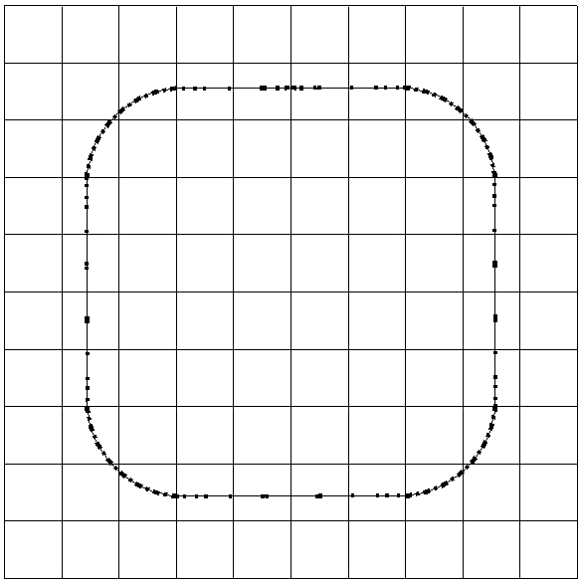
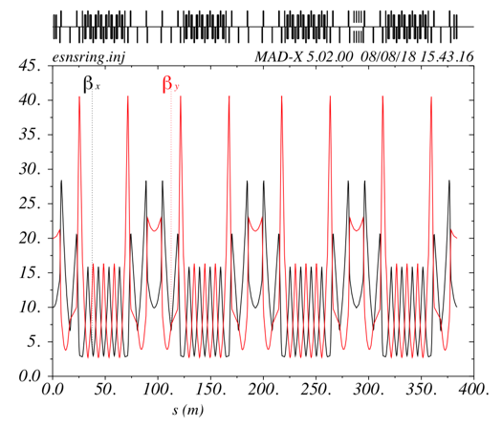
The Accumulator
lattice development
injection
4 superperiods
RF
extraction
FODO cells
H⁻ stripping
collimation
Dispersion-free straight sections

Slide 23
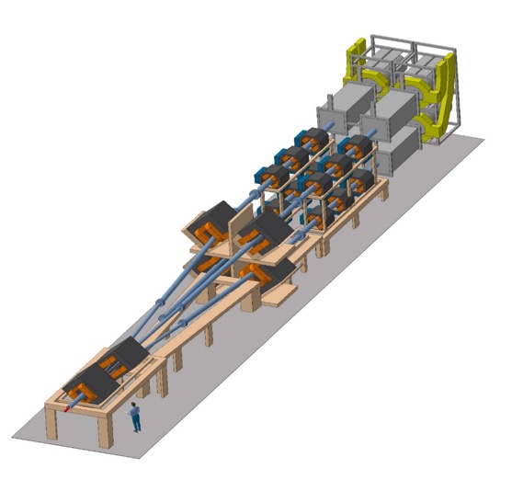
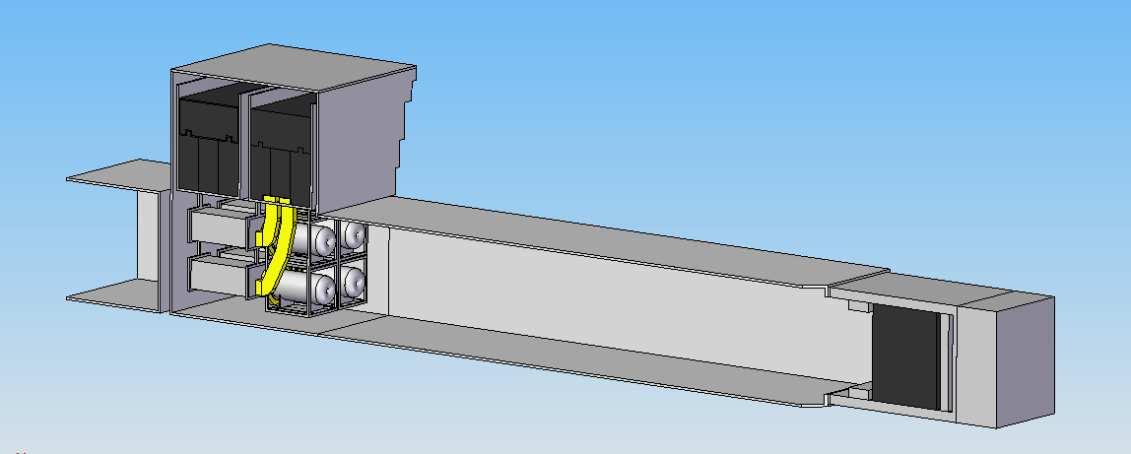
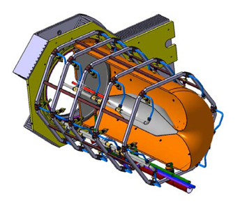
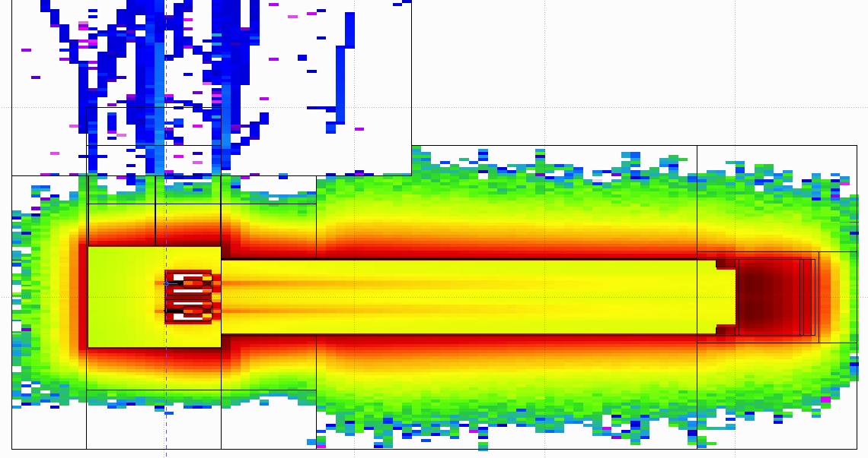
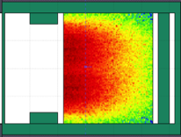
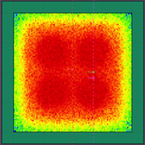
General Layout of the target station
Switchyard
8 m concrete
Split Proton Beam
Horns and Targets
Collimators
Decay Volume
(He, 4x4x25 m³)
Neutrino Beam Direction
Beam Dump

Slide 24
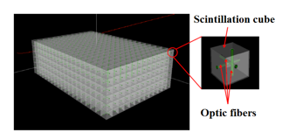
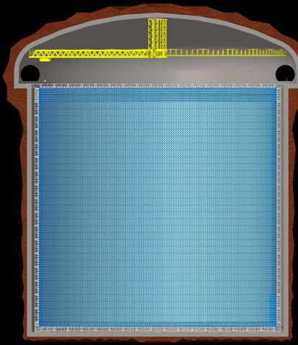
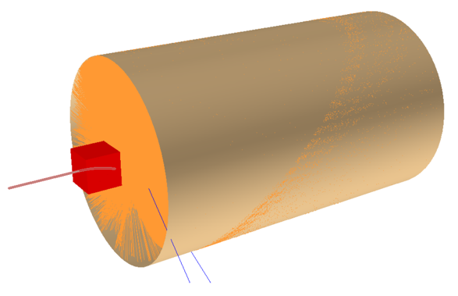
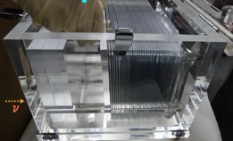
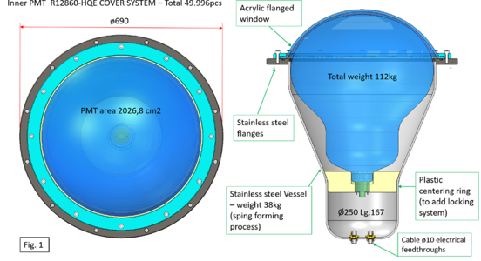
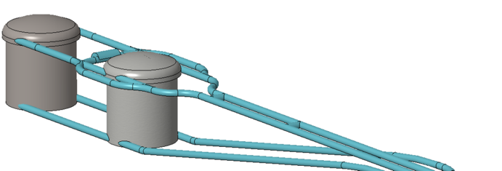
Detectors
Far Detector
Near Detector
Super-FGD like detector
- 1 t target mass
Beam
77 m
0.5 kt fiducial volume
water Cherenkov detector
NINJA-like water-emulsion detector
75 m
30% photocathode coverage
~500 kt
20" PMT

Slide 25
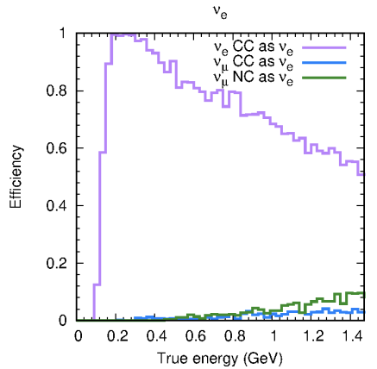

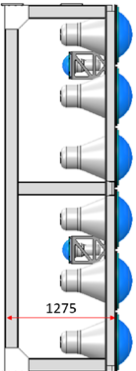
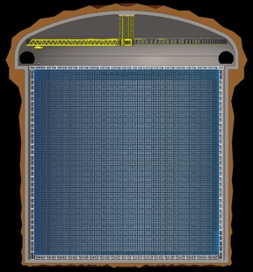
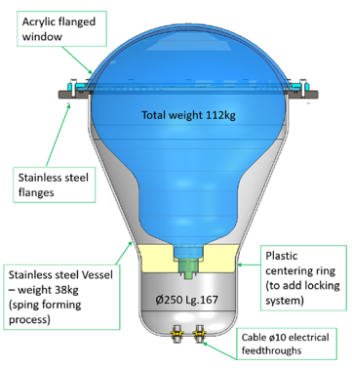
Latest Improvements
New Magriation Matrices for the far detector compared to those of MEMPHYS
Genetic Algorithm for Target Station optimisation
(using WCSim and fiTQun)
30% photocathode coverage
MEMPHYS WC detector
new far detector reconstruction algorithm
(publication is coming)
Phys. Rev. ST Accel. Beams 16, 061001 (2013)
horn optimisation
20"
x2
~500 kt
77 m
75 m

Slide 26
Physics Performance Improvement
540 km
360 km
current
performance
initial performance
ESSnuSB
θ₁₂ = 33.44°
θ₁₃ = 8.57°
θ₂₃ = 49.2°
Δm²₂₁ = 7.42e-5
Δm²₃₁ = +2.517e-3
2nd osc. max.
507 ktons far detector
contribution of atm. neutrinos still to be included
Neurino Factory
ESSnuSB
EUROnu
θ₁₂ = 33.2°
θ₁₃ = 9.2°
θ₂₃ = 45°
Δm²₂₁ = 7.64e-5
Δm²₃₁ = +2.45e-3
1st osc. max.
10 years
https://arxiv.org/abs/2107.07585
best version of NF

Slide 27
Improvements (discovery potential)
current
performance
540 km
360 km
initial performance
~more than 70% after 10 years
discovery potential at the level of the Neutrino Factory!
EUROnu performance
10 years

Slide 28
Improvements
(precision measurements)
540 km
360 km
initial performance
current
performance
Precision measurements
ESSnuSB
EUROnu
10 years
more in https://arxiv.org/abs/2107.07585
Neurino Factory

Slide 29
Choice to be done soon between the two mines
70% δ_{CP} coverage at 5σ!
https://arxiv.org/abs/2107.07585
CPV discovery
precision measurement
better than 8° precision on δ_{CP} for all values!

Slide 30
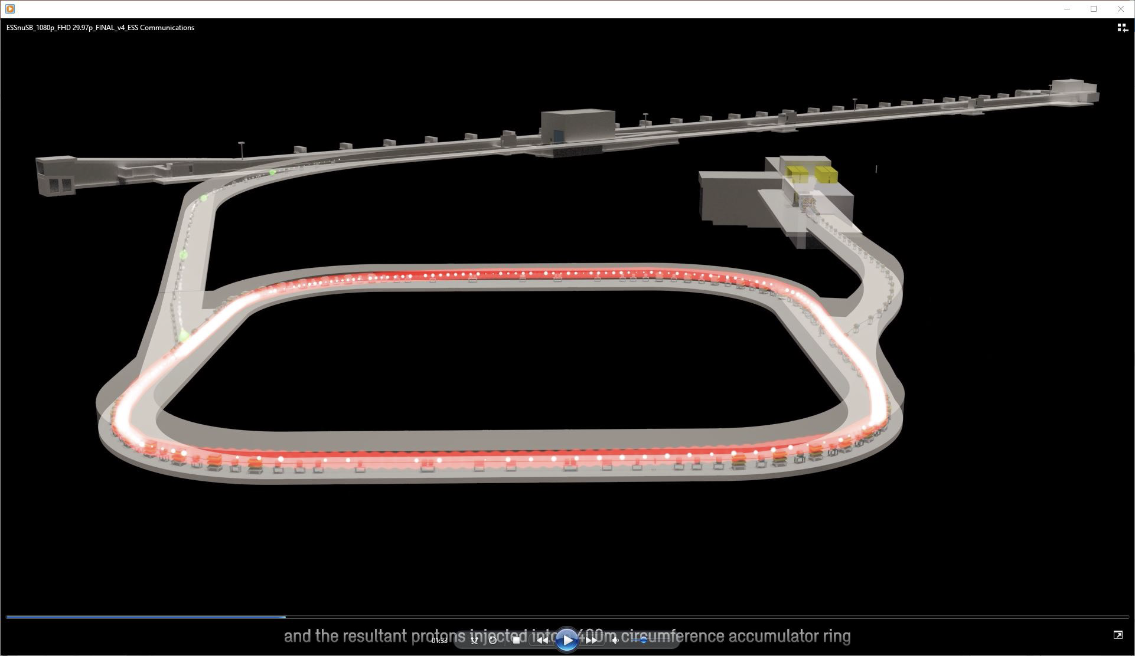
What to do after?

Slide 31
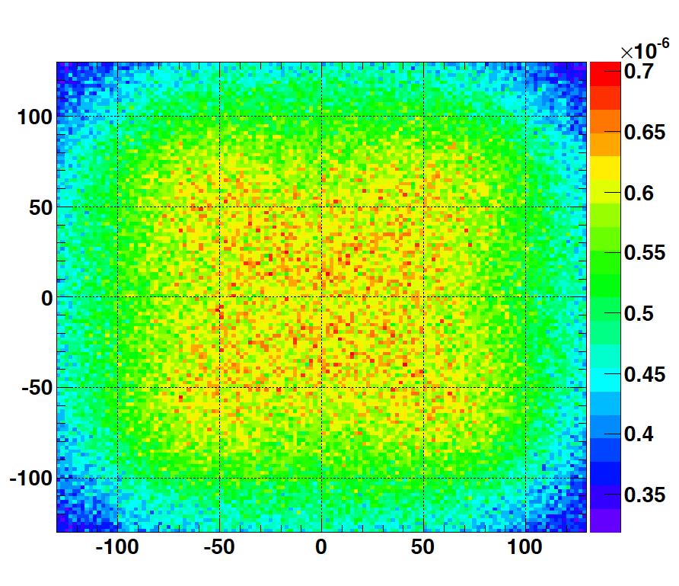
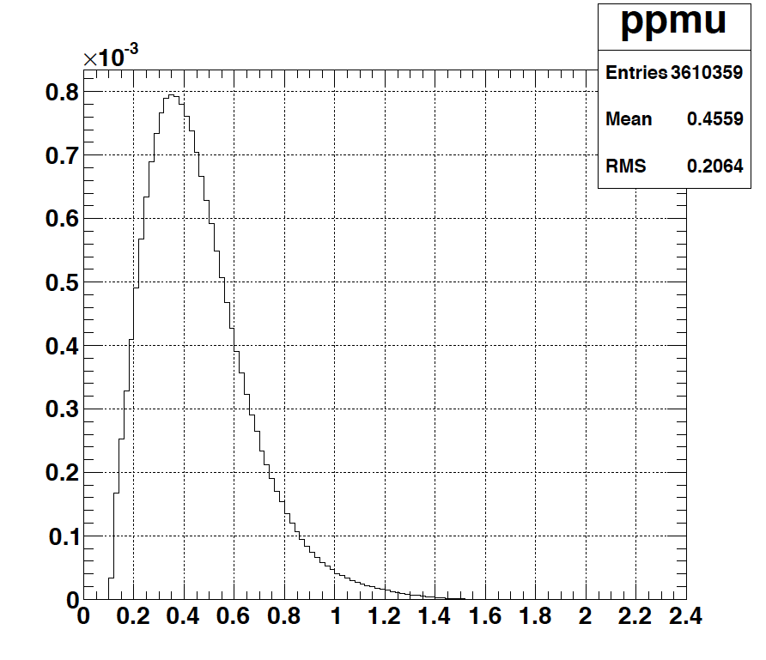
Muons at the level of the beam dump
2.7x10²³ p.o.t/year
y (cm)
muons at the level of the beam dump
(per proton)
more than 4x10²⁰ μ/year from ESS compared to 10¹⁴ μ used by all experiments up to now (10¹⁸ μ for COMET in the future).
4.2x10²⁰ μ/year
(16.3x10²⁰ for 4 m²)
x (cm)
10⁻³
4.1x10²⁰ μ/year
input beam for future 6D μ cooling experiments (for muon collider),
low energy nuSTORM,
Neutrino Factory,
Muon Collider.
muons/proton
<E_{μ}>~0.46 GeV
<L_{μ}>~2.9 km

Slide 32
ESSνSB and (R&D) synergies
ν_{μ} + ‾ν_{e}
ν_{μ} or ‾ν_{μ}
ν_{e} + ‾ν_{μ}
Super Beam
nuSTORM
2.7x10²³ p.o.t/year
+Decay At Rest and Coherent scat.
(with short pulses)
Neutrino Factory
Muon Collider

Slide 33
What to do more?
Further important studies needed before start ESSnuSB construction.
  new studies must be significantly different to those already done,
  supplementary studies required for the present proposal (according to present WP conclusions),
  site specific civil underground engineering: at ESS-site and far detector site,
  detailed studies of the safety and licensing requirements needed for the later approval by the authorities as well as how to take environmental protective measures into account
  preparation of the R&D phase before TDR,
  Muons (synergies): design studies of an ESS-based low energy nuSTORM and a Muon Collider Proton Complex Test Facility.

Slide 34
Proposed scenario for 2022-2025

Slide 35

New participants are welcome

Slide 36
Conclusions
The ESS proton linac will be soon the most powerful linac in the world.
ESS can also become a neutrino facility (ESSνSB ) with enough protons to go to the 2nd oscillation maximum:
  increase significantly the CPV sensitivity and precise measurement of δ_{CP}
  less sensitive to systematic errors
Rich muon program for future ESS upgrades
  Low energy nuSTORM
  Muon Facilities' R&D
Excellent conditions for DAR and Coherent Scattering experiments
New applications under preparation,
  please join!

Slide 37
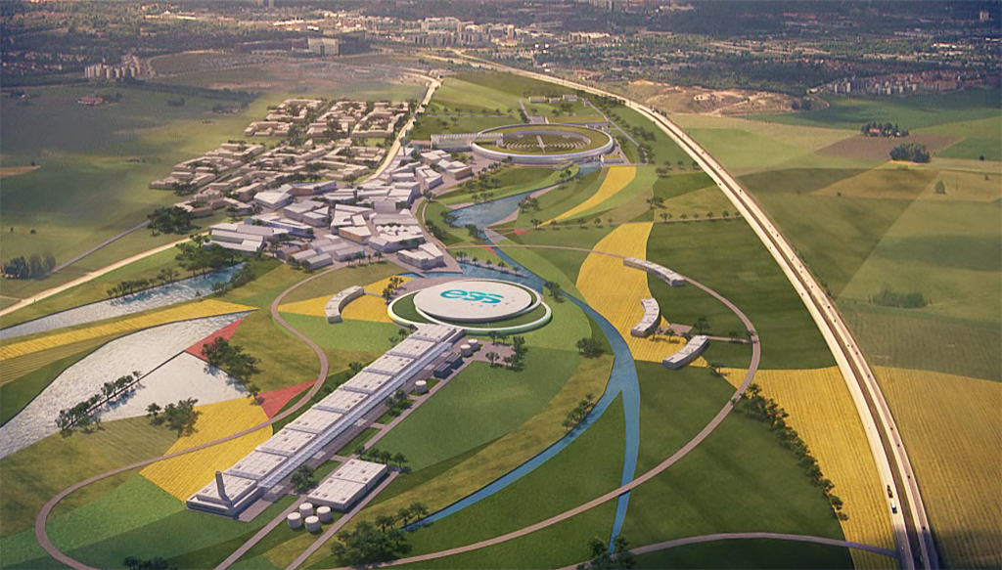
Backup

Slide 38
ESSnuSB structure and participating institutions
Starting date: 01/01/2018
Ending date: 31/12/2021 → 31/03/2022,
Duration: 48+3 Months,
3 months extension due to COVID19
Kick-off meeting: 15 January 2018, Lund (ESS),
90% of the budget already received,
All deliverables and milestones ready on time (some rescheduling due to COVID19 has been arranged with the EU Project Officer)
11 countries

Slide 39



Possible ESSνSB schedule
(2nd generation neutrino Super Beam)
2022: End of ESSνSB Design Study, CDR and preliminary costing
2012: inception of the project
2016-2019: beginning of COST Action EuroNuNet
2018: beginning of ESSνSB Design Study (EU-H2020)
2022-2025: Preparatory Phase, TDR
2025-2027: Preconstruction Phase, International Agreement
2027-2035: Construction of the facility and detectors, including commissioning
2035-: Data taking
Nucl. Phys. B 885 (2014) 127

Slide 40


Muons at ESS (ESSμSB)
Carlo Rubbia
arXiv:1908.05664

Slide 41

Muons at ESS (ESSμSB)

Slide 42
Linac, accumulator, race-track and muon activities
WP3
study of the muon race-track
ESSnuSB
Near
Detector
nuSTORM
Near
Design study of a nuSTORM race-track storage ring located on the ESS site and study how the uniquely high flux of pions and muons from the ESSnuSB targets station can be injected into such a ring to produce a high flux of equal amounts of electron and muon neutrinos of low energy for neutrinos cross-section measurements and sterile neutrino searches using
a dedicated small close nuSTORM near detector and the ESSnuSB Near Detector
as a far detector for the nuSTORM beam.

Slide 43
Low Energy nuSTORM at ESS
Sterile Neutrino searches
Neutrino cross sections measurements with unprecedented precision
LBL performance improvement by systematic error mitigation
To be adapted for lower muon energies (~0.5 GeV)
Proposed at FERMILAB and CERN (~3.8 GeV muons)
preliminar studies for ESS
sterile neutrino searches

Slide 44
nuSTORM
sterile neutrino searches
Proposed at FERMILAB and CERN (~3.8 GeV muons)

Slide 45

Decay At Rest at ESS
Possible if short pulses (~μs)
π⁻
~99%
capture
ν_{e}
Well known neutrino spectra (DAR).
Very high neutrino intensities ~ 5x10¹⁵ ν/s.
Separate neutrinos of different flavors by time cut.
Role that neutrino-nucleus interactions play in the supernova explosion process and subsequent nucleosynthesis.
Accurate knowledge of neutrino-nucleus cross sections is important (almost no data exist).
This lack of knowledge significantly limits our understanding of supernovae and of terrestrial observations of cosmic neutrinos to probe the deepest layer of these powerful explosions.
p
A
μ⁺
τ ≈ 2.2 μs
DAR
e⁺
π⁺
τ ≈ 26 ns
ν_{μ}
Fragments
ν_{μ}

Slide 46


Coherent Scattering at ESS
JHEP 02 (2020) 123
ESS can generate the largest pulsed neutrino flux suitable for the detection of Coherent Elastic Neutrino-Nucleus Scattering (CEνNS ).
Innovative detector technologies able to profit from the order-of-magnitude increase in neutrino flux provided by the ESS, along with their sensitivity to a rich particle physics phenomenology accessible through high-statistics, precision CEνNS measurements, are under study.

Slide 47

Systematic errors
Phys. Rev. D 87 (2013) 3, 033004 [arXiv:1209.5973 [hep-ph]]

Slide 48

Optimisations

Slide 49

Expected event spectrum

Slide 50

Expected event spectrum

Slide 51

Expected event purity

Slide 52

Expected event purity

Slide 53


Coverage

Slide 54


Systematics
We included additional bin-to bin uncorrelated nuisance parameter for all signal and background channels (uncorrelated)

Slide 55


δ_{CP} and matter-antimatter asymmetry magnitude
(Jarlskog invariant)
(from the already observed CP violation in the hadronic sector)
Theoretical models predict that if |sinδ_{CP}|≳0.7 (45°<δ_{CP}<135° or 225°<δ_{CP}<315°), this could be enough, under assumptions, to explain the observed asymmetry.
(Nucl.Phys.B774:1-52,2007, arXiv:hep-ph/0611338)

Slide 56
The H2020 ESSνSB Design Study
A H2020 EU Design Study has been submitted March 2017 (Call INFRADEV-01-2017)
Title of Proposal: Discovery and measurement of leptonic CP violation using an intensive neutrino Super Beam generated with the exceptionally powerful ESS linear accelerator.
Duration: 4 years
Total cost: 4.7 M€
EU funding received: 3 M€
15 participating institutions from
11 European countries including CERN and ESS
6 Work Packages
ESSνSB
BENE (2004-2008)
ISS (2005-2007)
EUROν (2008-2012)
LAGUNA (2008-2010)
LAGUNA-LBNO (2010-2014)
COST Action CA15139 (2015-2019)

Slide 57




Targetry, hadron production, muon extraction
WP4
including studies using 2 ns proton bunches
+prepare target R&D
muon extraction at the level of the ESSnuSB beam-dump

Slide 58



Muons at the level of the beam dump
<E_{μ}>~0.5 GeV
<L_{μ}>~3 km
$L_{dt}$ ($m$) | $N_{μ}$ ( ${μ^{+}}/{pot}$ ) | $N_{μ}$ ( ${μ^{+}}/s$ ) | $N_{μ}$ ( ${μ^{+}}/{200d}$) | $\left\langle P_{μ}\right\rangle$ ($GeV/c$)
$$25$$ | $$0.02$$ | $$2.5×{10}^{14}$$ | $$4.3×{10}^{21}$$ | $$0.48$$
$$50$$ | $$0.01$$ | $$1.2×{10}^{14}$$ | $$2.1×{10}^{21}$$ | $$0.56$$
$$100$$ | $$4.5×{10}^{−3}$$ | $$0.6×{10}^{14}$$ | $$1.0×{10}^{21}$$ | $$0.64$$
decay tunnel length

Slide 59

Detectors and Physics performance
WP5
Near (LEnuSTORM) and Far (ESSnuSB near) detectors
  cross-section measurements
Physics performance
  LEnuSTORM (sterile neutrinos)
astroparticle physics program with the Far Detector

