Slide 1
nuSTORM
Update since last presentation to nuSTEC board: 10Dec21

Slide 2
CERN
Horn and bubble chamber
First neutrino beam
IHEP
SKAT, JINR
CERN
Gargamelle, Aachen/Padova, CDHS,
CHARM, BEBC, CCFR, NOMAD, CHORUS
FNAL
MINOS, MINOS+, NOvA
Global neutrino
progamme
Hyper-K
LBNF/DUNE
CERN Neutrino Platform
CERN
OPERA, ICARUS
BNL
first neutrino
“beam”
BNL/FNAL
CITF, HPWF, 7’ BC, 15’ BC, E605,
E613, E734, E776, NuTEV
KEK/J-PARC
K2K, T2K
CERN
Horn #2 & Gargamelle
1950
1960
1970
1980
1990
2000
2010
2020
2030
ν_{μ}
discovery
Development of
E/w SM, QPM, QCD
Development of
Standard Neutrino
Model
ν_{e}/ν_{μ}
universality
Neutral
Current
discovery
Discovery of
CP-invariance violation?
Innovation in detectors to provide:
— High-precision
— Large data sets
— Control of systematics
Innovation in accelerators to go beyond

Slide 3
To go beyond the sensitivity of DUNE & HK
Beam-based uncertainties and pernicious biases
  Example: error budget from T2K
Energy
scale
mis-calibration
Missing
energy
(neutrons)
Event
mis-classification

Slide 4
nuSTORM specification: energy range
Guidance from:
  Models:
    Region of overlap
    0.5—8 GeV
  DUNE/Hyper-K far detector
  spectra:
    0.3—6 GeV
Cross sections depend on:
  Q² and W:
    Assume (or specify) a detector
    capable of:
      Measuring exclusive final states
      Reconstructing Q² and W
    → E_{μ} < 6 GeV
So, stored muon tunable in energy range:
DUNE
Hyper-K
1 < E_{μ} < 6 GeV

Slide 5
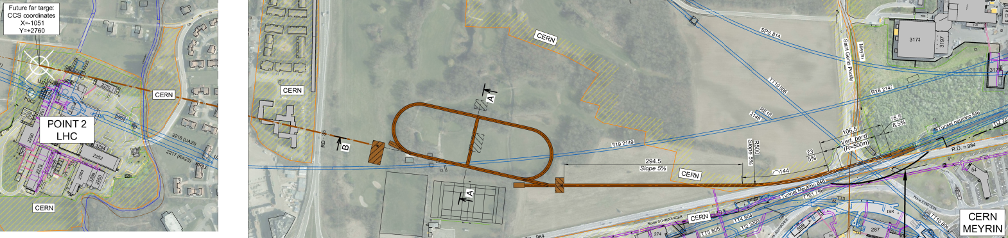
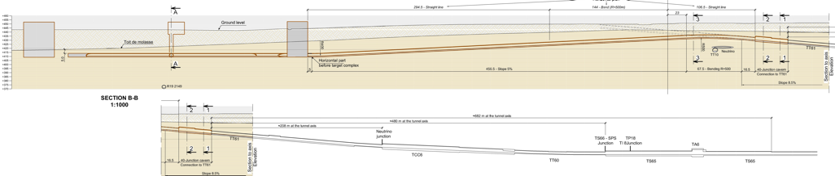
nuSTORM: overview
CERN-PBC-REPORT-2019-003
doi = "10.17181/CERN.FQTB.O8QN"
Extraction from SPS through existing tunnel
Siting of storage ring:
  Allows measurements to be made ‘on or off axis’
  Preserves sterile-neutrino search option

Slide 6
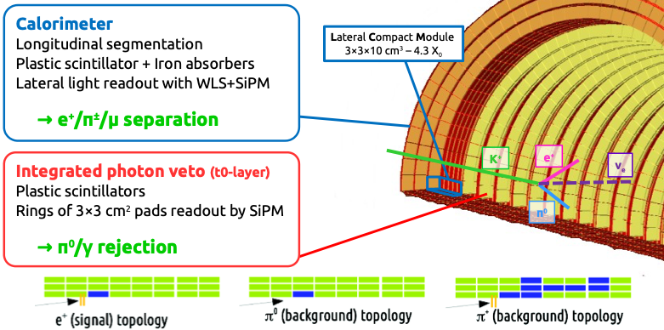
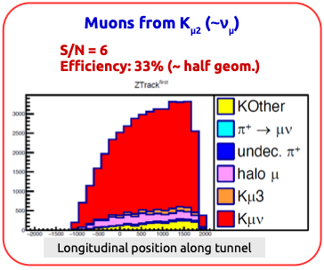
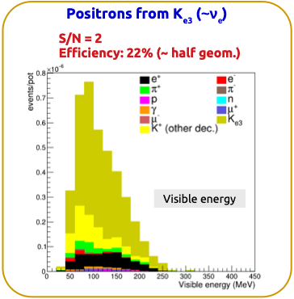
ENUBET: monitored neutrino beam
Enhanced NeUtrino Beams from kaon Tagging
10.1016/j.nima.2019.05.003
ENUBET collaboration supported by ERC & CERN through PBC:
Design/simulation of transfer line performed
  Static focusing demonstrated
  "Pulsed slow extraction" demonstrated
Full simulation of lepton monitoring with adequate S/N
Flux systematic assessment in progress

Slide 7
ENUBET and nuSTORM
Scientific programme
  Precise, systematic, ν_{e}, cross section
  Exquisite sensitivity to BSM
ENUBET &

Slide 8
ENUBET and nuSTORM
Scientific programme
  Precise, systematic, ν_{e}, cross section
  Exquisite sensitivity to BSM
Capability
  Uniquely high quality neutrino beam
  Path to new horizon at energy frontier

Slide 9
ENUBET and nuSTORM
Scientific programme
  Precise, systematic, ν_{e}, cross section
  Exquisite sensitivity to BSM
Capability
  Uniquely high quality neutrino beam
  Path to new horizon at energy frontier
Opportunity
  ESPP:
    Neutrino cross sections and muon collider

Slide 10
ENUBET and nuSTORM
Scientific programme
  Precise, systematic, ν_{e}, cross section
  Exquisite sensitivity to BSM
Capability
  Uniquely high quality neutrino beam
  Path to new horizon at energy frontier
Opportunity
  ESPP:
    Neutrino cross sections and muon collider
Partnership:
  ENUBET, nuSTORM; PBC & iMC

Slide 11
ENUBET and nuSTORM
Scientific programme
  Precise, systematic, ν_{e}, cross section
  Exquisite sensitivity to BSM
Capability
  Uniquely high-quality neutrino beam
  Path to new horizon at energy frontier
Opportunity
  ESPP:
    Neutrino cross sections and muon collider
Partnership:
  ENUBET, nuSTORM; PBC & iMC
Exploitation:
  Now! Physics case, capability case, scientific and peer-group partnership case:
    Foundations for endorsement of initiative at next ESPPU

Slide 12
nuSTORM White Paper
Getting going!
Goal: complete draft mid Jan22
New!
Working towards normalised event rates
Opportunity:
Near term (next 5 yrs):
Evaluate precision & sensitivity
Based on new simulation
Develop concrete proposal(s)
CERN (next ESPPU)
FNAL [BNL?]
Long term (<=2030):
Goal: shovel-ready project

Slide 13
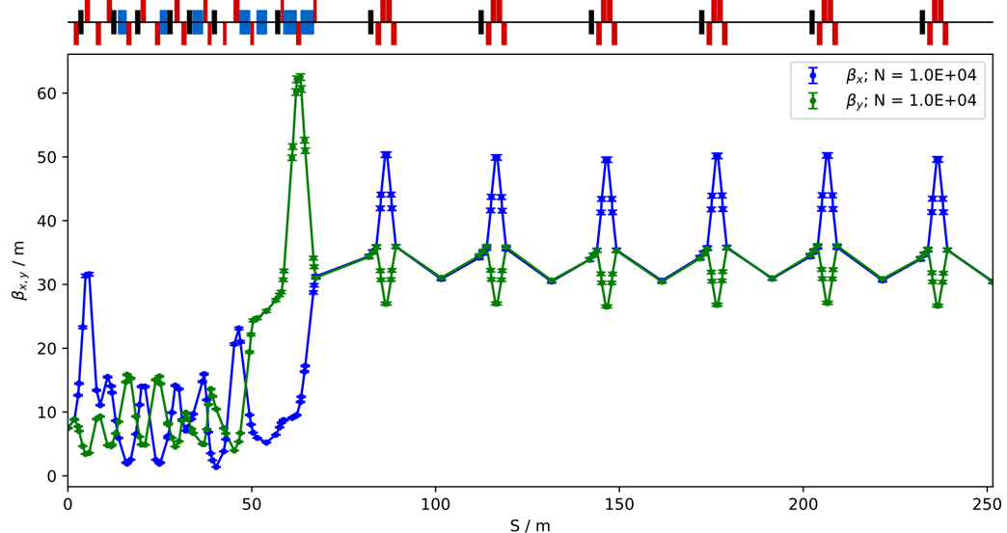
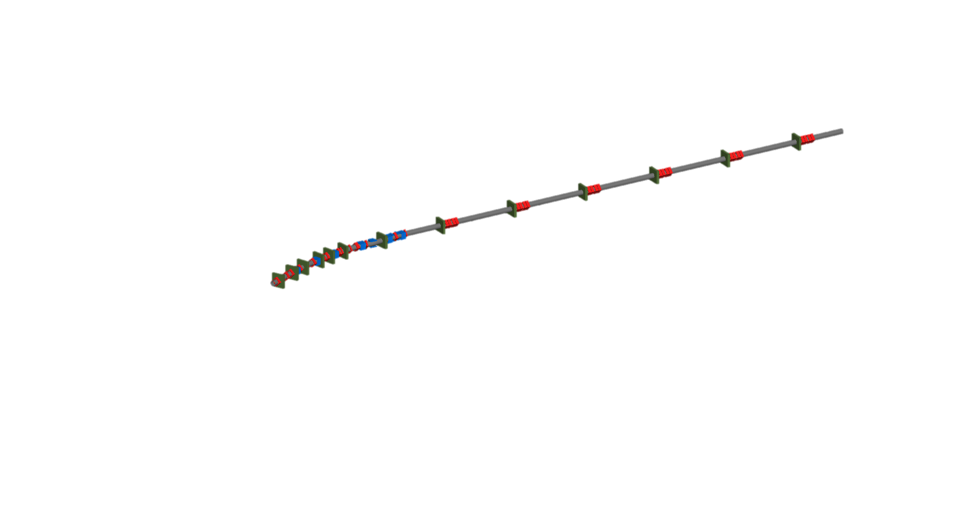
Progress
Target and capture:
  MARS/FLUKA simulations (J. Back / N. Mokhov)
    SPS now; PS in future
Pion transfer line complex:
  From d/s end of horn to injection into ring
  (T. Alves, J. Pasternak)

Slide 14
Progress
End-to-end simulation:
  Ring; now extended to “target to dump”
  Baba, Boyd,
  Jeamburaset, Kyberd,
  Nazim, Pasternak,
  Trung

Slide 15
Snowmass White Paper steps:
White Paper w/s:
  18:00 EST (23:00 GMT) 17Dec21
    Couple of presentations from us
    Valuable discussions
nuSTORM White Paper “due date”:
  Mid January 2022
    Responding to request from Laura Fields

