Slide 1
MICE Coupling Coil Test System Cryogenics
Roger Rabehl
Cryogenic Engineering and Operations Group Leader
Technical Division/Test and Instrumentation Department

Slide 2
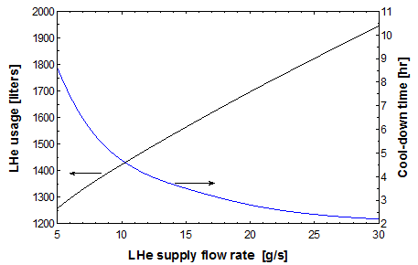
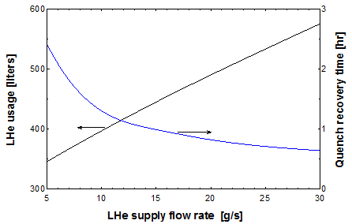
Cooling Method Selection
Compared LHe usage and cooling time for 300-4.5 K cool-down time and quench recovery for bath cooling (with displacers to direct the boiloff) and conduction cooling for 5-30 g/s LHe flow rates.
Cool-down
Quench recovery

Slide 3
Cooling Method Selection (cont’d)
Conduction cooling offers significant advantages.

Slide 4
Cryogenic Requirements
Cool-down and warm-up
Cool-down flow rate of 20 g/s with a specified ΔT between the measured magnet hot spot and the GHe supply
An unlimited ΔT_{max} cool-down requires ~3 hr and 1700 liquid liters LHe
A 40 K ΔT_{max} cool-down requires ~13 hr and 5100 liquid liters LHe, for example
What ΔT_{max} is allowable during cool-down and warm-up between 300 K and 80 K?

Slide 5
Cryogenic Requirements (cont’d)
Quench recovery
Quench recovery flow rate of 20 g/s with no ΔT restriction below 80 K.
Calculated uniform temperature of 87 K after a quench with all stored energy dissipated in magnet coils.
Quench recovery with no ΔT restriction requires ~1 hr
Quench recovery with ΔT_{max} based on measured magnet hot spot might be expected to require 2-3 hr

Slide 6
Cryogenic Requirements (cont’d)
Cold operations
Estimated static heat load (radiation from MLI-insulated vacuum vessel, conduction down magnet support structure) to magnet is 20-25 W.
Steady flow of 5 g/s provides plenty of margin for transfer line heat loads, current lead thermal intercepts, and heat load uncertainties. It is well below 22 g/s CHL liquefaction rate with one compressor and no LN₂ pre-cooling
Storage dewar operates at 10 psig (4.82 K), compressor suction operates at 1 psig (4.29 K) so a stable 4.5 K (4.2 psig) can be provided.

Slide 7
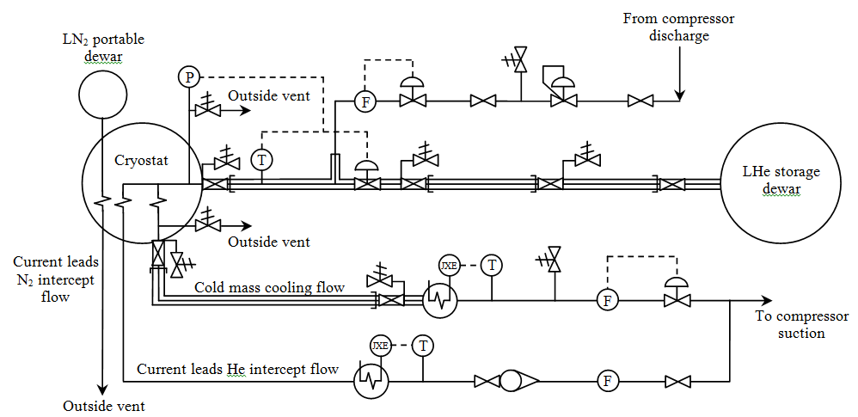
Cryogenic Process

Slide 8
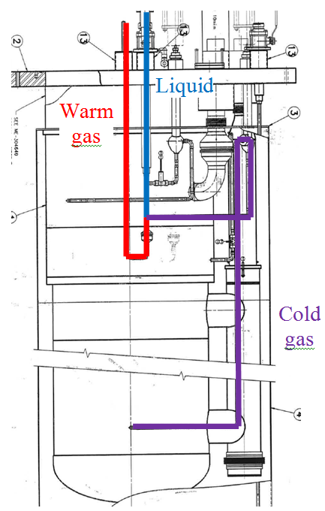
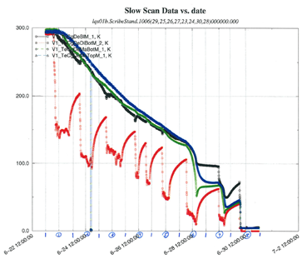
Cryogenic Process (cont’d)
A similar method of controlled cool-downs of large magnets have been accomplished in Fermilab’s Vertical Magnet Test Facility (VMTF)

Slide 9
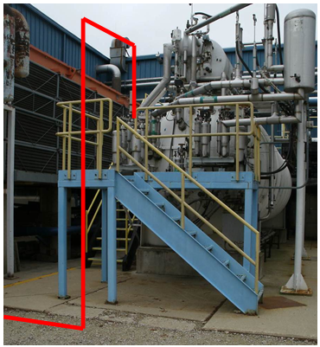
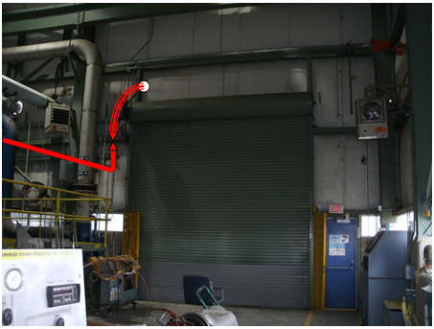
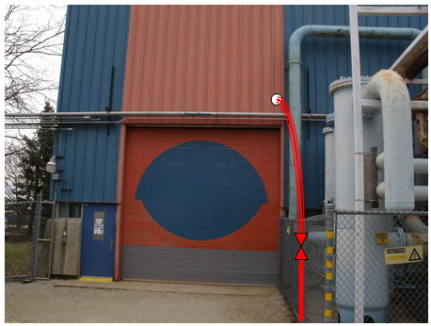
Cryogenic System Integration
Series of bayoneted transfer line sections will connect the cryostat to the CHL 10kl LHe dewar (final layout TBD)

Slide 10
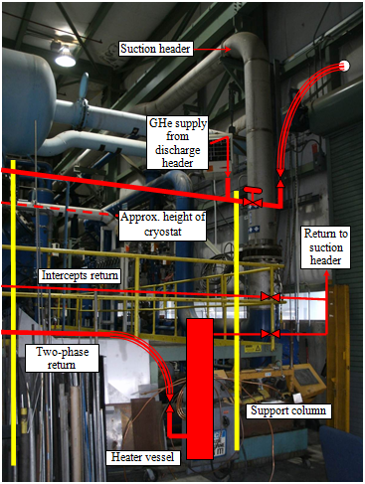
Cryogenic System Integration (cont’d)

