Slide 1
DUNE Status
Stefan Söldner-Rembold
Regina Rameika
DUNE UK Meeting
17 January 2022

Slide 2
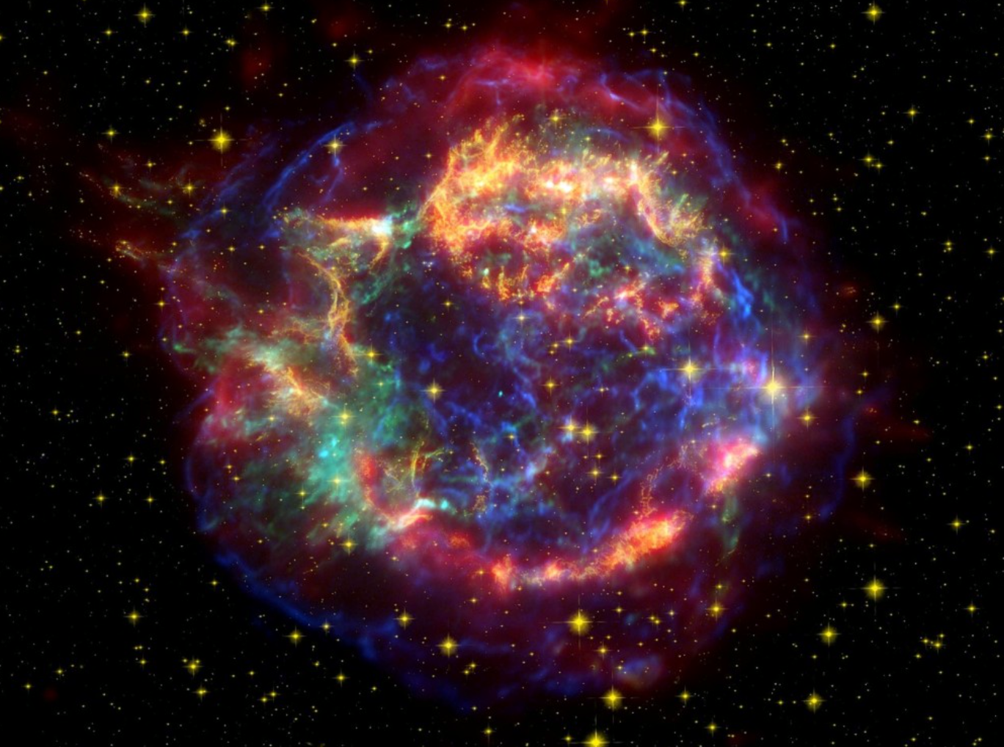
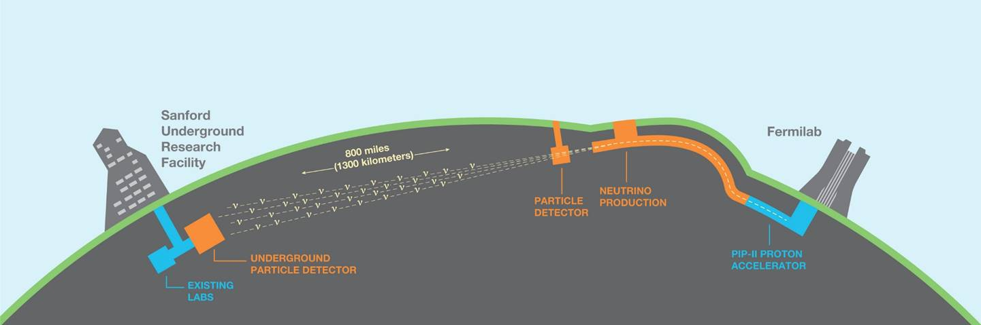
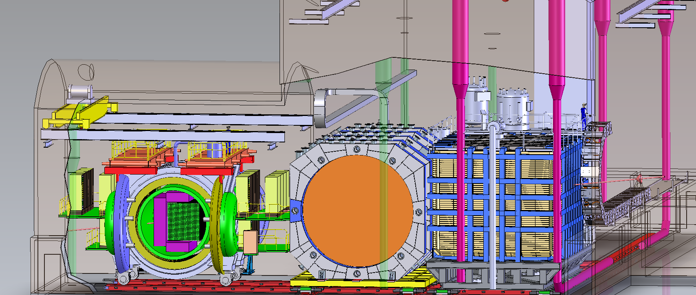
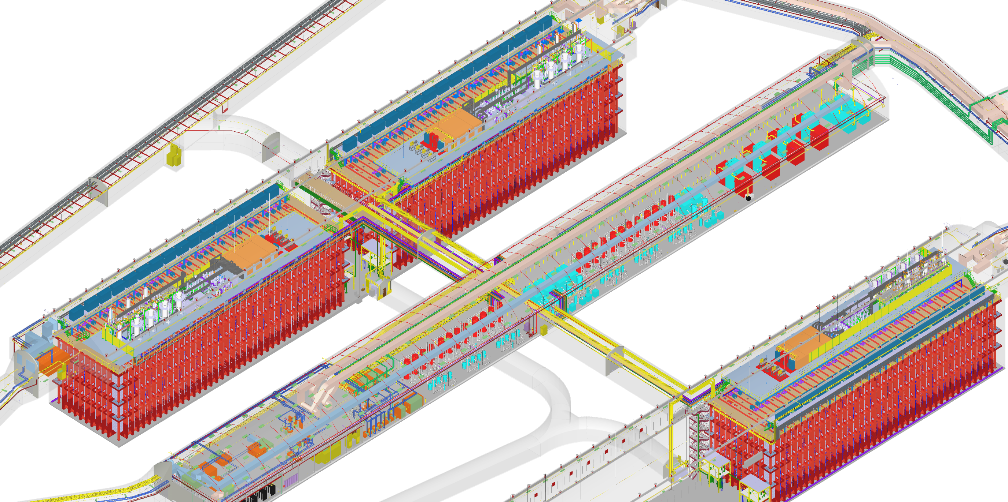
DUNE Vision and Goal
May 2018
The primary science goal of DUNE is to measure neutrino oscillation parameters, in particular the CP-phase δ and the neutrino mass ordering in a single experiment.
DUNE will also detect supernova neutrinos, measure solar and atmospheric neutrinos and search for physics beyond the SM.

Slide 3
DUNE Vision and Goal
May 2018
The DUNE neutrino oscillation program is exceptional due to several key features of the experiment and facility design :
  The 1300 km baseline between Fermilab and SURF location for the far detectors enables an unambiguous measurement of the neutrino mass ordering (mass hierarchy)
  The detector’s on-axis location provides for a wide-band energy spectrum of neutrinos to be seen in the near and far locations enabling detailed fitting of the oscillation parameters
  The liquid argon detector technology enables precise reconstruction of the neutrino interactions
  The Near Detector complex at Fermilab will support near detectors that will provide unprecedented control of systematic uncertainties in the prediction of the un-oscillated neutrino flux

Slide 4
DUNE Vision and Goal
May 2018
The ultimate DUNE detector will therefore comprise
  Four far detector modules
  The Near Detector Reference Design described in CDR
  A 1.2 MW beam upgradeable to 2.4 MW

Slide 5
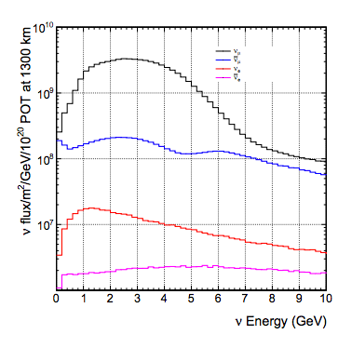
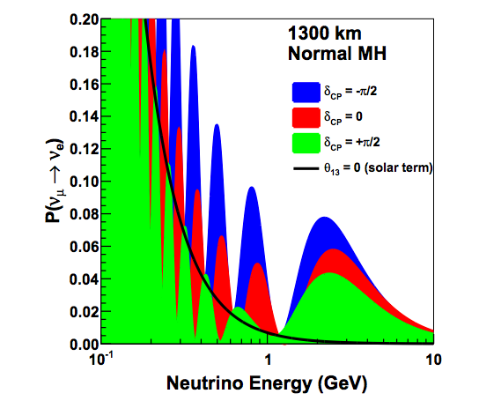
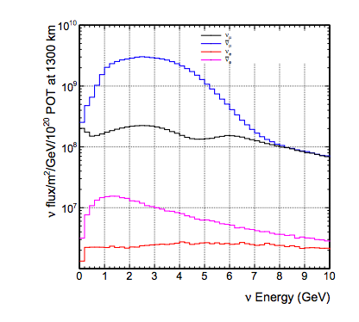
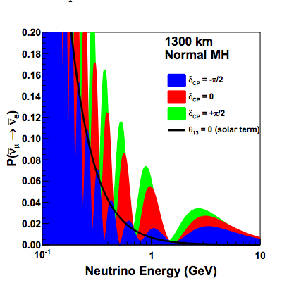
Neutrino Mode
Initial neutrino energy spectra (left) will be modified by neutrino oscillation probabilities (right)
Antineutrino Mode
ν_{e} appearance probability depends on mixing angles, CPV phase δ_{CP}, and matter effects. All four can be measured in a single experiment.
Wide-band beam and long baseline break the degeneracy between CP violation and effect of neutrino mass ordering.

Slide 6
Supernova Neutrinos
About 3000 events would be expected in the full DUNE Far Detector for a supernova at a distance of 10 kpc.
Measurement at early times tests mass ordering and SNB model (spectral parameters)
Three physics sensitivity papers (Long-baseline, Supernova, Beyond the Standard Searches) published in Eur. Phys. J C.

Slide 7
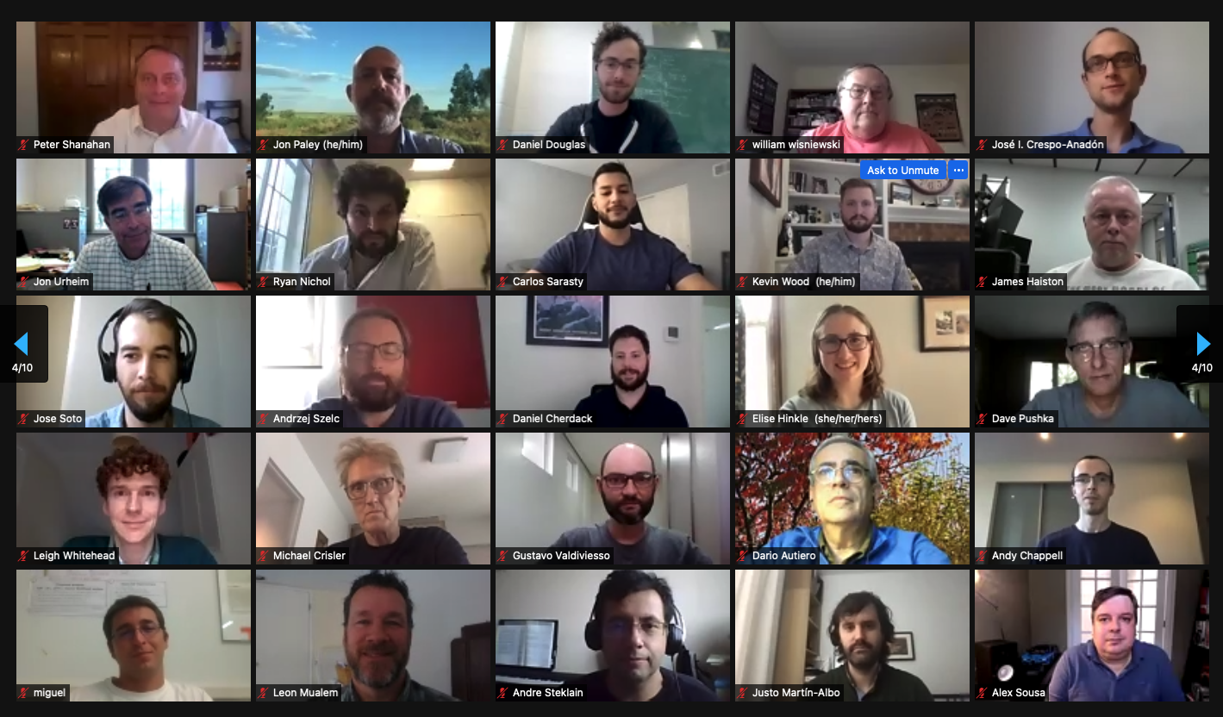
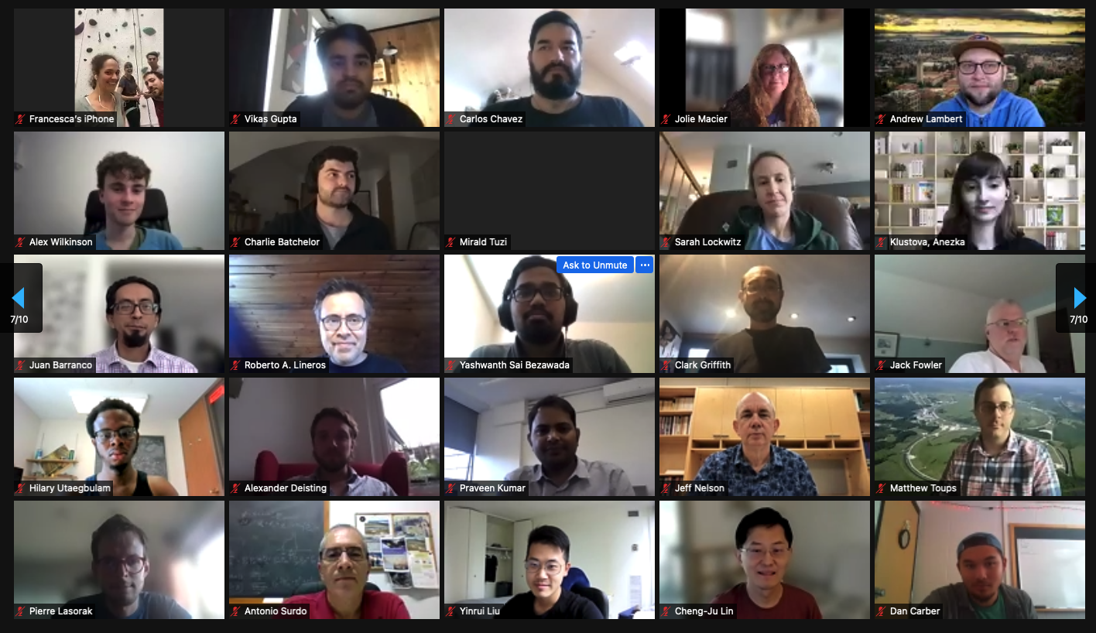
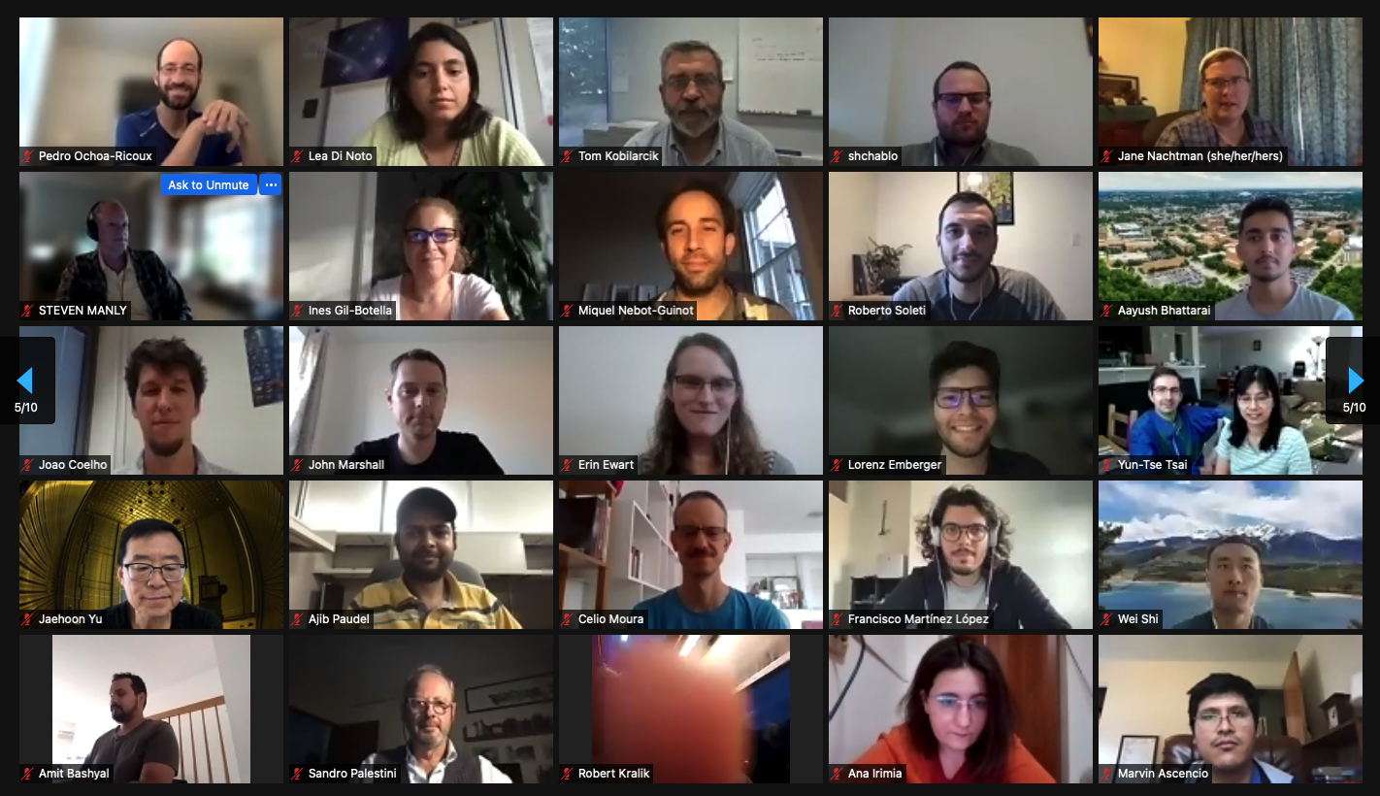
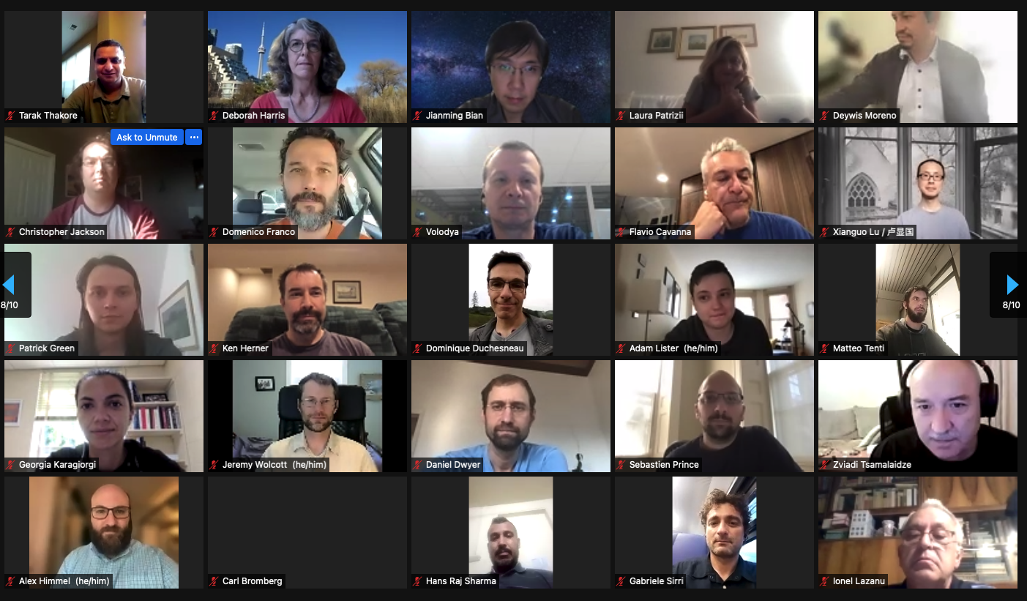

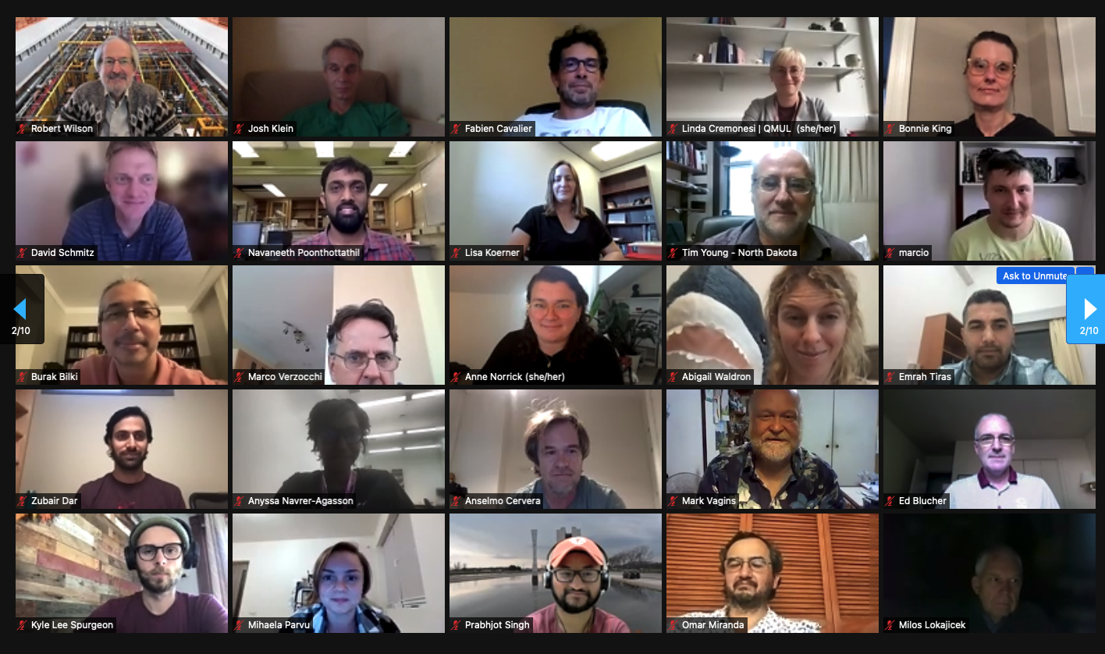
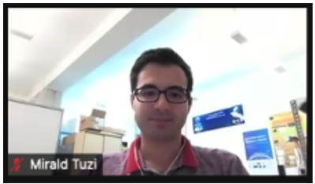
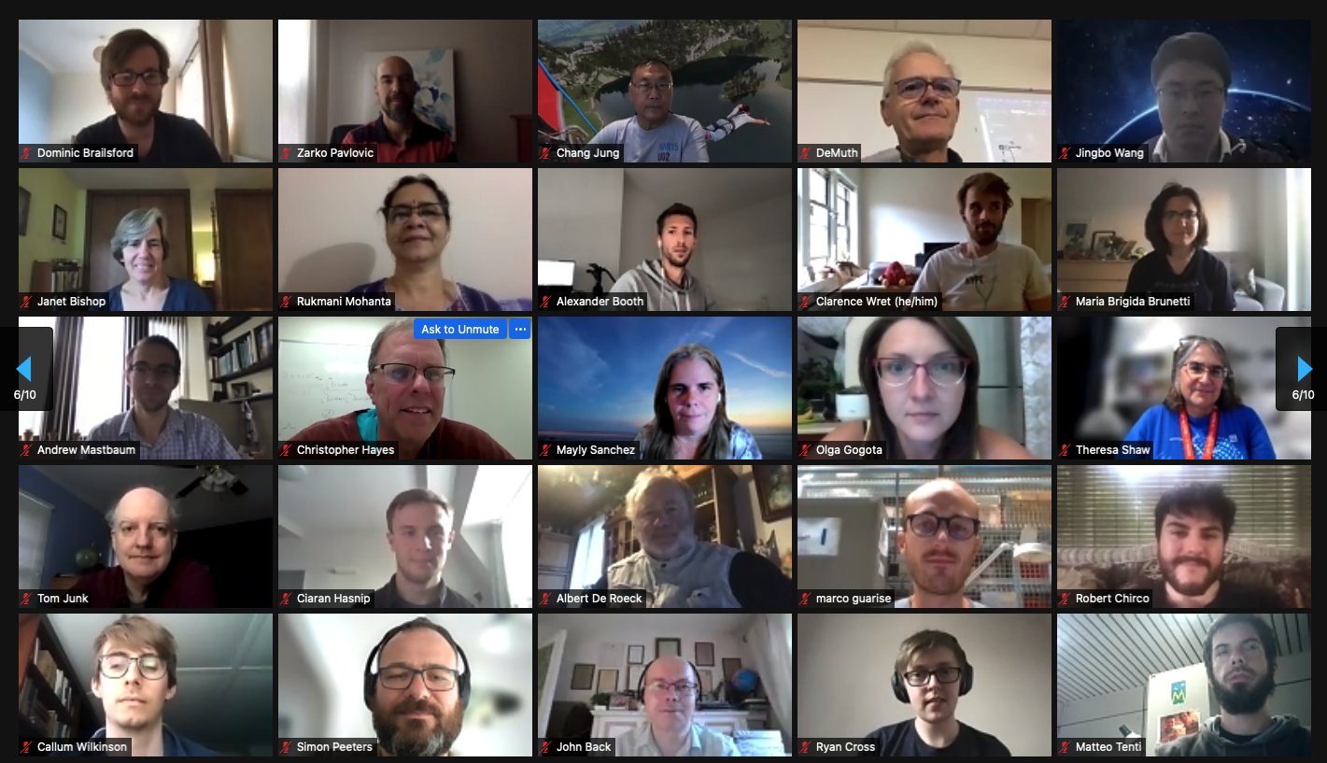
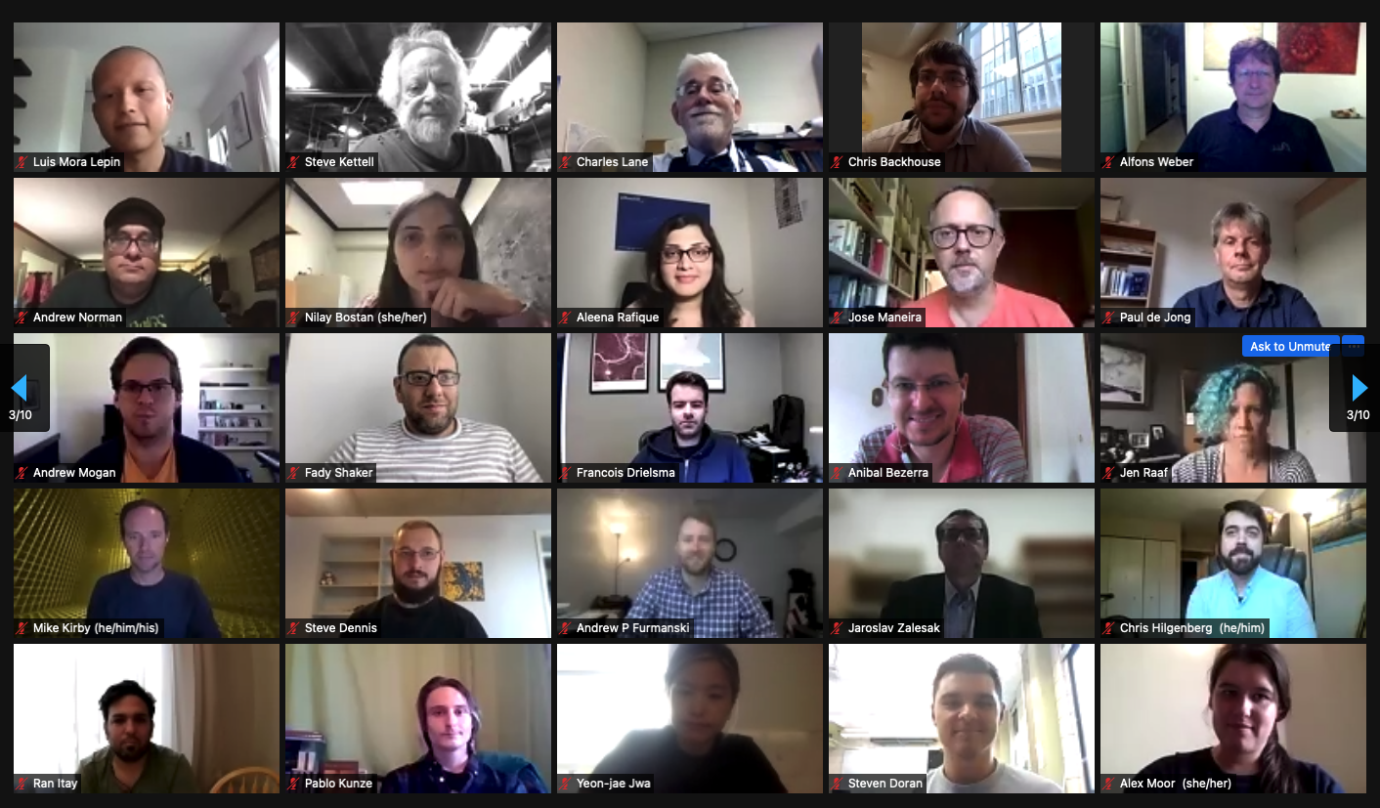
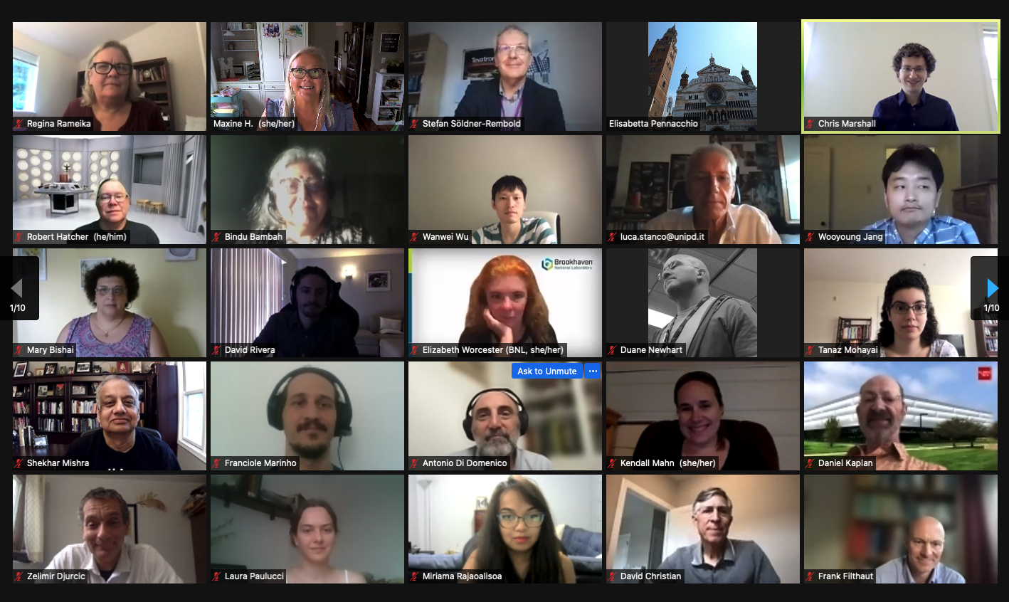

Slide 8
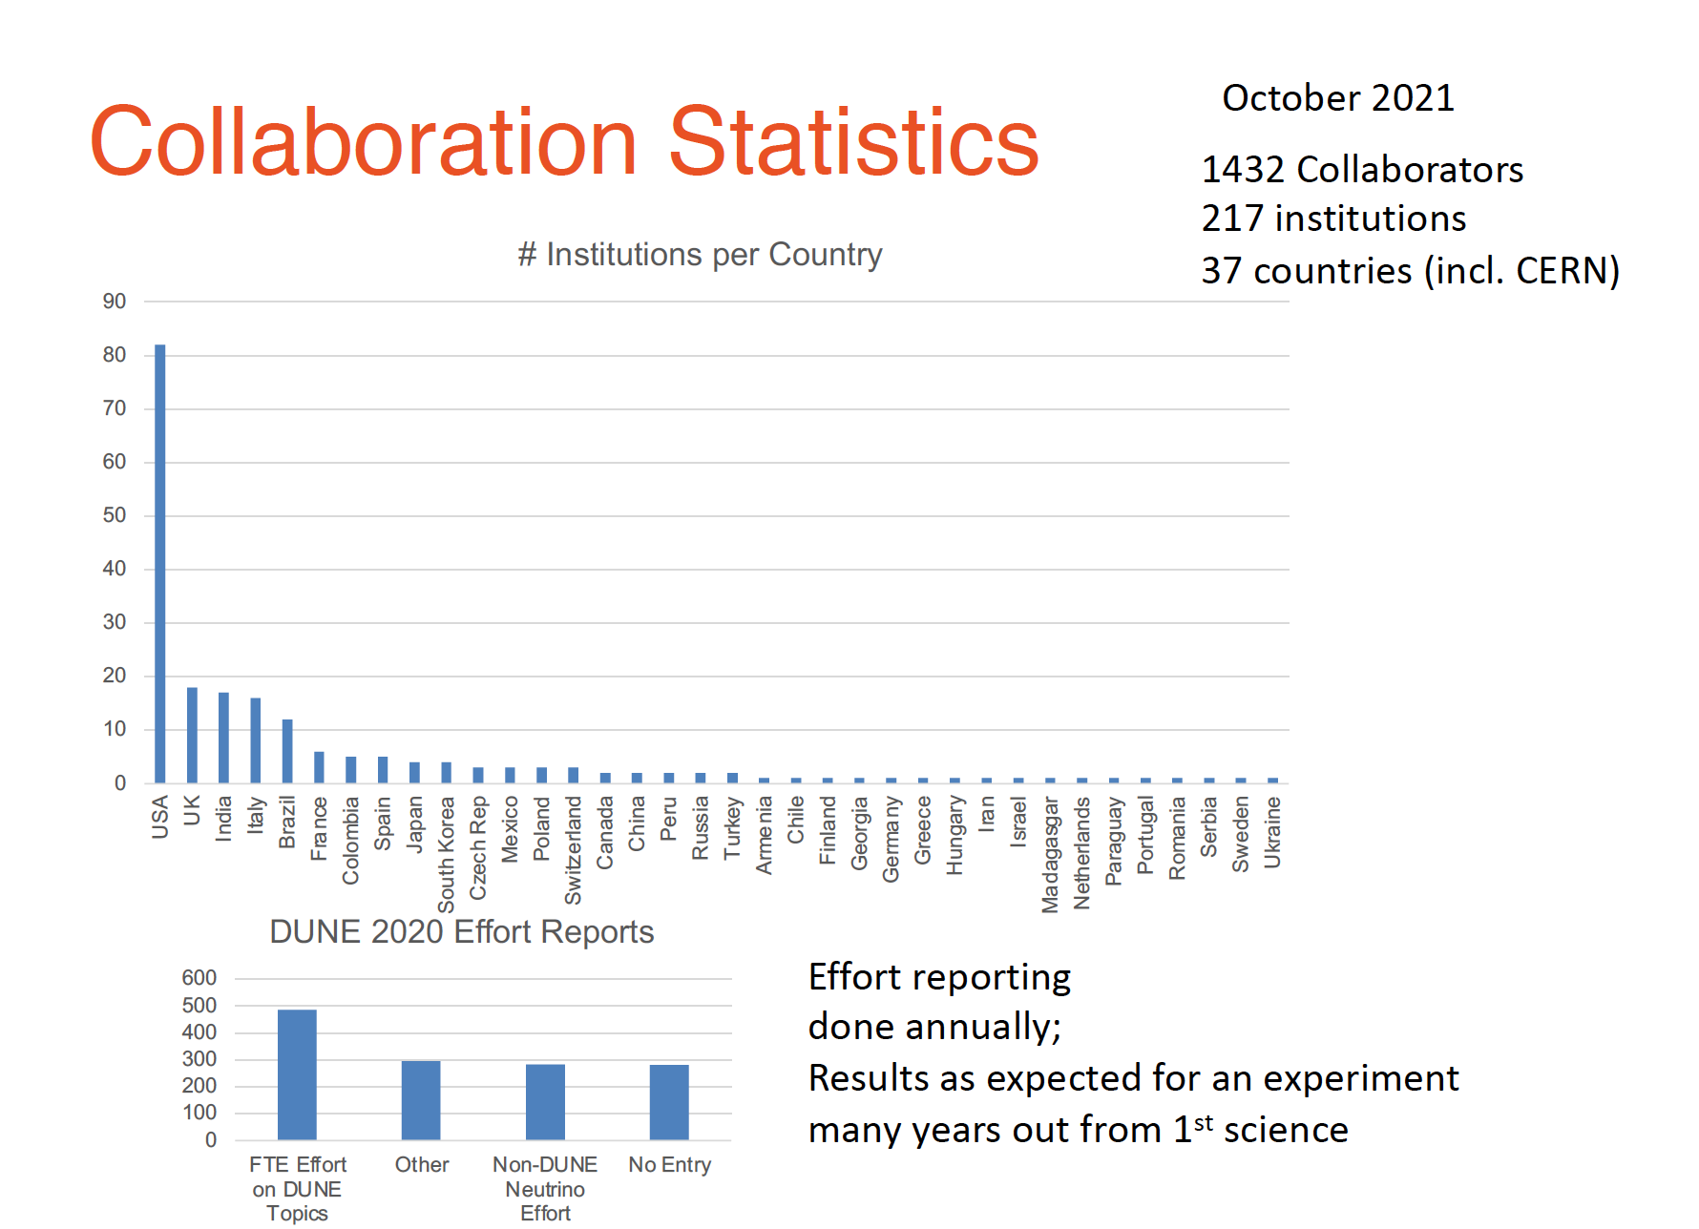

Slide 9
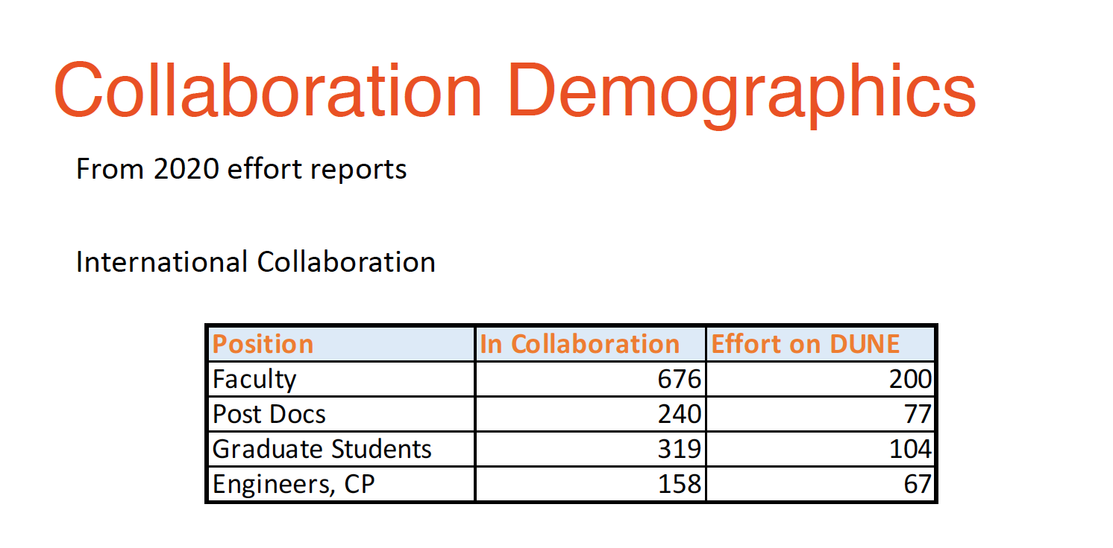
Reporting for 2021 starting this month.

Slide 10
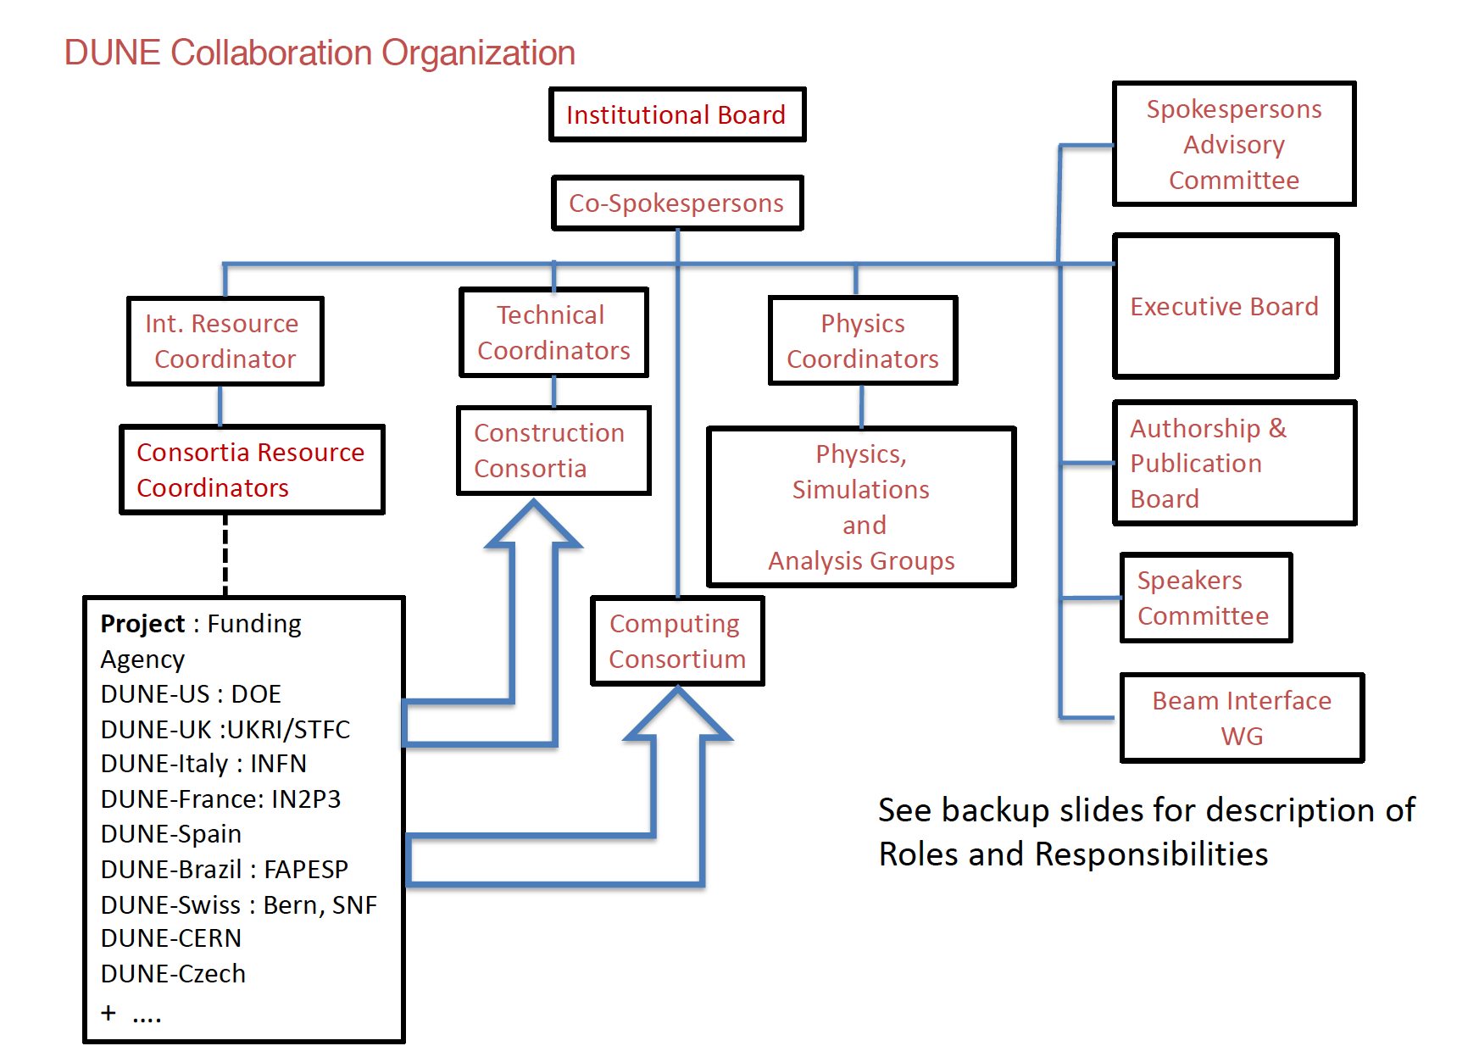

Slide 11
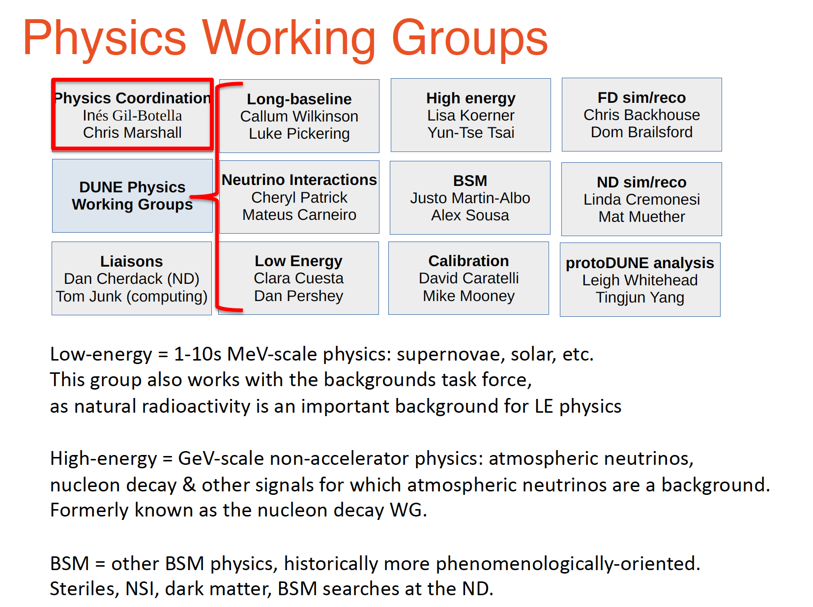

Slide 12
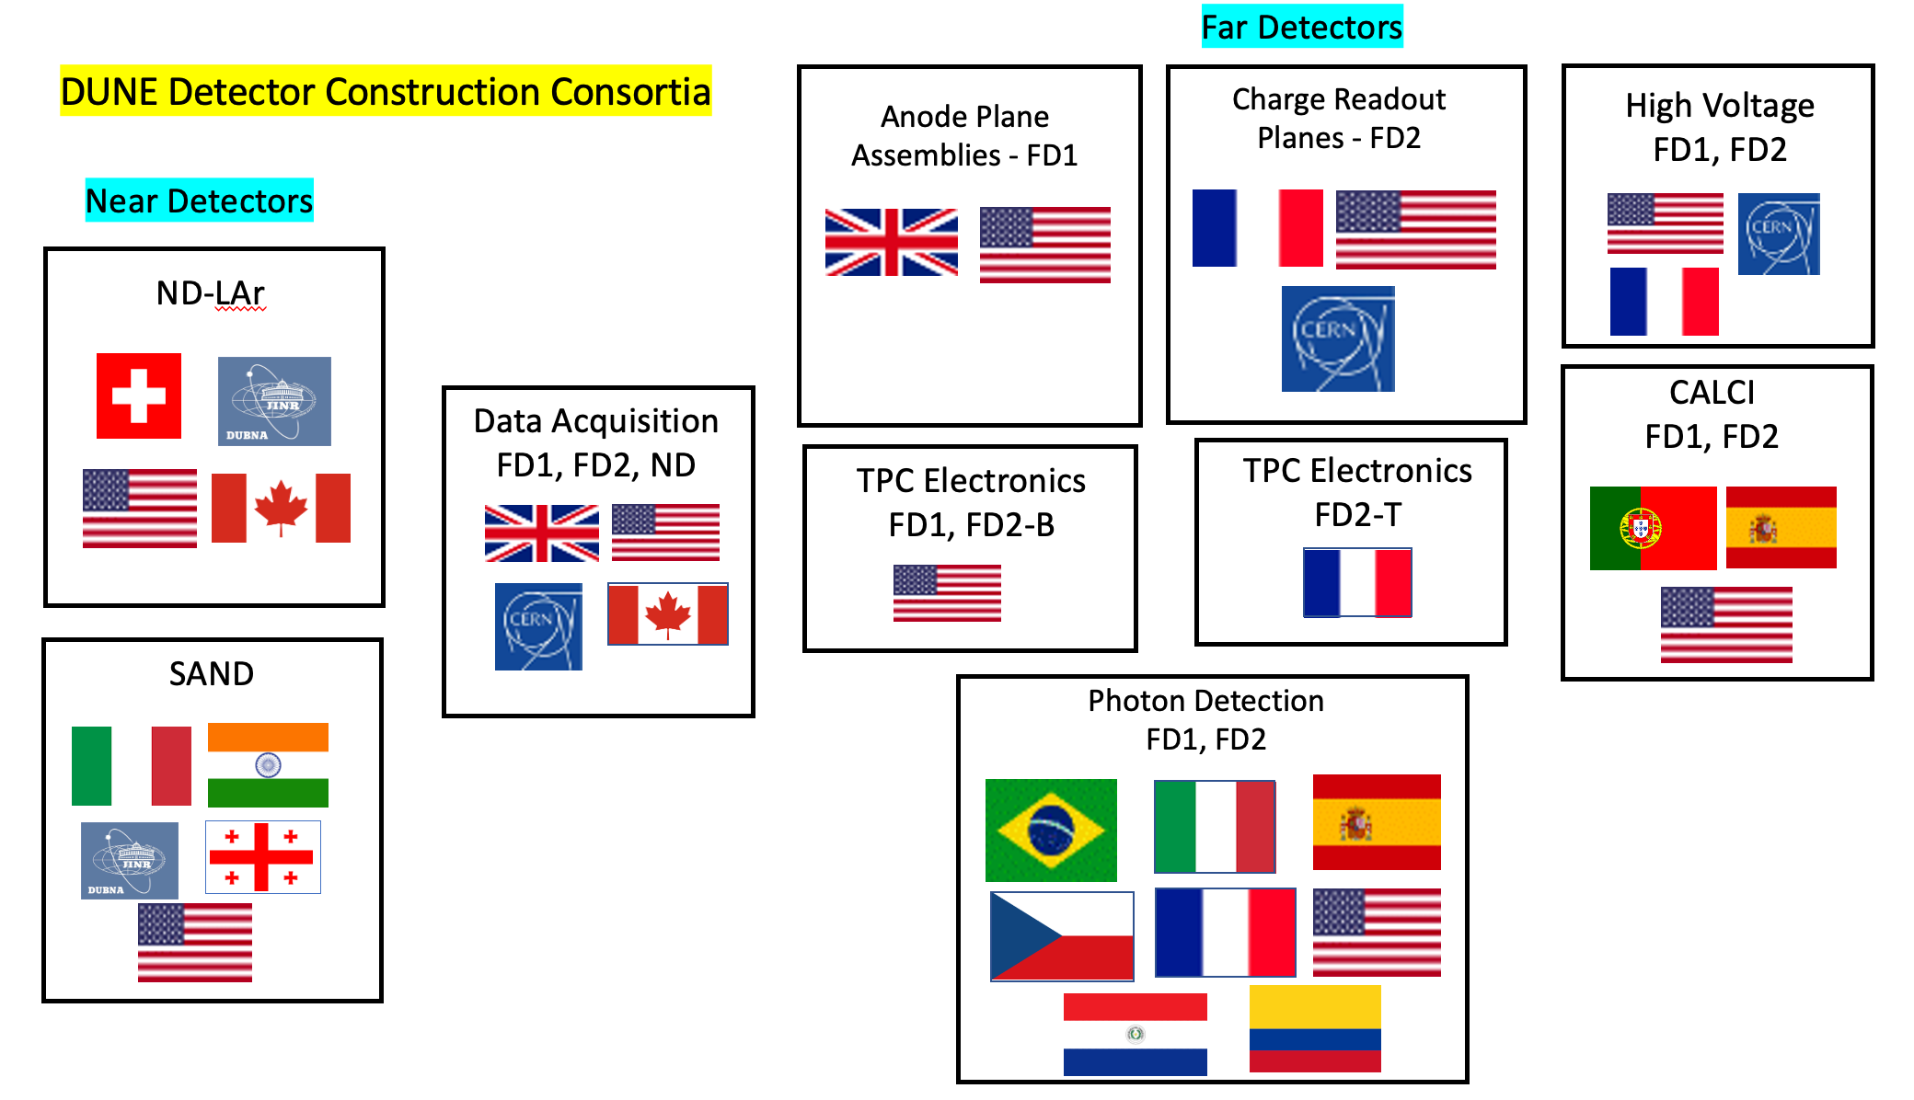
Detector Consortia

Slide 13
DUNE Executive Board
DUNE Management:
Spokespersons
Technical Coordinators
Int. Resources Coordinator
Physics Coordinators
plus:
Consortia Leaders
Beam Coordinator
IB Chair
EFIG Co-chair

Slide 14
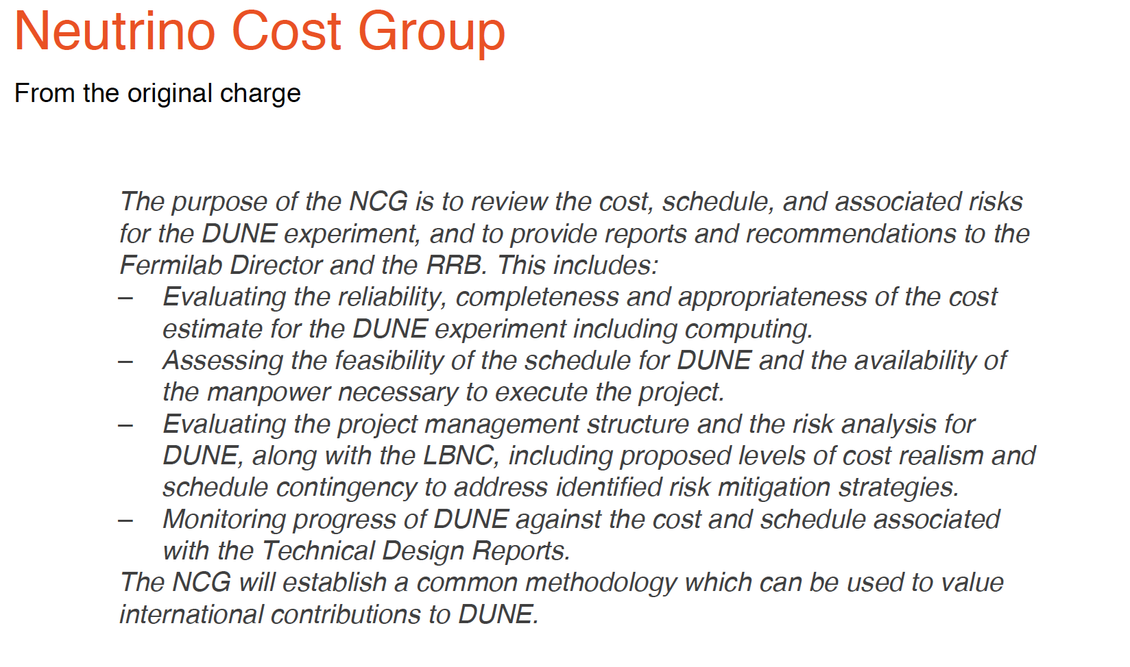

Slide 15
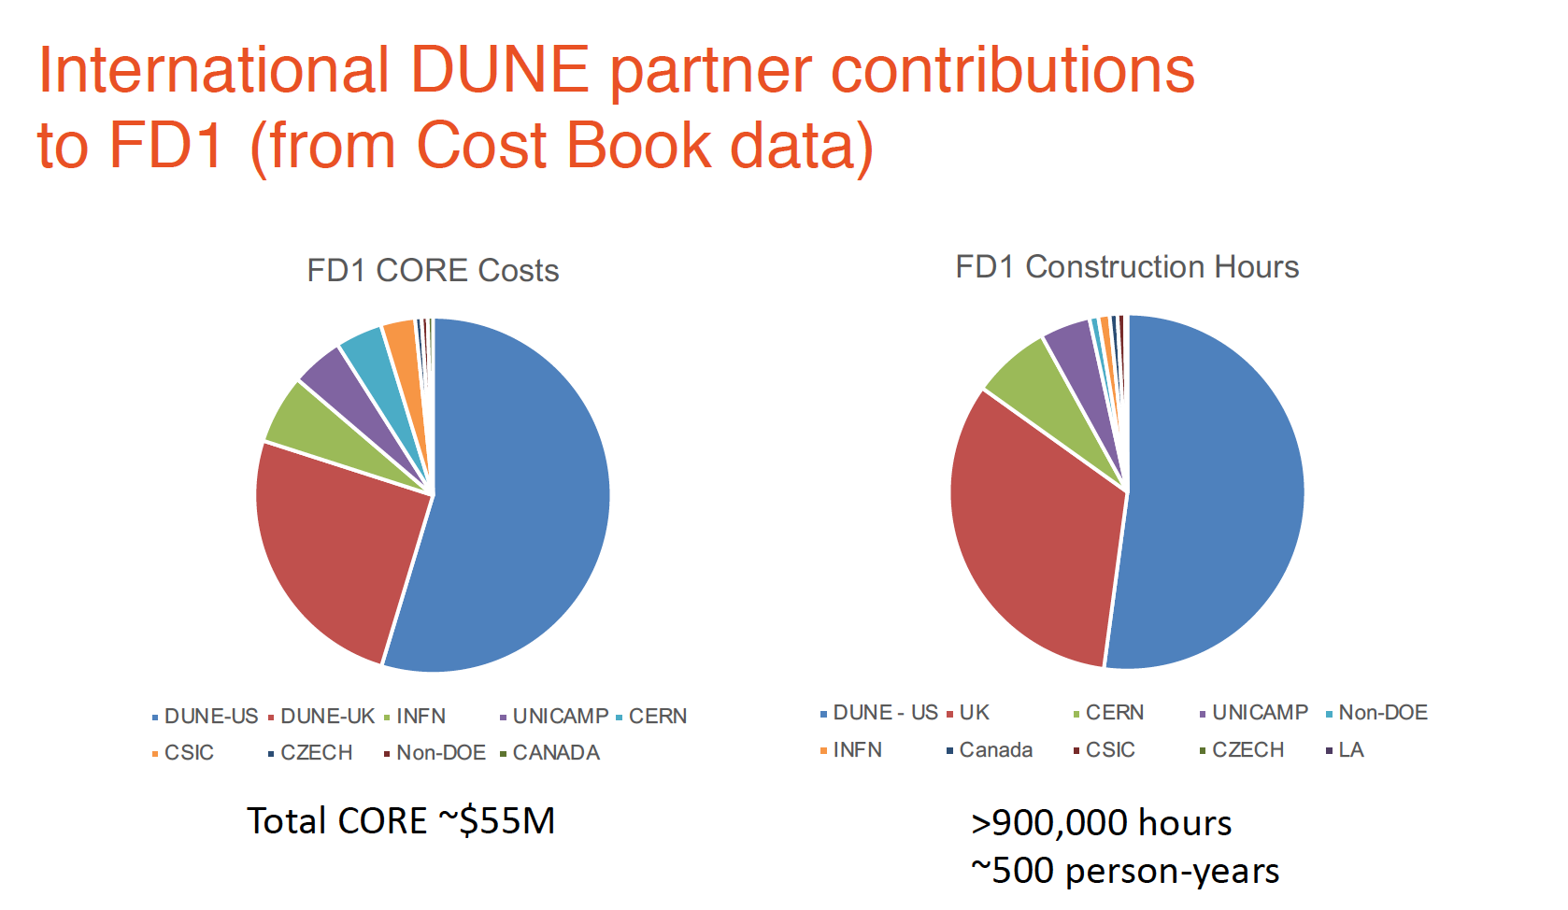
UK

Slide 16
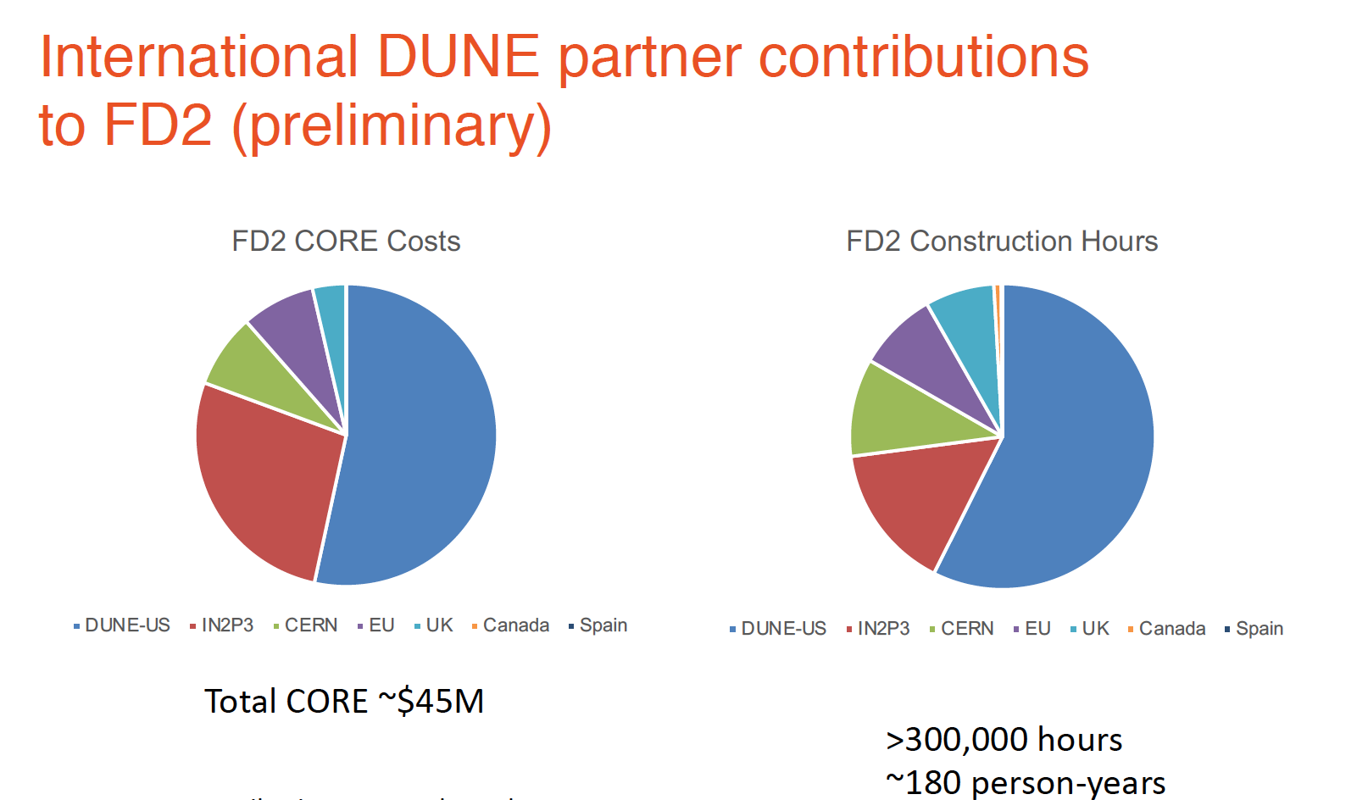
UK

Slide 17
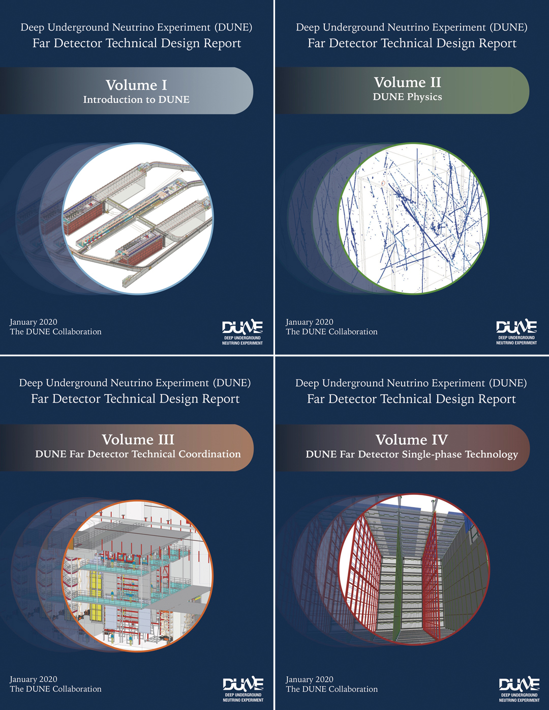
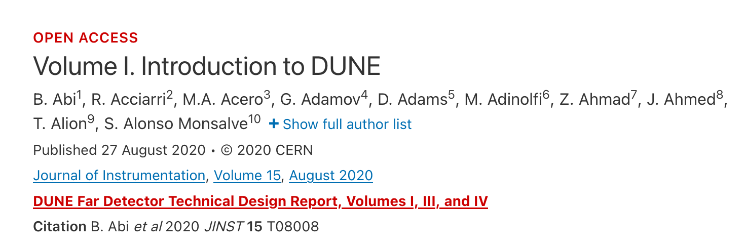
DUNE TDR
May 2018
TDR published in 2020

Slide 18
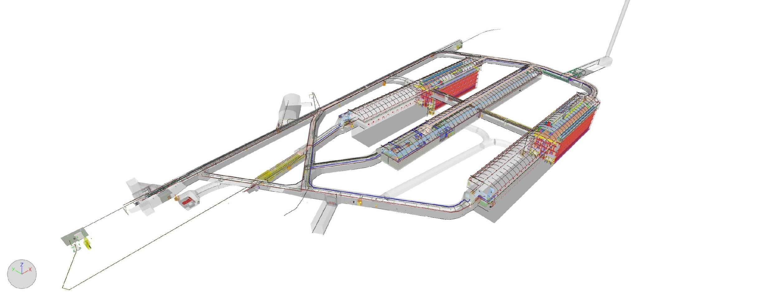
TDR Far Detector Strategy
TDR described 4 identically sized cryostats:
2 single phase (SP) + 1 dual phase (DP) + 1 “module of opportunity”, each about 17 kt
We have moved on from this – first two modules will be horizontal drift (FD1-HD) and vertical drift (FD2-VD), respectively.

Slide 19
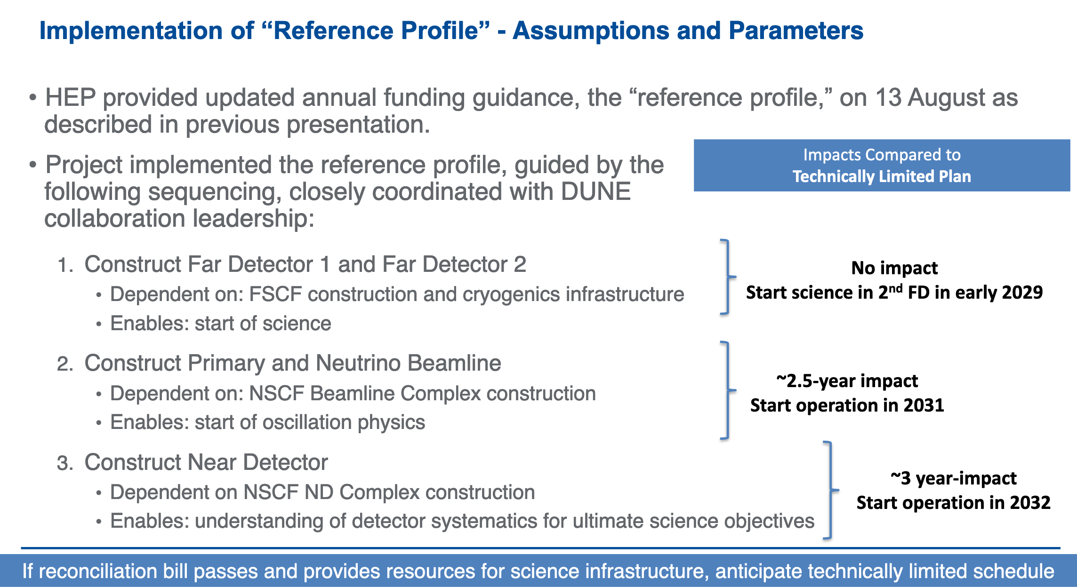
US funding profile

Slide 20
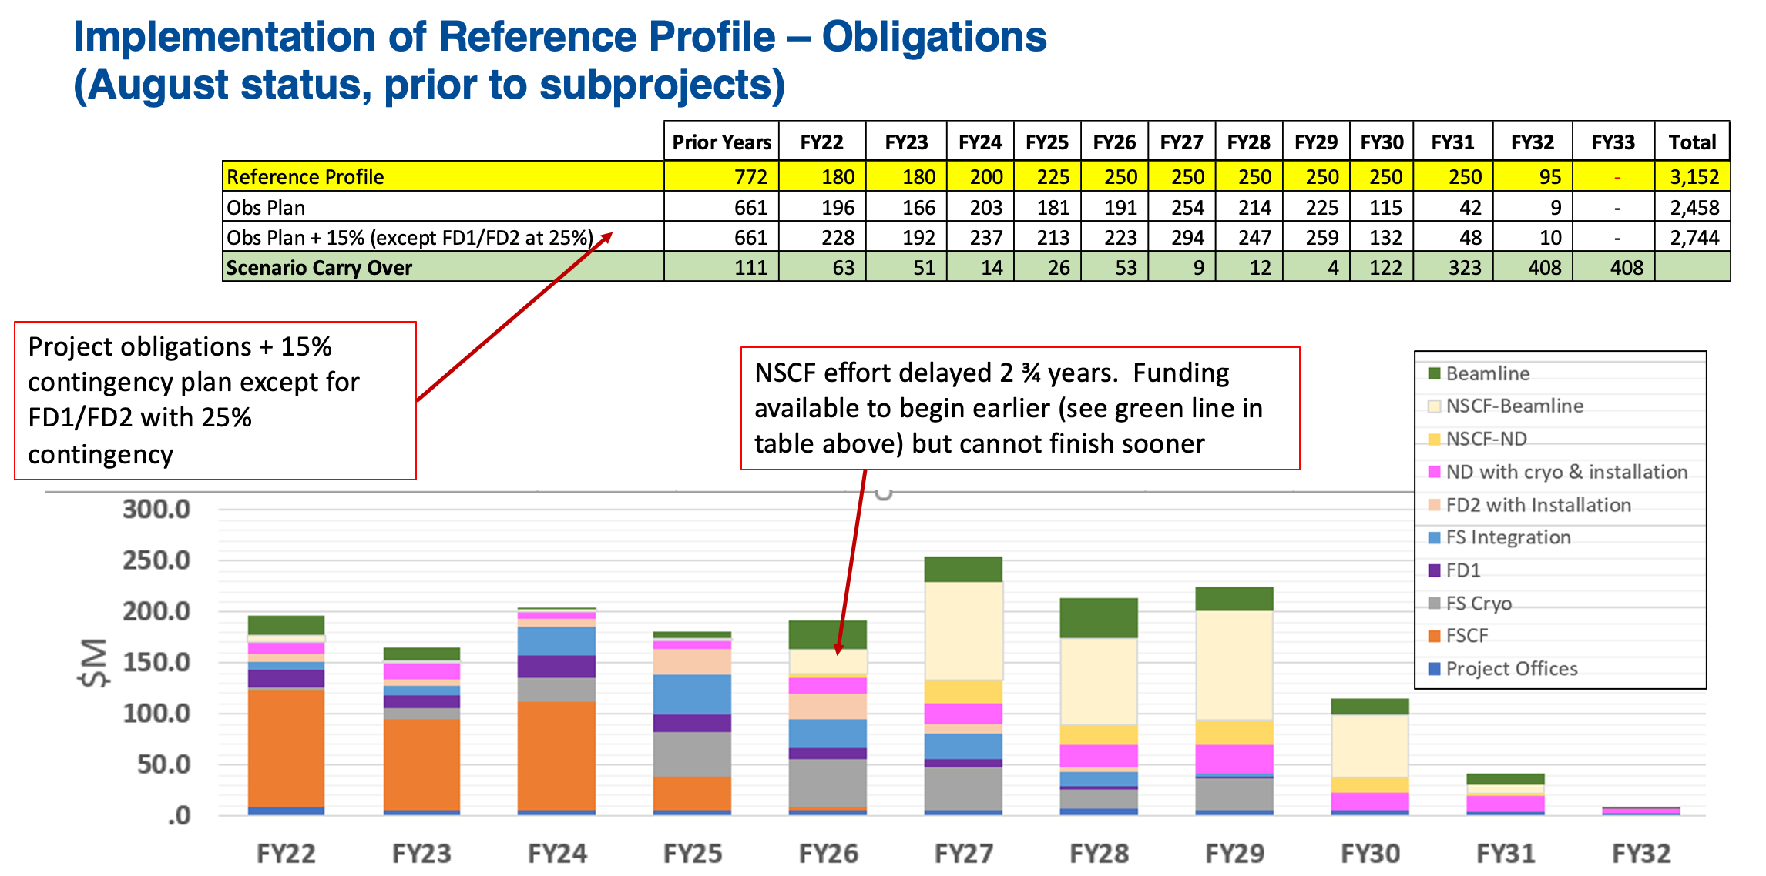

Slide 21
Construction Sequencing
Given the funding constraints for the facility and DOE contributions to the detectors that we are faced with, we believe that the following principles should apply :
  The Far Detectors should be completed ASAP
  Followed by the Beam, ASAP
  Followed by the Near Detector - Phase 1
Sequencing is not Prioritization!
LOGIC :
Without a Far Detector, we don’t need a beam;
without a beam we don’t need a Near Detector

Slide 22
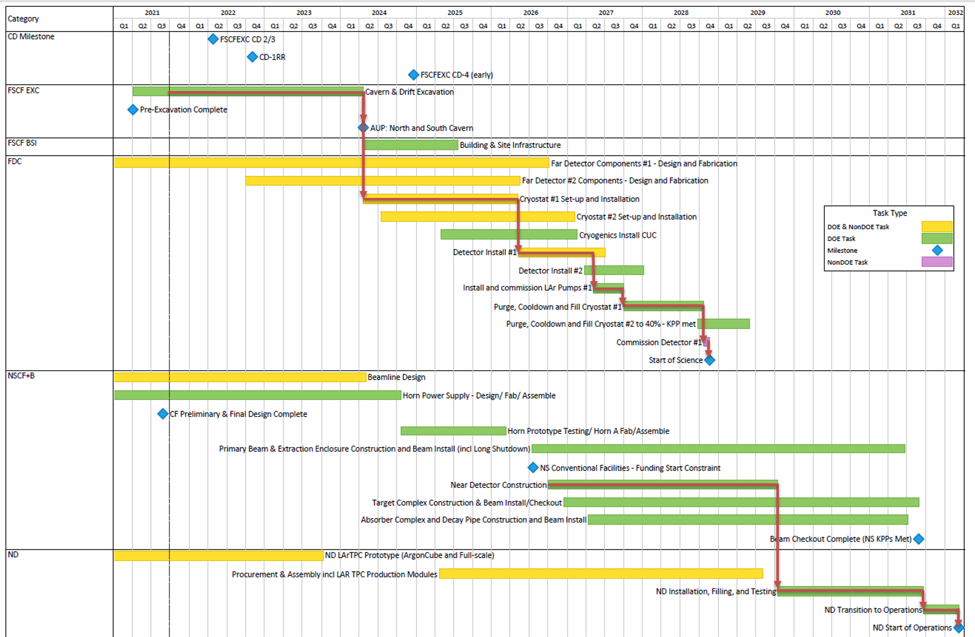

Slide 23
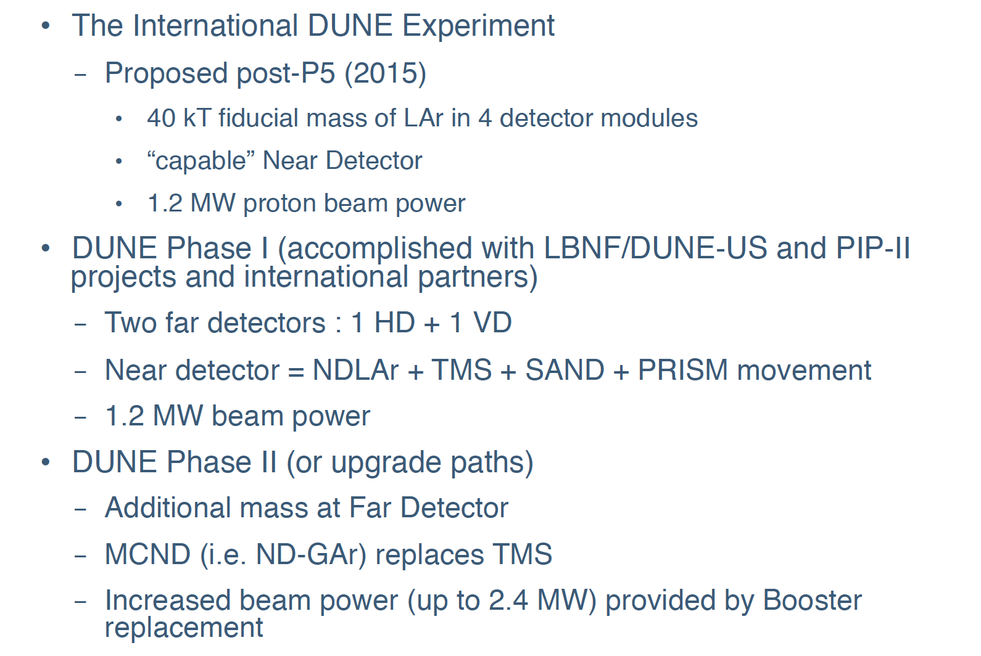

Phasing

Slide 24
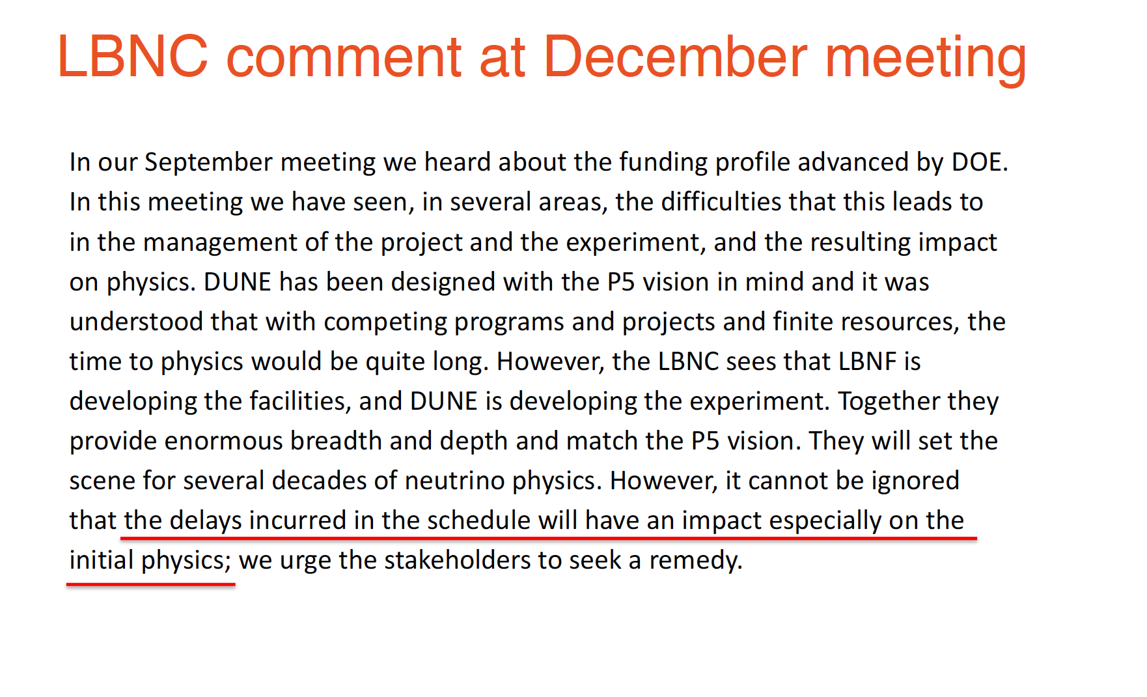

Slide 25
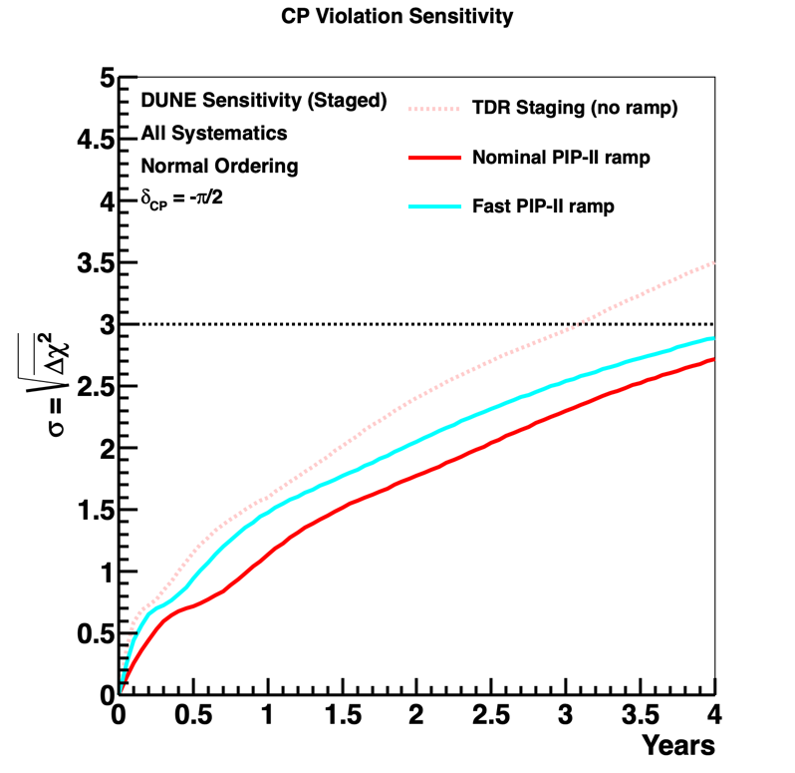
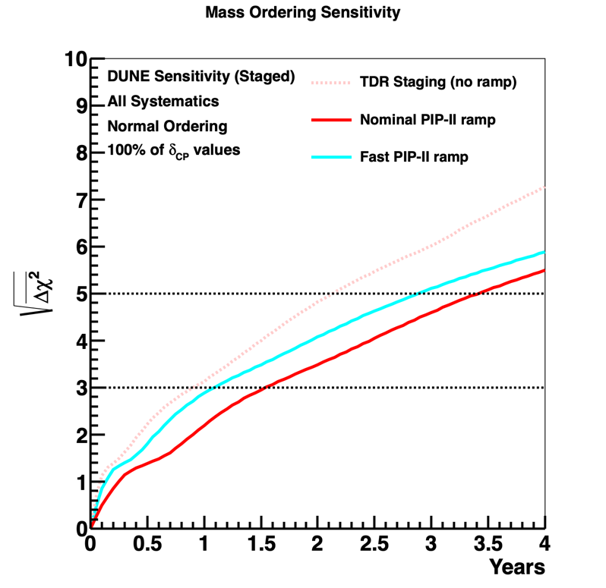
DUNE Sensitivity vs time
PIP-II expected power ramp
This profile assumes LBNF is ready for PIP-II upgrade
Mass Ordering
100% δ_{CP} values
CP Violation
δ_{CP} = -π/2
Q1FY29
Staging scenario with two far detectors and beam power ramp.
Initial physics goals for physics with the neutrino beam are mass ordering and 3σ sensitivity for maximal CPV.

Slide 26
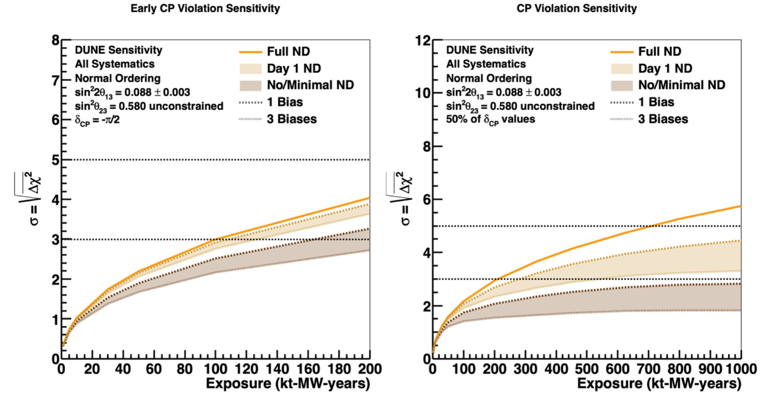
Impact of Near Detector
Significance
Full ND
Day 1 –ND
No ND
Exposure
Near Detector crucial to achieve science goals

Slide 27
Lots of successes
Excavation and Site preparation at SURF progressing well
APA construction started
ProtoDUNEs (both HD and VD) cold box tests at CERN
VD-CDR signed off and being published
NDLAr prototypes providing excellent data
Computing CDR in preparation
DUNE publications

Slide 28
Collaboration Publications
5 full DUNE authorship publications in 2021 so far, and 9 journal publications in 2020 (22 in total)
Focusing on detector studies, physics sensitivities and ProtoDUNE results.
Recent Highlights:
  Low exposure long-baseline neutrino oscillation sensitivity of the DUNE experiment, 2109.01304, submitted to PRD
  Searching for Solar KDAR with DUNE, 2109.01304, submitted to PRD
  Deep Underground Neutrino Experiment (DUNE) Near Detector Conceptual Design Report, Instruments 5 (2021) 4, 31.
  Design, construction and operation of the ProtoDUNE-SP Liquid Argon TPC, JINST 15 (2022) 01, P01005.
  Prospects for beyond the Standard Model physics searches at the Deep Underground Neutrino Experiment, Eur. Phys. J. C 81 (2021)
We are aiming for more ProtoDUNE physics publications in near future.

Slide 29
Summary
DUNE is committed to be the ‘best in class’ experiment to deliver world-leading science.
Initial physics goals for physics with the neutrino beam are mass ordering and 3σ sensitivity for maximal CPV – only DUNE can measure both in a single experiment.
Schedule remains a major challenge.
Consortia are making excellent progress in terms of delivering two far-detector modules and the near detector components.
”Strategic decisions need to involve all stakeholders.” UK should play a core role as the first committed international partner in these discussions.

