Slide 1
HDF5 Efforts in DUNE
Barnali Chowdhury, Tom Junk, Jake Calcutt, David Adams
12/14/2021

Slide 2
HDF5 in DUNE
Hierarchical Data Format (HDF) is a set of file formats (HDF4, HDF5) designed to store and organize large amounts of data.
DUNE has started writing DAQ output for Coldbox electronics in HDF5 format.
HDF5 library is used to do that
Questions I would answer
How does the HDF5 data look like for DUNE ?
How do we read data in hdf5 format and store it in an art event?
How do we decode physics out of the HDF5 data?
With an use case of Coldbox

Slide 3
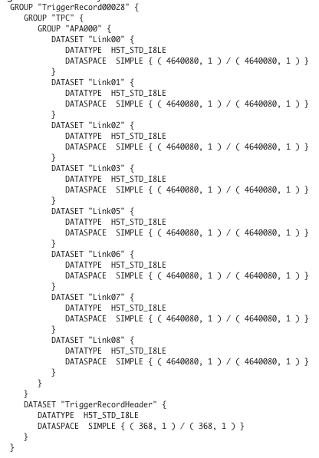
An Online View of DAQ Data in HDF5 format
HDF5 Data are organized as Trigger Records (TR) with a unique TR number / Sequence number per run.
Every TR contains a TR header and then a series of data Fragments.
Each Fragment corresponds to a part of the detector and contains the raw data produced during a time window as requested by the trigger.
Group, Dataset etc. are the keywords come from HDF5
np02_bde_coldbox_run011913_0009_20211028T161244.hdf5

Slide 4
HDF5Utils
Reading HDF5 Offline
dunetpc/dune/
HDF5RawInput_source.cc
HDF5Utils.cc
Opens HDF5 file
Saves in memory only top-level HDF5 groups
Fill the items in a single data product
Put that in an art event
Note : Independent of any detector configuration.
Idea : for the source to communicate with other read-in tools through the data product.
openFile
getTopLevelGroupNames
getMidLevelGroupNames
getGroupFromPath
getHeaderInfo

Slide 5
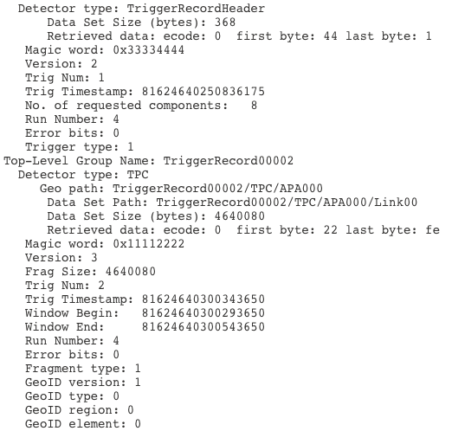
How to navigate through the detector payload?
To unpack the header words in TriggerRecordHeader datasets
Code is in HDF5Utils
The input source handles TriggerRecordHeader blocks and fill the top level info in the single data product of type raw::dunehdf5fileinfo.
Delayed Reader Functionality : Put proxies in the art event which lets downstream tools access the input file and deserialize it.
To read Fragments and unpack the waveforms
Code lives in Coldbox/
It reads the Fragments into a larsoft job and produce an art root file.

Slide 6
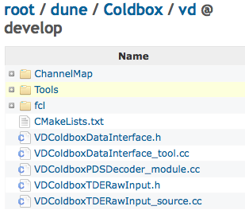
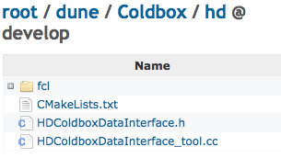
Coldbox
dunetpc/dune/
vd
hd

Slide 7
VD ColdboxDataInterface Tool
For HDF5, we want the VDColdboxDataInterface _tool.cc tool to read one CRU’s worth of data when it is called.
The tool reads in the raw::dunehdf5fileinfo data product out of an art event and access the already-open file using H5GOpen/H5Dread.
A method retrieveDataForSpecifiedAPAs in the tool reads in one CRU's worth of data at a time and deserialize them into raw::RawDigits and raw::RDTimestamps and RDStatuses.
The tool is called by dunetpc/dune/DataPrep module.
DataPrep is a producer module. Dataprep loops over CRUs, calling the input tool for each CRU.
It makes in-memory representations of 1 CRU's worth of raw::RawDigit, raw::RDTimeStamp, and raw::RDStatus .

Slide 8
VD ChannelMap
Six channel map files are installed.
Our decoder tools are specific to the VD detector – uses corresponding channel map
Fragments are converted ("decoded") to raw::RawDigits
requires offline channel numbers in them, so the channel map has to be applied to them.
Method getOfflChanFromSlotFiberChan from channel map service returns an offline channel number.
The method takes slot no., fiber no. as an input and covers 2 FEMBs & a CE channel no. from 0-255.
The WIB frames have crate, slot, and fiber identifiers. For the VD coldbox, there is only one crate. A crate has up to five WIBs in it, indexed by slot. "Fiber" indicates which FEMBs on the WIBs are sending the data. The Decoder unpacks these and uses them in the channel map.

Slide 9
UPS Products
There are 2 UPS products in CVMFS and Scisoft
dunedaqdataformats
hasv3_0_0, v3_1_0 and v3_2_1 versions available
they have NULL flavor and no qualifiers.
no build needed to make the products as they consist of headers and documentation only
dunedetdataformats
hasv3_0_0, v3_1_0 and v3_2_1 versions available
they have NULL flavor and no qualifiers.
no build needed to make the products as they consist of headers and documentation only
They are in dunetpc/ups/product_deps

Slide 10
How to run Coldbox jobs ?
vdcoldboxrawinput_job.fcl
Runs the input source on hdf5 file
reconstitutes TRH objects from these HDF5 data
vdcoldbox_dataprep.fcl
runs the raw decoder
reads the Fragments into a larsoft job.
makes an artroot file with raw::RawDigits.
vdcoldbox_raw_dataprep.fcl
Runs through the input source + the decoder
Does both jobs described in previous 2 fcl files.

Slide 11
HDColdbox (Coldbox/hd)
Repurpose the VDColdbox software to read HDColdbox data with a few modifications
May require specific modifications to the code to handle the specific features in future….thus kept separate from vd.
Dir. Structure : looks same except "VD" and "vd" are renamed to "HD" and "hd".
ChannelMap : uses PdspChannelMapService. services.PdspChannelMapService: @local::pdspchannelmap
Geometry : use the ProtoDUNE-SP geometry Geometry: @local::protodunev7_geo for the decode + dataprep stage.
fcl : Implement the modifications.
HDColdboxDataInterface_tool.cc The decoder calls GetOfflineNumberFromDetectorElements method in the channel map
handle 256 channels on two fibers
1 crate/APA, set default crate number as 3

Slide 12
Started participating in HEP CCE projects for Multi-Node processing and parallelism and its intersection with both modern computing facilities and software stacks.
Amit will share a few slides on HEP-CCE efforts in the context of DUNE.
Jake will talk about the development and debugging of Photon detector HDF5 decoder.
THANK YOU !

