Slide 1
ProtoDUNE II Data Management Milestones
Steven Timm
Dec 14 2021

Slide 2
ProtoDUNE II Big picture
Both coldboxes taking data right now
Horizontal Drift (NP04) – APA’s in coldbox with cold N2
Plus independent electronics test stand
Vertical Drift (NP02), CRP in coldbox with LAr
Top Electronics
Bottom Electronics
Photon Detectors
NP02 Cryostat HV testing
Legacy phototube readout
Arapucas and SiPM
All ProtoDUNE raw data 2 tape copies, 1@Cern CTA, 1 @FNAL

Slide 3
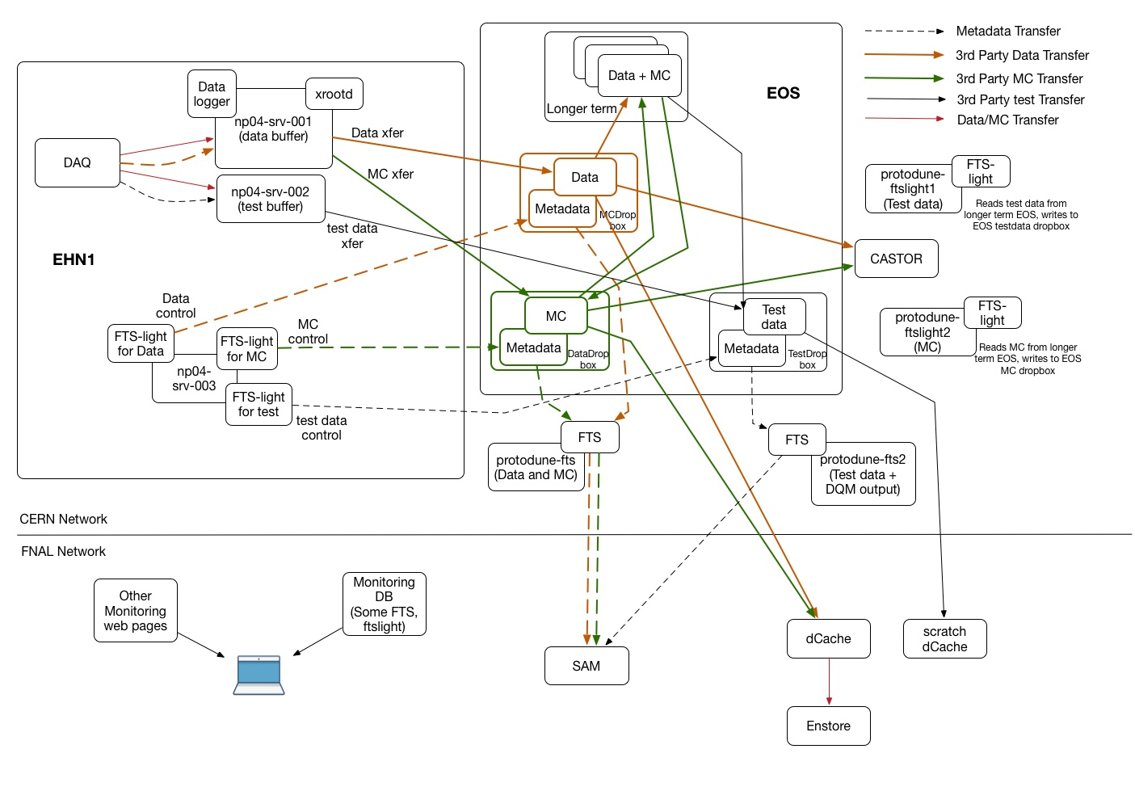
Data Flow Diagram PD-I

Slide 4
Goals by beam time
Unified file transport for NP02 / NP04 in EHN1->EOSPUBLIC
Use FTS3 for both (like NP02 does now)
Unified file auth for NP02/NP04
Rucio / FTS3 to do the CERN->FNAL transfer
Two stages:
Ingest daemon EHN1-> EOSPUBLIC (current Fermi-FTS-Light)
(Does not require live network connection to FNAL)
Declaration daemon EOSPUBLIC -> Metacat and Rucio
Rucio handles Transfer via FTS3.
Metacat, Rucio, and Data Dispatcher in production

Slide 5
ProtoDUNE-II Configuration
Ingest
Daemon
FTS3
Declaration
Daemon
DAQ
Data
Store
CERN
EOS
CERN
CTA
Red arrows: Control FTS3
Green arrows: Declarations
Yellow arrows: 3rd party xfer
Blue arrows: Data path
FNAL
dCache/
Enstore
Other Storage Elements
MetaCat
Rucio
FTS3

Slide 6
Rucio Ingest Daemon: Requirements
At Detector Hall in EHN-1
Detect New Files on DAQ data store
NP02 and NP04 do this differently try to make it the same next time around.
Extract metadata, add extra fields if necessary
Calculate checksum
Monitoring and retry logic
Initiate FTS3 3rd party transfer to first SE (EOS Public)
Right now we think this is *not* a Rucio upload
Right now we think Rucio does *not* manage the DAQ data store.
Rough replacement for FTS-Light functionality

Slide 7
Rucio Declaration Daemon
Rough replacement for Fermi FTS
Runs in computing center (currently in the CERN cloud)
Declare to Rucio and MetaCat
Make rules to send to CERN CTA and Fermilab Enstore
Delete file from initial DAQ data store
Monitoring and retry logic.
Replacing functions of current Fermi FTS
(Fermi FTS code can already use FTS3 as a transport)
Almost all of these functions also needed at Fermilab for files that come out of reconstruction/MC.

Slide 8
Rucio Policy: Ingest (1)
Files can move into Rucio by three ways:
Rucio Upload:
Copy the file into the storage Element by xrdcp and declare it.
File is owned by the user proxy that uploaded it.
Declare DID/replica for files already in the storage element
This is how we do it now
Files end up with the right user ID.
Moving from site to site via Rucio requesting the transfer via FTS3
All Rucio transfers (even those in user namespaces) use a production proxy and are owned by dunepro
File ownership questions get even harder when tokens replace proxies.

Slide 9
Rucio Policy: Ingest (2)
Rucio has an optional hook to say that every file declared to Rucio MUST also have metadata in an external Metadata Catalog
We are going to deploy this hook.
At Fermilab at least, normal users eventually will be able to write only to Scratch dCache
For production, declaration of metadata and of rucio replicas will be done by the new ingest scripts that replace Fermi FTS
Anything that gets to tape-backed storage MUST have metadata declared to be there.
That metadata must include the expected file retention lifetime.
Will need the equivalent of Sam4Users to do this for user files.
We do not expect the end user to have to learn and use Rucio commands to do their work.

Slide 10
Milestones Calendar Year 2022
Rucio database fully loaded
Metacat/Rucio become master
Implies we have all the clients to talk to them
Data dispatcher runs in place of SAM
Ingest/Declaration daemons ready
EHN1 DAQ systems reconfigured to use them
Data Challenge
Beam
Fondue and chocolate.

