Slide 1
g-2 Target Station Update and Plans
Beam Team Meeting
January 26, 2012
D. Still

Slide 2
Plan B
Use the target vault “as is” currently setup.
Possibly modify/redesign target, lens and or Pmag to optimize production but the vault mainly is similar.
~ 80- 90% of current effort for providing a g-2 target station has been done in this option.
It is unknown whether the pulsed devices can run at 100Hz with suitable cooling. Needs testing and analysis.
It is likely the pmag will be replaced by a cmag.
So far, production from simulations seem “reasonable” ~.87 E-5 Π⁺ /p

Slide 3
Work on Target Station
 | Spot Size at Target | Target | Lens | Collimator | Pmag | Dump
Simulations | Initial spot size σ = .55mm predict better production σ = .15mm | Initial prod estimates ~ 1E-5/POT With optimization ~ 2 E -5/POT | Currently working on optimizations for lens based on Target optimization. Initial estimates for mechanical stresses & fatigue | Not addressed | Initial estimates show loss of protons and | Current Dump has water leak looking at designs
New or Change Design | New Optics Design | Design Target | Changes to Current Design? Longer, Cooling, |  | PulsedCmag $50K Cmag (turns) Pmag (increased aperture) Pmag w spares | TD has initial design for 25kW dump Cu, H20 cooled ~ $6-9k Looking at cost for rebuilding current dump with modifications
Testing |  |  | Condition Lens 12Hz avg test g-2 pulse rate test |  | 12Hz Avg test w pmag | Need removal Installation plan
(Critical testing to gain confidence in Plan B)

Slide 4
The Lithium Lens
Lithium Lens Parameters | Pbar | G-2 12Hz | G-2 18Hz | G-2 Test Station
Peak Current | 62 kA | 22.6 kA | 22.6 kA | .5 kA
Pulse width | 400 µsec | 400 µsec | 400 µsec | 400 µsec
Gradient | 670 T/m | 670 T/m | 670 T/m | 670 T/m
Rep rate | .5 Hz | 12 Hz | 18 Hz | 12 Hz/ .5 Hz
Coil Resistance | 95 µΩ | 95 µΩ | 95 µΩ | 95 µΩ
Resistive Heating | 4 KW | 11.6 kW | 17.4 kW | 570 W /24 W
Beam Heating | 2 kW | +25% | +25% | +25%
Total Heating | 6 kW | 14.5 kW | 21.8 kW | 713 / 30W
Cooling system removal capacity | 11 kW | +32% | +100% | -6% / .3%
Scaling to the initial 18Hz rep rate at 25kW beam energy on the target
produced at total heat load of 20kW which was 2X more that cooling system.
This was one the of biggest concerns with Plan B.

Slide 5
g-2 Pulse Train at the Target (12Hz mode)
Begin cycle
End cycle
Lens pulse length 490 µsec
Bunch length
of 1 pulse
120 nsec
100Hz
30Hz
Pulse separation
Train propagation
800 msec
10 msec
90 msec
~
~
1
2
3
4
5
6
7
8
9
10
11
12
13
14
15
16
Pulse #
Cycle length
1.33 sec

Slide 6
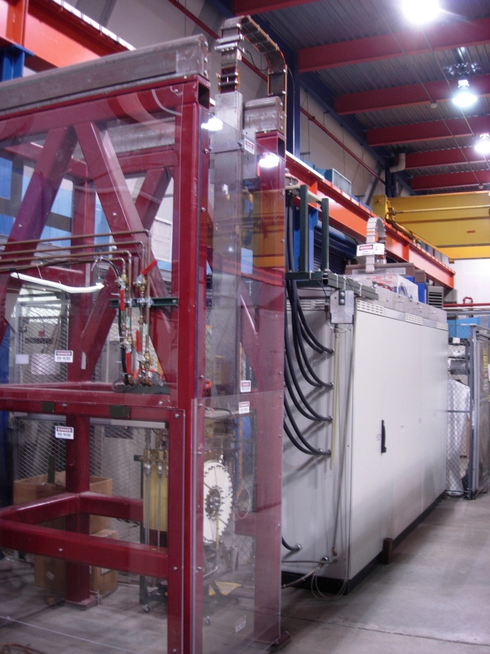
Lens Testing Schedule
Currently Conditioning Lens ( Jan 20 – Feb 3)
Requires procedure for powering from 40 – 75% of pbar stacking gradient.
12Hz average Testing (83msec pulse):
Having meetings with EE support to define test and power supply needs. Run lower gradient.
Requires inexpensive chip change.
Should be able to start (Feb 6 – 20)
Assess performance to see about g-2 pulse rate test.
g-2 Pulse Rate Test :
Currently having meetings with EE support and Mechanical Support to assess the plan.
May require power supply modifications which will mean $$ and time.
Time scale (Feb 20 – July)
AP0 Lens testing station

Slide 7
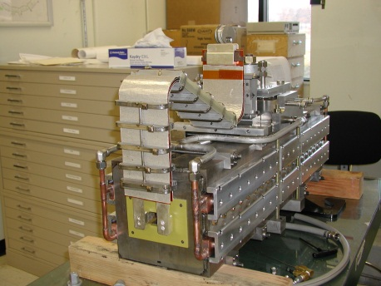
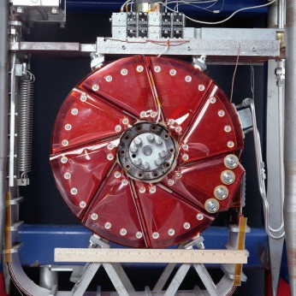
Plan B
Target
Lens
Pulsed magnet

Slide 8
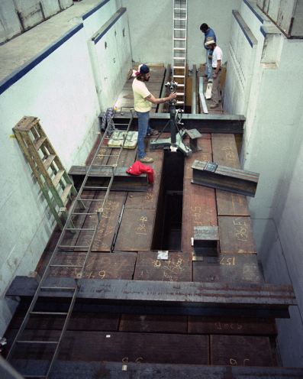
g-2 Target Enclosure
Beam line to Debuncher
(Looking from the side)
g-2 target building
(AP0)
Beam line from Recycler
Beam line to Debuncher
Desired to keep the enclosure in tact.
25 years of running beam
There are radiation concerns to modify
Beam Dump
(Looking from the top)

