Slide 1
Charge Readout Update
ND-LAr Management Board Meeting
December 1, 2021
Armin Karcher & Brooke Russell

Slide 2
Table of contents
1 Scope table
2 Design document status
3 Progress on addressing review recommendations
4 Risks
5 Prototyping plan

Slide 3
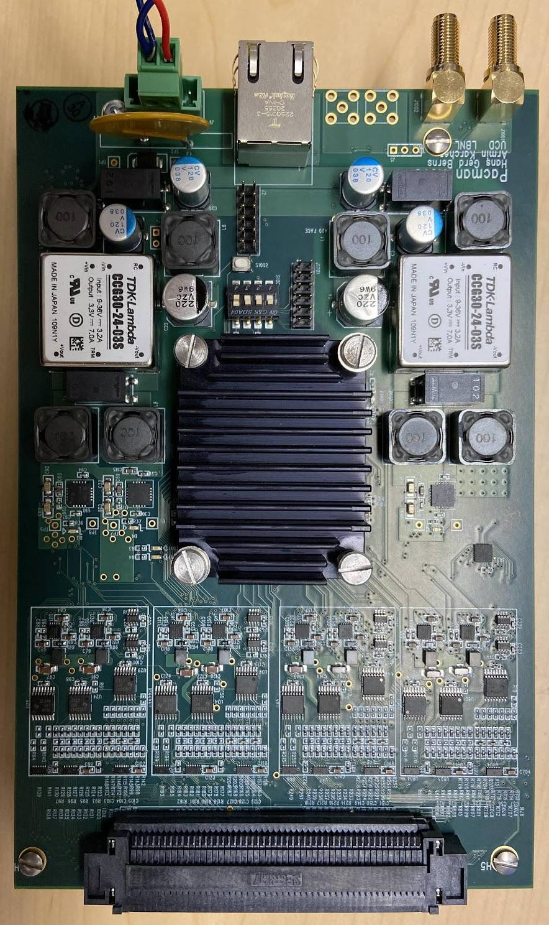
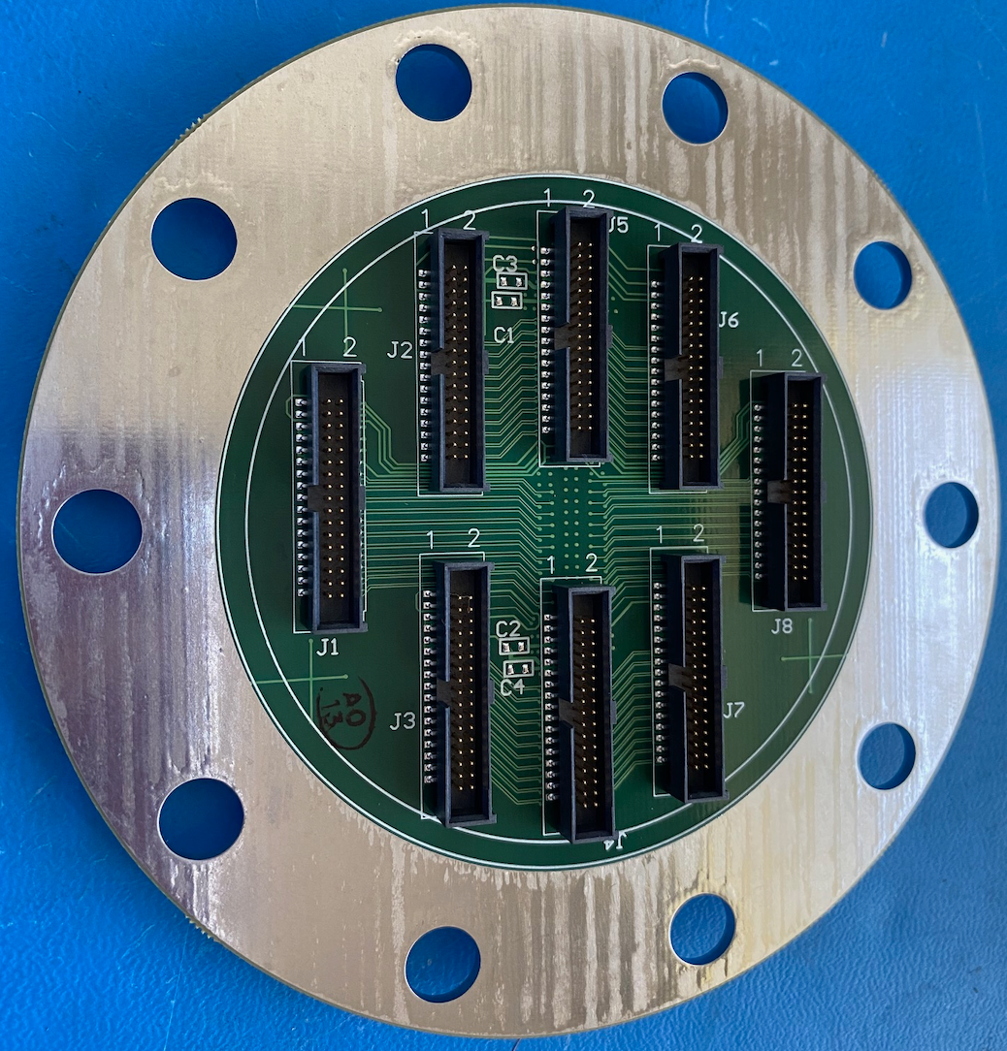
Charge Readout Scope
ND-LAr Charge Readout System
Institutional Responsibilities
20 controllers per power supply
7 supplies for detector
Task | Institutions
ASIC design and production | LBNL
ASIC test boards | UPenn
ASIC testing | Caltech, UCSB
Tile design and production | LBNL
Tile testing | UTA
Cables and feedthroughs | Rutgers
PACMAN hardware | UC Davis
PACMAN firmware | UC Irvine
Clock and power | LBNL
DAQ interface software | LBNL
Pixel Tile
Pixel Tile
1 switch per 48 controllers
3 switches for detector
Power Supply
Pixel Tile
Pixel Tile
Clock
Pixel Tile
Pixel Tile
DAQ
Ethernet Switch
Warm Controller
Sync
Pixel Tile
Pixel Tile
2 controllers per anode
140 controllers for detector
External Trigger
Pixel Tile
Pixel Tile
Feed-through
Pixel Tile
Pixel Tile
2 anodes per feedthrough
35 feedthroughs for detector
Pixel Tile
Pixel Tile
Pixel Tile
Pixel Tile
Pixel Tile
Pixel Tile
Pixel Array Controller And Network (PACMAN) card v1rev3
Pixel Tile
Pixel Tile
Scope table MOU in consortium Google drive
20 tiles per anode
1400 tiles for detector
10.24k pixels per tile
14.3M pixels for detector
295k ASICs for detector
8-tile PCB feedthrough

Slide 4
PDR Documentation Status
Category | Document | Documentation maturity | Design/plan maturity | Notes
Design | PDR chapter | mature | To be completed: PACMAN, clock, power, data subsections | link
Design | Grounding/shielding plan | mature, minor revisions expected | validated w/ 2x2 | EDMS # 2459151, 2459152
Design | Mechanical CAD for sub-system | 3D models exist | Design is mature, but changes expected
Design | Mechanical engineering drawings | Feed-through drawing done
Design | Mechanical assembly drawings and parts lists | Started for PACMAN enclosure | Not mature, but few unique components
Design | Electrical schematics & board layouts (anode tile) | Not done for full scale tile | Multiple designs, feed-back from 2x2 needed | Design scales from single ASIC layout
Design | Electrical schematics & board layouts (PACMAN) | 50% done | Performance seems OK, more feedback needed
Design | Specification of electrical cabling & wiring connections (warm side) | none | immature | Simple power cabling, COTS ethernet
Design | Specification of electrical cabling & wiring connections (cold side) | Mature, some more details needed | Mature, performance verification needed (FSD) | EDMS 2589306, 2589305
Design | Documentation links for commercial, off-the-shelf power supply | Mature, some more details needed | Commercial | PL506
Design | Documentation links for commercial, off-the-shelf fiber optic modules (for timing system) | Designed by others | Commercial | SFP Endpoint Fiber Splitter

Slide 5
PDR Documentation Status
Category | Document | Documentation maturity | Design/plan maturity | Notes
Requirements | EB-, TB-, consortium-held requirements | mature, minor revisions expected | validated w/ 2x2, FSD | EDMS # 2612983
Installation | Detector installation plan | immature | Module assembly is well understood
Interfaces | Consortium-Consortium | immature | Interfaces are understood and actively refined | EDMS documents outdated
Interfaces | Consortium-Installation | immature | More work needed
Interfaces | Consortium-Facilities | immature | Interfaces are understood, formal documentation missing
Engineering analysis | Analysis plans/notes | immature | Work done on ASIC, feed-through
Engineering analysis | Independent review report(s) | none | need to define what is needed | None needed for charge readout ?
QA/QC | Preliminary QA/QC plan | mature, needs links to individual testing plans | validated w/ 2x2 | EDMS # 2605601
QA/QC | 2x2 lessons-learned | informal, formalized documentation needed | in-progress
QA/QC | Preliminary manufacturing & procurement plan | mature, minor revisions expected | validated w/ 2x2 | EDMS # 2605602, 2605603
QA/QC | Plan for prototyping activities | informal, formalized documentation needed | validated w/ 2x2

Slide 6
PDR Documentation Status
Category | Document | Documentation maturity | Design/plan maturity | Notes
Cost/Schedule | Cost estimate | mature
Cost/Schedule | Institutional responsibilities | mature |  | scope table MOU
Cost/Schedule | Schedule summary | mature
Tracking Documents | Responses to past reviews | mature
Tracking Documents | Review office report on responses to past reviews | mature

Slide 7
Risks
Parts availability for semiconductors
ASIC foundry access
ASIC slow cryo failure (low risk, difficult to find, mitigate)
Tile PCB mechanical performance, in particular offshore production
System level ground integrity (full tile trigger instability)
Pixel far field response

Slide 8
Prototyping plan
ASIC
2020 LArPix-v2a increased channel density & migration to SRAM FIFO (Modules 0 & 1, SingleCubes)
2021 LArPix-v2b interstitial design to address crosstalk (Modules 2 & 3, SingleCubes)
2022 LArPix-v3 full physics performance (FSD, SingleCubes)
… LArPix-v4 QA improvements
… LArPix-v5 production version (ND-LAr)
Tile
2020 v2a 4.4 mm pixel pitch, 3.5 mm pixel size (Modules 0 & 1)
2021 v2b 3.88 mm pixel pitch, 2.6 (and 2.0) mm pixel size (Modules 2 & 3)
2022 v3 Full size tile PCB, finalize pixel geometry
Cable
2020 v2a twisted pair power/data cable (Modules 0 & 1)
2021 v2b FFC data cable, 18 AWG PTFE insulation power cable (Modules 2 & 3)
2022 FSD Full length cabling
PACMAN
2020 v1rev2 single tile driver
2020 v1rev3 high-density, eight-tile driver (Modules 0 & 1)
2021 v2b integrated timing system, low-swing IO, & power distribution system (Modules 2 & 3)
2022 v3 10-tile driver (FSD)

Slide 9
Summary
Scope is well understood and documented
Work is distributed over many institutions
Design work is generally fairly well advanced
Documentation needs to progress
Interface refinement still in progress
Risks will be resolved in 2x2 and FSD operation

