Slide 1
9 O’Clock Meeting
Gilberto Perez
MCR Crew Chief
Wednesday, December 1, 2021

Slide 2
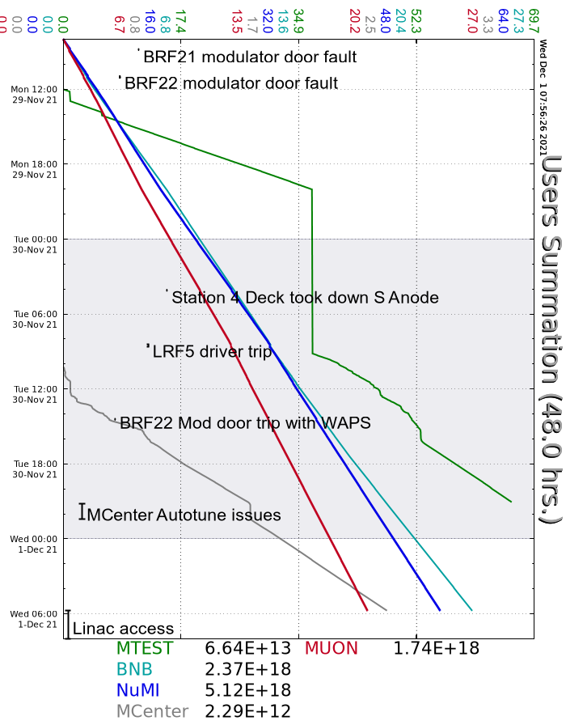
Since Monday…
Monday
Couple of Booster WAPS trips
Adjusted PreAcc extractor voltage as needed.
Tuesday
MIRF South Anode Supply trip.
Booster WAPS trips on mod door open faults
Wednesday
Beam to Mcenter inhibited due to autotune change to F:MC2H.
Prepared enclosures for access.
Linac
MI10/MI20-62
Enc. B
Enc. C
Transfer Hall
NuMI Absorber Hall
Muon Extraction
Muon M4
M03 – waiting on rad survey maps
Linac is back in controlled access to investigate a water leak.

