Slide 1
MI/RR Machine Status
Kyle J. Hazelwood
AD 09:00 Meeting
December 3, 2021

Slide 2
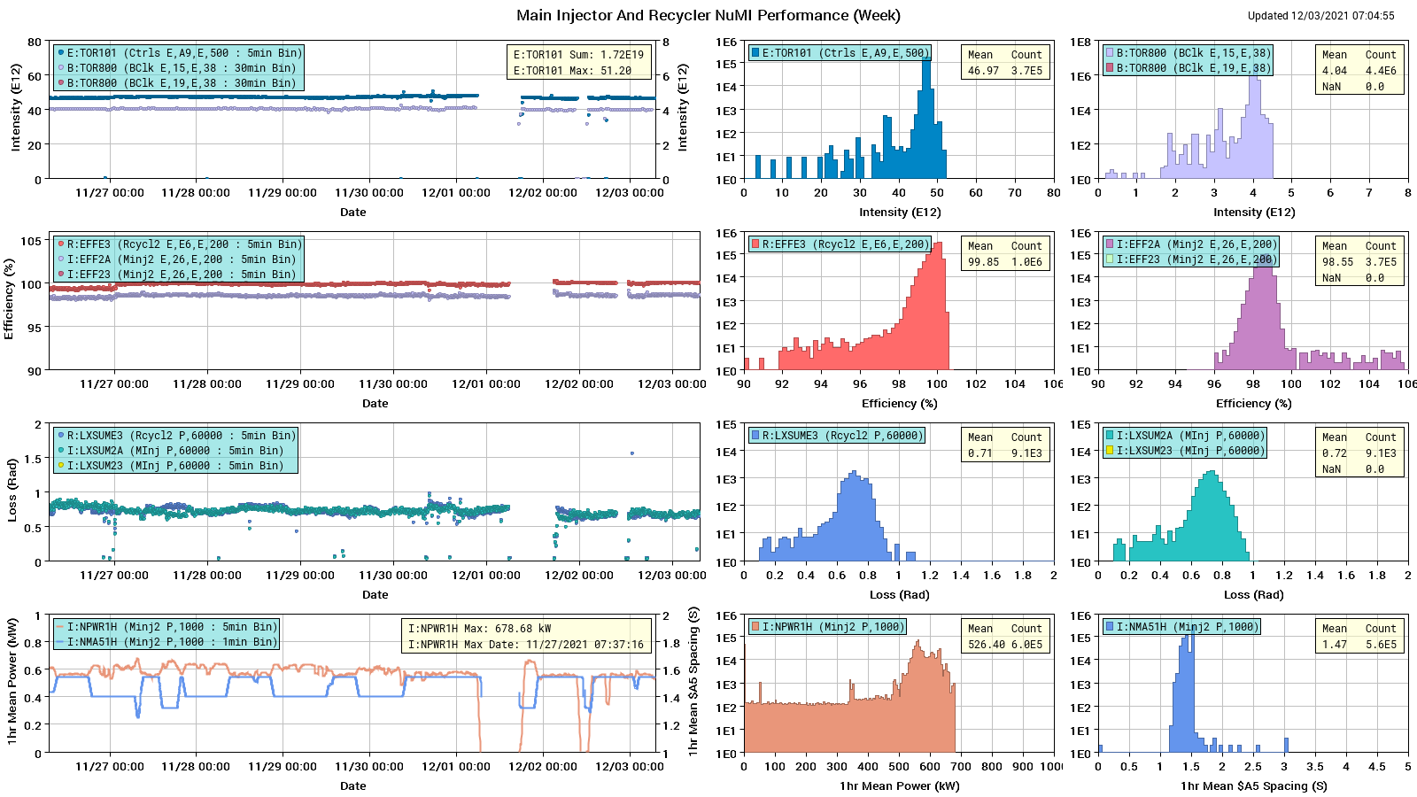
NuMI Performance

Slide 3
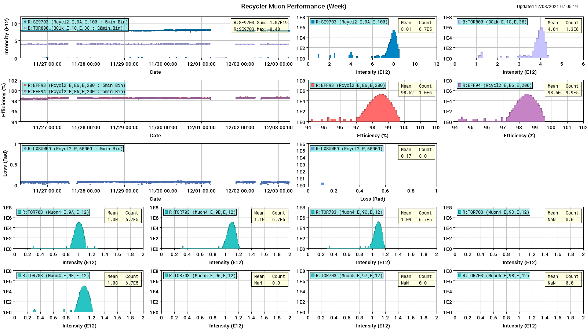
Muon Performance

Slide 4
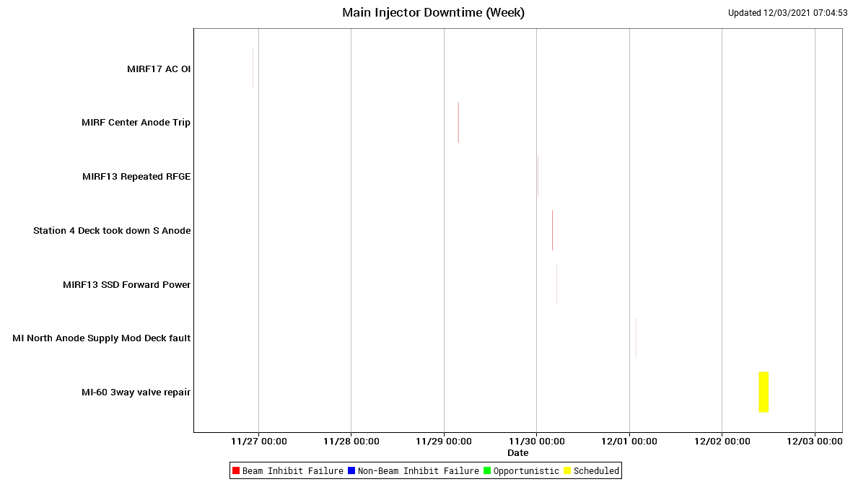
Main Injector Downtime

Slide 5
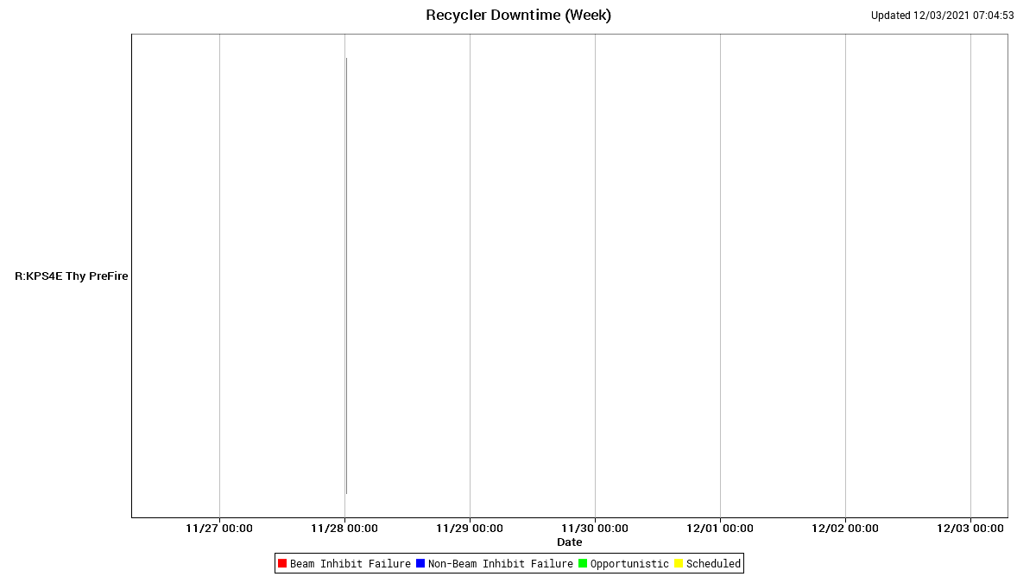
Recycler Downtime

Slide 6
Main Injector Slow Spill
Original installation had P1 Line extraction kickers at the higher Beta location
Septa tank 2
Septa tank 1
Kicker 2
Kicker 1
Q520
Kickers were no longer required and removed due to vacuum concerns.
During Shutdown 2021 the Septa were moved upstream to a higher Beta.
Septa tank 2
Septa tank 1
Q520

Slide 7
Main Injector Slow Spill
Comparison of Losses Before Move and After Move
At 5e11 protons per spill
Losses normalized to intensity have been reduced by over 50% at the extraction Lambertson
At the end of the 2021 Shutdown the AD/MI commissioning request was for 1 – 2 weeks of slow spill to the SY Dump to establish slow spill with the new Septa location.
Due to events beyond our control that time was not available.
AD/Operations put in fantastic tuning efforts to optimize slow spill out of the Main Injector and minimize losses.
Special acknowledgment to Nathan and Karl for their efforts!
Downstream
End of Septa
Front Face of Quad 521
Front Face of Lambertson

Slide 8
Summary
Issues
Wednesday Access
Replaced I:IP5232 and leak check area
Performed DALE measurements
Replaced pump head for MI52 pond pump
Tried upgrading QXR processor
Found MI60 3-way valve had failed during access
Ran valve in hand over night
Thursday
Replaced loop controller card for MI60 3-way valve
Pending Issues
Q123 has significant drip
8 hrs
TD inspected, thinks it can be fixed in place
Would like to do this before the holiday break
Next MI30 clean would fall on the holiday break
We would like to push it earlier or later
QXR processor upgrade was unsuccessful, looking for another opportunity
MW811 has a dead motor
Needed for lattice measurements
MW814 has bad limit switch
Needed for lattice measurements
C838AH Negative Limit switch needs replacing
Cant move collimator back in if moved out
Study Requests
New Recycler Lattice Implementation
2-4 hrs
Intermittent beam to experiments, possible higher losses
Recycler Scans
Will do most days
Under the $20, parasitic
MI Slow Spill Harmonic Quad Study
Need 2-3 hrs running to SY dump only
This is to test new harmonic quad settings
Perhaps December 15 during MTest changeout?
MI Chromaticity Scans
~2 hours
1.2s $2E to the MI dump

