Slide 1
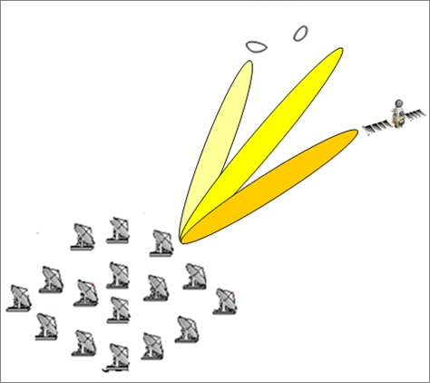
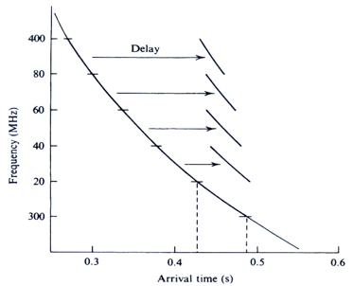
FRB search
  32-channel FRB backend
  2 snap2 boards, each with 16 RF input ports (working separately)
  GPU de-dispersion
  16 beams，0.1ms time resolution
  192-channel FRB backend
  24 K7 boards, each with 8 RF input ports (total 192 channels)
  12 GPU servers，each with 2 GPUs （total 24GPUs）for beam forming
  6 GPU servers， 12 GPUs for de-dispersion
  96 beams，0.1ms time resolution

Slide 2
FRB Backend Hardware setup for Dish array
de-dispersion
beam former
Notes:
schematic

Slide 3
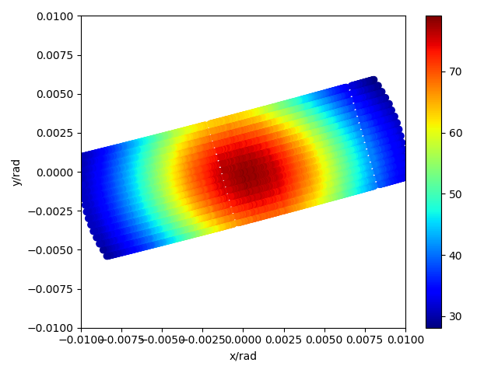
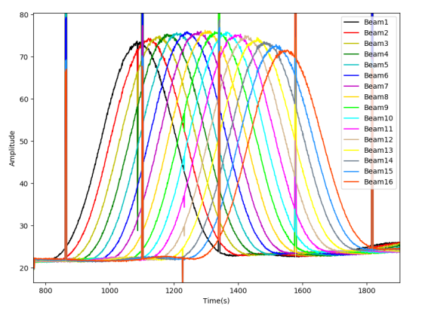
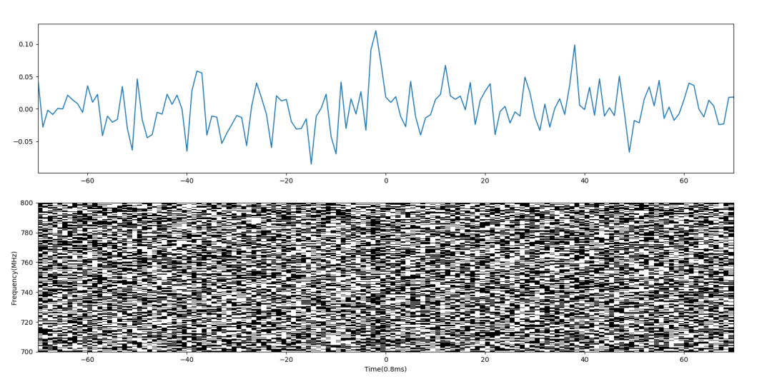
32-channel FRB backend
Using 16 beam to map the single antenna power beam
FRB 20201124A
16 beam @ Cygnus A transit

Slide 4
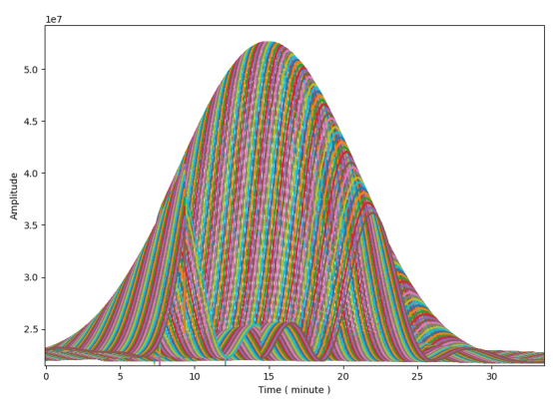
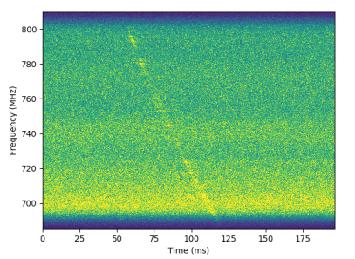
192-channel FRB backend
Pulsar B0329+54
192 beam along transiting trace of CasA

