Slide 1
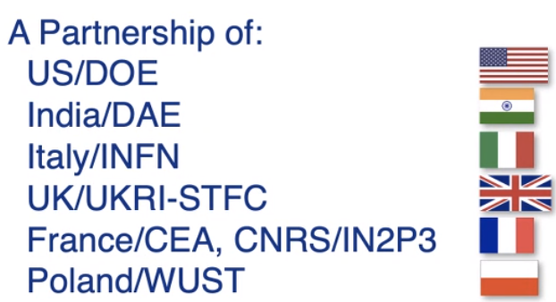
FNAL 650MHz coupler update
N.Solyak, J.Helsper for coupler team
01-Dec-2021

Slide 2
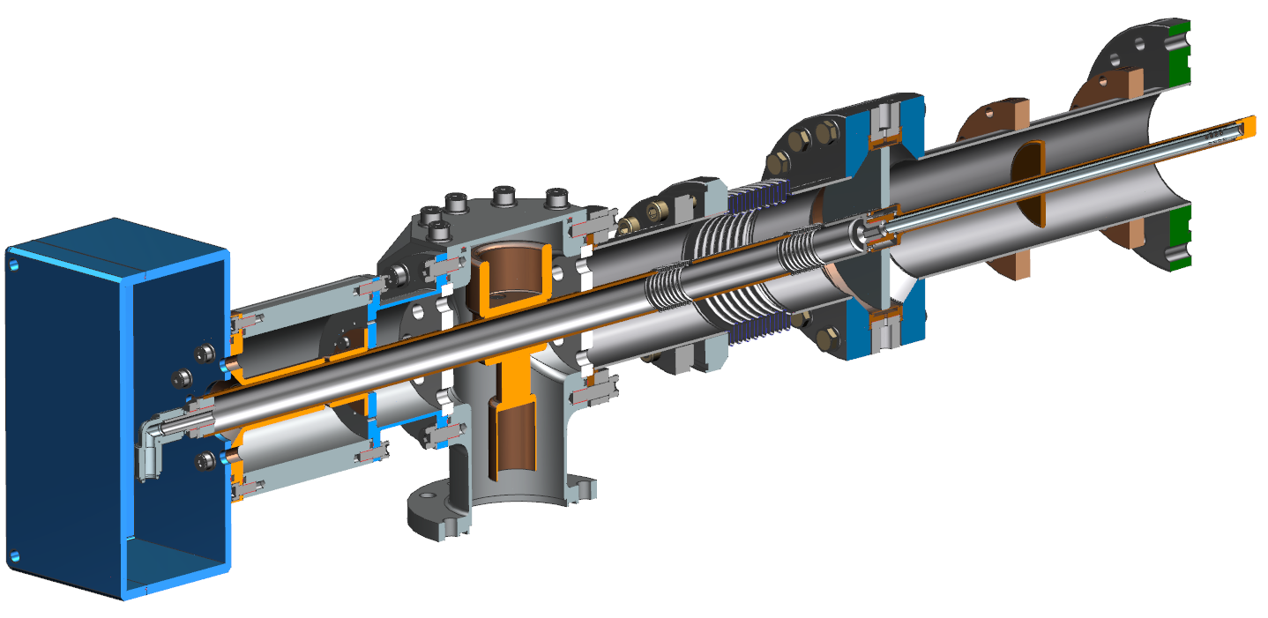
SSR2 Main Coupler assembly F10110745
Air Side Assembly
Instrumentation
box
Capacitor assembly
Vacuum End Assembly
Vacuum part consists of a 3” OD SS outer conductor, a copper antenna, and a ceramic window.
Inside surface of an outer conductor is coated with copper.
Design is similar 650MHz coupler, but not compatible.
T-junction
Air side: The inside surface of an outer conductor and outer surface of inner conductor is coated with copper.
12 May 2020

Slide 3
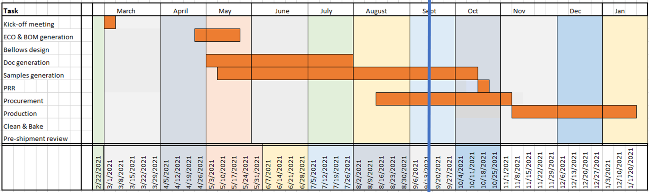
SSR Coupler status
ppSSR2 Coupler
  Procurement (4+2 antennas) full couplers is ongoing at CPI.
    MRR was conducted on Tuesday, Nov. 2nd.
      FNAL and CPI worked together to improve manufacturing documents – MIP, Inspection plan, and travelers
      CPI has been given approval to start manufacturing
    FNAL personnel visited CPI site Nov. 16.
      Impression was very good - FNAL is confident in CPI’s ability
  Procurement of DC blocks moving into manufacturing stage (F10140911, ED0013566)

Slide 4
SSR Coupler status
Minor design issues identified (same as for 650 coupler)
  Clearance of brass sleeves for inner conductor may not be enough for five layers Kapton (checking now)
  Inner conductor air fitting is Stainless Steel, which can gall with SS internal threads of inner conductor. The piece should be made of brass or Si-Brz instead

Slide 5
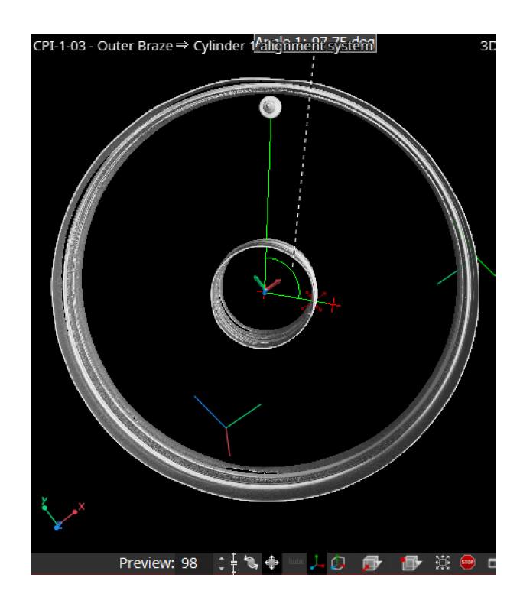
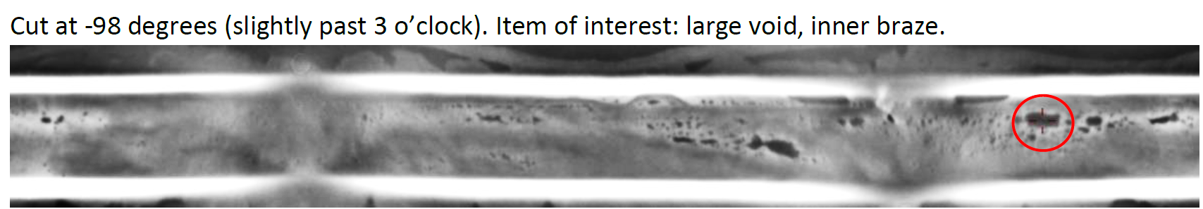
SSR Coupler Status
CT Scanning successful
  Next step is to section cut one window at multiple locations to study what appears as ‘voids’
  Using reference marker (screw), we can indicate angle for cut to view a specific defect
  It will be cut in four locations

Slide 6
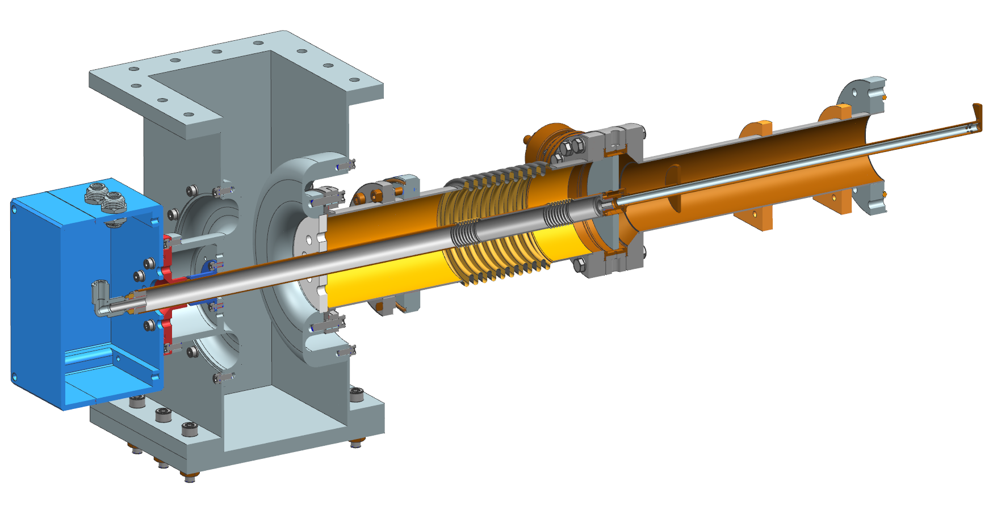
Pre-production 650 MHz Main Coupler assembly F10056895
Waveguide assembly
Vacuum End Assembly
Inner conductor
with bellows
Outer conductor
with bellows
Instrumentation box
Design is based on experience with prototypes assembly and test result.
Major modifications: thicker ceramics, standard WR1150 WG, air cooling line, vacuum gauge

Slide 7
HB650 coupler Update
Production (8+3) at Canon (CETD) in progress
  FNAL-CETD update weekly (or more frequently as requested) meetings/reports.
  Delivery delays due to copper oxidation issues (after 400C treatment and after cold shock in LN2) and leak in Air outer part bellow braze. (#6,7,8)
  VAC#1,2 received, cleaned, leak checked, assembled on Vacuum chamber and 120C baked (48 hrs), RGA scanned.
  Air parts #1,2 - received, leak checked, cleaned. Assembly on test stand on Dec.1
  Packing / Shipment schedule for others parts:
    Vacuum parts: VAC#3,4- Nov.24; VAC#5,#6 – Dec.8; VAC #7,8 – Dec.15; VAC#9,10 – Dec.21, VAC#11 – Dec.25.
    Air parts Shipment schedule: #3,4 – Nov.25; #5 –Nov.30; #6-Dec.19; #7,8 –Dec.25;
    Issue: Air outer parts #6,7,8 have below-to-SS brazing issues→ recovery:

Slide 8
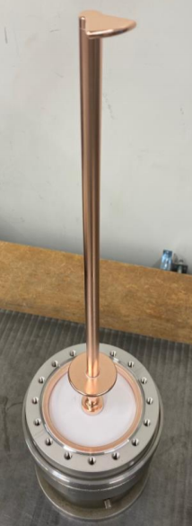
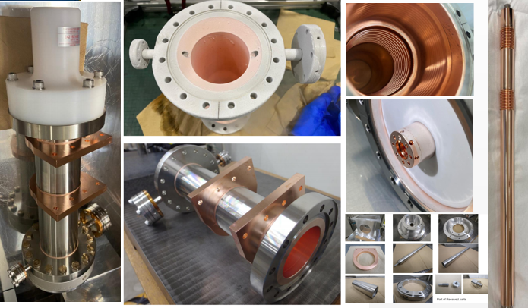
Manufacturing status (CETD, Japan): 8 + 3 vacuum parts

Slide 9
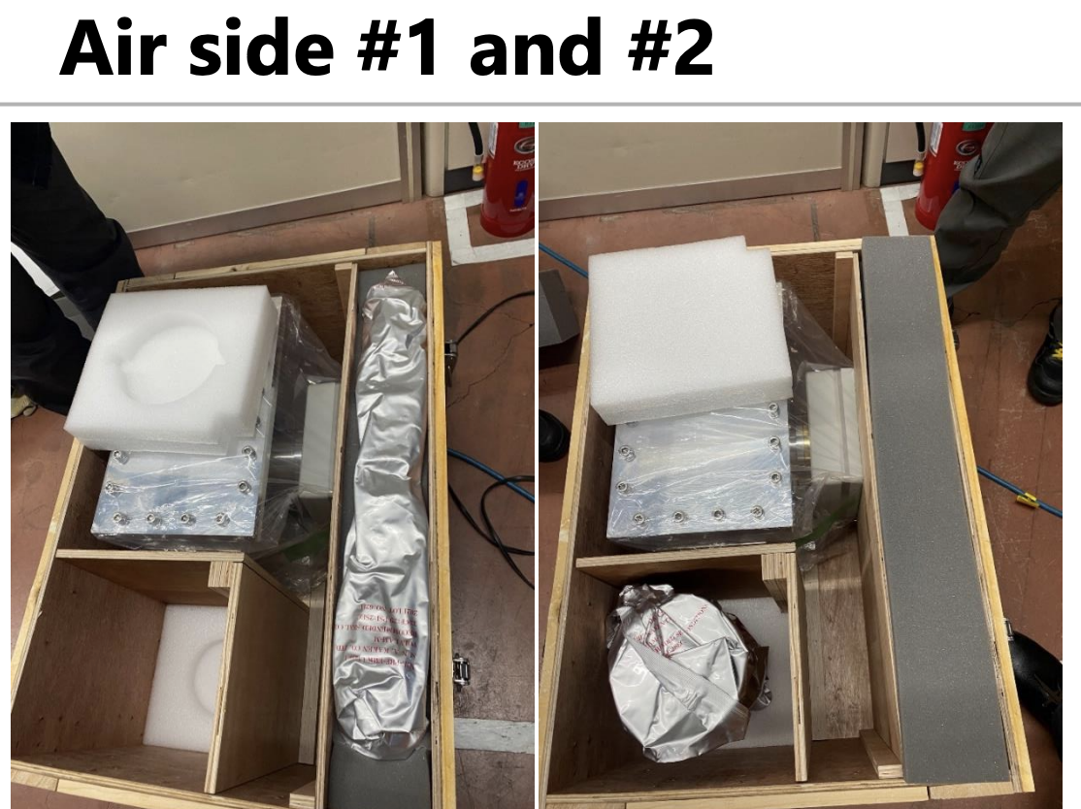
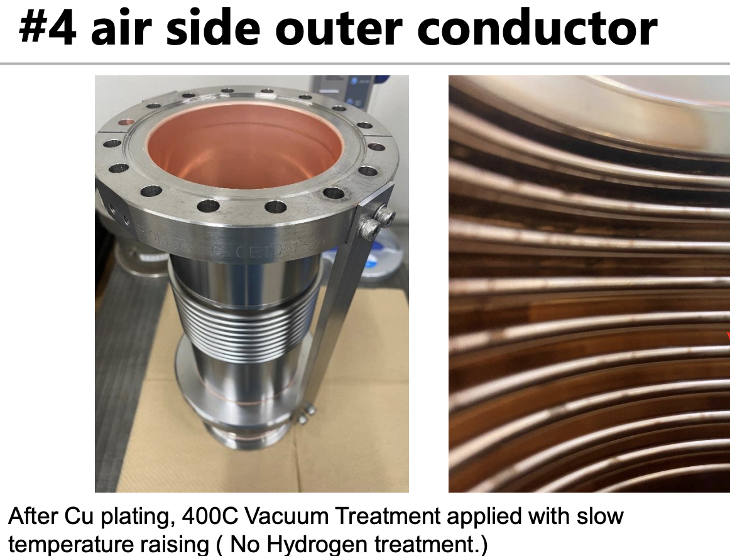
CETD update (Nov.11,2021)

Slide 10
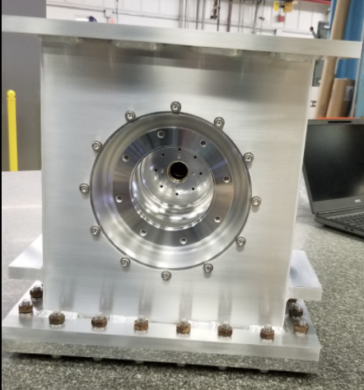
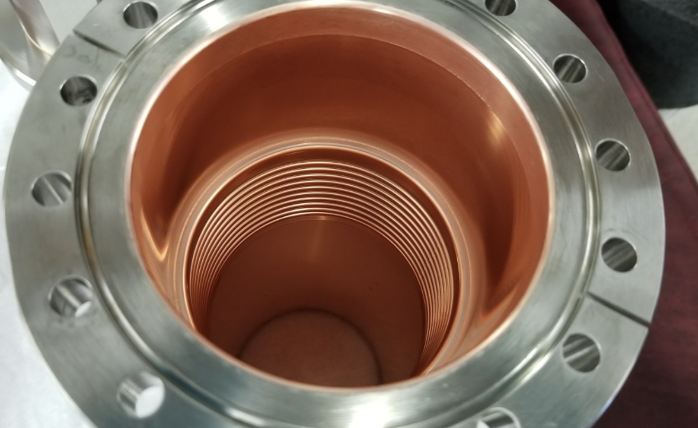
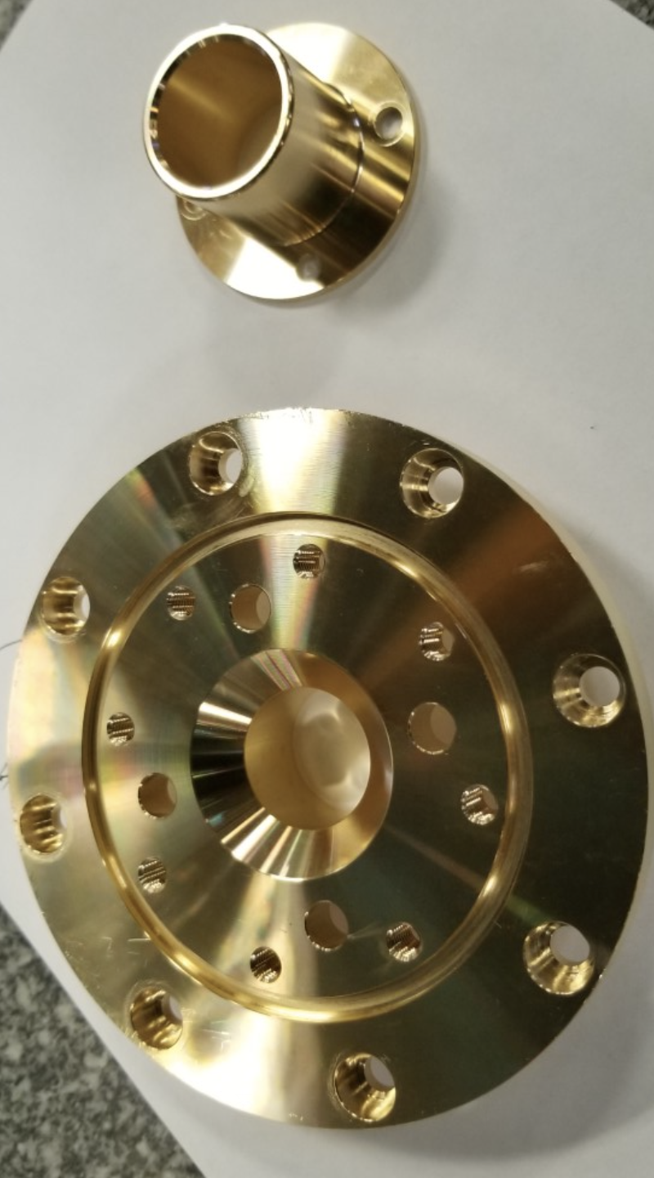
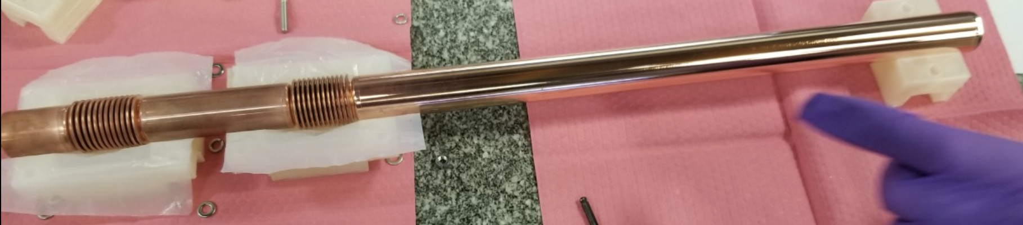
Coupler inspection #1,#2

Slide 11
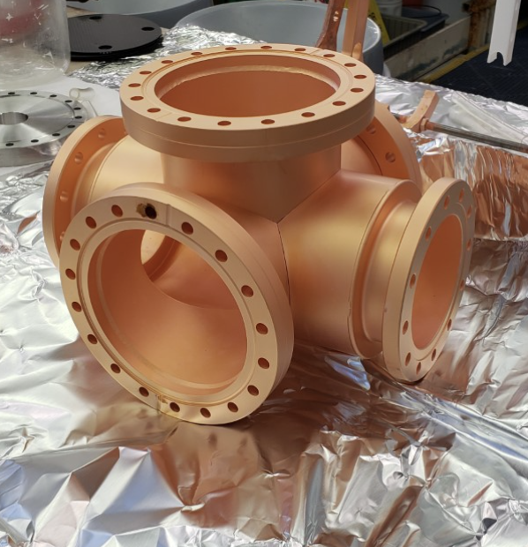
HB650 coupler Update (2)
    Preparation for coupler testing/processing.
  First pair of CETD couplers (#1,#2) assembled, pumped
  Test stand Vacuum pumping system (upgrade) – most parts in hand, but Vacuum Gate.
  2nd chamber –copper plated at SLAC. Derlivery end of this week
  Prepare test stand and RF source for test: Re-calibration directional couplers, Water distribution system, Temperature sensors re-mounted, software and electronics update to incorporate two coupler vacuum gauges, RF antenna in cave, paperwork.
  Documentation for incoming inspection, assembly, testing (travelers update).

Slide 12
