Slide 1
MI/RR Machine Status
Kyle J. Hazelwood
AD 09:00 Meeting
December 10, 2021

Slide 2
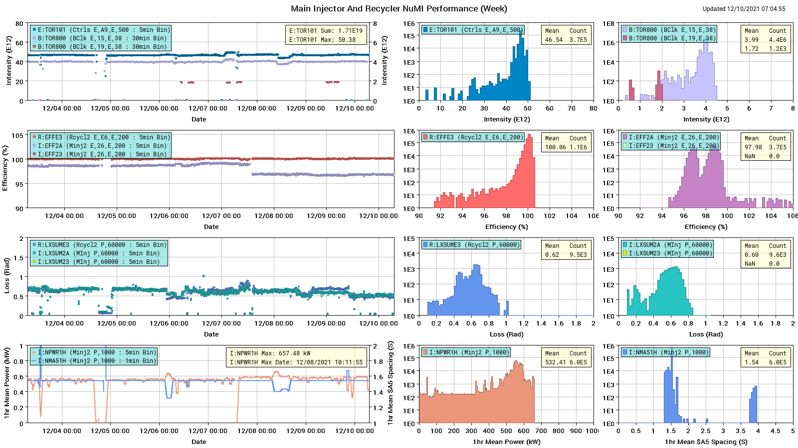
NuMI Performance

Slide 3
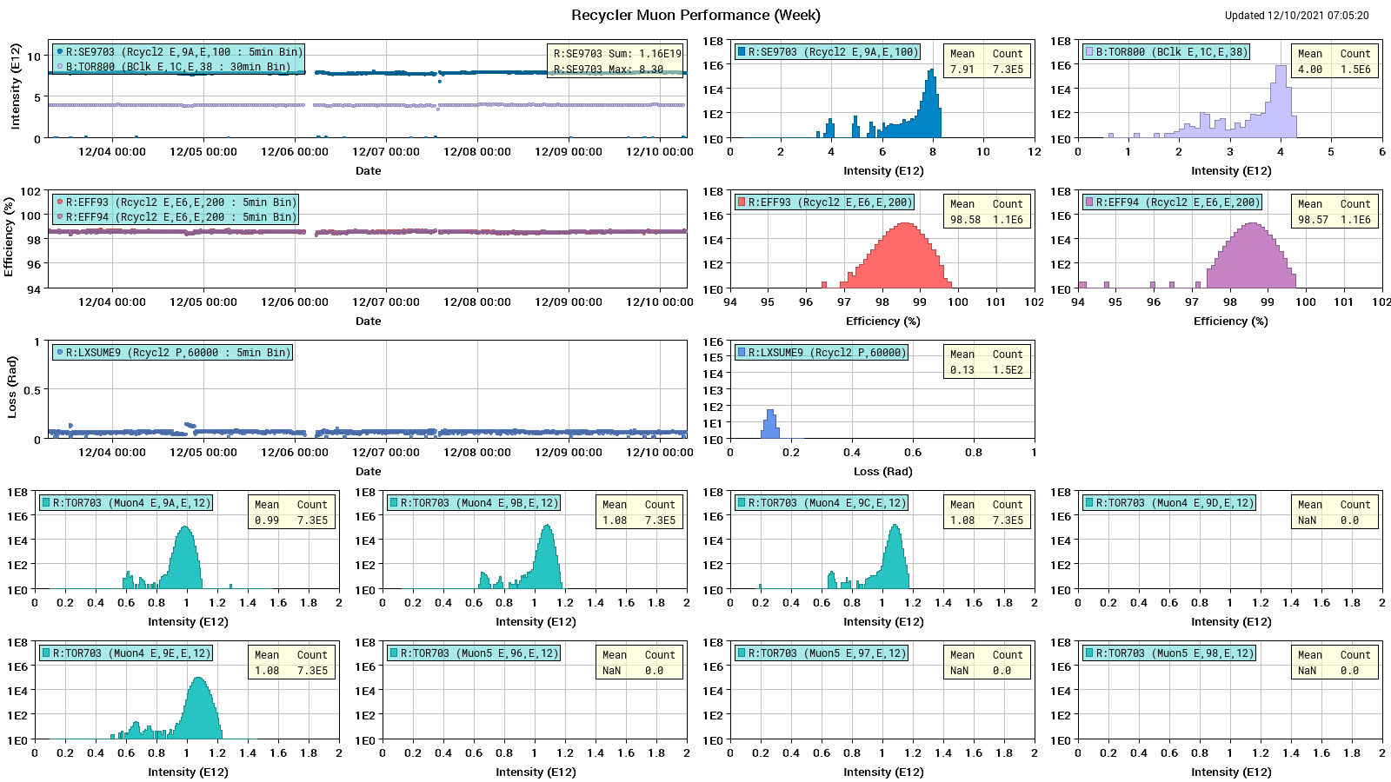
Muon Performance

Slide 4
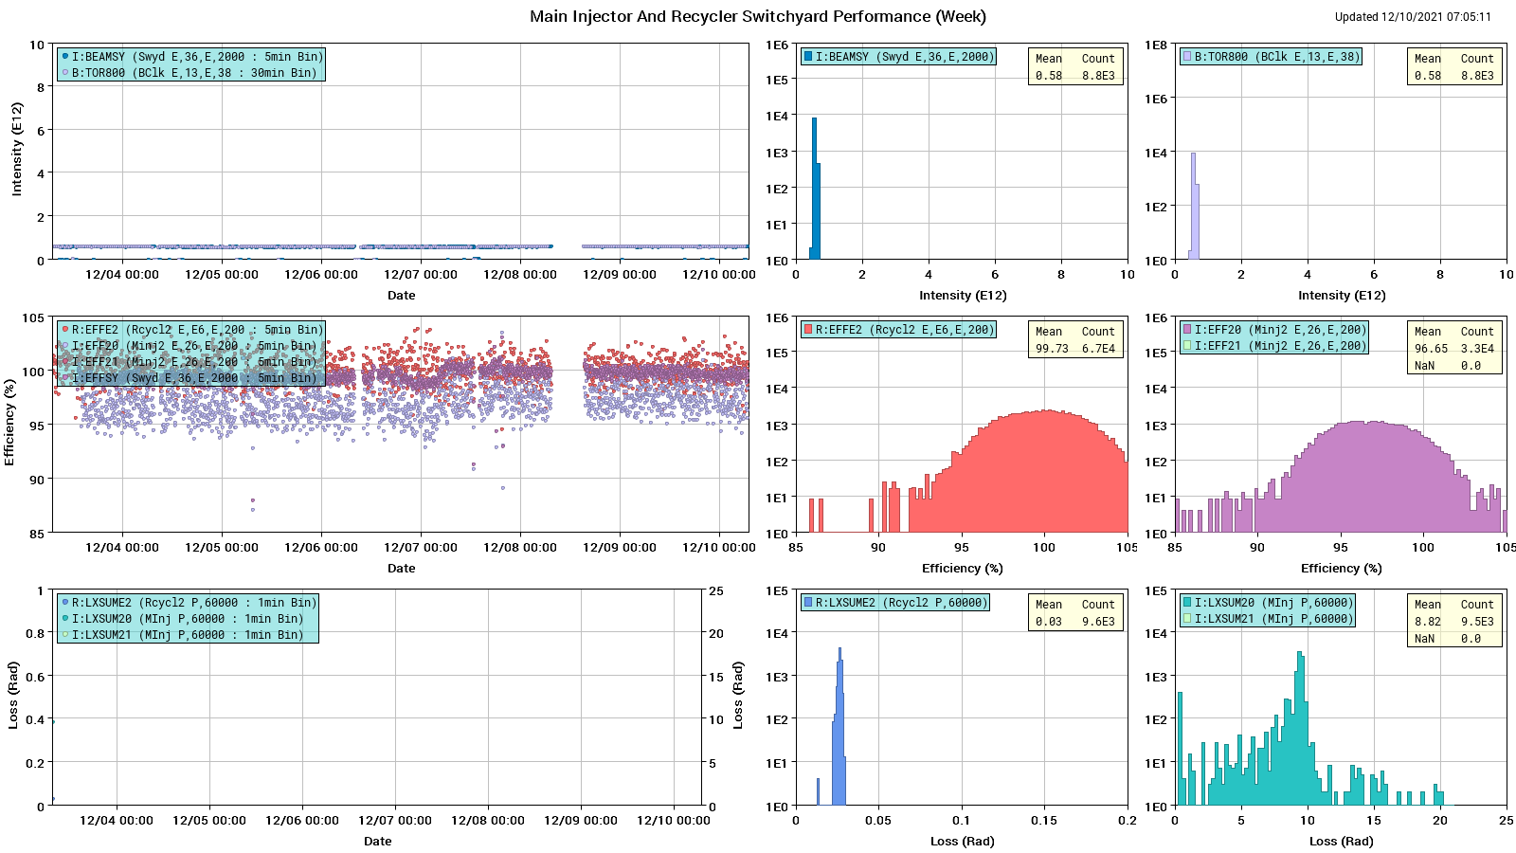
SY Performance

Slide 5
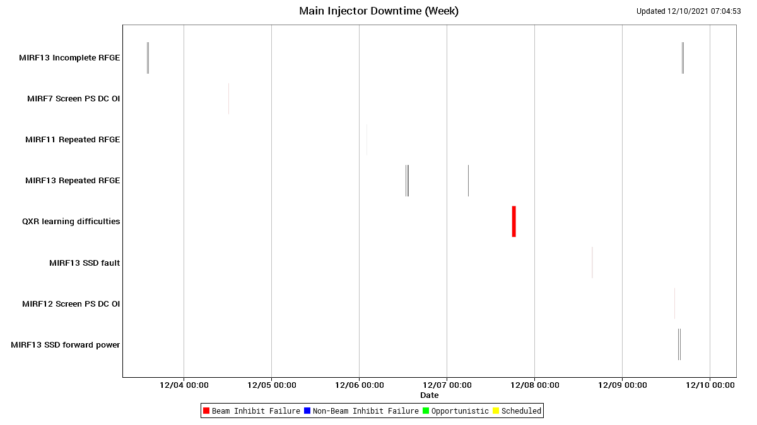
Main Injector Downtime

Slide 6
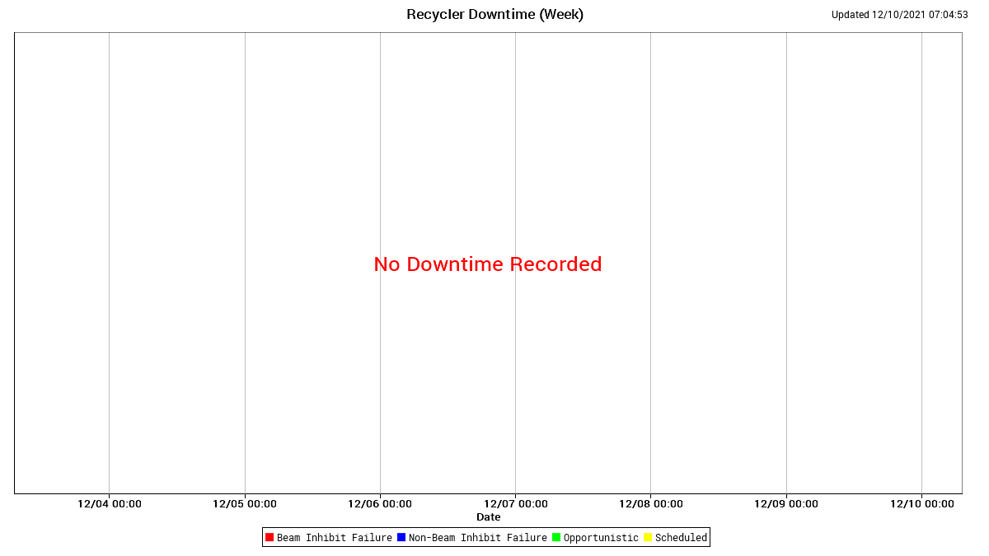
Recycler Downtime

Slide 7
Summary
Issues
R:TOR905 calibration
Pending Issues
Q123 has significant drip
8 hrs
TD inspected, thinks it can be fixed in place
Would like to do this before the holiday break
Next MI30 clean would fall on the holiday break
We would like to push it earlier or later
QXR processor upgrade
MW811 has a dead motor
Needed for lattice measurements
MW814 has bad limit switch
Needed for lattice measurements
C838AH Negative Limit switch needs replacing
Can’t move collimator back in if moved out
Study Requests
New Recycler Lattice Implementation
After the Holidays
2-4 hrs
Intermittent beam to experiments, possible higher losses
Recycler Scans
Will do most days
Under the $20, parasitic
MI Slow Spill Harmonic Quad Study
Need 2-3 hrs running to SY dump only
This is to test new harmonic quad settings
Perhaps December 22 during MTest changeout?
MI Chromaticity Scans
~2 hours (today)
1.2s $2E to the MI dump

