Slide 1
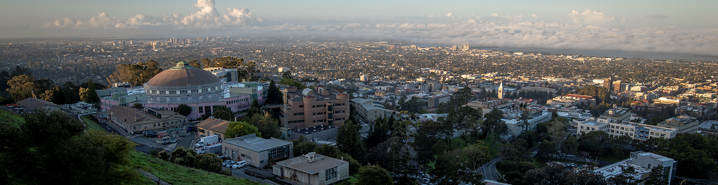
ASIC Design Activities at LBNL
Carl Grace 05/18/2022 HEP-IC 2022
Lawrence Berkeley National Laboratory

Slide 2
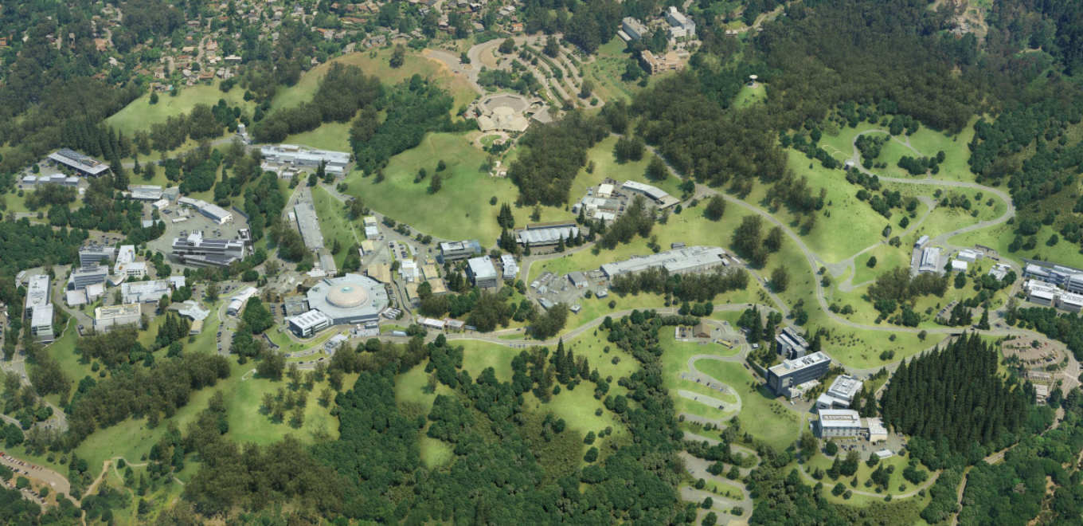
Lawrence Berkeley National Laboratory – Aerial view
Integrated Circuits Group

Slide 3
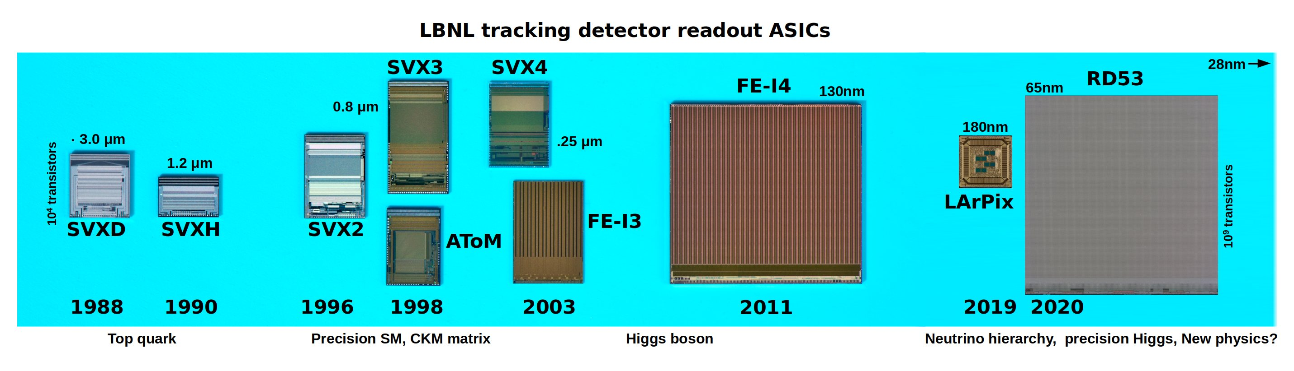
Sustained ASIC design effort at LBNL
  ASIC design capability grew out of LBNL Physics Division contributions to collider instrumentation in late 1980s
18 years of ASIC design activity at LBNL

Slide 4
Intel 0.8µm 1993
Intel 0.25 µm 1998
Intel 65 nm 2006
Intel Core 14 nm
LBNL tech nodes
0.35 µm
0.13 µm
65 nm
28 nm
0.8 µm
0.25 µm
0.18 µm
 | 1980s/90s | 2000-05 | 2005-10 | 2010-15 | 2015+
High-Energy Physics | SVX/II/3 AToM/BaBar | SVX4 | FE-I3 | FE-I4 POM | RD53A/B
Space + Neutrons |  | CRIC/CLIC | HERMES |  | PSD_CHIP
Neutrino + Spectroscopy |  | ATWD |  |  | ColdADC LArPix NanoCMOS
Imaging |  |  | CCDs/TEAM | K2/K3 HIPSTER | MTC/K4 4D-STEM
Light source | XRF | FCRIC/CCDs | FASTCCD | QERLIN HIPPO/VFCCD | PETAL1/2 VASE1/2
Computing |  |  |  | Rocket
Neuroscience |  |  |  | eChip | eChip2

Slide 5
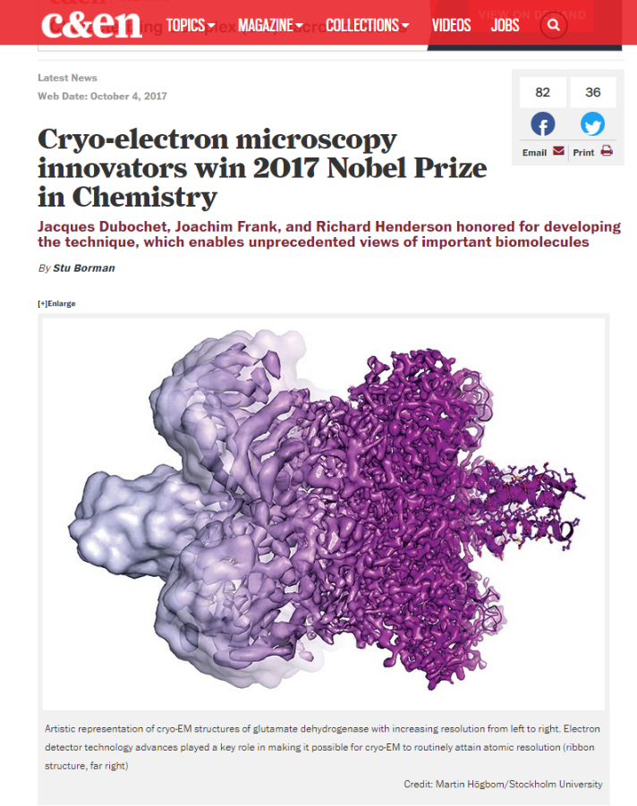
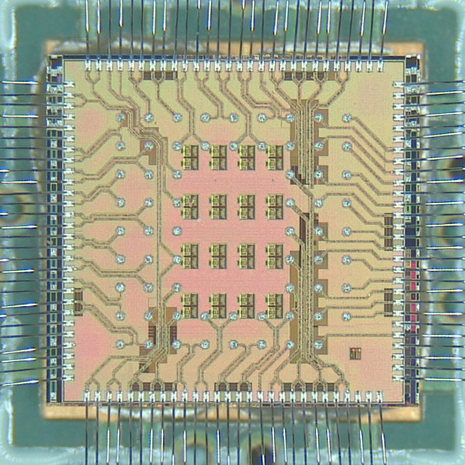
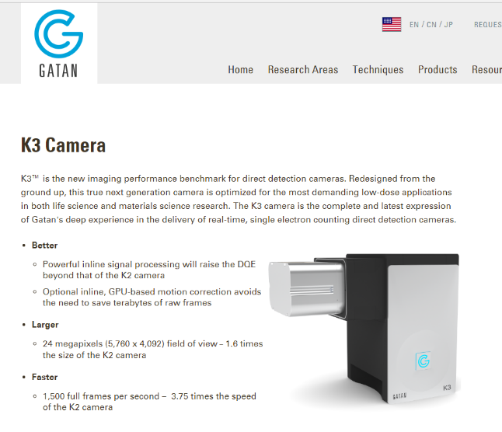
PETAL2: Line driver IC for Cryo-EM
Line driver and frame marker for next-generation real-time, single-electron counting direct detection cameras.
Interface with K3 sensor - a 24 Mpixel CMOS thinned sensor for Cryo-EM
35% area reduction, and
40% power reduction for existing camera assembly
Goal is sub-1 Å resolution

Slide 6

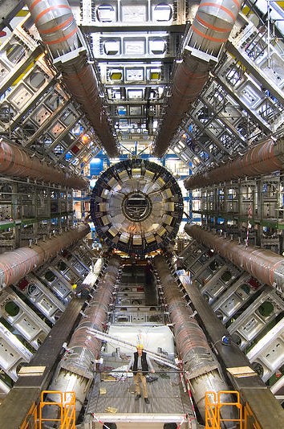
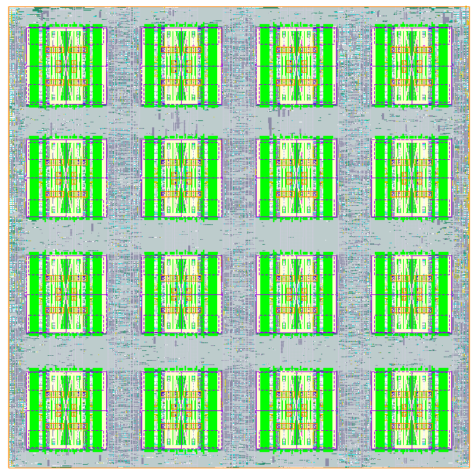
RD53: the next ATLAS/CMS readout IC for HL-LHC
Digital-on-top Methodology for HEP pixels
Highly integrated
Micro-power analog pixel “islands” in “digital sea”
Extreme operating corners - radiation, voltage, temperature
Large Design teams for very complex interoperation tool suites
  - SystemVerilog code-based chip integration
  - Automatic P&R of all IPs
Comprehensive verification methodology
  - Complete mixed-signal simulation
  - UVM—Universal Verification Methodology quantifies code verification coverage and
  - Verification code is many times the size of the actual logic code
  8x8 pixels/core
  200k transistors
  48x50 cores/chip
  153,600 pixels

Slide 7
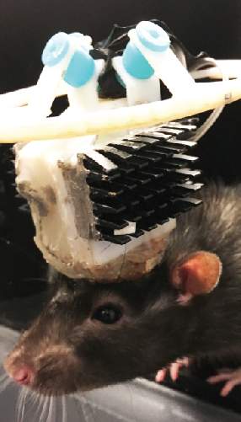
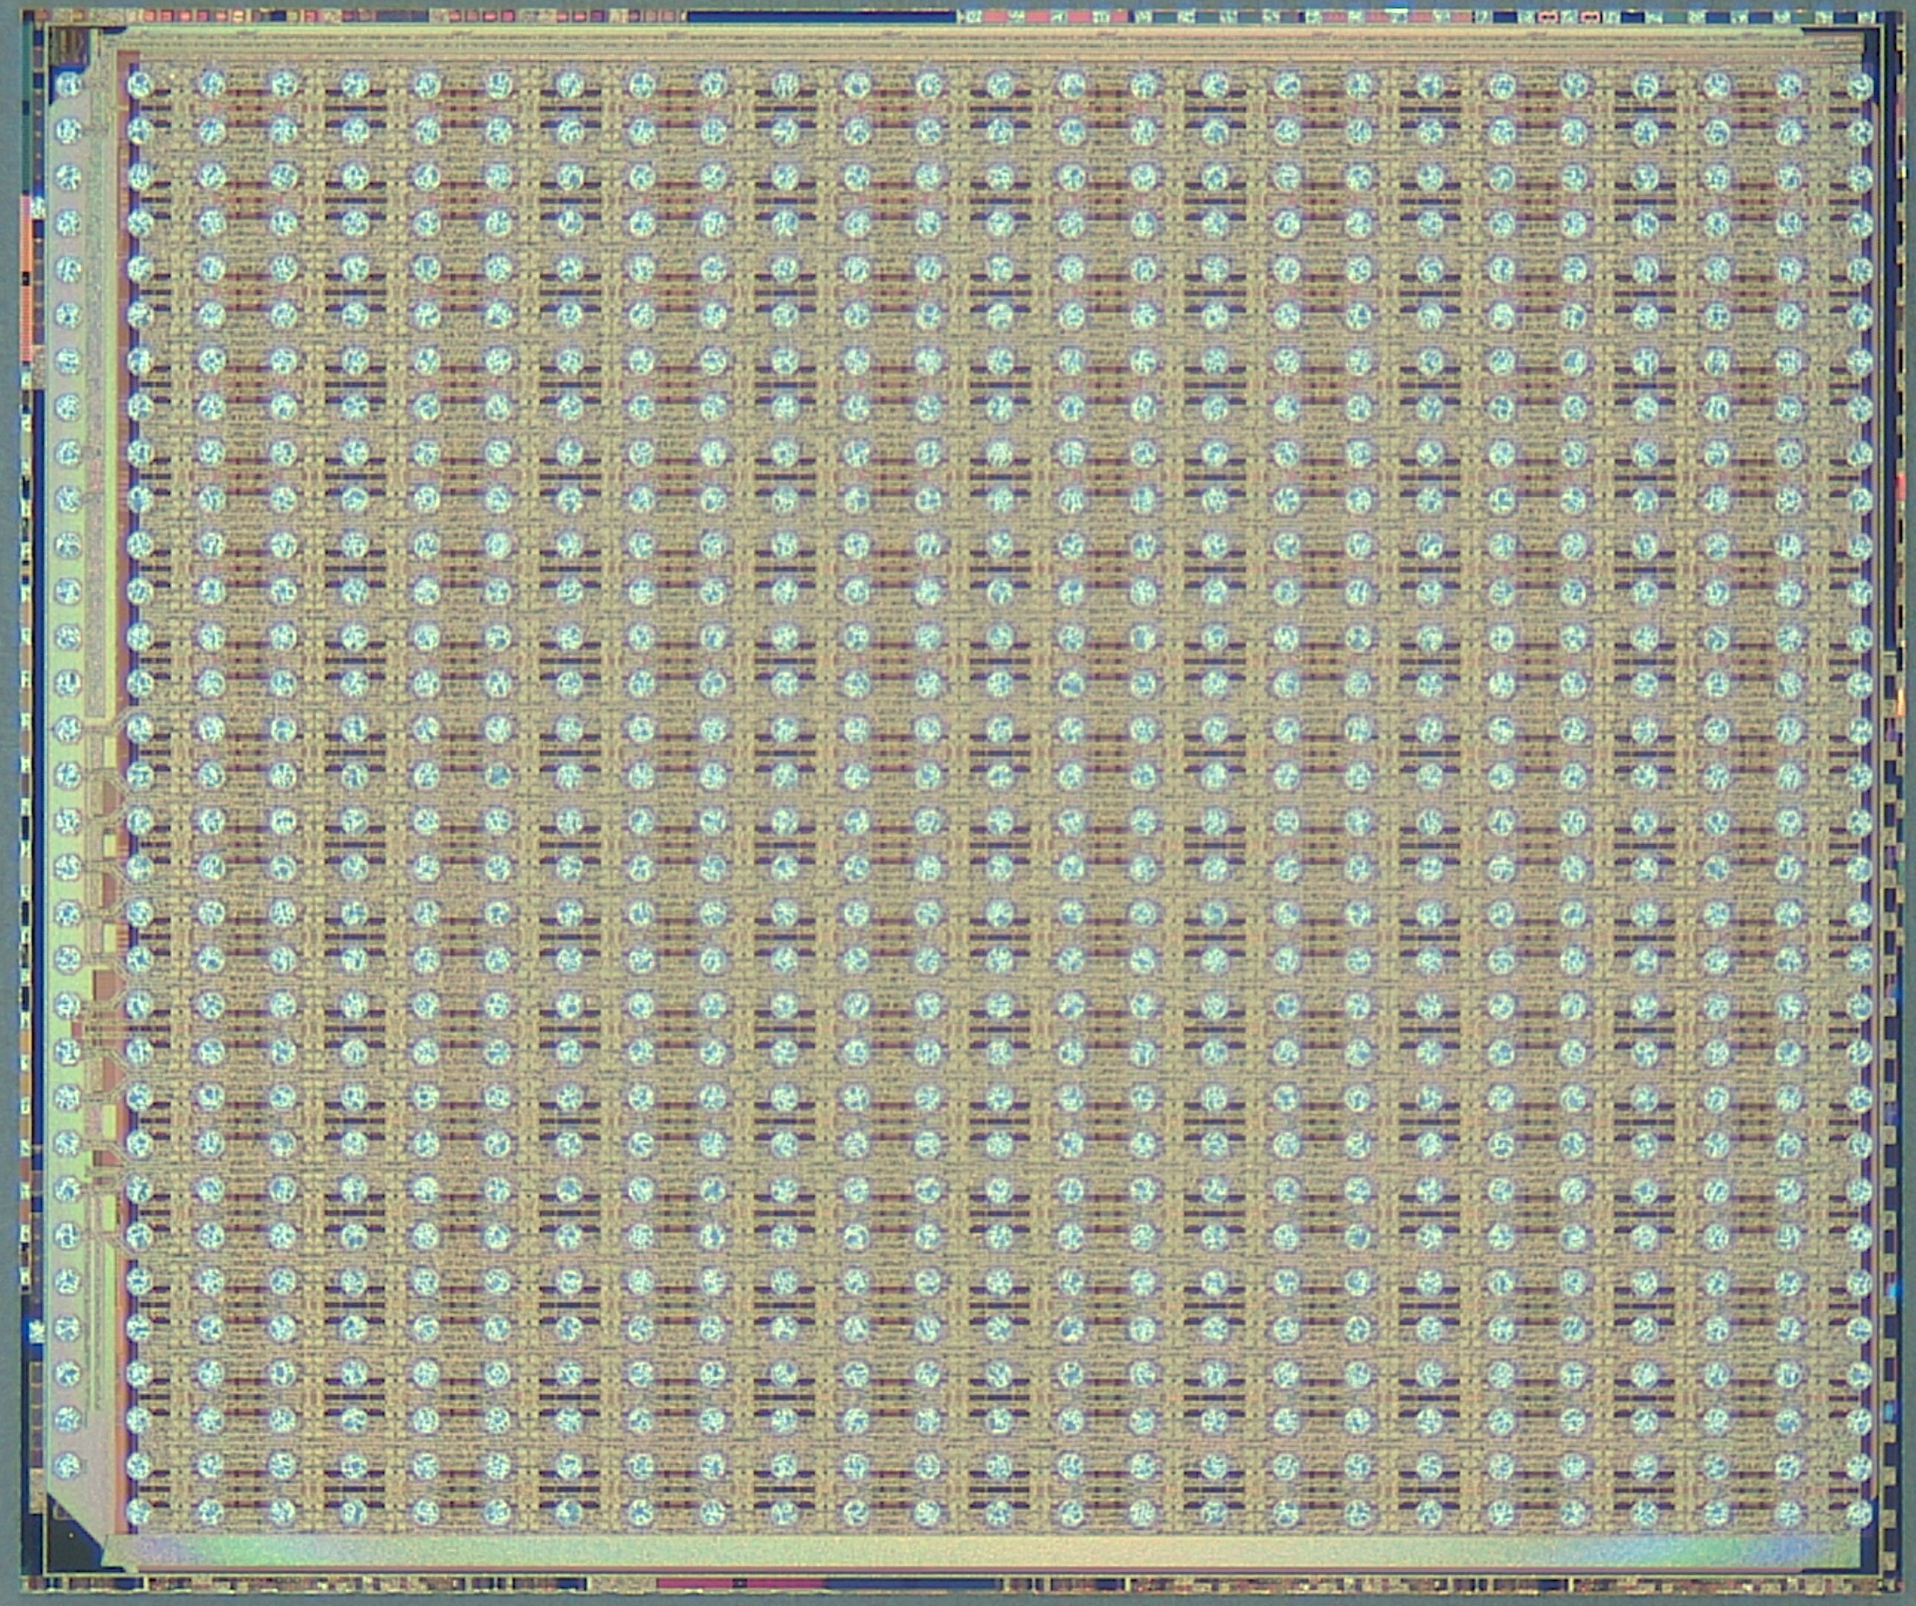
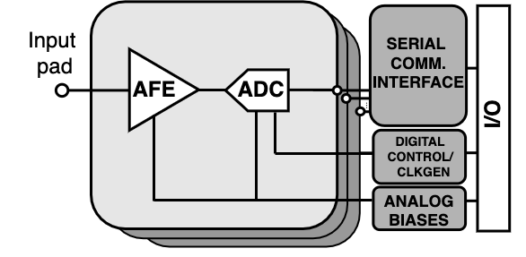
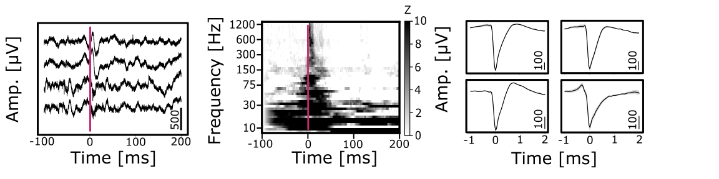


ECHIP2: A 512-Channel Neural Signal Acquisition ASIC for High-Density Electrophysiology
Small and lightweight
- 350mg per module
High channel count
Modularity and scalability
  - scalable to up to 4096 channels
High resolution and low noise
- gain and bandwidth programmable AFE
- 14b 30kS/s per-channel ADC
- 5.4μV noise in the AP band
- 3.1μV noise in the LFP band
Low power
- 244μW per channel

Slide 8

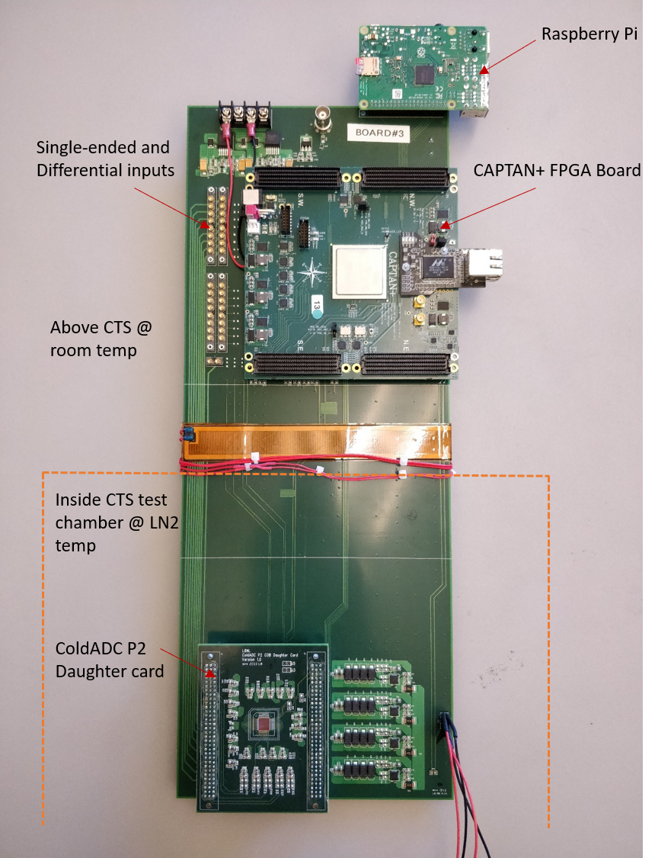
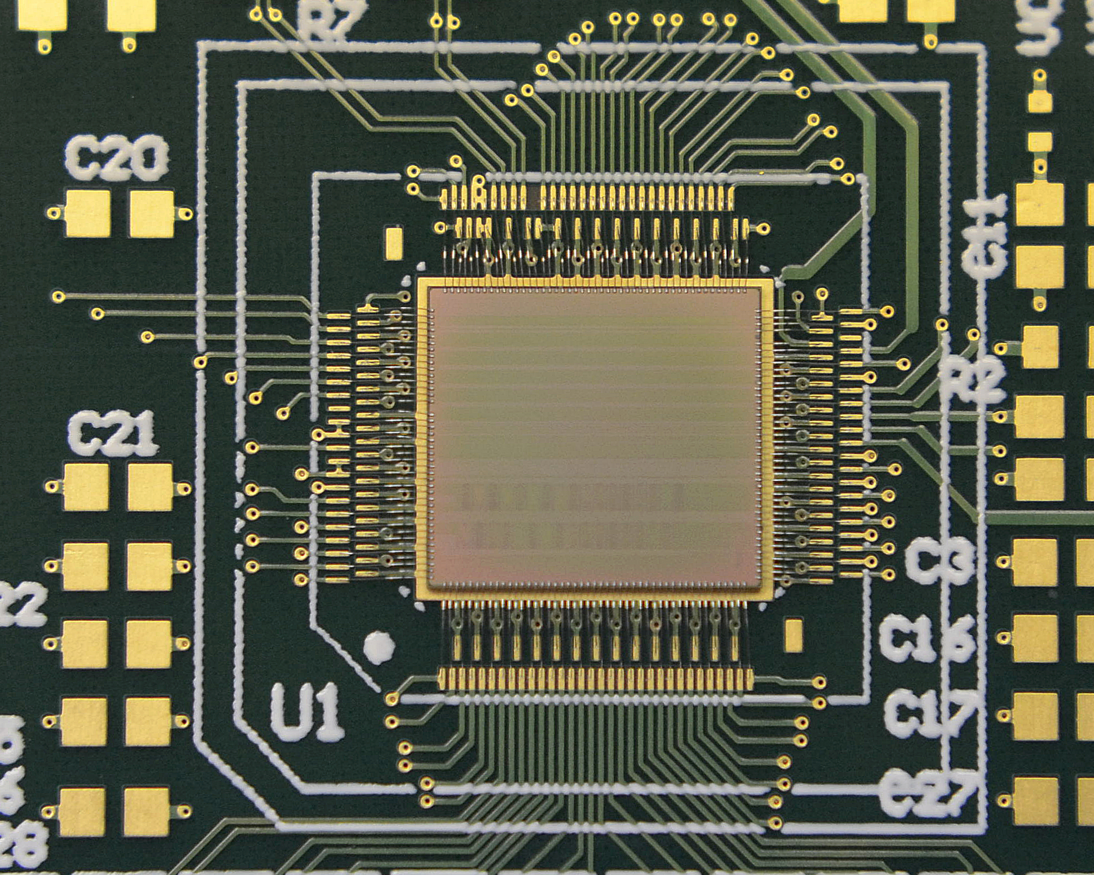
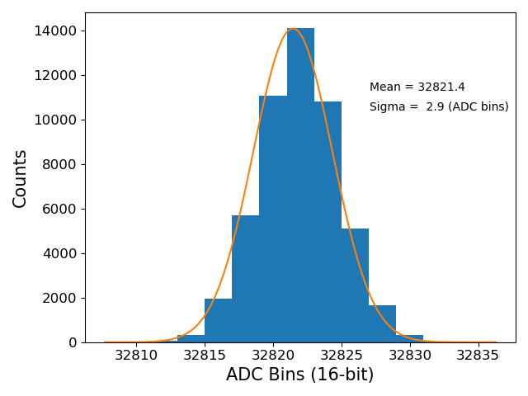
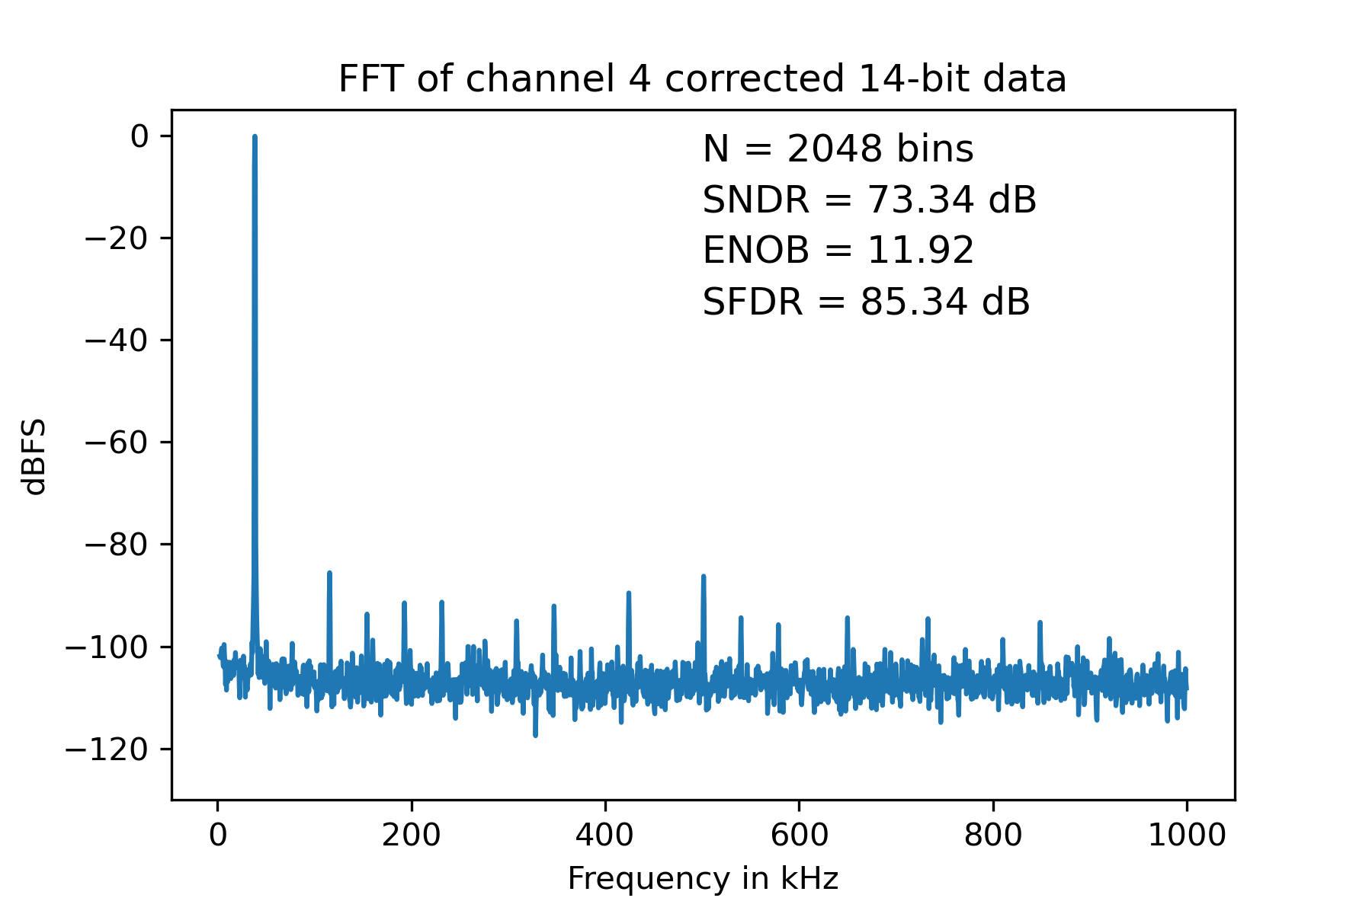
ColdADC: Low-Noise Digitizer for DUNE Far Detector
65 nm CMOS
16-Channel 2 MS/s digitizer with
12b ENOB at LAr temperature (-200 °C). Joint project with FNAL and BNL.
Measured noise = 130 µV-rms
Designed for 30-year reliability with custom cold simulation models

Slide 9
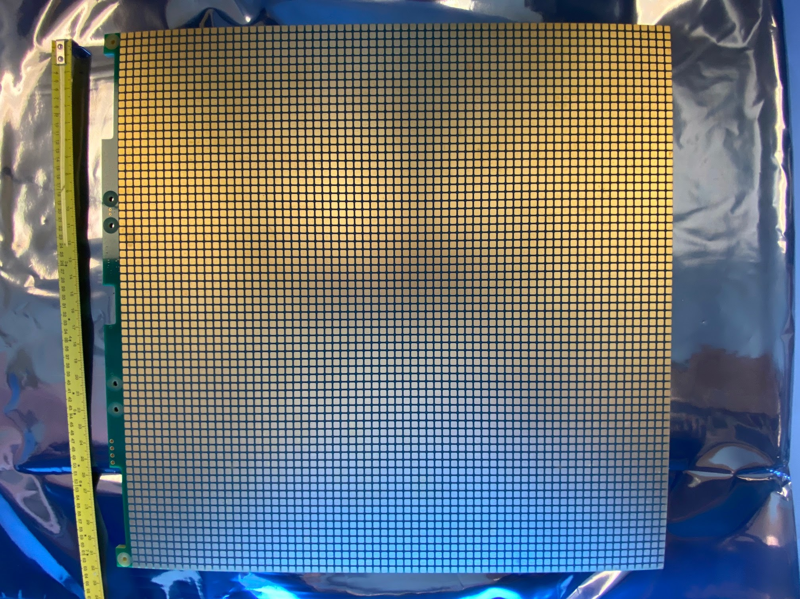
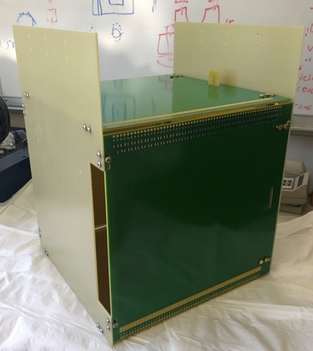
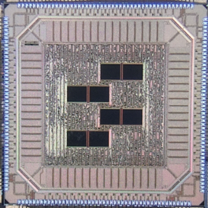
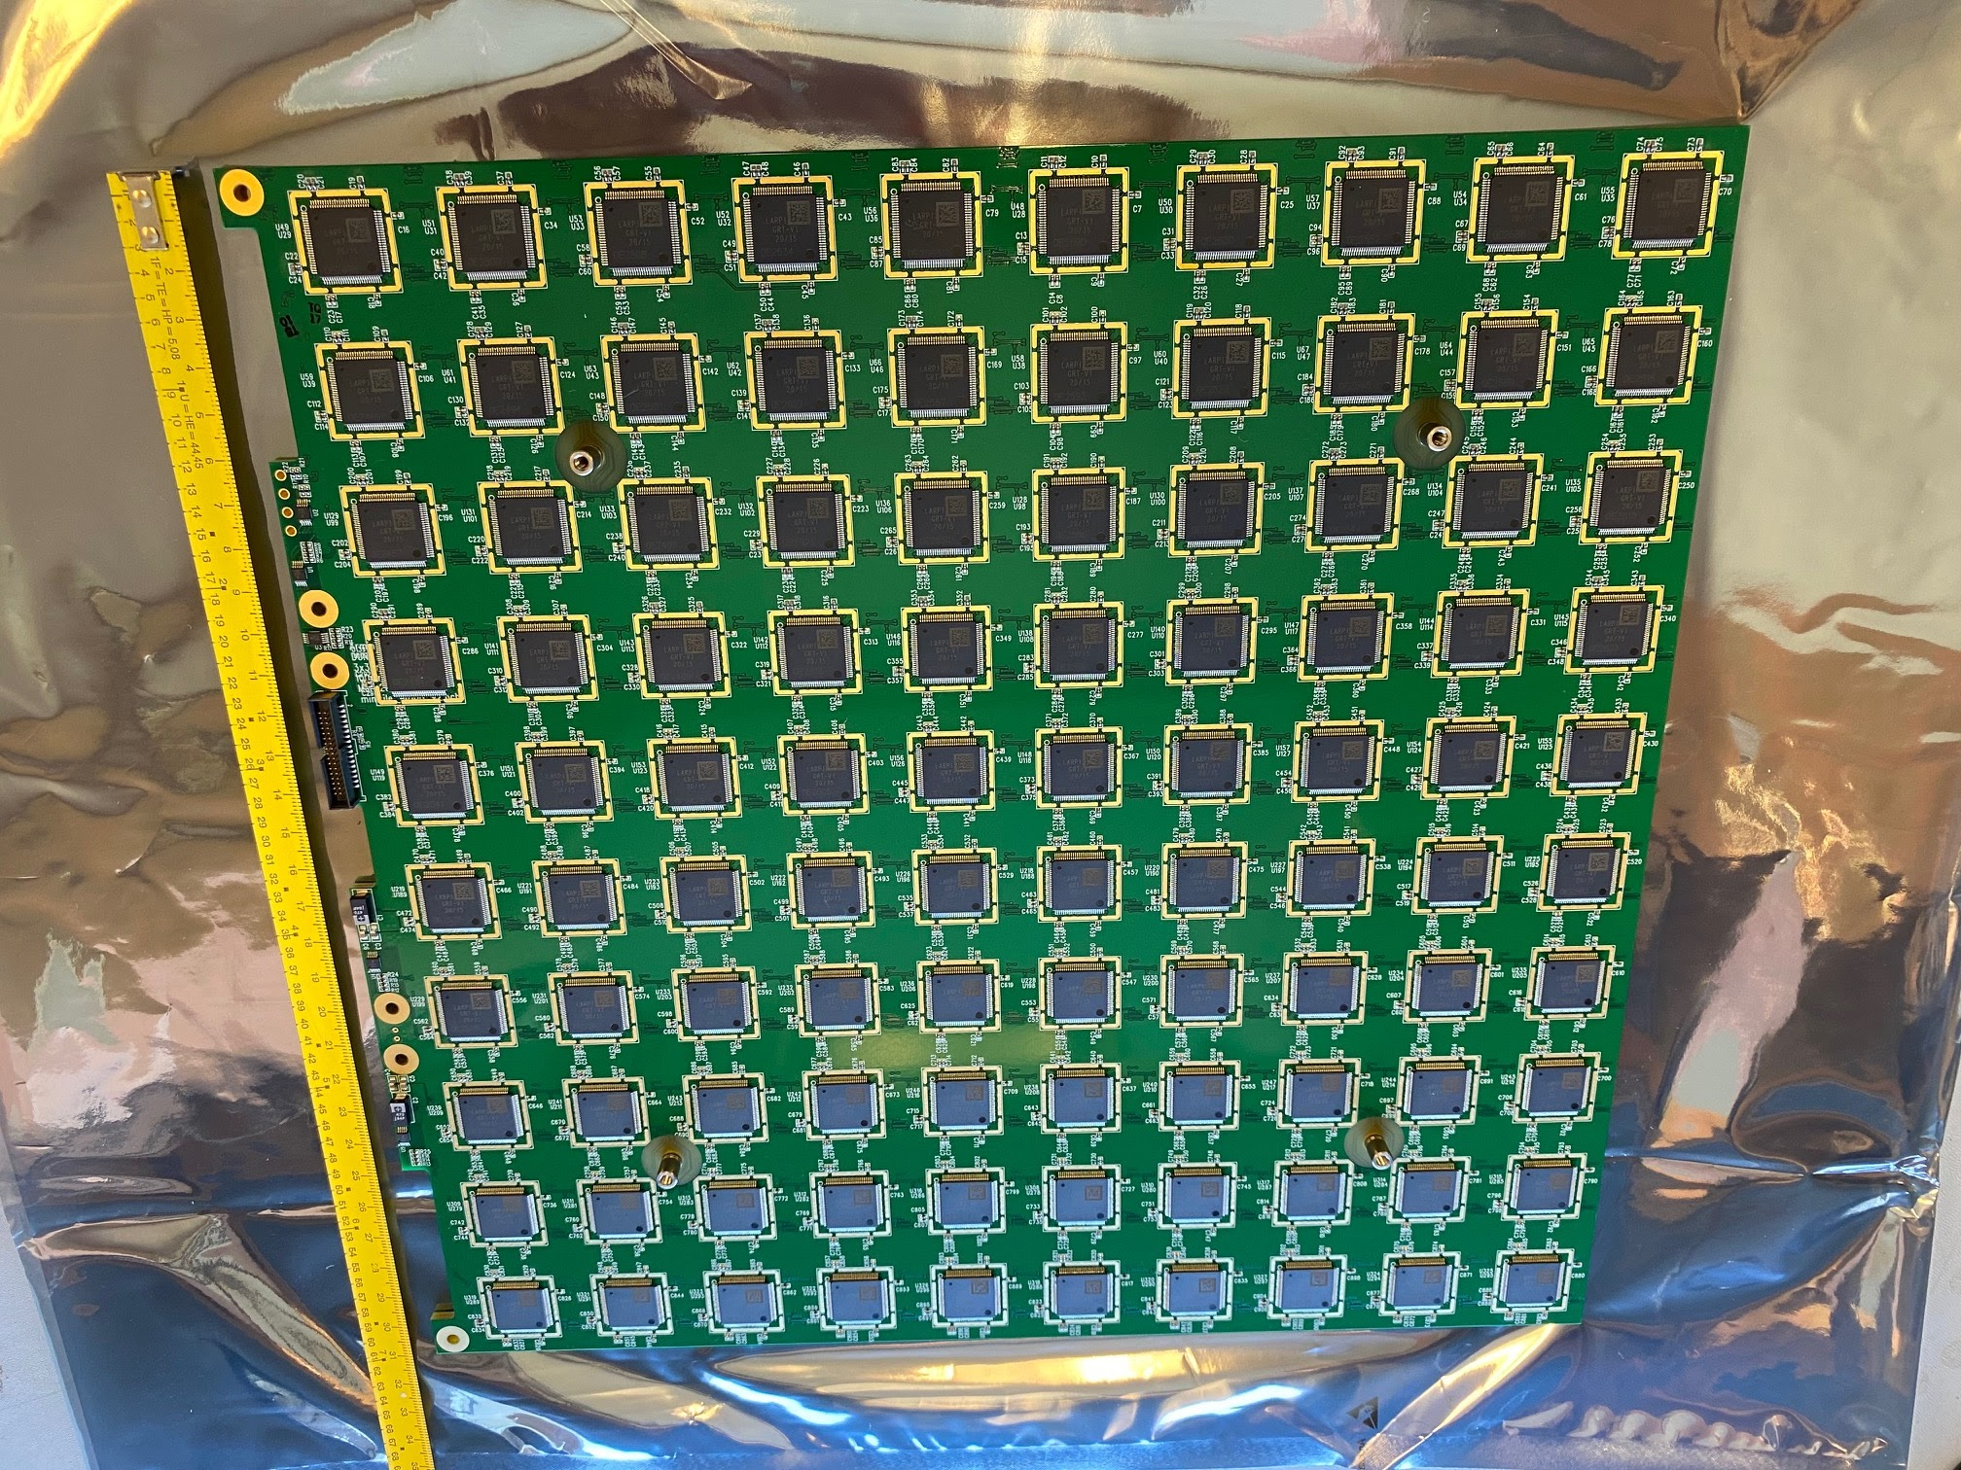
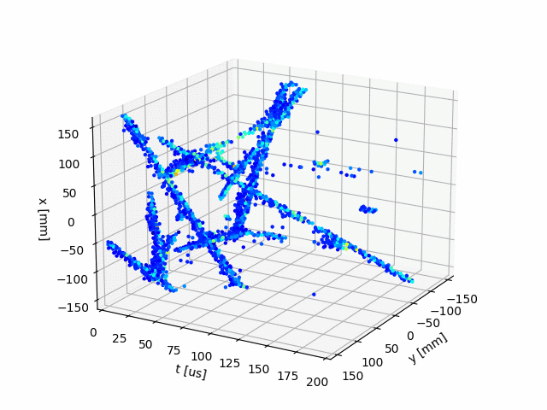
LArPix: Pixelated LArTPC Readout for DUNE Near Detector
Prototype tiles have 100 LArPix ASICs
(30 cm by 30 cm)
ND Tiles will scale to 160 ASICs/tile
64 Channel LArPix ASIC (25 mm²)
180 nm CMOS
10x10 Pixel Tile
8 events

Slide 10
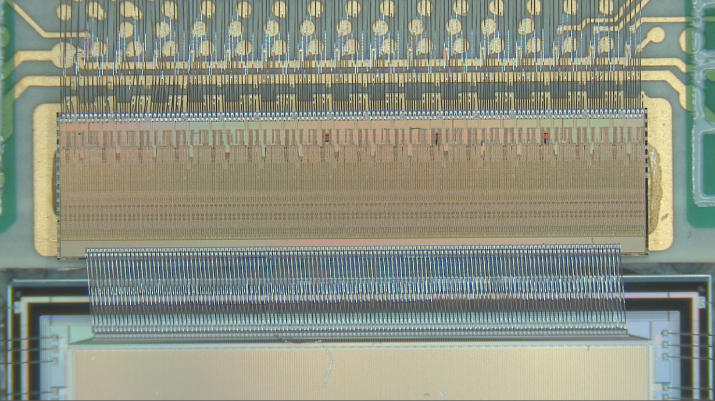
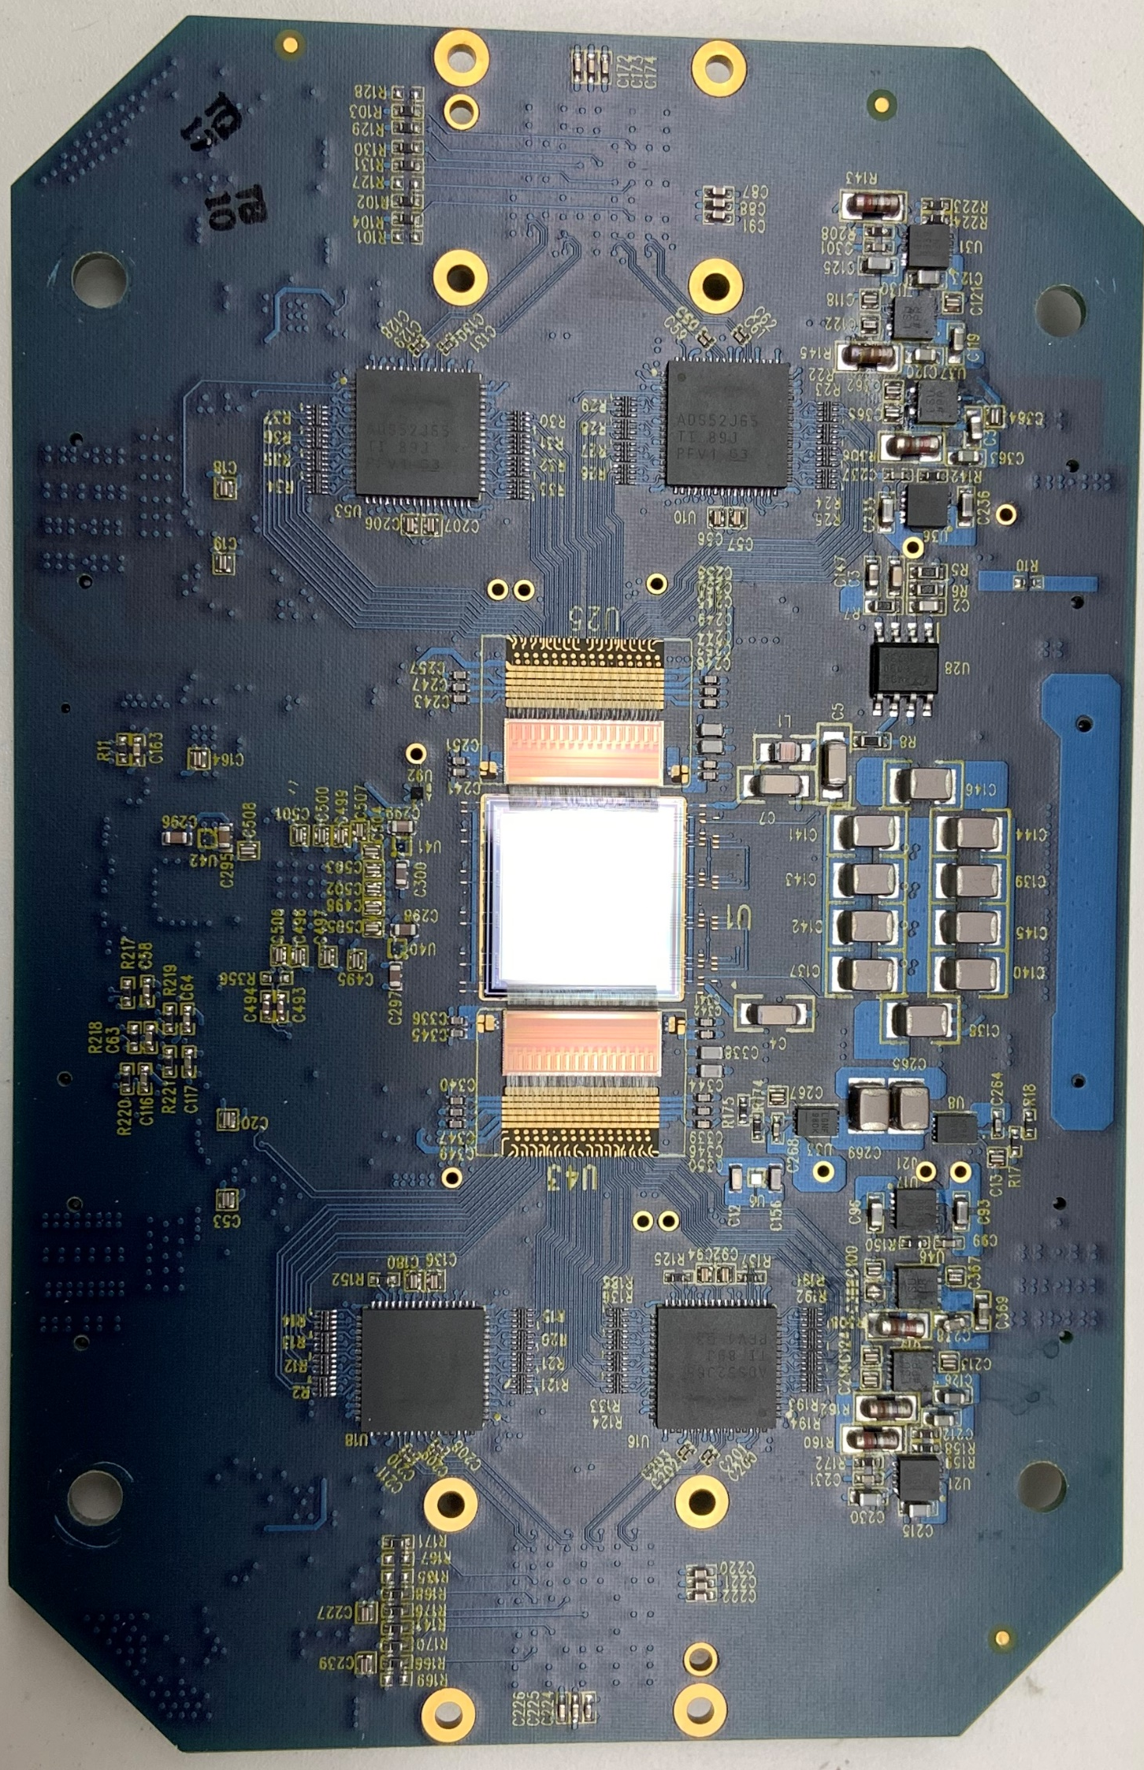
2 Mpixel X-Ray video camera smaller than an iPhone
Camera PCB with 512 readout channels:
VFCCD fully column-parallel
ADC(s)
3.3”
Close-up of VASE/sensor bonding
C. Grace NSS2019
Readout ASIC(s)
VASE2v1 or VASE2v2
(difference is value of C_{F})
4”
CCD
Each VASE2 ASIC comprises 256 channels with CSA and correlated double-sampling
ADC(s) One per 128
CCD columns

Slide 11
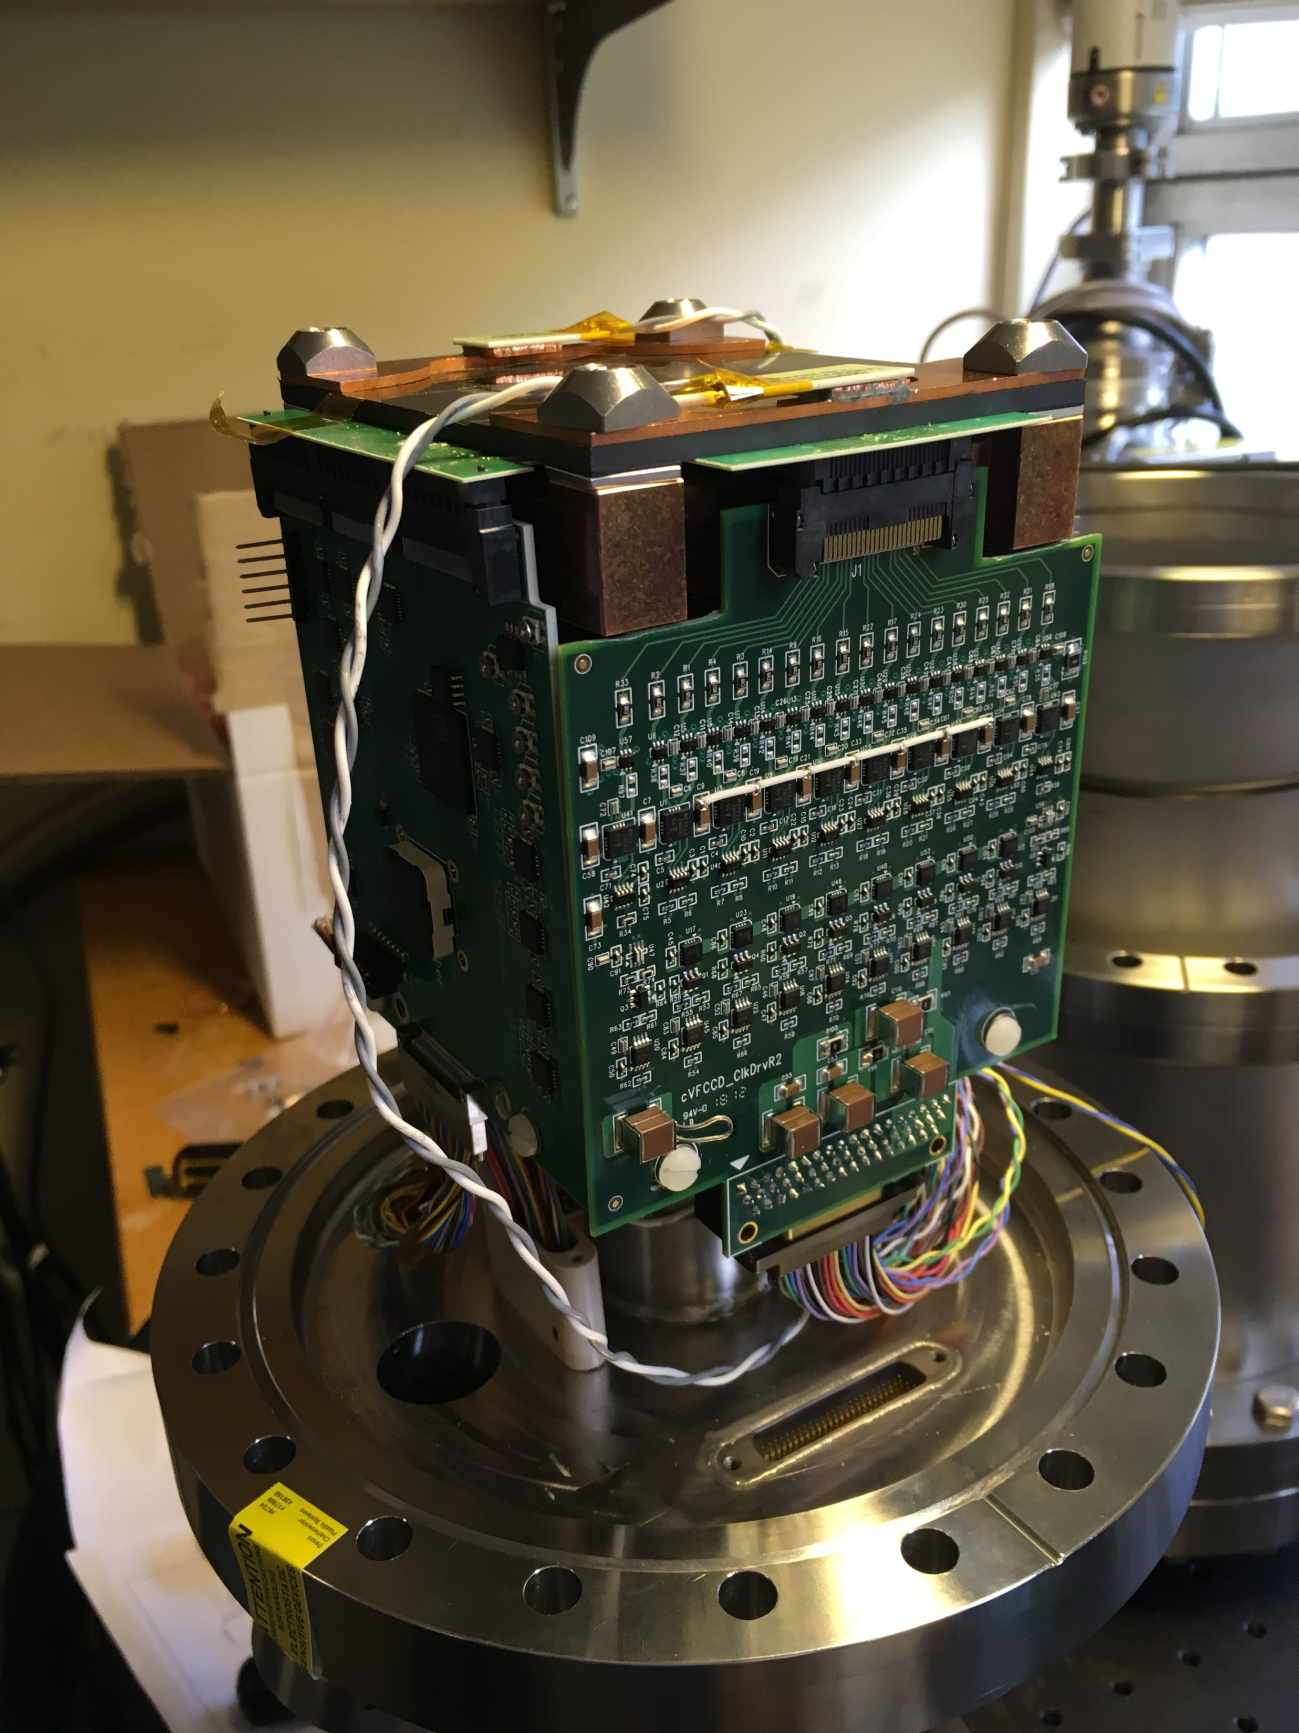
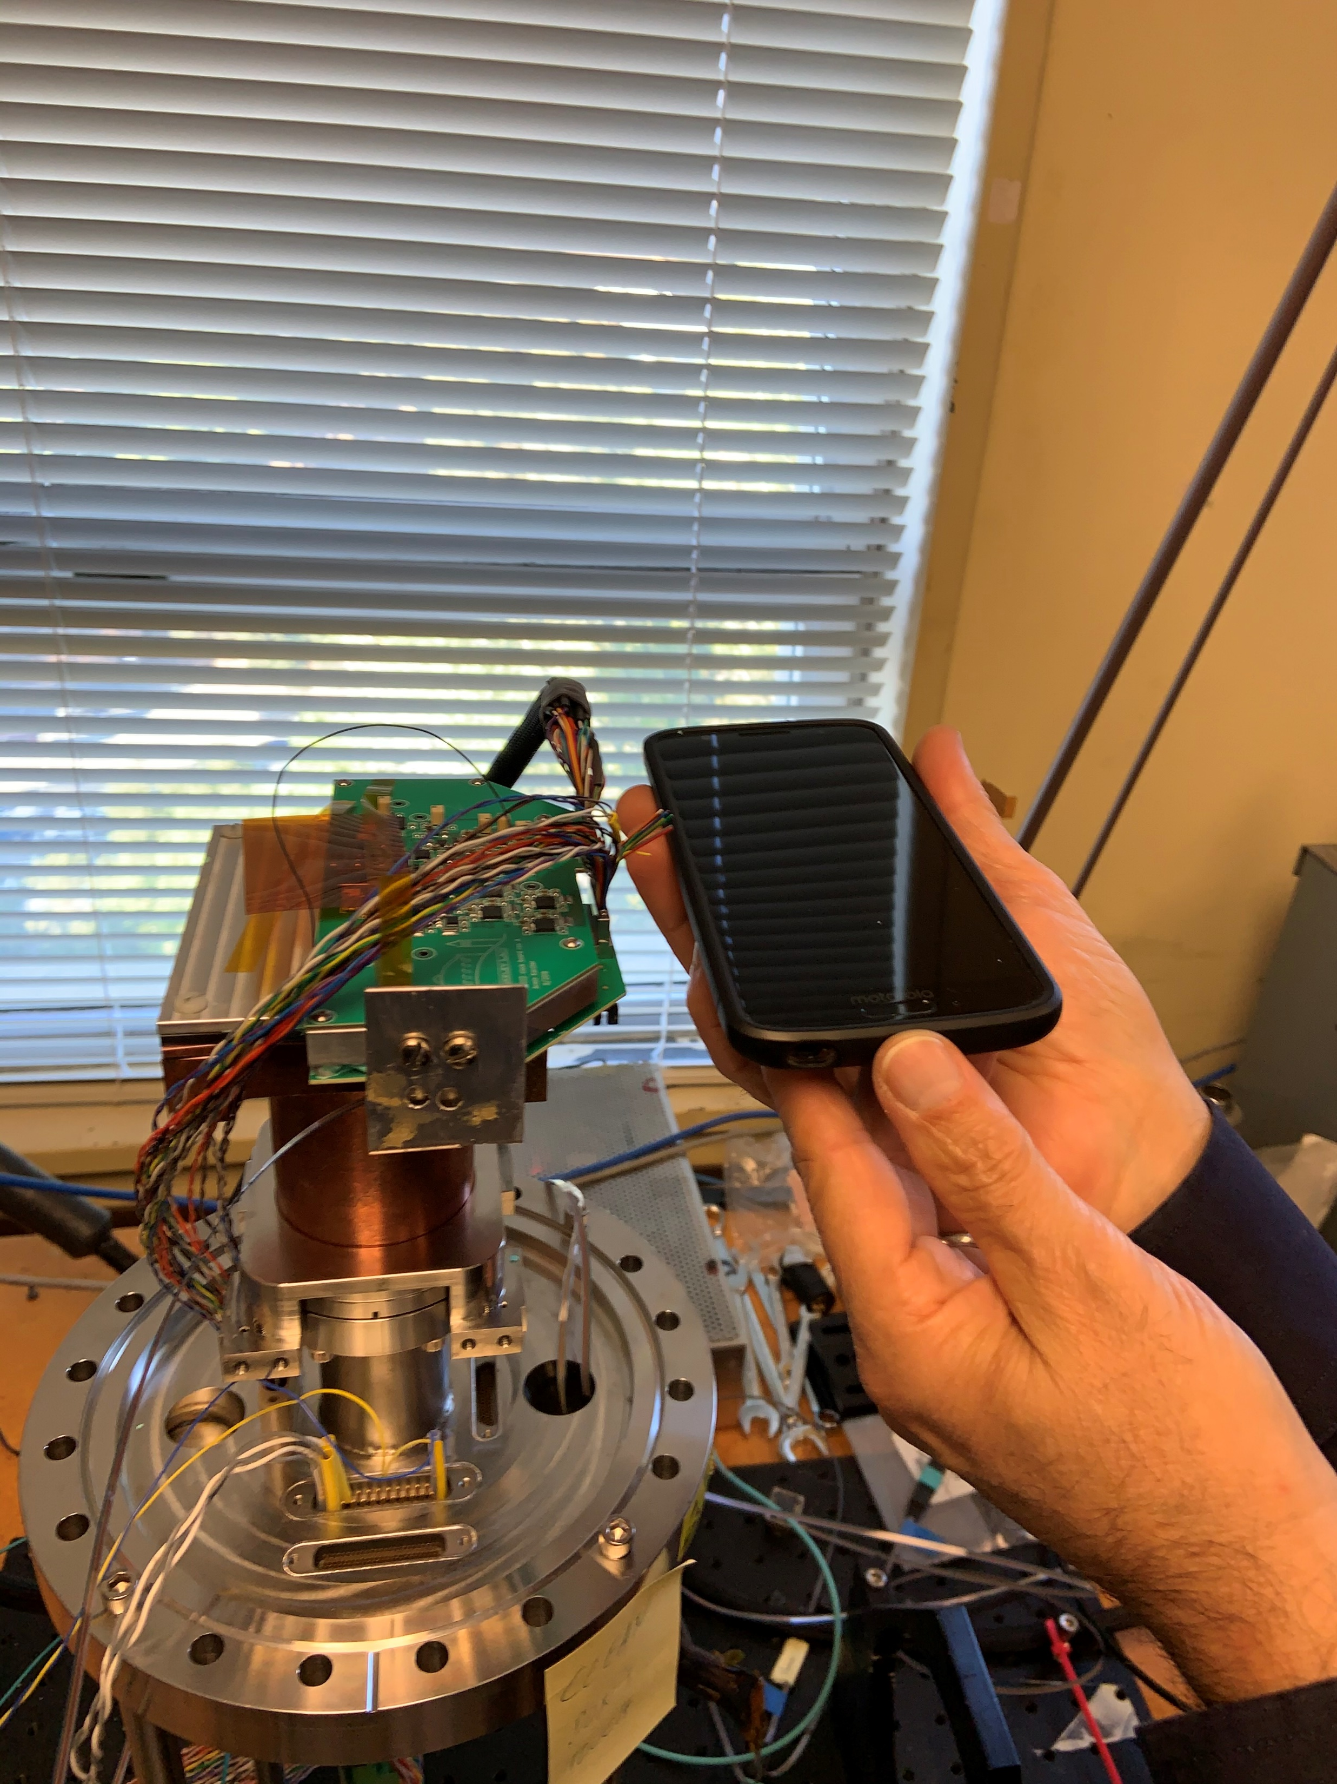
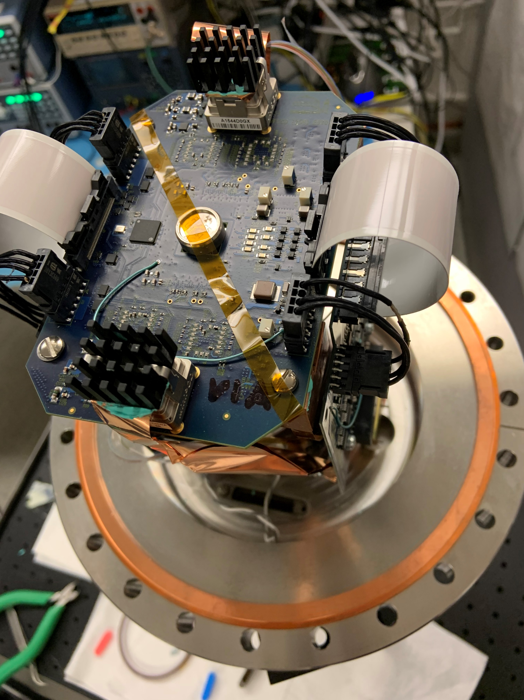
Compact cameras for soft X-ray imaging
Close collaboration with LBNL Electronics Systems group leads to new science capabilities
2018 Camera
2019 iVFCCD
2020 Camera

Slide 12
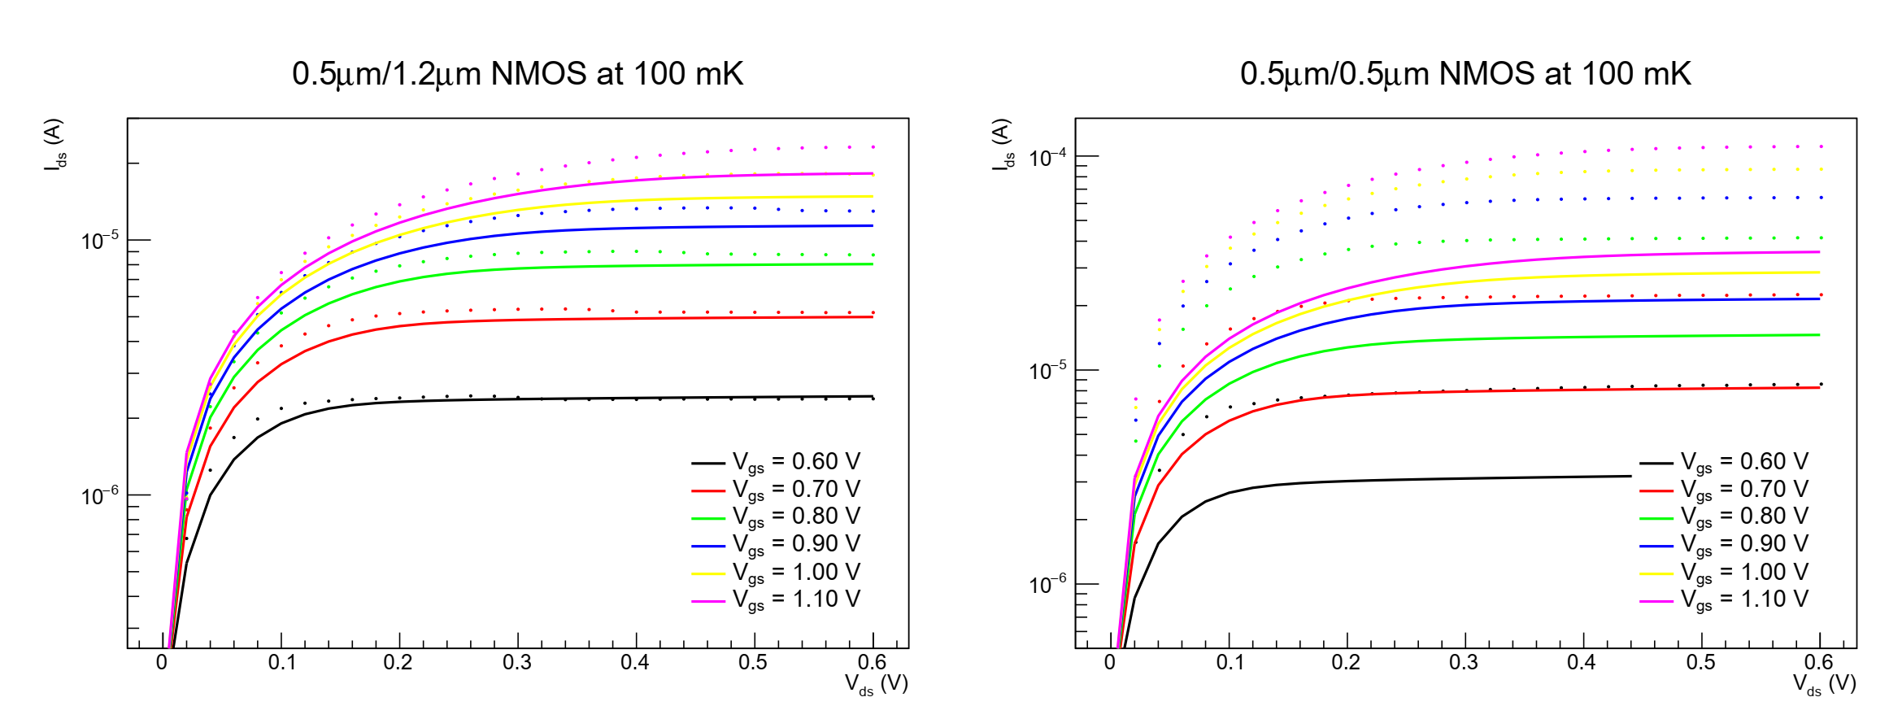
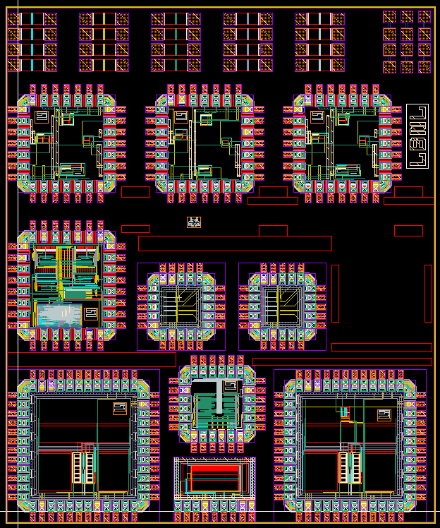
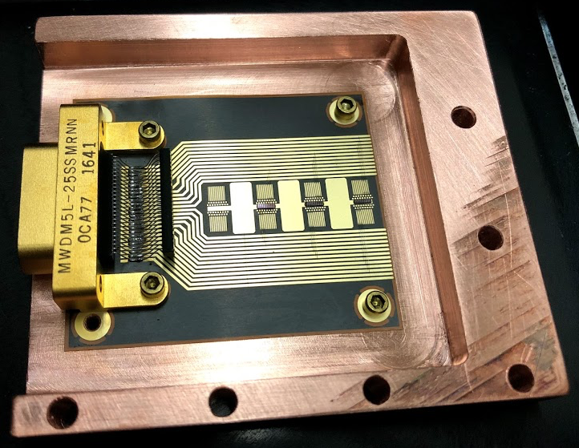
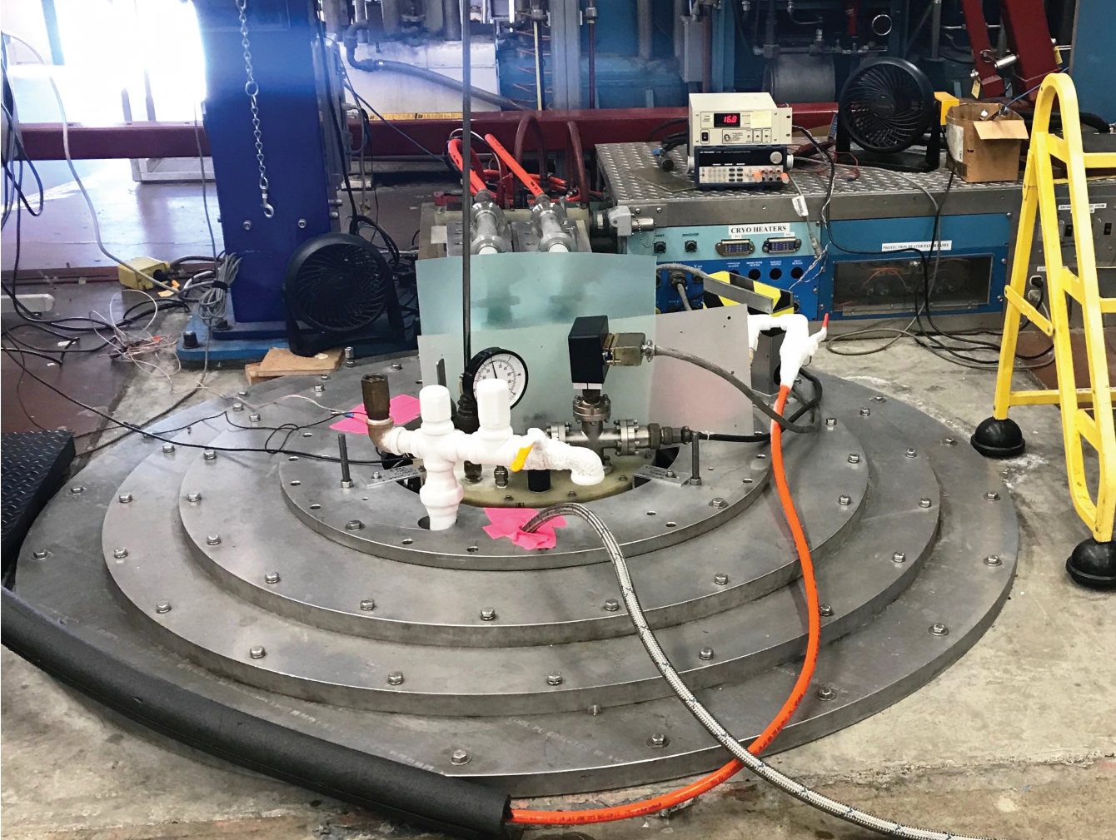
CryoCMOS
NMOS Devices displaying transistor behavior at 100 mK
Focus is on quantum sensor readout
Test setup compatible with temperatures down to approximately 10 mK

Slide 13
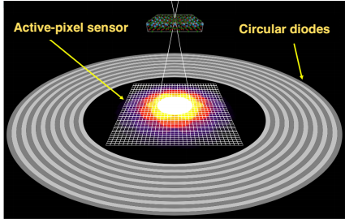
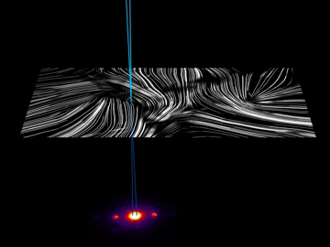
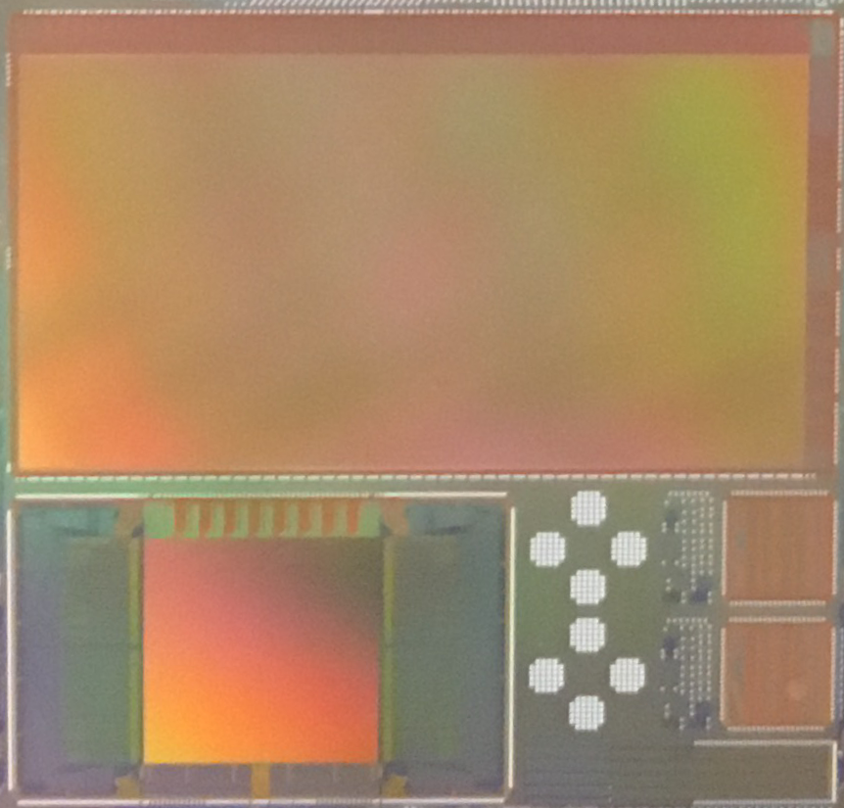
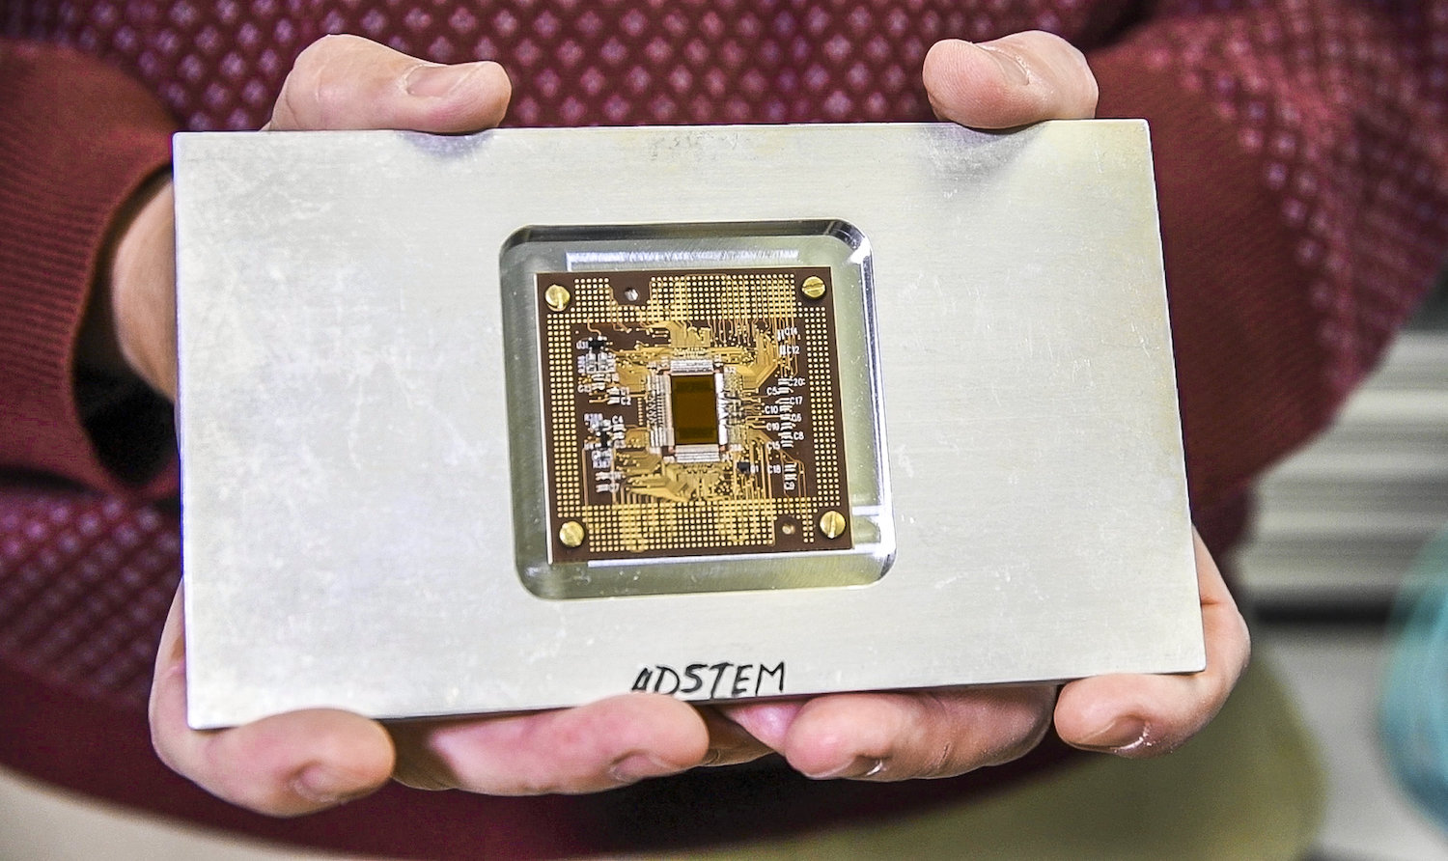

Specialized CMOS sensors
4D-STEM in action (scanning organic semiconductor at NCEM)
QERLIN – Soft X-ray “2D RIXS” detector
4D-STEM concept
Colin Ophus LBNL
4D-STEM camera generates 400 Gb/s data stream with direct fiber optic connection to NERSC
4D-STEM – ultra high-speed electron imager

Slide 14
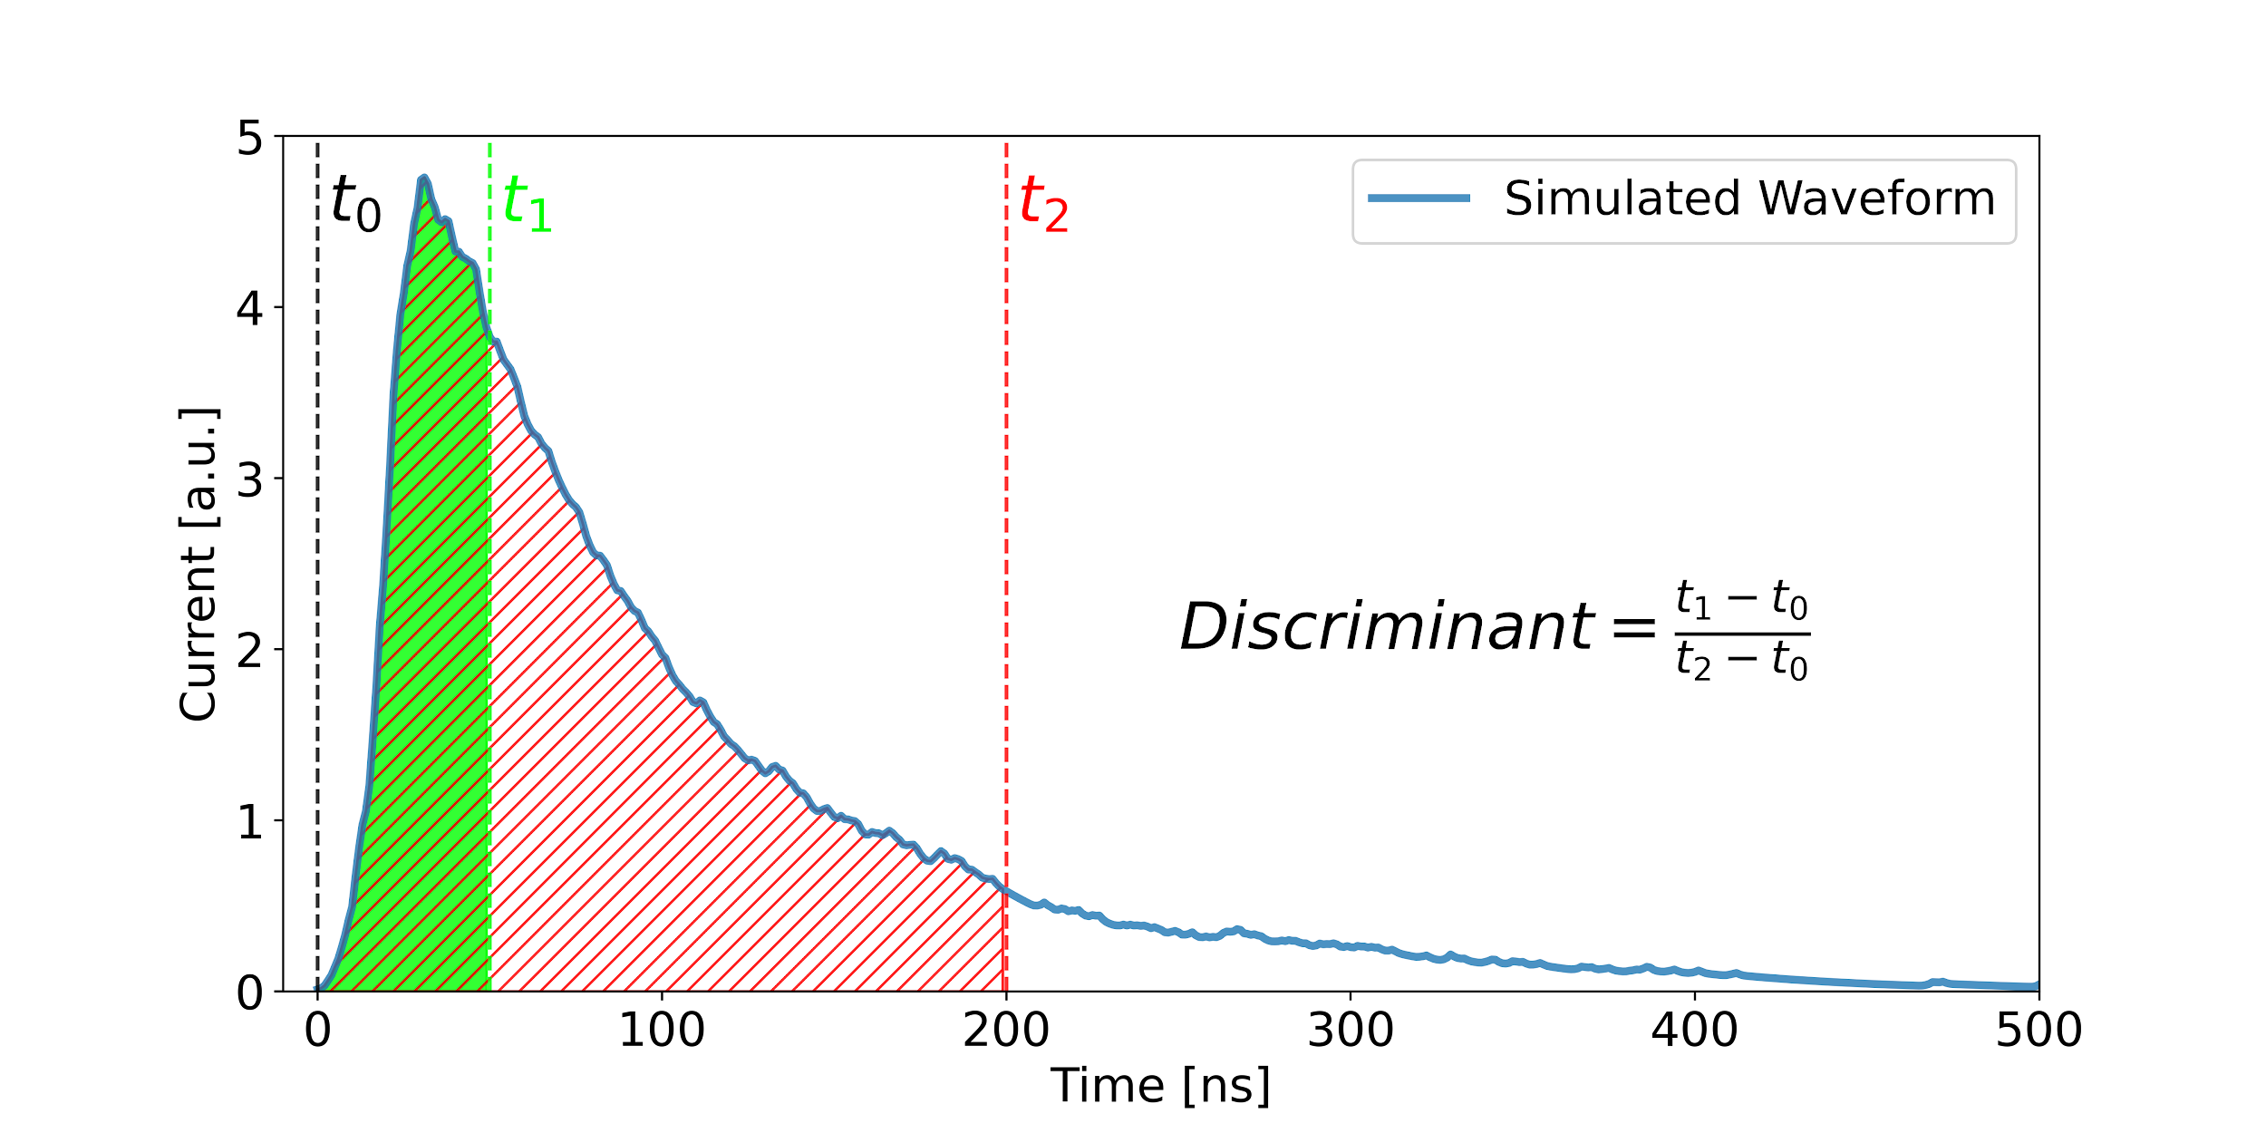
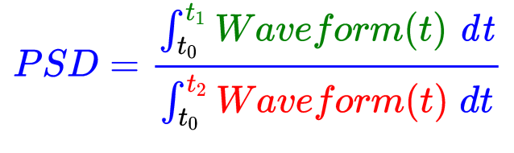
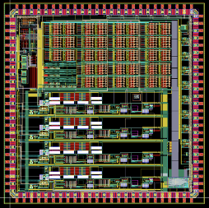
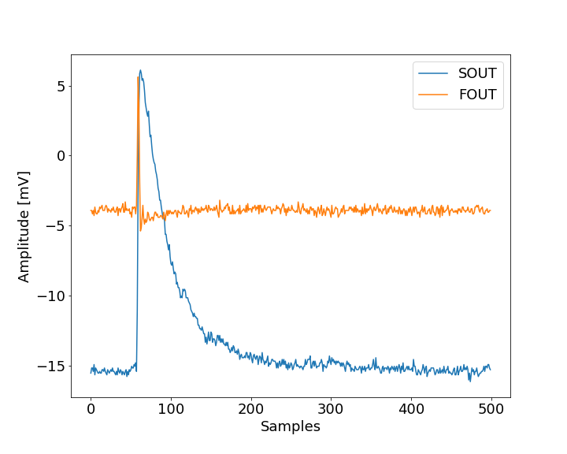
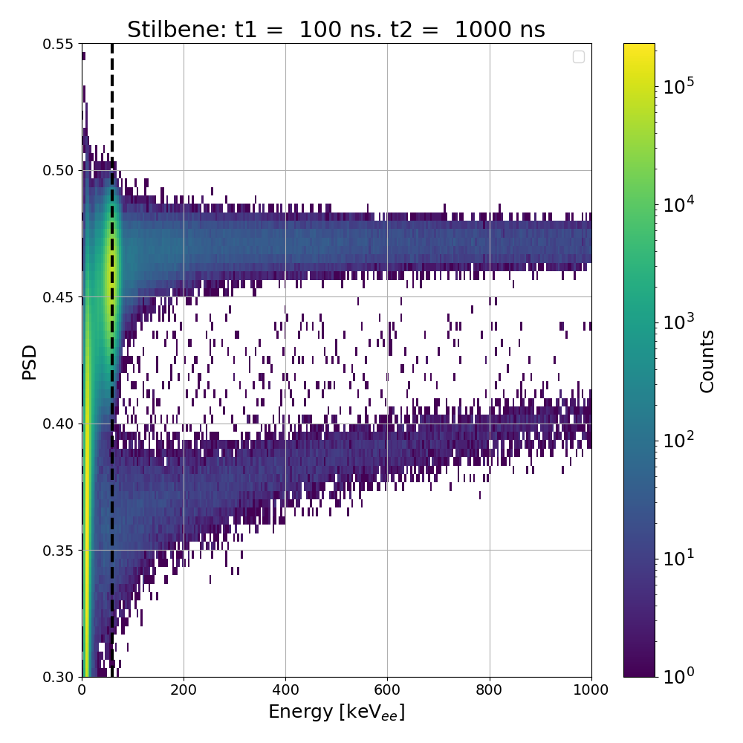
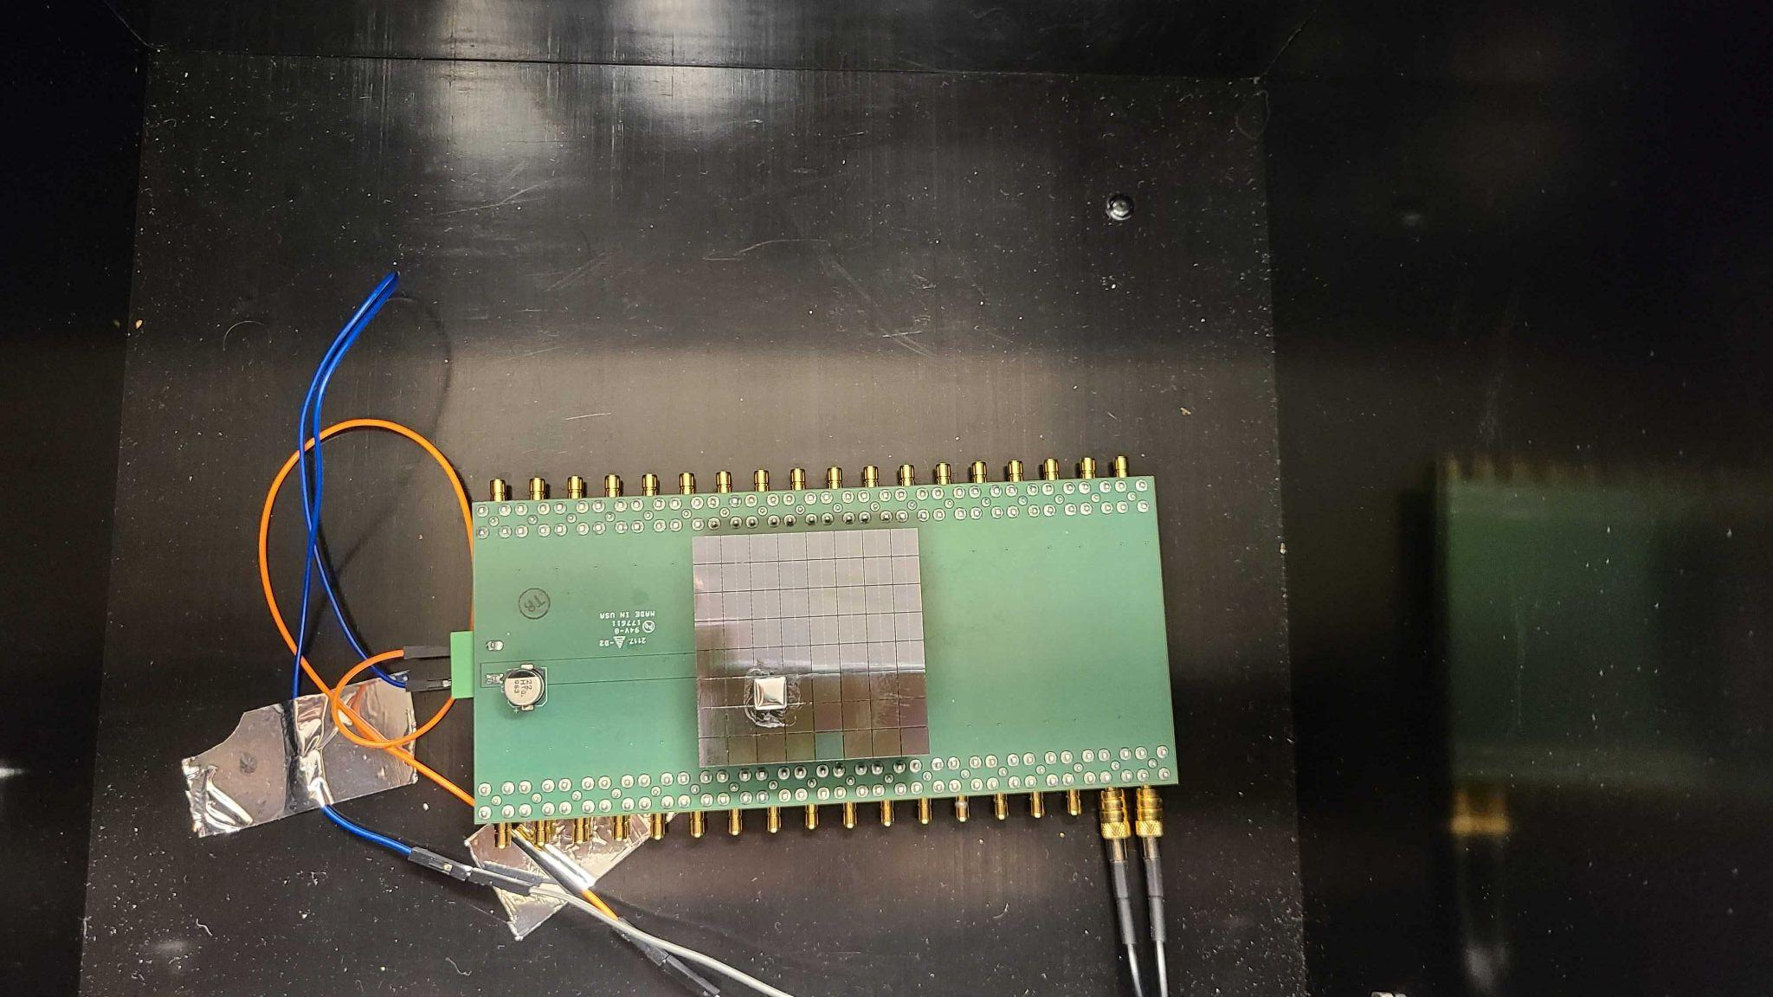

PSD_CHIP: Analog Pulse Shape Discrimination
Readout of scintillator coupled SiPMs. Discriminate between neutrons and gammas but comparing pulse shapes
180 nm CMOS
SiPM response
PSD concept
Joint project with UC Davis
Scintillator discrimination

Slide 15
Contributors
Peter Denes
Dario Gnani
Azriel Goldschmidt
Carl Grace
Jyothisraj Johnson
John Joseph
Armin Karcher
Amanda Krieger
Katerina Papadopoulou
Tarun Prakash
Thorsten Stezelberger
Craig Tindall
Panos Zarkos
LBNL Integrated Circuits Group
LBNL Semiconductor Detectors Group
LBNL Electronic Systems Group
LBNL Molecular Foundry

Slide 16
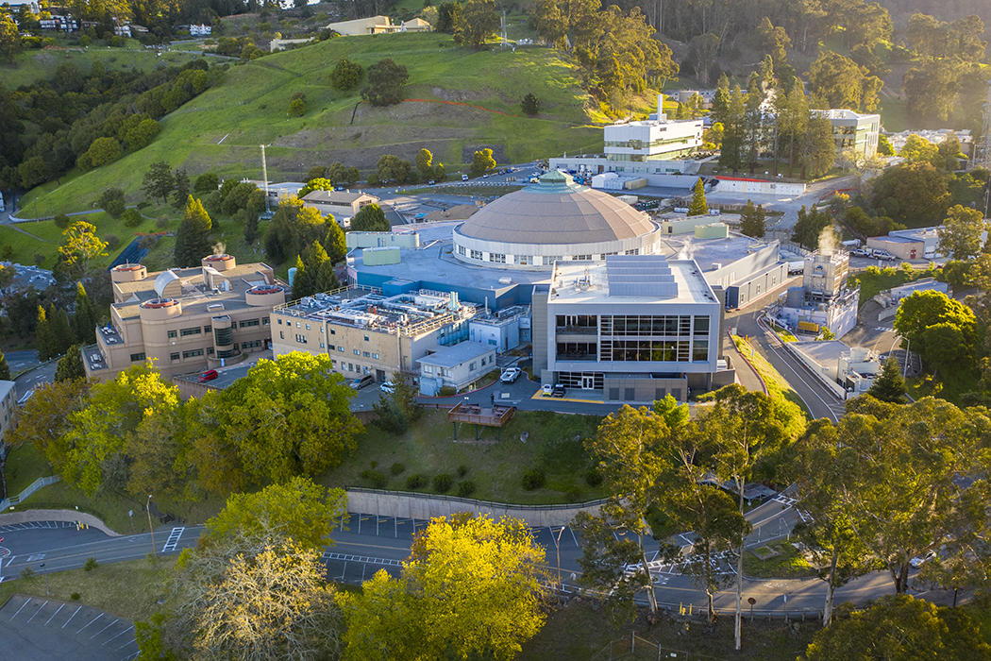
Thank You
This work was supported in part by the U.S. Department of Energy under Contract No. DE-AC02-05CH11231

