Slide 1
Cryogenic Instrumentation – DUNE Perspective
Carl Grace 05/19/2022 HEP-IC 2022
Lawrence Berkeley National Laboratory

Slide 2
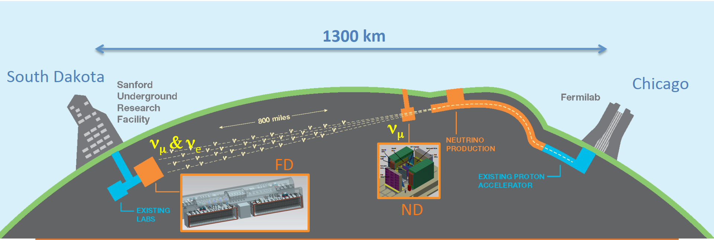
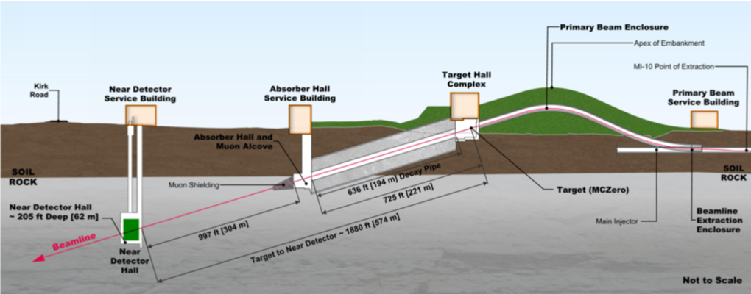
The DUNE Experiment
The Deep Underground Neutrino Experiment (DUNE) is an international science collaboration focused on neutrinos
Key Purpose:
Enable the search for CP Violation
Help us understand the matter/antimatter
imbalance of the universe.
LBNL is leading the development of the Near Detector (ND) and has an important role in the cold electronics for both the ND and Far Detector (FD).
Neutrinos have a mean-free-path of 60 light years in water so extremely intense beam and dense detector material (Liquid Argon) needed
Illustration courtesy LBNF

Slide 3
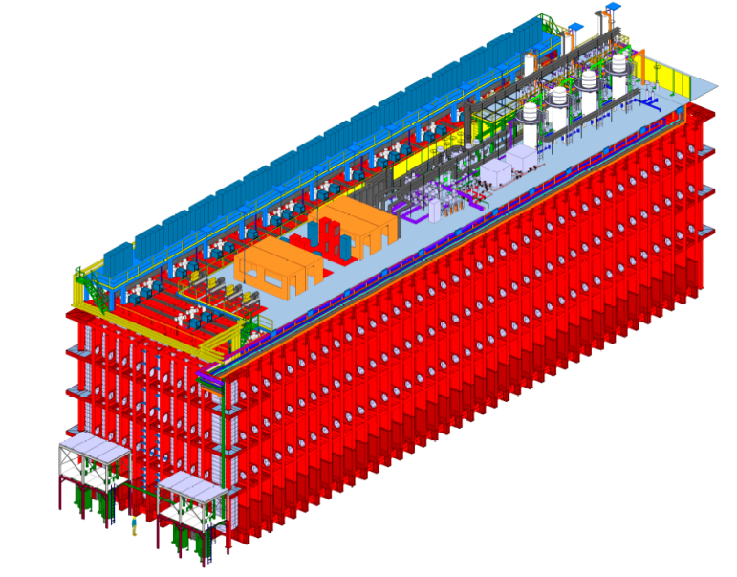
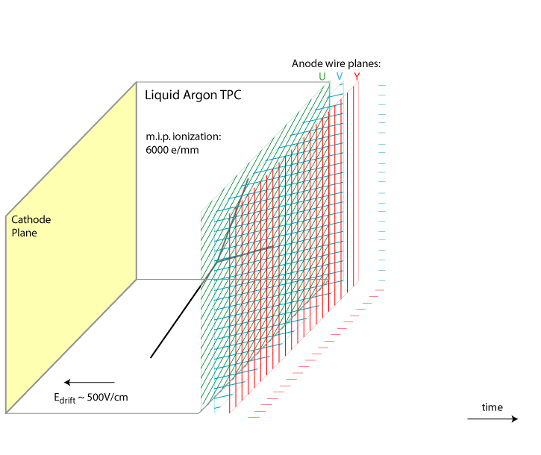
DUNE Far Detector
Fiducial volume of each detector is 10 kTon (17.5 kTon total mass)
Liquid Argon (LAr) is detection medium
TPC size: 12.0 m x 14 m x 58.2 m
Single-Phase module
JINST 15/T08010
Bo Yu (BNL)

Slide 4
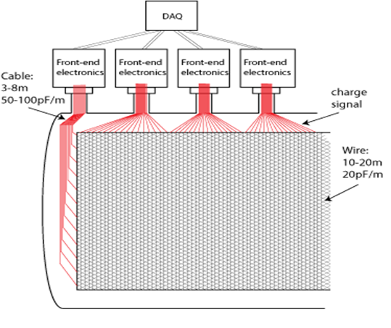
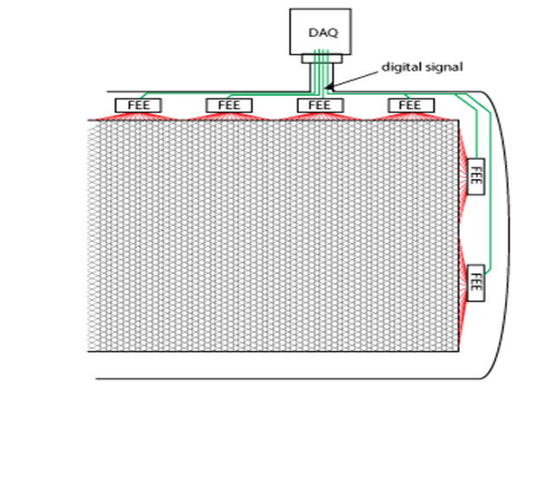
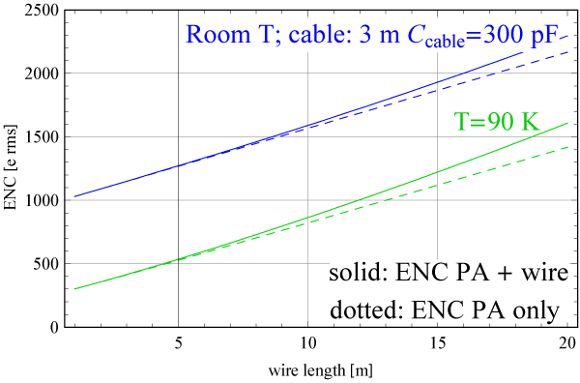
DUNE Far Detector – Scaling & Low Noise
Warm Electronics
Cold Electronics
JINST 15/T08008
Immersing CMOS electronics in LAr greatly reduces the cabling capacitance, allowing lower achievable noise, and serves as an enabling technology for DUNE

Slide 5
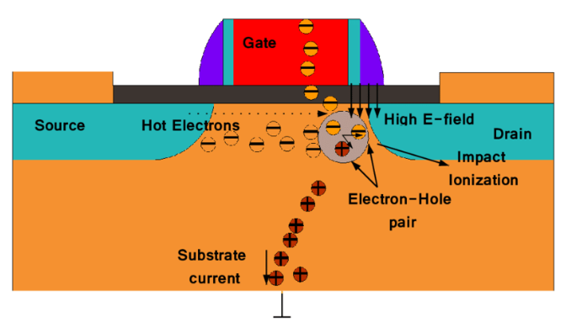
Key Electronics Challenge: Long-Term Reliability
Reliability and biasing drift
BNL and FNAL conducted lifetime studies and developed design guidelines to assure long-term reliability
UPenn and FNAL developed a cryogenic compatible standard cell library for 65nm CMOS
E. Afacan Thesis, 2016
“Hot” carriers cause early device aging

Slide 6
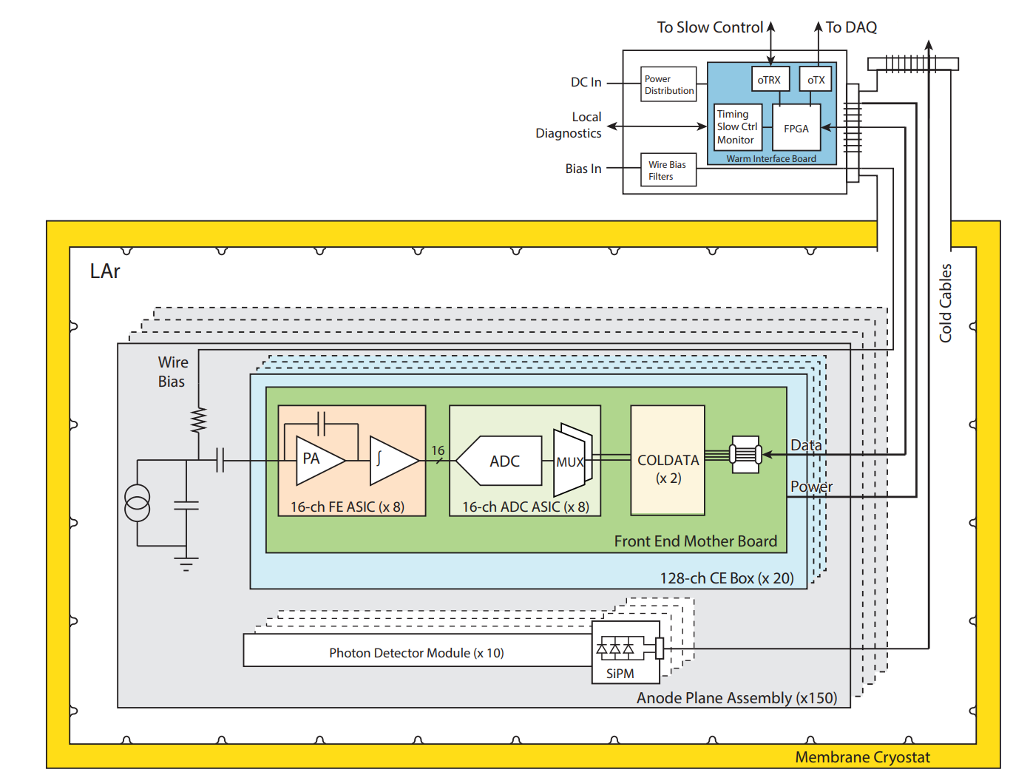
The DUNE Far Detector Electronics
Charge collection system uses 3-chip solution
LArASIC – 16 channel preamp
Cold ADC – 16 channel ADC
COLDATA – data aggregator and high-speed digital communications
All chips are immersed in LAr and have a 30-year required lifetime
24000 LArASIC, 24000 ColdADC, and 6000 COLDATA ASICs are required to instrument a Far Detector Single-Phase Module
JINST 15/T08010

Slide 7
DUNE Far Detector (LArASIC)
LArASIC requirements:
low noise : approximate ENC of 450 e⁻ with 1 µs shaping
low power (to not boil LAr) : 5.5 mW per channel achieved
16 channels
Ability to instrument both induction and collection wires

Slide 8
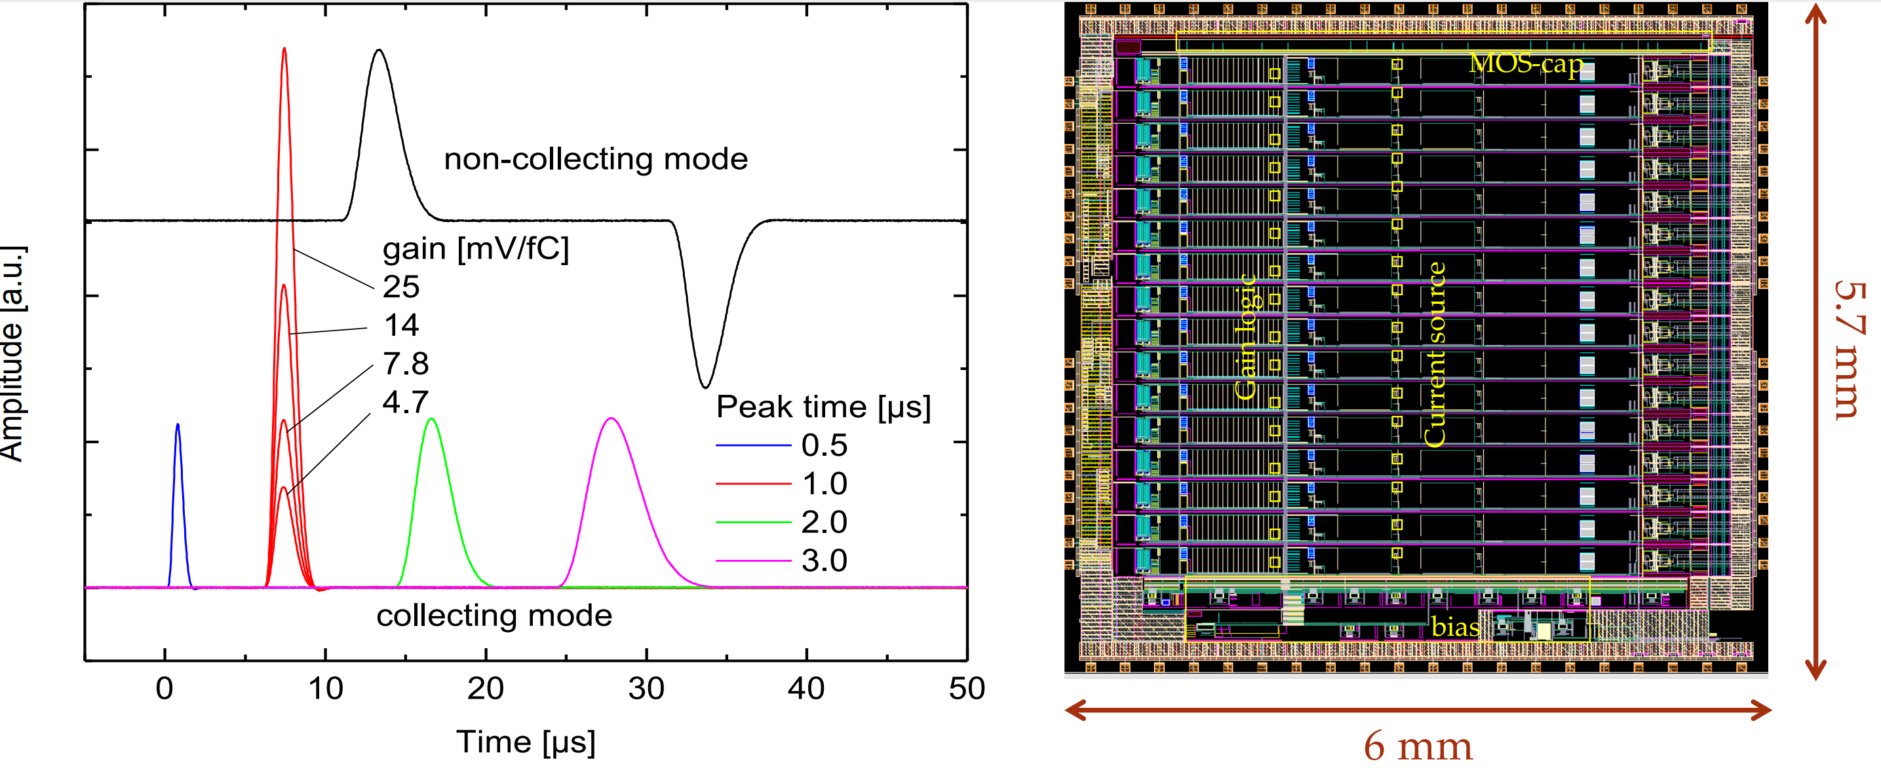
DUNE Far Detector (LArASIC)

Slide 9
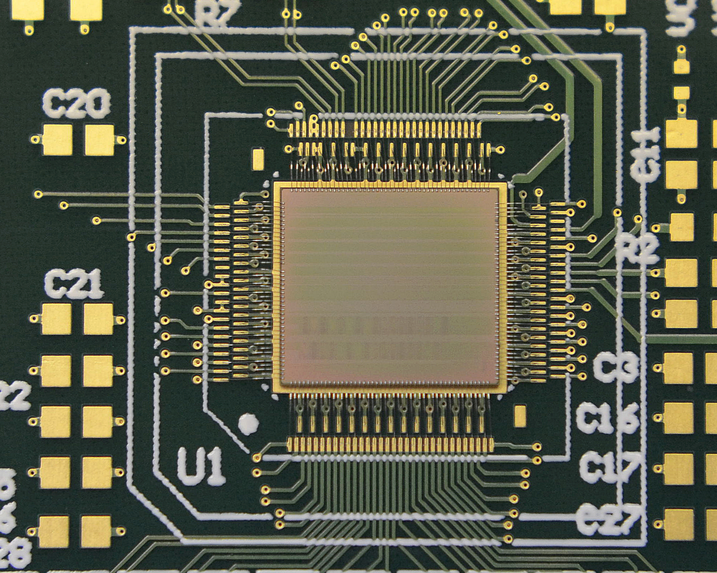
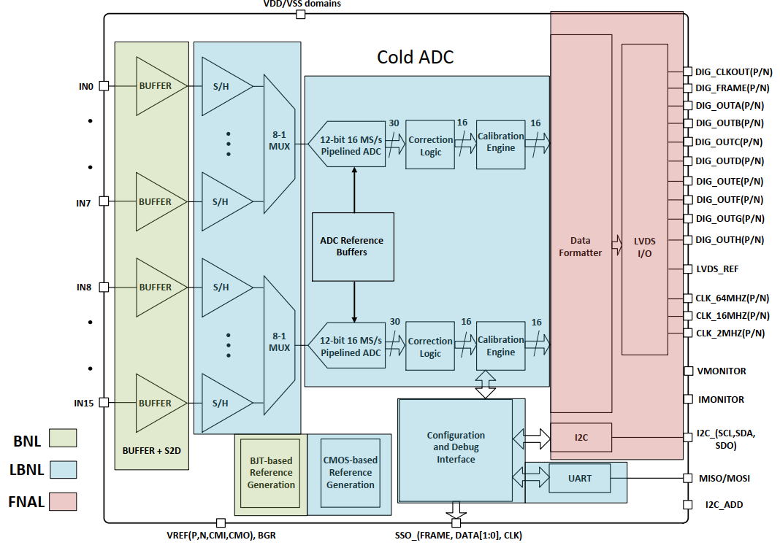
DUNE Far Detector (ColdADC)
Three-lab collaboration (LBNL, FNAL, and BNL) developed ColdADC to read out LArASIC in the DUNE Far Detector
65 nm CMOS
Functional Block Diagram
IEEE TNS 2022

Slide 10
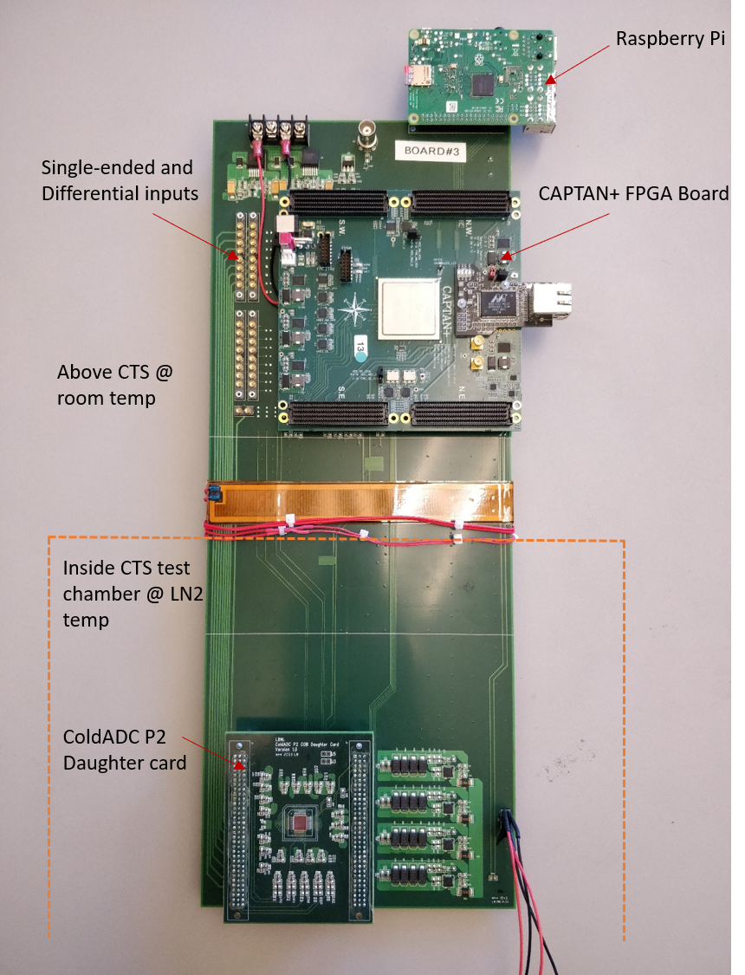
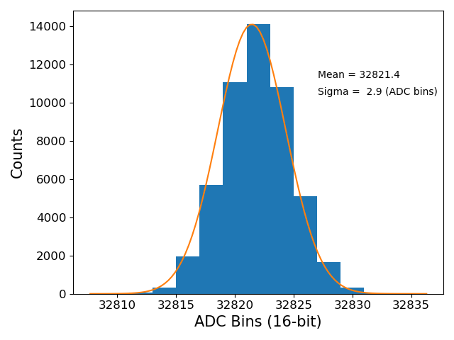
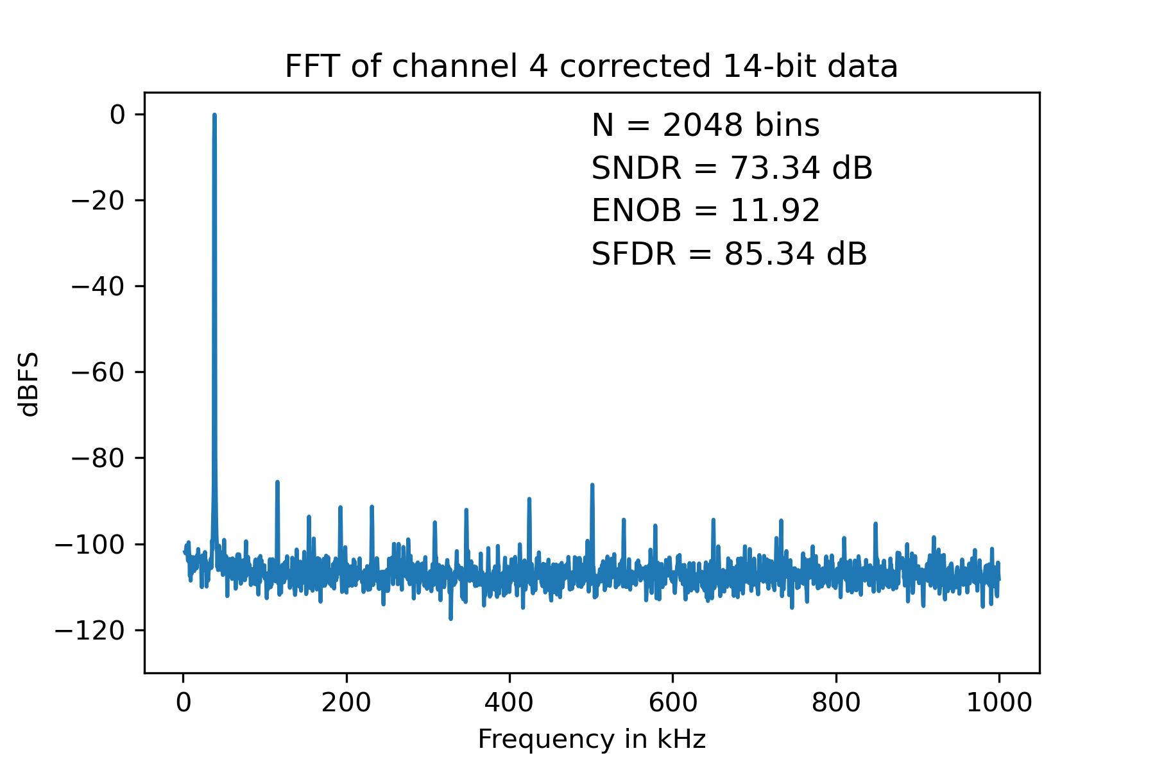
DUNE Far Detector (ColdADC)
The DUNE Far Detector ColdADC will operate for 30 years sealed in a cryostat and was designed using design techniques for reliability and custom simulation models. Interoperated successfully in recent run of ProtoDUNE.
Superior Noise Performance at Cold Temperature (well below preamp noise)
Excellent dynamic performance
(73.34 dB SNDR)
Measured Performance
IEEE Trans. Nuclear Science 2022
Achieved better noise performance than commercial solution used in Short Baseline Neutrino Detector (SBND) Experiment

Slide 11
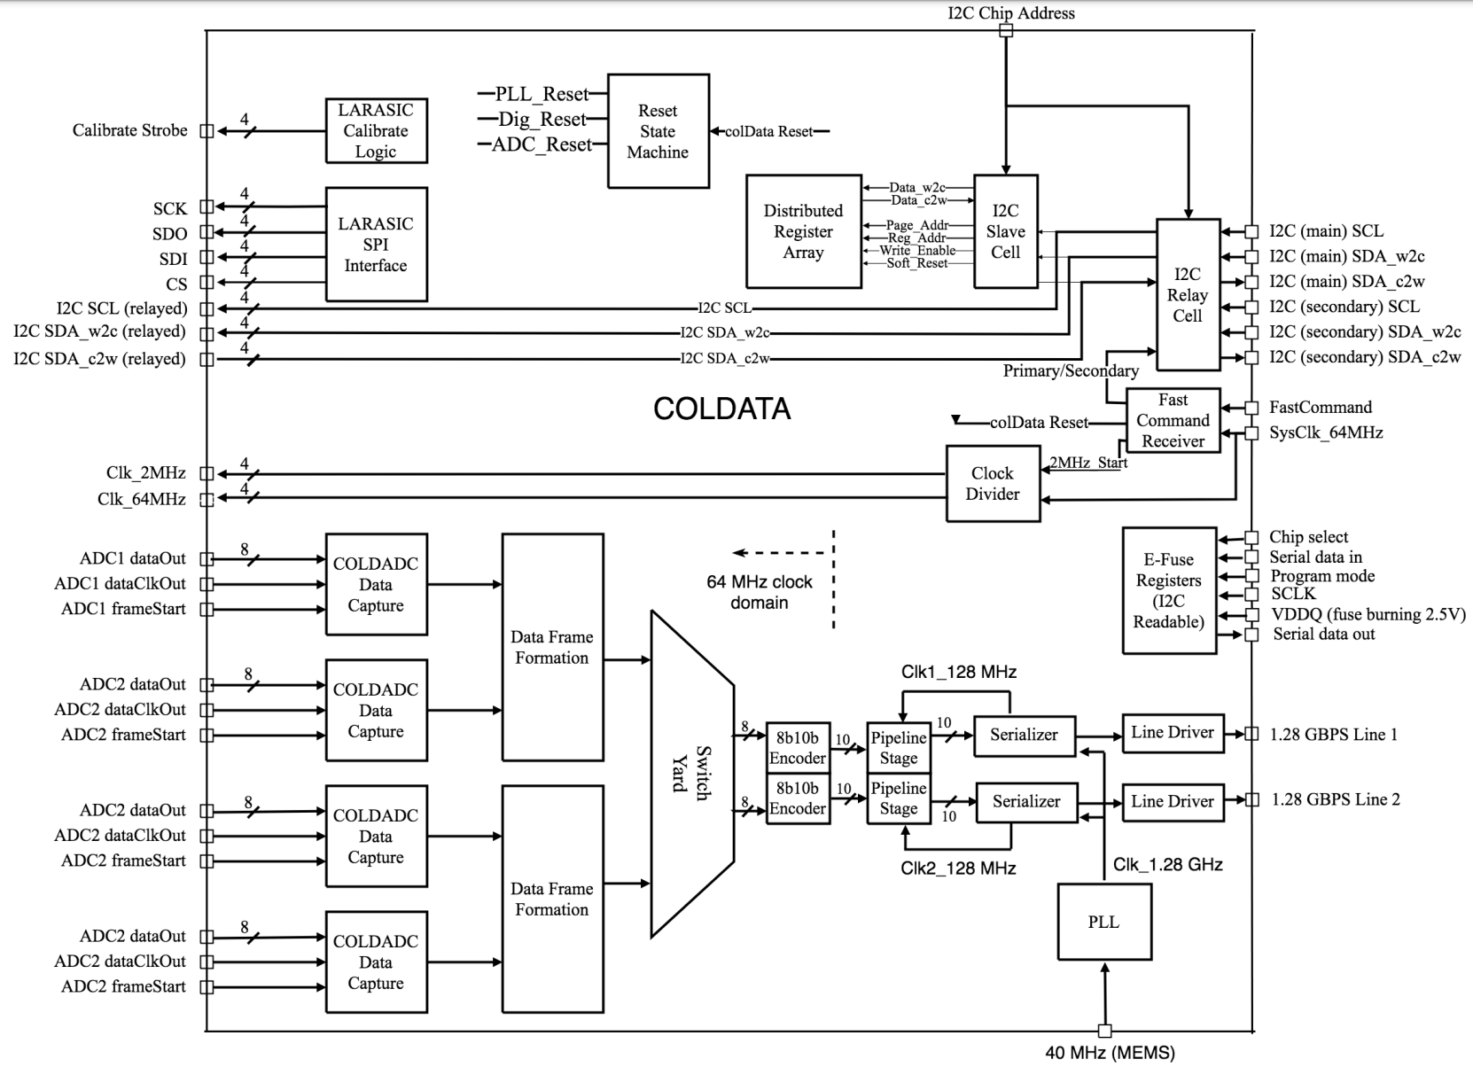
DUNE Far Detector (COLDATA)
COLDATA tasks
Data Formatter
High-Speed Serializer
Cable driver (to warm Front-End Motherboard)
PLL to generate all system clocks
Programmer for LArASIC and ColdADC (via serial interface)

Slide 12
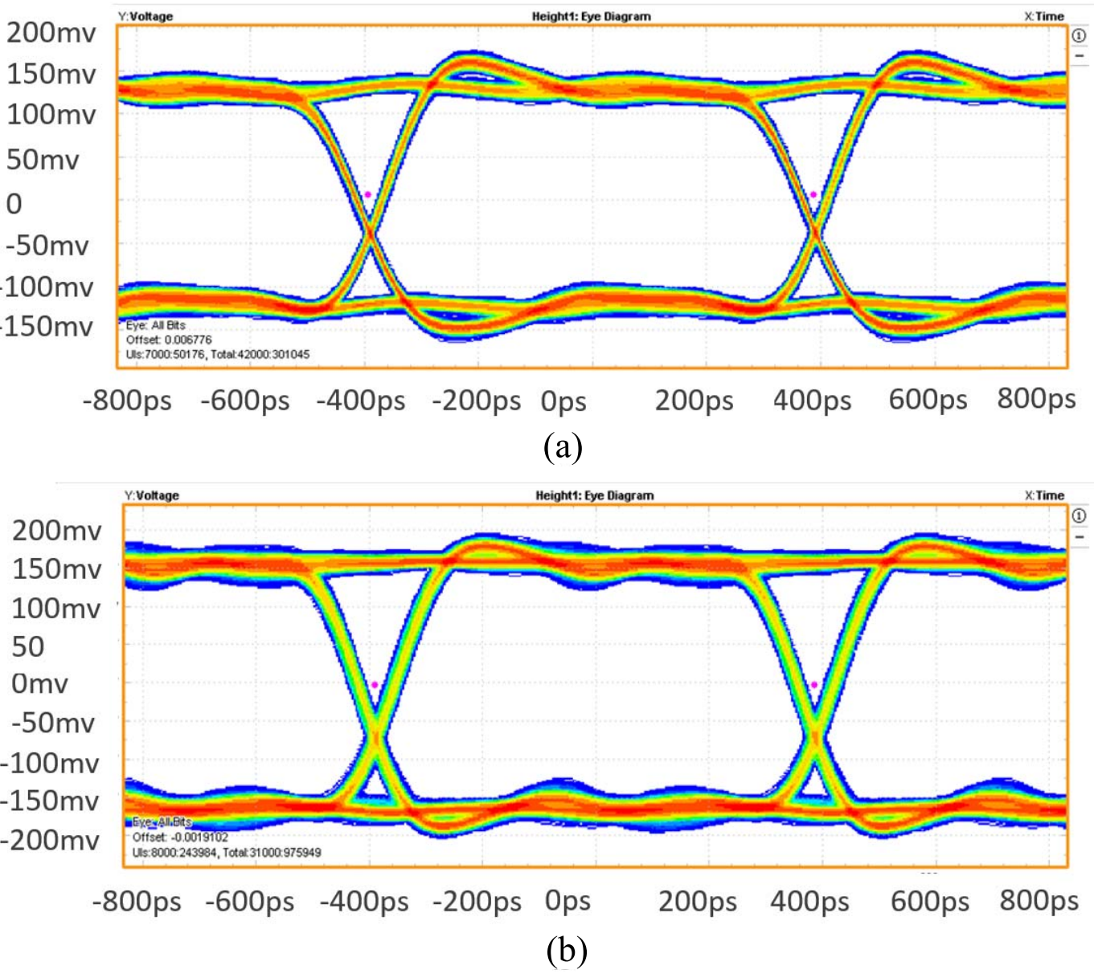
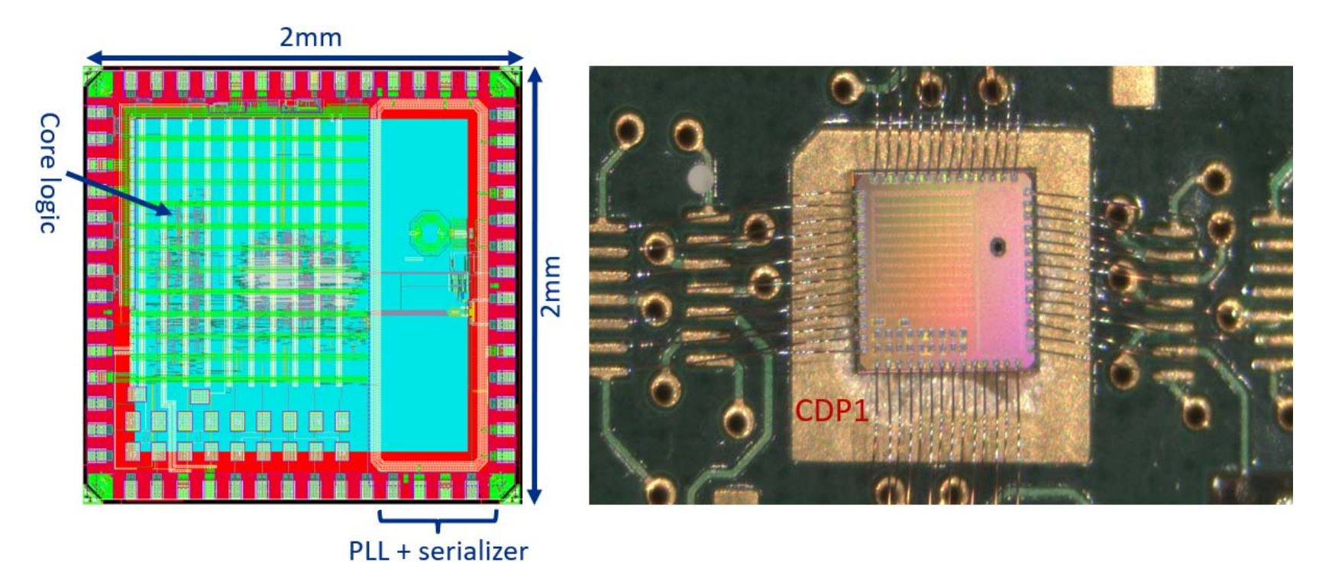
DUNE Far Detector (COLDATA)
RT
65 nm CMOS
LN₂ Temp
Measured Performance
IEEE Trans. Nuclear Science 2019

Slide 13
DUNE Near Detector
Power distribution and DAQ
Installation
Cryogenics
Energy chain and traveling systems
Conventional Facilities
Beam line monitor
LBNL developing readout electronics
For LAr detector
Liquid Argon detector

Slide 14
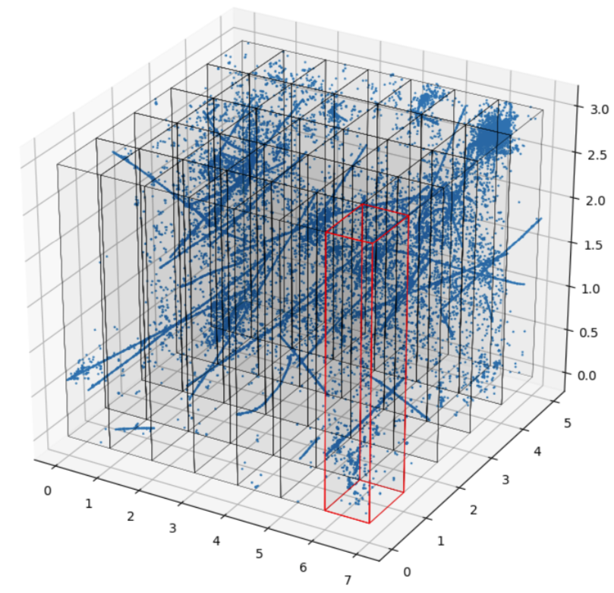
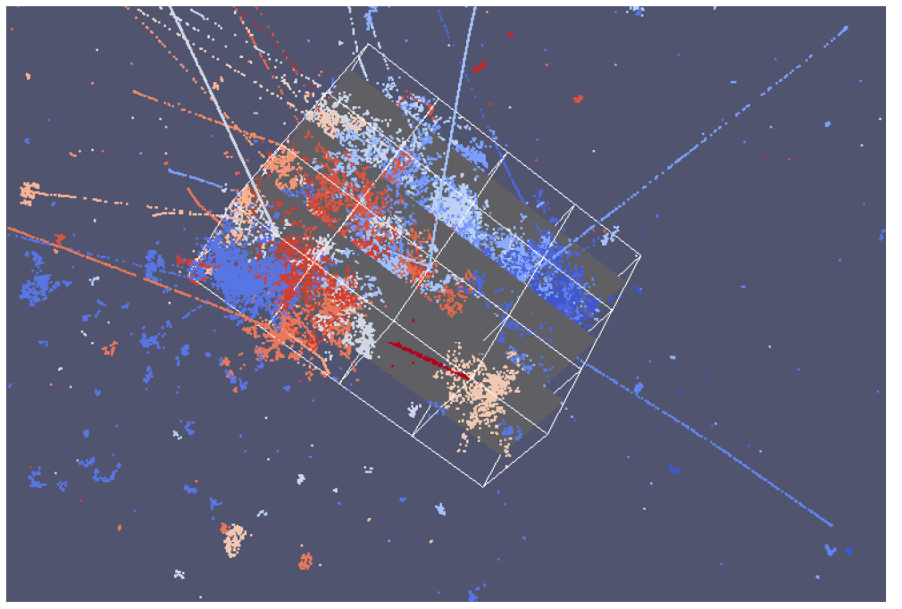
Key Near Detector technical challenge
The DUNE ND will experience ~10M neutrino events per year. Below is a simulation of neutrino pileup in the ND from a single beam pulse (each color indicates a separate neutrino interaction) not including neutrino background.
Approximately 50 neutrino interactions per beam spill

Slide 15
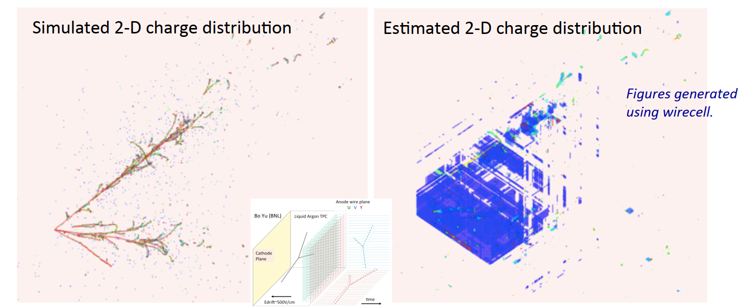
Key Near Detector technical challenge
The much larger Far Detector (FD) uses a conventional wire-based liquid Argon (LAr) Time Projection Chamber. Electrons generated by neutrino collisions are drifted in an electric field to wire planes in the cold volume.
3 GeV electron neutrino charge-current interaction in LAr.
When tracks/showers are parallel to anode plane, all signals are simultaneous. This leads to ambiguity which could be a showstopper with the high event rate in the DUNE ND.
Solution: True 3D readout with a pixelated detector immersed in LAr for the DUNE Near Detector.

Slide 16
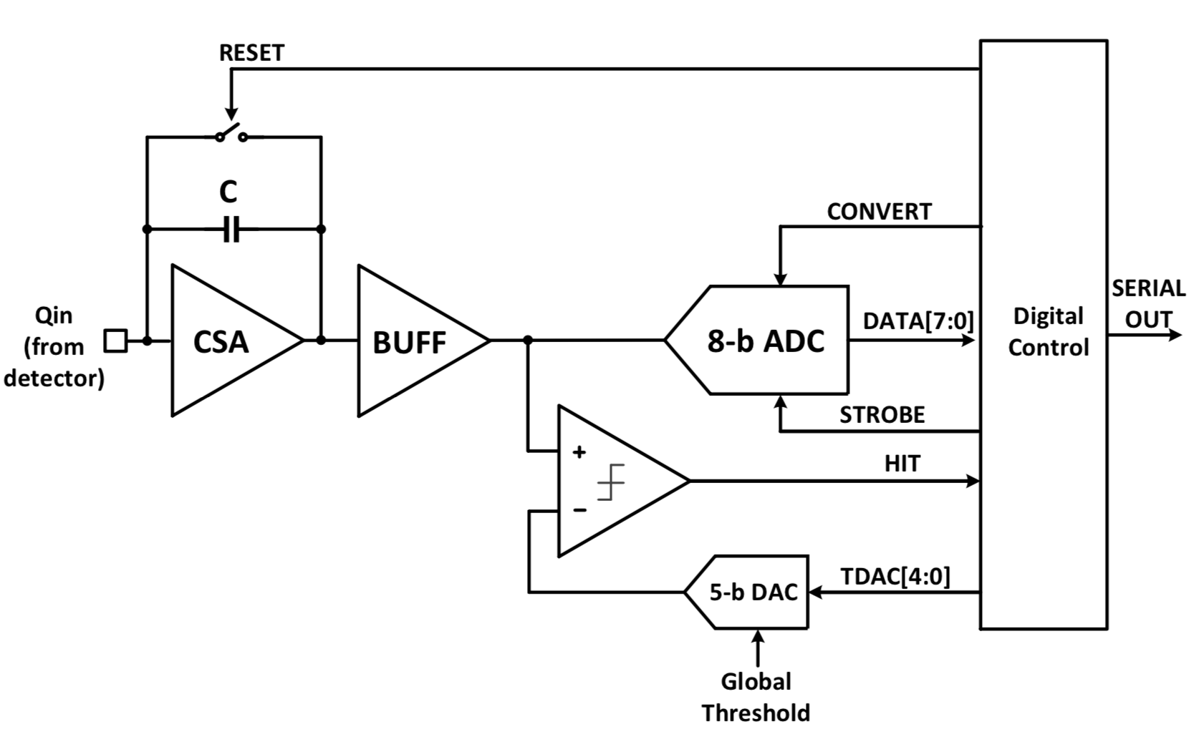
LArPix – Liquid Argon Pixel ASIC
Approach: Integrating Amplifier with Self-triggered Digitization and Readout
Digital Control
Front-end amplifier
64 channels per ASIC
Charge Sensitive Amplifier
Discriminator (self trigger)
ADC (per channel)
Digital Control logic
Global control logic
2k FIFO
On chip references and bias currents
Only decoupling capacitors needed
Immersed in Liquid Argon (-200° C)
Standard SAR Digitizer
Self-triggering Discriminator
Achieve low power: avoid digitization and readout of mostly quiescent data.

Slide 17
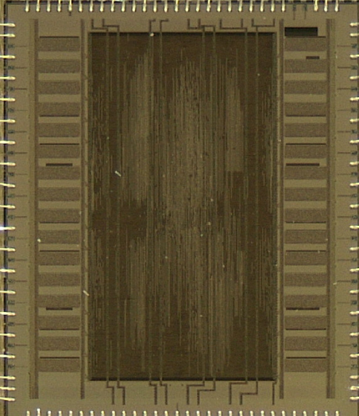
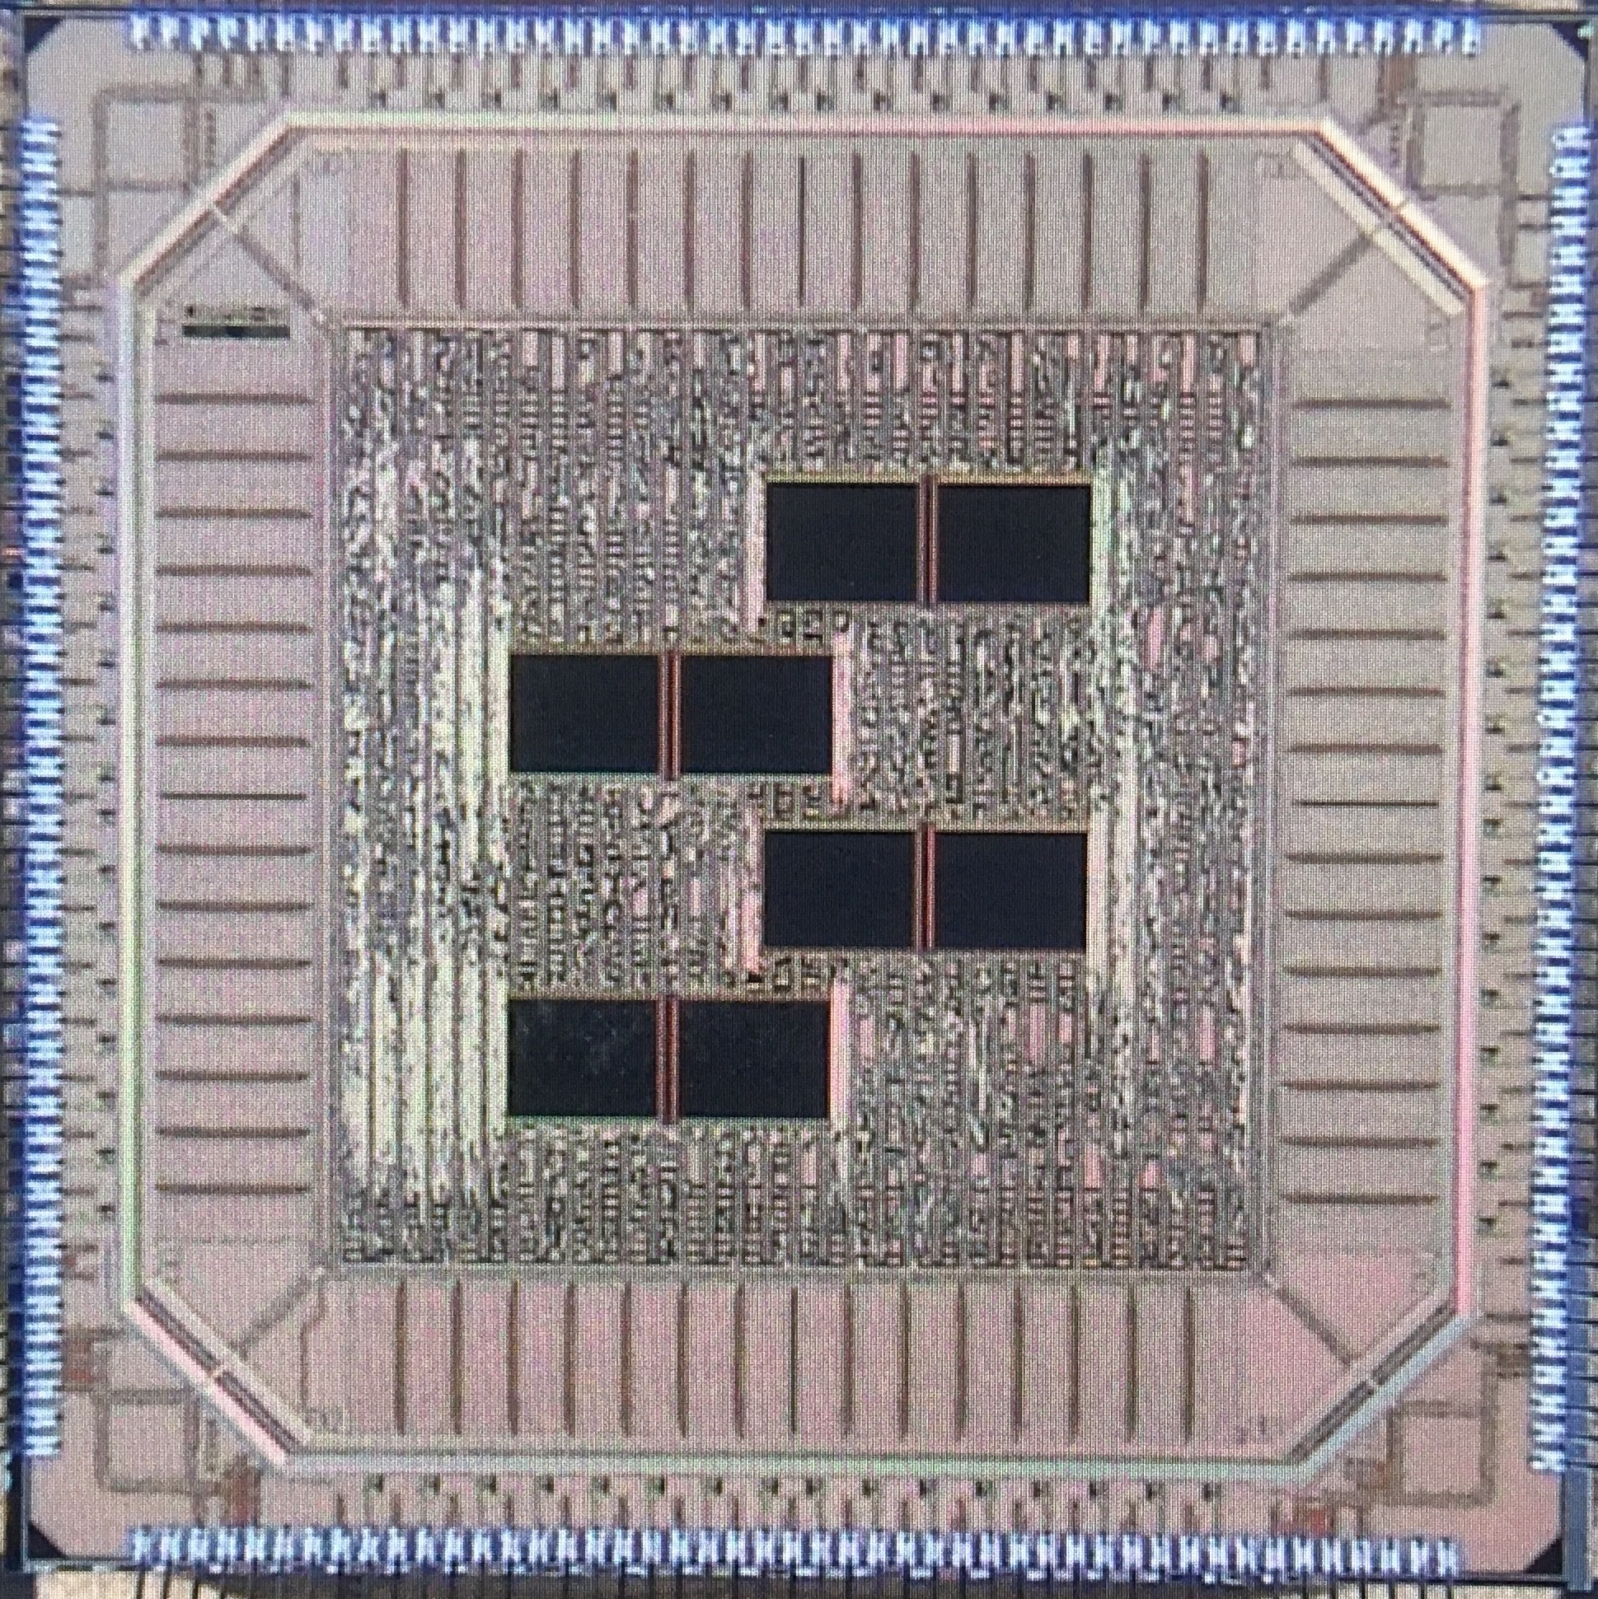
Quick Design Iteration → Continuous Improvement
5.28 mm
5.0 mm
6.25 mm
5.0 mm
LArPix-v2
LArPix-v1
32 channels, 33 mm²
64 channels, 25 mm²

Slide 18
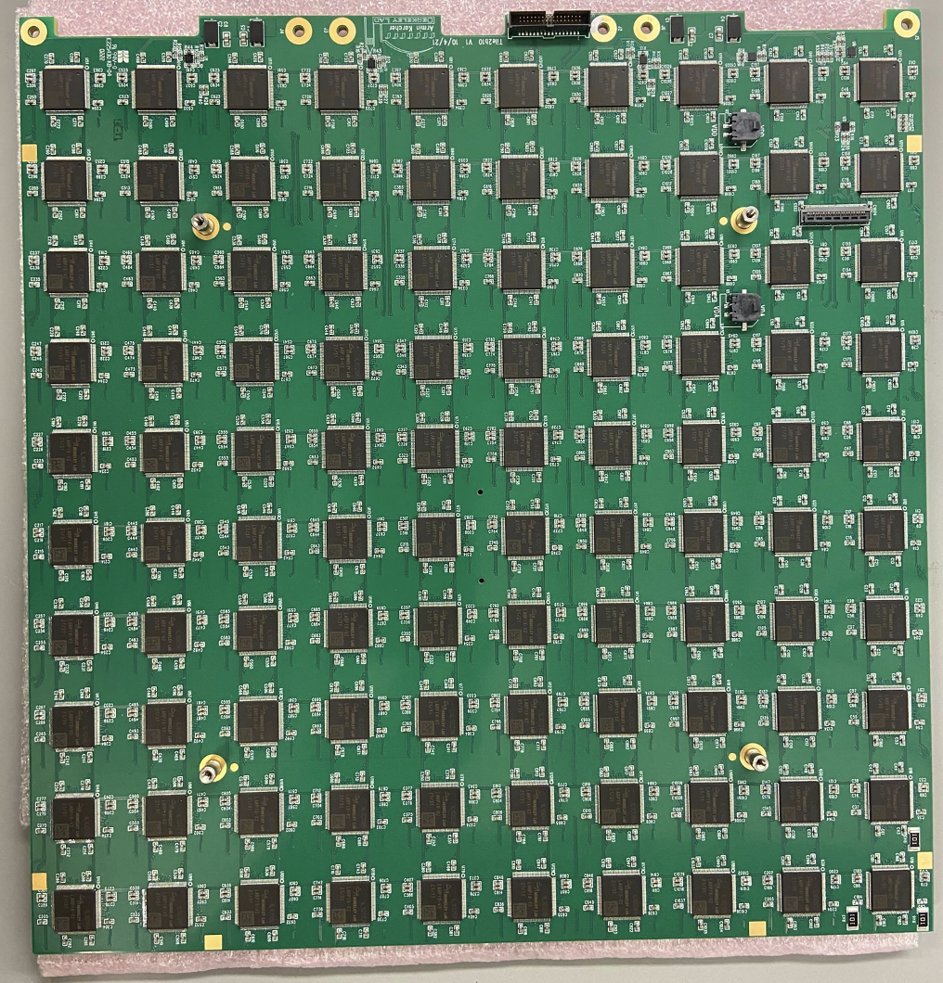
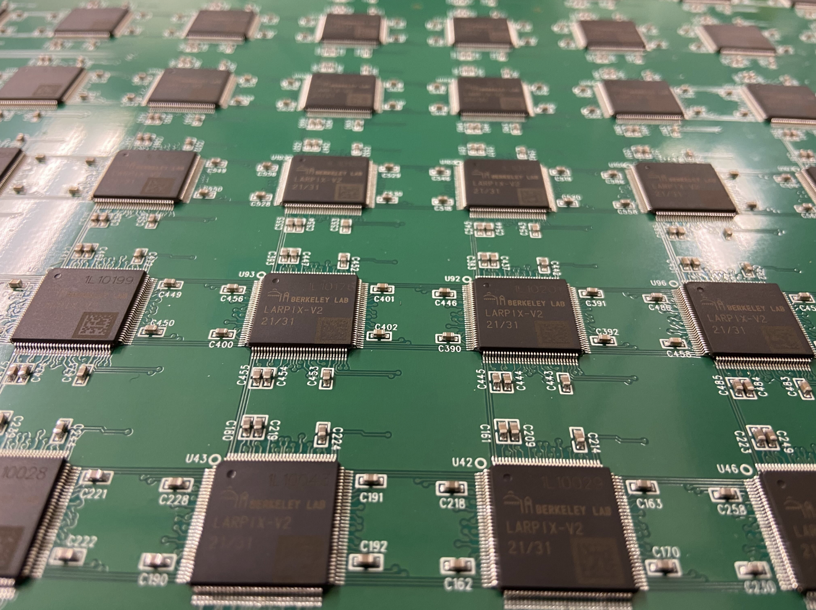
LArPix Pixel Tile
Closeup of tile
Prototype tiles have 100 LArPix ASICs
(30 cm by 30 cm)
ND Tiles will scale to 160 ASICs/tile
Tile with 100 LArPix-v2 ASICs (6400 channels)

Slide 19
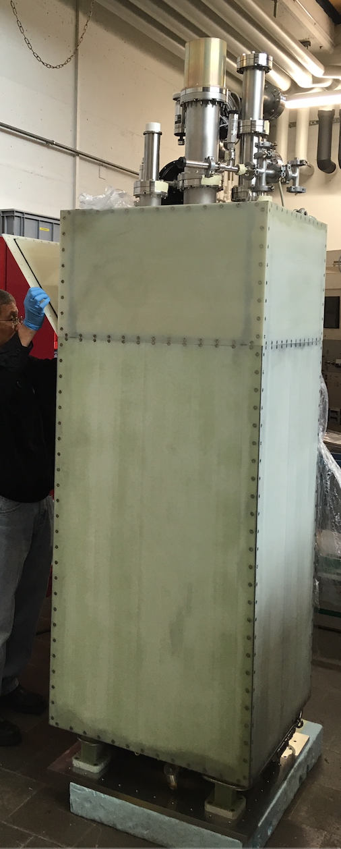
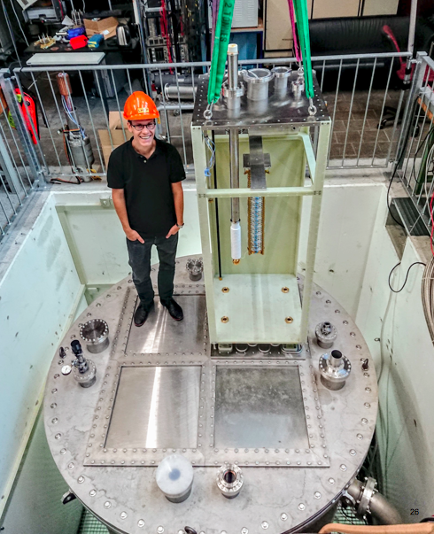
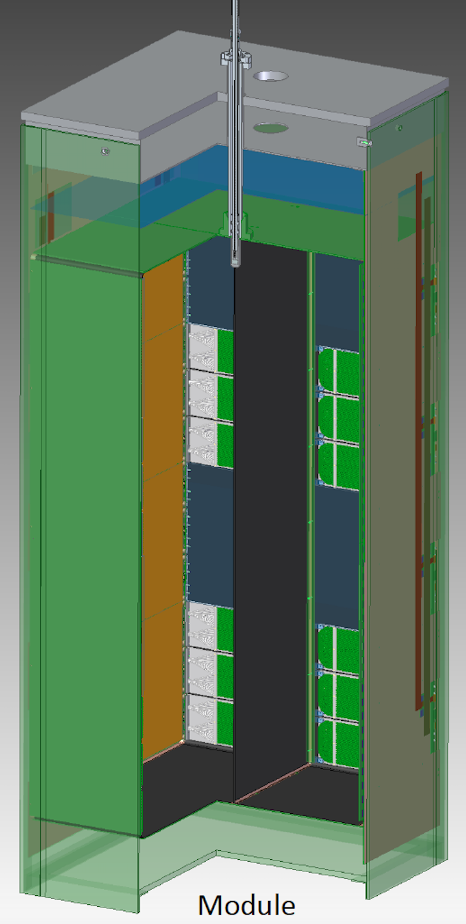
Demonstrate system scalability in large LArTPC: ArgonCube 2x2 Demonstrator
4 modular LArTPCs
Total active mass: ~3 ton
Readout area: 6.4 m²
400k pixels, 6.3k ASICs
System successfully operated.
Demonstrator for DUNE Near Detector

Slide 20
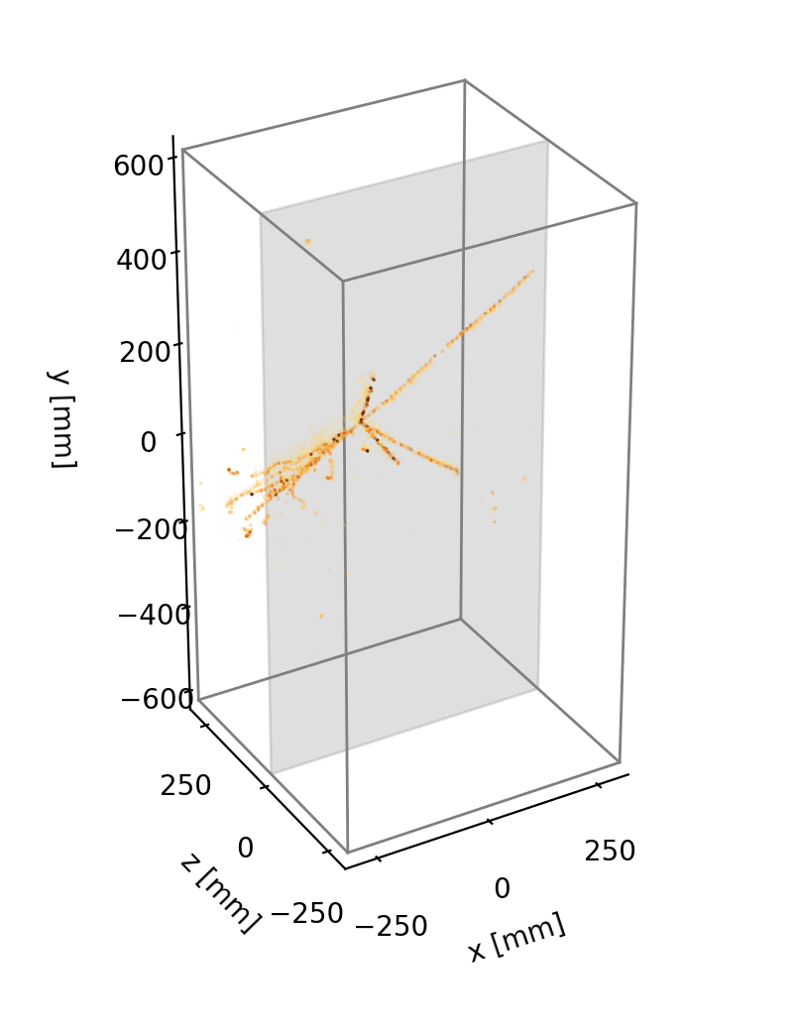
Demonstrate system scalability in large LArTPC: ArgonCube 2x2 Demonstrator
Raw data (no filtering) of cosmics in ArgonCube module0 demonstrator.
Pixelated detector delivers unprecedented track fidelity and would be impossible to implement without custom ASICs
The final DUNE Near Detector will require approximately 350k ASICs to instrument a 100m² pixel plane (22.4 Mpix)

Slide 21
Thank You
This work was supported in part by the U.S. Department of Energy under Contract No. DE-AC02-05CH11231

