Slide 1
Open-source ASIC design flows: An overview
Soumyajit Mandal and Grzegorz W. Deptuch
May 19, 2022

Slide 2
Open-source ASIC design flows: An overview
Soumyajit Mandal and Grzegorz W. Deptuch
May 19, 2022

Slide 3
Motivation and background
Remove the two main barriers to entry for ASIC design:
CAD tools
Process design kits (PDKs)
Takes inspiration from the many successful examples of free and open-source software (FOSS).
Several free and open-source tools and PDKs have been around for a while, but the PDKs were not manufacturable.
The first true FOSS ASIC flow (including a manufacturable PDK) was announced by SkyWater and Google in 2020.
Based on an open-source version of SkyWater’s 130 nm CMOS PDK.
MPW access is organized by eFabless.

Slide 4
Recent news

Slide 5
Potential advantages for HEP
Reduce (or entirely eliminate) CAD tool licensing costs.
Simplify collaborations with universities, small companies, etc.
Allow easy sharing of designs across multiple institutions (including international collaborators).
Take advantage of students’ familiarity with open-source software development to attract new ASIC designers to the field.
To get started, simply clone the Git repository at https://github.com/RTimothyEdwards/open_pdks.

Slide 6
Challenges
Limited availability of open-source PDKs:
So far, only the SkyWater 130 nm PDK is available.
Support for ReRAM macros and the 90 nm process may be added this year.
FOSS CAD tools do not have all the capabilities of commercial tools.
They also do not include much technical support.
There is no straightforward process for tool management (e.g., rolling out updates), although the community is working to make the process easier.

Slide 7
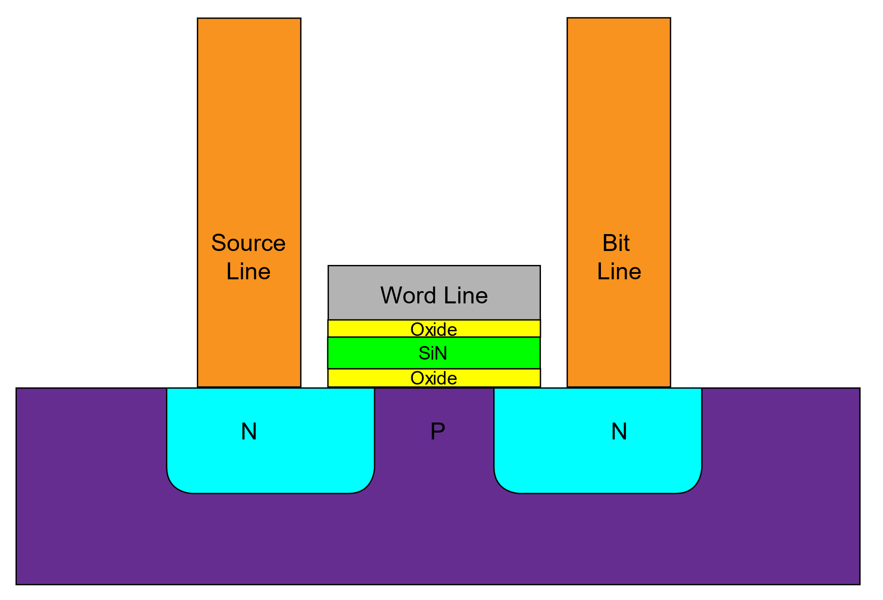
The SkyWater 130nm process
SKY130 is a mature 180nm-130nm hybrid technology developed by Cypress Semiconductor that has been used for many production parts.
The open-source version is a silicon–oxide–nitride–oxide–silicon (SONOS) technology (130nm node) with 1.8V nominal V_{DD} and 2.5V/5V I/O.
5 metal layers
Inductor-capable (no standard cells in PDK, but can be custom-designed)
Poly resistors, MIM capacitors
Non-volatile memory (NVM) cells using SONOS
HV transistor options
More details available in the PDK documentation:
https://skywater-pdk.readthedocs.io/en/main/
Documentation is incomplete…
SONOS memory cell

Slide 8
Open-source simulators
Analog simulators
ngspice (http://ngspice.sourceforge.net/)
Xyce (https://xyce.sandia.gov/)
While powerful, these simulators only support a limited set of simulation methods.
Important simulation methods for time-varying circuits (pss, pac, pnoise, etc.) are not yet available.

Slide 9
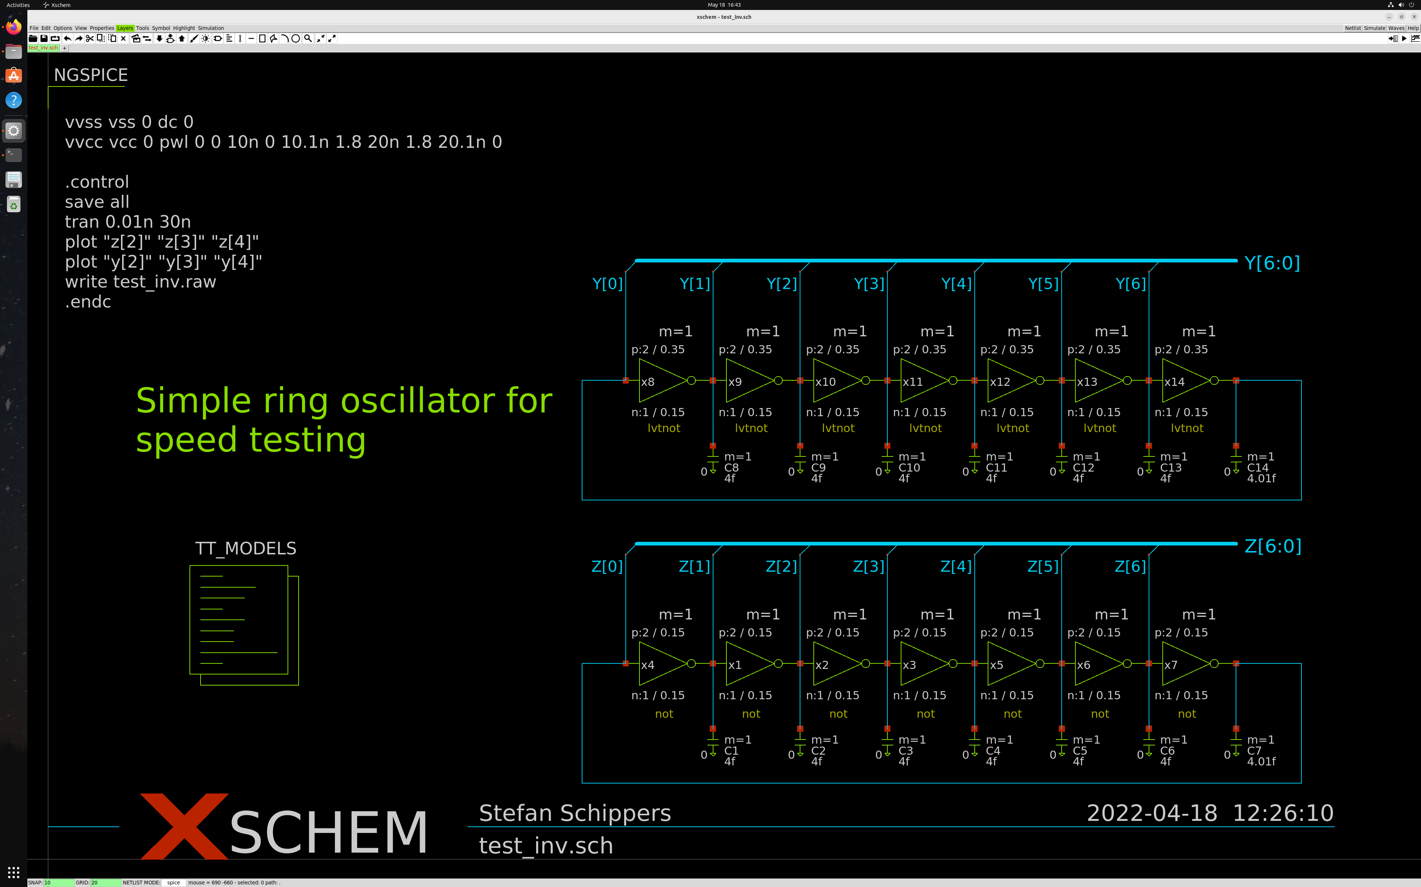
Open-source schematic editors
Analog / mixed-signal designs
Xschem (https://github.com/StefanSchippers/xschem)
Mosaic (https://github.com/NyanCAD/Mosaic)

Slide 10
Open-source layout tools
MAGIC (https://github.com/RTimothyEdwards/magic)
KLayout (https://www.klayout.de)
The default SKY130 layout flow (including DRC/LVS) is based on MAGIC.
Klayout is mostly used as a GDS viewer, although it also has limited editing and DRC/LVS capabilities.

Slide 11
Digital design flow
The default SKY130 installation includes a well-characterized digital standard cell library developed by Oklahoma State University (OSU).
OpenLane (https://github.com/The-OpenROAD-Project/OpenLane).
OpenLane is an automated RTL to GDSII flow based on several components including OpenROAD, Yosys, Magic, Netgen, CVC, SPEF-Extractor, CU-GR, Klayout, and custom scripts for design exploration and optimization.
The flow performs full ASIC implementation steps from RTL all the way down to GDSII.

Slide 12
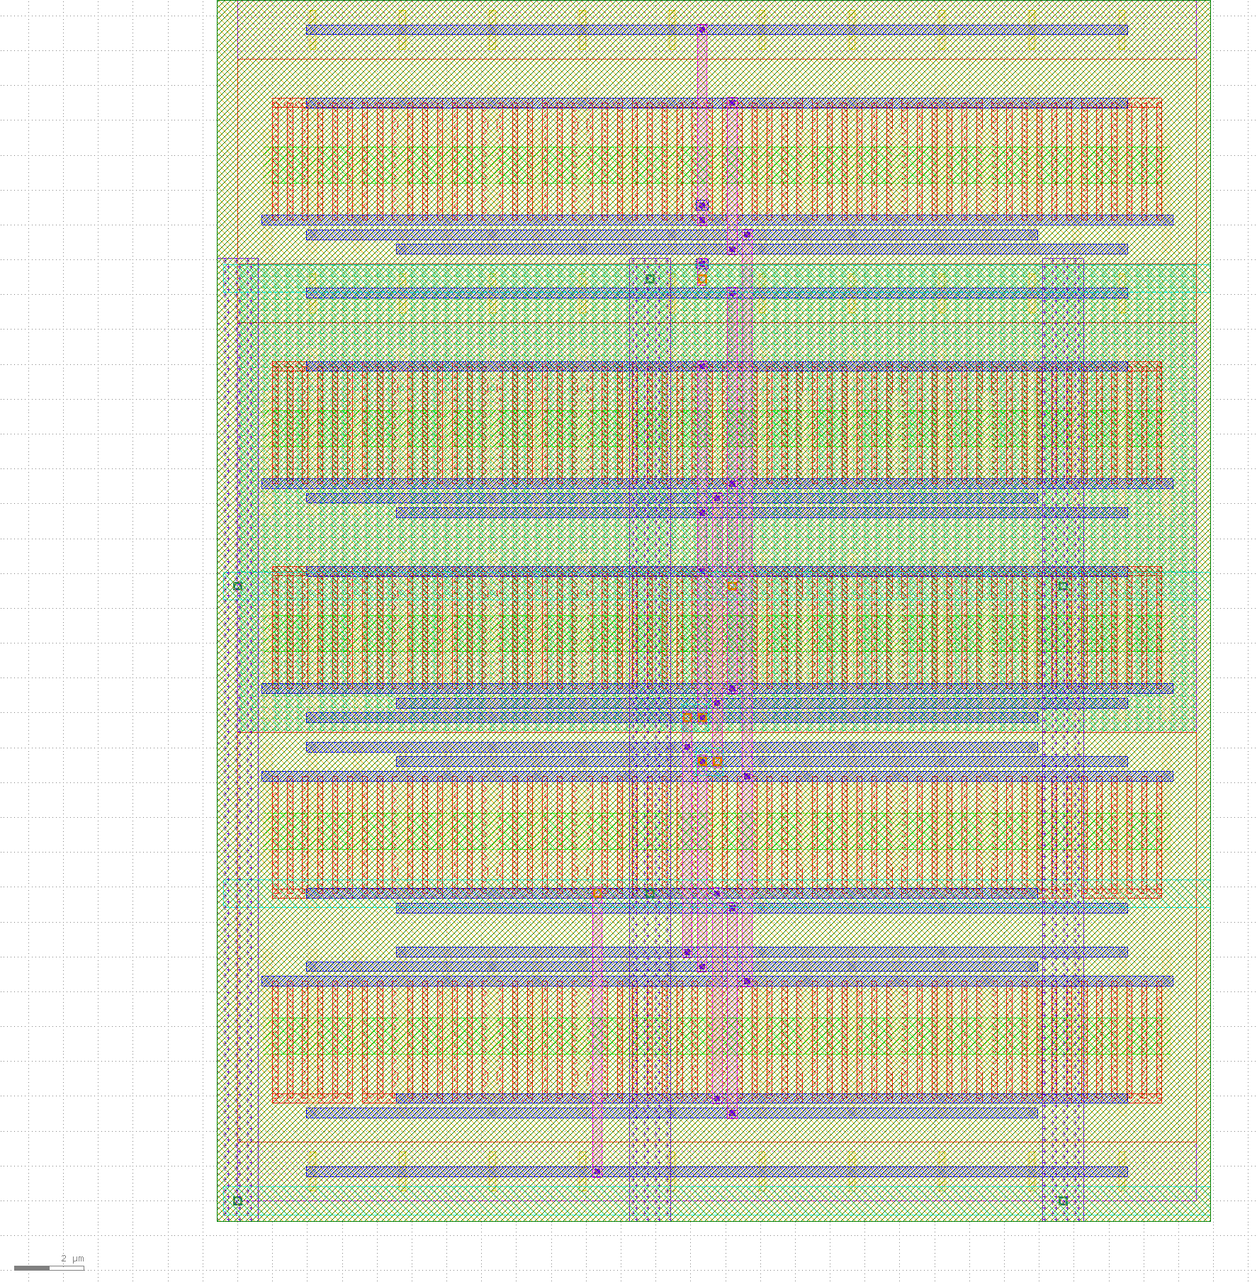
Other interesting open-source projects
Automated analog layout generation
ALIGN (https://github.com/ALIGN-analoglayout/ALIGN-public)
Sky130 PDK support for ALIGN (https://github.com/ALIGN-analoglayout/ALIGN-pdk-sky130)
MAGICAL (https://github.com/magical-eda/MAGICAL)
These tools try to satisfy the usual analog layout constraints (such as matching).
In many cases, post-layout performance is similar to hand-optimized layout.
Automatically laid-out 5-transistor OTA in the SKY130 process

Slide 13
So how do I get started?
The easiest way is probably to clone one of the following pre-configured Docker containers from GitHub:
IIC-OSIC-TOOLS: https://github.com/hpretl/iic-osic-tools
FOSS-ASIC-TOOLS: https://github.com/efabless/foss-asic-tools
Alternatively, you can of course individually download and install each of the tools yourself…
For the latest discussions, join the “skywater-pdk” Slack channel and its various sub-channels.
Also, consider joining the IEEE SSCS “PICO” open-source chipathon:
https://sscs.ieee.org/about/solid-state-circuits-directions/sscs-pico-design-contest

Slide 14
Questions?

