Slide 1
NuComp News
Lee Lueking
February 15, 2012

Slide 2
Outline
Maintenance day stuff
IF Computing Resource Summary
A closer look at GP Grid usage

Slide 3
Maintenance Day: Tomorrow Thursday 2/16
Several SLF4-->5 OS upgrades. Some reboots (minervagpvm’s).
ENCP update, STKEN, Feb, 16 with Chimera support, bug fix for CDMS and logging patch. Estimate 1hour.
Networking Services will be moving some switches to the new Nexus in FCC2. Work scheduled for 6-8 AM. Most of this maintenance to be transparent, but there may be a few brief disruptions.
BlueArc subnet (Scientific and Core-IT). NFS/CIFS should recover if properly configured with 600 second timeout/retry.
Intensity Frontier servers (DB servers, nearline, etc.) fmb02, fmb03, fmb04, fmb05, fmb06, fmb07, fmb08, fmb09, fnalmysqldev, fnalmysqlprd, websrv3, websrv4
SLF4 → SLF5 Upgrades
if01-04 Thursday February 16
fmb02-09 February 16 (waiting for go-ahead from MB)
All SLF4 systems for IF experiments have been upgraded or retired (or will be retired soon), except:
minos25: moving to a GPCF (and SLF5) system, in progress
minosgpvm02: variance requested
minervagpvm01: variance requested

Slide 4
Maintenance Days:Next Week 2/21, 2/22 to 2/23
New kernel updates requiring a reboot of fnalMySQLdev on Tuesday, Feb 21 around 9:30 AM. The downtime should be minimal but we would like 30 minutes.
There will be an 18hr ENSTORE "chimera" migration for STKEN, start at 18:00 on Feb. 22, and end by noon on the 23rd.
More information in Dmitry’s presentation

Slide 5
Maintenance Day: ~ Early May Possibly Week of May 1
Major upgrades, require several hours each
afs software will be upgraded
BlueArc Firmware upgrade
These need to be coordinated with CDF, D0 an other users at the lab.
They cannot be done concurrently because the same people are doing both.
Andy has more info…

Slide 6
BlueArc and AFS upgrades
BlueArc Firmware Upgrade ------------------------ Current Version v6.1 Proposed Version v8.1 -bug fixes -support for 512 LUNs/cluster Proposed Date April 30 ...pm (beam-shutoff) through May 1 ...am (start of business day) Impact drain-jobs / no new jobs till end of upgrade
AFS Upgrade -------------- Current Version openafs 1.4.11 Proposed Version openafs 1.4.14 Support for Compound Kerberos principal, used with kcron to access AFS space Proposed Date Several days after BlueArc upgrade. Downtime estimate (approx): 2-4 hours during early morning hours Impact We believe that AFS is mainly used interactively; however, groups that do use it for batch will have to refrain from running jobs during maint window.

Slide 7
IFront Computing Resource Summary
Central Storage
GP Grid Cluster
GPCF VM load averages

Slide 8
/experiment/data areas (1/2)
All areas summed
LBNE
ArgoNeuT
MINERvA
gm2
MINOS

Slide 9
/experiment/data areas (2/2)
Mu2e
MicroBooNE
NOvA
MiniBooNE

Slide 10
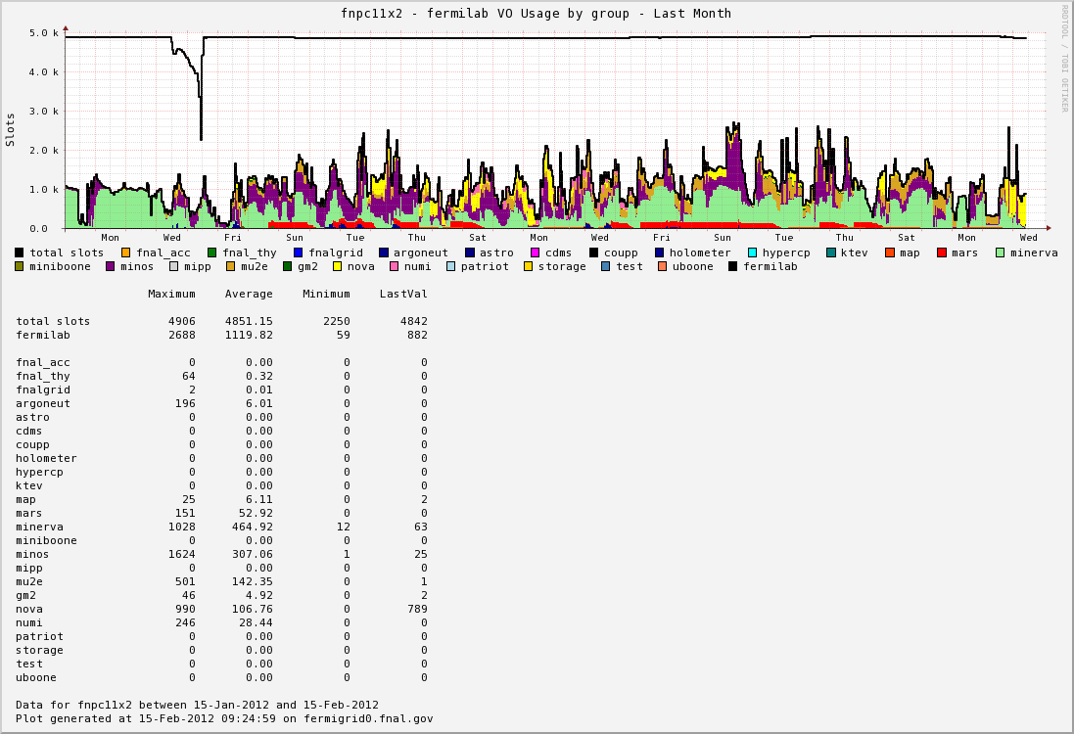
GP Grid Cluster Use Last Month

Slide 11
GPVM Ganglia 1minute Load Avg Stats for the last month
VM | Average | STD | Max. | Max. Date
minervagpvm01 | 0.21153025 | 0.467876691 | 2.58037103 | 1/26-10:48:00
minervagpvm02 | 0.554468251 | 0.708454717 | 4.9686002 | 1/27-20:24:00
minervagpvm03 | 0.304821098 | 0.670999754 | 6.99700298 | 2/11-18:48:00
minervagpvm04 | 0.098926997 | 0.330898702 | 4.12225694 | 2/11-18:48:00
minervagpvm05 | 0.057957736 | 0.146813024 | 1.76947024 | 2/13-01:36:00
novagpvm01 | 1.924431059 | 1.036308088 | 5.87722024 | 1/30-21:12:00
novagpvm02 | 0.149927919 | 0.274438826 | 1.97569444 | 1/27-00:48:00
novagpvm03 | 0.797596863 | 0.898417488 | 5.14992063 | 1/24-19:36:00
novagpvm04 | 0.451374913 | 0.494306981 | 2.02910714 | 1/30-21:12:00
novagpvm05 | 0.477614027 | 0.556400613 | 3.02738889 | 1/26-02:24:00
argoneutgpvm01 | 0.063351368 | 0.092136553 | 0.642244048 | 1/18-18:00:00
uboonegpvm01 | 0.049975361 | 0.108682649 | 0.968209325 | 1/25-15:12:00
uboonegpvm02 | 0.048890983 | 0.078813792 | 0.544076389 | 1/27-12:00:00
gm2gpvm01 | 0.046142096 | 0.080423428 | 0.687311508 | 2/14-14:00:00
lbnegpvm01 | 0.196815574 | 0.349988133 | 2.20190873 | 2/6-07:12:00
lbnegpvm02 | 0.18756297 | 0.397087959 | 2.18086111 | 2/14-14:00:00
mu2egpvm01 | 0.01048245 | 0.045930649 | 0.692962302 | 2/6-15:36:00
mu2egpvm02 | 0.064251144 | 0.142356022 | 1.01132044 | 2/6-21:12:00

Slide 12
March NuComp
Grid job monitoring
Small file archiving
SAM project update
New ECL features
MINERvA and NOvA conditions data access
Let me know if there are additional topics to discuss.

Slide 13
finish

