Slide 1
AF7 - Subgroup RF - miniWorkshop on Innovative Design and Modeling – Follow-up
Jan. 18, 2022
Sergey Belomestnykh
Emilio Nanni
Hans Weise

Slide 2
Agenda
Snowmass AF7 update
Past Innovative Design and Modeling workshop
Discussion of contributions

Slide 3


Snowmass AF Timeline
 | 2021 |  |  | 2022
 | Oct | Nov | Dec | Jan | Feb | Mar | Apr | May | June | Jul | Aug | Sep
Snowmass Timeline |  |  |  |  |  | Whitepaper Due Date: March 15th |  |  |  | Snowmass at Seattle: July 17-26
AF Timeline
AF Restart
Whitepaper Preparation
WP Initial Review
Complete AF TGC Report Drafts
Prepare Snowmass Discussion Materials
Snowmass
Final TGs and AF Report Editing
Today’s
Meeting
April 15: Requests for
Clarification (if needed)
August 31: Request POC Comments
May 30:
Preliminary TG Drafts Circulated to POCs for Comment
Executive Summaries Sent to
AF Conveners to Incorporate into Snowmass Meeting Documents
Final Reports Due September 30, 2022
Note:

Slide 4
AF7rf: RF
Updates:
  EIC RF Seminar “RF Technology Challenges for EIC” Wencan Xu (BNL) and Jiquan Guo (JLAB), Dec. 2nd
Plans include :
Need better understanding of white paper status, organizing follow up meetings for our three topical workshops
Reminder – ½ AF7-rf LOIs closer to other AF topical groups (we will review, discuss and summarize), ½ LOIs were organized into three topics and hosted workshops, discussions, attended workshops
AF7 - Subgroup RF - miniWorkshop on RF Systems and Sources Follow-Up, https://indico.fnal.gov/event/52406/ , Jan. 11th, 2022
AF7 - Subgroup RF - miniWorkshop on Innovative Design and Modeling Follow-Up, https://indico.fnal.gov/event/52407/ , Jan 18th, 2022
AF7 - Subgroup RF - miniWorkshop on Cavity Performance Frontier Follow-Up, https://indico.fnal.gov/event/52408/, Feb. 1st, 2022

Slide 5
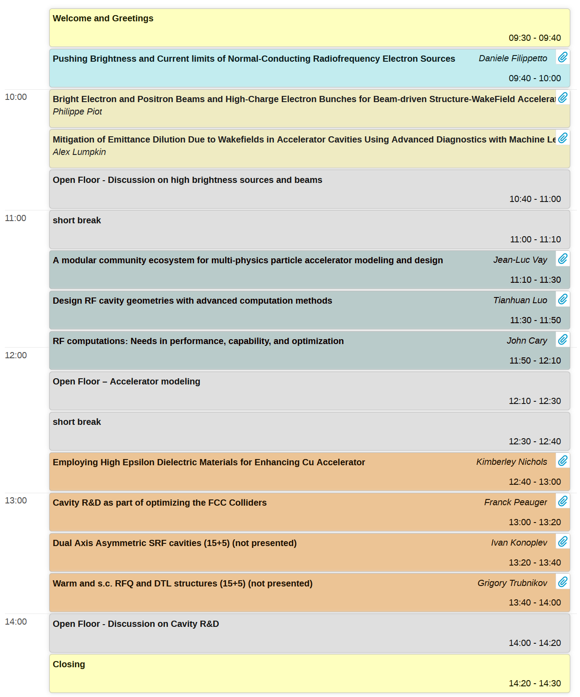
miniWorkshop on Innovative Design and Modeling Follow-up
10 LOIs in this topic
Workshop with presentations (8/10)
Three groups
  bright beams
  accelerator modelling
  cavity design
How do we turn this input into contributions? The White Papers…
We need CONTRIBUTORS and EDITORS for the White Papers (see next slide)

Slide 6
Snowmass Contributions Group Exercise (Anticipated)
 |  |  | contributor | indiv.WP | editor
Danile | Filipetto | dfilippetto@lbl.gov
Philippe | Piot | piot@nicadd.niu.edu
Alex | Lumpkin | lumpkin@fnal.gov
Jean-Luc | Vay | jlvay@lbl.gov
Tianhuan | Luo | tluo@lbl.gov
John | Cary | cary@colorado.edu
Kimberly | Nichols | knichols@lanl.gov
Franck | Peauger | franck.peauger@cern.ch
Ivan | Konoplev | ivan.konoplev@physics.ox.ac.uk
Grigory | Trubnikov | trubnikov@jinr.ru
how about today’s meeting participants?
any new interest to contribute? new ideas?
6

Slide 7
Snowmass Contributions Discussion
https://snowmass21.org/submissions/start
Knowing what contributions are coming will allow us to start organizing with AF and preparing the outline of the summary
More contributions can be good…. but we recognize this takes a lot of time
Collaborating and getting multi-institutional can increase impact
However(!) anyone should feel free/encouraged to submit a contribution they

Slide 8
Backup

Slide 9
AF7-rf LISTSERV
Dear Snowmass Accelerator Frontier / RF Accelerator Technology (AF7-RF) enthusiasts,
Please sign up and encourage others who are interested in this topic to join the list by sending a “SUBSCRIBE SNOWMASS-AF7-RF firstname lastname” (without quotation marks and substituting “firstname lastname” with their first and last names) command to listserv@fnal.gov.
You may leave the list at any time by sending a "SIGNOFF SNOWMASS-AF7-RF" (without quotation marks) command to listserv@fnal.gov.

Slide 10
Snowmass
Snowmass is a long-term planning exercise for the particle physics community, organized by the American Physical Society (APS)
Opportunity for the entire particle physics community to come together to identify and document a vision for the future of particle physics in the U.S. and together with its international partners
Contributions provide important input that influences future projects and scientific programs.

Slide 11
Snowmass 2021 Organization
10 Frontiers
  Energy Frontier
  Neutrino Physics Frontier
  Rare Processes and Precision
  Cosmic Frontier
  Theory Frontier
  Accelerator Frontier
  Instrumentation Frontier
  Computational Frontier
  Underground Facilities
  Community Engagement Frontier

Slide 12
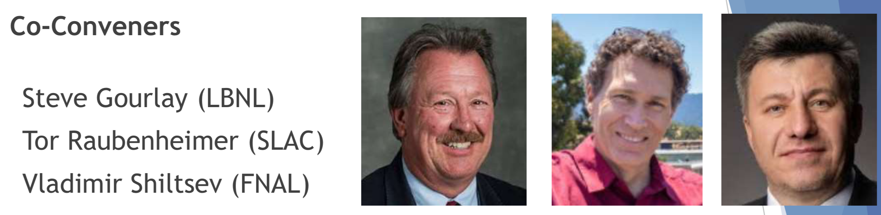
Snowmass Accelerator Frontier Organization
Frontier Conveners
Topical Group | Group Co-Conveners
AF1. Beam Physics and Education | Z. Huang (Stanford) | M. Bei (GSI) | S. Lund (MSU)
AF2. Accelerators for Neutrinos | J. Galambos (ORNL) | B. Zwaska (FNAL) | G. Arduini (CERN)
AF3. Accelerators for EW/Higgs | M. Ross (SLAC) | A. Seryi (JLAB) | Q. Qin (IHEP, Beijing)
AF4. Multi-TeV Colliders | M. Palmer (BNL) | A. Valishev (FNAL) | N. Pastrone (INFN, Torino)
AF5. Accelerators for PBC and Rare Processes | E. Prebys (UC Davis) | M. Lamont (CERN) | Richard Milner (MIT)
AF6. Advanced Accelerator Concepts | C. Geddes (LBNL) | M. Hogan (SLAC) | P. Musumeci (UCLA) | R. Assmann (DESY)
AF7. Accelerator Technology R&D
Sub-group RF | E. Nanni (SLAC) | S. Belomestnykh (FNAL) | H. Weise (DESY)
Sub-Group Magnets | G. Sabbi (LBNL) | S. Zlobin (FNAL) | S. Izquierdo Bermudez (CERN)
Sub-group Targets/Sources | Charlotte Barbier (ORNL) | Yin-E Sun (ANL) | Frederique Pellemoine (MSU/FNAL)

Slide 13
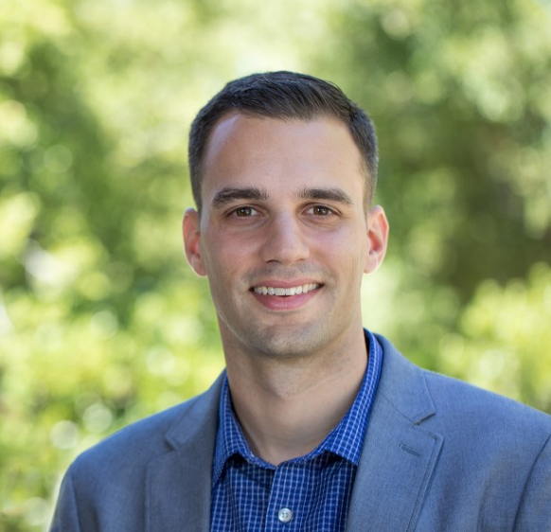
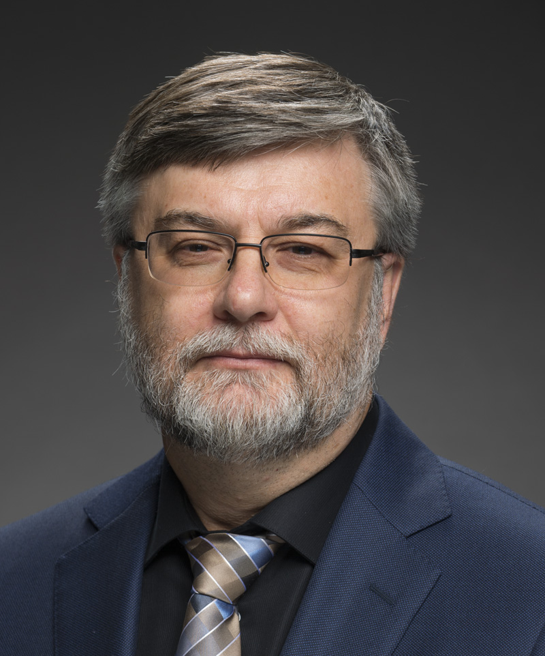
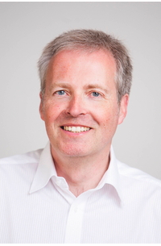
Accelerator Frontier 7: Accelerator Technology R&D
RF Subtopical Group
Accelerator Technology is the enabling foundation for accelerator-based HEP.
RF acceleration – primarily divided into SRF and NCRF, plus consideration for regions of overlap, e.g. RF sources
AF7 - RF Conveners
Emilio Nanni
SLAC
nanni@slac.stanford.edu
Sam Belomestnykh
Fermilab
sbelomes@fnal.gov
Hans Weise
DESY
hans.weise@desy.de

Slide 14
Snowmass Submissions
Snowmass submissions will take the form of Contributed Papers, such as white papers on specific scientific areas, with a maximum length of 10 pages each, due July 31, 2021 (THIS DATE MAY CHANGE)
Contributed papers are typically expected to be preceded by Letters of Interest (LoI), with a maximum length of 2 pages each, due August 31, 2020
We encourage LoI submitters to form teams for contributions (where appropriate)
Rally support behind contributions from others

Slide 15
Impact of Submissions
Snowmass is our opportunity to inform the community on R&D opportunities in our field
DOE’s P5 will follow Snowmass and utilize this information to lay out a decadal vision
  Accelerator Subpanel deliberations during the last P5 made a significant impact on resources for R&D
Contributions will have more impact if community works together
https://snowmass21.org/loi

Slide 16
miniWorkshop on RF Systems and Sources
Goal of this workshop:
  Discuss the submitted LOIs in this topic
  Learn about future research plans
  Discuss important HEP technical challenges
  Strategize as a community for our collective contribution to Snowmass
Events will be held in coming months for additional categories of LOIs submitted to AF7-rf.

Slide 17
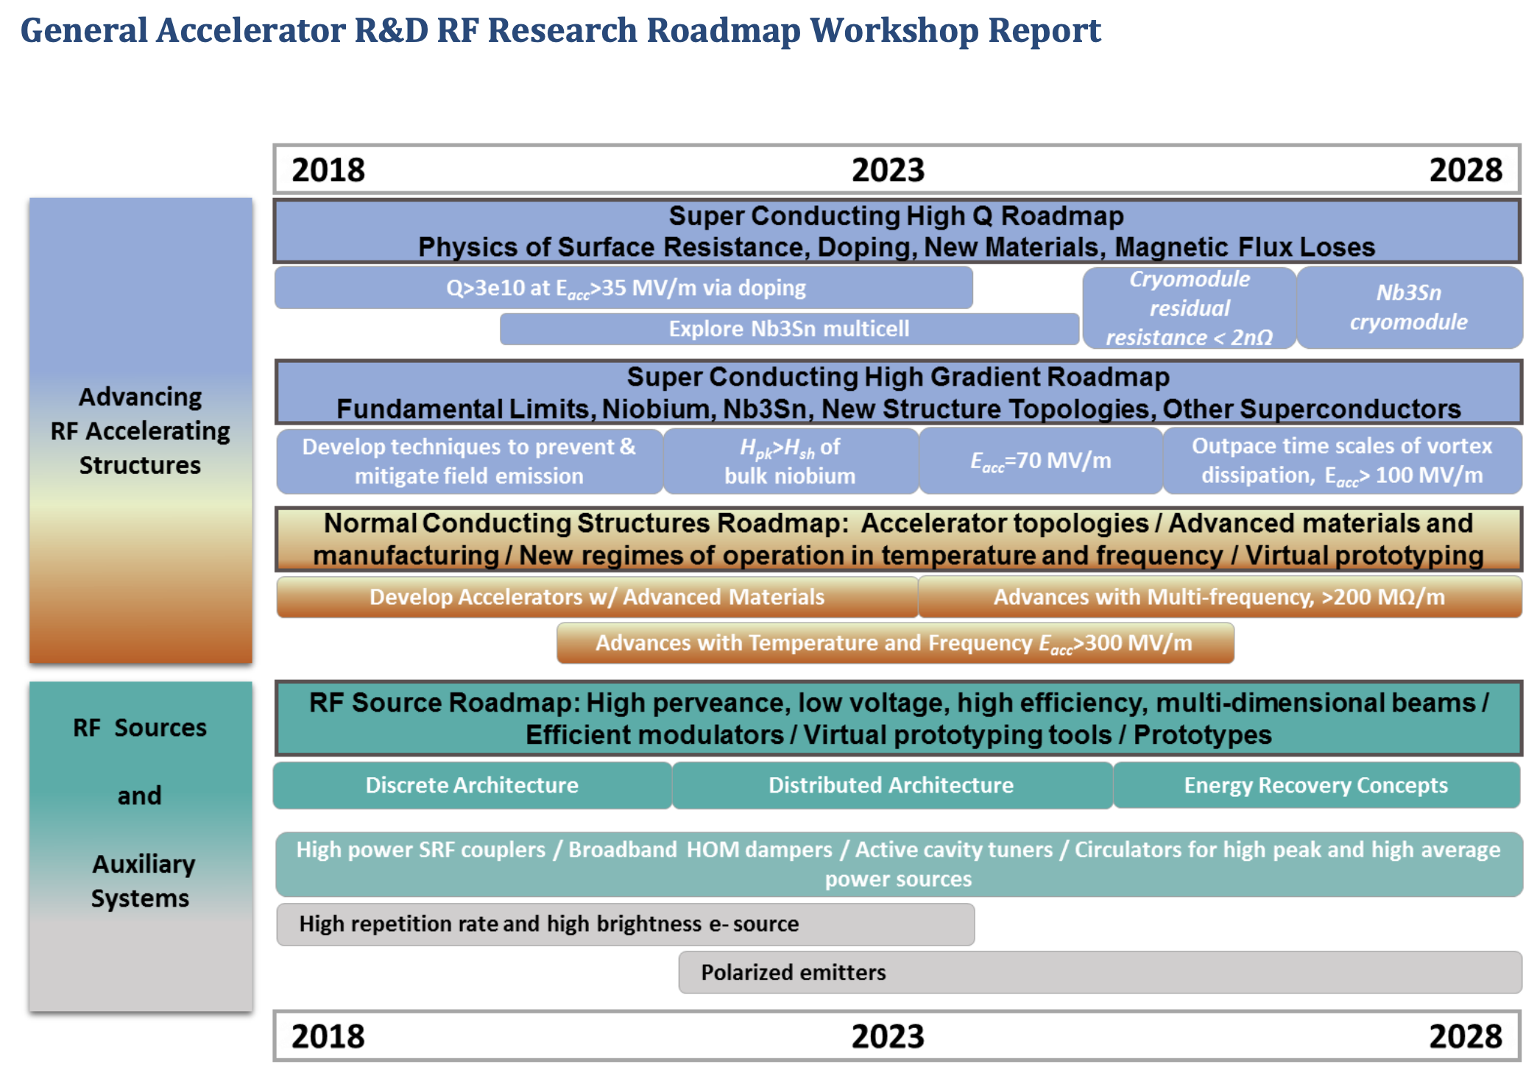
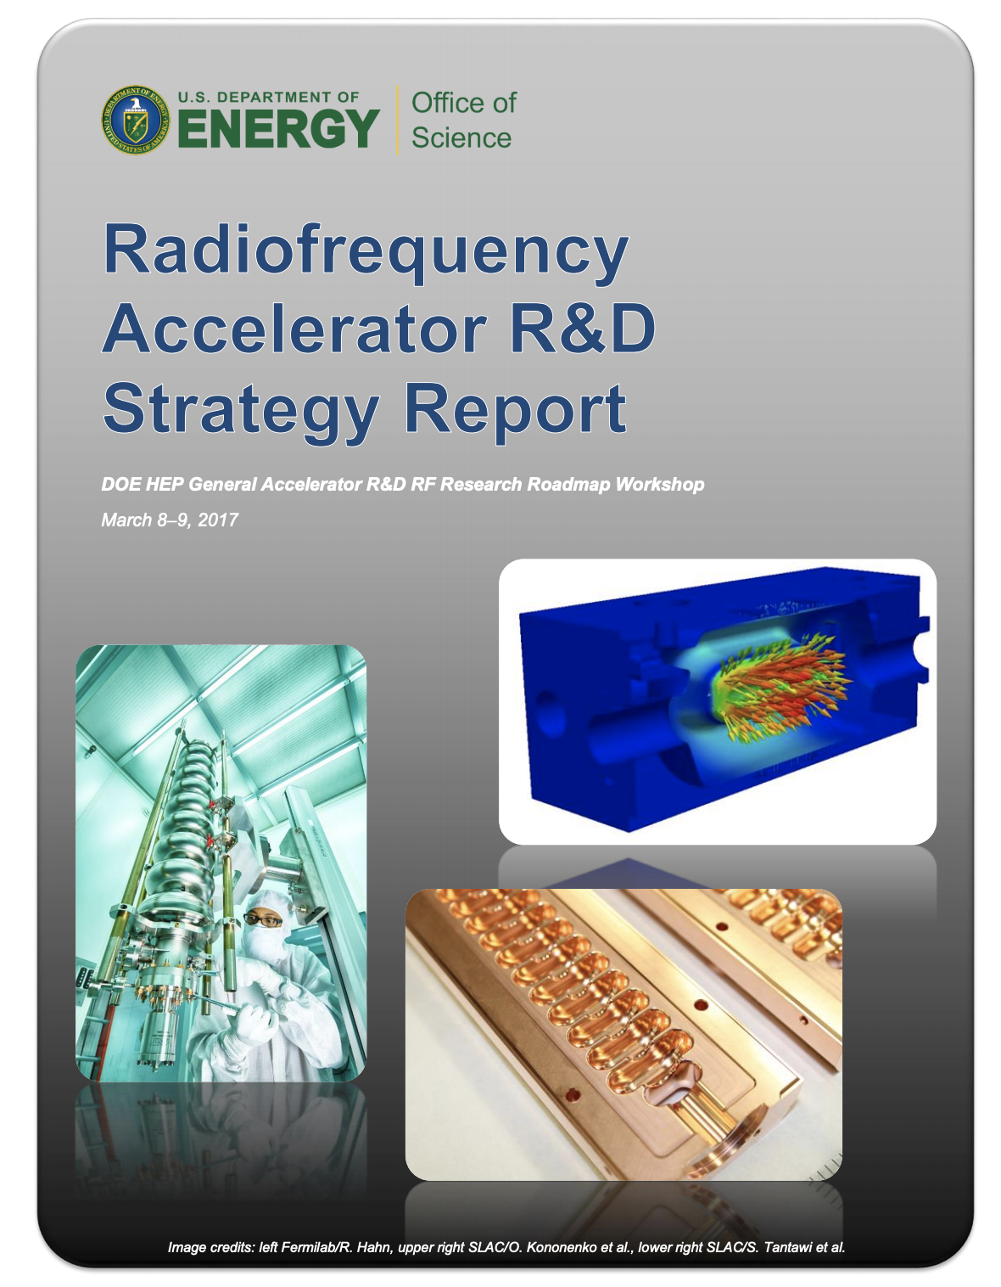
GARD RF Acceleration R&D Roadmap
Structure some discussion around DOE RF Accelerator Roadmap
  Does it capture the right topics / are we making progress?
In addition explore new or overlooked concepts/topics

Slide 18
GARD-RF R&D alignment with future HEP particle accelerators

Slide 20
Resources
Snowmass website, including upload for LOIs and contributed papers – https://snowmass21.org/start
Slack Channel – https://snowmass2021.slack.com/
GARD Roadmap https://www.osti.gov/servlets/purl/1631119
Snowmass 2013 proceedings – https://www.slac.stanford.edu/econf/C1307292/

Slide 21
Questions / Discussion Topics
Questions on Contributed Papers?
What contributions are you considering?
Can we build teams to submit contributions with strong impact?
What would those categories be for RF Systems and Sources?
Who or what would you like to hear from for future seminars ?

