Slide 1
AF7-Subgroup RF – mini-Workshop on Cavity Performance Frontier – Follow-up
Feb. 1, 2022
Sergey Belomestnykh
Emilio Nanni
Hans Weise

Slide 2
Agenda
Snowmass AF7 update
Past Cavity Performance Frontier workshop
Discussion of contributions
Last seminar
  “EIC (S)RF Systems and Technology Challenges” by Wencan Xu (BNL) and Jiquan Guo (JLAB) December 2nd, 2021

Slide 3

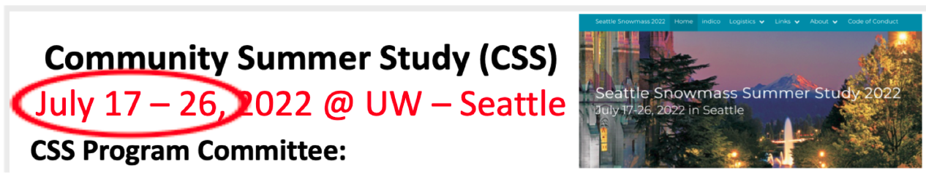
Snowmass AF Timeline
 | 2021 |  |  | 2022
 | Oct | Nov | Dec | Jan | Feb | Mar | Apr | May | June | Jul | Aug | Sep
Snowmass Timeline |  |  |  |  |  | Whitepaper Due Date: March 15th |  |  |  | Snowmass at Seattle: July 17-26
AF Timeline
AF Restart
Whitepaper Preparation
WP Initial Review
Complete AF TGC Report Drafts
Prepare Snowmass Discussion Materials
Snowmass
Final TGs and AF Report Editing
Today’s
Meeting
April 15: Requests for
Clarification (if needed)
August 31: Request POC Comments
May 30:
Preliminary TG Drafts Circulated to POCs for Comment
Executive Summaries Sent to
AF Conveners to Incorporate into Snowmass Meeting Documents
Final Reports Due September 30, 2022
Note:

Slide 4
AF7-rf: preparation of white papers
Reminder – ½ AF7-rf LOIs closer to other AF topical groups (we will review, discuss and summarize)
½ LOIs were organized into three topics and hosted workshops, seminars & discussions
Need better understanding of white paper status, organizing follow up meetings for our three topical workshops
AF7 - Subgroup RF - miniWorkshop on RF Systems and Sources Follow-Up, https://indico.fnal.gov/event/52406/ , Jan. 11th, 2022
AF7 - Subgroup RF - miniWorkshop on Innovative Design and Modeling Follow-Up, https://indico.fnal.gov/event/52407/ , Jan 18th, 2022
AF7 - Subgroup RF - miniWorkshop on Cavity Performance Frontier Follow-Up, https://indico.fnal.gov/event/52408/, Feb. 1st, 2022

Slide 5
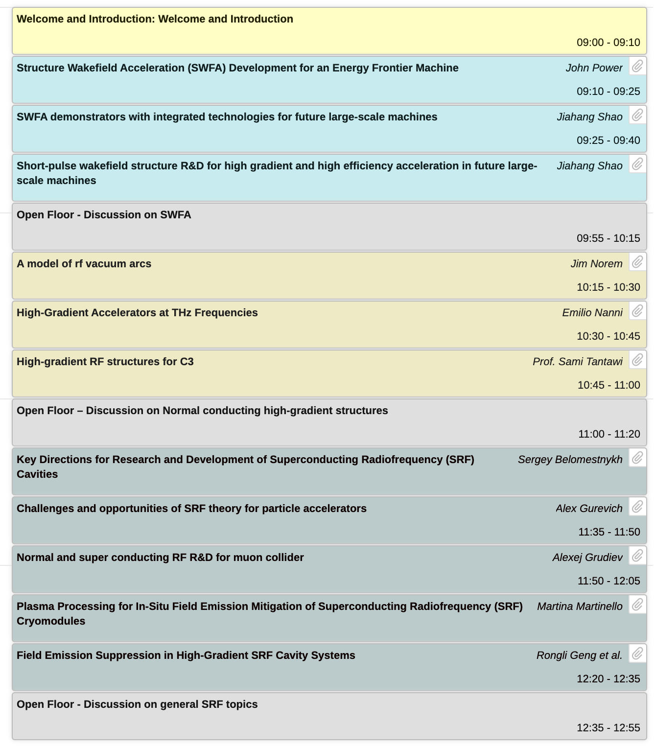
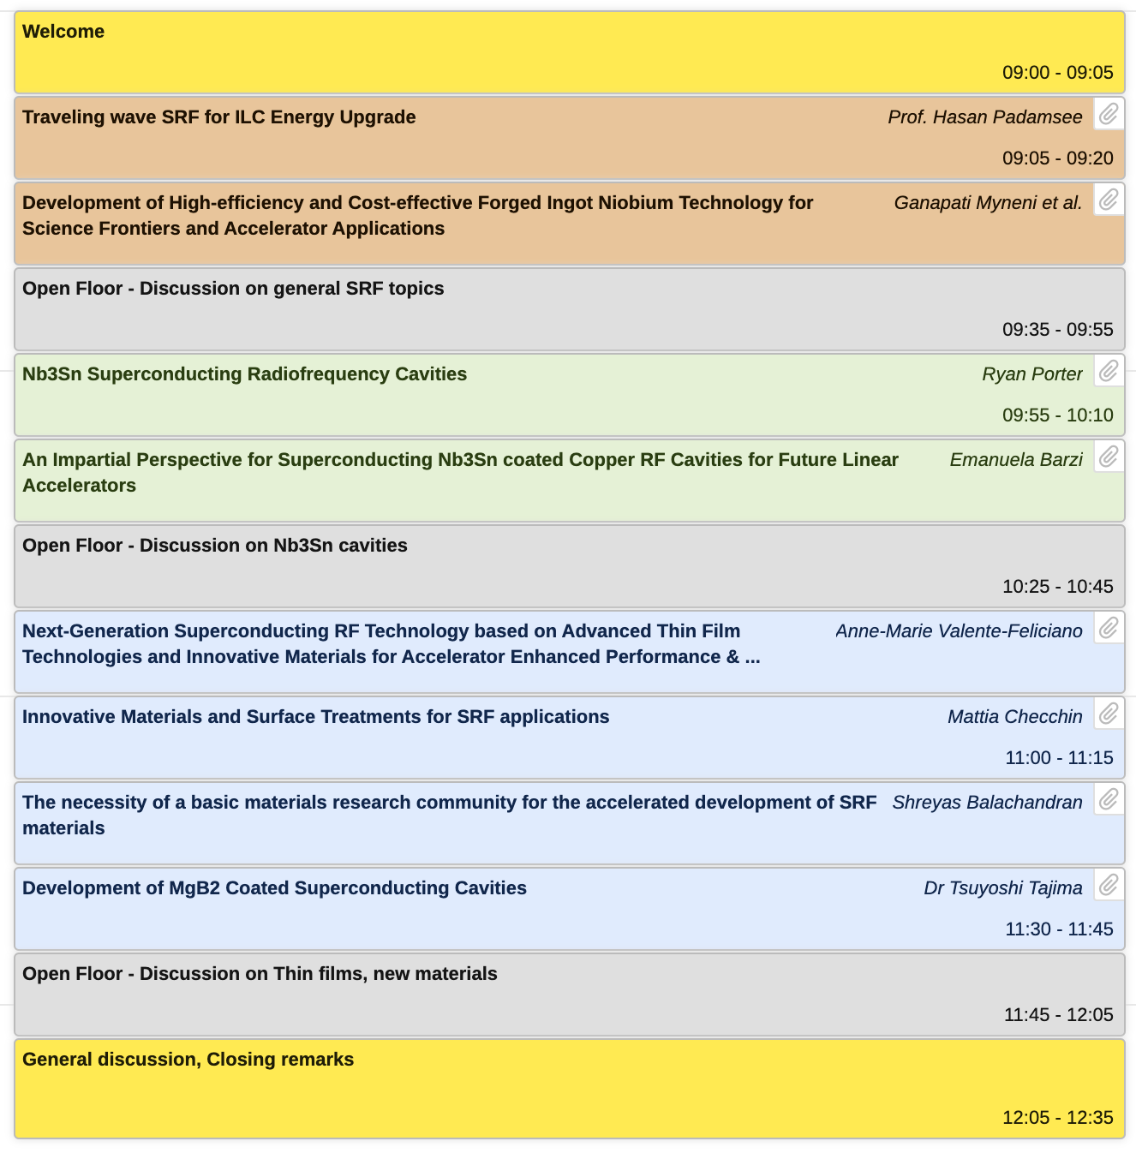
miniWorkshop on Innovative Design and Modeling Follow-up
Three groups
Structure wakefield accelerators
Normal conducting high-gradient structures
SRF R&D
19 Workshop presentations

Slide 6
miniWorkshop on Innovative Design and Modeling Follow-up
Three groups
Structure wakefield accelerators
Normal conducting high-gradient structures
SRF R&D
19 Workshop presentations
How do we turn this input into contributions?
The White Papers…

Slide 7
Snowmass Contributions Group Exercise (Anticipated)
We need CONTRIBUTORS and EDITORS for the White Papers
Title | Presenter | Contributor(s) | indiv. WP? | Editor(s)
Structure Wakefield Acceleration (SWFA) Development for an Energy Frontier Machine | John Power |  | Combined WP | Chunguang Jing
SWFA demonstrators with integrated technologies for future large-scale machines | Jiahang Shao |  |  | Chunguang Jing
Short-pulse wakefield structure R&D for high gradient and high efficiency acceleration in future large-scale machines | Jiahang Shao
A model of rf vacuum arcs | Jim Norem | E. Nanni (SLAC), potentially CLIC, PPPL, LANL | Y | Jim Norem
High-Gradient Accelerators at THz Frequencies | Emilio Nanni |  | Y | Emilio Nanni
High-gradient RF structures for C3 | Sami Tantawi |  | maybe | Emilio Nanni
Key Directions for Research and Development of Superconducting Radiofrequency (SRF) Cavities | S. Belomestnykh | Several labs worldwide | Y | S. Belomestnykh, Sam Posen
Challenges and opportunities of SRF theory for particle accelerators | Alex Gurevich | potentially Cornell, ANL | Y | Alex Gurevich, Jim Sauls
Normal- and super-conducting RF R&D for muon collider | Alexej Grudiev |  | ?
Plasma Processing for In-Situ Field Emission Mitigation of Superconducting Radiofrequency (SRF) Cryomodules | Martina Martinello |  | ?
Field Emission Suppression in High-Gradient SRF Cavity Systems | Rongli Geng |  | ?
Traveling wave SRF for ILC Energy Upgrade | Hasan Padamsee | FNAL, Cornell, Euclid TechLabs | Y | Hasan Padamsee

Slide 8
Snowmass Contributions Group Exercise (Anticipated)
We need CONTRIBUTORS and EDITORS for the White Papers
Title | Presenter | Contributor(s) | indiv. WP? | Editor(s)
Development of High-efficiency and Cost-effective Forged Ingot Niobium Technology for Science Frontiers and Accelerator Applications | Ganapati Myneni | KEK, other institutions | Y | Ganapati Myneni
Nb3Sn Superconducting Radiofrequency Cavities | Ryan Porter | Cornell, FNAL, JLAB | Y | Matthias Liepe, Sam Posen
An Impartial Perspective for Superconducting Nb3Sn coated Copper RF Cavities for Future Linear Accelerators | Emanuela Barzi | Team of international collaborators | Y | Emanuela Barzi
Next-Generation Superconducting RF Technology based on Advanced Thin Film Technologies and Innovative Materials for Accelerator Enhanced Performance & Energy Reach | A.-M. Valente-Feliciano | Several institutions worldwide | Y | A.-M. Valente-Feliciano
Innovative Materials and Surface Treatments for SRF applications | Mattia Checchin |  | ?
The necessity of a basic materials research community for the accelerated development of SRF materials | S. Balachandran | MSU, ASU | Y | S. Balachandran
Development of MgB2 Coated Superconducting Cavities | Tsuyoshi Tajima | collaborators? | likely | Tsuyoshi Tajima

Slide 9
Snowmass Contributions Group Exercise (Anticipated)
How about today’s meeting participants?
Any new interests to contribute? new ideas?
9

Slide 10
Snowmass Contributions Discussion
https://snowmass21.org/submissions/start
Knowing what contributions are coming will allow us to start organizing with AF and preparing the outline of the summary
More contributions can be good…. but we recognize this takes a lot of time
Collaborating and getting multi-institutional can increase impact
However(!) anyone should feel free/encouraged to submit a contribution they

Slide 11
Thank you!

Slide 12
Backup

Slide 13
AF7-rf LISTSERV
Dear Snowmass Accelerator Frontier / RF Accelerator Technology (AF7-RF) enthusiasts,
Please sign up and encourage others who are interested in this topic to join the list by sending a “SUBSCRIBE SNOWMASS-AF7-RF firstname lastname” (without quotation marks and substituting “firstname lastname” with their first and last names) command to listserv@fnal.gov.
You may leave the list at any time by sending a "SIGNOFF SNOWMASS-AF7-RF" (without quotation marks) command to listserv@fnal.gov.

Slide 14
Snowmass
Snowmass is a long-term planning exercise for the particle physics community, organized by the American Physical Society (APS)
Opportunity for the entire particle physics community to come together to identify and document a vision for the future of particle physics in the U.S. and together with its international partners
Contributions provide important input that influences future projects and scientific programs.

Slide 15
Snowmass 2021 Organization
10 Frontiers
  Energy Frontier
  Neutrino Physics Frontier
  Rare Processes and Precision
  Cosmic Frontier
  Theory Frontier
  Accelerator Frontier
  Instrumentation Frontier
  Computational Frontier
  Underground Facilities
  Community Engagement Frontier

Slide 16
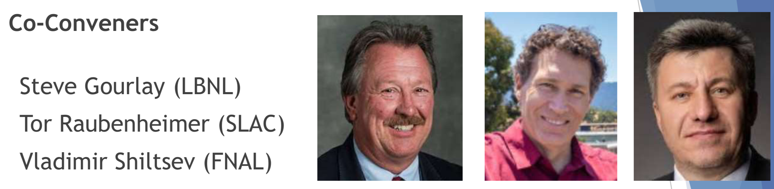
Snowmass Accelerator Frontier Organization
Frontier Conveners
Topical Group | Group Co-Conveners
AF1. Beam Physics and Education | Z. Huang (Stanford) | M. Bei (GSI) | S. Lund (MSU)
AF2. Accelerators for Neutrinos | J. Galambos (ORNL) | B. Zwaska (FNAL) | G. Arduini (CERN)
AF3. Accelerators for EW/Higgs | M. Ross (SLAC) | A. Seryi (JLAB) | Q. Qin (IHEP, Beijing)
AF4. Multi-TeV Colliders | M. Palmer (BNL) | A. Valishev (FNAL) | N. Pastrone (INFN, Torino)
AF5. Accelerators for PBC and Rare Processes | E. Prebys (UC Davis) | M. Lamont (CERN) | Richard Milner (MIT)
AF6. Advanced Accelerator Concepts | C. Geddes (LBNL) | M. Hogan (SLAC) | P. Musumeci (UCLA) | R. Assmann (DESY)
AF7. Accelerator Technology R&D
Sub-group RF | E. Nanni (SLAC) | S. Belomestnykh (FNAL) | H. Weise (DESY)
Sub-Group Magnets | G. Sabbi (LBNL) | S. Zlobin (FNAL) | S. Izquierdo Bermudez (CERN)
Sub-group Targets/Sources | Charlotte Barbier (ORNL) | Yin-E Sun (ANL) | Frederique Pellemoine (MSU/FNAL)

Slide 17
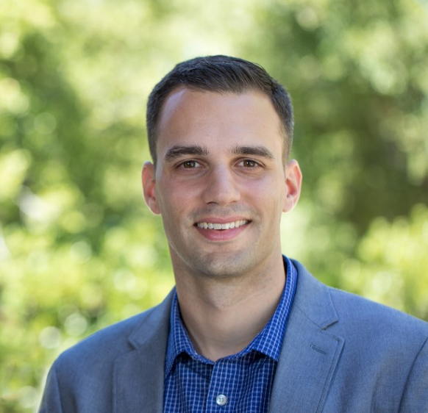
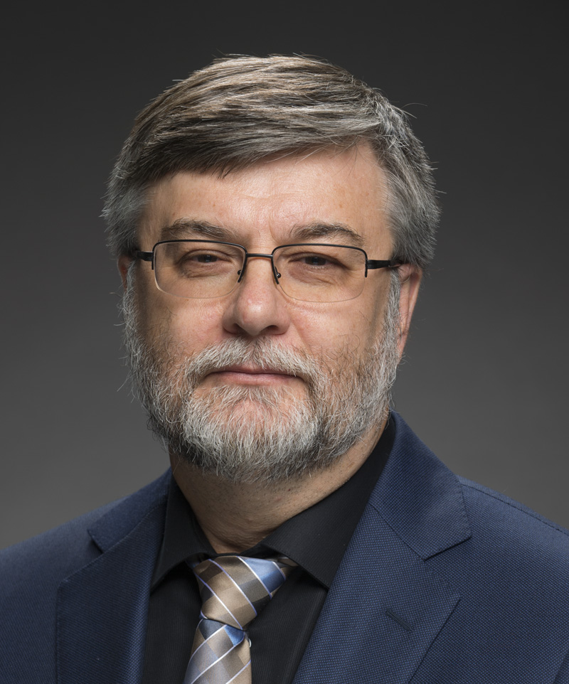
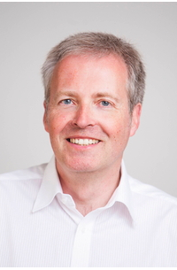
Accelerator Frontier 7: Accelerator Technology R&D
RF Subtopical Group
Accelerator Technology is the enabling foundation for accelerator-based HEP.
RF acceleration – primarily divided into SRF and NCRF, plus consideration for regions of overlap, e.g. RF sources
AF7 - RF Conveners
Emilio Nanni
SLAC
nanni@slac.stanford.edu
Sam Belomestnykh
Fermilab
sbelomes@fnal.gov
Hans Weise
DESY
hans.weise@desy.de

Slide 18
Snowmass Submissions
Snowmass submissions will take the form of Contributed Papers, such as white papers on specific scientific areas, with a maximum length of 10 pages each, due July 31, 2021 (THIS DATE MAY CHANGE)
Contributed papers are typically expected to be preceded by Letters of Interest (LoI), with a maximum length of 2 pages each, due August 31, 2020
We encourage LoI submitters to form teams for contributions (where appropriate)
Rally support behind contributions from others

Slide 19
Impact of Submissions
Snowmass is our opportunity to inform the community on R&D opportunities in our field
DOE’s P5 will follow Snowmass and utilize this information to lay out a decadal vision
  Accelerator Subpanel deliberations during the last P5 made a significant impact on resources for R&D
Contributions will have more impact if community works together
https://snowmass21.org/loi

Slide 20
miniWorkshop on RF Systems and Sources
Goal of this workshop:
  Discuss the submitted LOIs in this topic
  Learn about future research plans
  Discuss important HEP technical challenges
  Strategize as a community for our collective contribution to Snowmass
Events will be held in coming months for additional categories of LOIs submitted to AF7-rf.

Slide 21
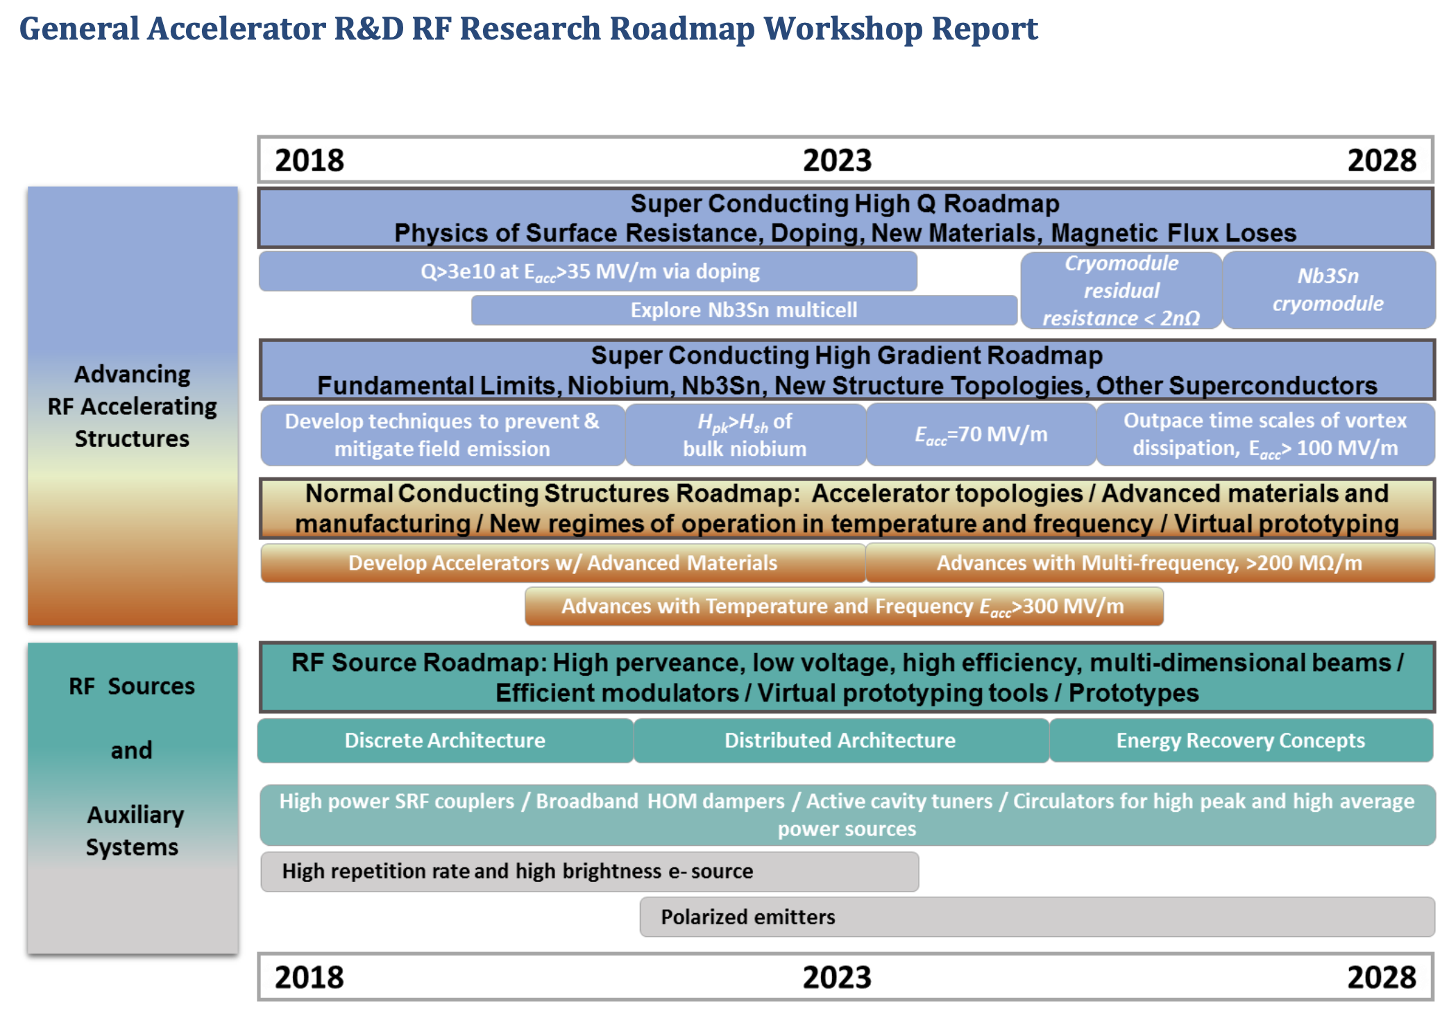
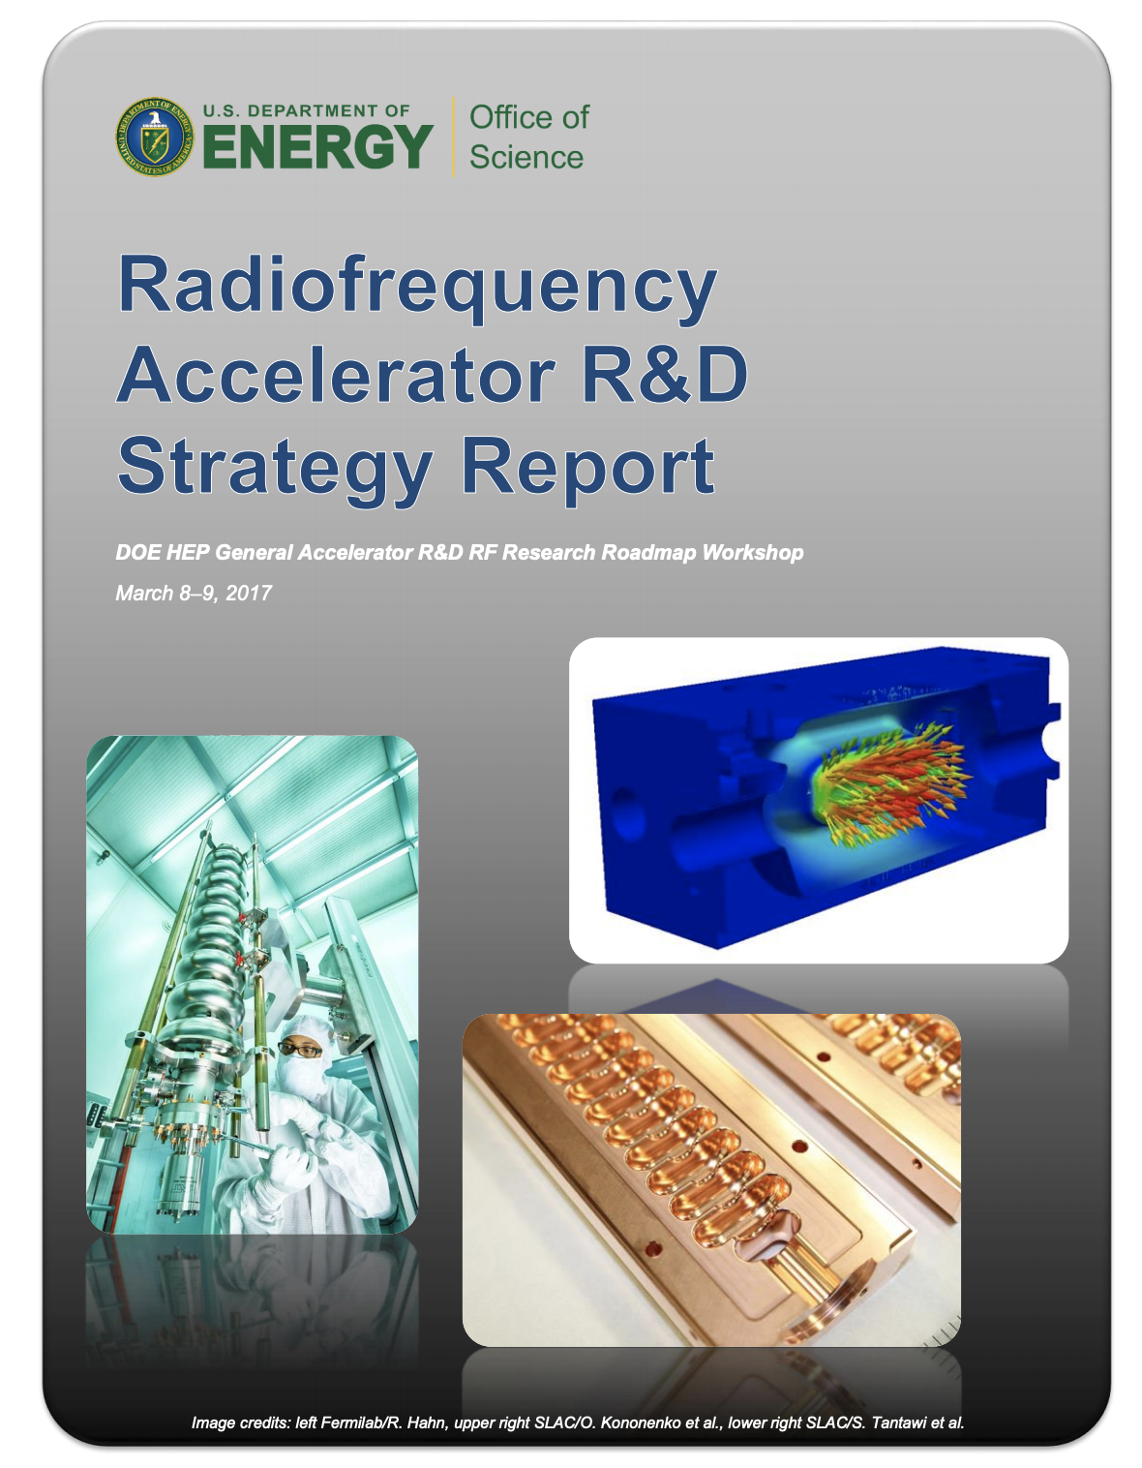
GARD RF Acceleration R&D Roadmap
Structure some discussion around DOE RF Accelerator Roadmap
  Does it capture the right topics / are we making progress?
In addition explore new or overlooked concepts/topics

Slide 22
GARD-RF R&D alignment with future HEP particle accelerators

Slide 24
Resources
Snowmass website, including upload for LOIs and contributed papers – https://snowmass21.org/start
Slack Channel – https://snowmass2021.slack.com/
GARD Roadmap https://www.osti.gov/servlets/purl/1631119
Snowmass 2013 proceedings – https://www.slac.stanford.edu/econf/C1307292/

Slide 25
Questions / Discussion Topics
Questions on Contributed Papers?
What contributions are you considering?
Can we build teams to submit contributions with strong impact?
What would those categories be for RF Systems and Sources?
Who or what would you like to hear from for future seminars ?

