Slide 1
CEF4 TG Summary Report – Status 24.May.22 S. de Jong, S. Malik, R. Ruchti
CEF4 TG Summary Report
Drafting in progress.
Overall process is ~ 85% complete.
Expected length ~ 12 pages
Awaiting further discussions for adding in synergy and interconnections and refining the text
Contributed Papers
Four CP contributions
Attached table provides links to arXiv.
Schematic Overview of Approach

Slide 2
CEF4 – Physics Education – Summary Report https://www.overleaf.com/project/623f4646a6bd6458eb0c0095 | Pages
Abstract | 0.5
1. Introduction | 1.5
2. Opportunities for Particle Physics Engagement in K/12 Schools and Undergraduate Education | 1
3. Educational Opportunities at the Graduate and Postdoctoral Level | 2.5
4. Collaborative Opportunities Across Academia | 1.5
5. International Particle Physics Opportunities for American Education | 2.5
6. Interconnections and Synergies | ~1
7. Conclusions | 0.5

Slide 3
CEF4 - Physics Education – CP Status Table
CEF4 has four Contributed Papers | arXiv references
CP2: Opportunities for Particle Physics Engagement in K-12 Schools and Undergraduate Education | https://arxiv.org/abs/2203.10953
CP3: Transforming U.S. Particle Physics Education: A Snowmass 2021 Study | https://arxiv.org/abs/2204.08983
CP1/4: Broadening the scope of Education, Career and Open Science in HEP | https://arxiv.org/abs/2203.08809
CP5: The Necessity of International Particle Physics Opportunities for American Education | https://arxiv.org/abs/2203.09336

Slide 4
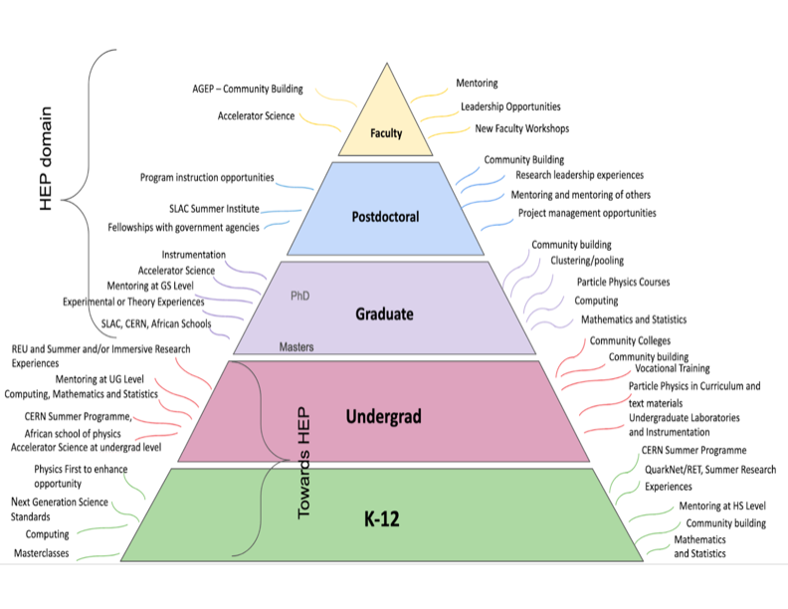
Pyramidal Education Schematic
Has helped frame the educational challenges and opportunities

Slide 5
Transmission Coefficients at each “Boundary”.
Begin with many students
End up with few reaching the top
Cultural, Geographic,
Demographic, Academic
Academic/Course Opportunities
Research Experiences
Mentoring Opportunities
Faculty engagement across institutions – R1, R2, Jr Colleges, Technical Schools
Interconnections with private
Sector
Connections with CEF1,2,3,5,6
Connections with Other Frontiers

Slide 6
Strong connections between HEP physicists and K/12 teachers and students. QuarkNet is a model.
Engage with other STEM Fields.

Slide 7
Get students into research experiences at the undergrad
level. Emphasize REU and other opportunities. Improved course offerings.
Connect with students at R1, R2, community colleges.

Slide 8
Extensive Survey
Develop skills for HEP and beyond academia. More formal training rather than peer learning. Statistics and Computer Science Courses.
Masters Degree revisitation.
Connections with Private Sector opportunities.

Slide 9
Investigate create ways faculty at R1, R2, PUI, CCs can interact and collaborate with each other and with laboratories.
Develop a broader range of research opportunities across academia.
Take advantage of Open Science opportunities.

Slide 10
Aims: Improve the overall participation in Particle physics and STEM.
Provide the skilled person power for the next two decades of HEP discovery science.
Engage at the various levels internationally.

Slide 11
CEF4 – Physics Education – Summary Report | Pages
Abstract | 0.5
1. Introduction | 1.5
2. Opportunities for Particle Physics Engagement in K/12 Schools and Undergraduate Education | 1
3. Educational Opportunities at the Graduate and Postdoctoral Level | 2.5
4. Collaborative Opportunities Across Academia | 1.5
5. International Particle Physics Opportunities for American Education | 2.5
6. Interconnections and Synergies | 1-2
7. Conclusions | 0.5

