Slide 1
Muon Colliders – Building a Vision for the Future
Mark Palmer
A personal perspective...
Energy Frontier Workshop, Brown University
4/1/2022

Slide 2
Can Muon Accelerators Address HEP Community Needs?

Slide 3
The Muon Collider Option – Step 1: Feasibility
MAP was charged with assessing “basic feasibility of the concepts”
What does this statement mean?
Rigorously, we attempted to address this from the perspective of Technology Readiness Levels (TRLs)
Aim was to identify critical issues whose maturity was in the TRL 1-3 range to ensure that viable development pathways were identified
Relative Level of Technology Development | Technology Readiness Level | Brief Description
Research to prove feasibility | 3 | Analytical and experimental critical function and/or characteristic proof of concept
 | 2 | Technology concept and/or application formulated
Basic technology research
 | 1 | Basic principles observed and reported
Energy Frontier Workshop, Brown University

Slide 4
Key R&D Challenges
Issues
Status
Target
Multi-MW Targets
High Field, Large Bore Capture Solenoid
Ongoing >1 MW target development
Challenging engineering for capture solenoid
Front End
Energy Deposition in FE Components
RF in Magnetic Fields (see Cooling)
Current designs handle energy deposition
Cooling
RF in Magnetic Field
High and Very High Field SC Magnets
Overall Ionization Cooling Performance
MAP designs use 20 MV/m → 50 MV/m demo
>30 T solenoid demonstrated for Final Cooling
Cooling design that achieves most goals
Acceleration
Acceptance
Ramping System
Self-Consistent Design
Designs in place for accel to 125 GeV CoM
Magnet system devel needed for TeV-scale
Self-consistent design needed for TeV-scale
Collider Ring
Magnet Strengths, Apertures, and Shielding
High Energy Neutrino Radiation
Self-consistent lattices with magnet conceptual design up to 3 TeV
> ~5 TeV – ν radiation solution required
MDI/Detector
Backgrounds from μ Decays
IR Shielding
Further design work required for multi-TeV
Promising initial physics studies at TeV-scale

Slide 5
The Muon Collider Option – Step 2: Detailed Technology Development & Demonstration
The next step after the feasibility evaluations has always been to mature the concepts to the level required for a full CDR
Execute an integrated effort to develop a baseline design that allows detailed component and system designs
Develop and validate individual components
Integrate components to achieve system demonstrations
This corresponds to TRL 4-6 efforts
This is the core effort proposed by the IMCC for the next ~5+ years
Relative Level of Technology Development | Technology Readiness Level | Brief Description
Technology Demonstration | 6 | Engineering/pilot-scale, similar (prototypical) system validation in relevant environment
Technology Development | 5 | Laboratory scale, similar system validation in relevant environment
Technology Development | 4 | Component and/or system validation in a laboratory environment
Energy Frontier Workshop, Brown University

Slide 6
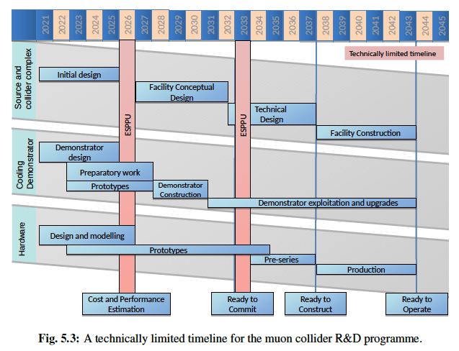
The IMCC Timeline

Slide 7
How Can We Deliver Steps 1 & 2? For any machine concept...
A US Collider R&D Program
Provide robust support for all collider-directed activities TRL 1-5,6
Sustained support required at each of these levels if the community wants to have realistic future options
Require basic research to develop options (TRL 1-3)
Require systems-level development and evaluation (TRL 4-6) to ensure that research community can make reliable assessments
This level of engagement would enable the US accelerator community to:
Participate in the IMCC
Transfer critical technical knowledge that is key to successful machine development
Preserve US involvement to preserve the possibility of a US site option
Continue work towards delivery of a mature MC design
Energy Frontier Workshop, Brown University

Slide 8
The Muon Collider Option – Step 3: Deliver a CDR for detailed community evaluation
“TRL 6 begins true engineering development of the technology as an operational system.” (DOE G 413.3-4A)
TRL 5 and 6 efforts
Enable delivery of a robust Conceptual Design Report
Set the stage for the full technical design of the facility
The CDR provides the basis for an informed decision by the community
Requires significant agency support (likely beyond the scope of the “Collider R&D” program) to deliver a robust CDR and community evaluation
Initiation of the pre-project effort
Relative Level of Technology Development | Technology Readiness Level | Brief Description
Technology Demonstration | 6 | Engineering/pilot-scale, similar (prototypical) system validation in relevant environment
Technology Development | 5 | Laboratory scale, similar system validation in relevant environment
Technology Development | 4 | Component and/or system validation in a laboratory environment
Energy Frontier Workshop, Brown University

Slide 9
The Muon Collider Option – Step 4: Enable a facility decision and move towards construction
A positive decision by the community to pursue this technology then delivers:
A full technical design
Followed by the start of construction
A technically limited effort would achieve enable a decision on the
Typically, HEP requires this level of maturity to start the Critical Decision process
Relative Level of Technology Development | Technology Readiness Level | Brief Description
System Commissioning | 8 | Actual system completed and qualified through test and demonstration.
 | 7 | Full-scale, similar (prototypical) system demonstrated in relevant environment
Note: TRL 9 corresponds to a facility operating at its design specification
Energy Frontier Workshop, Brown University

Slide 10
The Muon Collider Option – Conclusion
If we want to have a future US HEP Collider option, there must be a route for the support of direct Collider R&D
A critical outcome for this Snowmass is to make that case clear to the funding agencies
For the Muon Collider option:
Full engagement with the IMCC is expected to deliver MC advances that set the stage for an informed decision about the MC pathway within the next decade
Energy Frontier Workshop, Brown University

