Slide 1
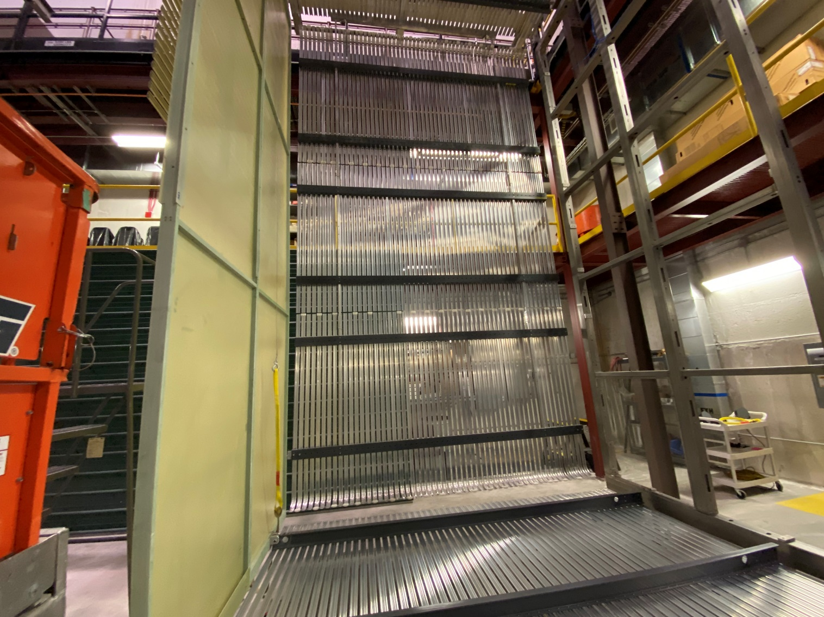
Ash River Installation Coordination
Monthly Report-December 2021
Tom Wieber
Charles Cadeau
University of Minnesota
TPC drift for ProtoDUNEII & Inverted APA @ Ash River

Slide 2
DUNE Workshop prep
pDUNE workshop concluded 11/18
Short Thanksgiving week
2 weeks to prep/transition pDUNE → DUNE
Outstanding shout out to Ash River crew making this possible!
Less Tom @ CERN for CR board retrofit
Prerequisites to Dec 13 DUNE workshop
CPA center nuts were fabricated to old spec, outside shop modified to latest design specs
Load test the CPA trolley
Determining the load rating wasn’t easy
Mark row 25 locations and drill holes for APA/CPA (Thanks Justin)
Figure out where the ‘high’ of the cold membrane is on the floor and mark out

Slide 3
DUNE Workshop December 13-16, 2021 Goals ← Google photo album link
Test the APA doublet installation with CERN trolleys and cable trays trolleys
Cable tray trolley interference issue unique to Ash River, need to figure out
Test the installation of the CPA with the new trolleys
Latest picking method still valid and works
Test CPA and APA Hanger supports and removal of trolleys
Could not try, shifted TPC
Verify that trolleys do not hit cryostat wall east side
No interference expected
Test the removal of the runway beams
Possible, additional tooling may be required
Test the installation of the end wall and lifting tooling
Communication between aerial and ground crew needs attention
Test the endwall pushing system
Works, modifications needed
Verify that the scissor lift can be removed from the cryostat after deployment.
Requires dissassembly
Test deployment of the field cages
Revisions to existing tooling required

Slide 4
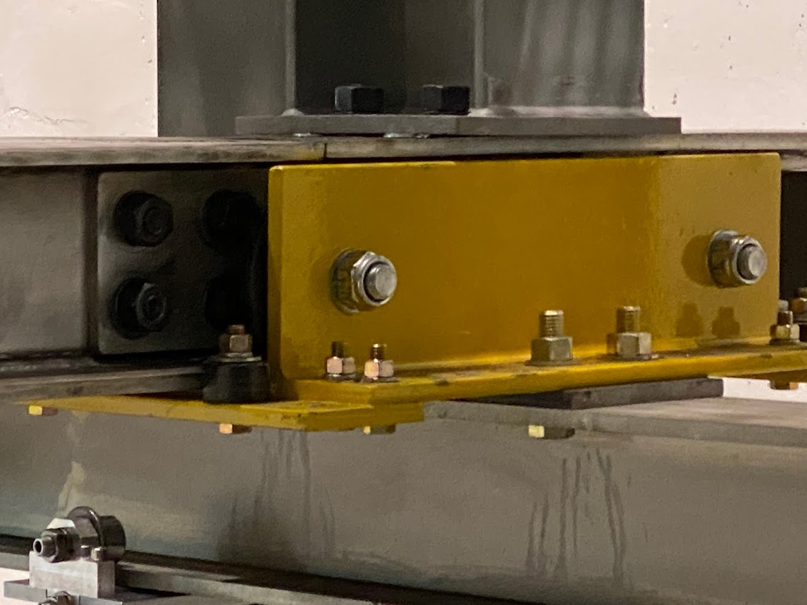
Workshop follow-up
East DSS stubs ~7cm too long
Verify against model and ensure trolley clearance
Shuttle beam trolleys require modifications to allow access to install bolts
Engineering checking requested clearance hole
Modify cable tray base plates that are too wide
12m APA needs mechanism for techs to hold during translation on the shuttle beam
Next three slides taken from Workshop Lessons Learned Document

Slide 5
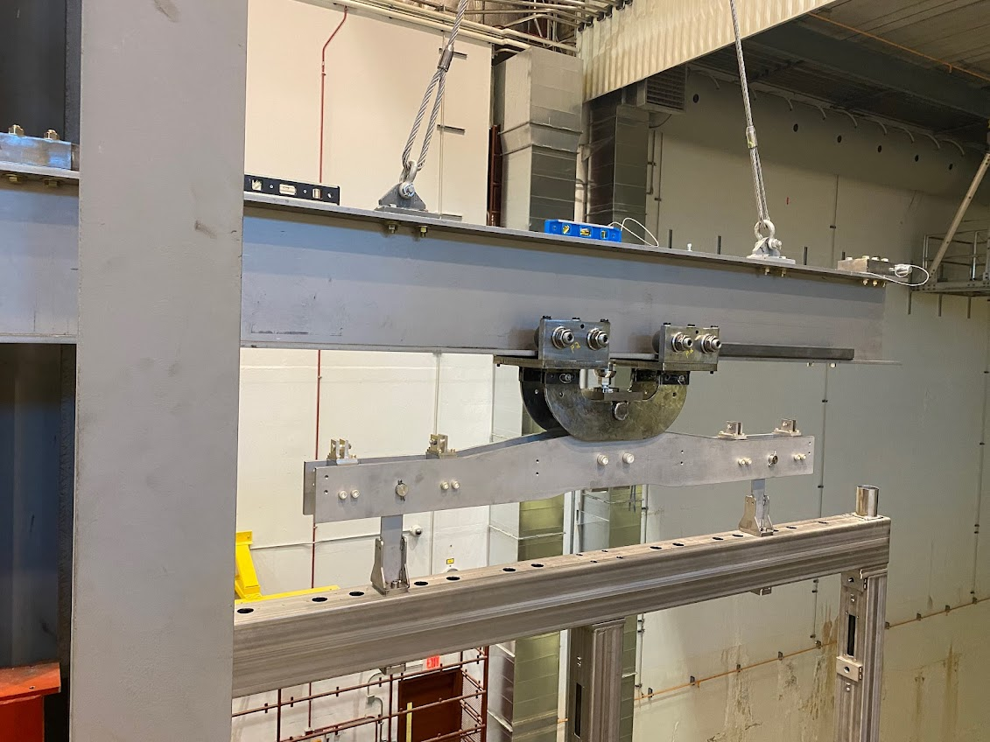
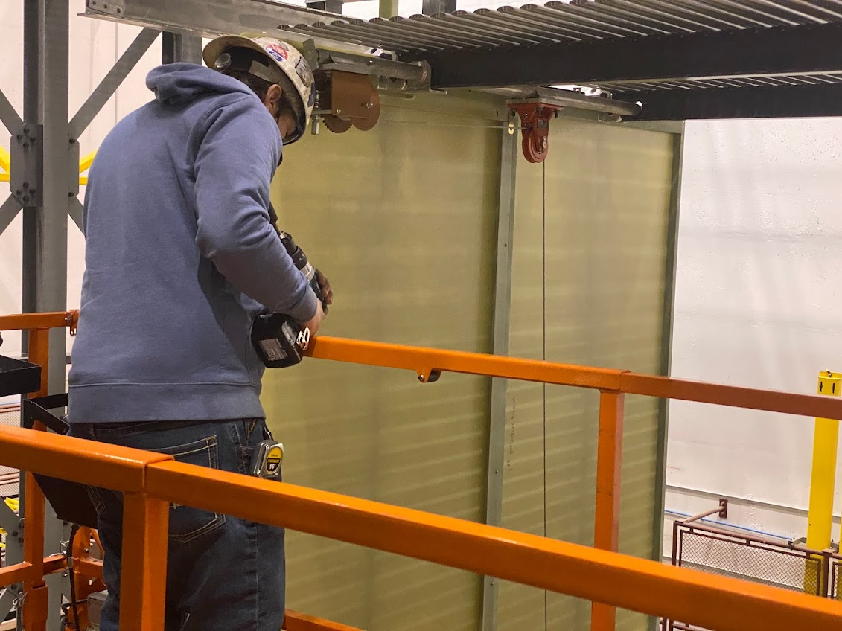
Workshop follow-up
Figure out a way to transfer APA doublet with cable tray off assembly tower
Runway beam removal is tight, method of pushing out or adding gap tolerance needed
Possible to translate the beam using EW style pushing mechanism?
Design/fabricate tool to hold bottom FC upright
Design/fabricate tool to hold CPA when deploying one FC
Bottom FC deployment tool needs to lose weight and installation help aid for scissor lift

Slide 6
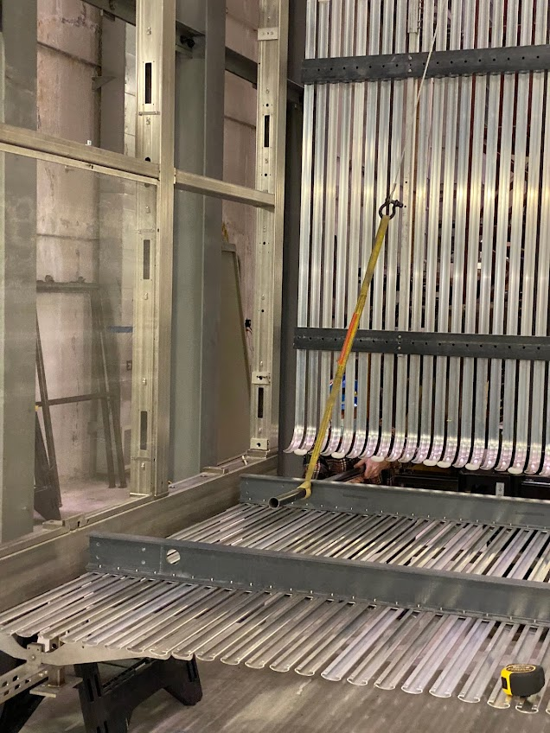
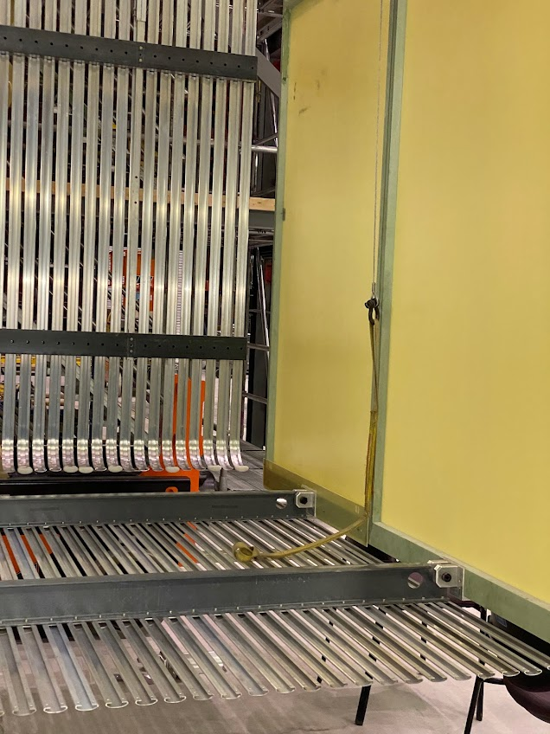
Workshop follow-up
Investigate bottom FC non-metal hook & cable
Check/measure EW swing with test weights for HV consortia
Drill holes in CPA for EW bracket
Revise EW pusher
Repeat EW hoist installation with runways removed
Check for tool installation interferences @ Ash River and model

