Slide 1
Computing Resource needs for 2022-23
H Schellman
January 26, 2022

Slide 2
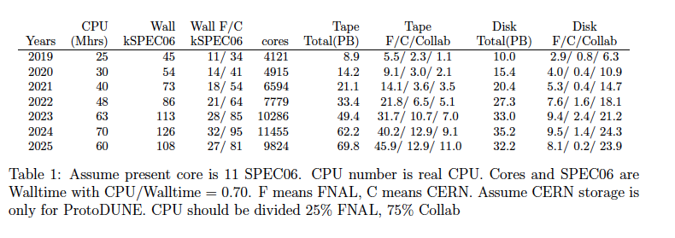
Requests from dune docdb-23419

Slide 3
Actual #’s for 2021

Slide 4
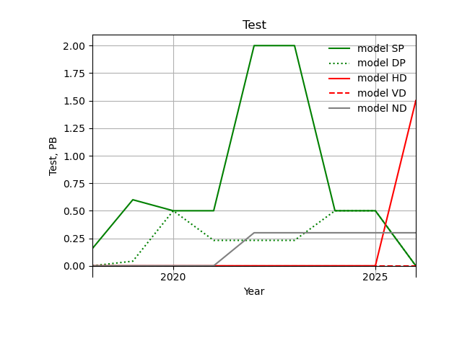
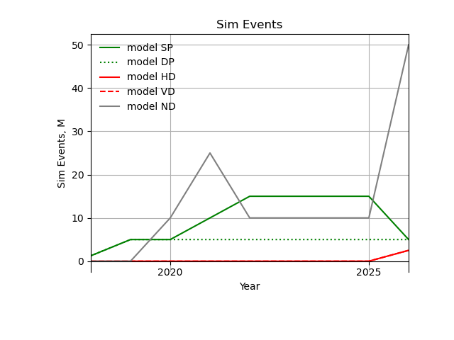
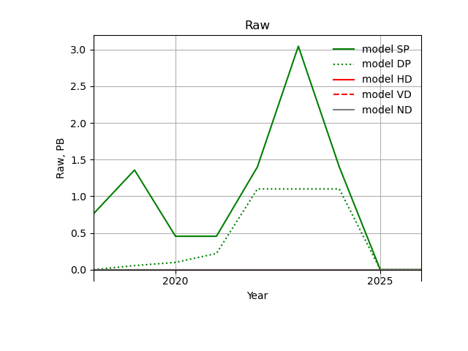
Resource estimates to 2026
2 copies of raw data on tape (+ 1 copy on disk if possible)
1 copy of “test” data stored for 6 months
1 copy of reco/sim on tape
Currently assume 1 reco pass over all data and 1 sim pass/year
Assume reco/sim resident on disk for 2 years
Assume 2 disk copies of reco and sim
impose shorter lifetimes on tests and intermediate sim steps.
Assume ProtoDUNE runs in late 2022 and early 2023. 20 M physics events in 2022 and 43M in 2023.
+ commissioning

Slide 5
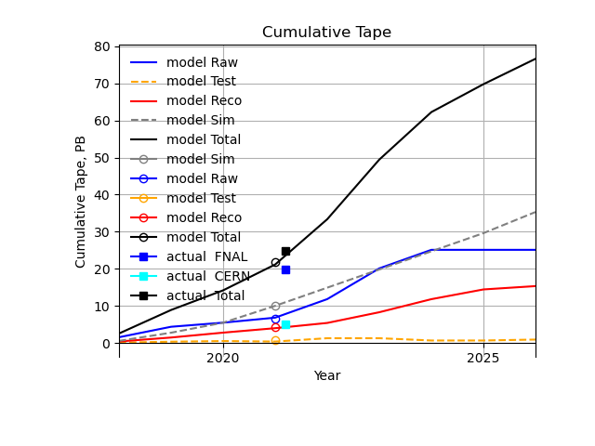
TAPE
Catalog sizes, PB
"Sim":10.0,
"Raw":3.3,
"Test":1.7,
"Reco":4.3
without duplicates
Actual size, PB
"FNAL":19.804,
"CERN":5.02
Catalog sizes count each file once
Model sizes apply replication rules
Actual includes multiple copies.
lines are projections used to make the request in July 2021
open circles are validation based on actual 2021 numbers

Slide 6
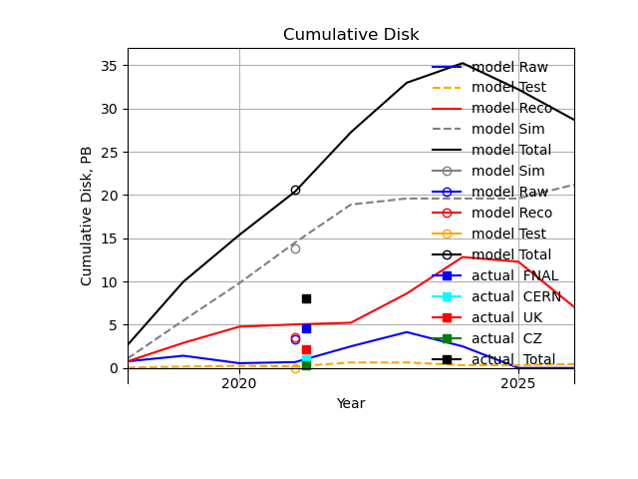
DISK
Catalog sizes, PB
"Sim":6.9 (last 2 years)
"Raw":3.3, (mainly cosmics)
"Reco":1.75, (last 2 years)
"Test":0.0
reported sizes from rucio, PB
"FNAL":4.6, (cache)
"CERN":0.975, (eos)
"UK":2.177,
"CZ":0.30
more being added to rucio
Catalog sizes count each file once
Model sizes apply replication rules
Actual includes multiple copies but is incomplete
lines are projections used to make the request in July 2021
open circles are validation based on actual 2021 numbers

Slide 7
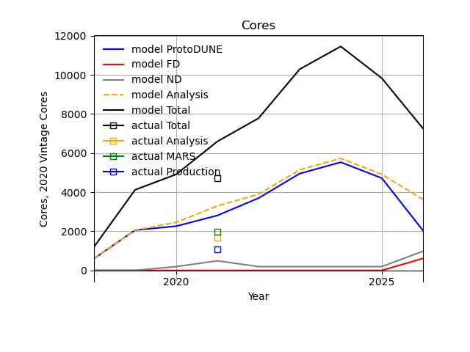
CORES
2021 measured
Analysis = 1679 cores
MARS = 1963 cores
Sim = 1062 cores
Total = 4703 cores
core ~ 11 SPEC06
lines are projections used to make the request in July 2021
squares are actual 2021 numbers

Slide 8
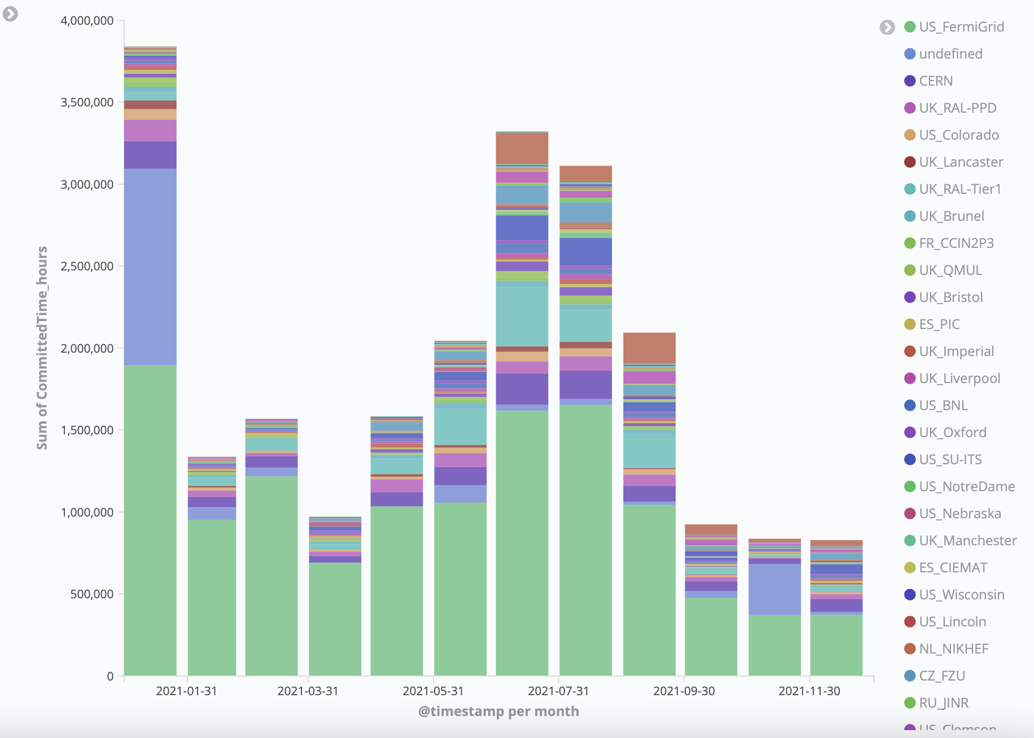
CPU utilization for 2021 without MARS

Slide 9
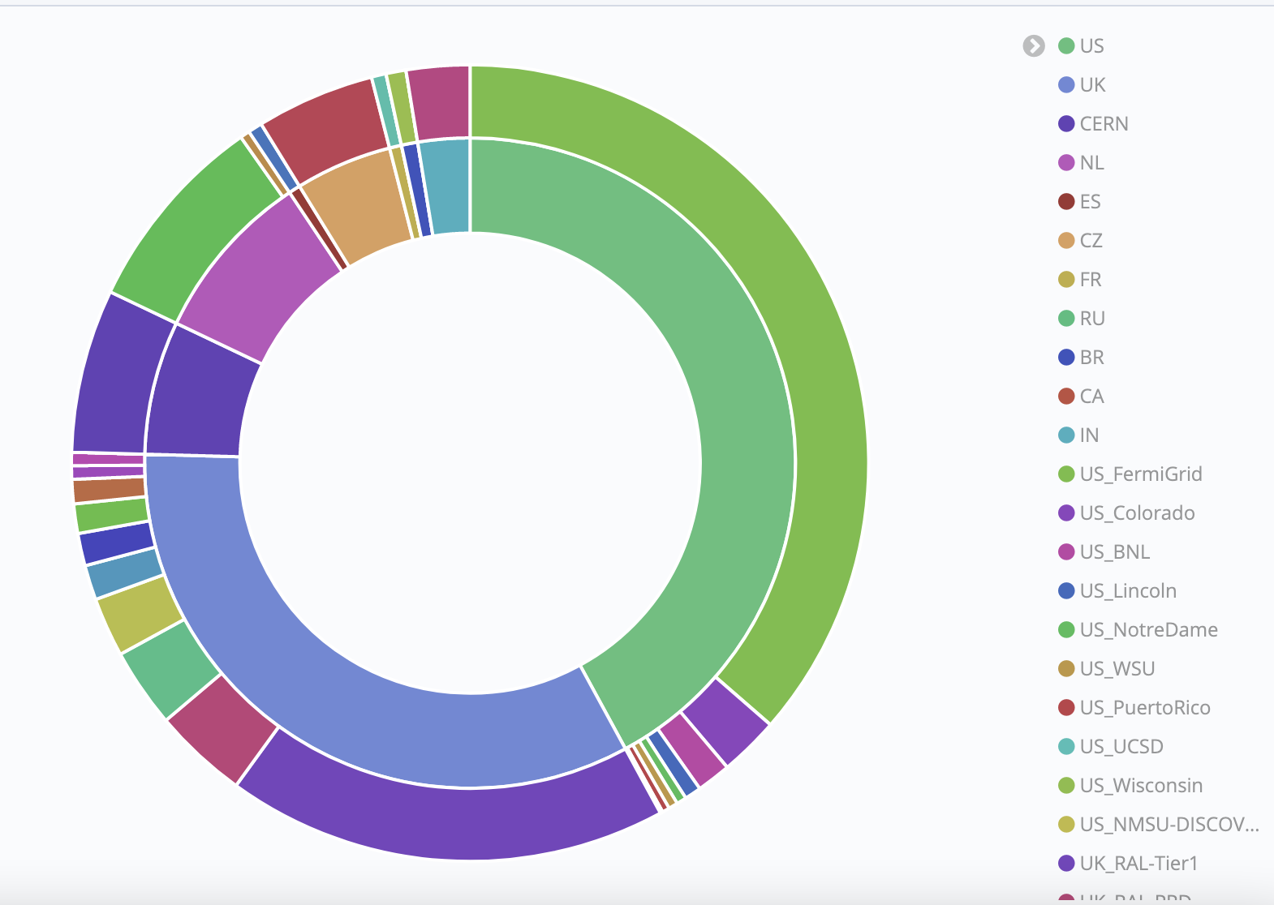
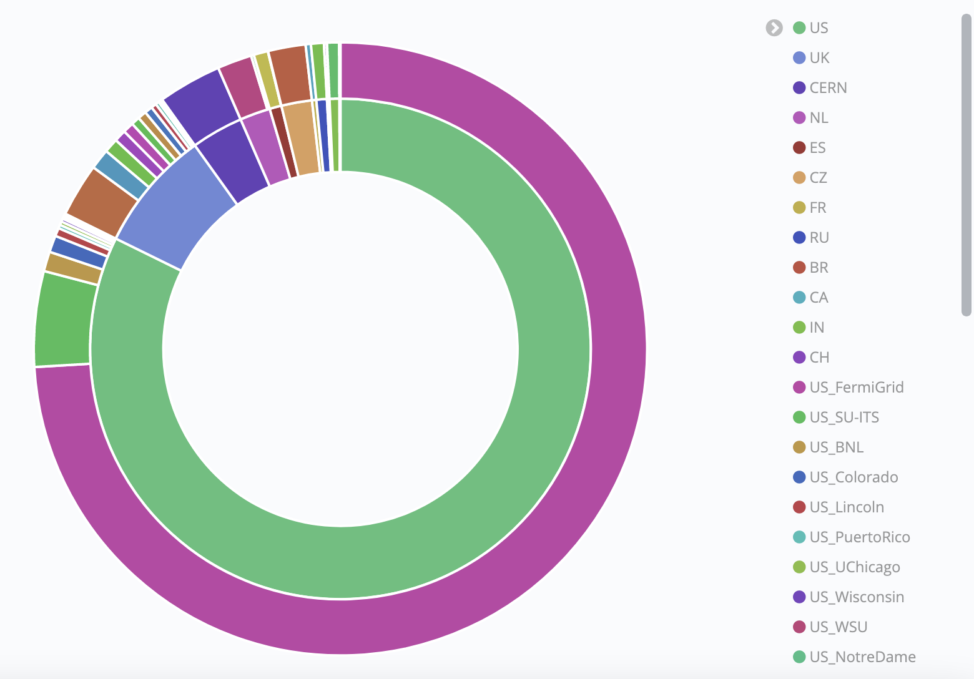
Where we are now: Analysis is moving offsite
This shows August 2021core-hrs contributions to analysis
US sites are contributing as are many sites worldwide

Slide 10
Why two copies on disk
FNAL+CERN does not have enough disk to keep one copy of all useful samples live at all times. Sim +reco for last 2 years is close to 9PB and we also need to stage raw data for reprocessing. Prestaging has been a major hurdle for the analysis efforts!
Analysis jobs are IO bound. The closer the disk the better.
We are moving files to the available rucio controlled space in Europe and India. Partial raw data and beam data/sim samples for ProtoDUNE.
SAM now has simple routing enabled to use local data when available and use data from Europe when in Europe. Should raise efficiency significantly. Same expected for India once enabled. Proposed data access/workflow systems will make this even more efficient.

Slide 11
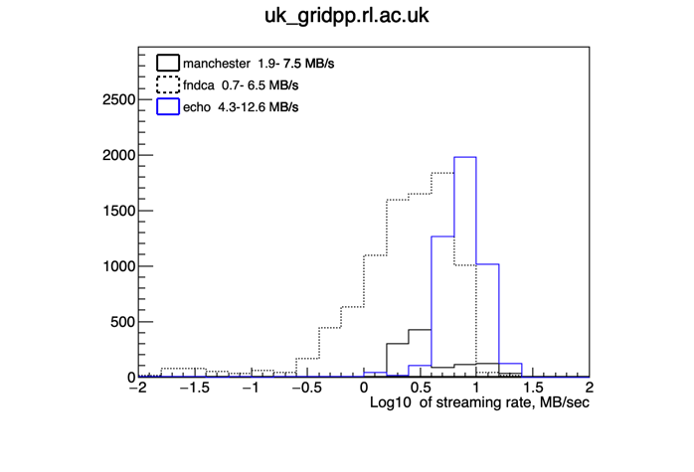
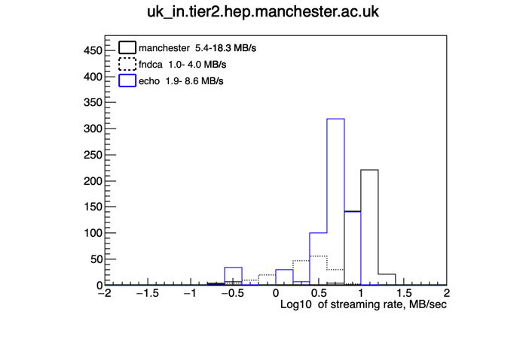
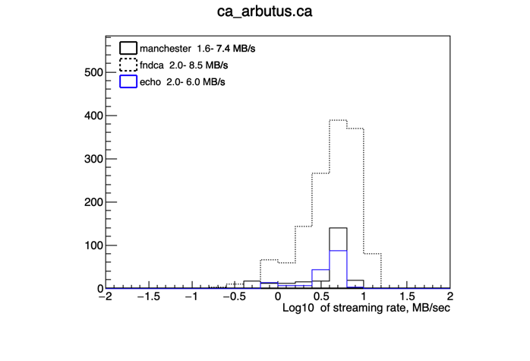
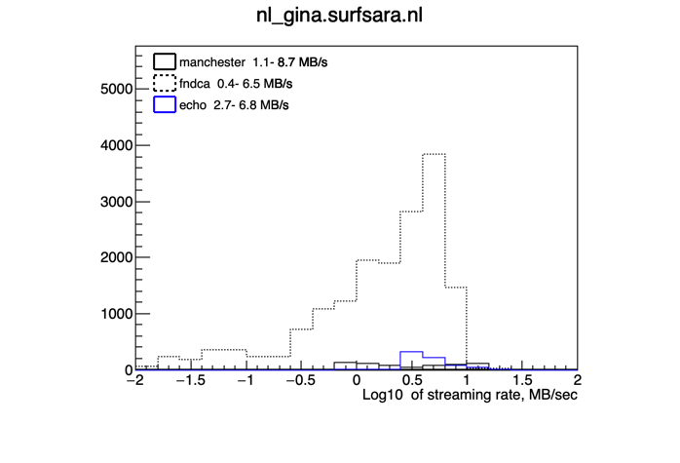
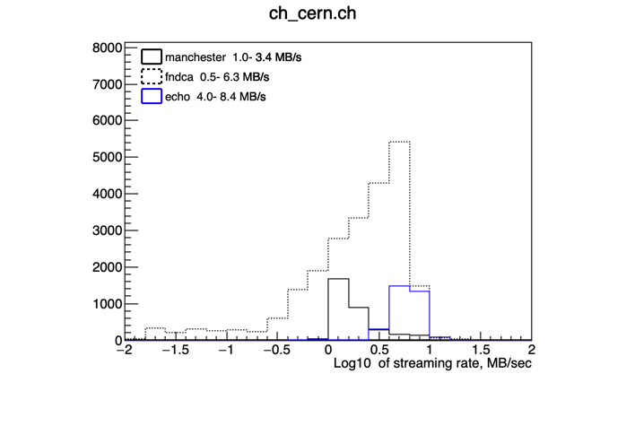
Log 10 of Streaming rates for different site disk combinations (pdspana) No difference between sites for sim or reco (~0.1 MB/s)

Slide 12
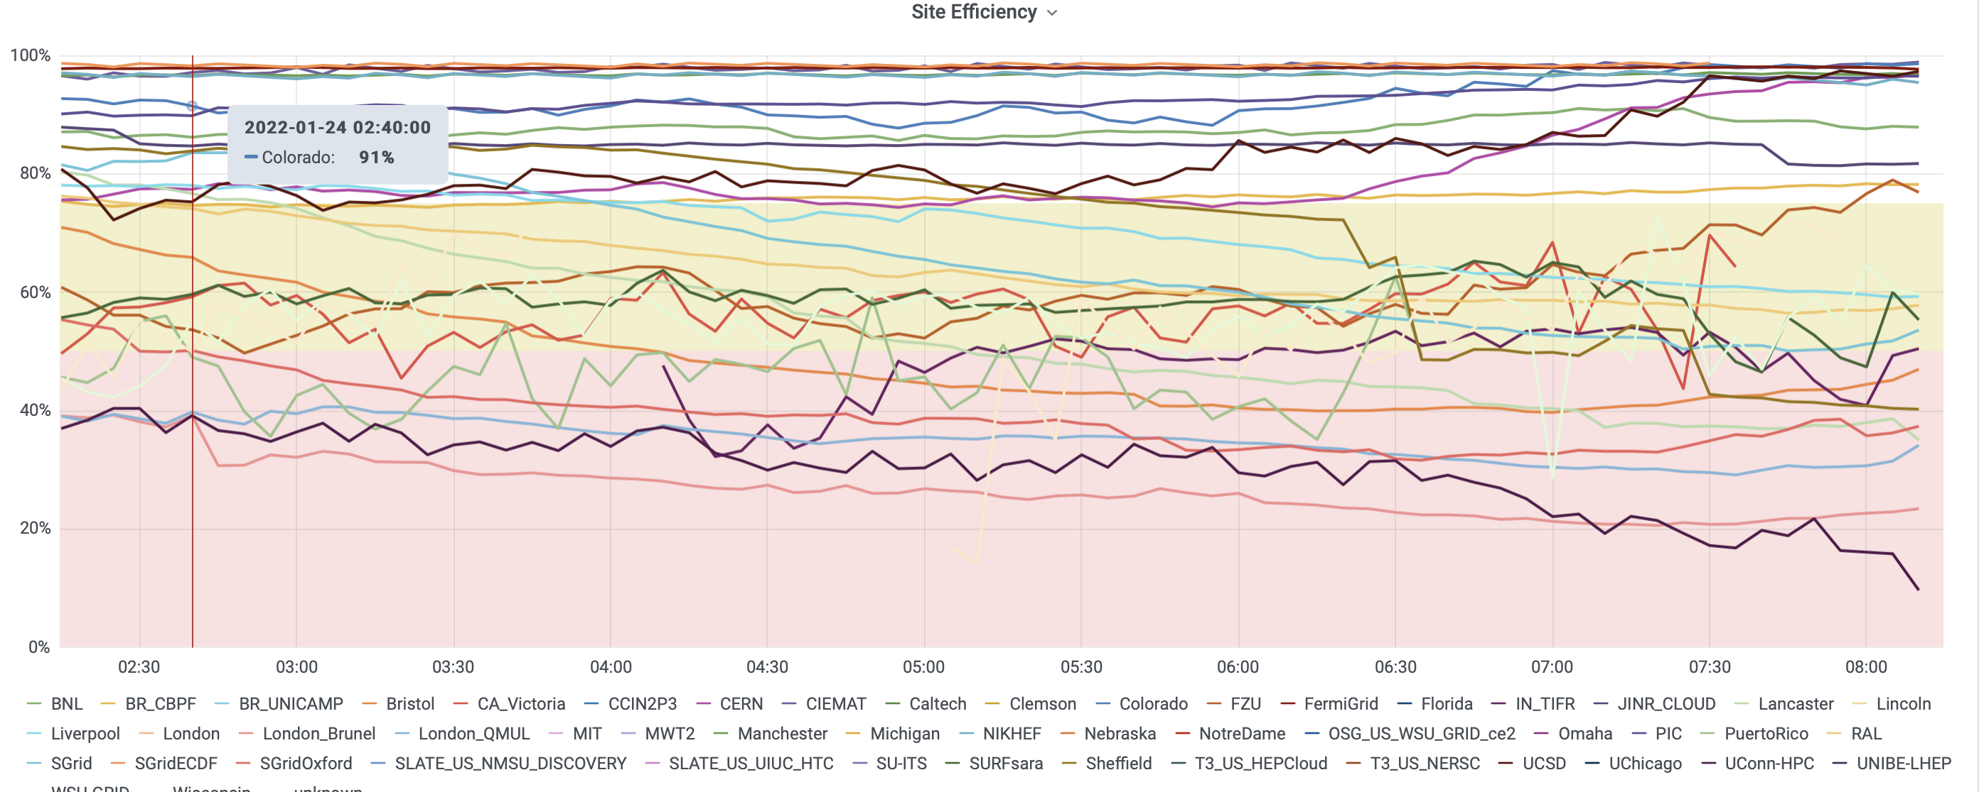
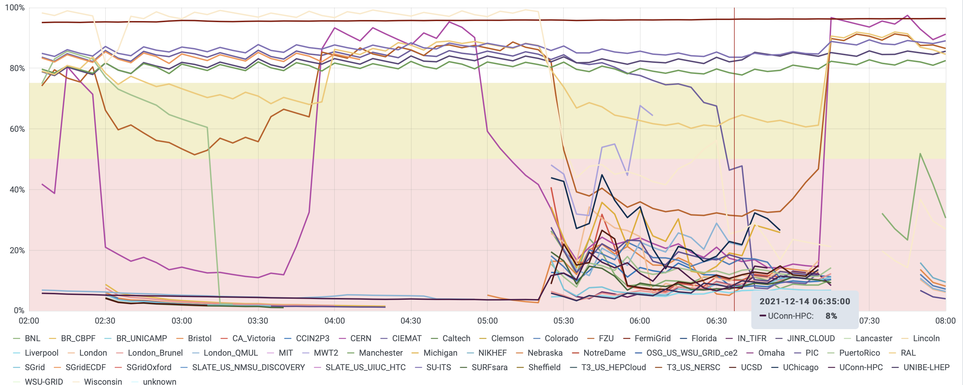
Recent site efficiencies. Mix of analysis and production
1/24/22 After sam optimization
Analysis jobs are still IO limited to ~ 50% efficiency
12/13/21 before sam optimization

Slide 13
Disk and CPU request
 | Cores requested | Cores pledged | Cores used | Disk request PB | Disk pledged PB | Disk used PB
2021 | 6594 | 11536 | 4700 | 20.4 | 13.0 | 9.0
2022 | 7780 | ~10095 | --- | 27.3 | 19.0
2021 request was based on assumption that PD II started in late 2021.
Disk was also underutilized in 2021 due to rucio startup. Rucio is now being brought up across sites and will fill pledged disk over next month. More will be needed to accommodate live disk copies of all sim/reco.
Disk/CPU increase in request from 2021 to 2022 driven by needs of the protoDUNE runs ProtoDUNE-II runs (VD coldbox, HD coldbox, ProtoDUNE-HD/VD commissioning, beam, cosmics)

Slide 14
Why so much more disk and CPU needed in 2022-2023?
Need to move more samples to collaboration disk for fast access
Expect to take significant ProtoDUNE RunII data before April 23
In 2018 we logged around 3.5 PB of raw and reconstructed data over a few months.
this is built into the model and explains the increase of 7 PB from 2021-22 to 2022-23
commissioning and Beam run

Slide 15
Matching pledges to needs
Requests for 2022-2023 are significantly larger due to the PD II running.
Here is how we can prioritize to use pledged resources effectively.
Disk - pledge < full need
Prioritize protoDUNE 2 raw and reconstructed data for disk
Must reduce # of available copies and/or disk lifetimes for samples.
Some samples will need to be staged from tape.
Cores - pledges > request but we can still optimize
Prioritize data and calibration samples
Rely more on opportunistic resources
Continue optimization of analysis job placement to raise efficiency

