Slide 1
Buncher Ring for a CLFV Muon Program
Eric Prebys, UC Davis

Slide 2
Outline
Review: the Mu2e experiment
After Mu2e
  Mu2e-II
  Beyond Mu2e-II (The need for an FFA)
Review: PIP-II
Competing needs for a compressor
  LBNF
  CLFV
Compressor parameters
Challenges

Slide 3
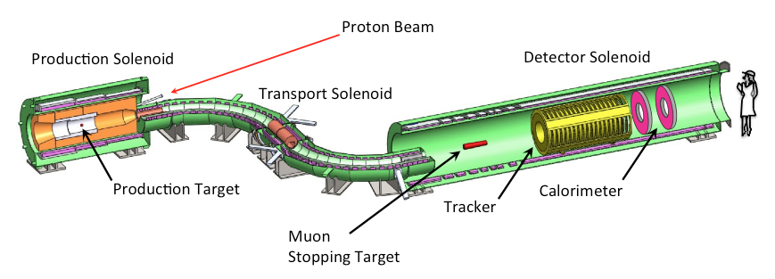
Reminder: the Mu2e Experiment
Production Target
  Proton beam strikes target, producing mostly pions
Production Solenoid
  Contains backwards pions/muons and reflects slow forward pions/muons
Transport Solenoid
  Selects low momentum, negative muons
Capture Target, Detector, and Detector Solenoid
  Capture muons on target and wait for them to decay
  Detector blind to ordinary (Michel) decays, with E ≤ ½m_{μ}c²
  Optimized for E ~ m_{μ}c²

Slide 4
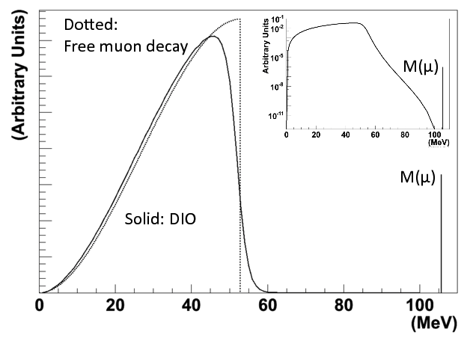
Decay-in-orbit Spectrum Motivates Detector Specs
We want to be blind to this (acceptance)
We must resolve this
(target and tracker mass)

Slide 5
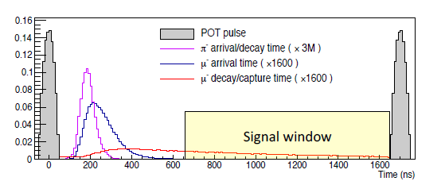
Beam Requirements
Most backgrounds are prompt with respect to the arrival of the muons to the capture target
  The most important are radiative decays due to residual pions!
The previous best experiment was limited by the need to veto around the arrival of every charged particle.
Solution: pulsed beam
“Straggling” through solenoids (put a pin in that!)

Slide 6
Mu2e Goals
3.2x10²⁰ protons on target
(3 years @ 8 kW)
~.4 background events
Bottom line:
  Single event sensitivity: R_{μe}=3x10⁻¹⁷
  90% C.L. (if no signal) : R_{μe}<7x10⁻¹⁷
  Typical SUSY Signal: ~40 events or more
Four order of magnitude improvement over previous best experiment (SINDRUM-II)

Slide 7
After Mu2e
Mu2e doesn’t see signal?
  Keep searching at higher sensitivity
  Going to higher-Z targets will enhance conversion probability
Mu2e sees signal?
  More running to increase precision and study nature of signal.
  Most important: dependence on the capture target!
Common
  More beam
  Higher-Z targets

Slide 8
Potential Future Plans
Mu2e-II
  Redo the Mu2e experiment using beam directly from the PIP-II linac (8 GeV -> 800 MeV)
  8kW->100 kW
    ~10 times the statistics
  Unless the signal from Mu2e is large, we’ll still be limited to aluminum or slightly heavier as a target.
  I’ll say very little about this.
ENIGMA
  Goal: 1 MW at 800-2000 MeV (depending on PIP-II upgrades)
    Cannot be done directly with PIP-II beam
  Other significant issues going to higher statistics and heavier targets.
  Let’s talk about those…

Slide 9
Target Nucleus Issue
We would like to go to higher Z nuclei either to enhance the rate if we don’t see a signal or to study the A-dependence if we do;
HOWEVER, heavier nuclei dramatically shorten the lifetime of the bound muons, which runs into problems with the long beam straggling time
    Example: The probability of interaction for a gold nucleus would be enhanced by ~1.5-2 relative to aluminum, but the lifetime goes from 880 ns to only 73 ns!
This curve would be dramatically shortened, so all the muons would decay away before the live window

Slide 10
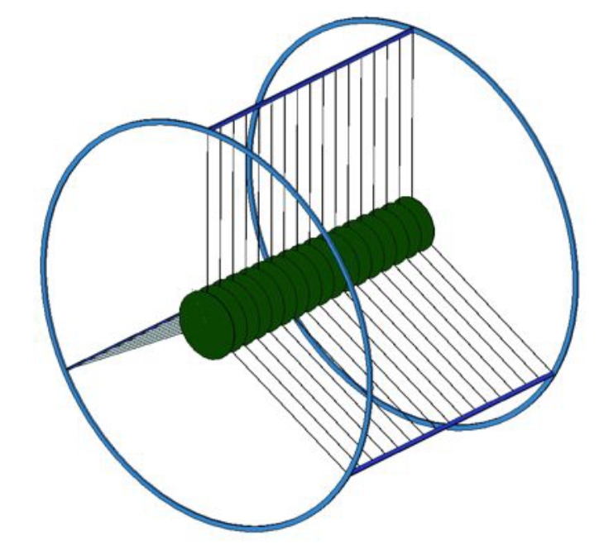
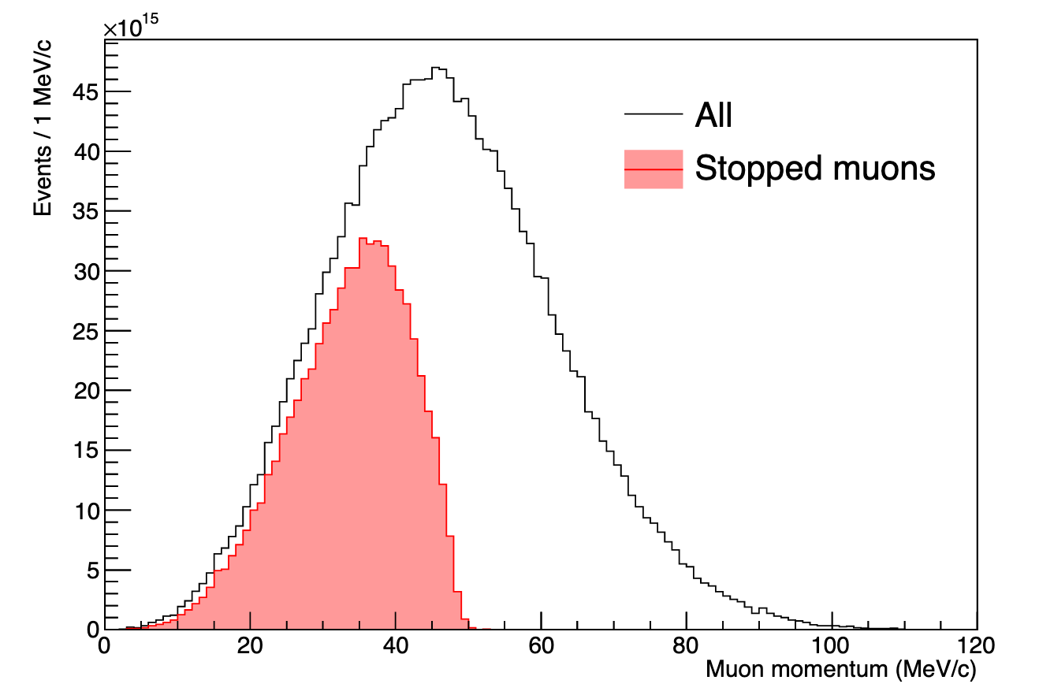
Capture Target Issue
Our tracking resolution is limited by scattering in our multi-layer capture target, which we need because of the muon energy distribution
To solve these problems we need:
  A different way for prompt backgrounds to die away
    i.e. eliminate need for veto
  A source of muons with much narrower energy distributions.

Slide 11
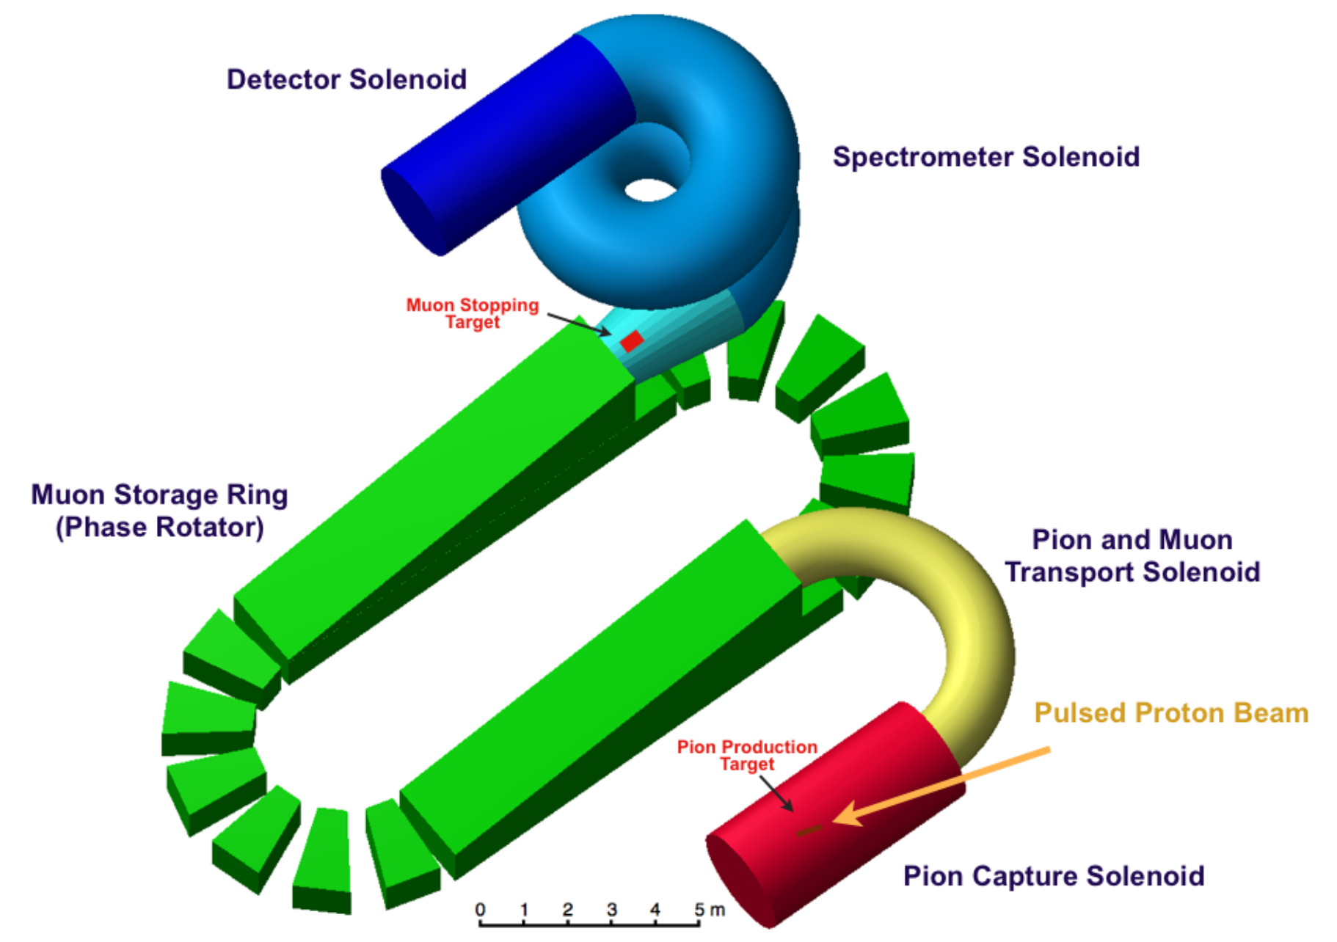
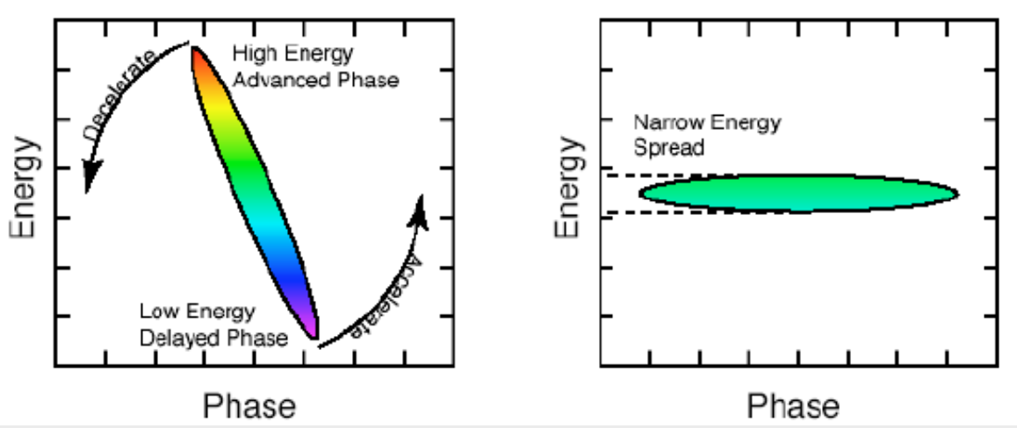
Solution: FFA*
This solution has been been developed for next generation of the competing COMET experiment at J-Parc
Muons will be injected into an FFA for about ~6 turns
  All the pions will decay away (eliminating the need for the veto)
  The beam will be phase rotated to reduce the energy spread.
Ultimately want 500-1000 kW!
Unfortunately, can’t feed this directly from PIP-II…
*J. Pasternak talk later in this workshop

Slide 12
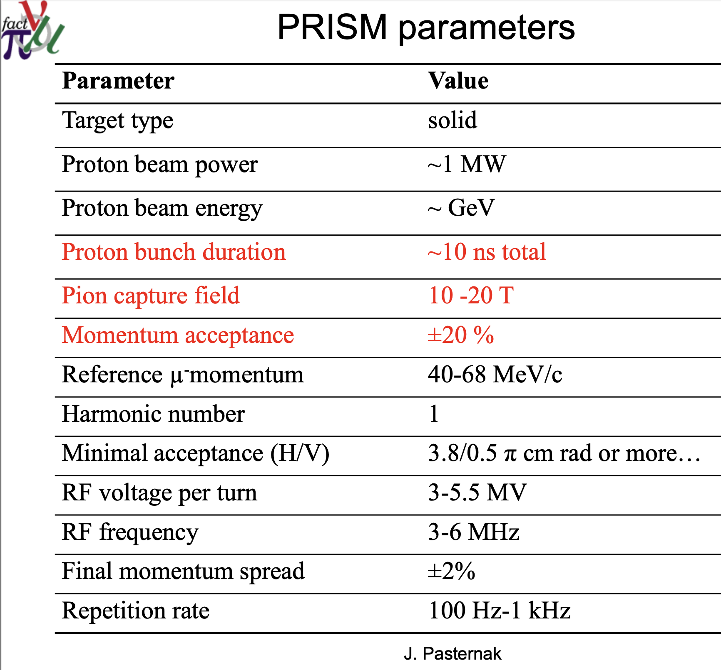
Would ideally like to lower this.
Induction linac, maybe?

Slide 13
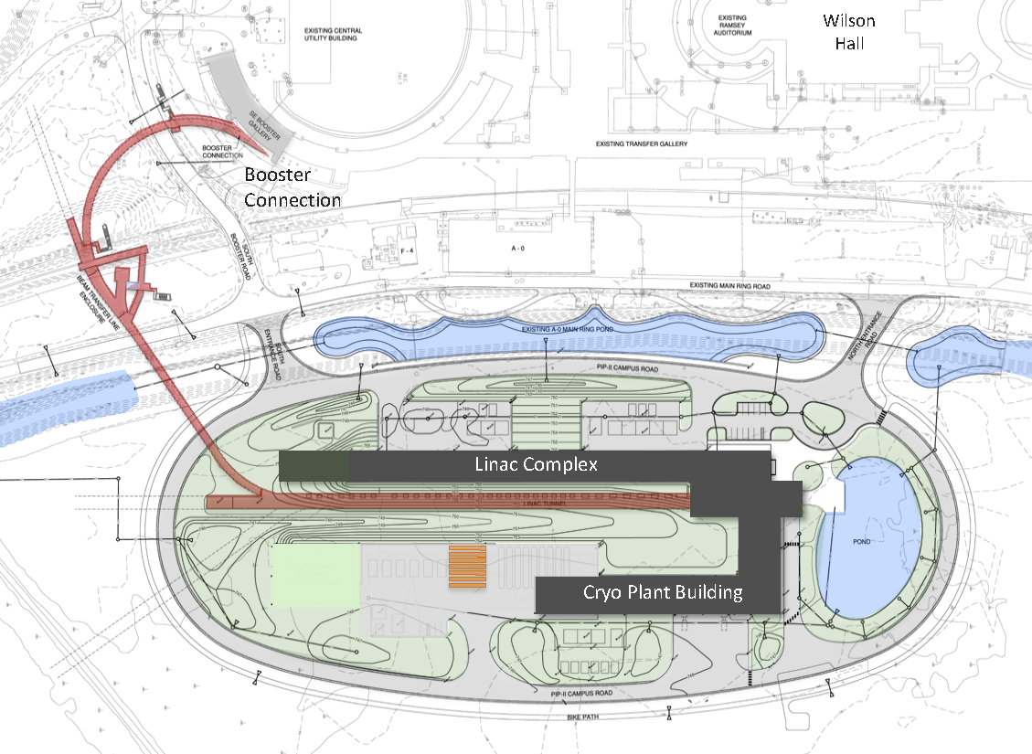
Review: PIP-II Scope Overview
To mu2e
800 MeV H− linac
  Up to 165 MHz bunches
  Up to 2 mA CW
  Up 1.6 MW
Upgraded Booster
  20 Hz, 800 MeV injection
  New injection area
Upgraded Recycler & Main Injector
  RF in both rings
Protons for the High Energy Program
  .55 ms injection into Booster at 20 Hz
  Only ~1% of available beam!
Additional beam
  Up to 1.6 MW
  All the beam to one experiment?
  3-way beam split?
The PIP-II scope enables the accelerator complex to reach 1.2 MW proton beam on LBNF target, but still leave most of the beam for other users!

Slide 14
Beam Switching*
Beam for muon production could be provided by this line (162.5 MHz)
or one of these lines
(40.125 or 80.25 MHz)
PIP-II Linac
*Lia Merminga, CD-2 Refresh

Slide 15
RF Beam Splitting
The Beam will go through an RF deflector running at 162.5/4=40.625 MHz
Individual beam lines are selected by choosing which bunches to populate.

Slide 16

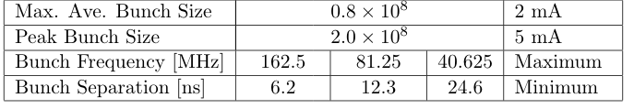
PIP-II Linac Beam Parameters
Note:
  Bunches can be arbitrarily populated, but bunch intensity cannot be changed quickly
  During LBNF running, we will have to live with 1.4x10⁸/bunch, as required by that program
    2mA into booster, painted (sparsified) into RF buckets

Slide 17
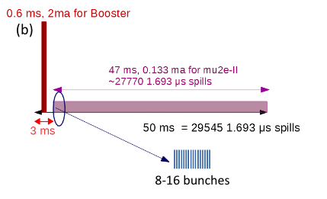
Mu2e-II Beam Formation
Possible beam structure (100 kW):
  10 bunch burst @ 600 kHz
  1.4x10⁸ protons/bunch
  600 kHz repetition rate
  = 100 kW
  3% duty factor
  0.12 mA
  These numbers are
  independent from the
  instantaneous bunch rate!
    ie, which line we’re in
The bunch rate only affects the pulse width
  162.5 MHz = 60 ns
  81.25 MHz = 120 ns
  40.625 MHz = 240 ns
All of these numbers would double for 200 kW
~275 162.5 MHz buckets
That’s all that would be needed from the accelerator end!

Slide 18
Need for a Bunch Compressor
In order to work, an FFA would need*
  > 10¹² protons/bunch
  ~ 10 ns bunch length
  100-1000 Hz
10¹² = 5000x(2x10⁸ ) = 31 μsec
  For these experiments, we need some sort of “bunch compressor” to accumulate beam into larger bunches, and then extract them to experiments.
Two LoIs were submitted related to this:
  E. Prebys, et al, “Letter of Interest: Bunch Compressor for the PIP-II Linac”,(Green field, permanent magnet ring) https://www.snowmass21.org/docs/files/summaries/AF/SNOWMASS21-AF5_AF0-RF5_RF0_Prebys2-203.pdf
  W. Pellico, et al, “FNAL Booster Storage Ring”,(this workshop) https://www.snowmass21.org/docs/files/summaries/RF/SNOWMASS21-RF6_RF0_pellico-029.pdf
3000 times too long!
*See J. Pasternak Talk

Slide 19
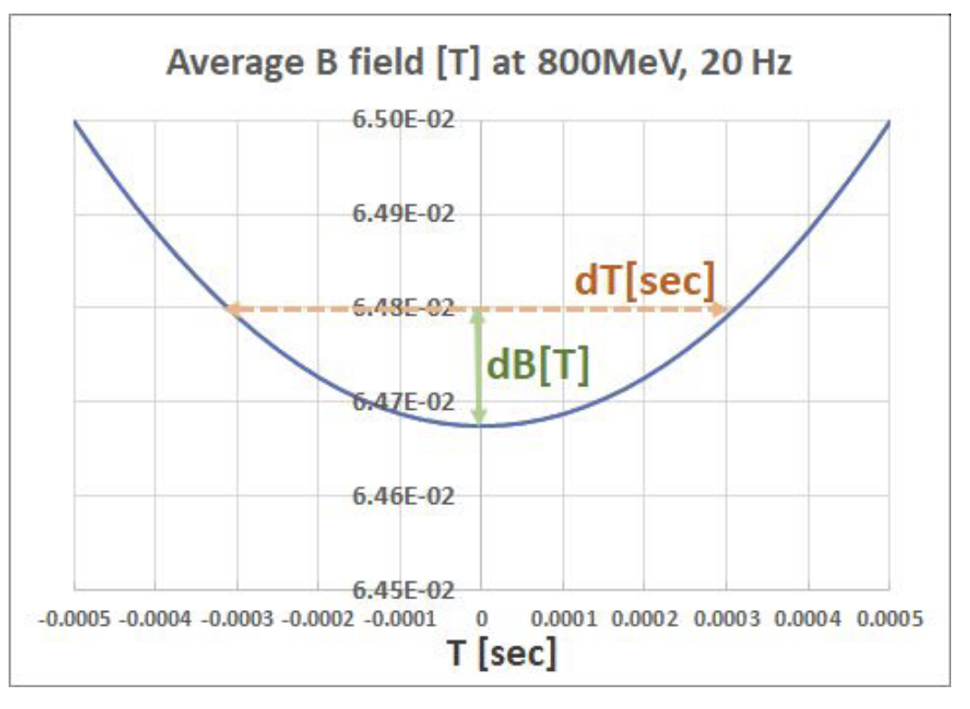
Competing Priorities
The neutrino program
  The Booster magnets will run at a 20 Hz
  offset sine wave.
    Initially, it will be flattened at the lower end during
    injection using the Booster corrector magnets.
  Injecting more beam into the booster will
  require a longer injection pulse, going
  beyond the ability of the corrector magnets to flatten the field.
  The Booster Storage Ring (BSR) would allow the protons to be pre-loaded, the way we preload protons in the Recycler for the Main Injector.
  It therefore must be at least the same circumference as the Booster!
  Might be other ways to solve this problem.
Muons (and others?)
  Want the shortest, most intense pulses we can get.
  As we will see, this will drive us toward the smallest possible ring circumference.

Slide 20
Filling a Compressor Ring
H⁻ beam would be injected into the compressor ring over many turns using charge exchange injection.
Bunch separation from PIP-II (6, 12, or 25 ns)
PIP-II bunches
Injection can be de-phased to lengthen (“paint”) bunches in ring (this will turn out to be important)

Slide 21
Modes of Operation
For Booster pre-loading
  Fill ring continuously over many turns.
  Transfer to Booster after accumulating enough protons
    Still a very small fraction of the total time line.
For FFA support
  Continuously fill ring.
  Time things so that individual bunches can be extracted as they fill up.
    This would take a bit to explain, so you’ll just have to trust me on it.
  Bottom line: total power out = total beam power in
Now, to understand beam stability issues…

Slide 22
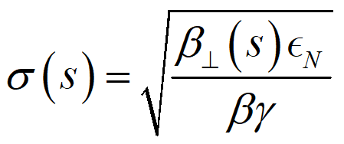
All the Accelerator Physics U Need 2 Know
Beam size in a proton accelerator is given by
Betatron lattice function. Typically 10s of meters in hadron machines
Normalized emittance, related to area in transvers phase space. Limited to 2-3 π-mm-mr by Booster and Main Injector
Position along nominal trajectory
Standard Lorentz parameters

Slide 23
Betatron Tune
Particle trajectory
Ideal orbit
As particles go around a ring, they will undergo a number of betatron oscillations ν (sometimes Q) given by
This is referred to as the “tune”
We can generally think of the tune in two parts:
6.7
Integer : magnet/aperture optimization
Fraction: Beam Stability

Slide 24
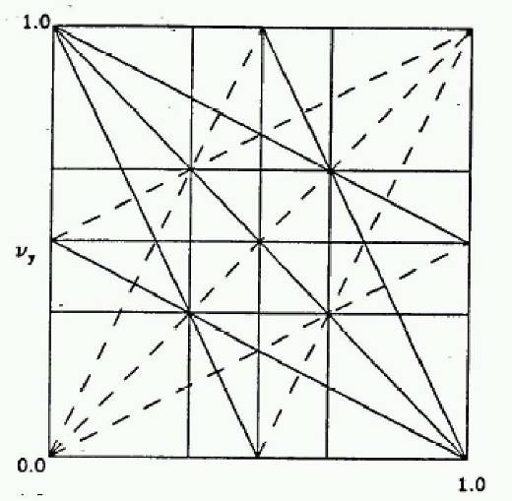
Tune, Stability, and the Tune Plane
If the tune is an integer, or low order rational number, then the effect of any imperfection or perturbation will tend be reinforced on subsequent orbits.
When we add the effects of coupling between the planes, we find this is also true for combinations of the tunes from both planes, so in general, we want to avoid
Many instabilities occur when something perturbs the tune of the beam, or part of the beam, until it falls onto a resonance, thus you will often hear effects characterized by the “tune shift” they produce.
“small” integers
➔Avoid lines in the “tune plane”
fract. part of Y tune
fract. part of X tune

Slide 25
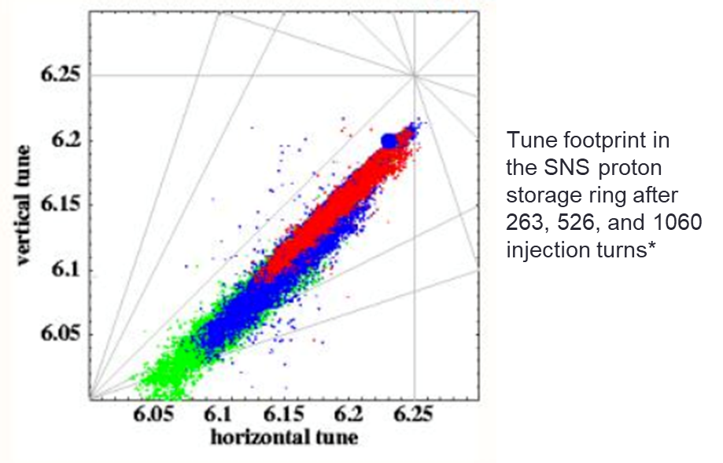
Space Charge Tune Shift
Consider the effect off space charge on the transverse distribution of the beam.
Space charge tune shift limits the
amount of beam that can be loaded
into a synchrotron.
The electric field is repulsive, but the magnetic field is attractive.
The forces exactly cancel at β=1.
-> Space chage effects go down (quickly) with energy.
Example: SNS

Slide 26
Ring Size and Space Charge Considerations
Once we’ve fixed the injection energy, for a ring with multiple bunches, the space charge tune shift limit is given by
  Maximize → “paint” longitudinally
  Minimize → This is why we want the smallest ring.
  Maximize → “paint” transversely
    No longer limited by MI aperture, but not without consequences
Bunch size
Bunch length
Number of bunches
~limit
Peak Current/Average Current
Normalized emittance
period

Slide 27
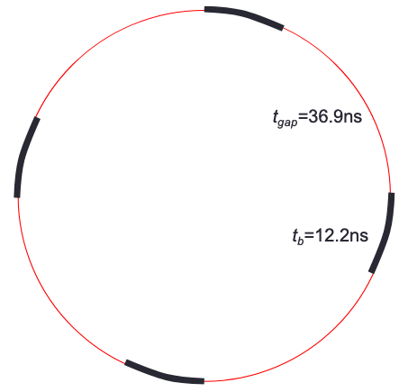
Strawman Parameters for Small Compressor Ring
Circumference = 49.7m
Number of bunches: 4
Bunch frequency: 20.31 MHz
Bunch length: 12.2 ns
Gap length 36.9 ns
  A kicker should be able to
  extract in this gap at ~100Hz
Note! At this frequency, power
is limited to 500 kW by the
2x10⁸ maximum bunch size!

Slide 28
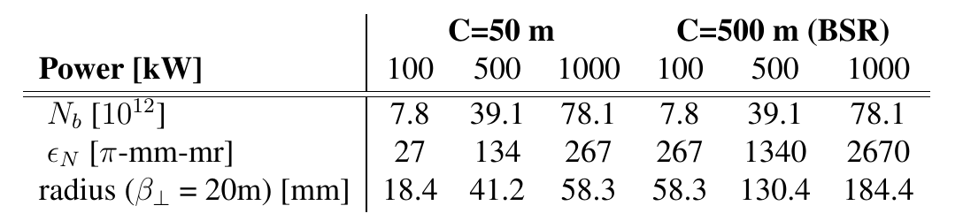
Comparing Small Ring to BSR
Assume extraction frequency = 100Hz, tune shift Δ_{ν}=.2
But can we even get to 1MW?
  Remember: at 20.31 MHz, power is limited to 500 kW by the 2x10⁸ bunch size
Magnet size and beam transport might be an issue

Slide 29
Going from 500 kW to 1 MW
Must go from 20.31 MHz to 40.625 MHz
Now need a 100 Hz kicker with a < 10 ns full rise and fall time
  This is very hard
Might be easier to go to two rings?

Slide 30
Challenges
Aperture size
  Magnets
  Beam transport
Injection
  500-1000 kW charge exchange injection is not trivial
Extraction kicker
  > 100 Hz would ease the space charge problem, but begins to get difficult

Slide 31
Summary
Getting to a 1 MW beam with a pulse structure needed by an FFA is extremely challenging.
The compressor ring needs for CLFV and LBNF are different
  CLFV wants the smallest ring possible
  LBNF needs a ring with the same circumference as the Booster
    Might be another solution, e.g. energy vernier adjustment on PIP-II, a la Linac 4 at CERN?
Useful to engage the rest of the PIP-II user community regarding their needs, if any.

Slide 32
BACKUP

Slide 33
General: Calculating Beam Rate and Power
Assume we have n_{b} bunches with N protons in each bunch every T seconds
Reminder: Limits
  N_{b,max}: 2x10⁸ (5 mA peak)
  Max. I_{ave}: 2 mA
0.8x10⁸ @ 162.5 MHz = 1.6MW
1.6x10⁸ @ 81.25 MHz = 1.6MW
2.0x10⁸ @ 40.625 MHz = 1.0MW
2.0x10⁸ @ 20.312 MHz = 0.5MW
This will be very important

