Slide 1
Proton EDM Storage Ring Experiment
William Morse
February 4, 2022

Slide 2
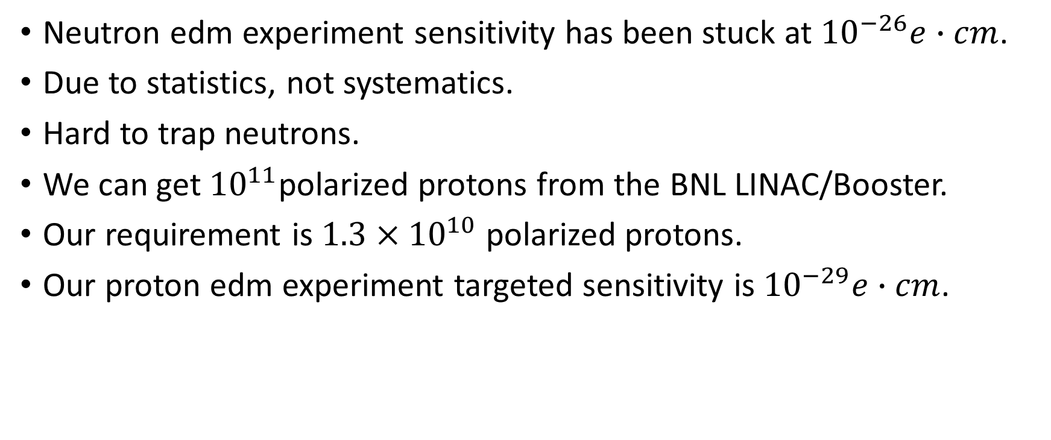
Proton EDM Storage Ring Experiment
Neutron edm experiment sensitivity has been stuck at $10^{−26}e∙cm$.
Due to statistics, not systematics.
Hard to trap neutrons.
We can get ${10}^{11}$polarized protons from the BNL LINAC/Booster.
Our requirement is $1.3×10^{10}$ polarized protons.
Our proton edm experiment targeted sensitivity is $10^{−29}e∙cm$.

Slide 3

Magic Momentum
No spin precession due to MDM in electric fields
$β=\sqrt{\frac{2}{g}}$
Muon 3.1 GeV/c, Proton 0.7GeV/c

Slide 4

Neutron edm exps are at $10^{−26}e∙cm$.

Slide 5
PEDM Ring - 800m circumference

Slide 6
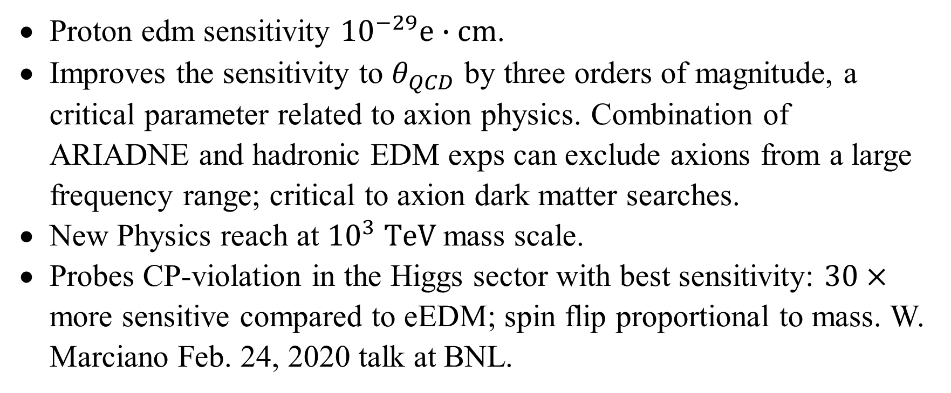
PEDM
Proton edm sensitivity ${10}^{−29}e∙cm$.
Improves the sensitivity to $θ_{QCD}$ by three orders of magnitude, a critical parameter related to axion physics. Combination of ARIADNE and hadronic EDM exps can exclude axions from a large frequency range; critical to axion dark matter searches.
New Physics reach at ${10}^{3} TeV$mass scale.
Probes CP-violation in the Higgs sector with best sensitivity: $30×$ more sensitive compared to eEDM; spin flip proportional to mass. W. Marciano Feb. 24, 2020 talk at BNL.

Slide 7
W. Marciano, Overview EDM theory, https://indico.fnal.gov/event/44782/timetable/?view=nicecompact

Slide 8
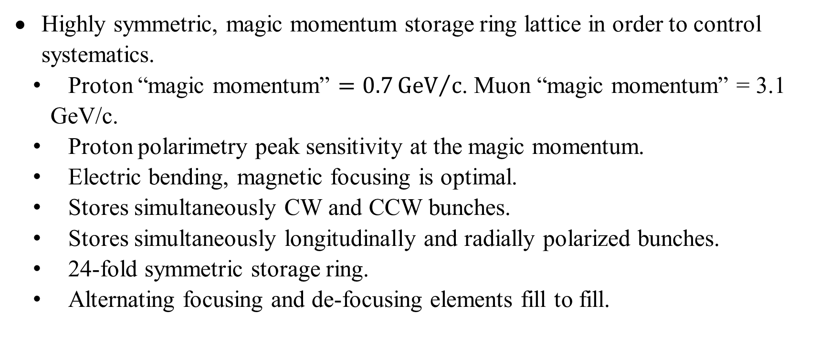
PEDM
Highly symmetric, magic momentum storage ring lattice in order to control systematics.
Proton “magic momentum” $=0.7{GeV}/c$. Muon “magic momentum” = 3.1 GeV/c.
Proton polarimetry peak sensitivity at the magic momentum.
Electric bending, magnetic focusing is optimal.
Stores simultaneously CW and CCW bunches.
Stores simultaneously longitudinally and radially polarized bunches.
24-fold symmetric storage ring.
Alternating focusing and de-focusing elements fill to fill.

Slide 9
Polarimeter

Slide 10
Polarimetry
E=233 MeV

Slide 11
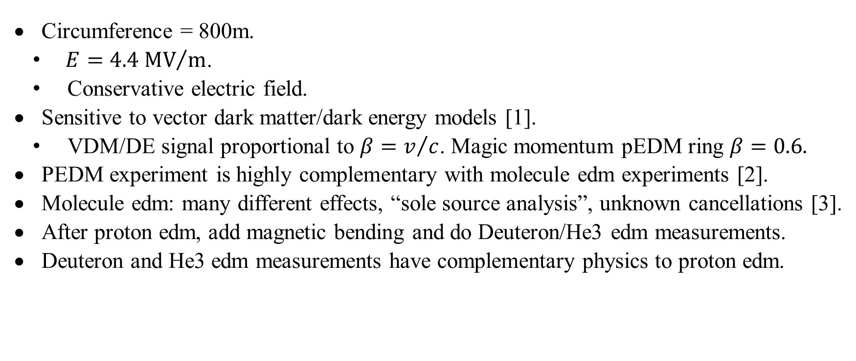

PEDM ${dS}/{dt=d×E}$
Circumference = 800m.
$E={4.4 MV}/m$.
Conservative electric field.
Sensitive to vector dark matter/dark energy models [1].
VDM/DE signal proportional to $β=v/c$. Magic momentum pEDM ring $β=0.6.$
PEDM experiment is highly complementary with molecule edm experiments [2].
Molecule edm: many different effects, “sole source analysis”, unknown cancellations [3].
After proton edm, add magnetic bending and do Deuteron/He3 edm measurements.
Deuteron and He3 edm measurements have complementary physics to proton edm.

Slide 12

FNAL ${dS}/{dt=d×E}$
Need polarized source and space for the ring.
We have talked with FNAL AD.
Valeri Lededev BD.
Want high E (sensitivity) and low circumference (cost).
Electrodes 20cm high, 4cm separation.
In AGS tunnel at magic energy: E = 4.4MV/m.
Riad Suleiman, JLab: Up to 5MV/m, doesn’t need R&D.

Slide 13
BD

Slide 14
PEDM
1. P.W. Graham et al., Storage ring Probes for Dark Matter and Dark Energy, PRD103, 055010, 2021.
2. N. Hutzler, Developing New Directions in Fundamental Physics 2020, 4-6 Nov. 2020.
3. T. Chupp, Developing New Directions in Fundamental Physics 2020, 4-6 Nov. 2020; T. Chupp et al., Rev. Mod. Phys. 91, 015001 (2019).

Slide 15
References
F.J.M. Farley et al., A new method of measuring electric dipole moments in storage rings, Phys. Rev. Lett. 93, 052001 (2004)
G.W. Bennett et al., An improved limit on the muon electric dipole moment, Phys. Rev. D 80, 052008 (2009)
N.P.M. Brantjes et al., Correction systematic errors in high-sensitivity deuteron polarization measurements, Nucl. Instrum. Meth. A664, 49 (2012)
W.M. Morse et al., rf Wien filter in an electric dipole moment storage ring: The “partially frozen spin” effect, Phys. Rev. Accel. Beams 16 (11), 114001 (2013)
E.M. Metodiev et al., Fringe electric fields of flat and cylindrical deflectors in electrostatic charged particle storage rings, Phys. Rev. Accel. Beams 17 (7), 074002 (2014)
E.M. Metodiev et al., Analytical benchmarks for precision particle tracking in electric and magnetic rings, NIM A797, 311 (2015)
V. Anastassopoulos et al., A storage ring experiment to detect a proton electric dipole moment, Rev. Sci. Instrum. 87 (11), 115116 (2016)
G. Guidoboni et al., How to reach a Thousand-second in-plane Polarization Lifetime with 0.97 GeV/c Deuterons in a storage ring, Phys. Rev. Lett. 117 (5), 054801 (2016)
N. Hempelmann et al., Phase locking the spin precession in a storage ring, Phys. Rev. Lett. 119 (1), 014801 (2017)

Slide 16
References
S. Haciomeroglu et al., SQUID-based Beam Position Monitor, PoS ICHEP2018 (2019) 279
S.P. Chang et al., Axionlike dark matter search using the storage ring EDM method, Phys. Rev. D 99 (8), 083002 (2019)
S. Haciomeroglu and Y.K. Semertzidis, Hybrid ring design in the storage-ring proton EDM experiment, Phys. Rev. Accel. Beams 22 (3), 034001 (2019)
P.W. Graham et al., Storage ring Probes for Dark Matter and Dark Energy, Phys.Rev. D 103 (2021) 5, 055010
Z. Omarov et al., Comprehensive Symmetric-Hybrid ring design for pEDM experiment at below 10⁻²⁹e-cm, arXiv:2007.10332 (2020)
On Kim, Yannis K. Semertzidis, New method of probing an oscillating EDM induced by axionlike dark matter using an rf Wien filter in storage rings, Phys. Rev. D 104, 096006 (2021), DOI: 10.1103/PhysRevD.104.096006

