Slide 2
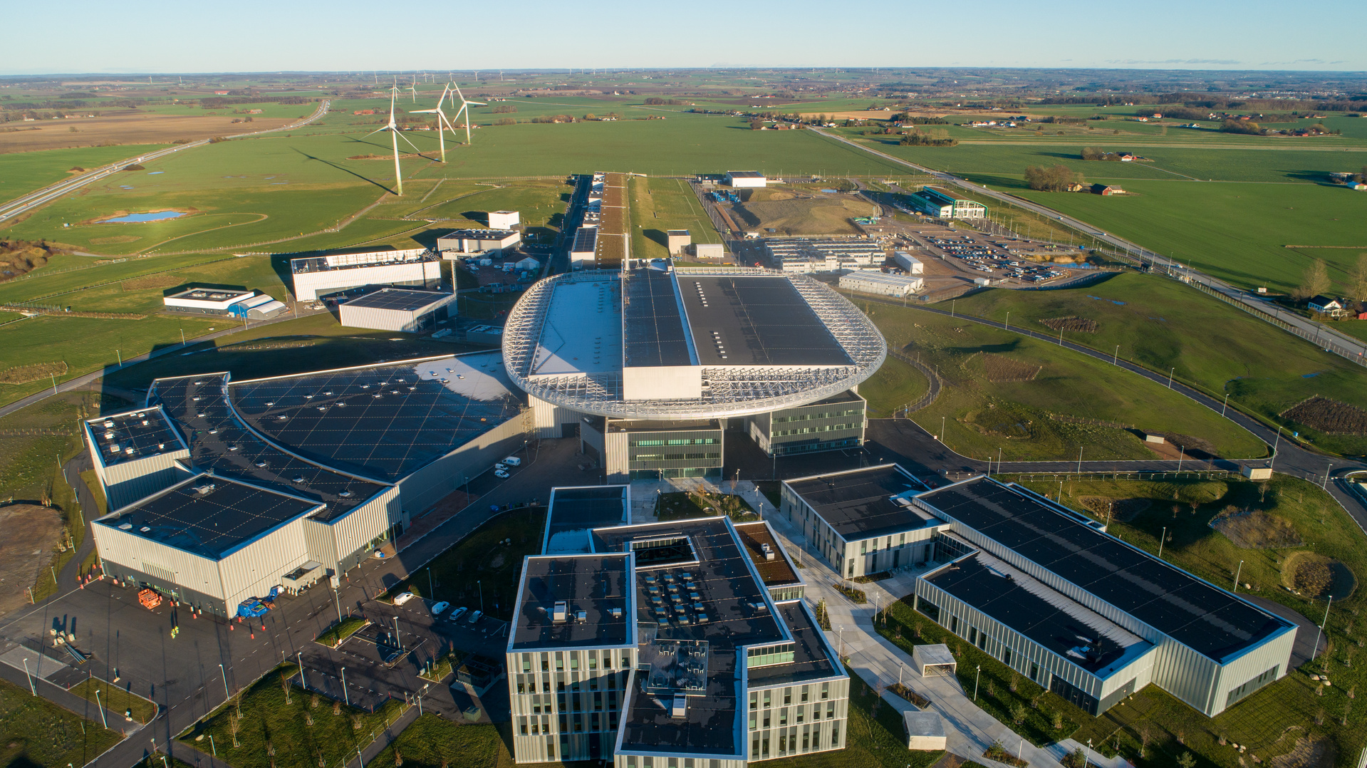
In-situ Beam on target monitor system at ESS
Presented by Dr. Cyrille Thomas
2022-02-04

Slide 3
Beam monitoring motivation
    Beam power and high potential of damage
    Assuring Nominal beam, control heat-load, …
Beam detection system overview
    Design overview and material selection
    Measure current density distribution, beam position: tuning and machine protection
Concluding remarks

Slide 4
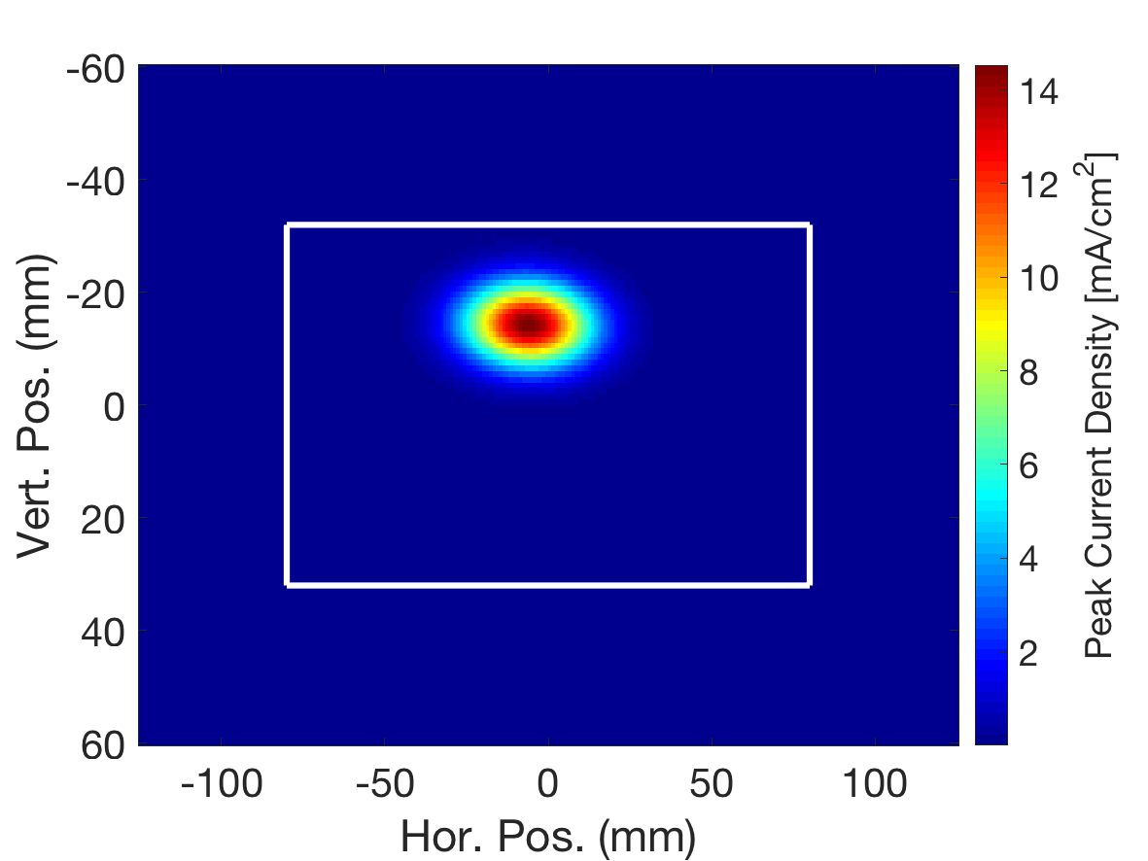
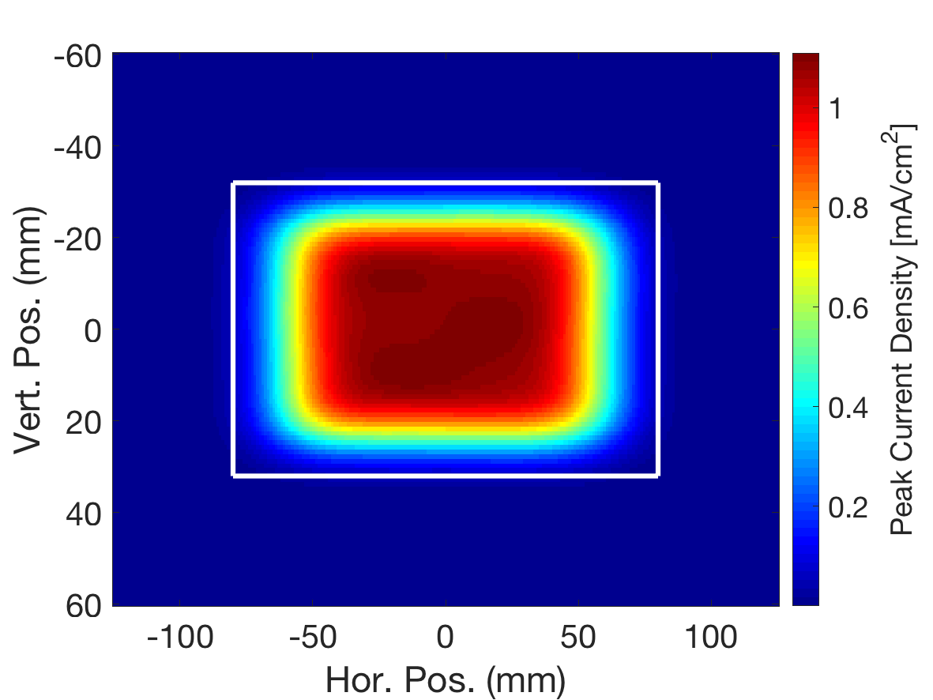
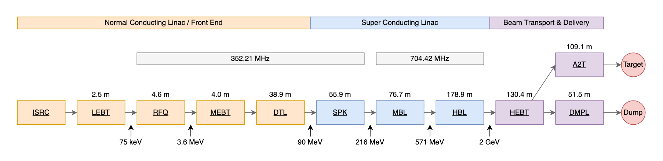
Beam Monitoring Motivation
ESS beam properties:
Protons: 2 GeV
Peak Current: 62.5mA
Pulse: 2.8ms, 14Hz
Average current: 2.5mA
Lattice:
Beamlet r.m.s size: 13mm x 5mm
Raster system: spread the beam over target area: 160mmx64mm
1µs beamlet
2.8ms pulse

Slide 5
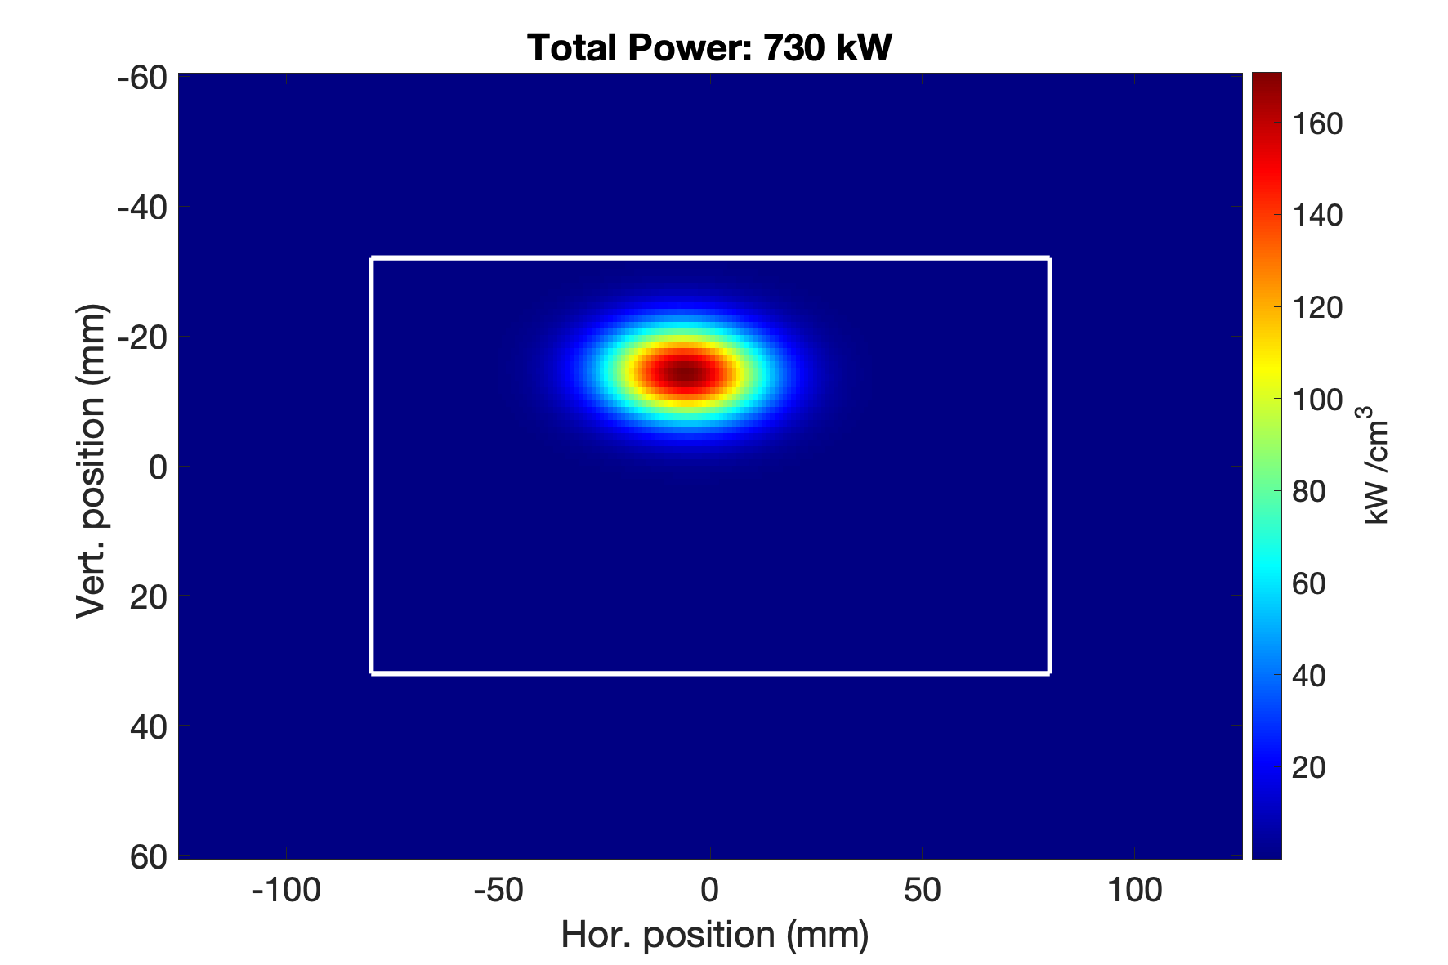
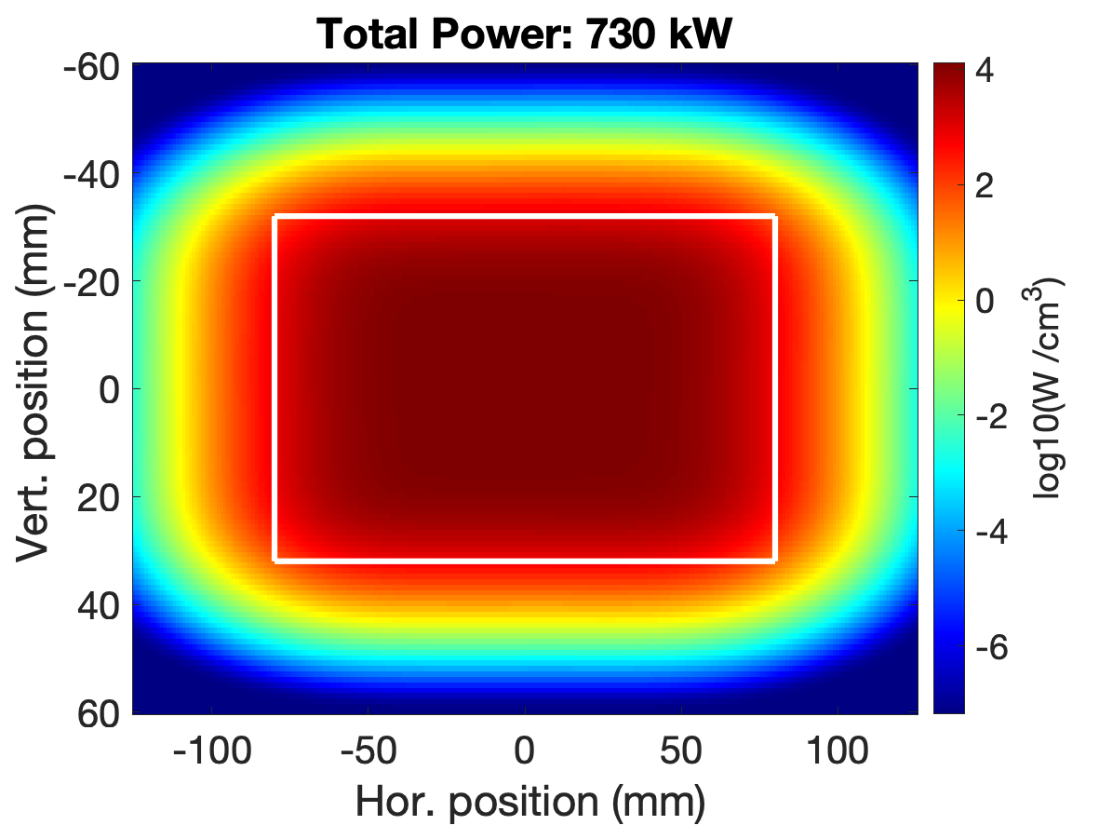
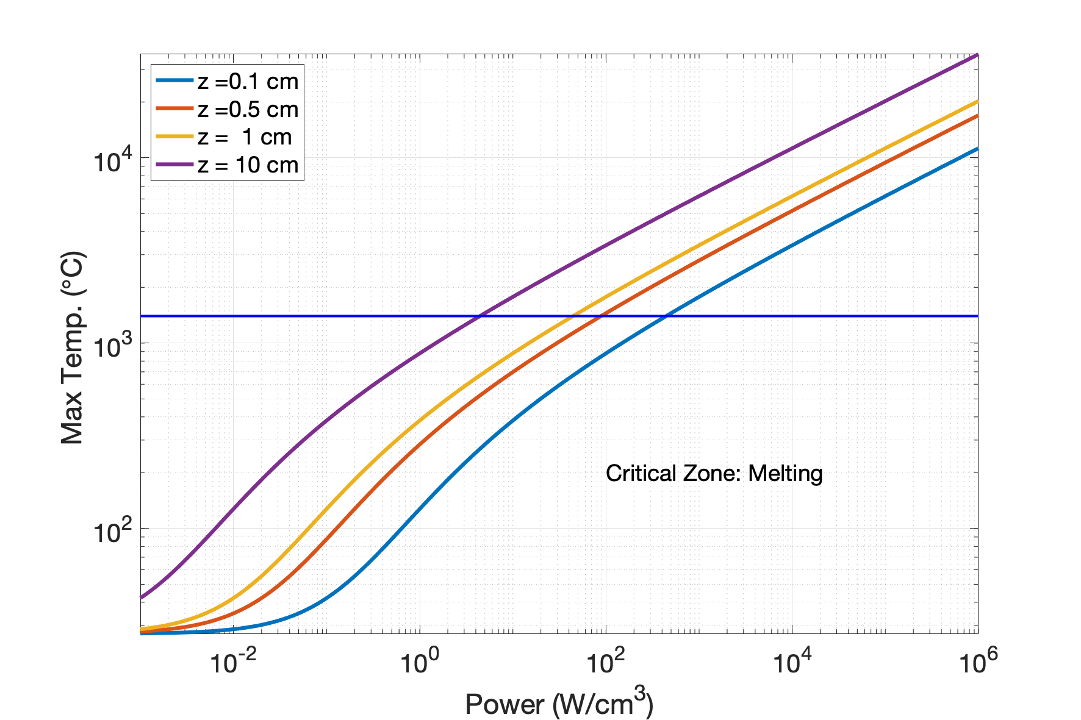
Ex. Power on Stainless Steel
ρ density
Heat equation simple model
C_{p} specific heat capacity
ε emissivity
Power density
Stefan–Boltzmann constant: σ_{B} = 5.670… 10⁻¹² W cm⁻² K⁻⁴
z = V/A
Radiative cooling
Melting condition region: 10-100 W/cm³
ρ density
dE/dz stopping power
I_{b} current density
Core beam > kW/cm³
Conduction cooling
Outer beam zone X>100mm, Y> 50mm
  1 W/cm³

Slide 6
Damage from the beam:
Melting materials
Thermomechanical stress
Fatigue from temperature cycle
Can be limited by beam control
But also …
Radiation Damage from proton beam and secondary particles:
Damage Types | Description
Neutron induced displacement damage | Change in material properties correlated with displacement damage caused by high neutron fluence
Proton induced displacement damage | Change in material properties correlated with displacement damage caused by high intensity proton beam
Thermal neutron capture | Change in material properties correlated with solid transmutations by thermal (E ≤ 0.625 eV) neutron capture
Fast neutron induced functional degradation | Degradation of material functionality correlated with high fast (E ≥ 0.1 MeV) neutron fluence
Helium embrittlement and swelling | Brittle behaviour and swelling of material due to high helium production rate caused by hadron irradiation
Radiation dose and dose rate | Change in material properties correlated with hadron and gamma induced dose and dose rate
Hardening of material with radiation dose
ESS-0028465 - ESS Materials Guide

Slide 7
Beam on Target Instrumentation Suite
Requirements:
Measure all critical beam properties
  Support fast machine tuning
  Support machine protection
Lifetime as long as possible / or equal to lifetime of machine component supporting them
Complementarity and Redundancy (>95% reliability and availability of the machine)

Slide 8
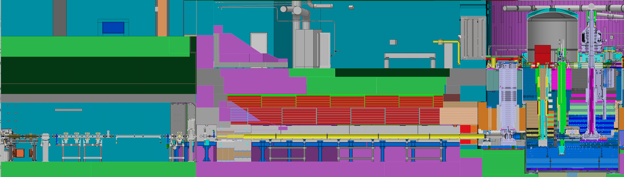
Instrumentation for Beam on Target: Overview
Accelerator region
Target region
PBIP
Raster system
TW
Current: 62.5mA
Energy: 1-2 GeV
Area = π 3x3 mm²
Peak power: 440 MW/cm²
Area = π 0.5x0.5 mm²
Peak Power: 16 GW/cm²
Area = 160x64 mm²
Peak Power: 1.3 MW/cm²

Slide 9
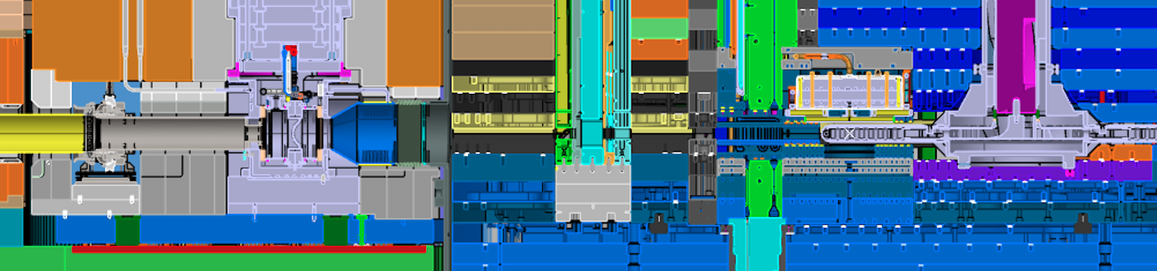
Beam on Target Instrumentation Suite
Complementary diagnostics: permits rapid and trustable verification
Redundancy: permits high availability and reliability
Fast and accurate online measurement supporting tuning, production and protection
IMG TW: 2D profile
GRID PBIP: 1D profile H and V
APTM PBIP: Halo, beam loss, scattering
IMG PBW: 2D profile
APTM PBW: Halo, beam loss

Slide 10
Instrumentation for Beam on Target: Overview
Beam position
Beam size
Edges positions
Uniformity
Current Density Distribution
Beamlet position
Beamlet size
Beam loss, halo, scattering
Raster pattern
IMG
GRID
BPM
descoped
APTM
Online systems
Supports:
Beam tuning: set beam properties
Beam operation: detect errant beam condition
direct
indirect

Slide 11
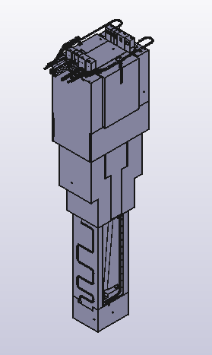
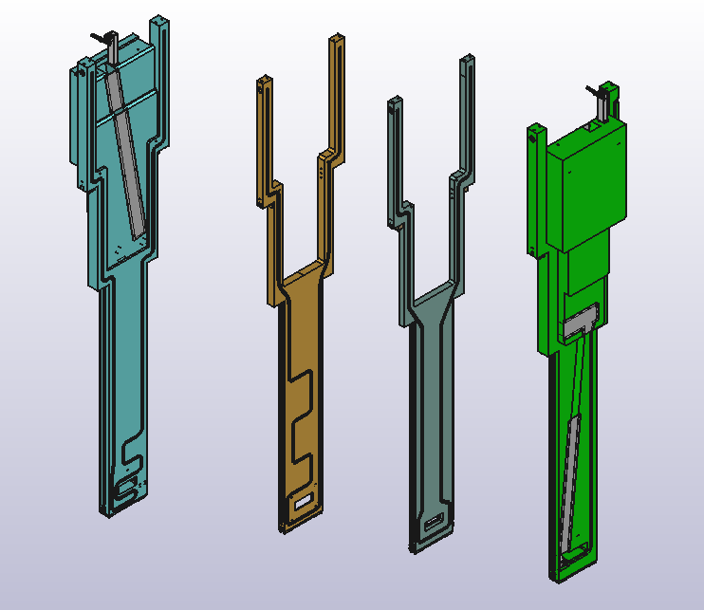
Proton Beam Instrumentation PLUG: PBIP
A Slice per each instrument
Each slice can be installed independently
IMG
GRID
APTM
IMG

Slide 12
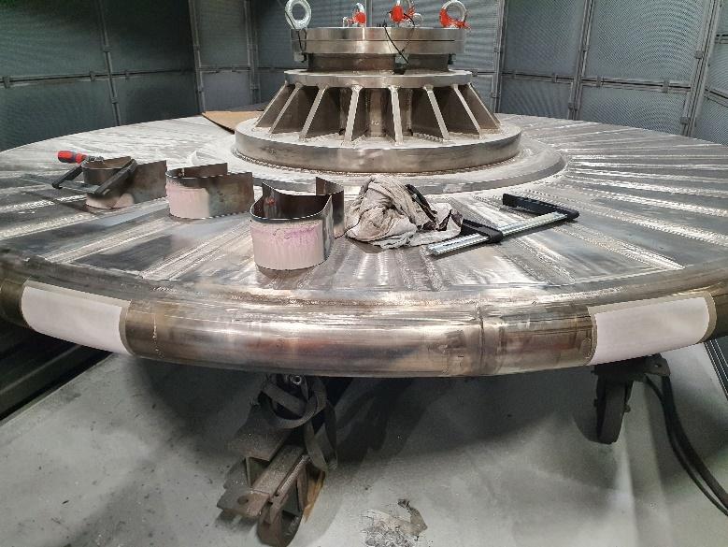
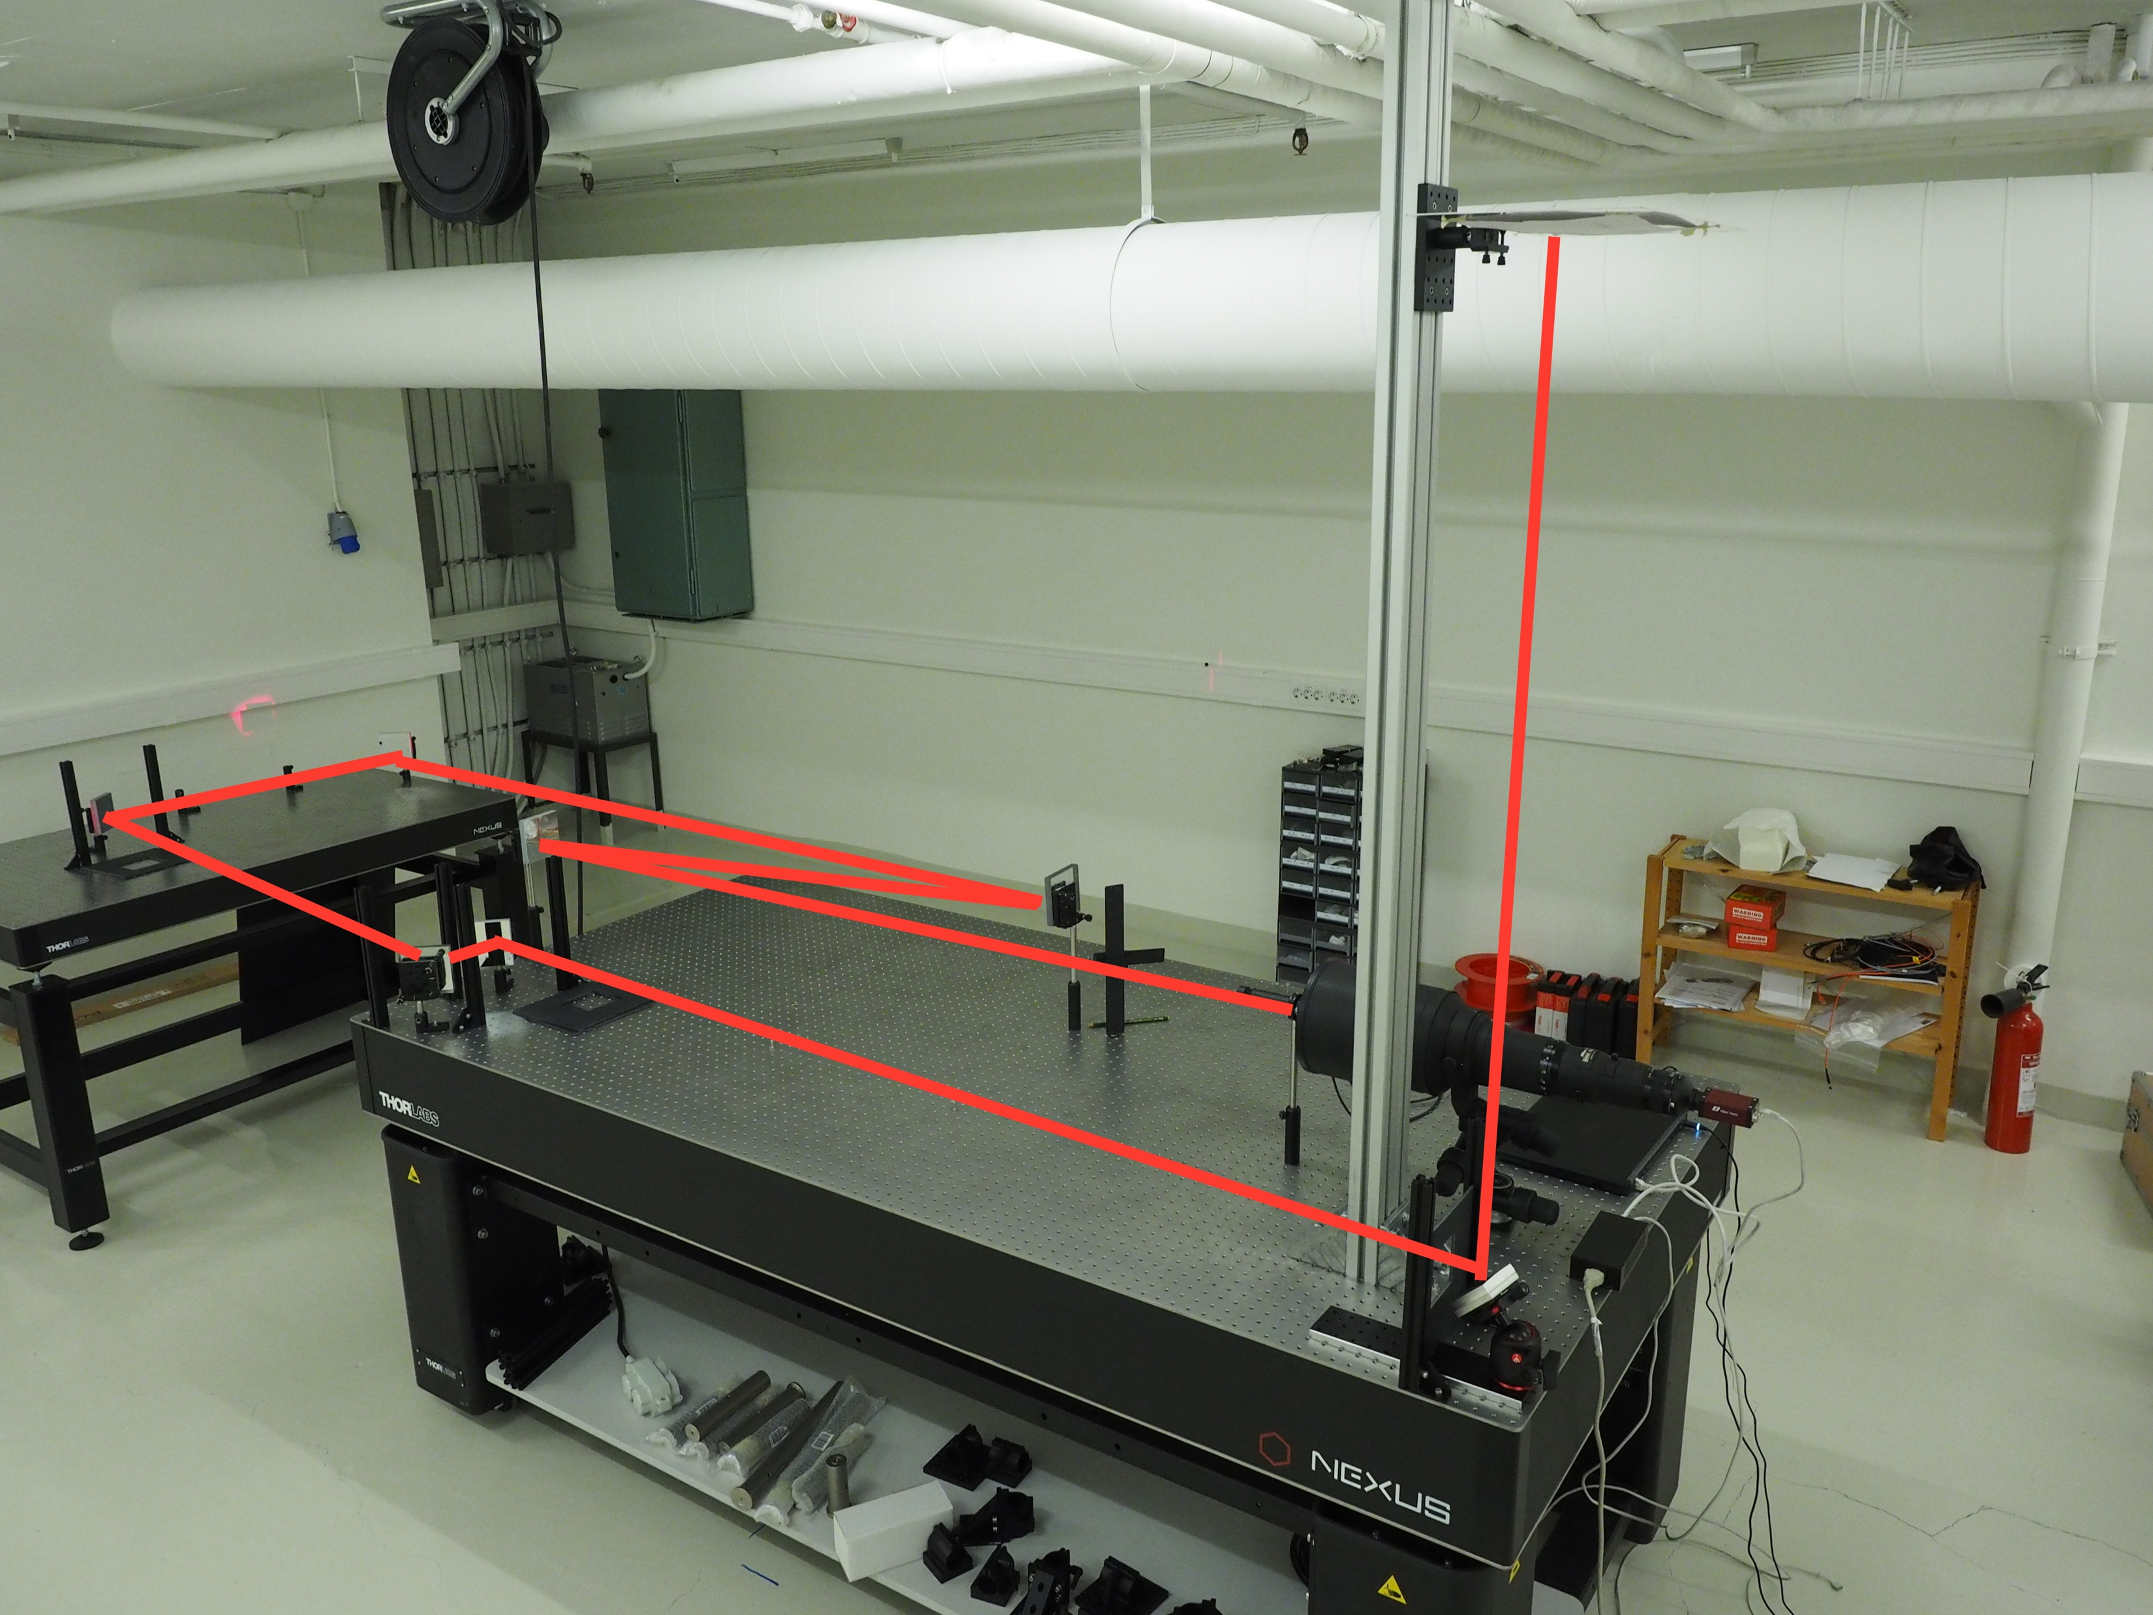
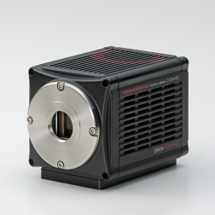
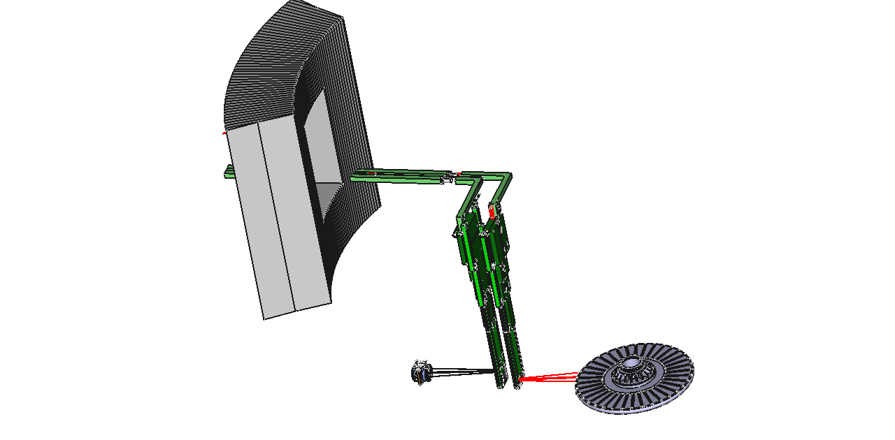
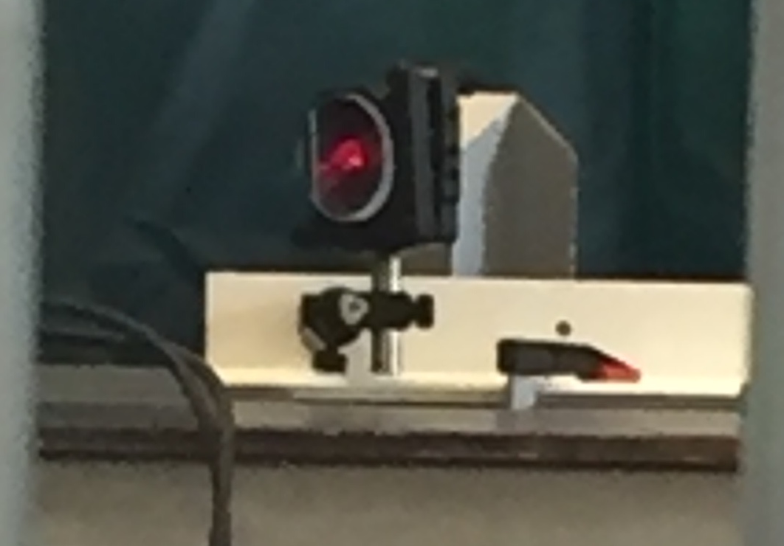
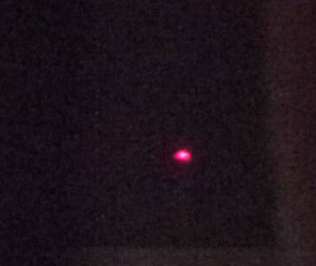
IMG
Luminescent Coating
Optics
Image readout
Image processing
Kintex Ultrascale 40 (KU040)
FPGA algorithm -> FBIS interlock
Image correction (distortion, normalisation, etc.)
Beam properties
Coordinate system (position of fiducials
ORCA-Flash4.0 V3
Optics assembly in Oslo University Lab
Peripherals
TW mockup coating with Chromia Alumina
Illumination
Spectrograph
Filters
Etc.
B18 X-ray beam inducing luminescence
8MeV proton beam inducing luminescence

Slide 13
Chromia Alumina Luminescent properties
Plasma and flame sprayed by HV (University West)
  Luminescent Yield: 10⁴ photons / MeV
    Sufficient in fresh sample conditions
    Measurement performed at Oslo University
OCL
  Temperature studies – ESS BI lab and OCL
  Influence of temperature: reduced yield with increased temperature
    25C -> 230C , yield drops by 70%
    Quenching temperature not measured, expected to be around 300C
  Irradiation studies at DTU
  Impact of radiation on yield
    rapid decay to asymptotic value around 5%
  Luminescence lifetime (ESS BI lab)
    3ms (@ room temperature and non-irradiated sample)
    Not measured at high temperature
    No data or prediction after first irradiation

Slide 14
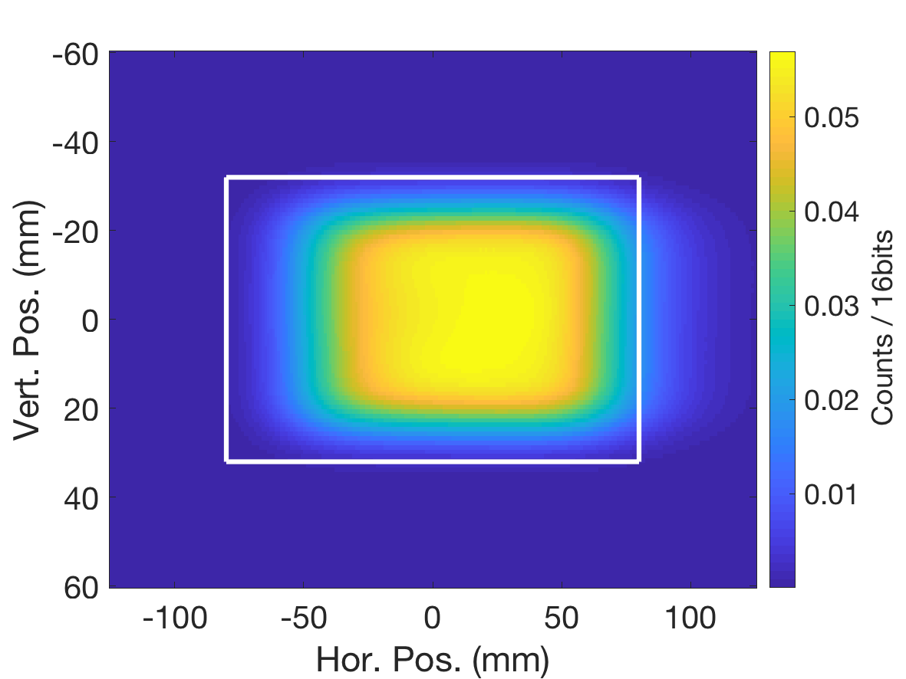
PBW IMG
TW IMG
Coating:
Fresh
Temperature 40C (PBW) and 230C (TW)
Beam:
62mA
2GeV
2.86ms
No scattering considered on the TW image
Beam | value | measured | Error (mm)
Size X (mm) | 36,4 | 36.4 | 0.1
Size Y (mm) | 14.7 | 14.7 | 0.1
Centre of mass x,y (mm) | 0, 0 | 0.07, 0.03 | 0.01
Edge position x left / right (mm) | -59 /59 | -59 / 59 | 0.01
Edge position y top / bottom (mm) | -24/24 | -24/24 | 0.01
Beam | value | measured | Error (mm)
Size X (mm) | 36,4 | 38.9 | 0.5
Size Y (mm) | 14.7 | 14.7 | 0.5
Centre of mass x,y (mm) | 0, 0 | 15.2, -0.03 | 0.05
Edge position x left / right (mm) | -59 /59 | -48.2 / 69.5 | +10.5
Edge position y top / bottom (mm) | -24/24 | -24/24 | 0.05
IMG PBW unique direct verification of the beam on target properties
IMG TW permit partial verification of the beam on target properties but with larger uncertainty in horizontal axis than allocated requirements
Notes:
First beam image scale
PBW: 0.5/16bit -> end of life: 5% 0.5 = 0.025/16bits = 1600counts
TW: 0.18/16bit -> end of life: 5% 0.18 = 0.025/16bits = 15counts

Slide 15
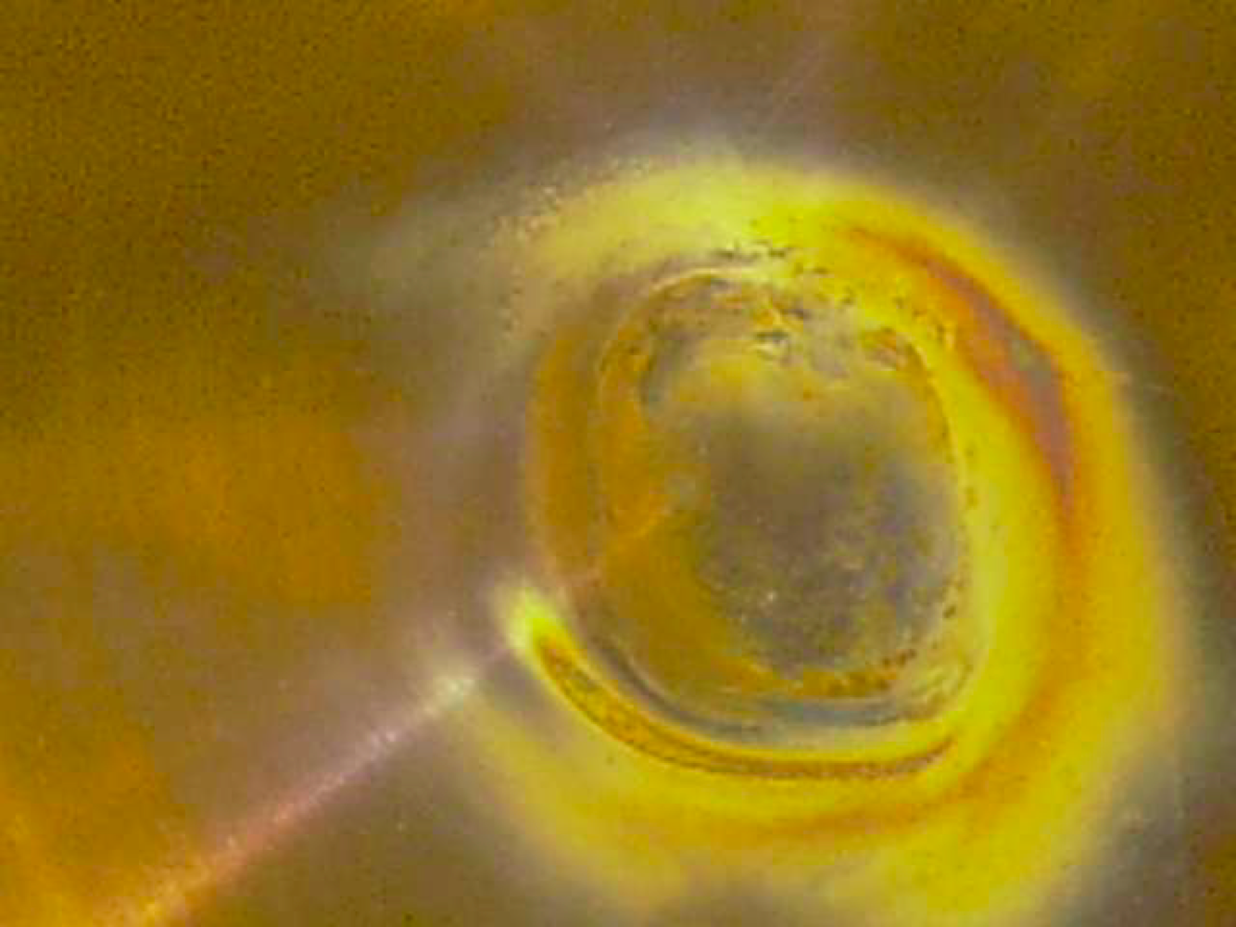
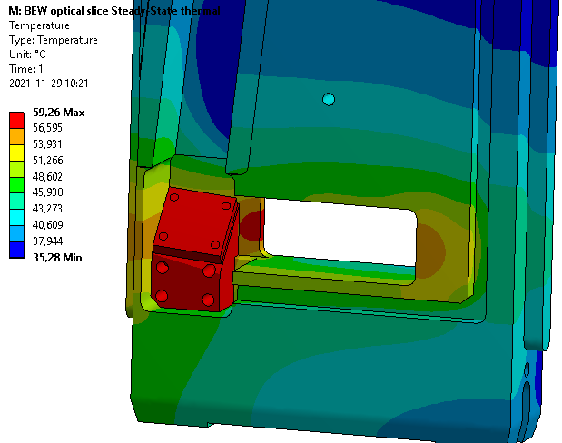
Critical element: Mirror M1
Thermo-mechanical issues:
Heat-load: melting?
Thermal stress: change in optics properties?
SNS M1 corroded (Courtesy W. Blokland)
J-PARC PBW corroded (Courtesy S. Meigo)
MCNPX power input: 40mW/cm³
Radiation dose -> 20kGy/h
Note: PBW Al6061 T6 takes ~6 DPA in 5000h
Corrosion:
ANSYS max temperature: 60C
Estimation of nitric acid production in the target area*:
Deformation not visible, and not measurable under tests
Pressure (mbar) | N_{HNO3} (moles/5000h) | Thickness (nm)
10⁻³ | 0.0026 | 3
10⁻¹ | 0.26 | 300
1 | 2.6 | 3000
* ﻿Measurement of radiolytic yield of nitric acid in air, Y. Kanda et al.
Expected Lifetime of Al mirror: 2 years
Solution:
Keep as low pressure as possible
Si protective layer

Slide 16
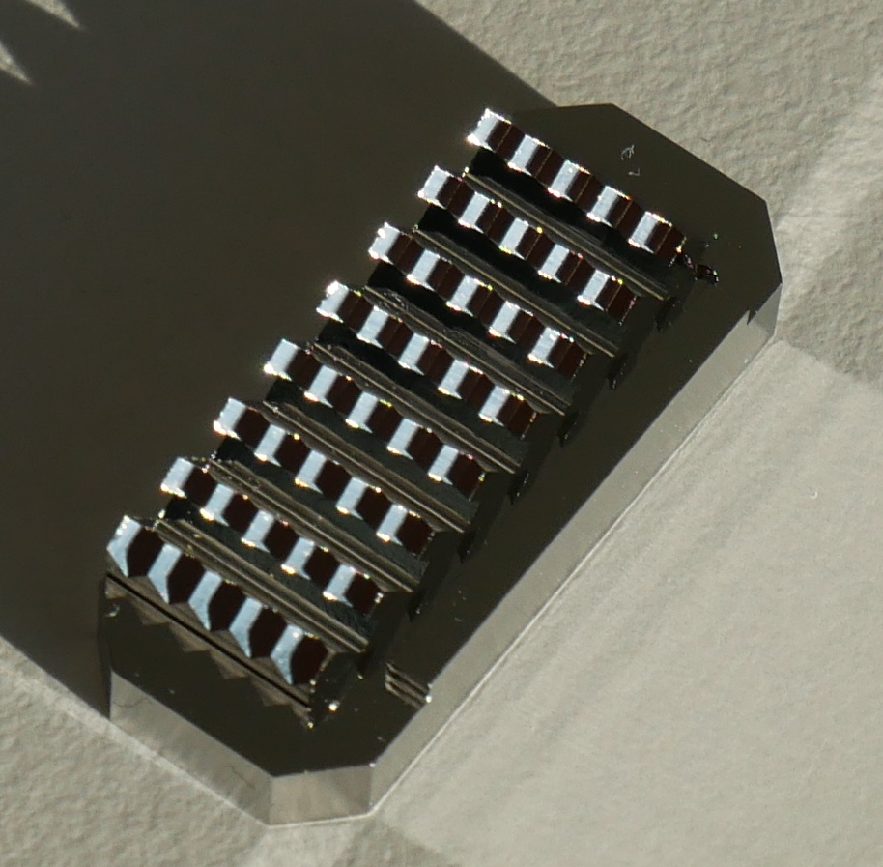
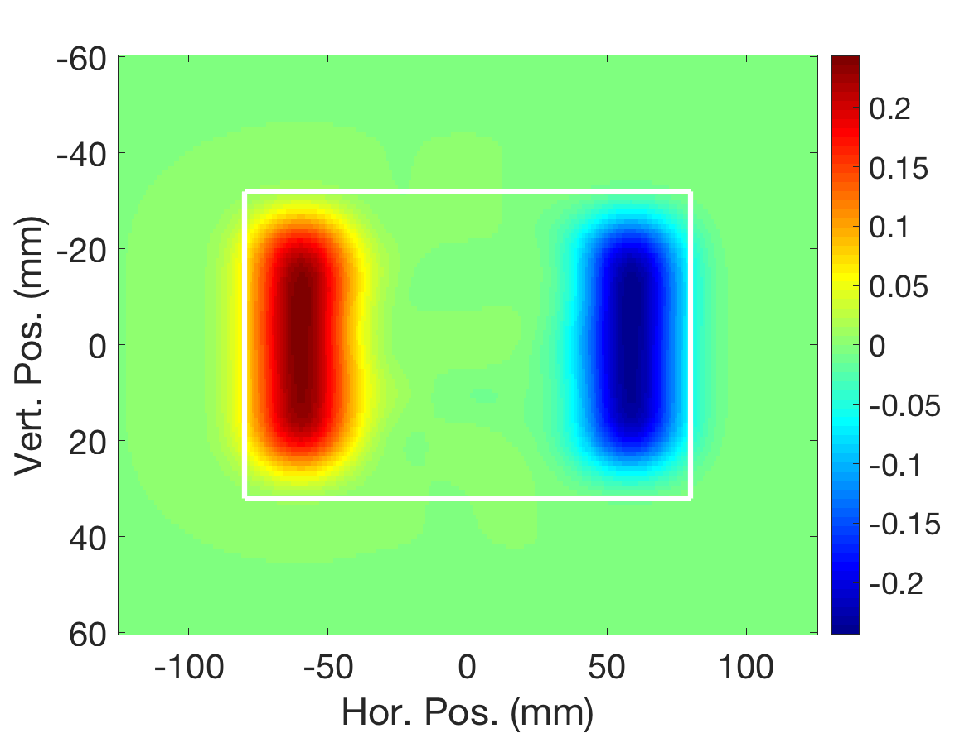
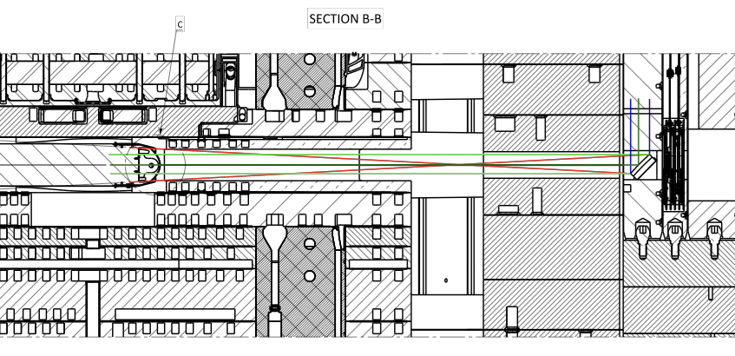
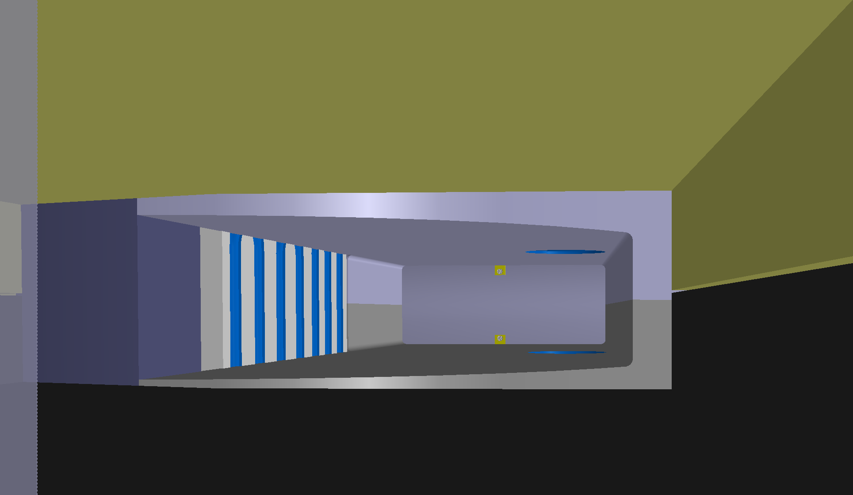
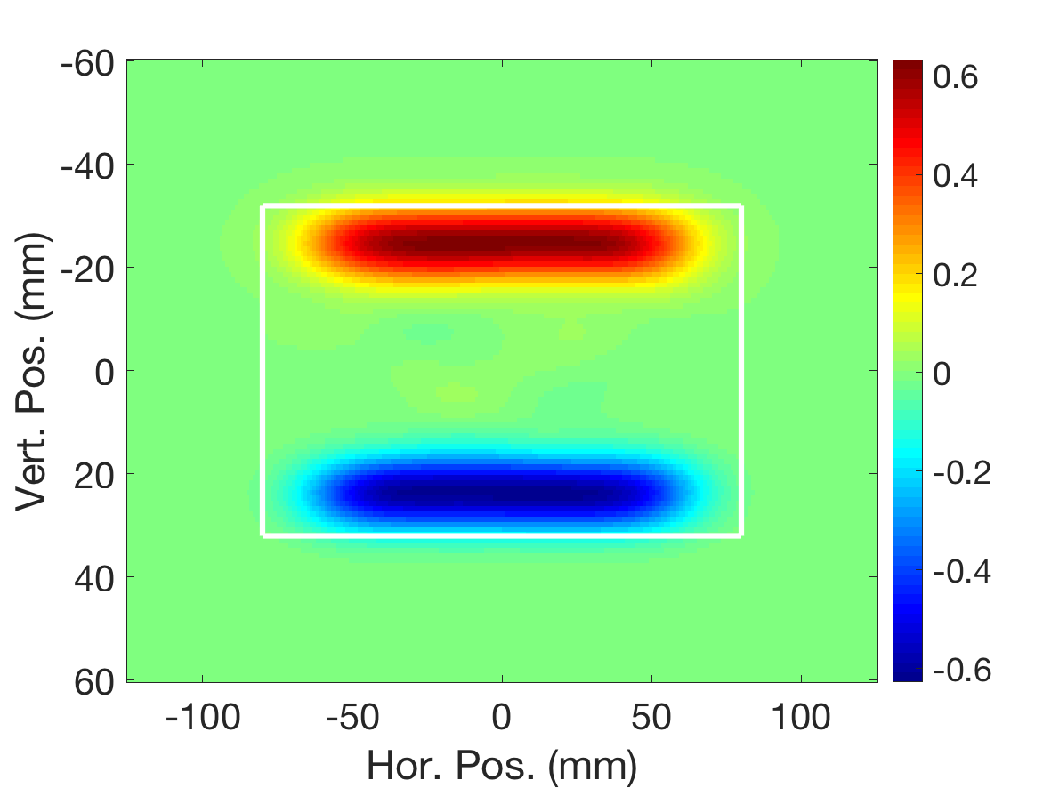
IMG: Measurements
Core Beam properties
Fiducials
Retro-reflectors array
Peak current density < 1.4mA/cm²
FZ Juelich / ESS design
Distribution of reference points in global ESS coordinate system
  Dimension on the images: position and size of the beam
Position of the TW, and motion
Position: far from the core beam -> no significant heat
SS 316L material, same as TW beam entrance window
Resistant to corrosion, but may need to be protected
Beam position: ±4mm (H) ±3 (V)
Beamlet profile and r.m.s sizes:
σ_{x} x σ_{y} >33 mm²
Beam edges: ±2mm
Fiducials
TW
TW
M1

Slide 17
IMG: Measurements
TW and PBW temperature
Dual or Single Gaussian fit:
Luminescent spectra vs. Temperature
Peak's centre(s) linearly depend on Temperature

Slide 18
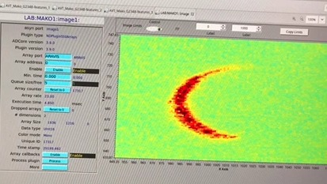
Challenges and possible issues
Uncontrolled / unpredicted scattering or halo:
  Larger heat load on M1, inducing image quality degradation
    Compensated by the fiducials
Fast degradation of the fiducial
Total loss of luminescence, due to contamination
Fast corrosion of M1, in spite of SiO protective layer
3ms laser rastered pulse through full IMG system,
… what can possibly go wrong …

Slide 19

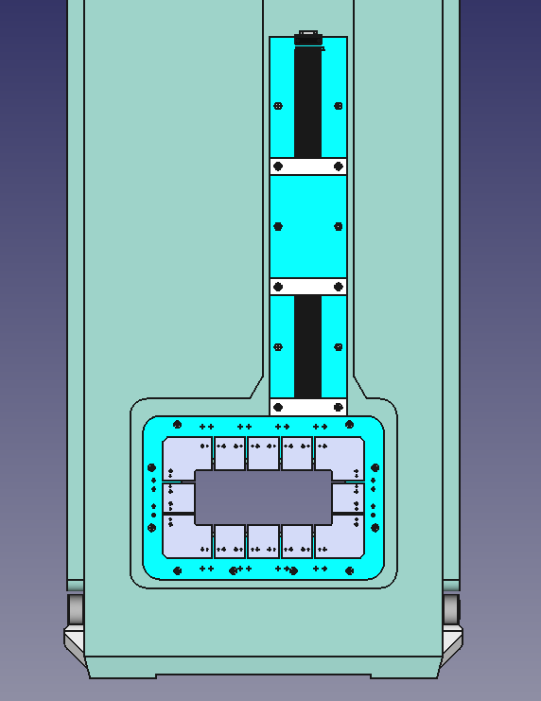
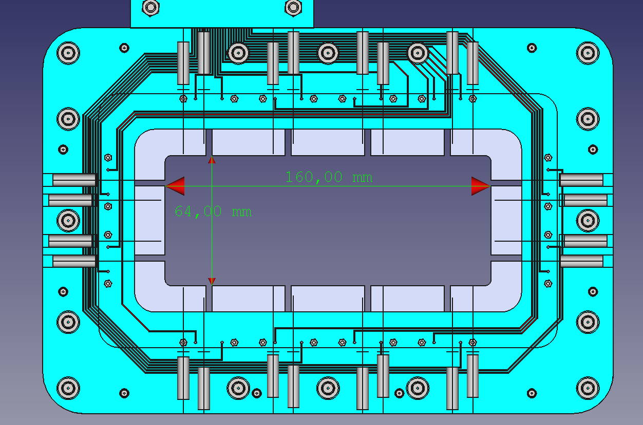
APTM
Readout electronics
Plug slice
Current: pico4 AMC on Struck board, µ-TCA crate
Temperature readout: Standard ECAT modules control by µ-TCA platform
Fast interlock system to abort beam within 20µs
TC: read Temperature – proxy for beam current density
Ni Blades: read Proton induced current

Slide 20
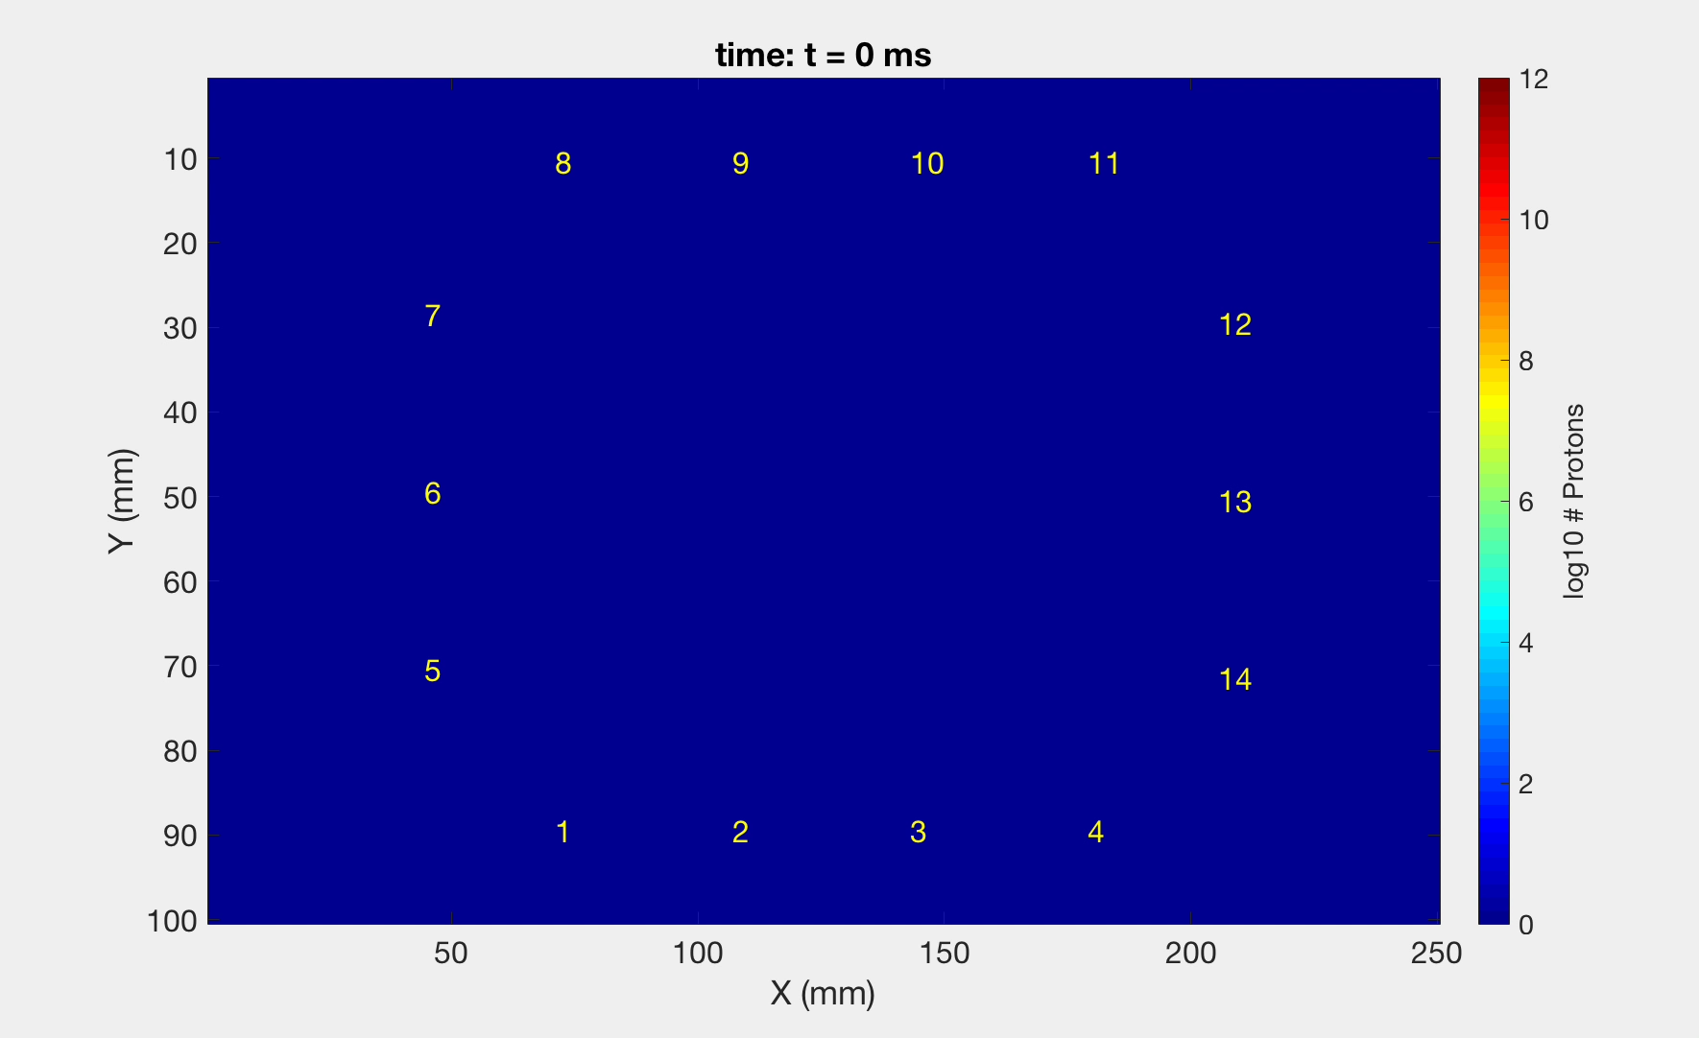
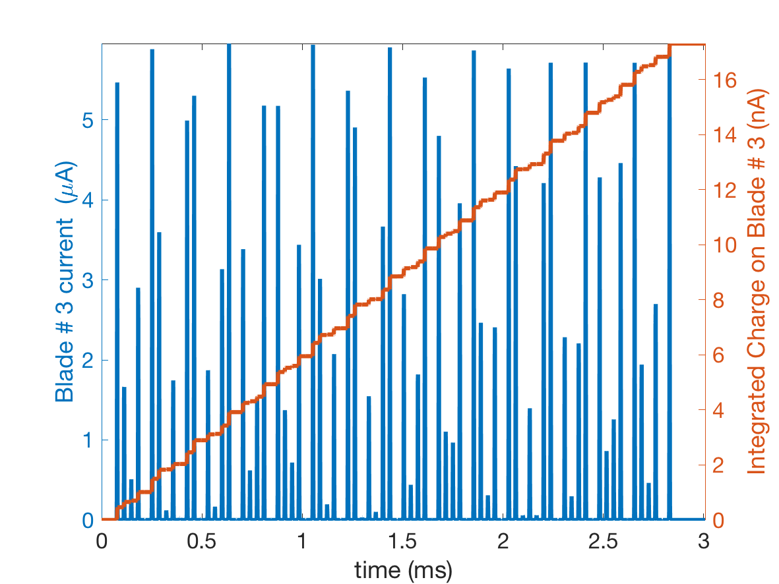
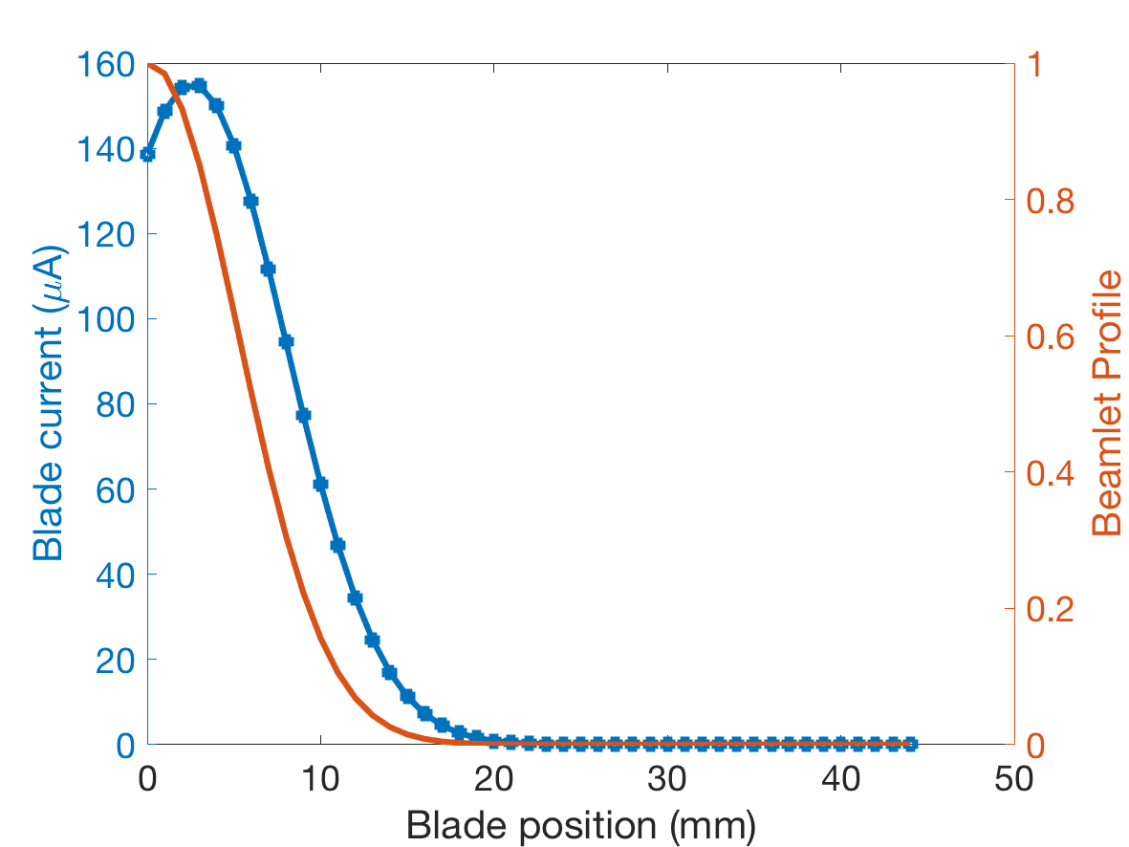
APTM model
Current in blade #3 during nominal pulse
Model based in SEY theory
Confirm by experimental verification of APTM prototype (J-PARC collaboration)
  Found SEY larger than predicted
  Effectiveness of bias at -50V
  Correlation between current and temperature readout

Slide 21
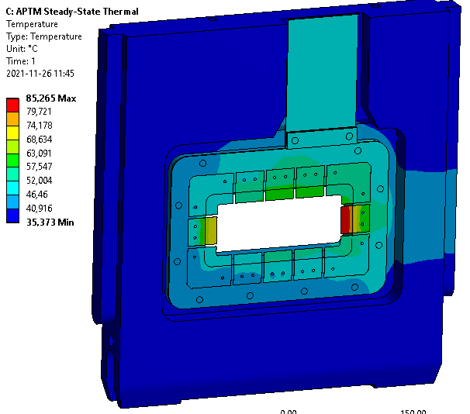
APTM: Critical elements
Non rastered beam
Thermal damages
Blades and TC:
Heat up to 85C in nominal operation
  Possible fatigue from thermal cycles
Ceramic PCB:
Heat up to 45C in nominal operation
  Possible thermal stress at the bolts
Reach >>2000C in 1 non-rastered pulse
Single shot peak temperature
Steady state peak temperature
Corrosion Resistant materials
Nominal beam: steady state regime
Radiation damages
Blades and TC:
Expect He embrittlement and swelling
99.9% Nickel Blade
Alumina Ceramic
Gold PCB wires
SS304 TC sheath
Ceramic PCB:
Dose: 4kGy / h
Rated for >100MGy at least (CERN-HS-RP-093): lifetime > 2years
Aluminum support
Dose: 4kGy / h << PBW dose
Expected lifetime > 2 years
Connectors:
Rated for 1GGy: Dose 4kGy/h -> expected 40MGy in 2 years (10⁴ h)

Slide 22
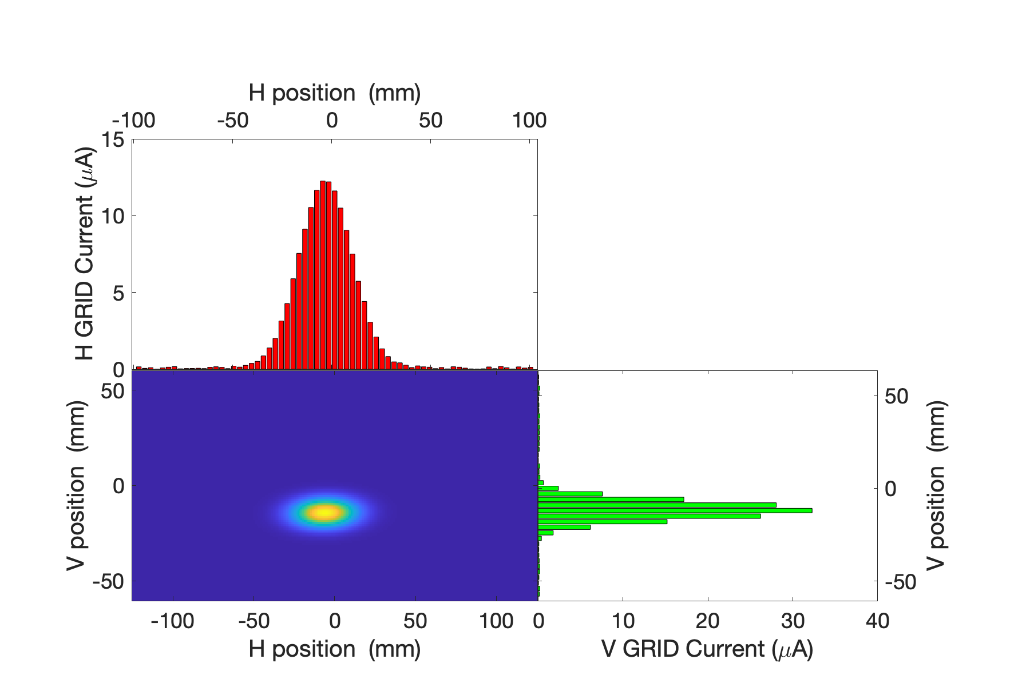
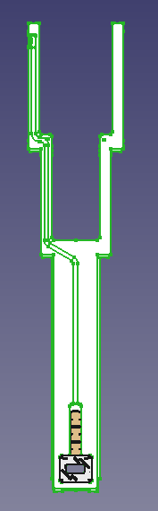
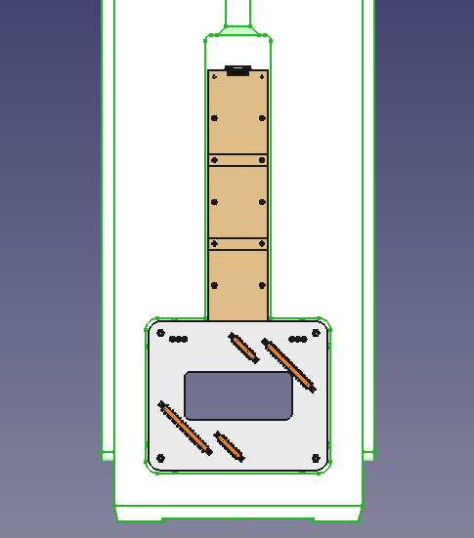
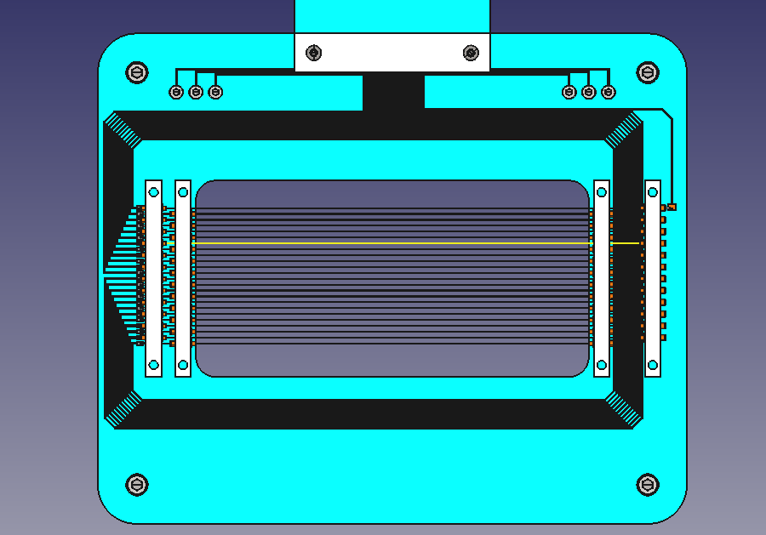
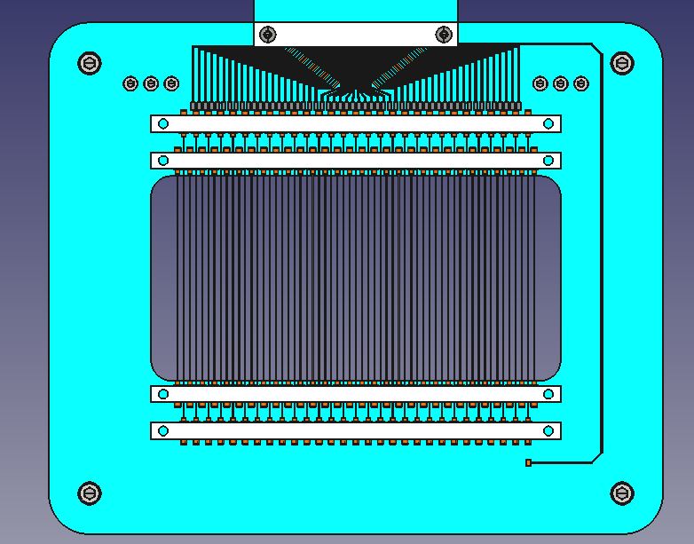
GRID
Plug slice
Readout electronics
Current: pico4 AMC on Struck board, µ-TCA crate
t= 100µs
Sampling 1µs
Beamlet centre and width
Struck with Kintex board as concentrator for FPGA processing
Fast interlock system to abort beam within 20µs

Slide 23
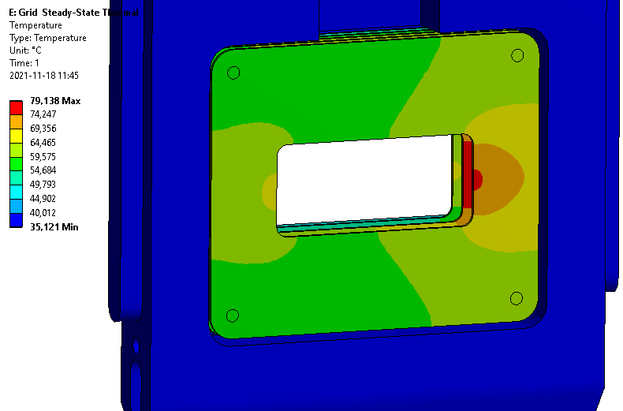
GRID: Critical elements
Thermal damages
SiC wires:
Heat up to 300C in nominal operation
  Possible fatigue from thermal cycles
Heat to 1200C for non-rastered beam
Proven to be long-lived at J-PARC and ISIS
MCNPX + ANSYS, steady state nominal beam
Ceramic PCB:
Heat up to 75C in nominal operation
  Possible thermal stress at the bolts
Reach >>2000C in 1 non-rastered pulse
Radiation damages
Corrosion Resistant materials
SiC wire
Alumina Ceramic
Gold PCB wires
Macor
SS316L
Ceramic PCB:
Dose: 4KGy/h
SiC wires:
Dose: 5DPA / year
He-embrittlement and swelling more important at high temperature

Slide 24
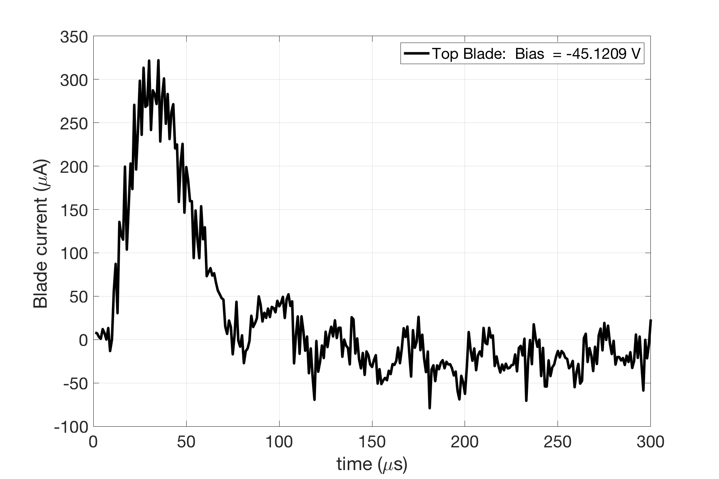
Challenges and possible issues
Uncontrolled / unpredicted scattering or halo:
  Larger heat load on ceramics and smaller parts, causing mechanical failure
Unpredicted Fast corrosion of components, causing failure in signal acquisition
Electromagnetic noise as seen at J-PARC but too large to prevent reliable measurements
J-Parc pulse on Dump, as seen by APTM Ni Blade.
Strong noise from turbo-pump

Slide 25
Concluding Remarks
The ESS Beam carries an intrinsic damage potential to the target and target components, hence the beam delivery system and beam properties require a tight control.
The beam properties can be measured by a suite of instruments, which carry complement and redundant beam properties measurements.
The design of each instrument has to bring reliable measurement to permit fast tuning of the beam and machine protection. This remain a challenge due to the harsh environment associated with the high power beam and the proximity of the spallation target.
The lifetime of each instrument depends on the selection of the materials to survive heat deposition and radiation damage, as long as possible or at least for time defined for instance by cost consideration.

Slide 26

Special Thanks to all our collaborators
Oslo University
Håvard Gjersdal
Erik Adli
University West
Shrikant Joshi
IMP
Haihua Niu
HongMing Xie
ESS
Beam Diagnostics
Neutronics
Stony Broke
Sanjay Sampath
J-PARC
Shin Ishiro Meigo
FZ Juliech
ESSB
SNS
Vim Blockand

