Slide 1
Fermilab “Site Filler”: Muon Collider? David Neuffer Fermilab
January 2022

Slide 2
Outline
Fermilab –
Site filler - Muon Collider ?
possible future high-energy facility on Fermilab site
Motivation
“Energy Frontier”
Muon Collider Components
Muon source
Accelerator
Fast-cycling
Collider Ring
Parameters
Up to ~10 TeV Muon collider “site-filler”
Scenarios, Time lines, etc.

Slide 3
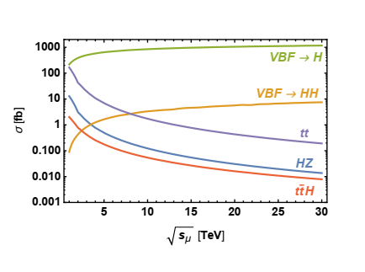
Energy Frontier
10TeV μ⁺-μ⁻ collider has an energy reach of
100 TeV pp collider
Need High- Luminosity
(͞qq events σ ~ 1/s)
Vector boson fusion
σ ~ ln(s)
Goal is ~ 2 attobarn⁻¹/year
L = 2 10³⁵ cm⁻²s⁻¹ 10⁷ s/year
pp Collider
Electro-weak new physics
͞qq new physics
μ⁺-μ⁻
collider

Slide 4
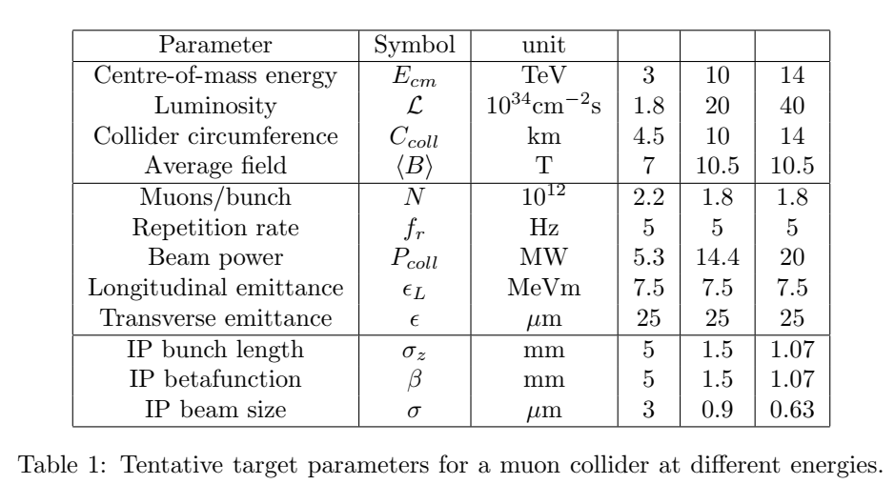
Muon Collider - MAP Concept
An international collaboration on Muon Collider
MUST (MUon STudy)
3 → 10→ 14 TeV Collider
μμ Collider R&D included in European Strategy Doument

Slide 5
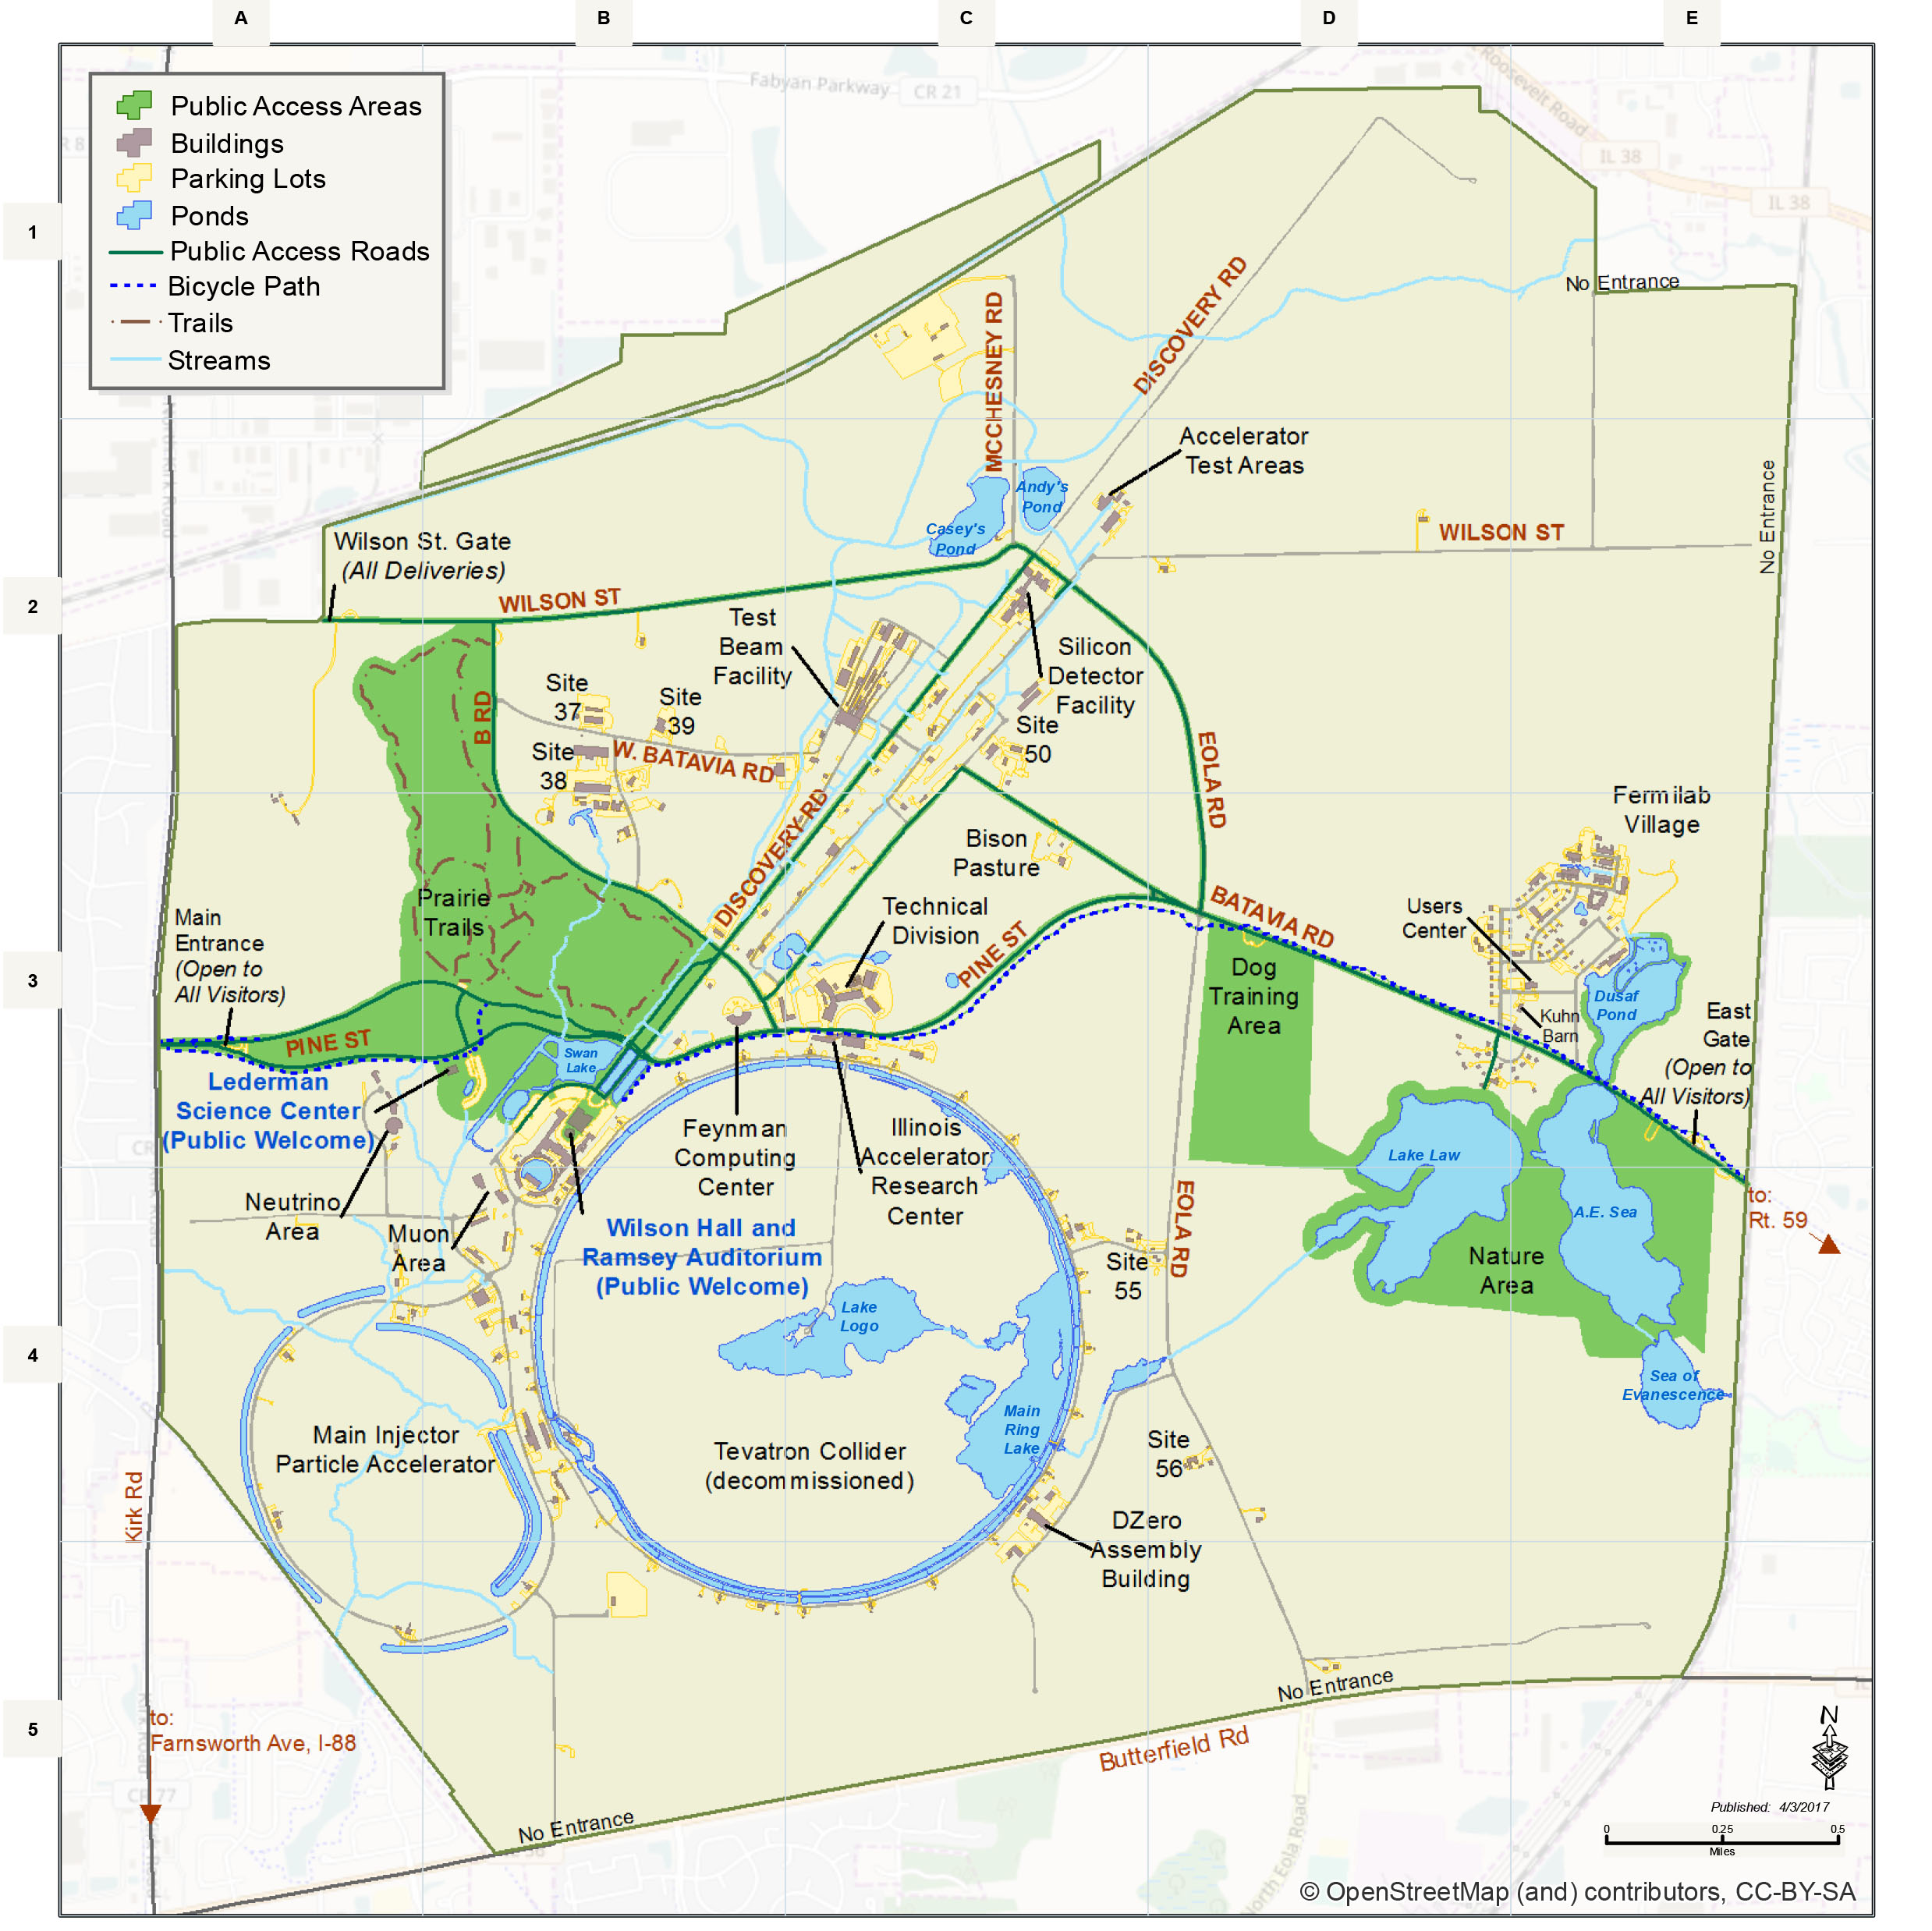
Site filler Accelerator
Largest
Radius is ~2.65 km
~16.5 km Circumference
~2/3 LHC
~RCS accelerator
If B_{ave}= 3 T → E_{μ}= 2.4 TeV
(B_{max} = 8T, B_{pulse} =±2T)
Doubled ?
B_{ave}= 6.3 T → E_{μ}= 5 TeV
(B_{max} = 16T, B_{pulse} =±4T)
10 TeV collider
Collider Ring ~10 km
B_{ave} = 10 T
τ_{μ} = 0.104 s
Accelerator Ring
Collider Ring

Slide 6
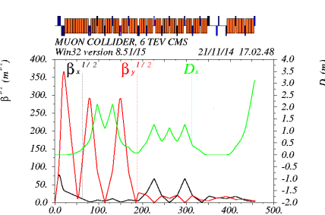
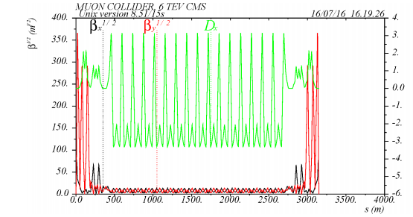
Sample collider lattice-
6 TeV (3x3) lattice – MAP
Wang, Nosochkov, Cai and Palmer JINST 11, P09003
C=6.3 km (B_{ave}= 10 T)
Max pole-tip fields
15-20 T dipoles, 15 T quads
~16 T bending
~isochronous
Extrapolate to 10 TeV
C→10.5 km, R=1.67 km
Fits within Fermilab site
Accelerator is larger
Includes rf, cycling elements

Slide 7
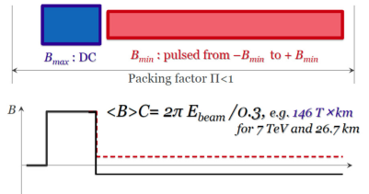
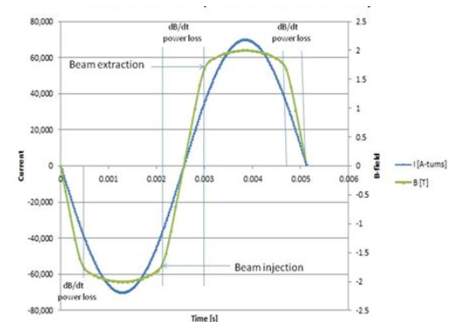
Acceleration methods
Linear Accelerator
5 TeV → > 100 km
Race-track Recirculating Linac (RLA)
(like CEBAF)
Separate return transports
5-6 turns → ??
cost/complexity of multiple turns
Rapid Cycling Synchrotron
B_{typ} = ~1.5 T, 15- 60 Hz
Hybrid – High field + pulsed
Example:
B_{max}=8T B_{pulsed}=±2.0, f= 0.25
3.5 / 0.5 T

Slide 8
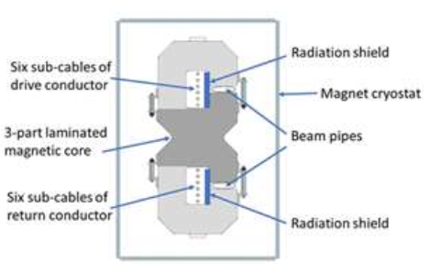
Bending, Accelerating fields:
Conventional (Ferric)
~ 2T
Superconducting –NbTi
Tevatron ~4 T
LHC ~8 T
Superconducting Nb₃Sn
HL-LHC + → 16T
HTS superconductor …
REBCO → 40 T ?
Pulsed magnets
±2 T → ± 4 T ~200-600 T/s
12 T/s HTS → 270 T/s
Piekarz et al. NIM A 943, 162490 (2019)
Piekarz et al. Fermilab-conf-21-695 (2021)
SRF accelerating fields
17 MV/m (650 MHz PIP-II)
30 MV/m (1300 MHz SLS-2)
Future upgrades
40 → 50 MV/m → 80??
Pulsed rf – Cu → ??
50 → 100 MV /m

Slide 9
Acceleration to 5 TeV at Fermilab
0-65 GeV Linac + 10-turn RLA
65 GeV → 5 TeV
RCS 1 – 65→330 GeV r=1km
Normal conducting: 0.3→1.55T
RCS 2 – 330→1000 GeV r=1km
Hybrid 8±2 T
RCS 3 – 1 → 5 TeV “site filler”
Hybrid 16±4 T
65 GeV → 5 TeV Scenario
 | RCS-LE(nc) | RCS-HE(hybrid) | RCS-HF 16/4 hybrid
Input Energy | 65 | 330 | 1000 GeV
Output Energy | 330 | 1000 | 5000 GeV
Circumference | 6.28 | 6.28 | 16.5 km
Pack Fraction | 0.75 | 0.83 | 0.88
Total straight section | 1.57 | 1.07 | 1.96
B-highfield |  | 8 | 16 T
B-lowfield |  | ±2 T | ±3.95 T
B_{ave} | 0.3→1.55 T | 1.4→4.4 T | 1.44→7.2 T
Fraction high-field |  | 0.34 | 0.27
Acceleration Scenario
Acceleration turns | 36 | 97 | 270
Acceleration Time | 0.76 | 2.03 | 15 ms
Beam survival | 0.80 | 0.85 | 0.75
Rf voltage (φ_{s} = 60°) | 8.63 GV | 7.94 GV | 17.1 GV
Ramp Rate | 1650 T/s | 1970 T/s | 530 T/s
~6 GeV Recirculating Linac
650 MHz
~10 turns to 65GeV
3 GeV Linac
650 MHz SRF

Slide 10
5 TeV with ±2 T RCS components
Requires additional site-filler RCS ring
1->3.25 TeV
19% 16 T magnets
3.25→ 5 TeV
37% 16 T magnets
~ 10 GV more rf
Decay losses higher
65 GeV → 5 TeV Scenario
 | RCS-LE(nc) | RCS-HE(hybrid) | RCS-HE 1 | RCS-HE 2
Input Energy | 65 | 330 | 1000 GeV | 3250 GeV
Output Energy | 330 | 1000 | 3250 GeV | 5000 GeV
Circumference | 6.28 | 6.28 | 16.5 km | 16.5 km
Pack Fraction | 0.75 | 0.83 | 0.88 | 0.88
Total straight section | 1.57 | 1.07 | 1.96 | 1.96
B-highfield |  | 8 | 16 T | 16 T
B-lowfield |  | ±2 T | ±2.0 T | ±2.0 T
B_{ave} | 0.3→1.55T | 1.4→4.4 T | 1.44→4.7 T | 4.7→7.2T
Fraction high-field |  | 0.34 | 0.192 | 0.37
Acceleration Scenario
Acceleration turns | 36 | 97 | 161 | 249
Acceleration Time | 0.76 | 2.03 | 8.9 ms | 13.7 ms
Beam survival | 0.80 | 0.85 | 0.80 | 0.85
Rf voltage (φ_{s} = 60°) | 8.63 GV | 7.94 GV | 16.1 GV | 8.1 GV
Ramp Rate | 1650 T/s | 1970 T/s | 450 T/s | 290 T/s

Slide 11
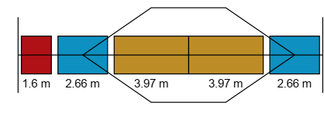
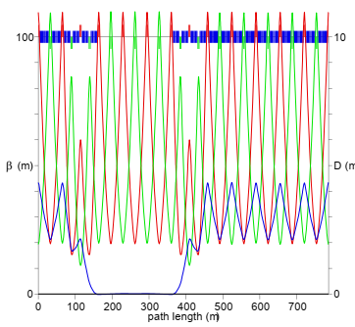
Hybrid RCS Acceleration
High-field fixed and low-field cycling magnets interleaved
Orbit through cycling magnet varies in acceleration
Quadrupoles needed
Fixed or ramped ?
Fixed fields probably not stable
Limited to ramping fields
0→2 T ( or 0→4 T at pole tips)
Extra length for ramping quads must be included in lattice
Sample Lattice
A. Garren and S. Berg
MAP-doc-4307 (2011)
750 GeV in Tevatron
Quadrupoles are ramped to keep tune constant
25m

Slide 12
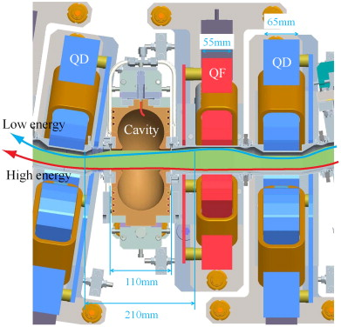
Fixed Field Accelerators
Fixed field alternating- gradient (FFA)
Scaling -> edge focusing
Constant tunes
Non-scaling
Crosses integer tunes
CBETA
~RLA with FFA arcs
Tests concept

Slide 13
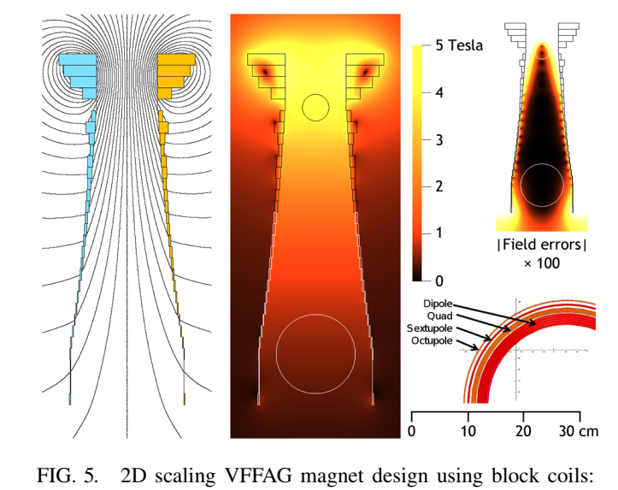
FFA acceleration
Vertical FFAG
S.Brooks, PRSTAB 16, 084001 (2013)
~same circumference for all energies
More isochronous
Edge focusing
Scaling → non-scaling
Adaptable to muons ?

Slide 14
Site filler Accelerator
Proton Source
PIP-III→target
μ Cooling
Linac + RLA → 65 GeV
RCS 1 and 2 → 1000 GeV
Tevatron-size
RCS 3 → 5 TeV
Site filler accelerator
10 TeV collider
Collider Ring ~10 km
Accelerator Ring
Collider Ring
Protons
Cooling
RCS 1-2

Slide 15
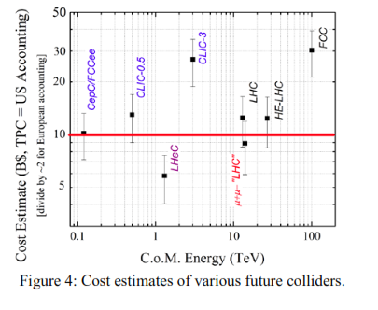
Costs ??
Affordable?
according to Shiltsev cost model (JINST 9 T07002 (2014)):
α≅ 2B$ for civil construction,
β ≅ 1, 2 or 10 B$
for NC, SC magnets or SRF
γ≈ 2B$ wall plug power
L=16, 60 GV rf, E_{cm}=10, P= ? MW
~10^{1±0.5} G$ ?

Slide 16
Summary
Fermilab site filler
Muon Collider up to ~10 TeV Collider is possible goal
(5 × 5 TeV)
Requires ~16 T dipoles , in RCS scenarios
With rapid-cycling 2—4 T magnets

Slide 17
Thank you for your attention

Slide 18
~4 TeV (2 x 2) Muon Collider (~2005)
Muon Collider
2 TeV ring (~8T magnets)
RLA accelerator
~18 turns
2km linacs -50 GeV each
~30 MV/m rf
Arcs are ~8T magnets each
Not quite site filler
Easily expand to 2.5x2.5
(5 TeV)
Double gradients, B_{max}
10 TeV (5 x 5) – (16 T – 60 MV/m)

