Slide 1
Target and cooling channel for Muon Colliders
Katsuya Yonehara
Muon collider workshop
January 26, 2022

Slide 2
Possible contents in White paper
MAP baseline is a good start point for the white paper
It is also important that our effort is synergetic to the European strategy plan
Plan is adding alternate thoughts to appeal the US contribution to be unique
In this presentation, we will discuss
MAP solenoid base target system
Proposed US strategy plan for target system
MAP design cooling channel
Proposed US strategy plan for cooling channel

Slide 3
MAP baseline
Cooling
Transmission efficiency of 6D cooling is 20 %
Transmission efficiency of Final cooling is 50 %
Decay process is involved in an efficiency calculation
Proton driver
4 Mega-Watt 8 GeV protons
N_{p} = 3.13E15 protons on target
Front End
Proton to muon conversion efficiency is 10-15 % for each sign
Acceleration & Collider Ring
Total transmission efficiency is 70-80 %
Goal of the European strategy plan is optimizing each element
Ex) Improve performance for each
Ex) Check feasibility and practicality
We approach the same goal with a unique way

Slide 4
Solenoid-based target system
K. McDonald, NuFACT15
Peak field 20 Tesla solenoid
Tapered field strength to adiabatic transfer transverse momentum into longitudinal
Tungsten beads, CH2, and He gas to protect SC outer conductor (Nb₃Sn+NbTi) from radiation
Hg as target material

Slide 5
Challenge for Solenoid-based target system
No solution of proton beam damper in the target system
Beam damper is inside the solenoid magnet
Need to remove 4 MW heat from the magnet
Extreme radiological hazard
If Hg as target material, Hg is toxic and actively reacts with Al and SS
SS damaged (cavitation on Hg surface) reported at SNS and MERIT experiment
SNS Hg target changeout four times per year
Magnetic shield for 20 Tesla solenoid required
No practical design exists

Slide 6
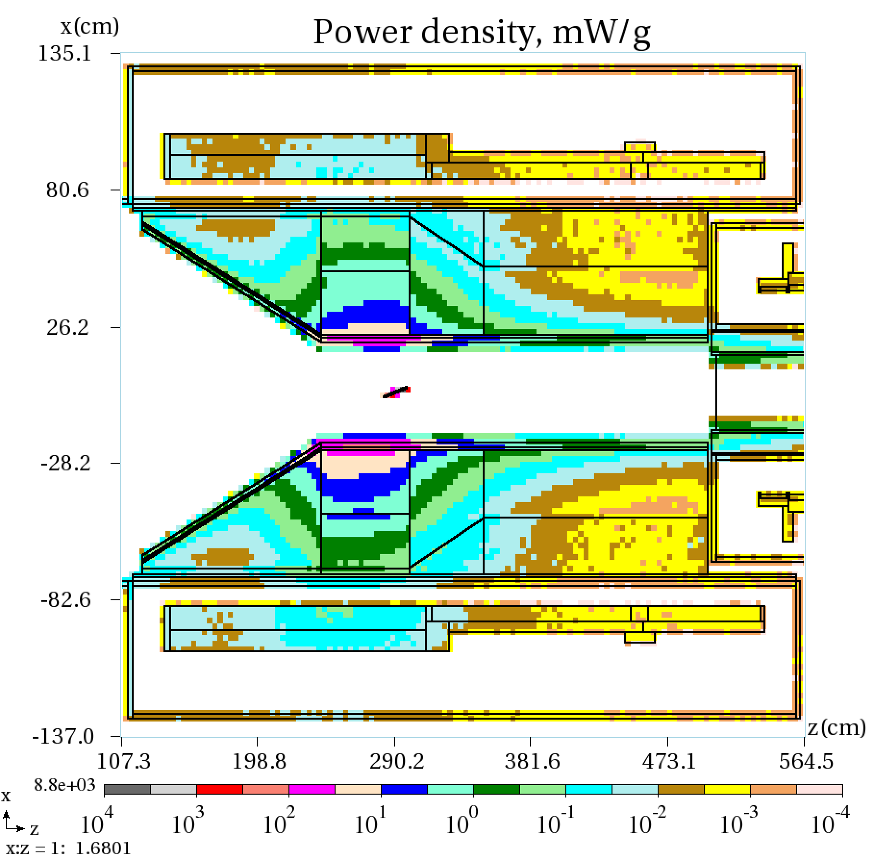
Proposed US strategy plan for target system
Study of muon yield with C target
Use a new target material
Carbon graphite (past study shown in righthand plot)
Nano fiber
Best mixing
Study radiological hazard and design beam dump
So far, we do not have any idea for a solenoid-based target system (100 kW@Mu2e has already challenging, see righthand plot)
Horn-based target system is considered to mitigate the beam dump issue
Ding et al., IPAC2016
Design study of Mu2e solenoid-based
W target system

Slide 7
Alternate design: Horn target system
Lorentz force ($b_{φ}\left[r\right]∙p_{z}$) makes focusing
Assume path length inside horn field is parabolic
$θ=\frac{eb_{φ}l}{p_{z}}∝\frac{I∙r}{p_{z}}$
Beam dump can be outside horns
Widely used for neutrino experiments
T2K: 515 kW (2020)
NuMI: 843 kW (2021)
Both use C graphite
Horn survives more than 10⁷ beam pulses
Van der Meer’s original sketch of magnetic horn in 1961

Slide 8
Two horn designs
Extract forward and backward scattered pions
Design study has begun
Ratio of forward and backward pion yields is significantly unbalanced
Phase spaces of forward and backward pions are quite different; need to optimize the extraction optics for each pion
Form FODO optics
Looks more attractive option now

Slide 9
Optimizing target
HEP target shape is monochromatic
Simplify optimization (mainly for high gain pion yield)
Simulation and experiment show that pion yield peak around one interaction length thus an impact thermal stress is also maximum around there
Possibly changing shape of target around high stress area to mitigate stress and improve pion yield
HEP target material uses the same material
Possibly, there is the best mix to achieve high stress resistive and high pion yield
Apply AI to optimize the target system
AI is widely used for material science, why not for us?
We need a data base and High Performance Computering (HPC)

Slide 10
MAP Cooling channel
D. Stratakis, Muon Forum, 11/18/21
Stage 8 (last section)
End-to-end cooling in Rectilinear channel
Alternate solenoid lattice
Solenoid coil is tilted to induce a dispersion for emittance exchange
Looks most feasible technique although the last section is technologically challenging

Slide 11
MAP baseline final cooling: High solenoid channel
Apply 30-Tesla solenoid magnet and decelerate muons to gain extremely low beta function
Present design has high muon loss
No practical accelerator (ex. induction linac) after cooling is designed yet

Slide 12
US strategy for cooling
Snake HFOFO channel
Both charged muons can be cooled down
They have a π-phase offset
Apply practical beam optics in simulation

Slide 13
Apply HTS for Final Rectilinear Cooling Channel
D. Summers
Extend MAP base cooling channel by applying HTS
US has a very strong High Field magnet community
Applying HTS for accelerator complex will be a great impact for not only MC but also entire HEP accelerator community

Slide 14
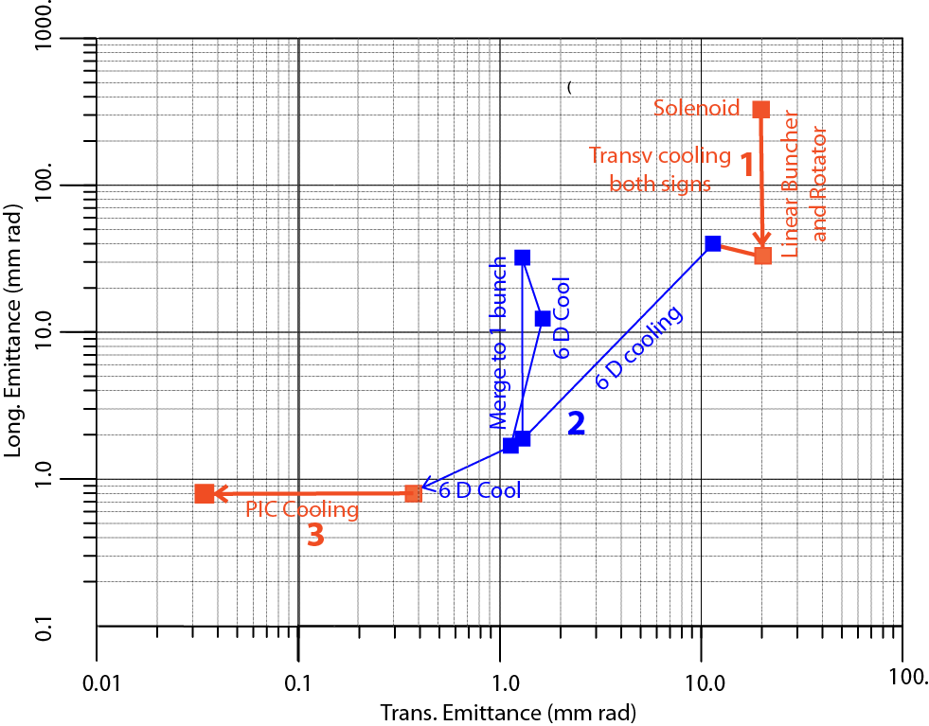
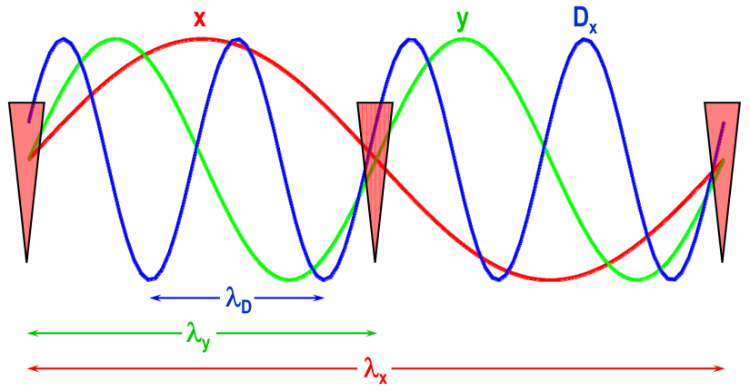
Parametric-resonance Ionization Cooling (PIC) in present muon emittance evolution scheme
C. Rubbia
Conventional
cooling
PIC
50 Tesla solenoid
Phase advance
Exceptional cooling
Correlated optics for periodic focusing at absorber positions λ_{D} = λ ⇒ λ_{x} = 2λ_{y} = 4λ

Slide 15
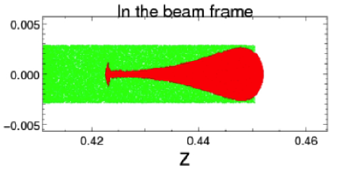
Plasma lens in gas filled RF cavity
High RF gradient + strong focusing will solve the aberration due to longitudinal-transverse coupling
Consider plasma focusing in gas-filled RF cavities
Idea supported by initial simulations
Bunch length ~ 100 ps
σx ~ σy ~ 2 mm
n_{μ} = 10¹² μs/bunch
β = 0.88 (200 MeV/c)
Gas pressure 200 atm
Beam focused by plasma lens
Red: muon
Green: electron
Plasma lens
Absorber plates
Parametric resonance lenses
Apply short length high gradient RF acceleration fields and strong focusing to induce longitudinal phase rotation
w

Slide 16
R&D of plasma lens in cooling
Plasma simulation by using High Performance Computing (HPC) facility
Validate charge neutralization
Characterize beam-induced plasma
Time domain plasma dynamics
Degree of freedom to control plasma dynamics
Cooling simulation with plasma lens
Apply stochastic process in cooling simulation
Optimize plasma parameter to maximize cooling
Plasma pinch vs lowest equilibrium emittance
Experimental demonstration
Beam-induced plasma vs preform plasma
Study beam-gas-plasma interactions at cooling channel condition

Slide 17
Cooling demonstration facility
CERN proposed a very nice muon cooling demonstrator
We need to describe the demonstrator in the US
I do not have a time to investigate the possible test facility in the US
AP0 at Fermilab can be a good candidate

Slide 18
Summary
Outline of the target and cooling sections for White paper is based on MAP baseline
It is also important to note that our effort is synergetic to the European strategy plan
We appeal that the US approach is unique
We will look at the cutting-edge technology which can be a breakthrough of the present intrinsic issue on MC design
R&D HTS for accelerator complex
Apply HPC for target physics and plasma lens for cooling
Study AI to optimize beam optics
Need to search muon cooling demonstrator in the US
Good exercise to R&D the front-end channel

