Slide 1
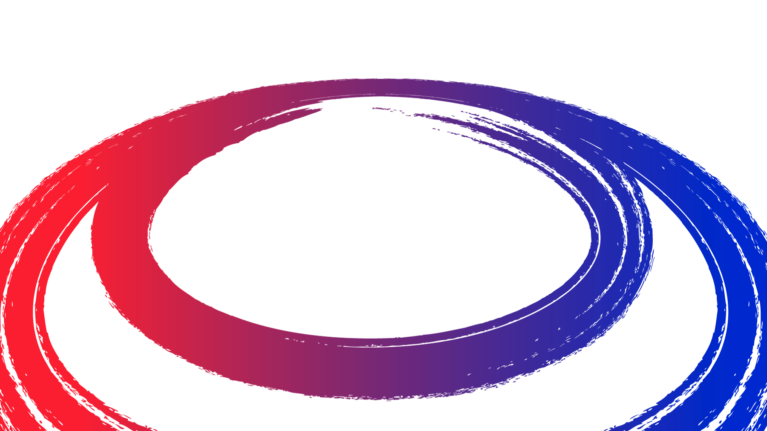
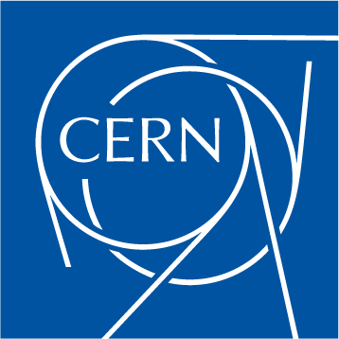
Neutrino Radiation Assessment and Mitigation
C. Ahdida, C. Carli, N. Guilhaudin, G. Lacerda, A. Lechner, G. Lerner, Y. Robert, D. Schulte, K. Skoufaris
Workshop on Muon Driven Colliders
26th and 27th January 2022

Slide 2
Outline
Recap of the Neutrino Radiation Issue
Analytical Approximation of Radiation from Neutrinos
Overview of workflow related to a refined dose model
FLUKA MC Studies
Geoprofiler
Summary and Outlook

Slide 3
Recap of the Neutrino Radiation Issue
Radiation due to showers generated by neutrinos reaching the earth surface
Matter in front (“shielding”) does not help but makes situation even worse
Narrow radiation “cone” for a short piece of the machine with length
Strong increase with muon energy
Cross sections about proportional to energy
Typical energy per interaction of neutrino with matter proportional to muon energy
Opening of radiation inversely proportional to muon energy
Radiation cone
Collider ring
3

Slide 4
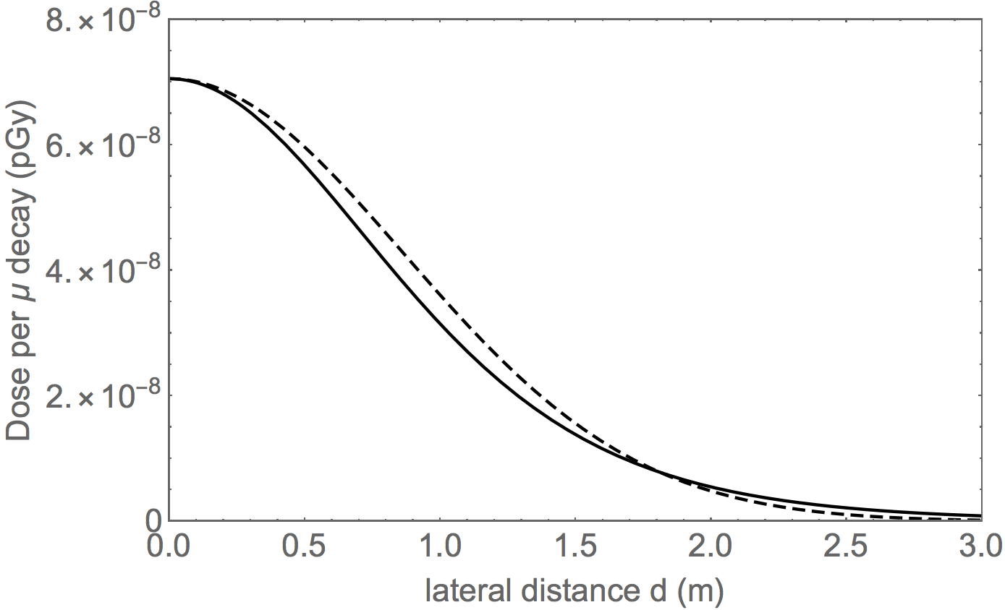
Analytical Approximation of Radiation from Neutrinos
Analytical estimate base on approach by B. King
Neutrino energies from production in muon rest system and Lorentz boost
Cross section assumed proportional to energy
Identical (almost) similar results for μ⁻ and μ⁺ and despite different cross sections …
Absorbed dose per muon decay at distance L_{s} and offset d with γ the relativistic Lorentz factor)
Absorbed dose per muon decay for
10 TeV com energy at L_{s} = 100 km
Conversion absorbed dose to effective dose 1 Sv/Gy optimistic!

Slide 5
Analytical Approximation of Radiation from Neutrinos
Dose due to neutrinos for realistic lattice with divergence from beam
Needs integration over longitudinal position
Rms opening angle of cone becomes and
With the repetition rate times the number of muons per cycle and the circumference
Additional widening of cone due to time dependent orbit or machine deformations to be added later

Slide 6
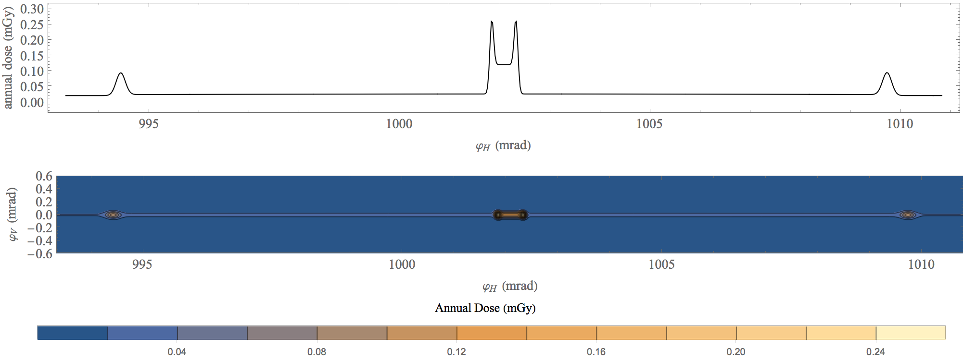
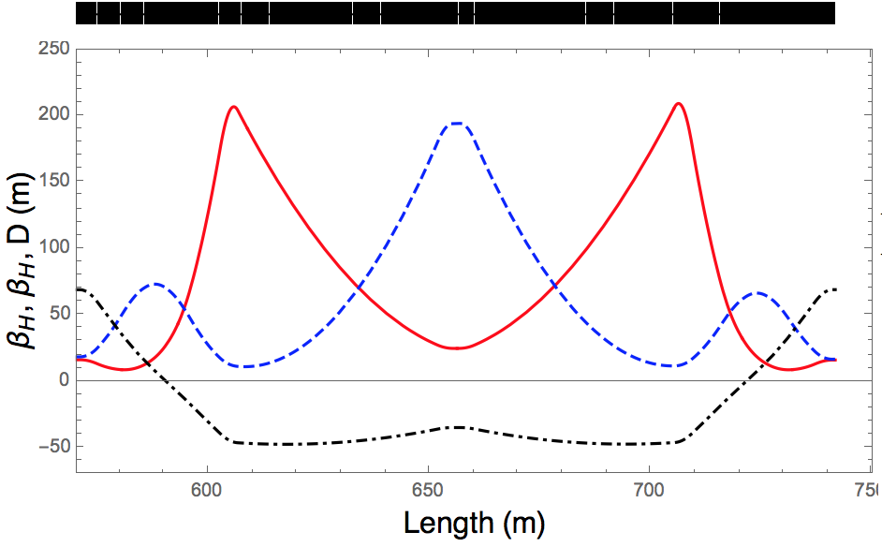
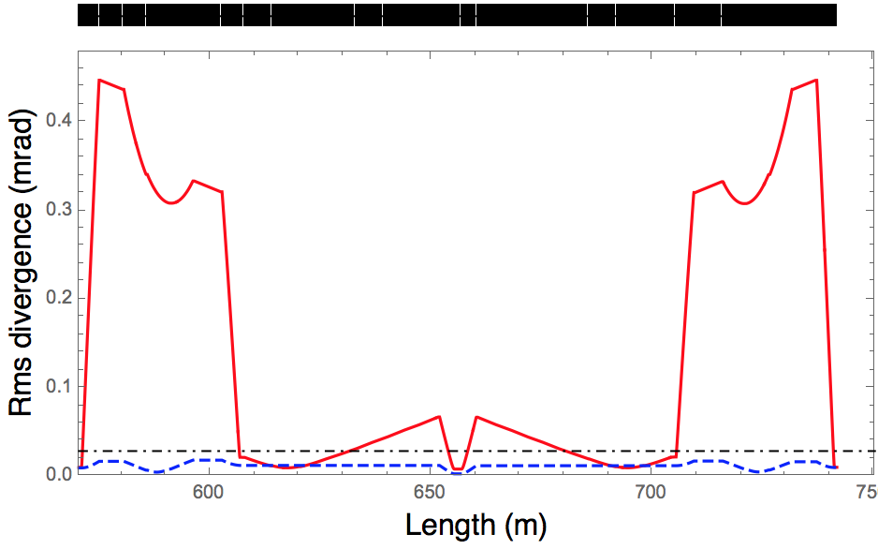
Analytical Approximation of Radiation from Neutrinos Dose from arc cell for 3 TeV com MAP lattice
0.30 m drift with some divergence
X-pole with 2 T dipolar
0.30 m drift with small divergence
5000 h operation
Beam intensity to be checked

Slide 7
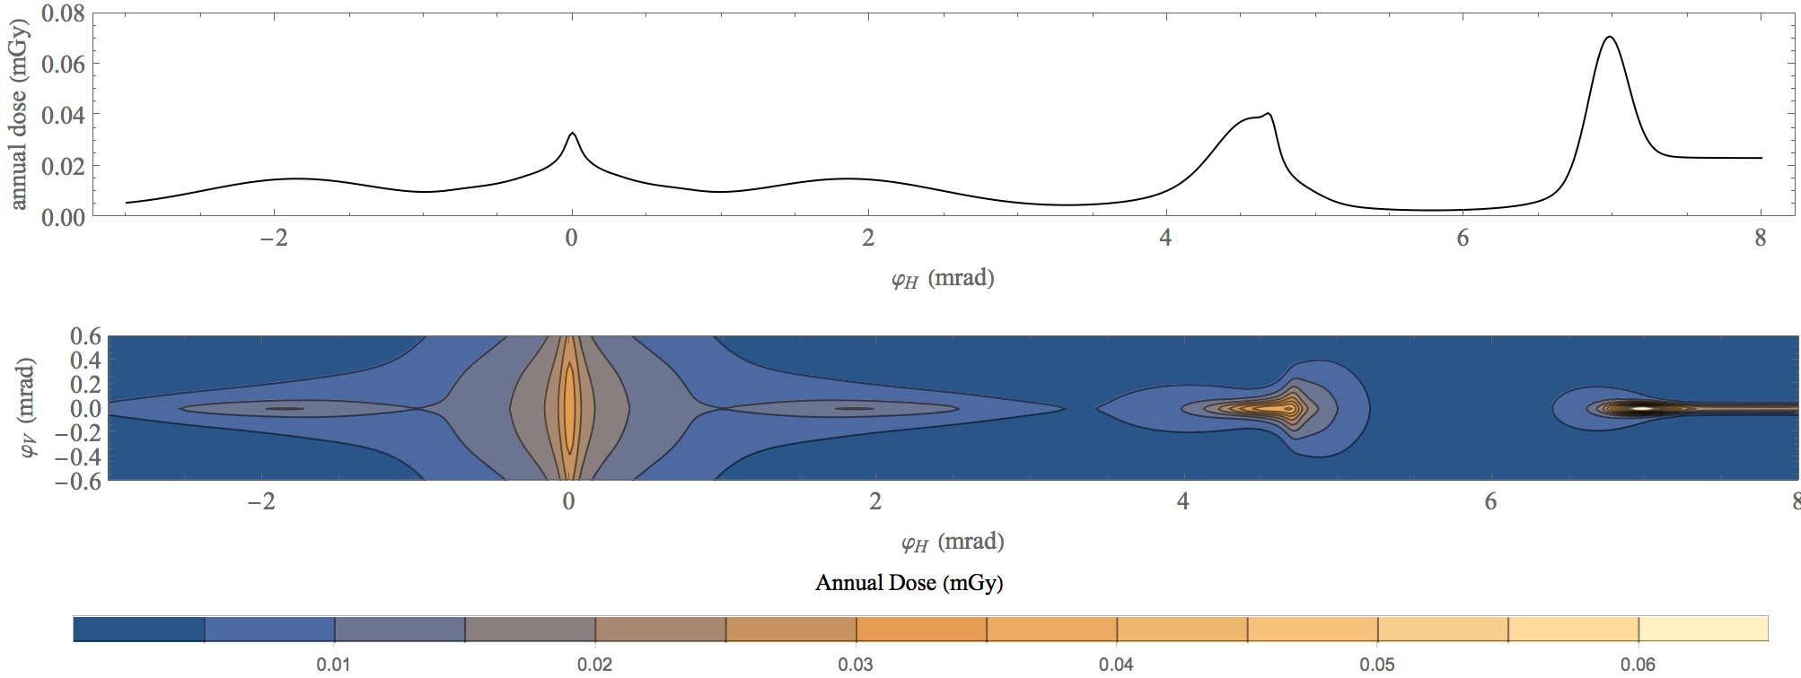
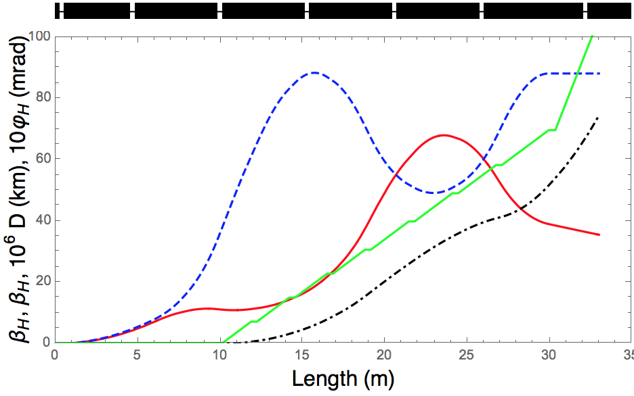
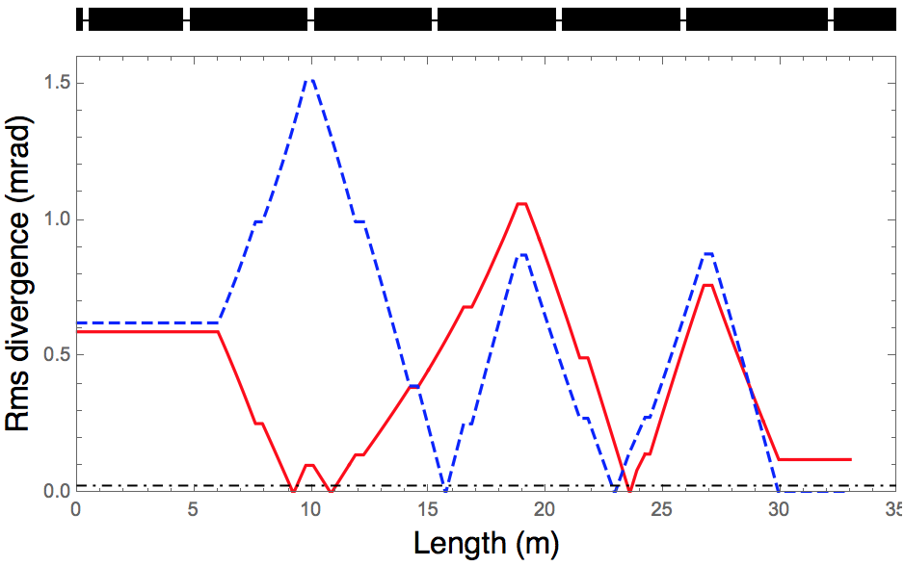
Analytical Approximation of Radiation from Neutrinos Dose from region around IP for 3 TeV com MAP lattice

Slide 8
Overview of workflow related to a refined dose model
Slide by C. Ahdida
MC simulations
Dose surface map
Dose assessment
Operational scenarios
Sensitivity analysis
Demonstration of compliance
Folding with realistic source term
Optimization process

Slide 9
FLUKA MC Studies
Motivation
Get an improved model for the dose distribution generated by neutrinos
Verify and improve analytical expression given before
Effective dose instead of absorbed dose
Quantify widening of neutrino radiation cone due to transverse extension of shower
Procedure
Start with mono-energetic muon beam without divergence
Generation of neutrinos from muon decay
Obtain effective dose distribution (per decayed muon) at different distances from muon decay
Fit with simple expressions – Gaussians good enough?

Slide 10
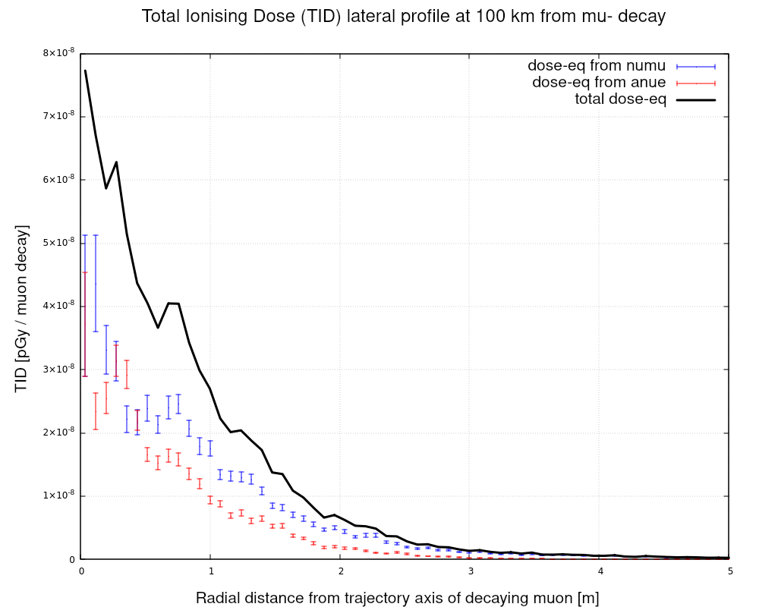
FLUKA MC Studies
Work by G. Lerner
Very first results
Plot shows absorbed dose for direct comparison
At a first glance good agreement with analytical estimate
Effective dose distributions for μ⁻ and μ+ at different distances expected very soon

Slide 11
Geoprofiler – Radiological Analysis
Slides by G. Lacerda
Goal: Geolocate and display neutrino radiation affected areas for a given accelerator scenario.
Interactively as it is edited and positioned, requiring good performance.
Issue: Large study area and complex calculations in geolocation and radiation dose estimation.
Problem needs to be simplified and the solution approximated as best as possible!
Initial Approach: Focus on tracking and geolocating a few directions of most intense radiation (sections surrounding interaction points) with simple line models.
Flexibly allow analysts to select other interesting study points
Iterative improvements:
Display general radiation data sourced from refined dose model.
More encompassing and realistic radiation spread model.
Characterization of land and dose impact at “hotspots”.
* Unrealistic positioning, for illustrative purposes only!

Slide 12
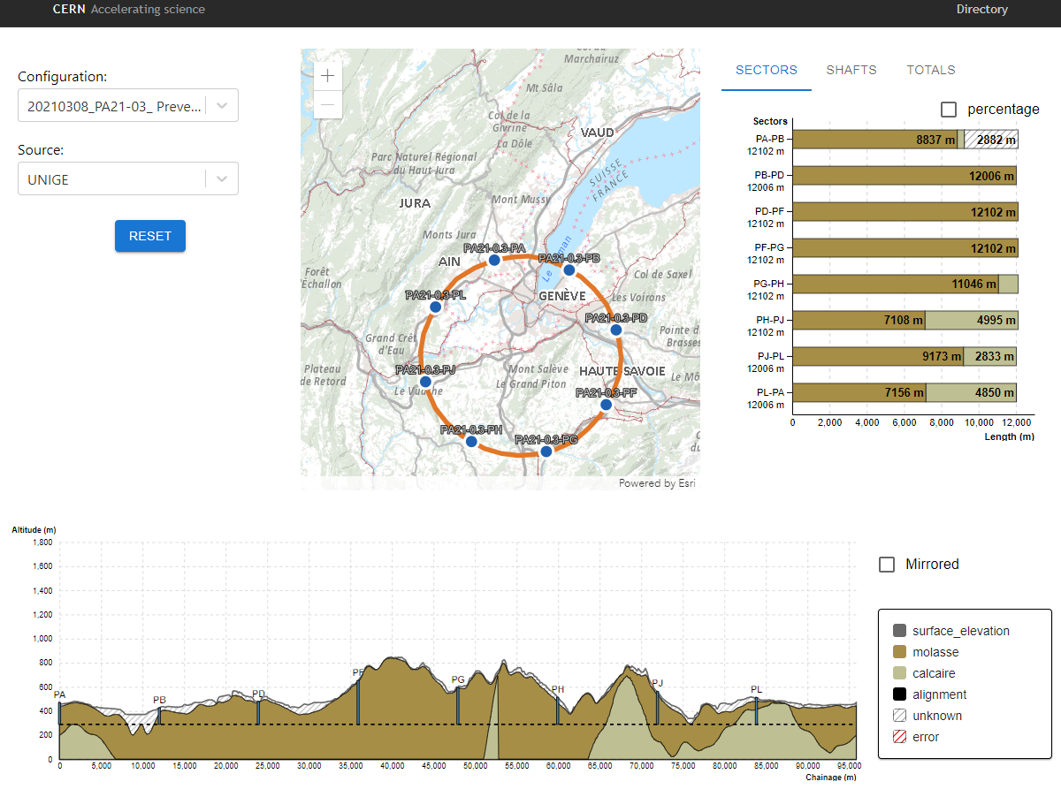
Geoprofiler – Radiological Analysis
Slides by G. Lacerda
* Unrealistic positioning, for illustrative purposes only!
Geoprofiler Application – currently focused on geological analysis, allows the user to edit and reposition the ring with immediate recalculation of the geology along the tunnel.
Radiological Analysis Goal: Quick exploration and identification of locations of good potential concerning land jurisdiction / rights, urbanization, minimal radiation impact, etc.
For this it will feature:
Enlarged study area
Multiple tunnels per configuration / scenario
Radiation dose impact estimate charts
Information about impacted areas (rights, urbanization …)
* Prototype, for illustrative purposes only!

Slide 13
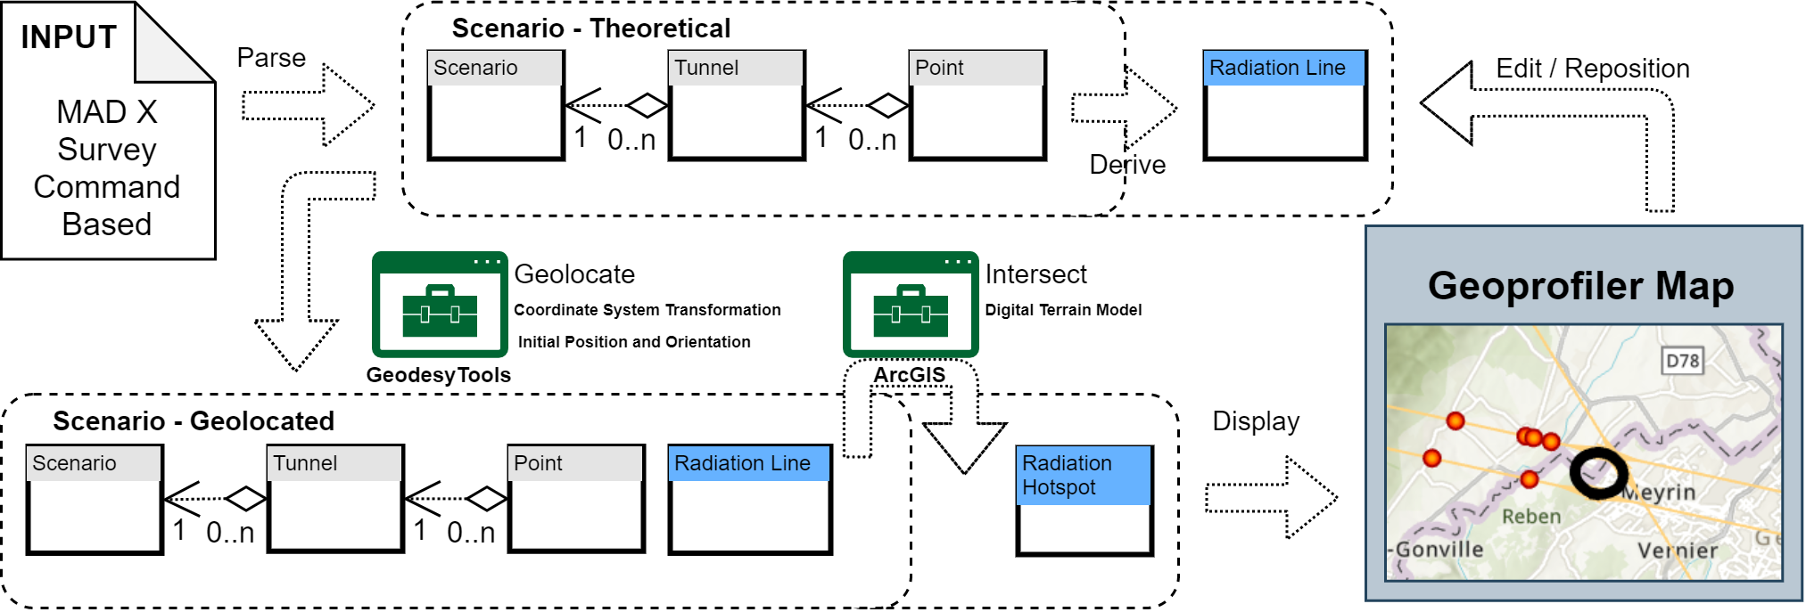
Geoprofiler – Radiation Geolocation Workflow
Slides by G. Lacerda
Additional metadata identifies initial coordinate system, position and orientation.
More information, such as descriptive tags, functional sections and surface access points, can be encoded in similar fashion.
In the input:
Each survey command output section defines a tunnel of the scenario.
Markers identify interaction points and other points of radiological interest.

Slide 14
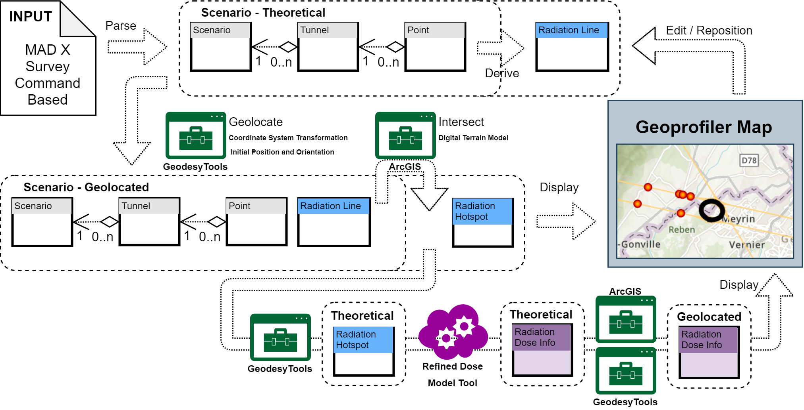
Geoprofiler – Radiation Geolocation Workflow
Slides by G. Lacerda
Adding Dose Information
An independent dose model tool allows for separation of concerns.
Implies transforming back and forth between coordinate systems.

Slide 15
Summary and Outlook
Radiation due to showers generated by neutrinos reaching the earth surface a serious issue
Doses increase strongly with muon energy!
Procedure to assess dose due to neutrinos being set up
FLUKA simulations for realistic radiation cone without divergence from beam
Folding of lattice properties (geometry, divergence, orbit deformations …) with neutrino radiation cone
Tool to geo-localize areas with (high) effective doses
Optimizations to reach acceptable maximum doses once 10 TeV lattice available
Lattice (attention to straight sections, divergence from dispersion in arc …)
Positioning of machine (hot spots only in suitable locations)
Spreading of radiation over larger area by time varying orbit deformations and/or deformation of whole machine

