Slide 1
Cylinder FRB backend
96 beams pointing: Az 0 Alt 60 ~ Az 0 Alt 90 ~ Az 180 Alt 60
PSR | B0329+54 | Crab | B2021+51
Period (ms) | 714.5 | 33.39 | 529.2
DM | 26.7 | 56.7 | 22.5
Az | 0 | 180 | 0
Alt | ~75 | ~67 | ~82
S (400MHz)(mJy) | 1500 | 550 | 77
S (1400MHz)(mJy) | 203 | 14 | 27

Slide 2
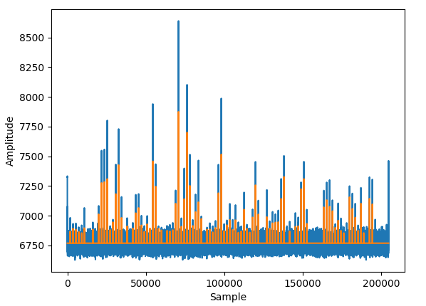
B0329+54
Blue: De-dispersed data
Orange: Candidates found by pipeline

Slide 3
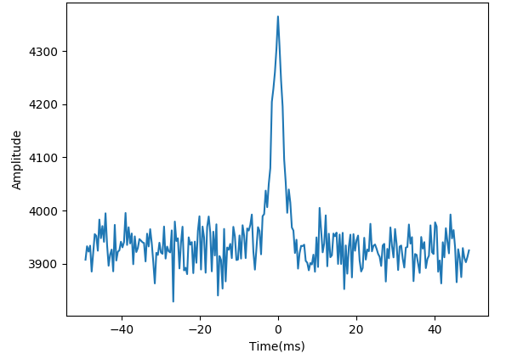
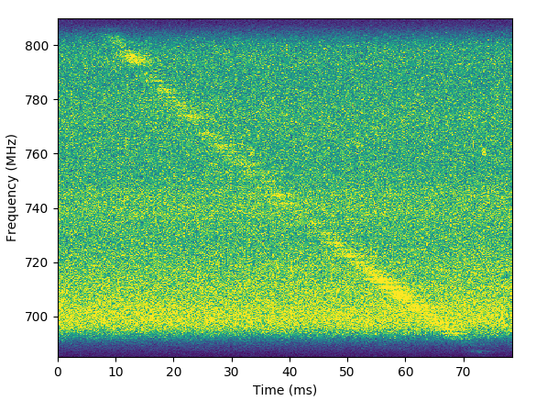
B0329+54
De-dispersed time – amplitude plot
Raw data waterfall plot

Slide 4
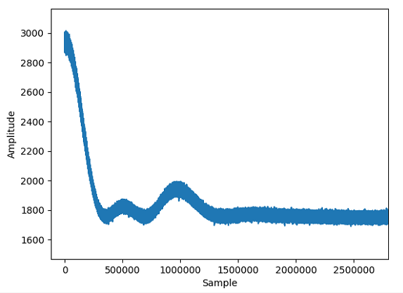
Crab (M1)
M1

Slide 5
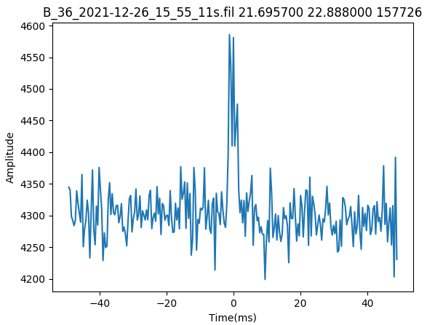
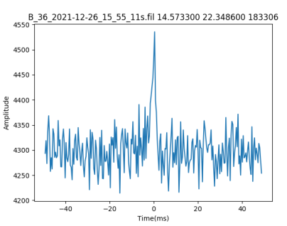
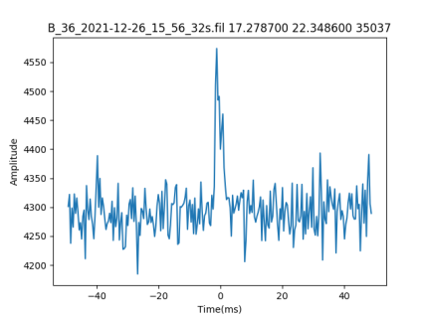
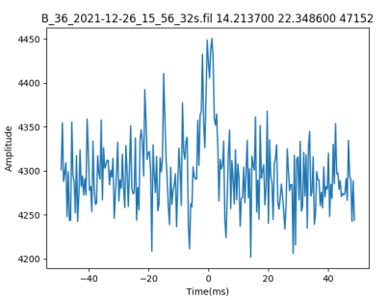
B2021+51

Slide 6
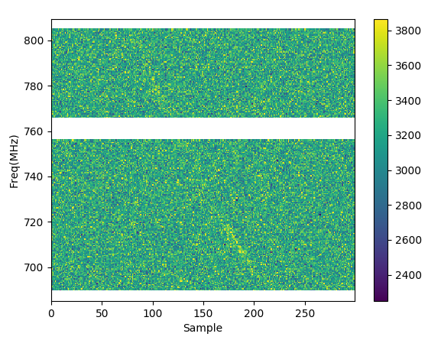
B2021+51

