Slide 1

IF05: White paper #5 meeting
January 21, 2022
Anna - Kevin

Slide 2
WP#5: MPGD for tracking and Muon detection at future high energy physics colliders
Title | LOI title | Contact(s) | Status | In overleaf
Executive Summary |  | Anna.Colaleo@cern.ch Kevin.Black@cern.ch | In preparation | yes
 | MPGDs for tracking and muon detection: progress review and updated R&D roadmap | hohlmann@fit.edu | no feedback from the proponent.
High granularity resistive Micromegas for high rates | Pixelated resistive MicroMegas for high-rates environment | paolo.iengo@cern.ch | ok. Paper in good shape | yes
Advanced GEM detectors for future collider experiments | Advanced GEM detectors for future collider experiments | Antonello.Pellecchia@cern.ch, Jeremie.Merlin@cern.ch | first draft. We will receive an update on 28th January | Yes
μ-RWELL for HEP experiments | micro-RWELL detector | Giovanni.Bencivenni@lnf.infn.it | ok. Paper in good shape | yes
Gas system for HEP |  | Beatrice.Mandelli@cern.ch Roberto.Guida@cern.ch | first draft. We will receive an update on 28th January. | no

Slide 3
Schedule for IF5- White paper #5
28 January: second draft for papers:
  “Gas system for HEP”
  “Advanced GEM detectors for future collider experiments
31 January: suggestions to the authors
7 February: second and almost final draft for:
  “High granularity resistive Micromegas for high rates”
  “μ-RWELL for HEP experiments”
  Executive summary
15 February: third draft for
  “Gas system for HEP”
  “Advanced GEM detectors for future collider experiments”

Slide 4
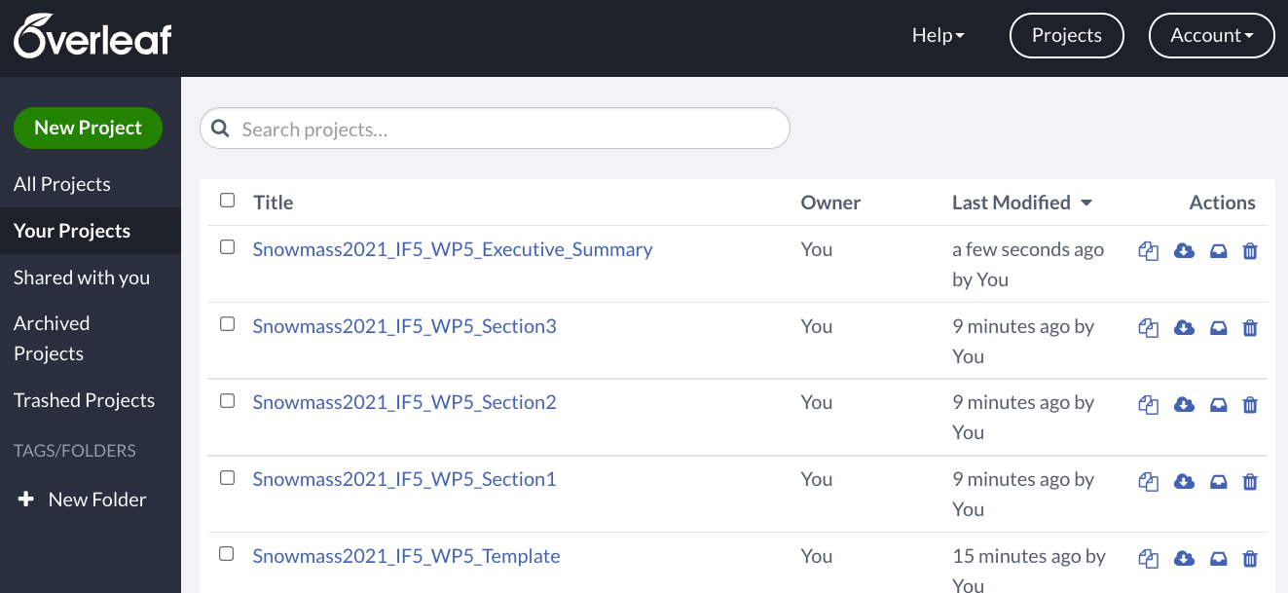
Common overleaf
- Section 1: Executive_summary
Section 2: High granularity resistive Micromegas for high rates
Section 3: Advanced GEM detectors for future collider experiments
Section 4: μ-RWELL for HEP experiments
Section 5: Gas system for HEP

