Slide 1
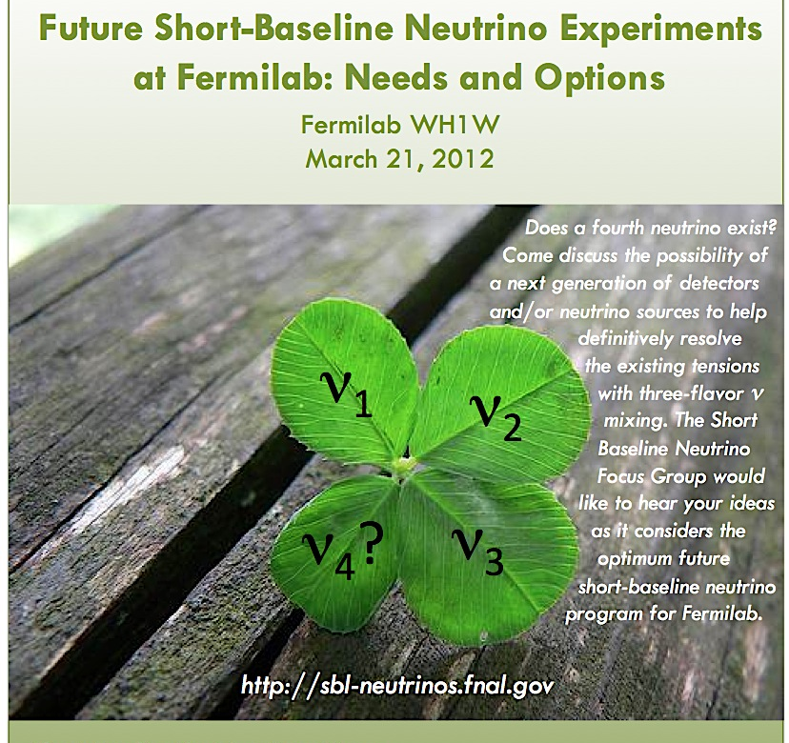
INTRODUCTION

Slide 2
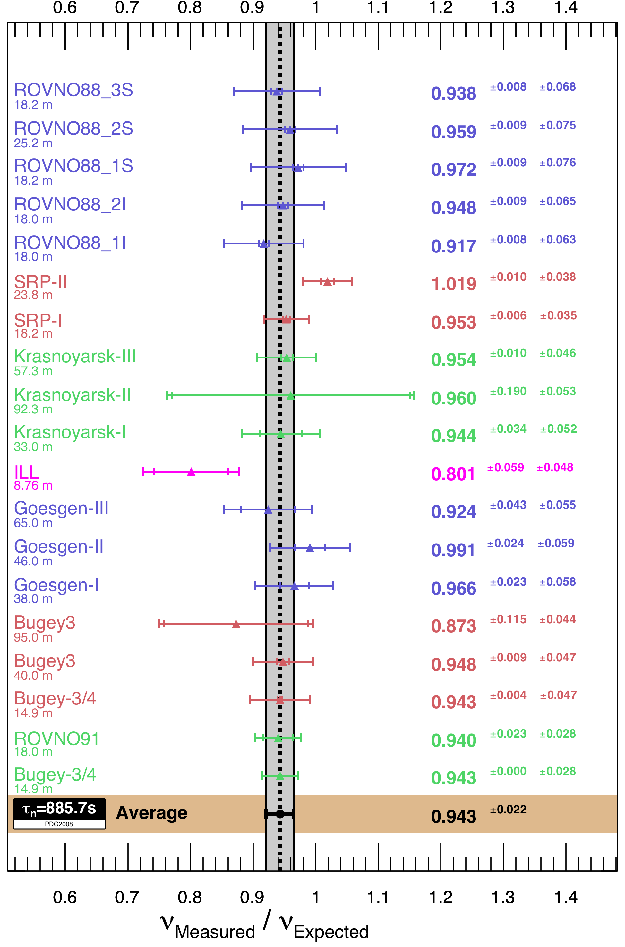
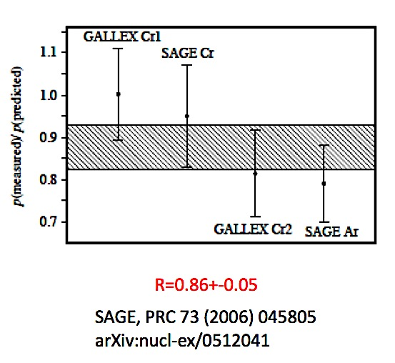
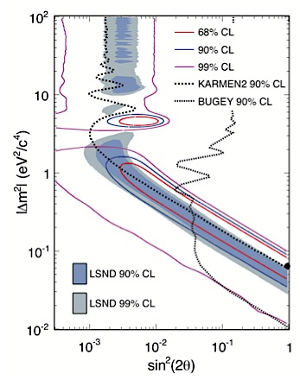
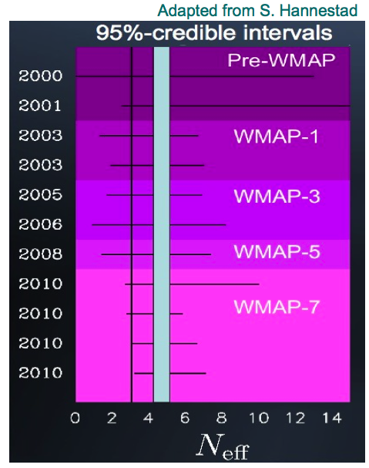
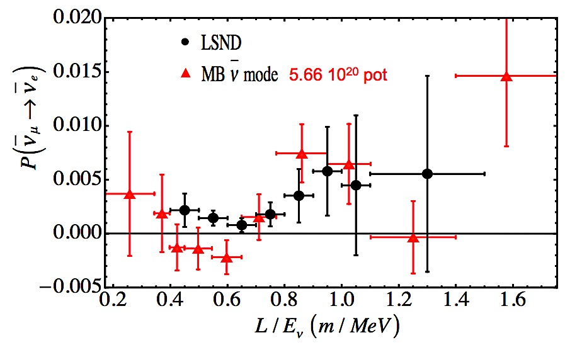
MOTIVATION
Is 3-flavor mixing the whole story ?
Average = 0.943 ± 0.023 (χ²=19.6/19)

Slide 3
FOCUS GROUP
Short-Baseline Neutrino Focus Group was convened by the
Fermilab Directorate and given the following charge:
Several neutrino oscillation experiments have produced results that exhibit, at the level of a couple of standard deviations, a tension with the simple three-flavor mixing framework. These tensions might be purely statistical in origin, or might arise from one or more unidentified systematic effects, or from new physics. Together with the laboratory and the community, we would like to ask you to consider new generation detectors and/or new types of neutrino sources that would lead to a definitive resolution of the existing anomalies. With this in mind:
1. Evaluate to what extent the ongoing and planned neutrino experiments will be able to resolve the origin of each of the couple of sigma tensions with three-flavor mixing. Identify any additional measurements that might be needed, and options for making these measurements.
2. Compare with competing facilities the future capabilities at Fermilab for supporting a short baseline neutrino program to definitively resolve the present anomalies, and suggest what the optimal short baseline neutrino program might be beyond the presently approved and running experiments.
First meeting of the Focus Group was Jan 9, 2012.
Final report due on May 31, 2012; presentation at June PAC meeting.

Slide 4
FOCUS GROUP
Steve Brice FNAL
Bonnie Flemming Yale
Steve Geer * FNAL
Andre de Gouvea Northwestern
Debbie Harris FNAL
Patrick Huber Virginia Tech
Boris Kayser FNAL
Geoff Mills LANL
Koichiro Nishikawa KEK
Stephen Parke FNAL
Chris Polly FNAL
Andre Rubbia ETH Zurich
Bob Tschirhart FNAL
Richard Van de Water LANL
Bob Zwaska FNAL
Sam Zeller FNAL

Slide 5
STRATEGY
Phase 1:
Summarize present situation & the expected impact of the already approved program. Specify what, beyond this, future experiments must do (requirements) to arrive at definitive results. List options to be considered.
→ Write interim report. (Will begin after this meeting)
Phase 2:
Compare options against the requirements. Construct a “strategic plan” that would be attractive for Fermilab.
→ Write final report. (Due date: May 31st)

Slide 6
ORGANIZATION
Tensions Sub-Group
Summarize tensions with 3-flavor mixing, expected impact of near-term experiments, & requirements for longer-term definitive experiments.
Options Sub-Group
Summarize options to be considered, including new detectors and/or new types of neutrino source.
Cross-Sections & Fluxes Sub-Group
Summarize near-term expectations, and what is possible / desirable in the longer term.
Facility Parameters Sub-Group
Summarize relevant parameters of the evolving Fermilab accelerators c.f. the evolving parameters for corresponding facilities elsewhere.

Slide 7
SUB-GROUPS
Tensions Sub-Group:
S. Brice
A. de Gouvea
P. Huber
B. Kayser (facilitator)
G. Mills
R. Van de Water
G. Zeller
Options Sub-Group:
B. Fleming
A. de Gouvea
G. Mills
S. Parke
A. Rubbia
R. Tschirhart (facilitator)
Cross Sections & Flux
Sub-Group:
B. Fleming
D. Harris
P. Huber
C. Polly
G. Zeller (facilitator)
Facility Parameters
Sub-Group:
A. Rubbia
R. Tschirhart
R. Van de Water
R. Zwaska (facilitator)

Slide 8
COMMUNITY INPUT
PRIOR MEETINGS
  Short-Baseline Neutrino Workshop, FNAL, May 12‑14, 2011
  Fundamental Physics at the Intensity Frontier, Nov 30-Dec 2, 2011, Rockville, MD
  ➔ neutrino group report
  Sterile Neutrinos at the Crossroads, Sep 25-28, Blacksburg, VA
  ➔ white paper on sterile neutrinos
THIS MEETING
  Provides an opportunity for the sub-groups to communicate how they are proceeding, early thoughts, etc.
  Provides an opportunity for the community to present ideas & give input through comment & discussion.

Slide 9
Morning Agenda
Session 1 - Chair: S. Parke
09:00-09:10 Welcome Y-K. Kim
09:15-09:25 Introduction S. Geer
09:30-09:50 Sterile ν Workshop Report J. Link
09:55-10:10 Tensions Group Report B. Kayser
10:15-10:30 σ & Fluxes Group Report G. Zeller
10:35-10:55 COFFEE
Session 2 - Chair D. Harris
11:00-11:15 Options Group Report G. Mills
11:20-11:35 Evolution of Facilities S. Holmes
11:40-11:55 Proving light sterile neutrinos W. Louis
12:00-12:15 MicroBooNE & LAr1 G. Karagiorgi
12:20-13:20 LUNCH

Slide 10
Afternoon Agenda
Session 3 – Chair: P. Huber
13:20-13:35 Short-Baseline with NOvA M. Messier
13:40-13:55 Low Energy Muon Ring A. Bross
14:00-14:15 nu-tau Appearance A. de Gouvea
14:20-14:35 Coherent NC Elastic Scattering J. Yoo
14:40-14:55 Ricochet Sterile Neutrino Search E. Figueroa-Feliciano
15:00-15:15 Source & Reactor Experiments K. Heeger
15:20-15:35 Very-Short_baseline Reactor Expts N. Bowden
15:40-15:55 COFFEE
16:00-17:00 Colloquium: J. Klein
“From Anomaly to Problem to Physics: Lessons from Solar Neutrinos”
Session 4 – Chair: A. Rubbia
17:15-17:30 OscSNS at FNAL ? R. Van de Water
17:35-17:50 NA61 / Shine D. Schmitz
17:55-18:10 Capabilities of Upgraded MIPP R. Raja
18:15-18:25 Final Remarks
18:30-19:30 “Reception”

