Slide 1
Evolution of Proton Capabilities: Fermilab and Elsewhere
Steve Holmes
Short Baseline Neutrino Workshop
March 21, 2012

Slide 2
Outline
Fermilab
  Proton Improvement Plan
  Project X
Elsewhere
  J-PARC
  CERN
  PSI
Notes:
Test
2

Slide 3
Fermilab Capabilities Today
The Fermilab Proton Source (Linac + Booster) can currently deliver about 41 kW at 8 GeV
  4.3E12 protons per pulse × 8 GeV × 7.5 Hz
This power is currently deployed as follows:
  28 kW to the Main Injector for acceleration to 120 GeV and delivery to the NuMI target ⇒ 390 kW at 120 GeV
  14 kW to the Booster Neutrino Beam program (MiniBoone) at 8 GeV
Inherent limitations in the current performance are:
  The Main Injector is operating with a 2.2 second cycle time, primarily due to 0.67 fill time at 8 GeV
  Booster could in principle run at 15 Hz, but is only delivering beam at 7.5 Hz
The former limitation is removed by NOvA

Slide 4
NOvA Upgrades (2013)
The Main Injector cycle time will be reduced to 1.33 seconds:
  Utilization of the Recycler as a proton accumulator eliminates 0.67 seconds and allows accumulation of an extra (12th) Booster pulse
  Additional rf stations and upgrades to the quadrupole power supplies does the rest
Booster operates at 9 Hz (beam)
  There is no increase in Booster beam intensity per pulse
  NOvA beam power = 390 × (2.2/1.33) × (12/11) = 700 kW at 120 GeV
The inherent performance limitations will be:
  If the Booster is limited to 9 Hz there is no beam left for the 8 GeV program
This limitation is removed the Proton Improvement Plan

Slide 5
Proton Improvement Plan
(2016)
Goals
  Increase beam repetition rate to 15 Hz
  Retain current per pulse intensity ⇒ > 2E17 protons/hour
  Eliminate major reliability vulnerabilities and maintain reliability at present levels (>85%) at the full repetition rate
  Eliminate major obsolescence issues
  Ensure a useful operating life of the proton source through at least 2025
Scope
  Replace Cockcroft-Walton with RFQ
  Upgrade DTL High Power RF System
  Booster Solid State RF System
  New Booster RF cavities
  Booster Tuner System Upgrade
  Booster Collimation Upgrade
  Instrumentation/Controls Upgrades
  BRF Anode and Bias supplies & test stand
  Conventional Systems Upgrades
  Vacuum System Upgrades

Slide 6
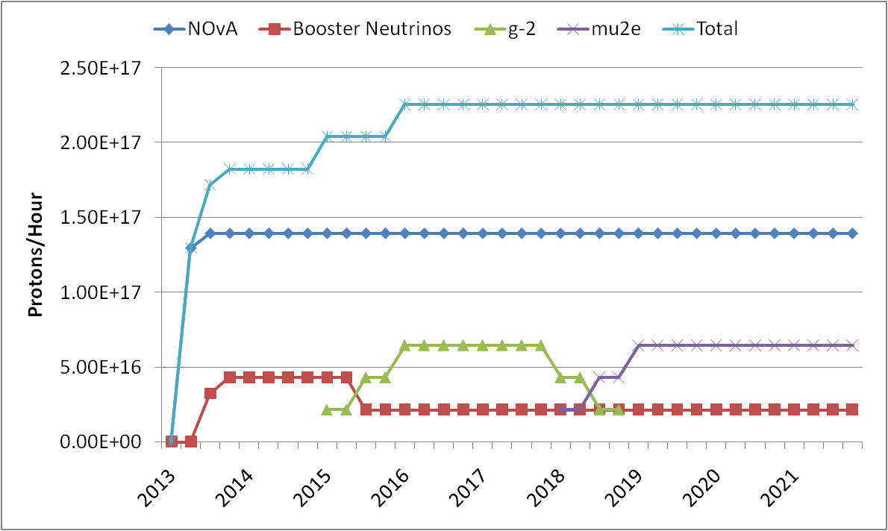
Proton Improvement Plan
(2016-2021)
120 GeV
8 GeV

Slide 7
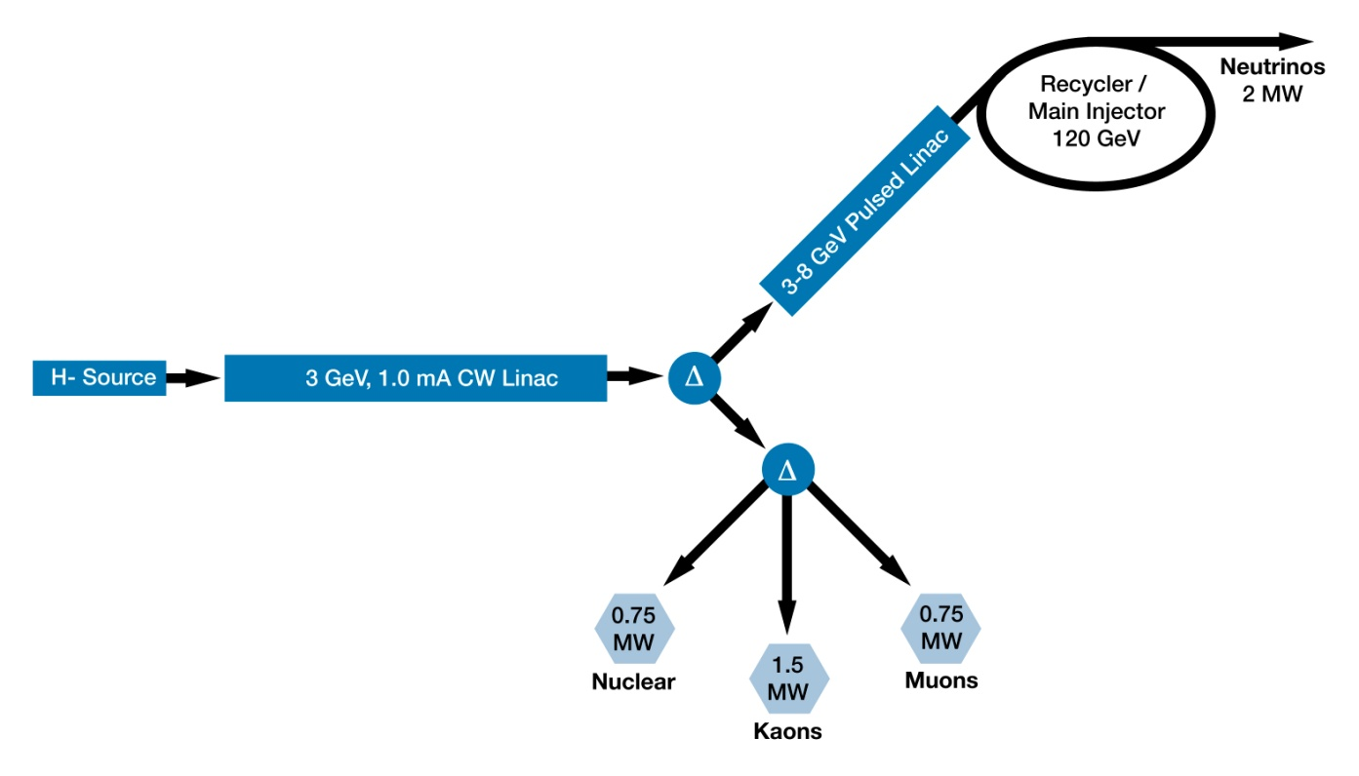
Project X
Reference Design
3 GeV CW superconducting H- linac; 1 mA average beam current.
3-8 GeV pulsed linac capable of delivering 300 kW at 8 GeV
Upgrades to the Recycler and Main Injector to provide ≥ 2 MW to the neutrino production target at 60-120 GeV.

Slide 8
Project X Performance Goals
Linac
Particle Type H⁻
Beam Kinetic Energy 3.0 GeV
Average Beam Current 1 mA
Linac pulse rate CW
Beam Power 3000 kW
Beam Power to 3 GeV program 2870 kW
Pulsed Linac
Particle Type H⁻
Beam Kinetic Energy 8.0 GeV
Pulse rate 10 Hz
Pulse Width 4.3 msec
Cycles to MI 6
Particles per cycle to MI 2.6×10¹³
Beam Power to 8 GeV 190 kW
Main Injector/Recycler
Beam Kinetic Energy (maximum) 120 GeV
Cycle time 1.4 sec
Particles per cycle 1.6×10¹⁴
Beam Power at 120 GeV 2200 kW
simultaneous

Slide 9
Project X Staging
Staging opportunities are under discussion with DOE
  Goals
    <$1B/stage
    Significant physics program at each stage
    Full Reference Design ultimately realized
Stage 1
  1 GeV CW linac injecting into existing (upgraded) Booster
Stage 2
  Add 1-3 GeV CW linac
Stage 3
  Add 3-8 GeV pulsed linac injecting into (upgraded) Recycler/MI
Stage 4
  Upgrade power to 4 MW at 8 GeV

Slide 10
Power Profile for the Research Program
Program: | Stage-0: Proton Improvement Plan | Stage-1: 1 GeV CW Linac driving Booster & Muon Campus | Stage-2: Upgrade to 3 GeV CW Linac (MI>70 GeV) | Stage-3: Project X RDR (MI>60GeV) | Stage-4: Beyond RDR: 8 GeV power upgrade to 4MW
MI neutrinos | 470-700 kW** | 515-1200 kW** | 1200 kW | 2300 kW | 2300-4000 kW
8 GeV Neutrinos | 15 kW + 0-50 kW** | 0-40 kW* + 0-90 kW** | 0-40 kW* | 85 kW | 3000 kW
8 GeV Muon program e.g, (g-2), Mu2e-1 | 20 kW | 0-20 kW* | 0-20 kW* | 85 kW | 1000 kW
1-3 GeV Muon program | ----- | 80 kW | 1000 kW | 1000 kW | 1000 kW
Kaon Program | 0-30 kW** (<30% df from MI) | 0-75 kW** (<45% df from MI) | 1100 kW | 1100 kW | 1100 kW
Nuclear edm ISOL program | none | 300 kW | 300 kW | 300 kW | 300 kW
Ultra-cold neutron program | none | 300 kW | 300 kW | 300 kW | 300 kW
Nuclear technology applications | none | 300 kW | 300 kW | 300 kW | 300 kW
# Programs: | 4 | 8 | 8 | 8 | 8
Total* power (mean): | 660 kW | 2020 kW | 4210 kW | 5490 kW | 11300kW
* Operating point in range depends on MI energy for neutrinos.
** Operating point in range is depends on MI injector slow-spill duty factor (df) for kaon program.

Slide 11
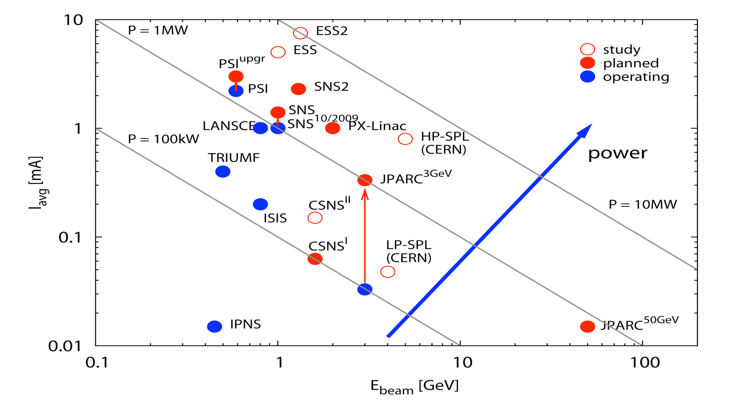
Elsewhere
Project-X
M Seidel, PSI

Slide 12
The High Duty Factor Proton Source Landscape This Decade...
x Duty Factor
*
Project-X CW-Linac
PSI
*
TRIUMF
power
*
Stopped/Slow kaon yield/Watt
* Beam power x Duty Factor

Slide 13
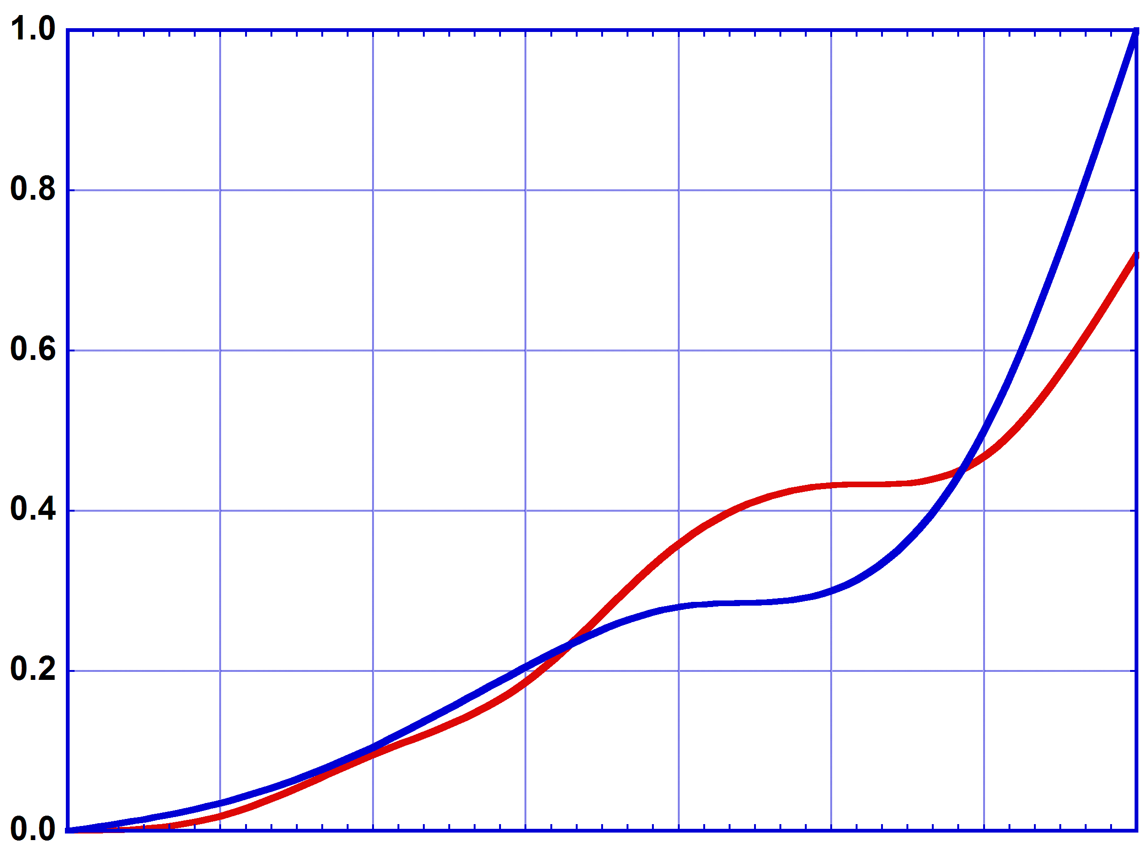
J-PARC
Current Plan
RCS Power
MR Power
3 GeV (RCS)
pre-earthquake plan
30 GeV (MR)
pre-earthquake plan
Earthquake
J-PARC Power Projection [MW]
Construction of 400 MeV Linac
New Funding for 3 years
for Linac and 3 GeV
200 kW
400MeV
RFQ,
IonS.
Normal
Summer
145 kW
Earthquake
Stop
2008 2009 2010 2011 2012 2013 2014
FY

Slide 14
Summary
Fermilab has a plan of continuous improvement to proton performance
  Today → NOvA → PIP → Project X
  400 kW → 11000 kW
This program will support a world leading Intensity Frontier program encompassing:
  Long and short baseline neutrinos
  Rare processes based on muons, kaons, and nuclear edms
  Nuclear energy applications
This program will provide a platform for eventual construction of a muon based facility(ies)
  Neutrino Factory (Intensity Frontier)
  Muon Collider (Energy Frontier)
Project X is the centerpiece of the program
  >5 MW beam power available in Reference Design; upgradable to >9 MW
  CW linac is unique for this application, and offers capabilities that will be hard/impossible to duplicate in a synchrotron
But the competition doesn’t rest
So we need to keep moving!

Slide 15
Backup

Slide 16
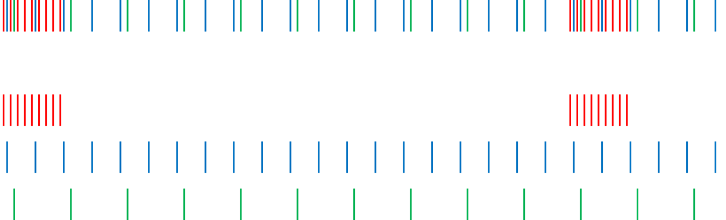
Project X Operating Scenario
1-3 GeV Program
1 μsec period at 3 GeV
Muon pulses (12e7) 162.5 MHz, 80 nsec 700 kW
Kaon pulses (12e7) 27 MHz 1540 kW
Nuclear pulses (12e7) 13.5 MHz 770 kW
Ion source and RFQ operate at 4.4 mA
77% of bunches are chopped @ 2.1 MeV ⇒ maintain 1 mA over 1 μsec
Separation scheme
1 μsec
Transverse rf splitter

Slide 17
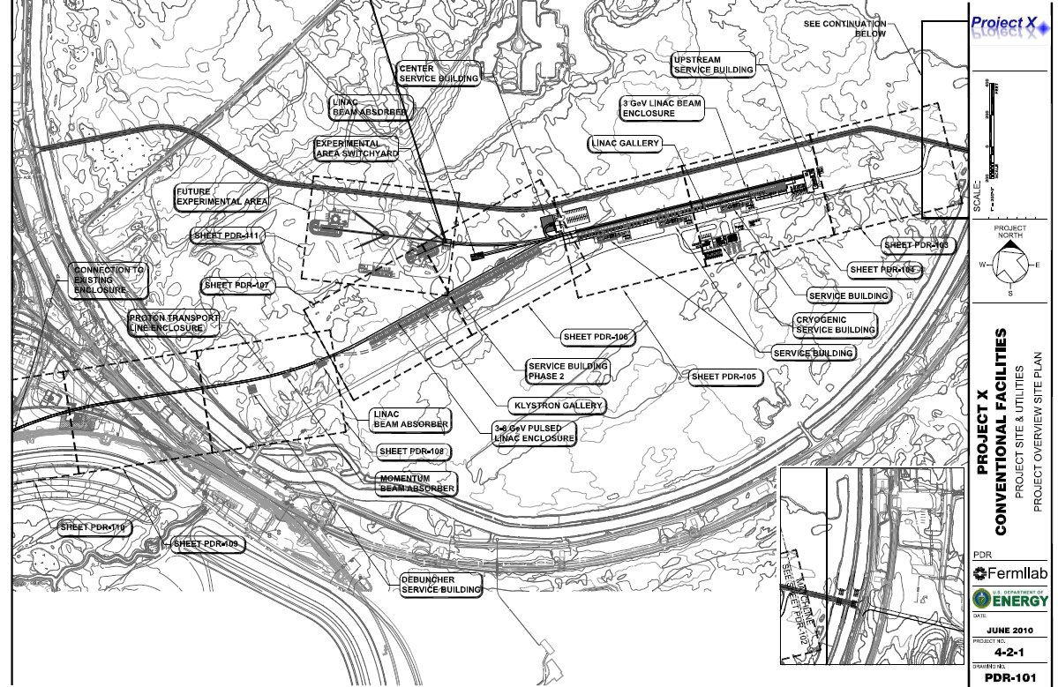
Siting

Slide 18
CERN
Proton Upgrades
Most recent info I have is from early late 2009
Plan appeared to go on hold following Chamonix 2010
  Except Linac4 which is under construction
New European strategy under development that could bring (some of this) back to life
Proton flux / Beam power
50 MeV
Linac2
Linac4
160 MeV
1.4 GeV
PSB
(LP)SPL
4 GeV
26 GeV
PS
PS2
50 GeV
Output energy
450 GeV
SPS
SPS+
1 TeV
LHC /
SLHC
DLHC
7 TeV
~ 14 TeV

Slide 19
Beam Configurations
Low Energy Neutrinos
Accumulator Ring Concepts
  Issues
    Injection
    Extraction

Slide 20
Reference Design Capabilities
3 GeV CW superconducting H- linac with 1 mA average beam current.
  Flexible provision for variable beam structures to multiple users
    CW at time scales >1 μsec, 10% DF at <1 μsec
  Supports rare processes programs at 3 GeV
  Provision for 1 GeV extraction for nuclear energy program
3-8 GeV pulsed linac capable of delivering 300 kW at 8 GeV
  Supports the neutrino program
  Establishes a path toward a muon based facility
Upgrades to the Recycler and Main Injector to provide ≥ 2 MW to the neutrino production target at 60-120 GeV.
Utilization of a CW linac creates a facility that is unique in the world, with performance that cannot be matched in a synchrotron-based facility.
Notes:
ADS Development with Nuclear Energy Applications

Slide 21
R&D Program
The primary elements of the R&D program include:
  Development of a wide-band chopper
    Capable of removing bunches in arbitrary patterns at a 162.5 MHz bunch rate
  Development of an H- injection system
    Require between 4.4 – 26 msec injection period, depending on pulsed linac operating scenario
  Superconducting rf development
    Includes six different cavity types at three different frequencies
    Emphasis is on Q₀, rather than high gradient
      Typically 1.5E10, 15 MV/m (CW)
      1.0E10, 25 MV/m (pulsed)
    Includes appropriate rf sources
    Includes development of partners
Goal is to complete R&D phase by 2015

Slide 22
SRF Linac
Technology Map
β=0.11
β=0.22
β=0.4
β=0.61
β=0.9
β=1.0
CW
Pulsed
162.5 MHz
2.1-10 MeV
325 MHz
10-160 MeV
650 MHz
0.16-3 GeV
1.3 GHz
3-8 GeV
Section | Freq | Energy (MeV) | Cav/mag/CM | Type
HWR (β_{G}=0.1) | 162.5 | 2.1-10 | 9/6/1 | HWR, solenoid
SSR1 (β_{G}=0.22) | 325 | 10-42 | 16/18/ 2 | SSR, solenoid
SSR2 (β_{G}=0.47) | 325 | 42-160 | 36/20/4 | SSR, solenoid
LB 650 (β_{G}=0.61) | 650 | 160-460 | 42 /14/7 | 5-cell elliptical, doublet
HB 650 (β_{G}=0.9) | 650 | 460-3000 | 152/19/19 | 5-cell elliptical, doublet
ILC 1.3 (β_{G}=1.0) | 1300 | 3000-8000 | 224 /28 /28 | 9-cell elliptical, quad
Notes:
I would suggest that you point out that Indian DAE labratories are already working on SSR1, 650 and ILC cavities.

Slide 23
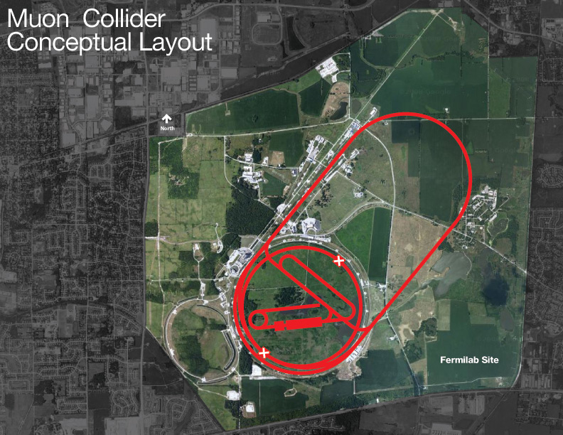
Joint PX/NF/MC Strategy
Project X shares many features with the proton driver required for a Neutrino Factory or Muon Collider
  NF and MC require ~4 MW @
  10± 5 GeV
  Primary issues are related to
  beam “format”
    NF wants proton beam on
    target consolidated in a few
    bunches; Muon Collider requires
    single bunch
  Project X linac is not capable of
  delivering this format
It is inevitable that a new ring(s) will be required to produce the correct beam format for targeting.

Slide 24
Accelerator Requirements: Rare Processes
 | Proton Energy (kinetic) | Beam Power | Beam Timing
Rare Muon decays | 2-3 GeV | >500 kW | 1 kHz – 160 MHz
(g-2) measurement | 8 GeV | 20-50 kW | 30- 100 Hz.
Rare Kaon decays | 2.6 – 4 GeV | >500 kW | 20 – 160 MHz. (<50 psec pings)
Precision K⁰ studies | 2.6 – 3 GeV | > 100 μA (internal target) | 20 – 160 MHz. (<50 psec pings)
Neutron and exotic nuclei EDMs | 1.5-2.5 GeV | >500 kW | > 100 Hz

