Slide 1
AtomECS
Dr. Elliot Bentine

Slide 2
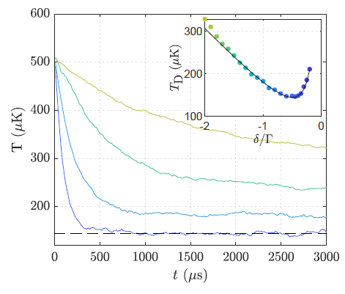
AtomECS
Software suite for simulating cold atom experiments.
Started as MOT simulation code but now has many features.
Magnetic fields, analytic or precalculated over grid.
Scattering forces on atoms in near-resonant optical fields.
Multi-beam rate equation approach.
Respects Doppler limit, to some extent recoil limit.
More detail given in paper.
Magnetic and dipole-force traps.
S-wave collisions between particles.
Written in rust using Entity Component System (ECS) pattern.
Data-oriented architecture gives great parallel performance.
Unit tests, integration tests and continuous integration
Automated testing of each module in the program, and all modules together. Currently 37 different tests.
Make changes without fear of breaking functionality!
Developers now also include:
Cambridge: Xintong Su, Kimberly Tkalcec, Brian Bostwick
Oxford: Abigail Coughlan, David Garrick
Above: Simulations of Doppler limit in AtomECS for a 3D MOT. Inset: Good agreement between theoretical limit over a range of beam detunings.

Slide 3
Entity-Component-System (ECS) pattern
The ECS bit of AtomECS
Each thing is an entity.
Entity 1
Entity 2
Entity 3
Entity 4
Position
Position
Position
Position
Components describe the entities.
Velocity
Velocity
Velocity
BField
Systems implement program functionality by operating on collections of entities and components

Slide 4
Advantages of ECS
1. Produces a flat, contiguous program memory structure – really fast for getting memory into processor.
2. Easy parallelisation! Systems are explicit about the components they read and write, and so solving dependency is easy.
3. Behaviour by composition avoids the behaviour by inheritance antipattern. Flexible program structure.
…
…
‘Atom’
‘laser beam’
Position
Velocity
Position
Velocity
UpdatePositionSystem
Entity 1
Entity 1
Position
Velocity
Position
Velocity
Write Access:
Position
Position
Position
Position
Velocity
Position
Velocity
Read Access:
Velocity
…
…
Velocity
Intensity
CalculateDopplerShiftSystem
Mass
Direction
Versus ‘heap’ in managed-memory applications
Write Access:
DopplerShift
Detuning
Read Access:
Velocity
4. Small systems implement very specific features – easy to test!
$→$ Trivial to run simultaneously!

Slide 5
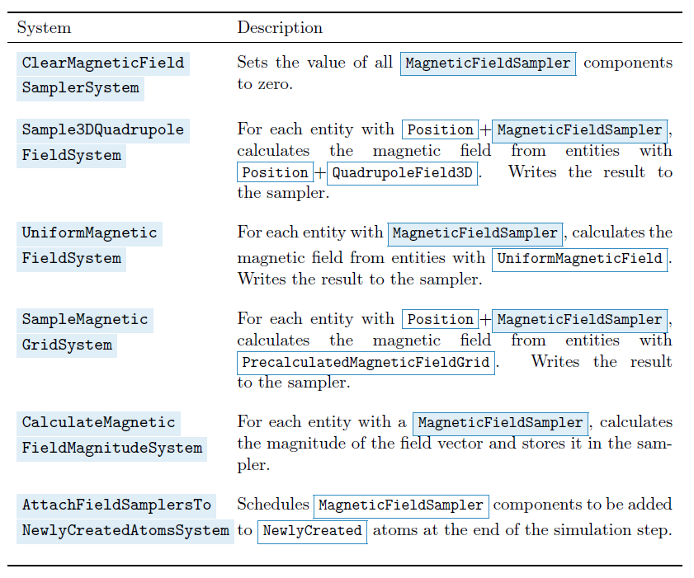
Example systems
Systems used in the magnetics module, which calculate the magnetic field at each atom’s location.

Slide 6
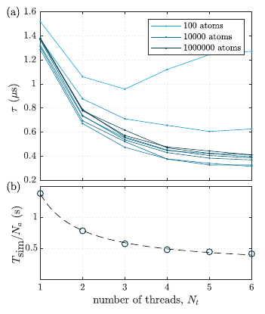
AtomECS performance
(a) shows the wall time per step per atom for a MOT simulation.
For >1000 atoms the parallel execution becomes effective.
(b) shows fit to Amdahl’s law for 10⁶ atoms. Gives ~85% of program parallelised.
Benchmarks:
AION 2D MOT, capture from an oven: 10⁶ atoms initially ejected, 15ms of motion, 200 atoms captured. 4s to simulate.
Evap,magnetic trap: 5x10³ pseudo-particles simulated, s-wave collisions, 2s of motion. Takes 2.5s to simulate.
Right: Load balancing of AtomECS over multiple CPU cores

Slide 7
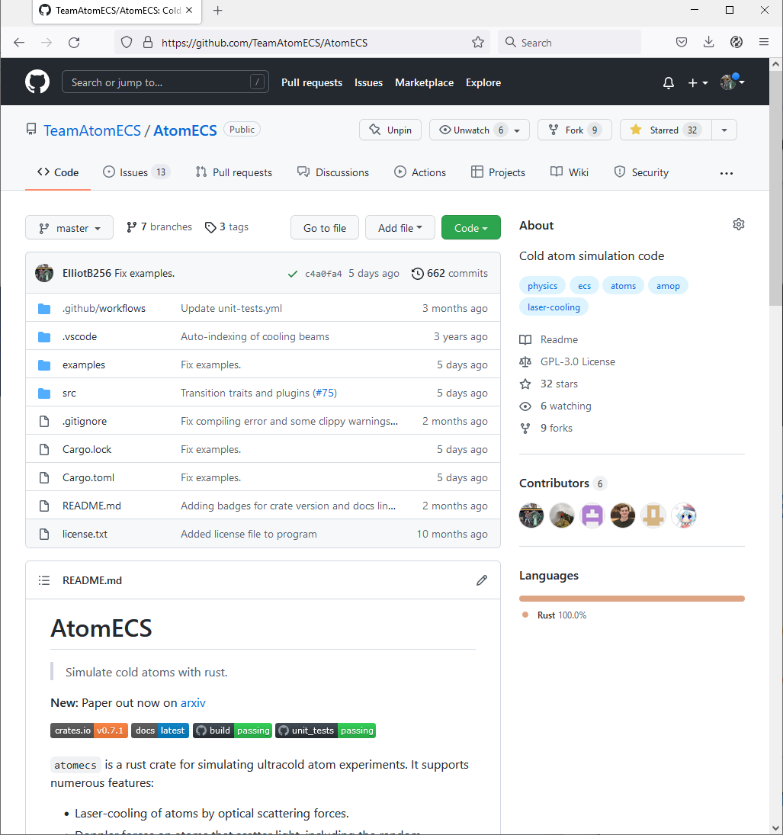
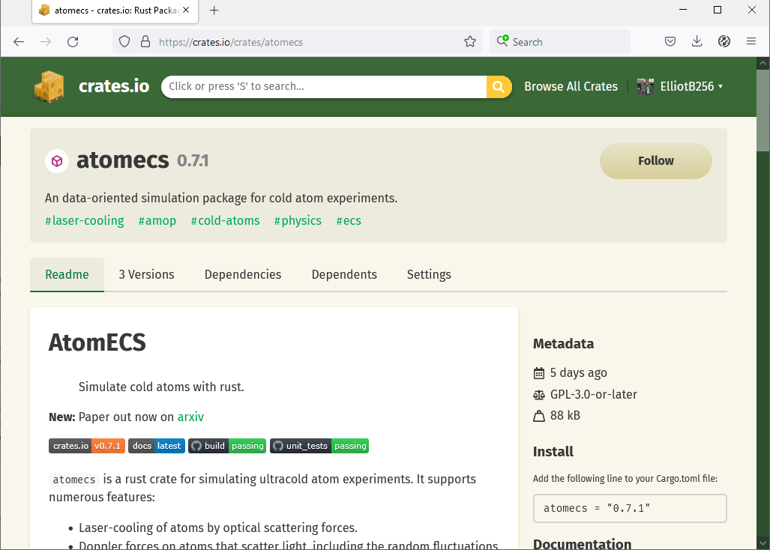
Development cycle
Written in rust (‘c-like’)
Repository hosted on GitHub
Open source, GPL-3.0
Development milestones listed
Issue-driven development
Developer raises a pull request to fix an issue.
Community review, comments & discussion
Continuous integration/unit tests run
PR merged back into the codebase
Updates published to the rust ‘crates’ repository.

Slide 8
AtomECS & AION
Oven
2D-MOT
Blue MOT
Red MOT
ODT loading
Evap
Trans-port
Final cooling
Cloud splitting
Launch
AI seq
Imaging
(Abi & Leonie)
AtomECS I:
Optical scattering forces
Atom sources
Performance optimisations
https://arxiv.org/abs/2105.06447
AtomECS II:
Dipole traps
magnetic traps
s-wave collisions
Cooling transition Stark shift
Inelastic collisions
Current sidearm simulations:
Chamber 1: Capture and cooling of fast atoms from oven into 2D MOT.
Chamber 2: Capture and cooling of atoms from the 2D MOT source.
Upcoming simulations @ Ox:
Chamber 1: Van der Waals collisions with thermal atoms $→$ required for oven scaling

Slide 9
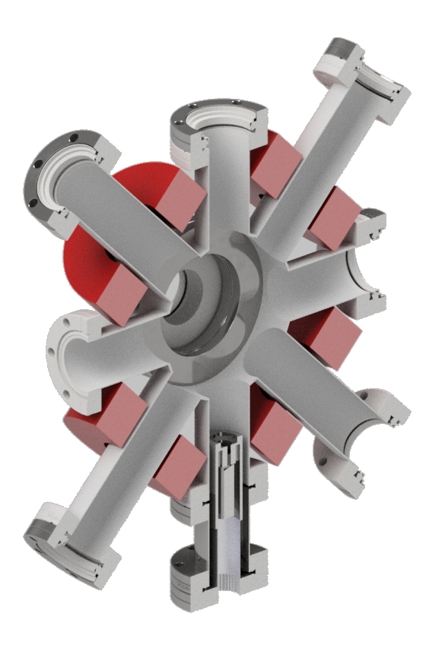
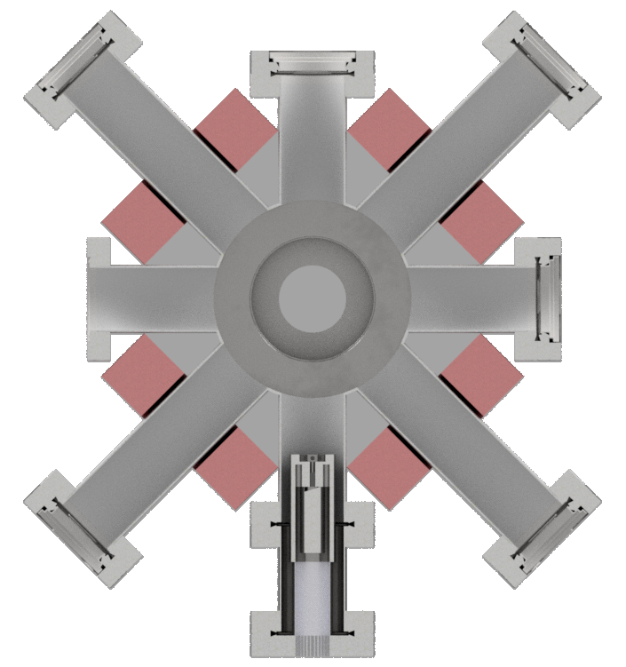
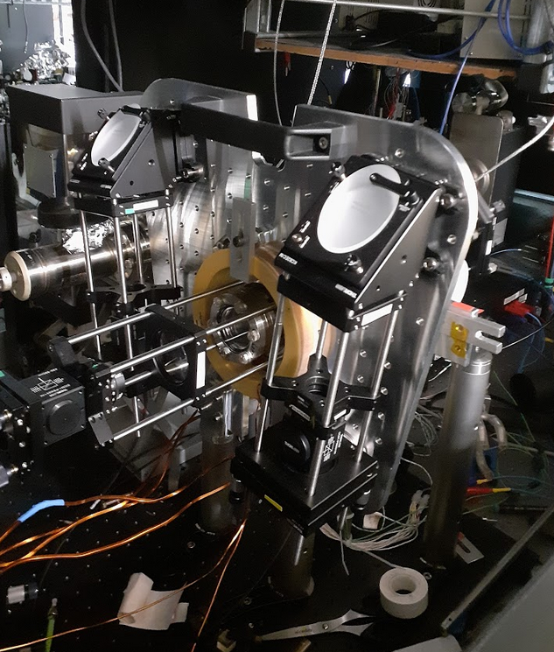
Transverse-loaded 2D MOT
Current AION sidearm source:
Atoms exit from oven, collimated by nozzle.
Large area, high-power beams exert laser cooling forces ($v_{c}\sim 140 m/s)$
Narrow, high-intensity push beam directs atomic flux towards the second chamber.
Flux improvement:
Cooling beam radius: larger capture volume; longer stopping distance; angle
Oven performance: collimation; higher flux; larger size
Hybrid with Zeeman slower beam
Nosske et al, PRA 96 (2017)
2
3
1
Sr 2D MOT source at Oxford

Slide 10
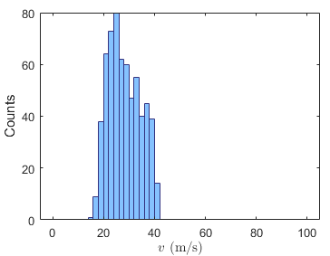
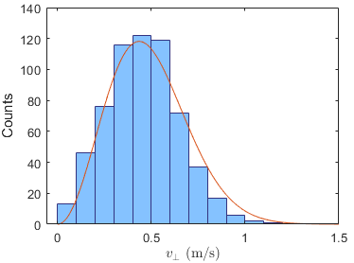
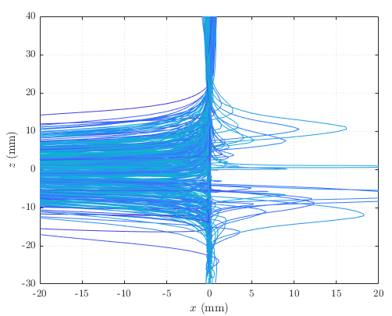
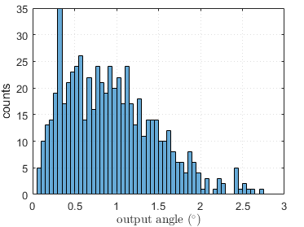
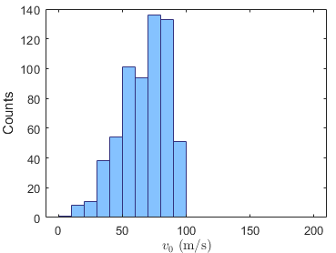
Simulated 2D MOT properties
Axial and transverse velocity distributions
Remember that only ‘captured’ atoms are counted
Shows distribution of atoms below 40m/s target velocity
Transverse velocity corresponds to about ~1mK temperature
Visualisation of trajectories
No significant overshoot – atoms turn and are directed out of the aperture
Angular divergence
Initial velocities of captured atoms

Slide 11
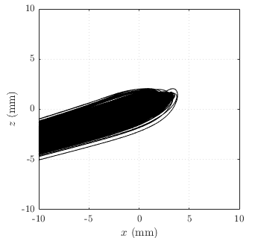
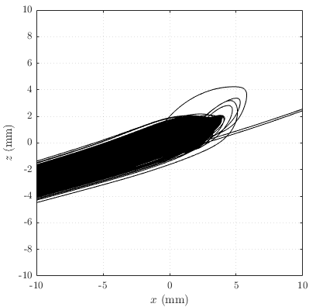
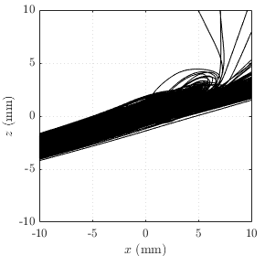
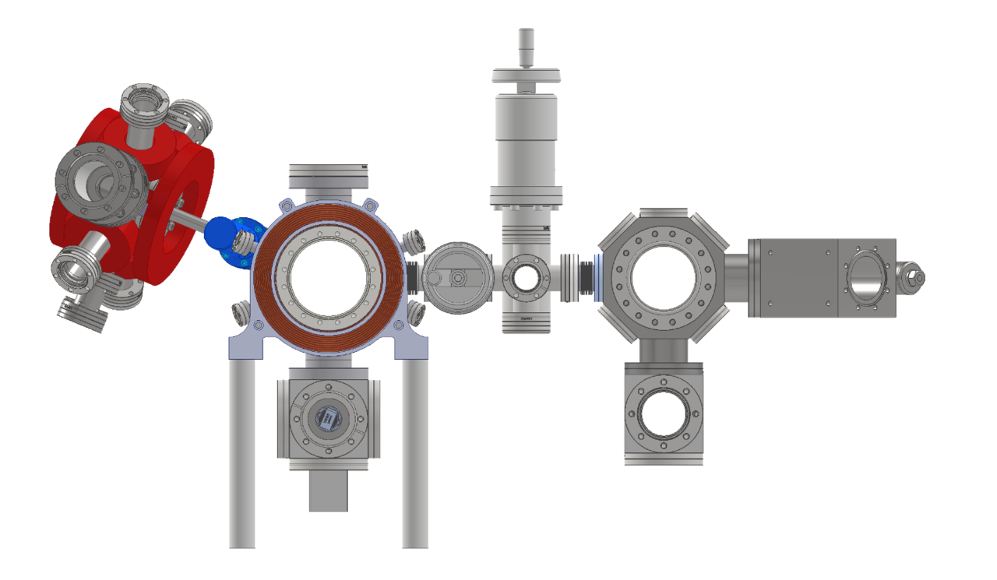
Chamber 2 MOT recapture
Incoming velocity
40m/s
50m/s
60m/s
cooling_beam_waist: 9.0955
cooling_beam_detuning: -56.1467
quadrupole_gradient: 40.9443
Constraints
Incoming_velocity = 50m/s $→$ 10m/s greater than target axial velocity of the source for contingency.
transverse_temperature = 1mK
cooling_beam_power = 5mW
Capture fraction $≈1$

Slide 12
Cold Atoms at Oxford
Team AION
Dr. Elliot Bentine
Dr. Thomas Hird
Abigail Coughlan
Dr. Kenneth Hughes
Prof. Chris Foot
Team BEC
Thank you for listening!
Abel Beregi
David Garrick
Shinichi Sunami

Slide 13
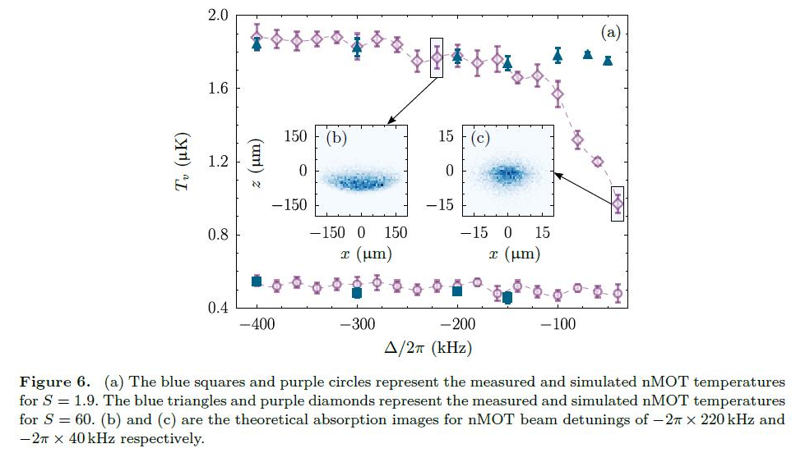
Red cooling transition
https://github.com/TeamAtomECS/AtomECS/issues/7
AtomECS
arXiv:1706.04807v1

Slide 14
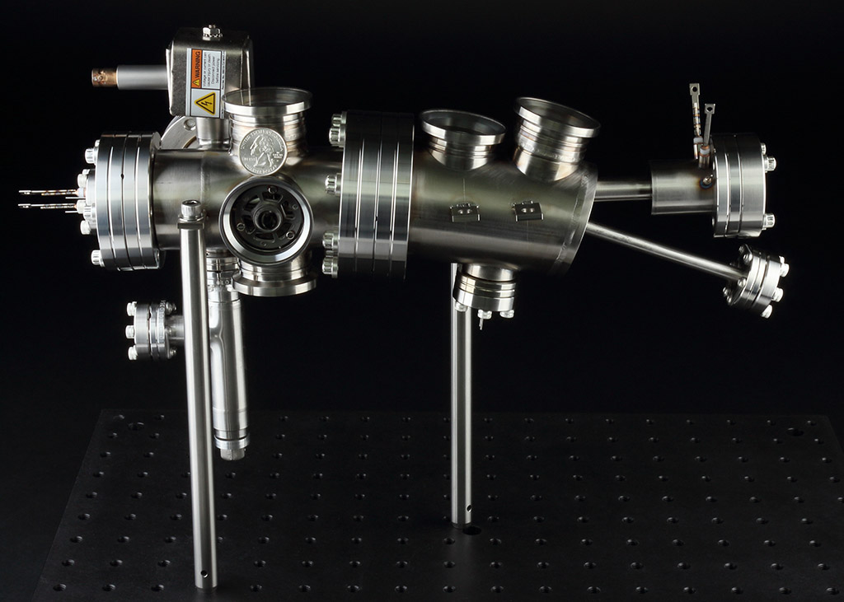
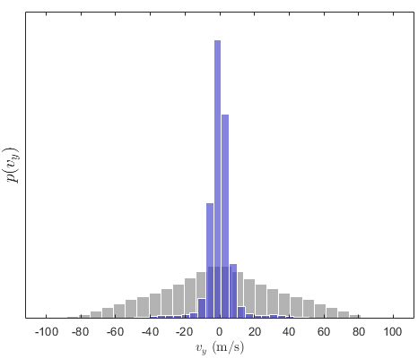
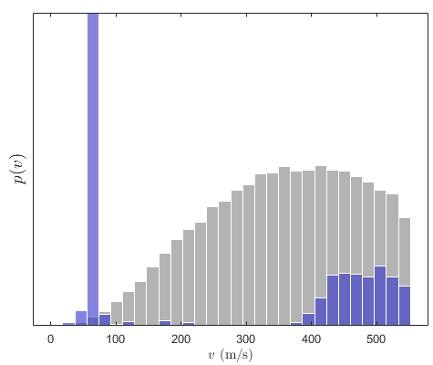
Zeeman slower
Also considering a design based on a Zeeman slower combined with transverse cooling.
3
Transverse Cooling
Zeeman slower
1
2
Oven
4
$r_{0}$ = 7mm,
P = 120mW
0.1%
5%
AOSense source: includes Zeeman slower, heated window, transverse cooling
Current simulations show similar performance – but at lower required cooling power, and smaller size.
$→$May provide better scaling to higher fluxes.

