Slide 1
MAGIS-100 Simulations
Fermilab contributions, perspective and context
This Talk: Mathematica-based simulations
  Phase Resolution Study
  Dark Matter Sensitivity Study
Dylan’s talk: Python implementation

Slide 2
Phase Resolution Simulation - GOALS
Provide a package that can be jointly developed & shared with other MAGIS Collaborators and can be used to:
  Evaluate the statistical sensitivity of measurements
  Explore systematic limitations
hence
  Inform design & operational parameter choices
  Inform optimization of the data-taking plan to maximize science yield
  Facilitate development of advanced analysis techniques
  Facilitate a mock data challenge before data taking
and along the way
  Build analysis team(s)

Slide 3
Mathematica-based Simulation - CONTRIBUTORS
Jeremiah
  Developed analytical (wavefunction-based) description of the two-port atom populations at the end of the interferometer. (ND-doc-767)
  Turned the Mathematica code into a package for Collaboration use.
Leonie
  Studied effects of diffusion in imaging region, resulting in a change to our assumed imaging time (ND-doc-921)
  Is studying LMT stray paths
Sam
  Axion studies (ND-doc-1484)
  Beginning to study impact of transverse motion
Tim
  Provided atom-interferometer expertise to guide parameter choices and other advice.
SG
  developed the code to map the cloud population onto a pixel array, simulate statistical fluctuations and noise, fit the resulting measured populations to extract the phase & repeat many times to compute the phase resolution. (ND-doc-845)
  DM simulations & study (ND-doc-1290)

Slide 4
Simulation - details
1
Start with (Jeremiah: ND-doc-767)
analytically derived wavefunction → atom population in the imaging region at end of interferometer sequence
Simulation ingredients (SG: ND-doc-845)
photon emission rate & imaging time
Atom diffusion during imaging
optics: geom. acceptance & magnification
CCD pixel geometry & quantum efficiency
pixel readout noise: Gaussian fluctuations
Atom statistics: Poisson fluctuations
Photon emission statistics: Poisson fluctuations
500
pixel z-index
1000
1
200
400
pixel x-index

Slide 5
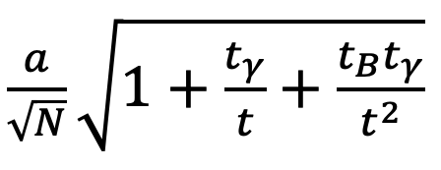
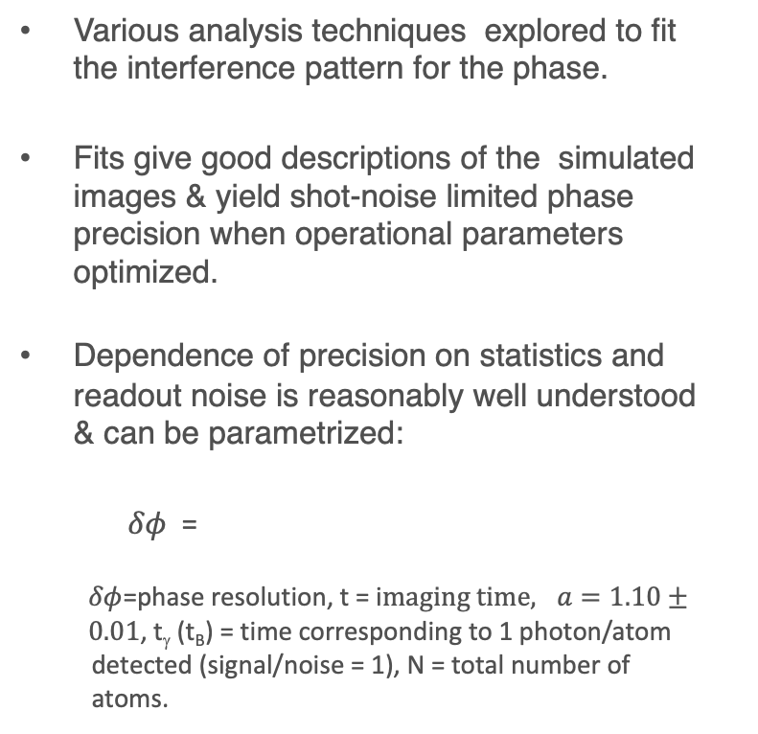
Simulation Results
(ND-doc-845)
single-port fringes
Various analysis techniques explored to fit the interference pattern for the phase.
Fits give good descriptions of the simulated images & yield shot-noise limited phase precision when operational parameters optimized.
Dependence of precision on statistics and readout noise is reasonably well understood & can be parametrized:
$δφ$ =
$δφ$=phase resolution, t = i$maging time, a=1.10± 0.01$, t_{γ} (t_{B}) = time corresponding to 1 photon/atom detected (signal/noise = 1), N = total number of atoms.
photons/bin (x1000)
two-port asymmetry
Asymmetry

Slide 6
Present Limitations
1
No realistic optics model (only calculated geometrical acceptance factor and a specified magnification).
No stray paths (important for high LMT studies) not included. Hence no good model for an imperfect contrast yet.
500
Looking Forward
pixel z-index
Leonie is implementing a parametrization of LMT stray paths into the package.
Imagine that the optics studies within the Collaboration will result in a parametrization that can be incorporated for a more complete optics description including DOF effects.
1000
1
200
400
pixel x-index

Slide 7
Dark Matter Studies: ND-doc-1290
Present code not intended to be multi-user ... but able to produce simulated DM datasets that can be used to develop analysis tools etc.
User A
code for Physics
Model X
Analysis Study 1
Collaboration accessible Disk
Analysis Study 2
docDB
User B
code for Physics
Model X
Analysis Study 3
User Z
code for Physics
Model X
Analysis Study N
Present Goals: (i) Initial DM study to verify analytical expectations for experimental sensitivity, (ii) Datasets on Collaboration accessible disk + document in docDB
May need something more formal if we need a “production simulation.”

Slide 8
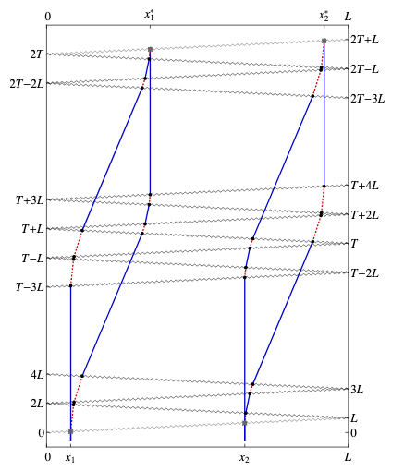


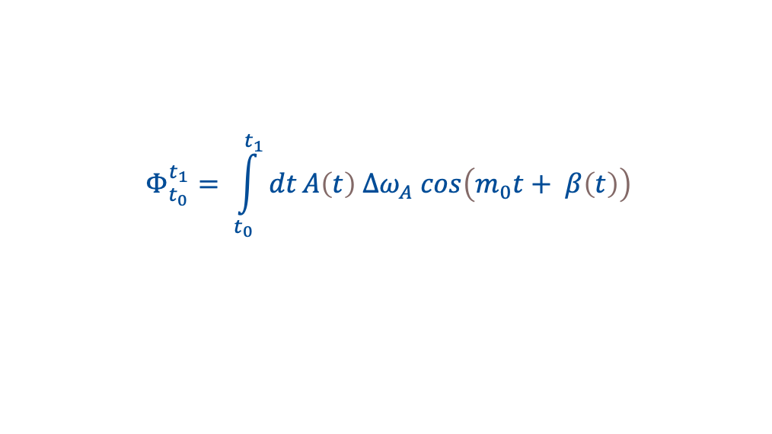
Dark Matter Model
Arvanitaki et al; Search for light scalar dark matter with atomic gravitational wave detectors, arXiv:1606.04541v1 [hep-ph] 14 Jun 2016
I have modified the Arvanitaki et al model to include evolution of the DM wave:
$$Φ_{t_{0}}^{t_{1}}= \int_{t_{0}}^{t_{1}}{dt}A\left(t\right) ∆ω_{A} cos\left(m_{0}t+ β\left(t\right)\right)$$
amplitude
evolution
phase
slip

Slide 9
Dark Matter Simulation
DM assumed to be fully virialized with
Maxwell-Boltzmann velocity distribution
cut off at the galactic escape velocity.
Resulting freq. spread (typically 1 part in 10⁸) generates DM wave evolution (i.e. decoherence).
Example of a simulated DM “fingerprint” over an interval ~ the coherence time.
Simulate many experiments, each with its own DM “fingerprint,” & calculate the gradiometer phase difference δφ smeared by the experimental resolution for each measurement in a data taking campaign.
Write to disk the sequence of δφ for others to use (e.g. Jeremiah for a study of DM + GGN).
Verified expected sensitivity to DM based on analytical estimates & study analysis techniques to discover/exclude DM with a given mass → ND-doc-1290.

Slide 10
Dark Matter STATUS (ND-doc-1290)
Black/Brown: on average SNR=1 with/without DM evolution c.f. proposal sensitivity
Green: Corrected for L=50m
Blue: Threshold sensitivity (only 5% chance of background fluctuation) ... Includes “look elsewhere” effect.
Red: 90% CL sensitivity
Dark Matter Plans
Threshold & 90%CL sensitivities depend on analysis technique – ongoing study to see if they can be improved
Very simple DM model so far. Developing a multi-species model to explore analysis possibilities.
DM+GGN combined studies (with Jeremiah)

Slide 11
Final Remarks
MAGIS-100 is in a sense somewhere between a traditional atom-interferometer experiment and a traditional particle physics experiment.
Detailed experiment simulations are expected in particle physics experiments, and I think they will be essential to build confidence in the analysis of data from a DM campaign ... but the scale of the required simulation effort & associated computing resources is unclear. We need to make our best guess.
An important activity from the Fermilab team not covered in this talk is the work Mandy has been doing:
  Understand the computing resources we want Fermilab to provide
  Onboarding Collaboration members
Fermilab also has expertise for data production & pipelines
  Desirable to grow the team

