Slide 1
MAGIS Simulation & Analysis Workshop: Diffusion & LMT Stray Paths
Leonie Hawkins – 24th January 2022

Slide 2
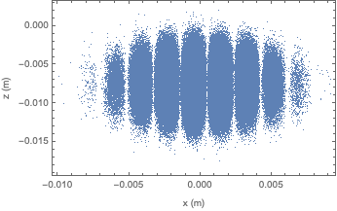
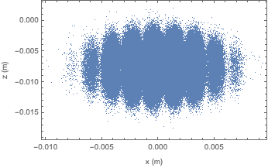
Cloud Diffusion During Imaging
Aim: putting limits on imaging time due to cloud diffusion
Photons scattered from imaging beam, recoils cause diffusion
Isotropic emission of photons, fit to 2D projection in plane of fringes
Mathematica simulation - results parameterised, module MAGIS for Case Study notebook

Slide 3
Structure of the Simulation: Diffusion

Slide 4
Structure of the Simulation: Diffusion
Implemented using Mathematica
Uses built in functions, no external packages
Generates new random sample of atom coordinates & applies an initial velocity distribution
Photons emitted in a randomly generated direction
All fitting done using Mathematica’s inbuilt NonLinearModelFit function
Parameterised result in terms of atom displacements/imaging time, module in MAGIS case study simulation to diffuse cloud
461/689/698 nm transitions

Slide 5
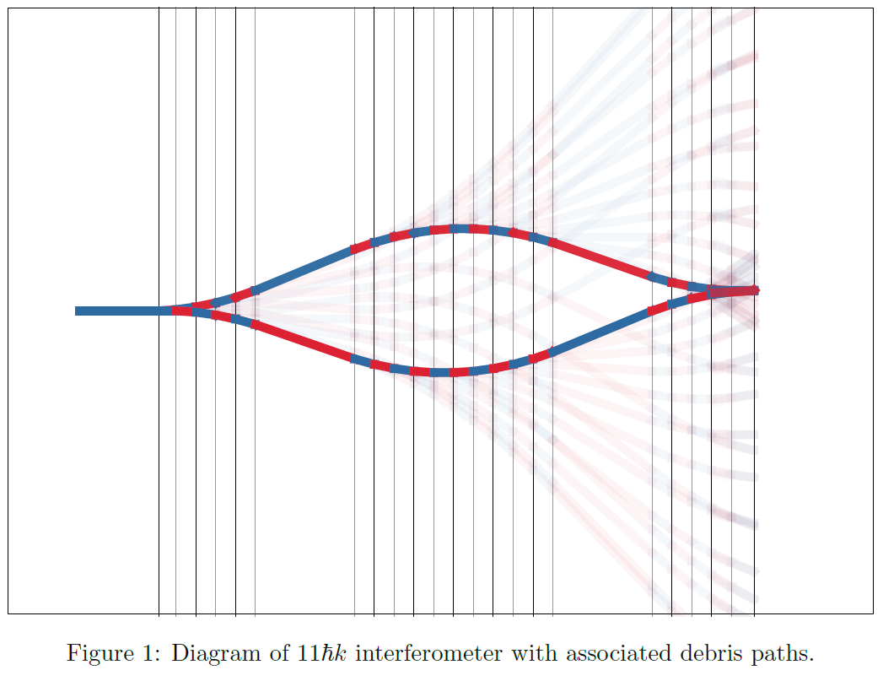
LMT Stray Paths Simulation
Exploring effects of LMT pulse inefficiencies across cloud
Non-uniform Rabi frequency
Noise on laser beam intensity
Include in MAGIS case study Mathematica notebook
Reductions in contrast
Atom losses
Phase precision
Stray clouds

Slide 6
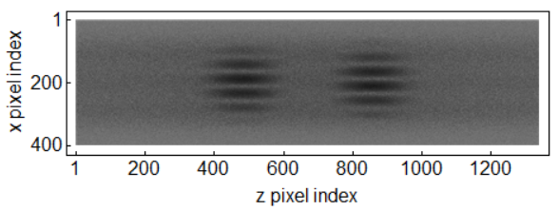
Structure of the Simulation: LMT
Simulation of stay paths generated at each LMT pulse (TJ Wilkason)
Parameterised results as function of stray path amplitude & LMT order
For a range of beam/cloud size ratios
Separate distributions for z and x distributions
Mathematica module to convert parameterisation into a simulated image
Sample atom coordinates from this module and run MAGIS Case Study for increasing LMT order & beam/cloud ratios

Slide 7
External Packages & Functions: LMT
Main body of simulation & Case Study module – all built in Mathematica functions
NonLinearModelFit function for fitting
Stray path amplitude simulation – Mathematica packages containing functions
Path integrals of atom travelling through interferometer, laser pulses, constants for Sr
Packages created by Jason Hogan

Slide 8
Summary
Mathematica simulations contributing modules to MAGIS Case Study notebooks
Cloud diffusion during imaging: optimal imaging time
Recoils from photon scattering, parameterised in terms of atom displacement
Technical note on doc-db (ND-doc-921)
LMT stray paths: contrast & phase precision loss with increasing LMT order

Slide 10
Backup Slides

Slide 11
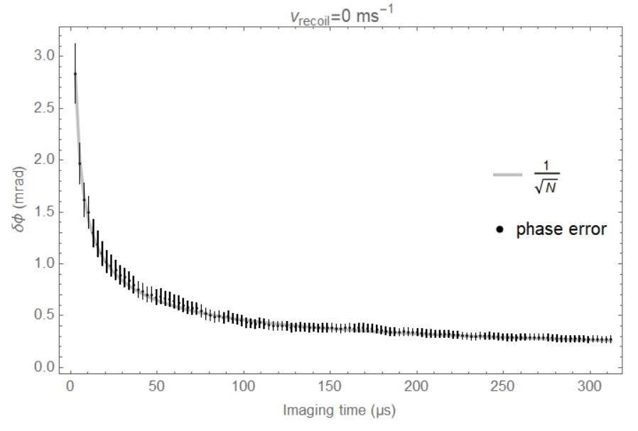
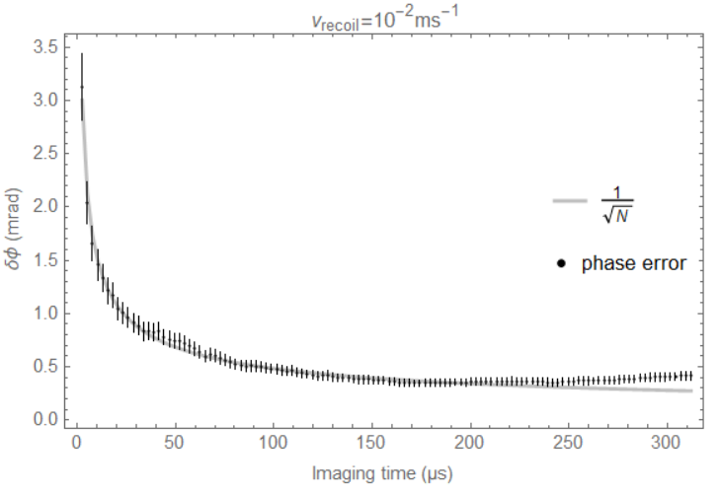
Results: Phase Precision vs. Imaging Time
150 microseconds optimal
Technical note on doc-db (ND-doc-921)

Slide 12
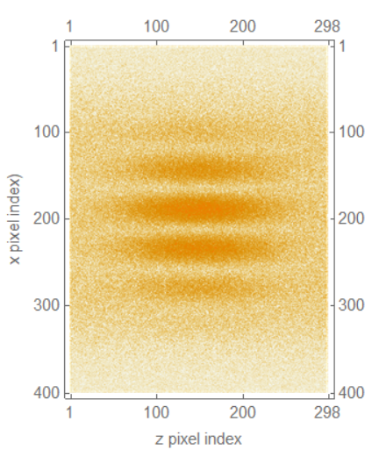
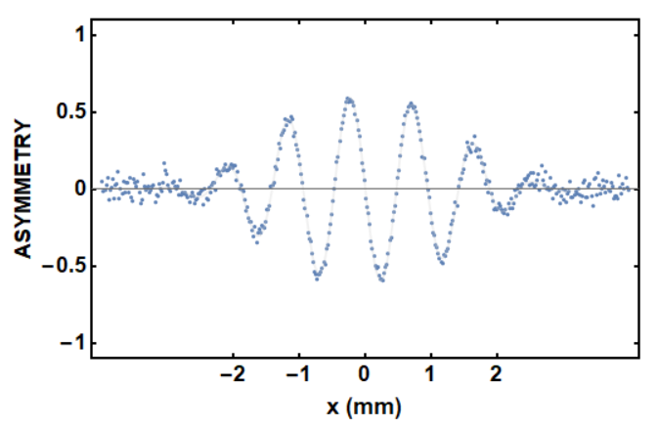
E.g. 200 LMT pulses, B/C ratio 5
99% pulse efficiency gives contrast of 0.59

Slide 13
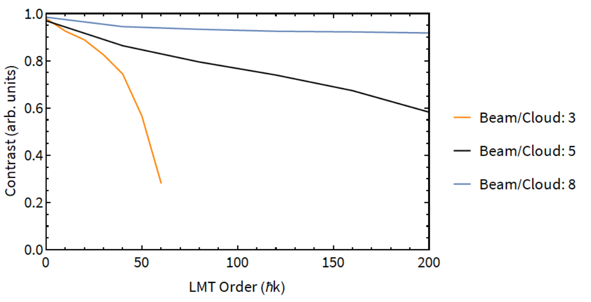
Contrast Loss vs. LMT Order

Slide 14
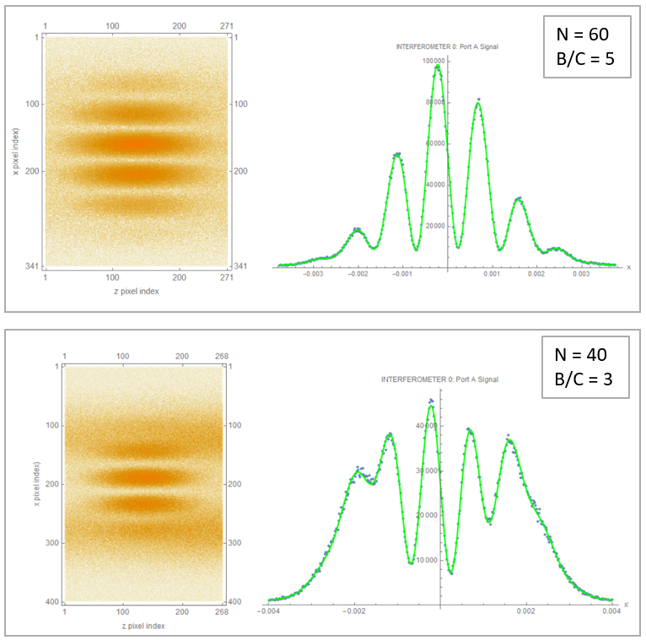
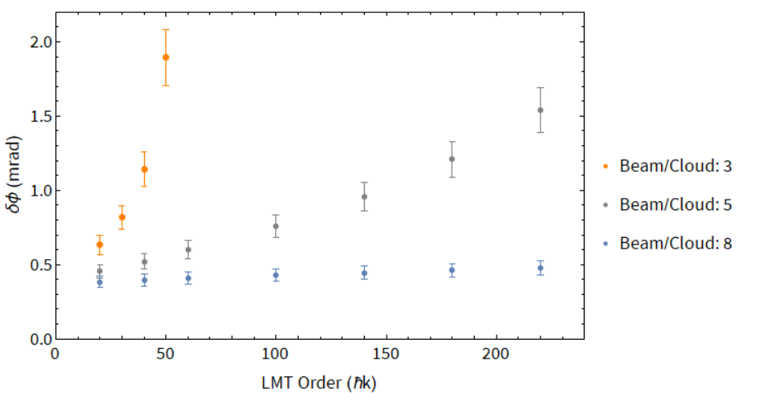
Phase Resolution vs. LMT Order
Mean error on phase, for 99% pulse efficiency

