Slide 1
Bottom CRP Supports Consortium Meeting Design Update
Ian Jentz
Jan. 19, 2022
University of Wisconsin – Madison
Notes:
50 minute oral presentation

Slide 2
Bottom CRP Supports:
Design update overview
Support Component: bottom support post and foot design, attachment to CRP
Placement of Supports: CRP attachment points and placement on Cryostat floor
Controlling Contraction: Controlling slip between foot and support

Slide 3
Support Component:
bottom support post and foot design, attachment to CRP
Support Component: bottom support post and foot design, attachment to CRP
Placement of Supports: CRP attachment points and placement on Cryostat floor
Controlling Contraction: Controlling slip between foot and support

Slide 4
Support Design
Bolts to Bottom CRP composite structure using a 27mm dia. ring of 4 M4 bolts.
Aluminum post out of 2 in rod stock, reduces machining operations and limits thermal shrinkage
2 end drilling operations (1 on each end of post), 1 lathe operation
low thermal contraction compared to plastics
Sliding plastic connection between foot and post.
Attached to bottom of post using M2 screws.
Interchangeable between fixed, 1D free, or 2D free.
Choice of material TBD (PEEK or Polyimide are best candidates)
120 mm square stainless-steel foot. Matches thermal expansion of membrane floor, providing un-moving platform.
Chamfered edges to prevent floor damage
Universal fittings for fixed, 1D free, and 2D free configurations.
Retaining screw keeps assembly together during placement
CRP composite structure
Universal Aluminum Post
Sliding connection, free and fixed configurations
Foot distributes weight

Slide 5
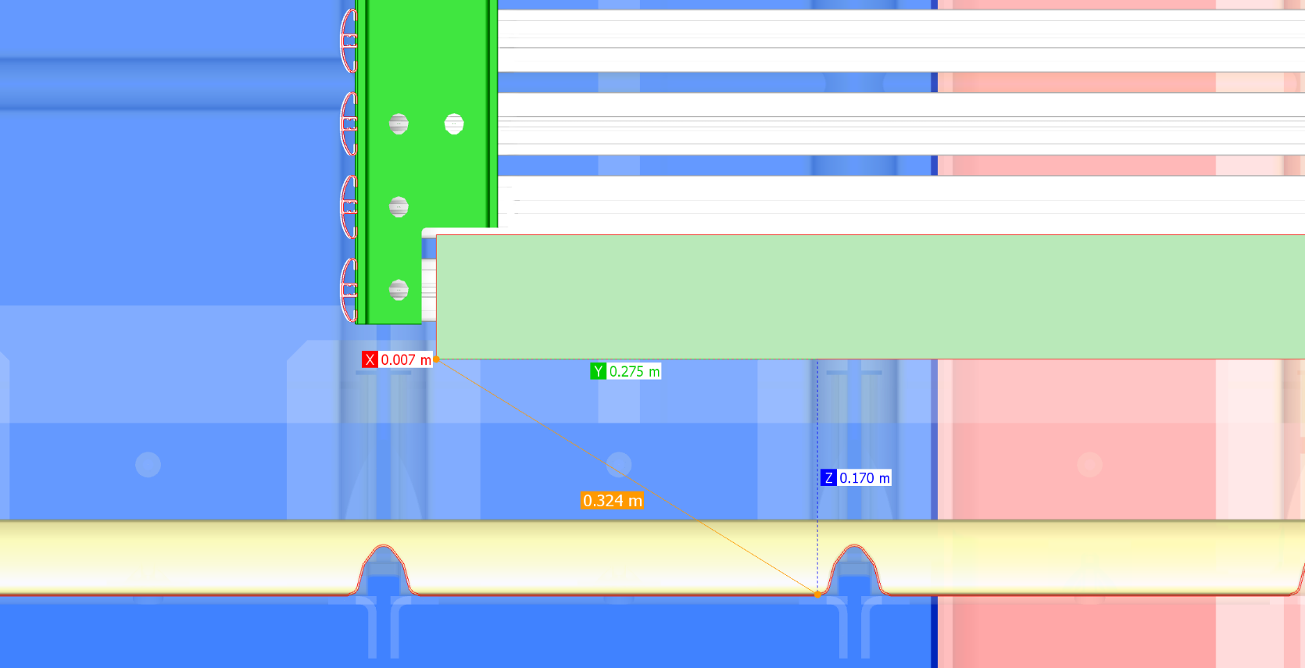
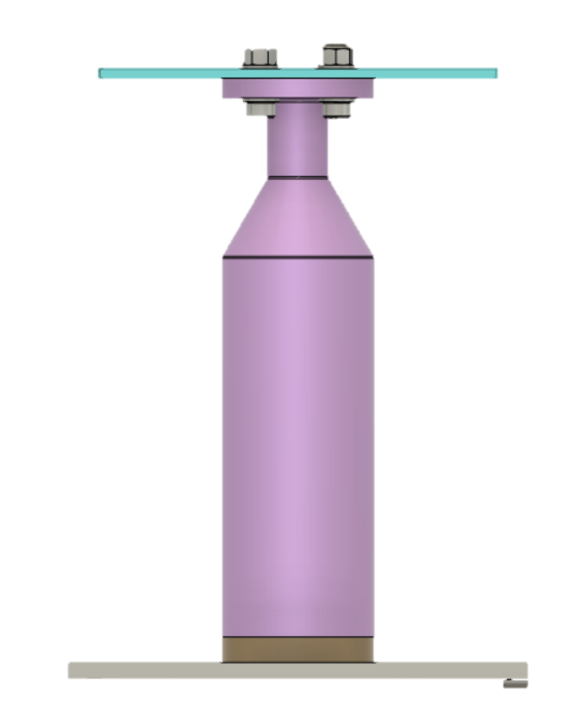
Clearance
CRP Module
15.35 cm
Membrane floor
15.35 cm of clearance between membrane floor and CRP structure
At membrane corrugations this is reduced to 11.6 cm and 13.6 cm
The CRP-2 structure occupies 8.785 cm
supports have 15.35 cm to cover

Slide 6
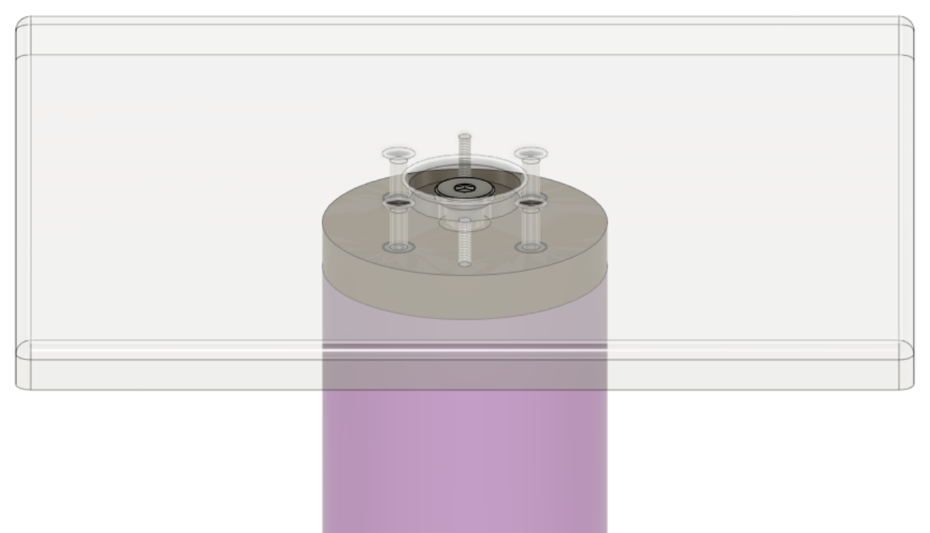
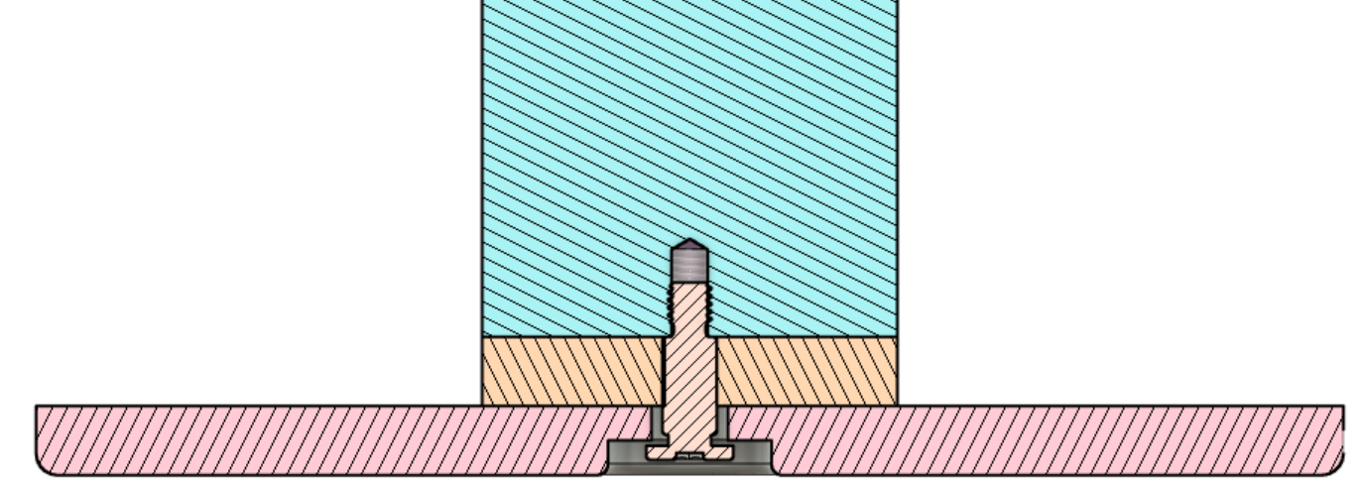
Stainless steel foot
Retaining screw
Oversized hole allows motion of sliding connection
Aluminum post
Low friction plastic
mounting holes for 1D and fixed connections
Stainless steel
Chamfered edges
Gap between head prevents bolting of foot
120 x 120 mm footprint
Chamfered edges prevent damage to membrane floor
retaining screw through center keeps foot from falling off during assembly
Shoulder screw maintains clearance so foot can move
Recess for retaining screw is milled into bottom of foot

Slide 7
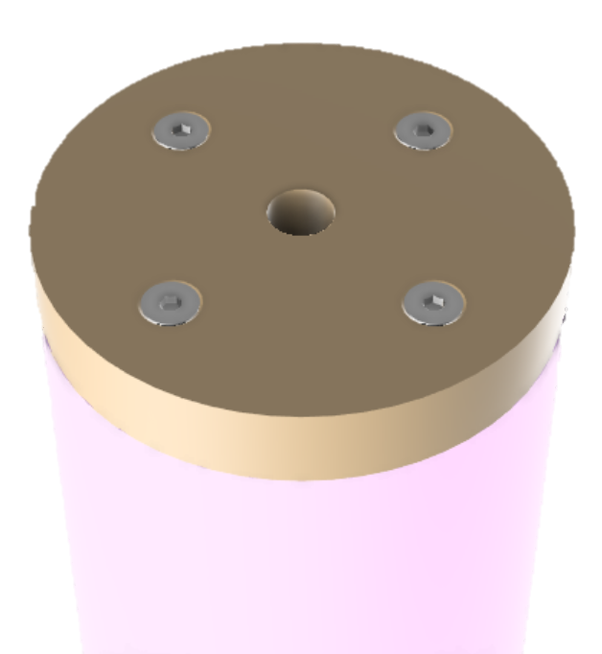
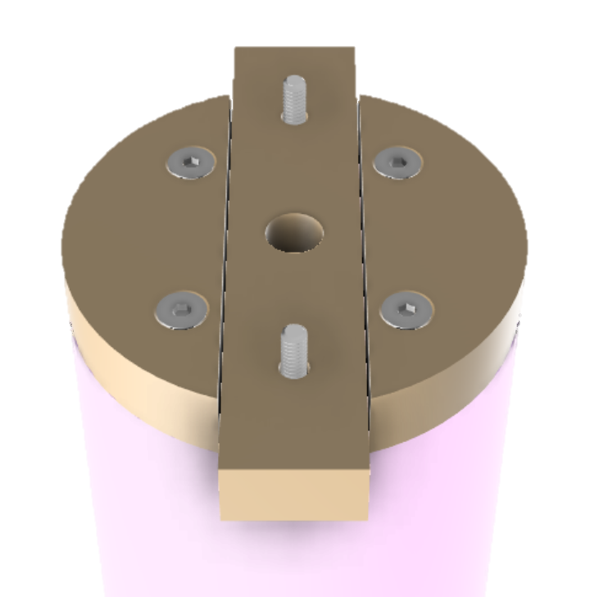
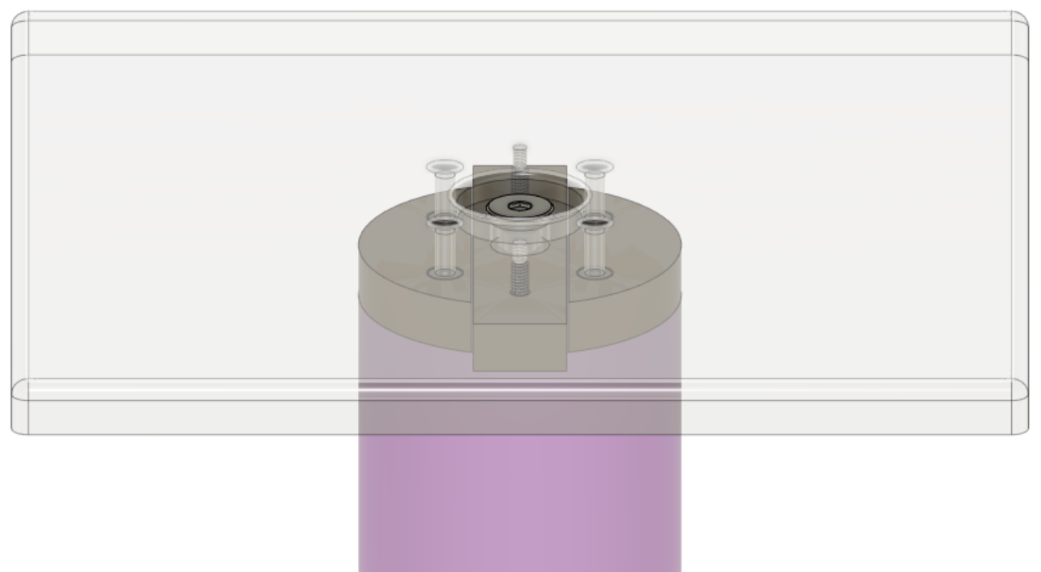
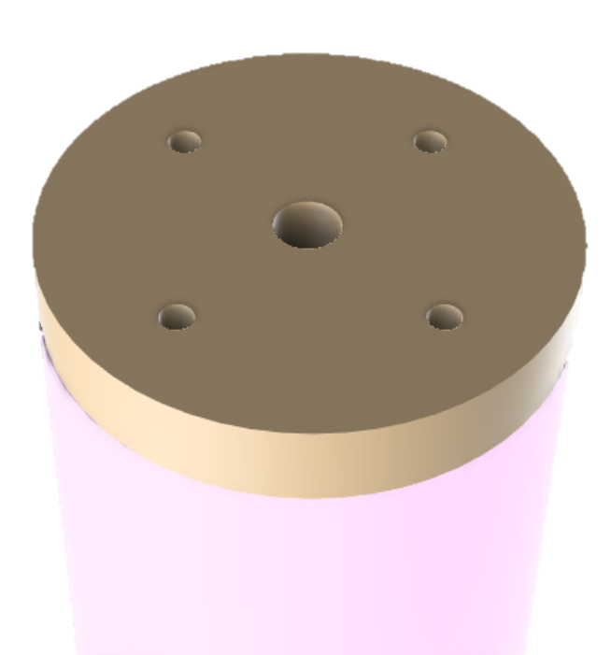
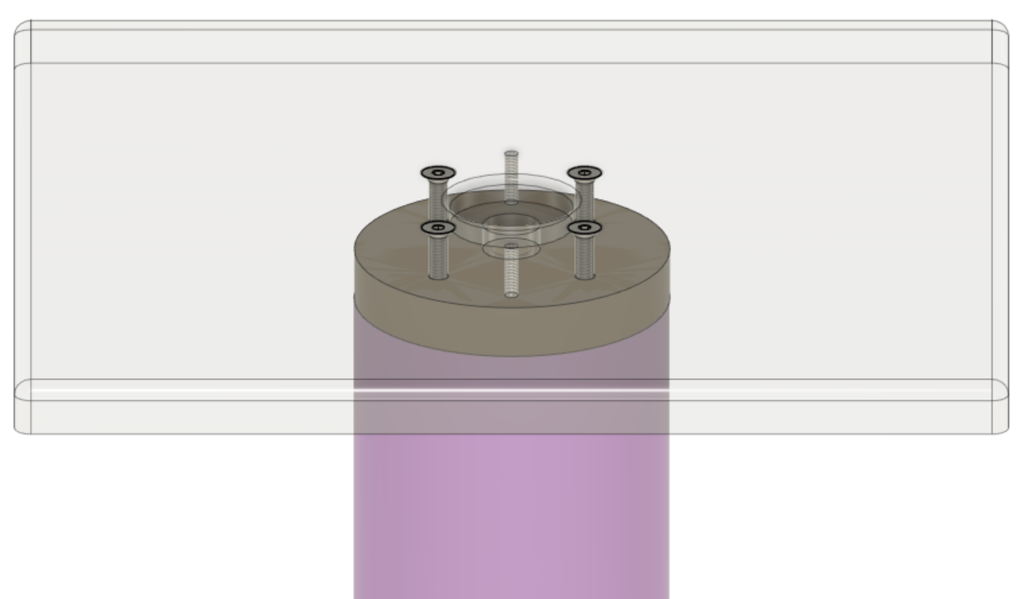
Motion is controlled by mounting different sliding connections
Retaining screw
Plastic connection fixed to post only
retaining screw through center keeps foot from falling off during assembly
2D Free
Sliding connection
Hole for retaining screw
Plastic connections fixed to post
Plastic bar fixed to foot
retaining screw through center keeps foot from falling off during assembly
1D Free
Sliding connection
Bar fixed to foot
Screws through foot and plastic connection bind post to foot
Fixed
connection
binding screws

Slide 8
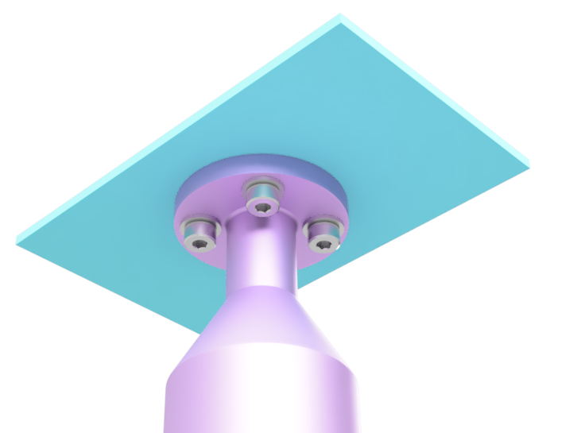
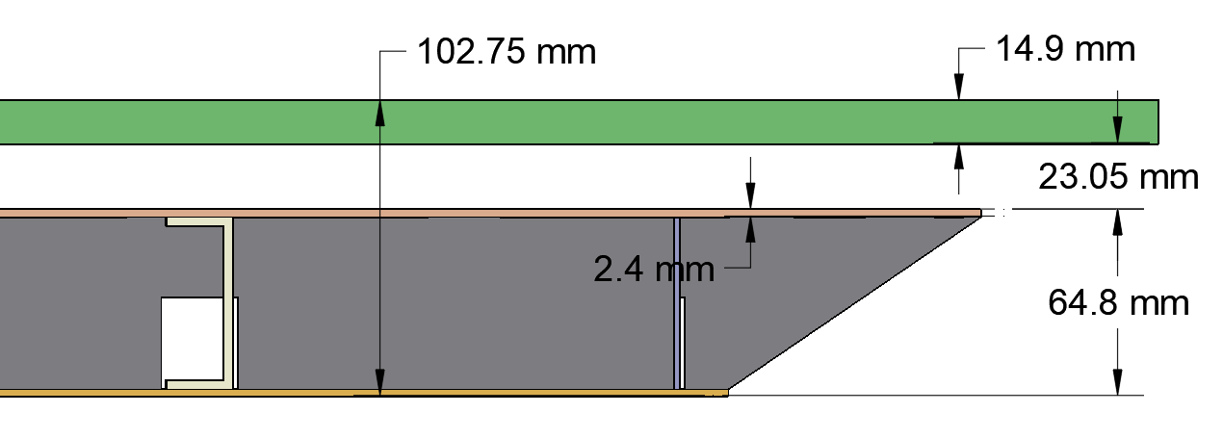
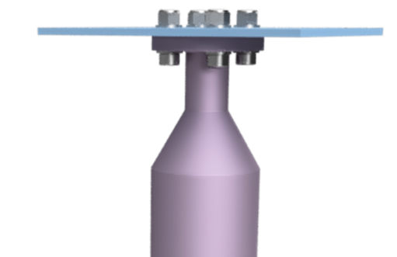
Connection to CRP composite structure
CRU assembly
CRP Composite structure
Bolts to Bottom CRP composite structure using a 27mm dia. ring of 4 M4 bolts.
6 locations coincident with stiffening C beams
Can be installed from underneath assembled CRU
Recess is lathed out of aluminum post for access to bolt heads from below

Slide 9
Placement of Supports:
CRP attachment points and placement on Cryostat floor
Support Component: bottom support post and foot design, attachment to CRP
Placement of Supports: CRP attachment points and placement on Cryostat floor
Controlling Contraction: Controlling slip between foot and support

Slide 10
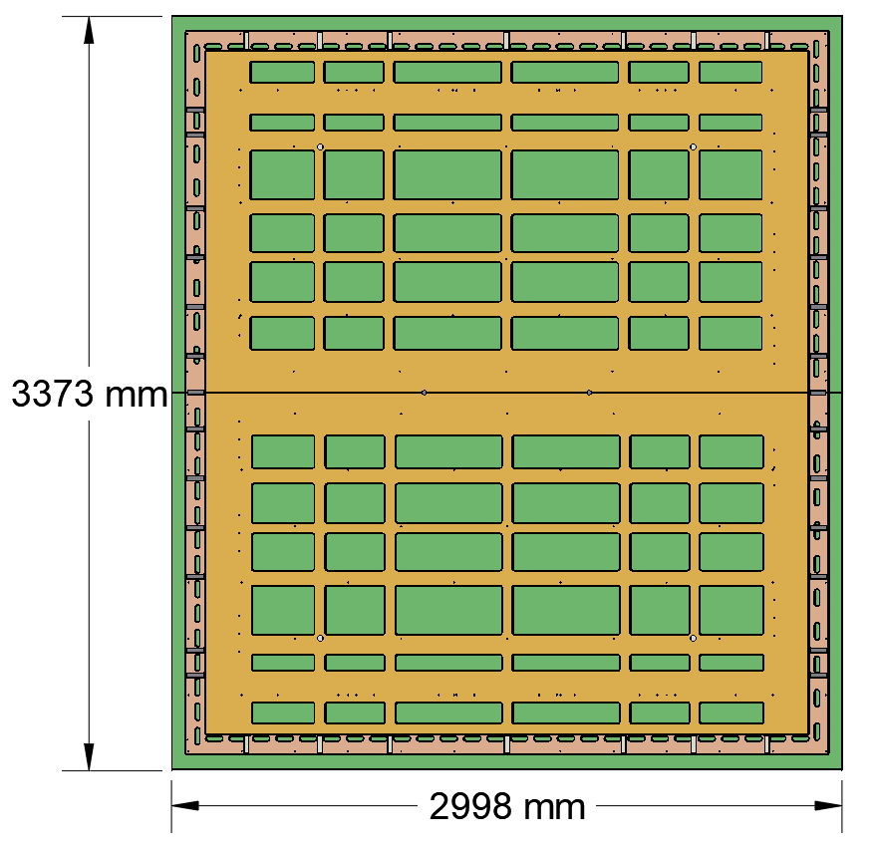
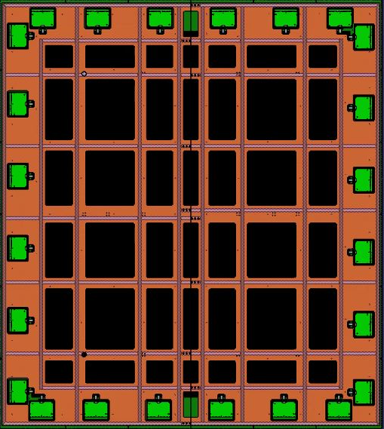
Bottom CRP Mounting configuration
6 locations coincident with stiffening C beams
Choice of fixed support location to control CRP shrinkage
Fixed near corner so groups of 4 CRPs stay together
CRP Composite structure
Mounting locations

Slide 11
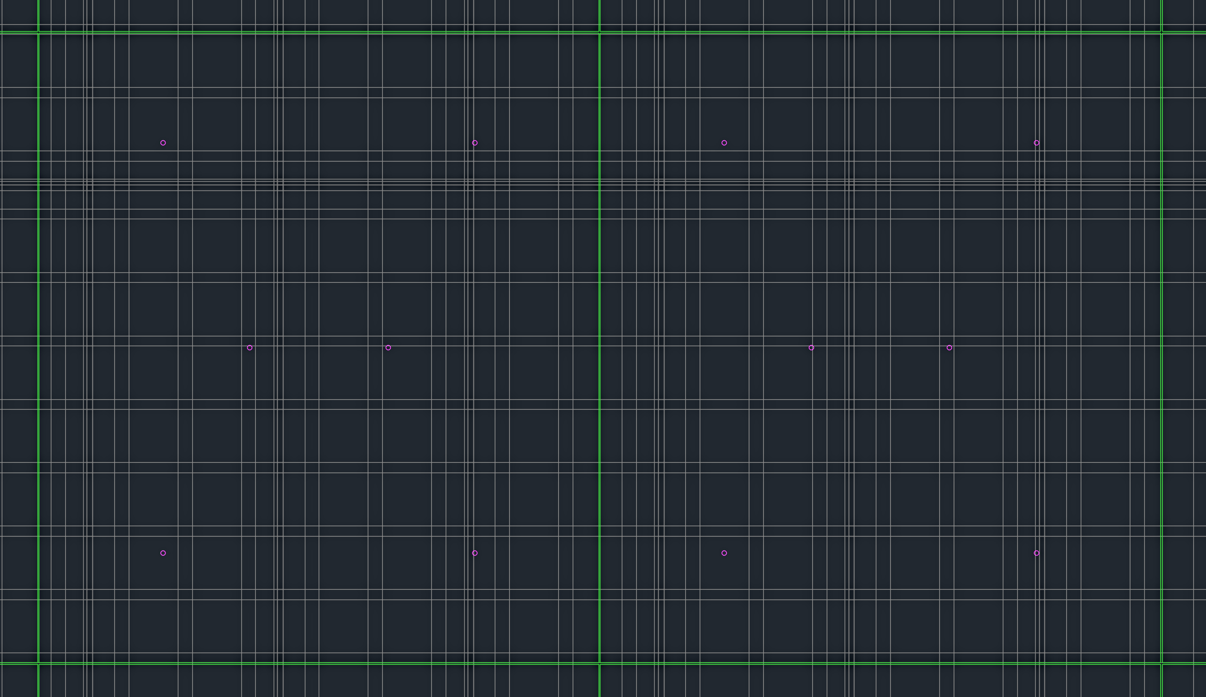
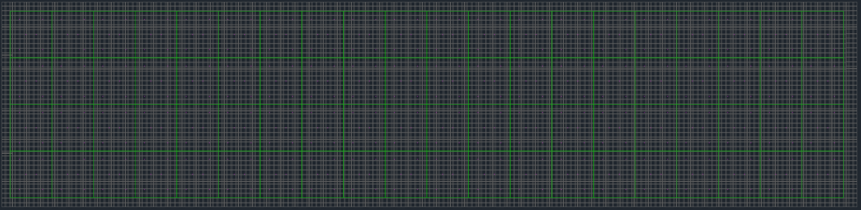
Evaluation of possible support locations on Cryostat floor
5 CRPs with no valid locations
15 with 1 valid location
32 with 2 valid locations
11 with 3 valid (would be stable)
17 with 4 valid
Good location
Bad location,
On corrugation
Bad location,
On seem
Good location
Position of 80 CRP units considered relative to open spaces in membrane floor.
CRP placement gives 6 locations for supports
Need to avoid corrugations & seams
Need to add more CRP mounting locations
CRPs
Mounting locations
Membrane floor corrugations & seams

Slide 12
Controlling Contraction:
CRP attachment points and placement on Cryostat floor
Support Component: bottom support post and foot design, attachment to CRP
Placement of Supports: CRP attachment points and placement on Cryostat floor
Controlling Contraction: Controlling slip between foot and support

Slide 13
Goal: controlled sliding during thermal contraction
Thermal contraction
Membrane floor is stationary (contraction taken up in corrugations)
CRP composite structure contracts
Fixed feet need enough steel-steel contact to remain stationary
Free feet need to slide first
Frictional interfaces
Plastic to stainless steel, at connection to foot
Stainless steel to stainless steel, between foot and membrane floor
200 kg / 6 supports -> 327 N per support
Aluminum post
Low friction plastic
Stainless steel foot
Stainless steel membrane floor
2D Free
Sliding connection
$$F=μN$$

Slide 14
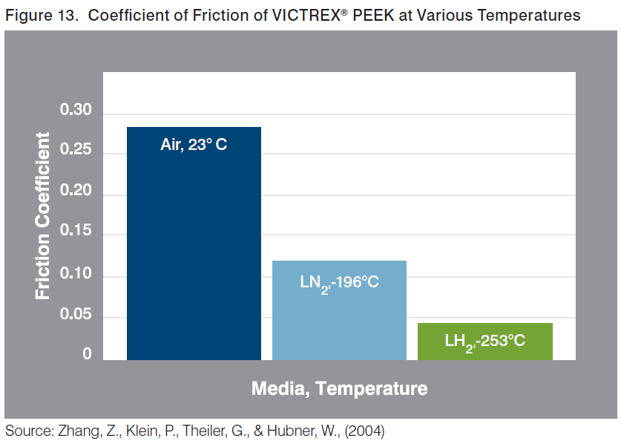
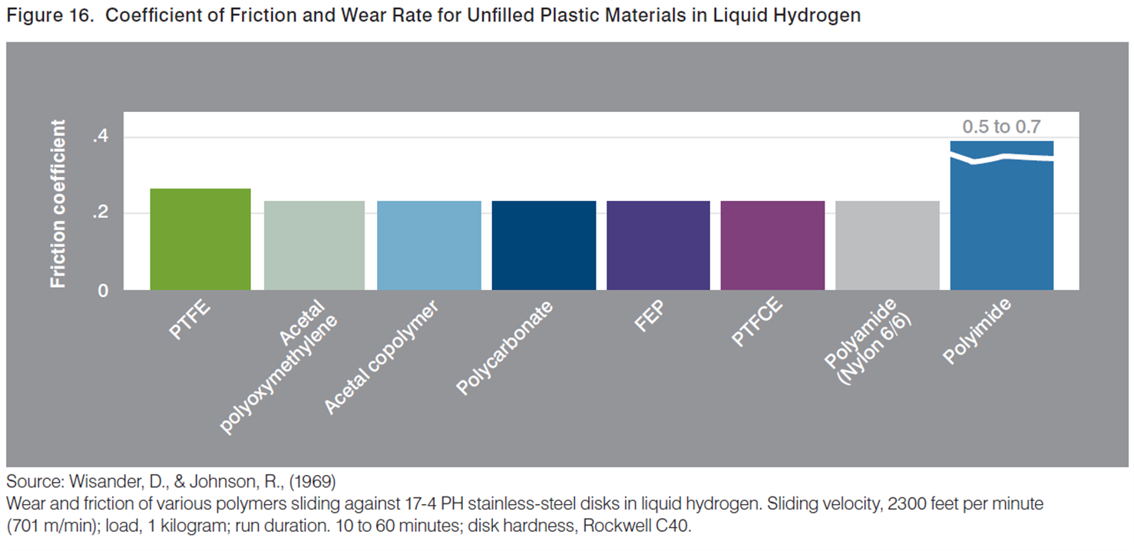
Friction in sliding
Static coeff of friction for dry steel-steel: 0.5-0.8
2D Free
Sliding connection
Sliding connection needs low friction at LAr temps (-183 C)
PCTFE or PEEK would provide low friction
Polyimide has higher friction, and is more expensive (wont use)
PEEK is most attractive, and is already being used in CRU-to-CRP spacers

Slide 15
Need investigation into friction coefficients
Why component friction must be understood
Guarantee fixed supports won’t slide during filling
Hold against thermal contraction and flowing Ar
Controlled sliding of free supports to accept thermal contraction
Knowledge gap
Static coefficient of friction at LAr temperatures (-183 C)
Effect of LAr wetting
Specific components and surface finishes
plastic to stainless, and stainless to membrane floor
Experimental
Test static coefficient of friction under LN₂ (-196 C)
Various plastics to stainless steel
Stainless steel to stainless steel
Test breakaway force for real bottom support components

Slide 16
Bottom CRP Support Progress Summary
Completed Work
First iteration design of bottom support component
Evaluation of possible support locations on Cryostat floor
Ongoing Work (next quarter)
Iterating with CRP structure design team to place more support attachments
Determining weight distribution from CRP structure to supports and membrane floor
Proposed work (next year)
Design LN₂ (-196 C) environment friction coefficient testing
Test breakaway force for real bottom support components

