Slide 1
Update on the 2nd 3-View CRU Design with a 60° Relative Angle
Bo Yu
Jan 19, 2022

Slide 2
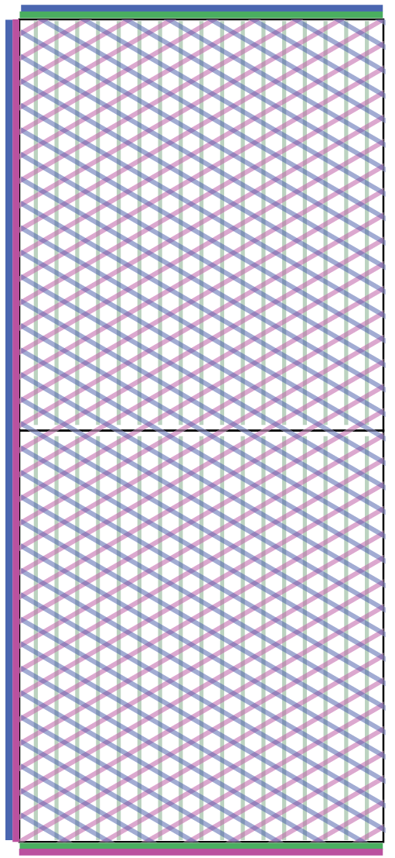
A New 3V Design with 1536 ch per CRU
292ch
96ch
The CRU design described in the current CDR has 48°, 0°, 90° strip angles with respect to the beam direction. It has 1600 readout channels. The size of the CRU is 2998mm x 1686mm.
The 0° angle is parallel to the beam, which is not preferred. A single diagonal view gives an asymmetric angular response.
The 1600 readout channel count was aimed at fully utilize a feedthrough design for the top electronics. However, if one reduces the channel count by 4% to 1536, the bottom electronics can save 20% of its signal flanges and free up 20% of available feedthrough ports for other purposes.
Implementing additional clearance between CRPs for installation expands the area of the TPC and pushes the field cage too close to the cryostat wall.
To satisfy these new considerations, a new 3V anode layout is being developed in conjunction with the new TPC layout proposed by CERN:
Change the strips angles to ±30°, 90° (collection).
Change the CRU orientation to have its long edge perpendicular to the beam.
Change the total channel count to 1536ch => two SFT flanges per bottom CE penetration.
Reduce the envelop of the CRU by a few mm to allow more clearance between CRPs without expanding the TPC footprint.
Implement edge connectors to bring signals from anodes to readout electronics adapter boards.
380ch
3370mm
380ch
292ch
96ch
1496mm

Slide 3
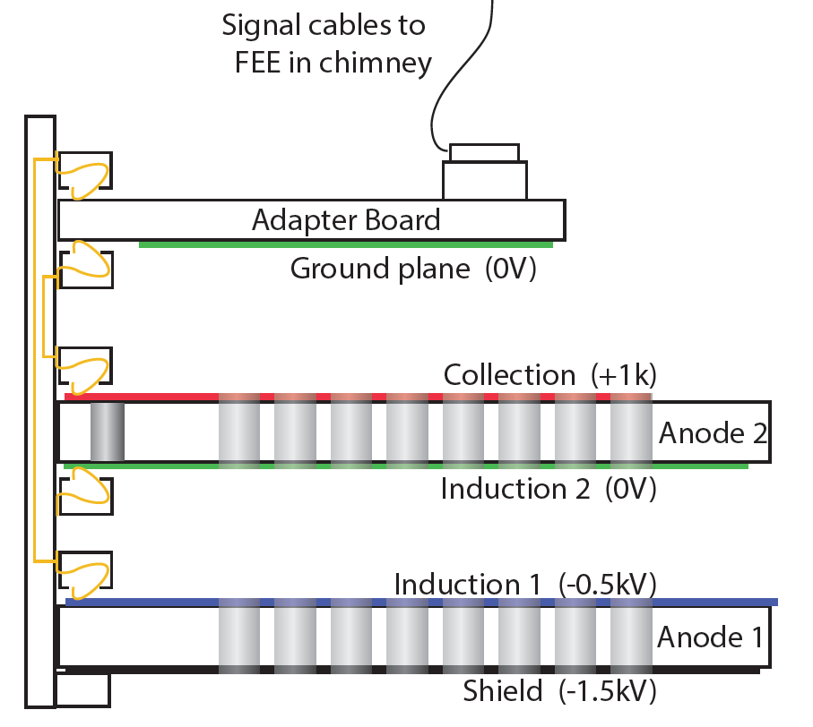
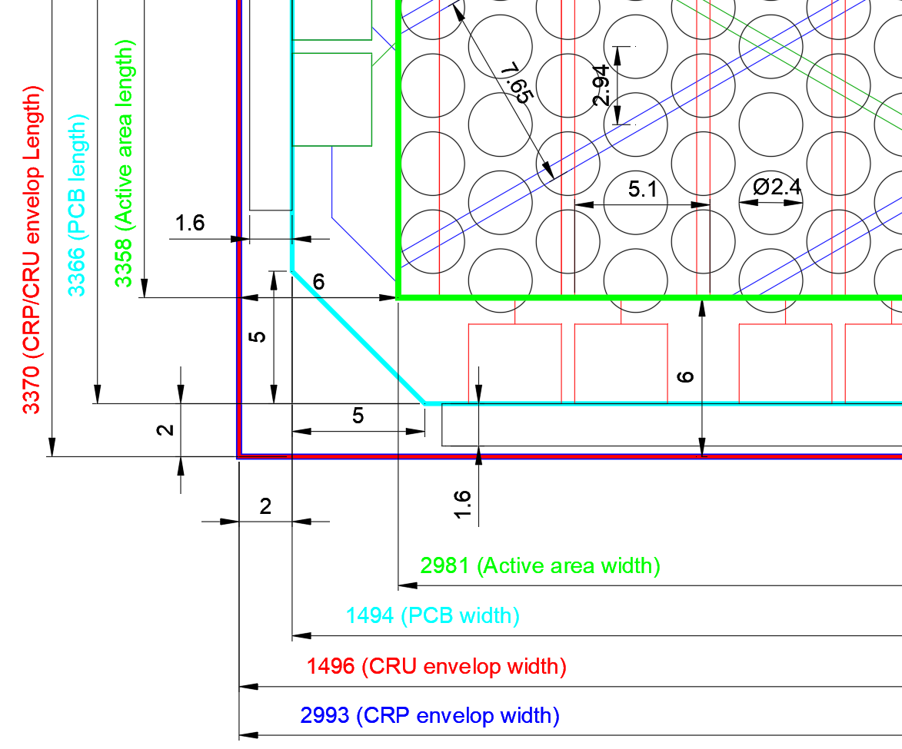
Key Dimensions
Use edge connectors to bring anode signal to the readout adapter boards. This Eliminates the need to solder connectors on the large PCBs.
Edge fingers
Edge card
Edge fingers
Edge card
Active area: (1490mm x 3358mm)
The left and right CRUs on a CRP are identical (180° rotation). Across the CRU gap (1mm) within a CRP, the induction strips are aligned, and the collection strip pitch is maintained.
Anode PCB envelop: (1494mm x 3366mm)
CRP envelop: (2993mm x 3370mm)
CRU envelop: (1496mm x 3370mm, 1mm gap between a CRU pair)

Slide 4
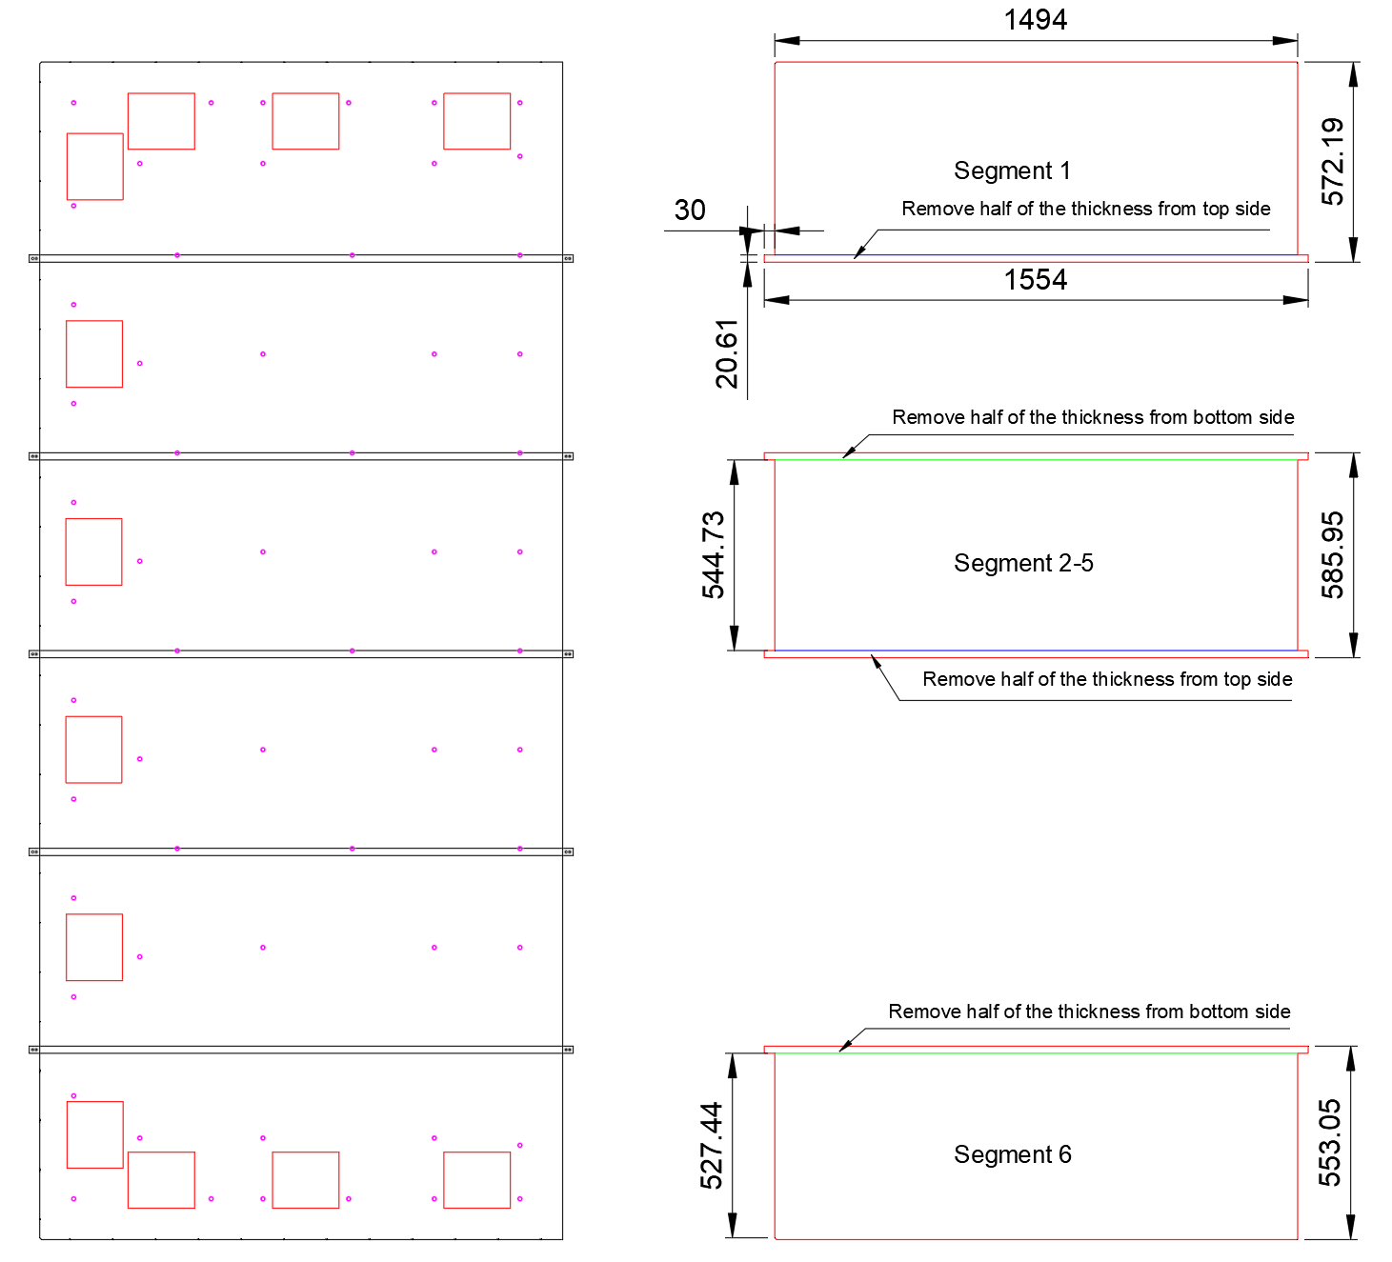
Dividing the Anode into 6 Segments
Due to PCB fabrication limitations, the anode is once again made from 6 segments.
The anode support pattern is tailed to match the strip pattern such that the middle 4 segments are identical.

Slide 5
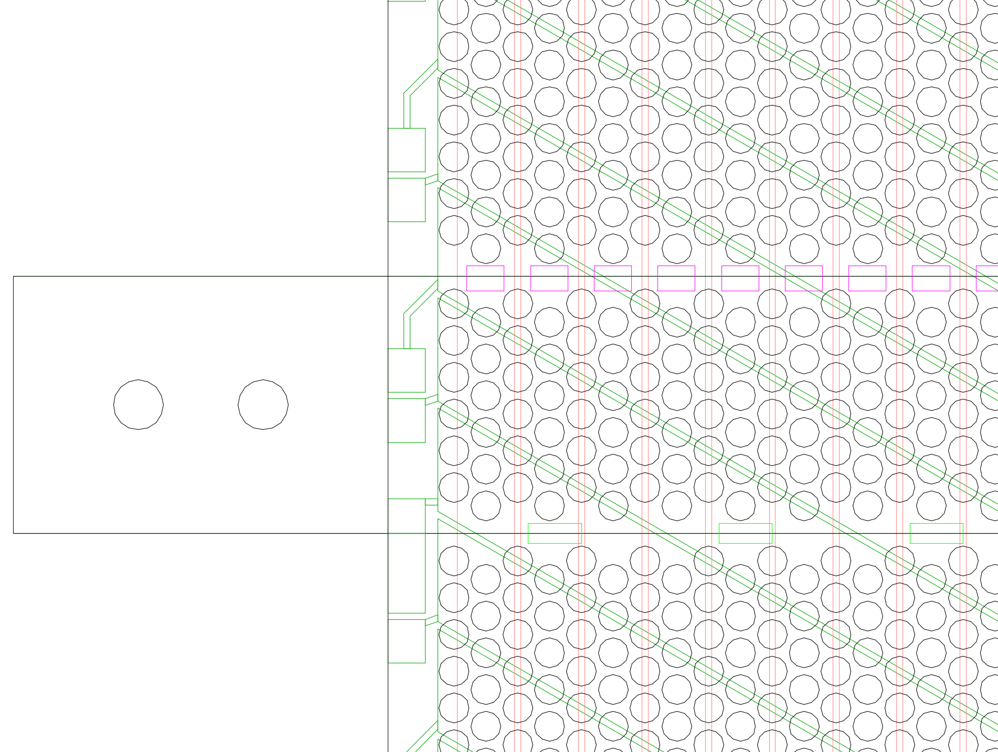
Anode PCB Layout Details
This is a small portion of the anode where two segments overlap to form the half lap joint.
At the request of the CERN PCB shop, two rows of holes have been removed at every joint on the 2nd anode to make room for the glue filling step before the screen printing of the silver paint patches.
Collection strip
Collection silver paint patch
Gap on top layer
Splice joint tab
& pinning holes
Gap on bottom layer
Induction 2 silver paint patch
Induction 2 edge fingers

Slide 6
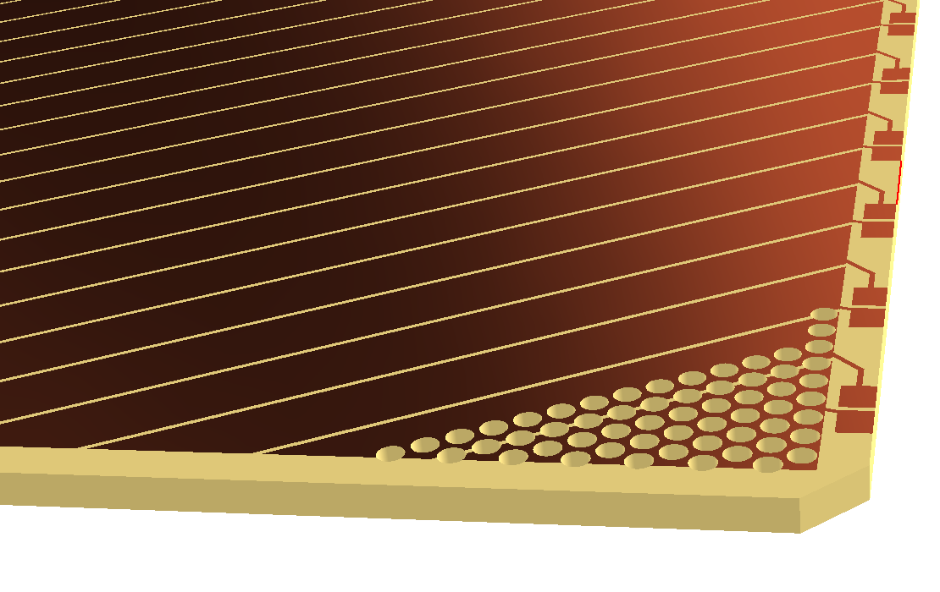
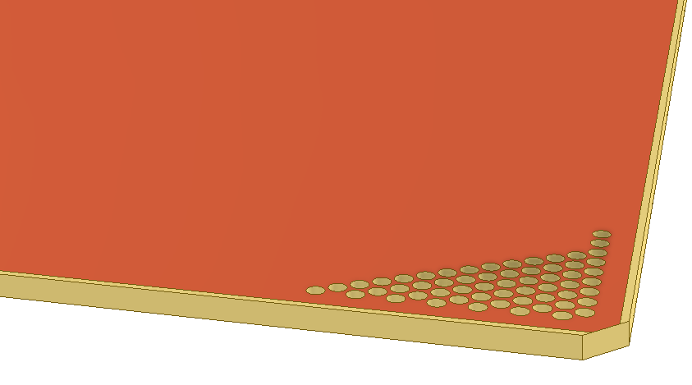
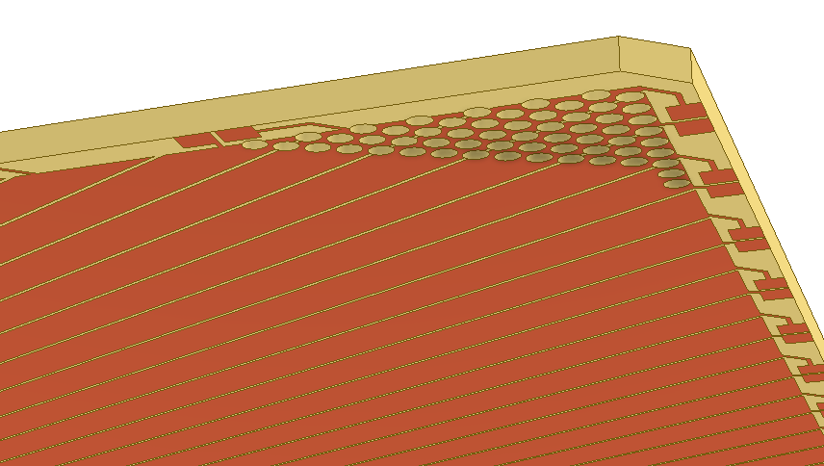
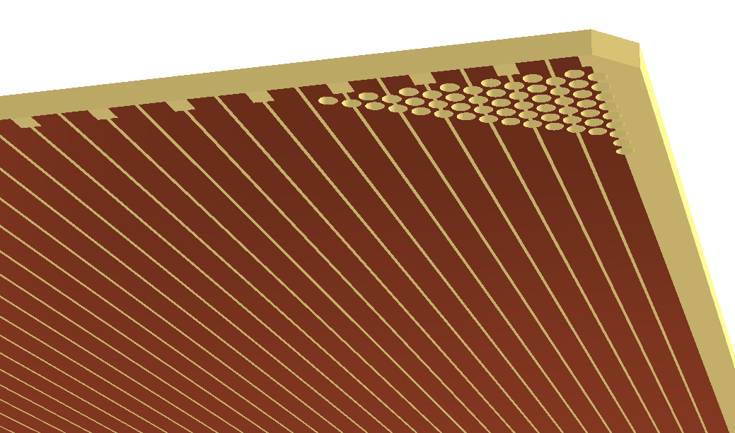
3D Model of the Anodes
Shield plane
2nd induction plane
Collection plane
1st induction plane
Using separate edge connectors, the need to install connectors (pins or sockets) on the anode PCBs has been eliminated. The bare anode PCBs go straight to CRU assembly (after the mechanical bonding and electrical interconnect).

Slide 7
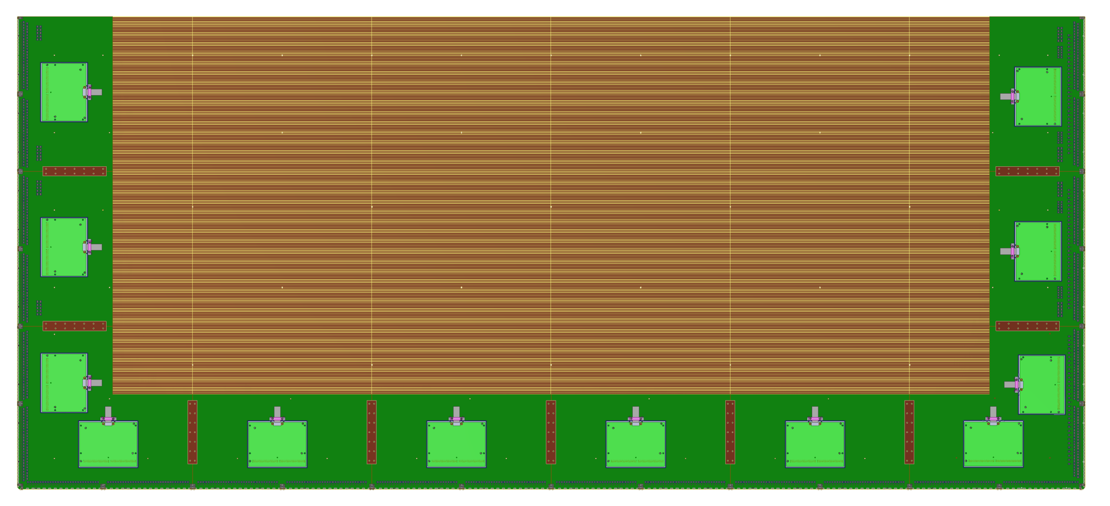
Arrangement of the Bottom CE Adapter Boards
Short board 1
Short board 2
Corner board 1
Long board
Corner board 2
Top electronics adapter boards have not been designed yet pending the decision on the cable arrangement.

Slide 8
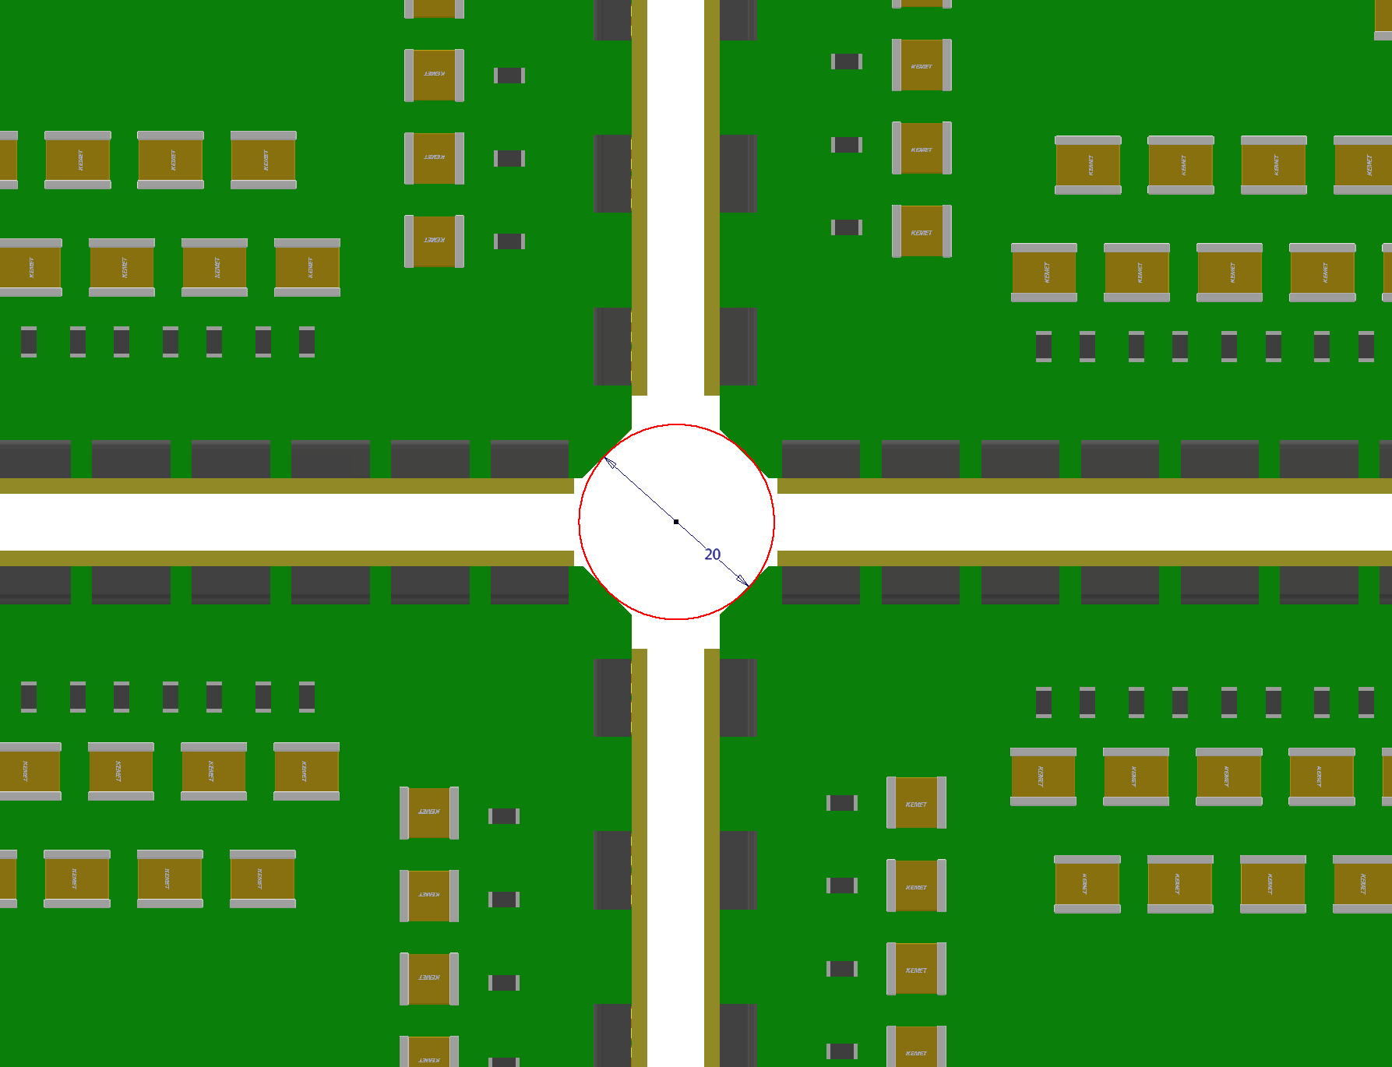
Purpose of the Chopped Corners on the Anode PCBs
The 2 chopped corners on the anode/adapter PCBs provide a larger opening at the 4 CRP intersection for the passing of cathode suspension ropes.
This provides a ~20mm hole for the cathode ropes while the nominal CRP to CRP gaps can be kept reasonably small (~5mm in this case).

Slide 9
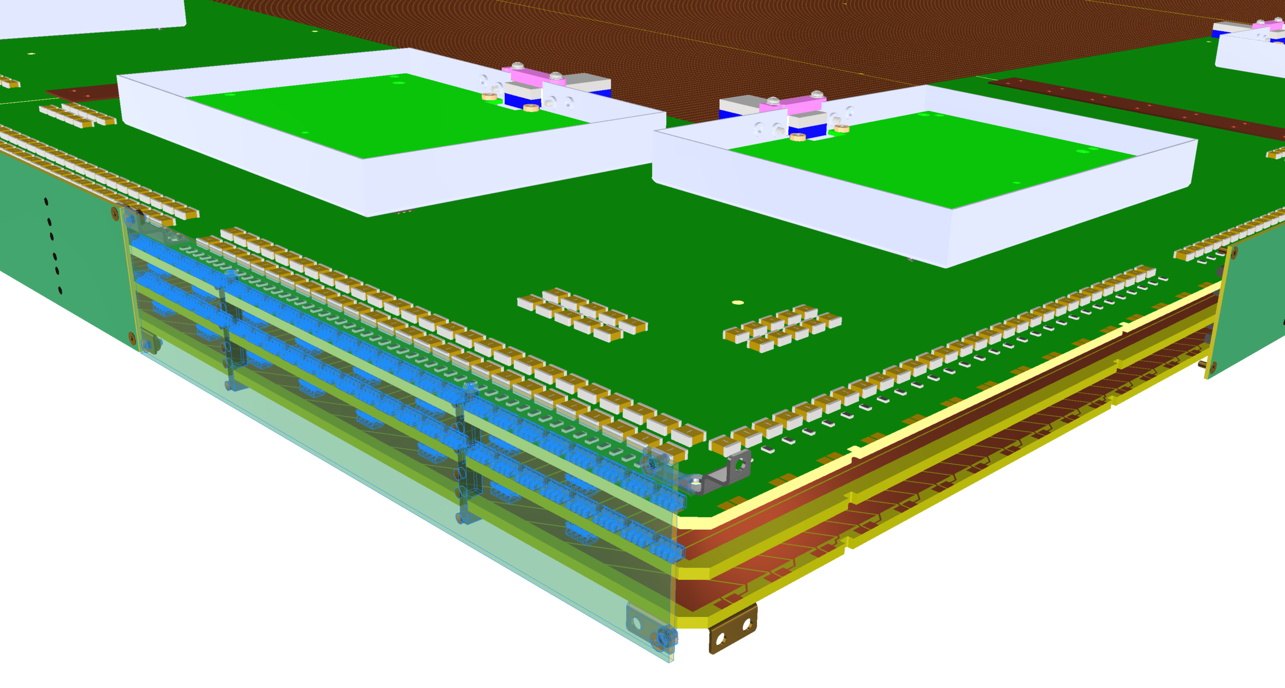
Corner Details of a Bottom CRU

Slide 10
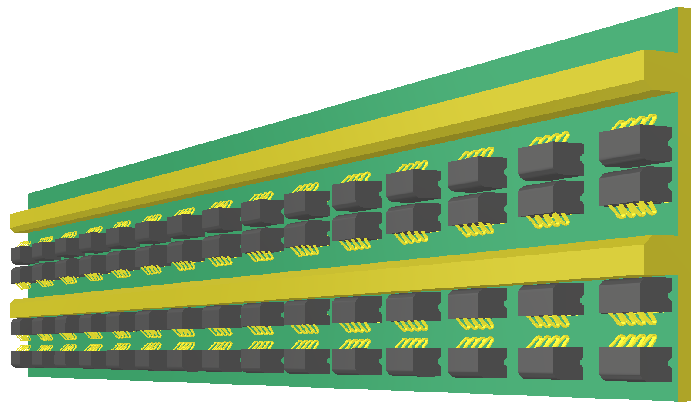
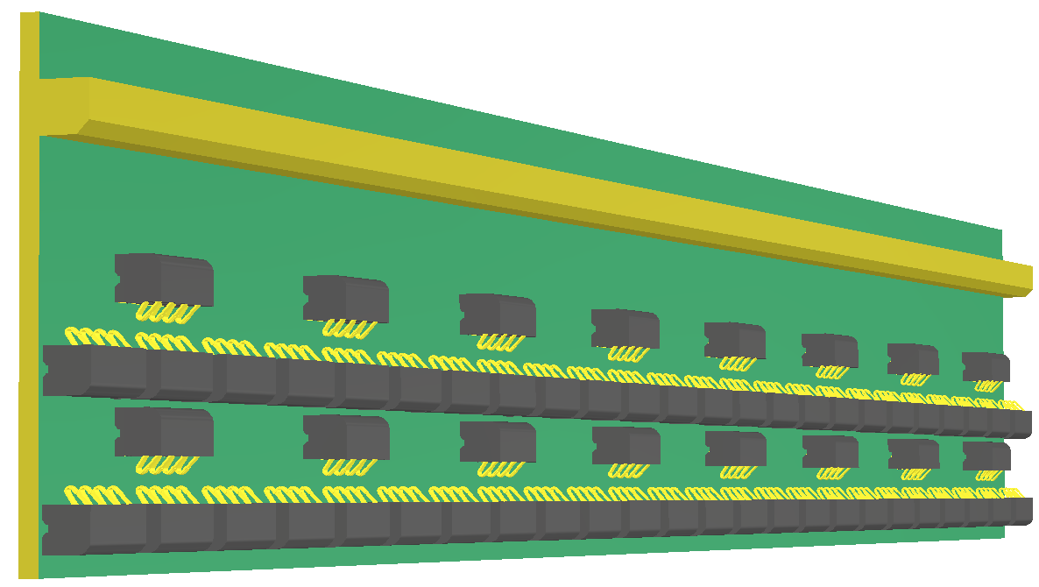
Edge Connectors used in 50L Test
Two spring contacts per channel
Short card to read out 2nd induction and collection signals
Long card to read out both induction planes
Anode 1
Anode 2
CE adapter board

Slide 11
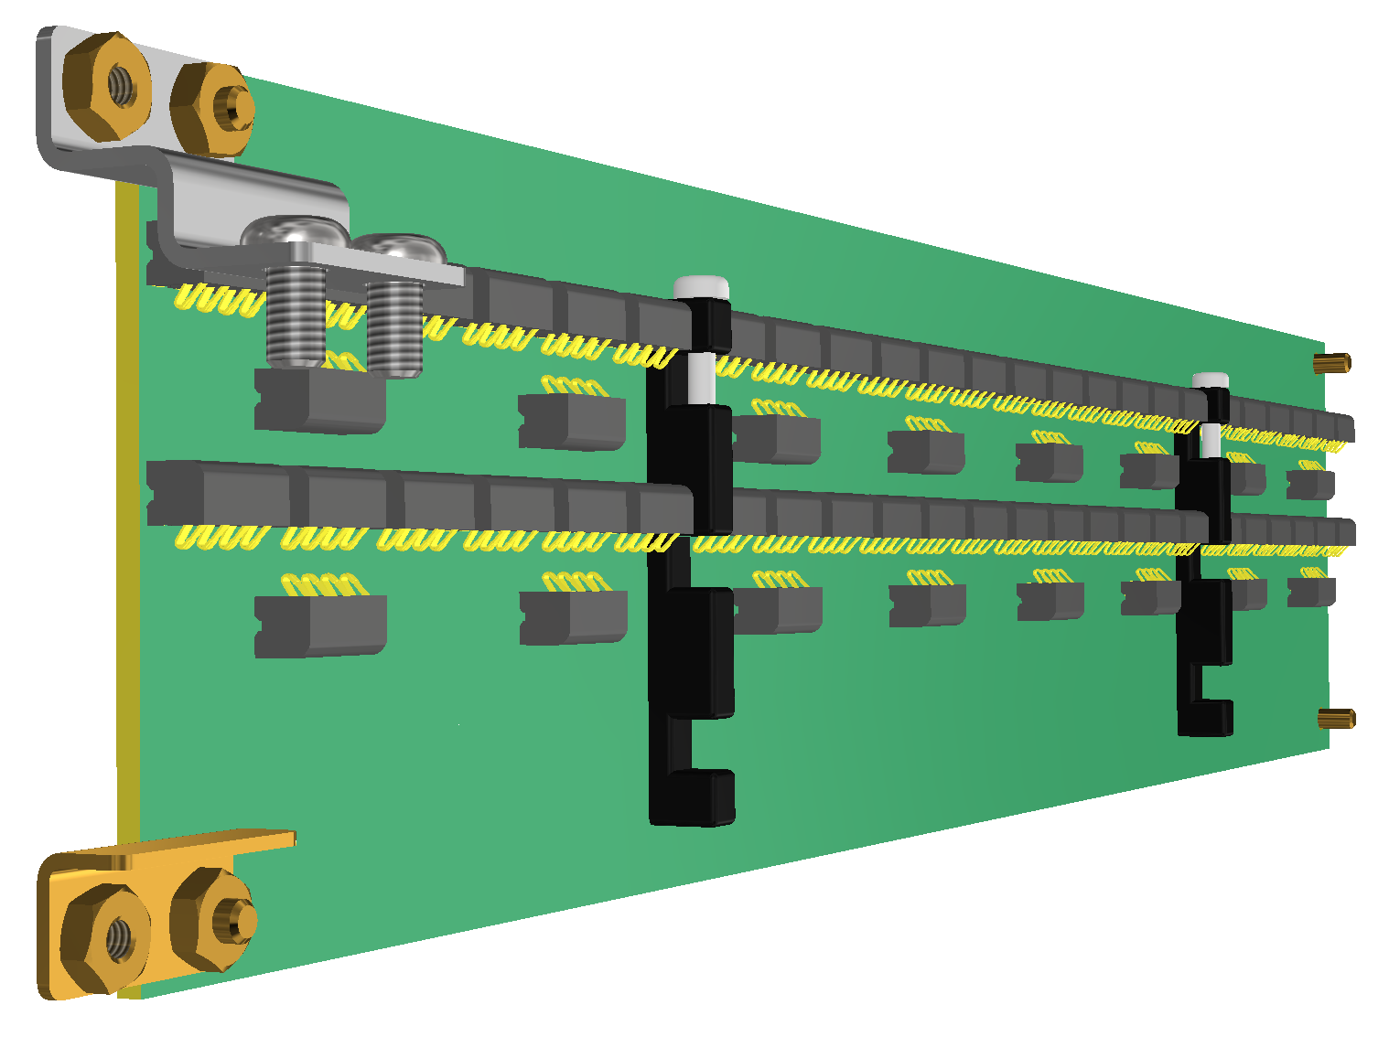
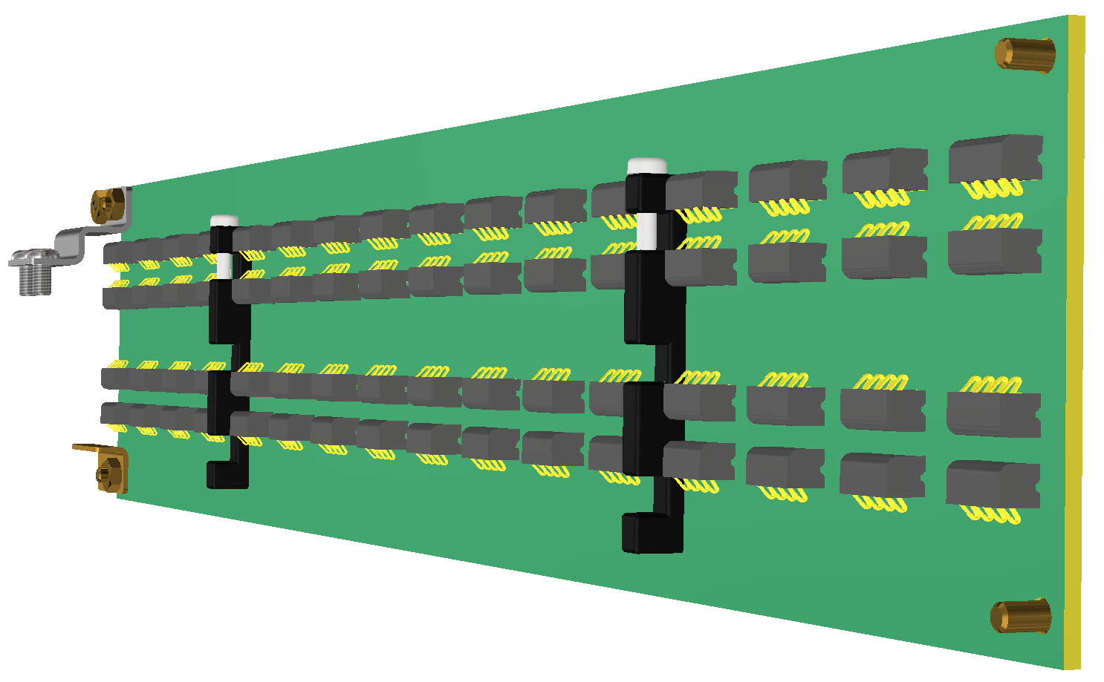
Edge Connectors
Bracket screwed on to adapter board
Short card (~260mm) to read out 2nd induction and collection signals
Long card (~280mm) to read out both induction planes
Anode 2
Anode 1
Bracket soldered to the shield plane

Slide 12
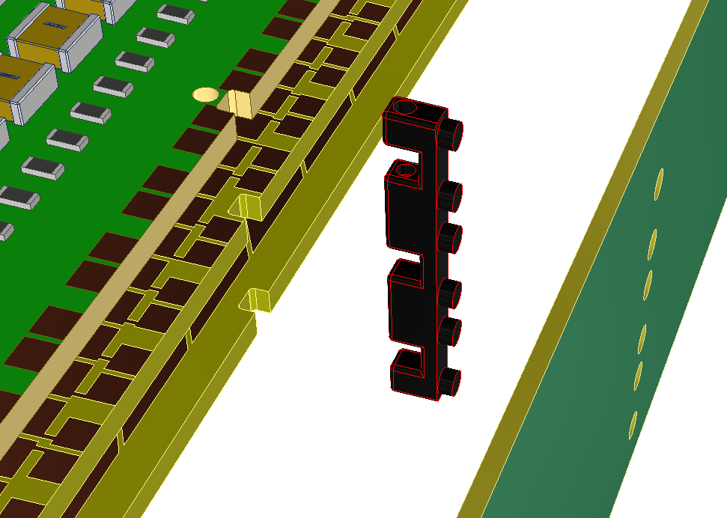
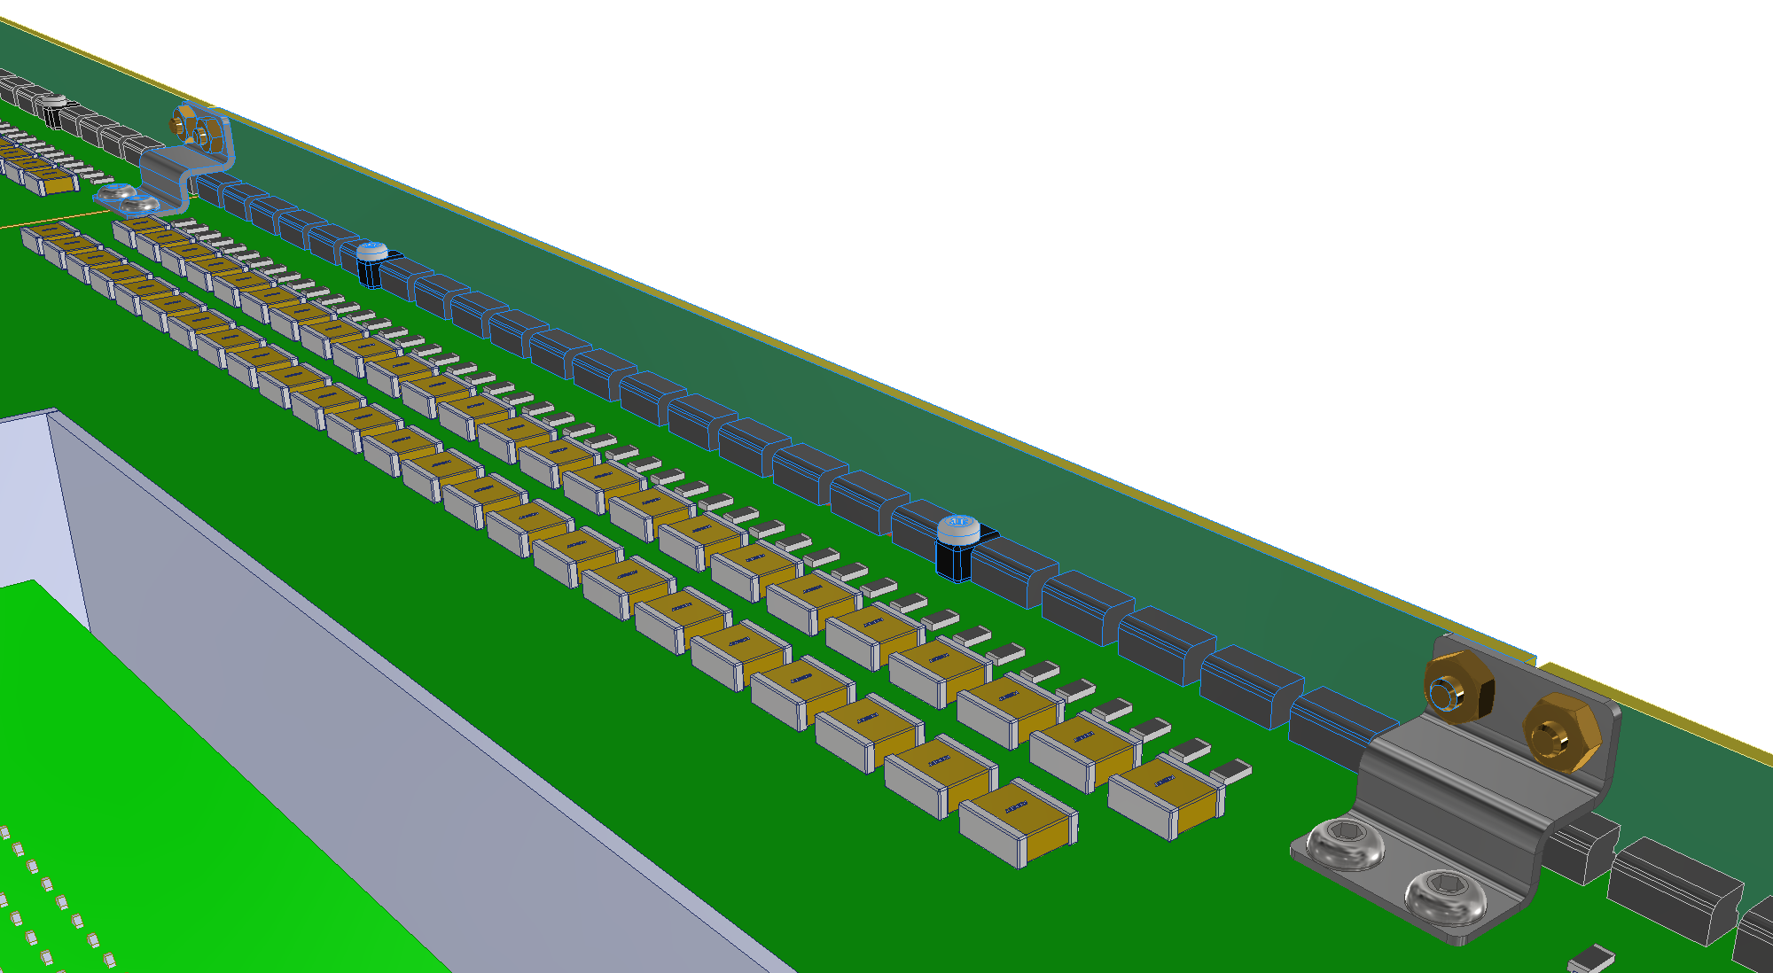
Edge Connector Features
Bracket screwed on to adapter board
Bracket soldered to the shield plane
Injection molded card guide glued onto the edge board, and snap into the notches in the PCB stack.
A screw is used to lock the card guide to the adapter board

Slide 13
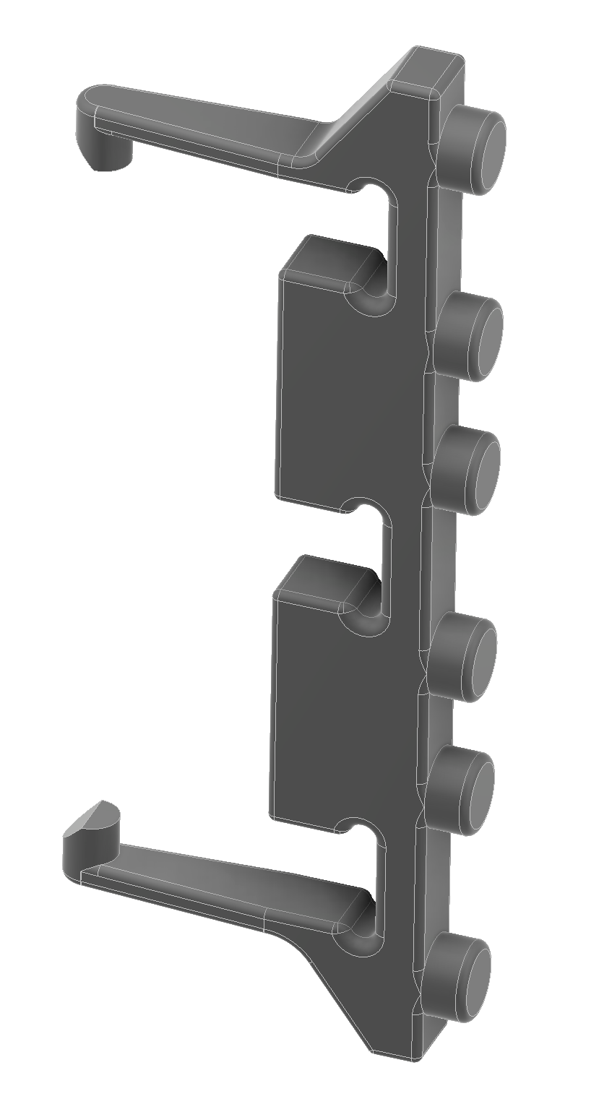
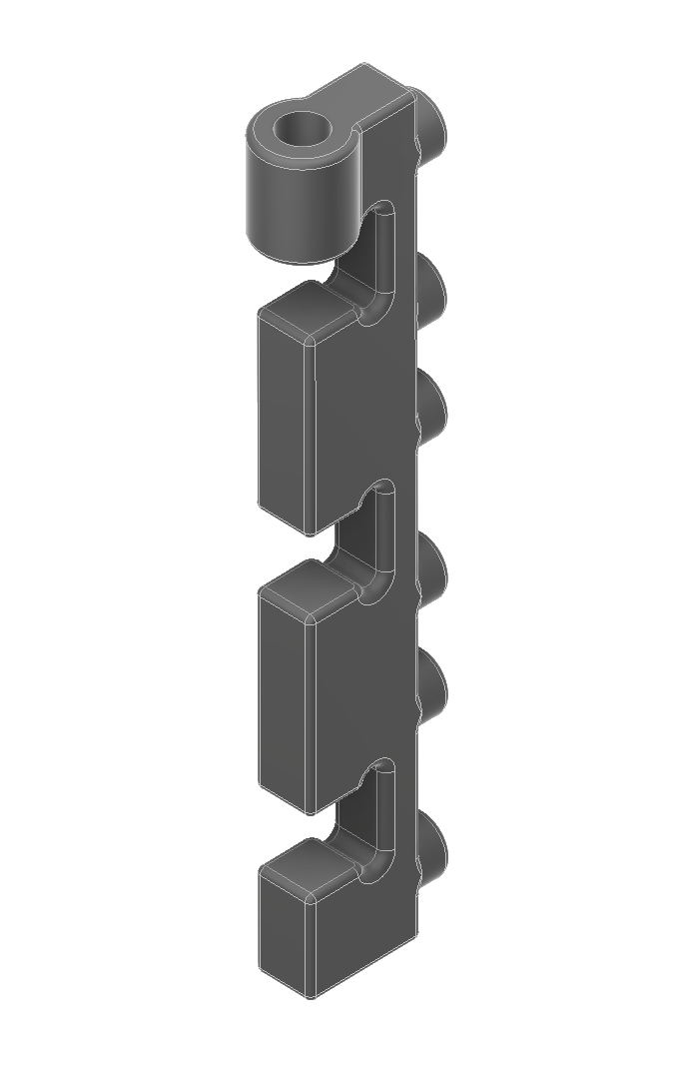
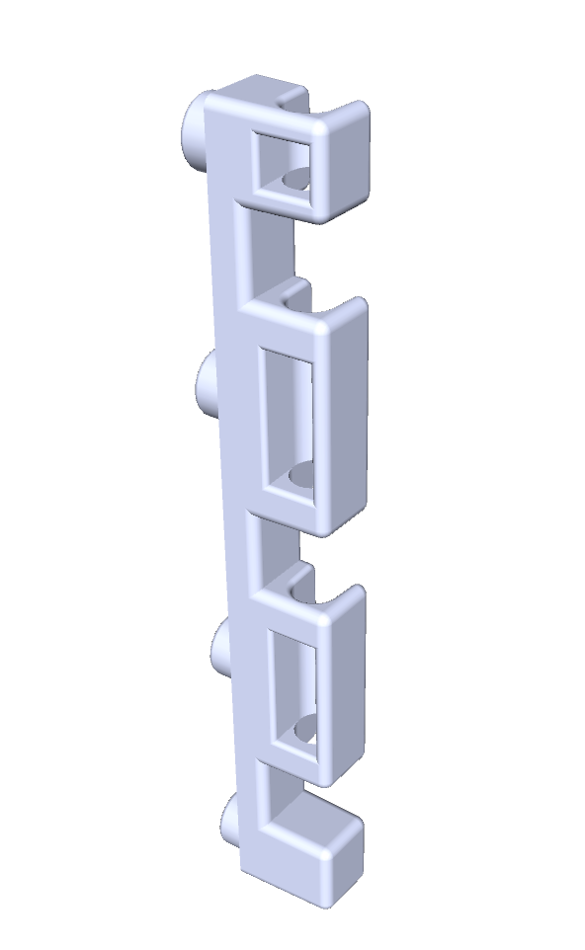
Other card guide options
Use a screw to lock onto adapter board.
Use a long G10 rod to lock onto all three PCB layers
Self locking onto the top and bottom PCBs.

Slide 14
Summary
The 2nd 3-View PCB anodes design is complete. Gerber files are with CERN PCB shop to add the milling features.
Several edge connector board locking feature concepts have been developed. We need to select the ones for prototyping and testing.
The PCB layout of the edge connector boards and the BDE adapter boards will start soon.
For the BDE electronics, additional adapter board ground plane interconnects will be implemented, based on the cold box test results last December.
Additional capacitors will be added to each adapter board to further stabilize the bias lines and improve noise performance. Similar capacitor banks can also be implemented to improve the shield plane stability.
Waiting for the TDE guidance on the features of the TDE adapter boards.

