Slide 1
Neutrinos from Stored Muons νSTORM
ν physics with a μ storage ring

Slide 2
The “Collaboration”
P. Kyberd,¹ D.R. Smith,¹ L. Coney,² S. Pascoli,³ C. Ankenbrandt,⁴ S.J. Brice,⁴ A.D. Brossa,⁴ H. Cease,⁴ J. Kopp,⁴ N. Mokhov,⁴ J. Morfin,⁴ D. Neufer,⁴ M. Popovic,⁴ P. Rubinov,⁴ S. Striganov,⁴ A. Blondel,⁵ A. Bravar,⁵ E. Noah,⁵ R. Bayes,⁶ F.J.P. Soler,⁶ A. Dobbs,⁷ K. Long,⁷ J. Pasternak,⁷ E. Santos,⁷ M.O. Wascko,⁷ S.K. Agarwalla,⁸ S.A. Bogacz,⁹ Y. Mori,¹⁰ J.B. Lagrange,¹⁰ A. de Gouvêa,¹¹ Y. Kuno,¹² A. Sato,¹²
V. Blackmore,¹³ J. Cobb,¹³ C. D. Tunnell,¹³ J.M. Link,¹⁴ P. Huber,¹⁴ and W. Winter¹⁵
¹Brunel University, ²University of California, Riverside,
³Institute for Particle Physics Phenomenology, Durham University
⁴Fermi National Accelerator Laboratory, ⁵University of Geneva
⁶University of Glasgow, ⁷Imperial College London, ⁸Instituto de Fisica Corpuscular, CSIC and Universidad de Valencia, ⁹Thomas Jefferson National Accelerator Facility, ¹⁰Kyoto University,
¹¹Northwestern University, ¹²Osaka University, ¹³Oxford University, Subdepartment of Particle Physics, ¹⁴Center for Neutrino Physics, Virginia Polytechnic Institute and State University
¹⁵Institut für theoretische Physik und Astrophysik, Universität Würzburg
LOI submitted to Fermilab PAC (P-1080) & arXiv:1206.0294

Slide 3
Motivation
The idea of using a muon storage ring to produce neutrino beams for experiments is not new
50 GeV beam – Koshkarev @ CERN in 1974
1 GeV – Neuffer in 1980
The facility/program I will describe here can:
Address the large Δm² oscillation regime and make a major contribution to the study of sterile neutrinos
Either allow for precision study if they exist in this regime
Or greatly expand the dis-allowed region
Make precision ν_{e} and ν_{e}-bar cross-section measurements
Provide a technology ( μ decay ring) test demonstration and μ beam diagnostics test bed
Provide a precisely understood ν beam for detector studies

Slide 4
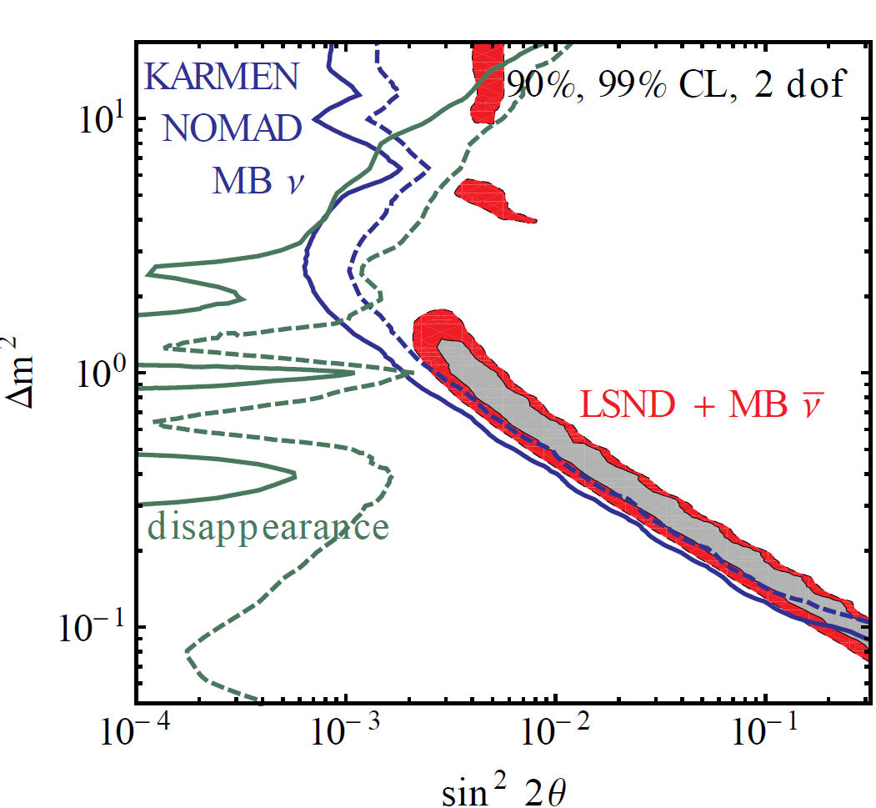
Short-baseline ν oscillation studies
Sterile neutrinos arise naturally in many extensions of the Standard Model.
GUT models
Seesaw mechanism for n mass
Cosmological models of evolution of early universe
“Dark” sector
Experimental hints
LSND
MiniBooNE
Reactor “anomaly”
Global constraints on sterile ν in a 3+1 model

Slide 5
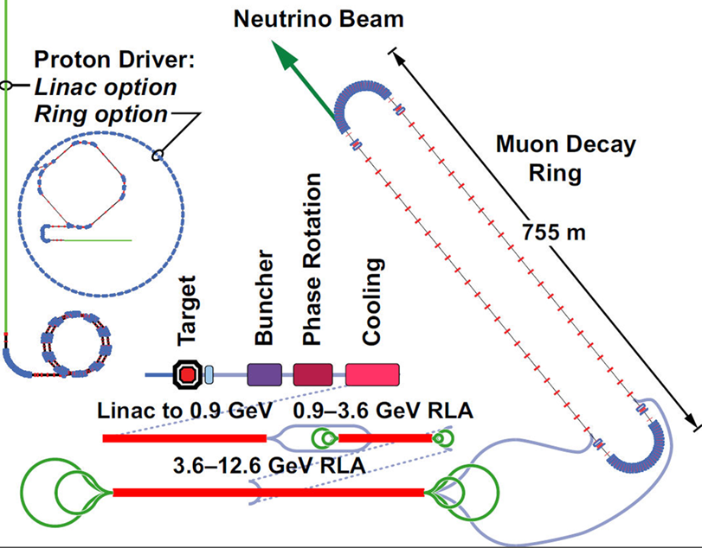
Neutrinos from STORed Muons
IDS-NF
Single baseline, Lower E
This
is the simplest
implementation
of the NF
150 m
And
DOES NOT
Require the
Development of
ANY
New Technology
10-100kW

Slide 6
μ-based ν beams
Flavor content fully known
“Near Absolute” Flux Determination is possible in a storage ring
Beam current, polarization, beam divergence monitor, μ_{p} spectrometer
Overall, there is tremendous control of systematic uncertainties with a well designed system

Slide 7
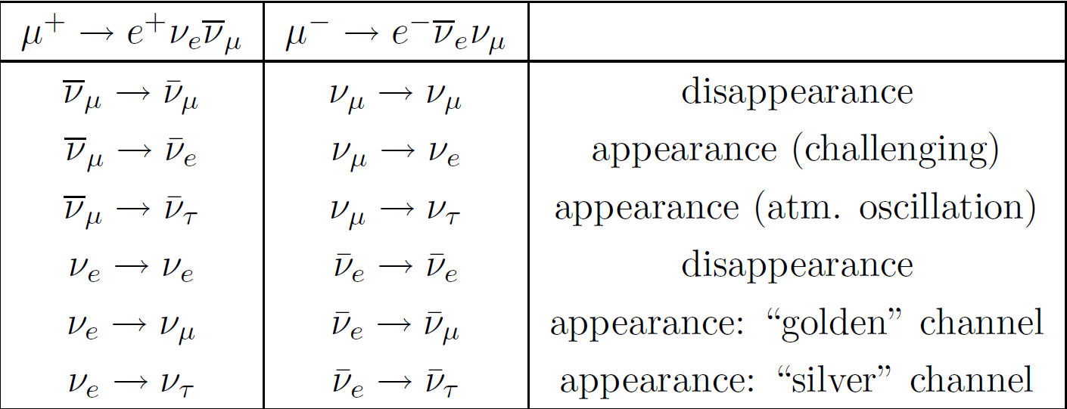
Oscillation channels
8 out of 12 channels potentially accessible

Slide 8
The Facility

Slide 9
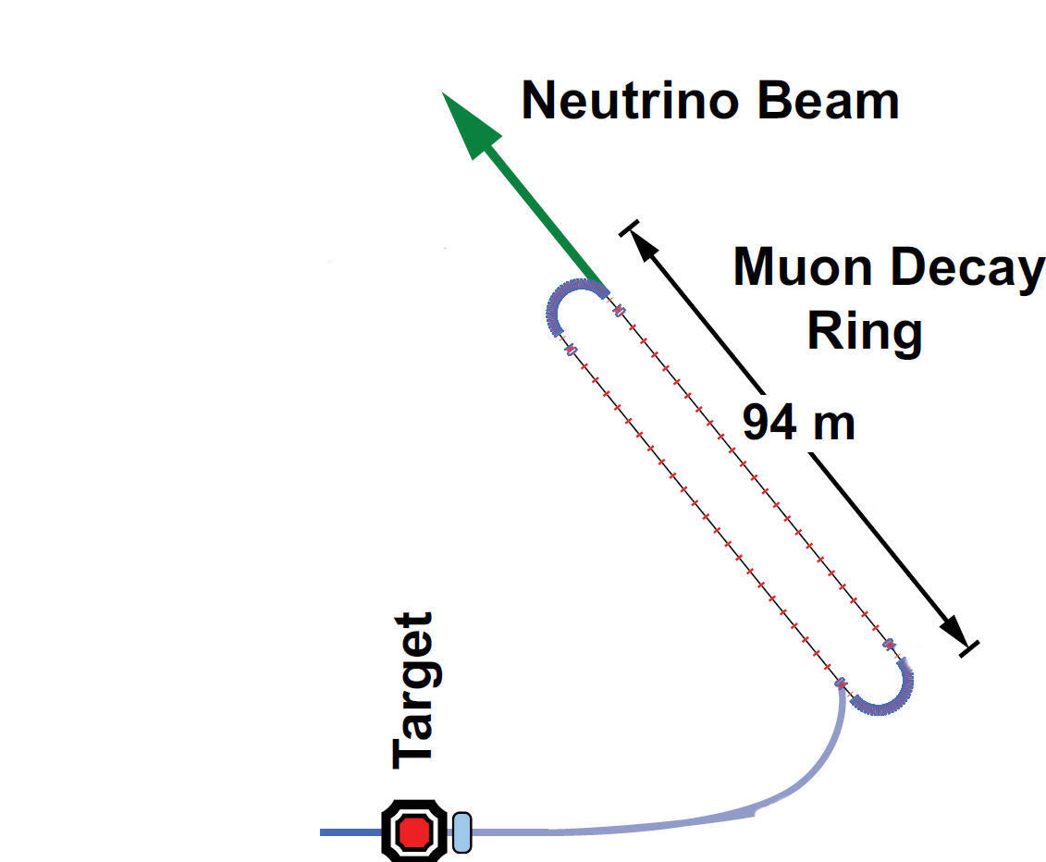
Baseline(s)
100 kW Target Station
Assume 60 GeV proton
Fermilab PIP era
Be target
Optimization on-going
Li Lens or horn collection after target
Collection/transport channel
Two options
Stochastic injection of π
Kicker with π → μ decay channel
At present NOT considering simultaneous collection of both signs
Decay ring
Large aperture FODO
Racetrack FFAG
Instrumentation
BCTs, mag-Spec in arc, polarimeter
150 m

Slide 10
π production
In momentum range
4.5 < 5.0 < 5.5
Obtain
≈ 0.11 π±/pot
with 60 GeV p
Target/capture optimization ongoing

Slide 11
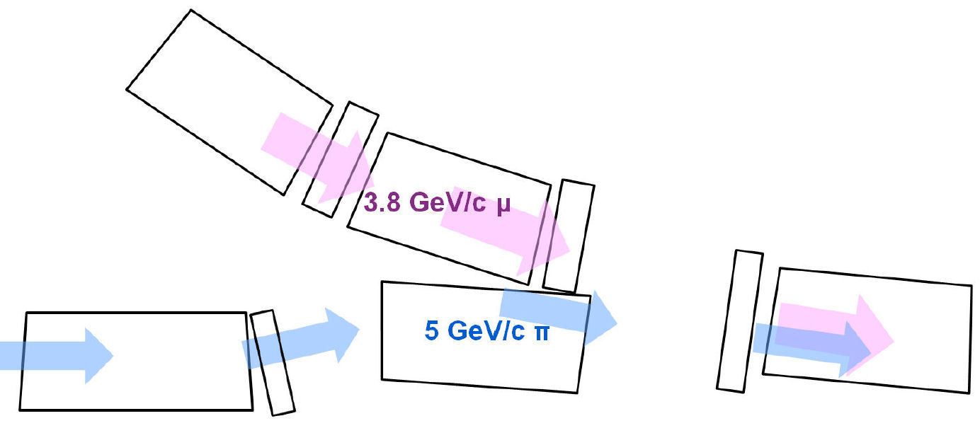
Injection Concept
π’s are in injection orbit
separated by chicane
μ’s are in ring circulating orbit
lower energy - ~3.8 GeV/c
~30cm separation between
Concept works for FODO lattice
Work in progress for RFFAG

Slide 12
FODO Decay ring
3.8 GeV/c ± 10% momentum acceptance, circumference = 350 m

Slide 13
FFAG Racetrack
δp/p ≈ 15%
3.8 GeV/c
Low dispersion in straight

Slide 14
RFFAG Tracking Studies

Slide 15
FFAG Tracking
>90%
dynamic
aperture

Slide 16
FODO vs. RFFAG

Slide 17
The Physics Reach

Slide 18
Assumptions
N_{μ} = (POT) X (π/POT) X ε_{collection} X ε_{inj} X (μ/π) X A_{dynamic} X Ω
10²¹ POT in 5 years of running @ 60 GeV in Fermilab PIP era
0.1 π/POT
ε_{collection} = 0.8
ε_{inj} = 0.8
μ/π = 0.08 (γct X μ capture in π → μ decay) [π decay in straight]
Might do better with a π → μ decay channel
A_{dynamic} = 0.75 (from G4Beamline simulation)
Ω = Straight/circumference ratio (0.43)
This yields ≈ 1.7 X 10¹⁸ useful μ decays

Slide 19
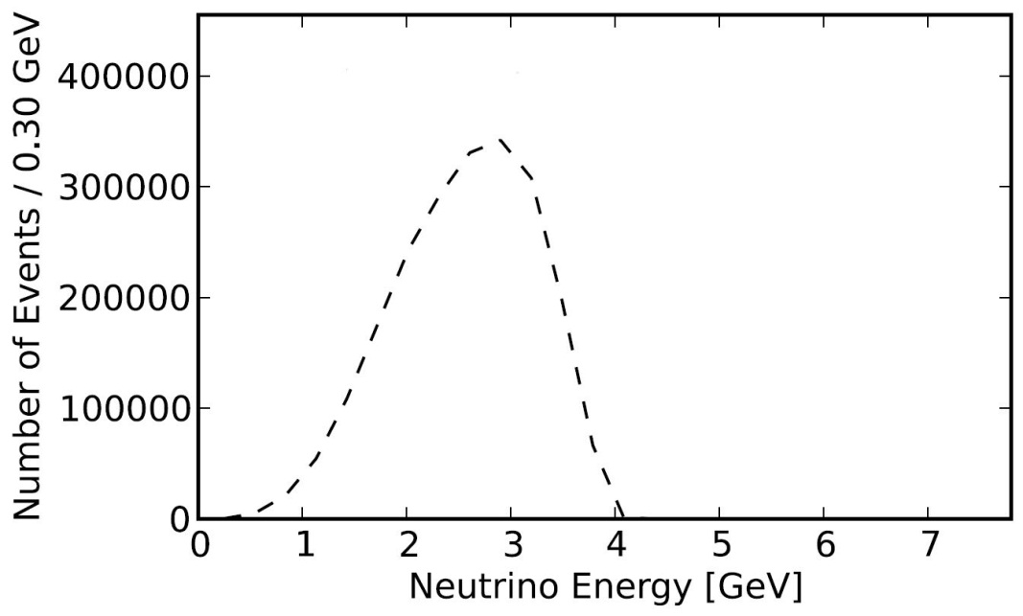
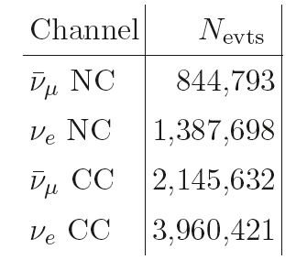
E_{ν} spectra (μ⁺ stored)
ν_{e}
ν_{μ}-bar
Event rates/100T
at ND hall 50m from straight

Slide 20
Experimental Layout
Appearance
Channel:
ν_{e} → ν_{μ}
Golden Channel
Must reject the
“wrong” sign μ with
great efficiency
150
~ 1500 m
Why ν_{μ} → ν_{e}
Appearance Ch.
not possible

Slide 21
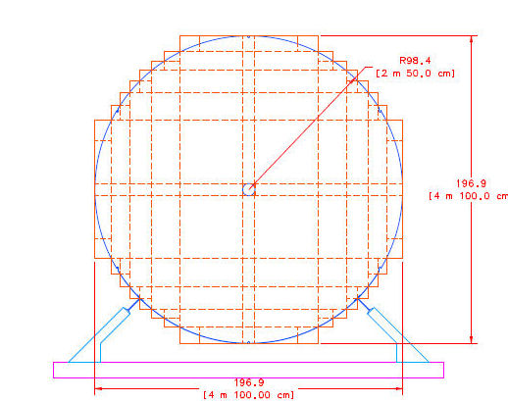
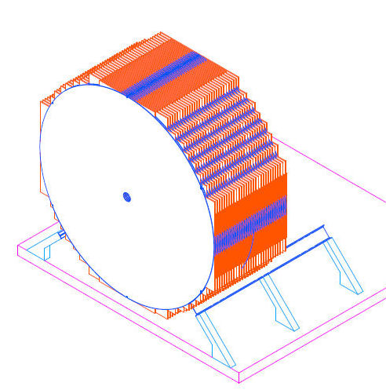
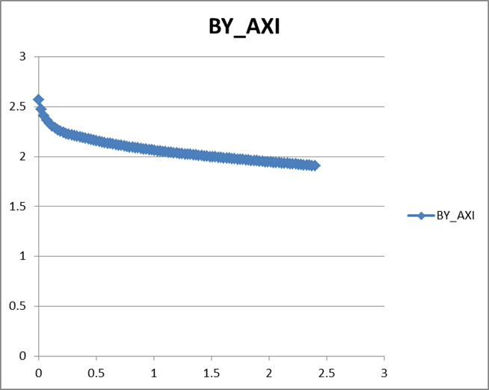
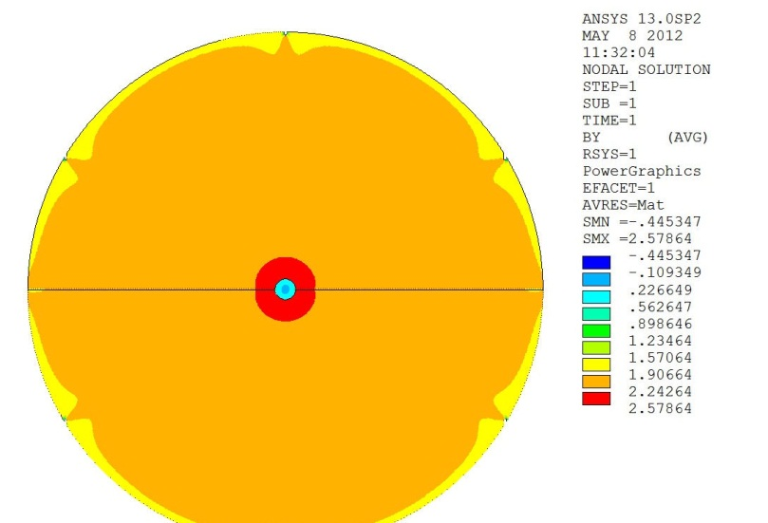
Baseline Detector Super B Iron Neutrino Detector: SuperBIND
Magnetized Iron
1.3 kT fiducial volume
Following MINOS ND ME design
1 cm Fe plate
5 m diameter
Utilize superconducting transmission line for excitation
Developed 10 years ago for VLHC
Extruded scintillator +SiPM
20 cm hole
For 3 turns
of STL

Slide 22
Event Candidates in SuperBIND
Hits
R vs. Z

Slide 23
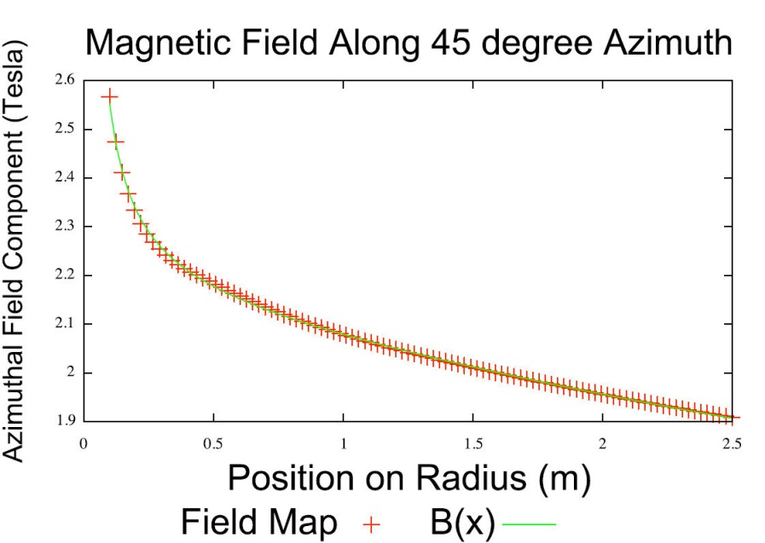
Simulation
Full GEANT4 Simulation
Extrapolation from ISS and IDS-NF studies for the MIND detector
Uses GENIE to generate the neutrino interactions.
Involves a flexible geometry that allows the dimensions of the detector to be altered easily (for optimization purposes, for example).
Does not yet have the detailed B field, but parameterized fit is very good
Event selection/cuts
Cuts-based analysis
Multivariate to come later

Slide 25
Event reconstruction efficiency
Left: 1 cm plates, Right: 2 cm plates

Slide 26
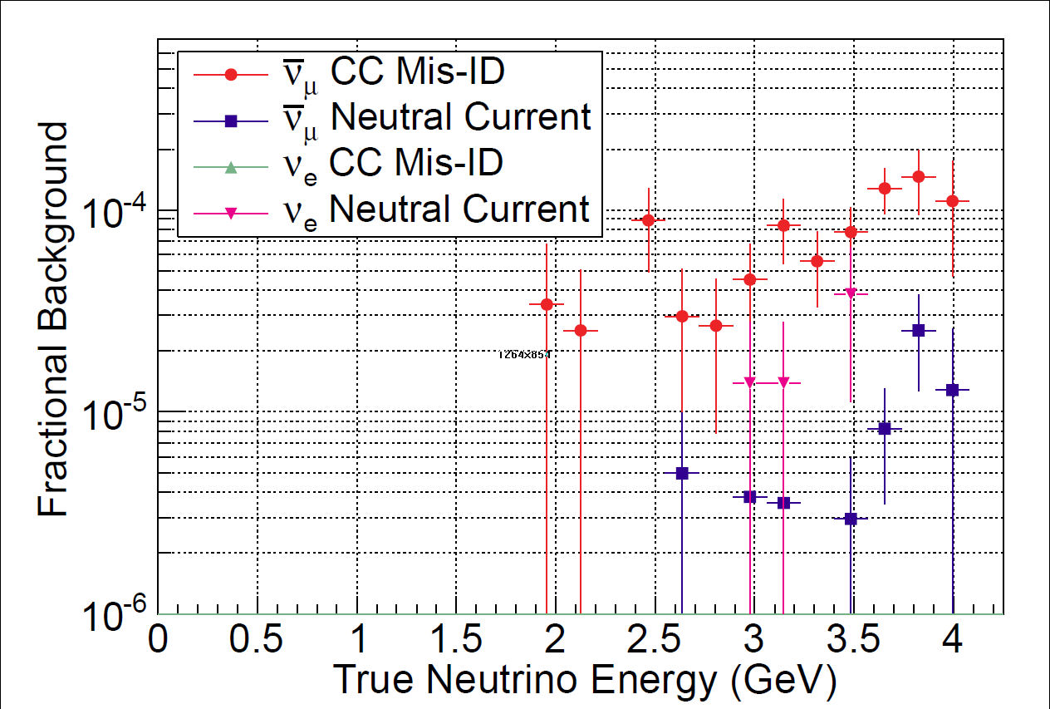
Backgrounds
Left: 1 cm plates Right: 2 cm plates

Slide 27
Raw Event Rates
3+1
Assumption
Appearance channels

Slide 28
ν_{e} → ν_{μ} appearance CPT invariant channel to MiniBooNE

Slide 29
ν_{e} → ν_{μ} appearance CPT invariant channel to MiniBooNE
3+1
Assumption

Slide 30
Required μ charge mis-ID rate needed for given sensitivity

Slide 31
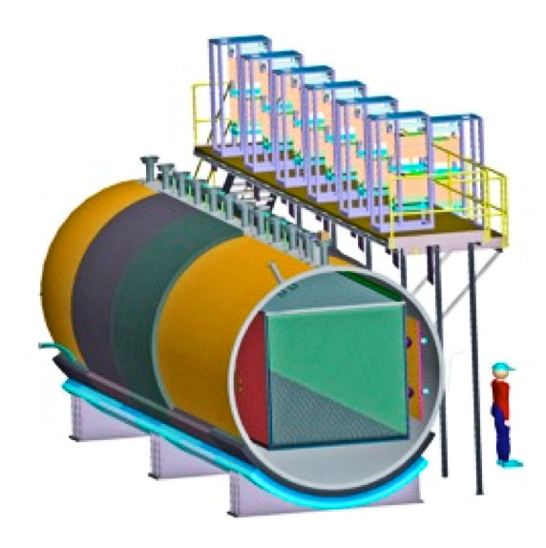
Detector Considerations
Other options
Totally Active Scintillator - TASD
LAr
Present opportunity to measure ν_{e} appearance?
Must be Magnetized, however
A hybrid approach (external μ spectrometer) is a possibility

Slide 32
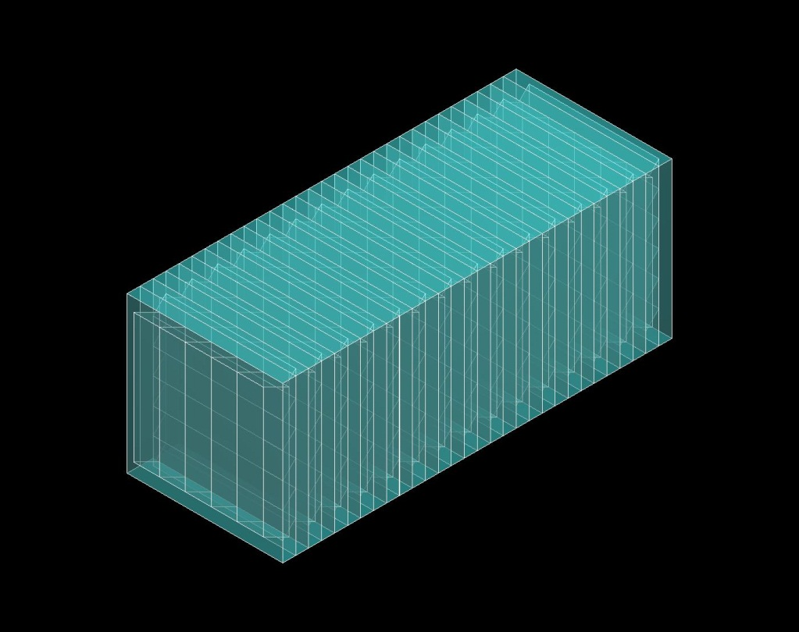
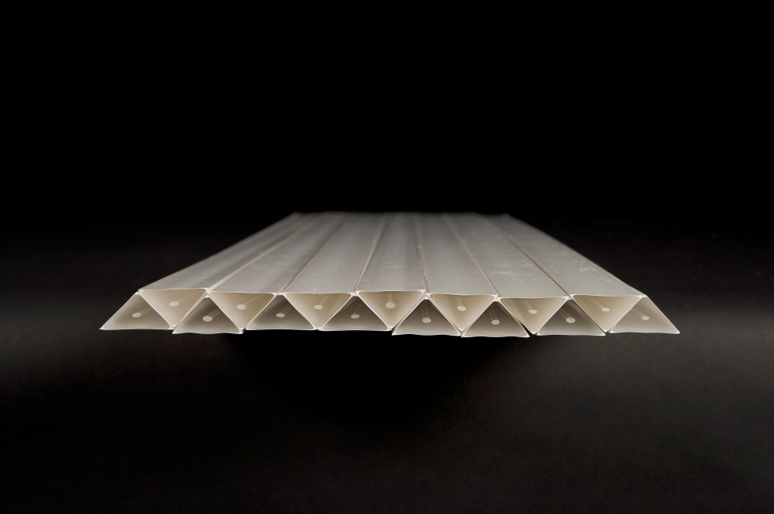
Fine-Resolution Totally Active Segmented Detector (IDS-NF)
Simulation of a Totally Active Scintillating Detector (TASD) using Noνa and Minerνa concepts with Geant4
3333 Modules (X and Y plane)
Each plane contains 1000 slabs
Total: 6.7M channels
150 m
15 m
15 m
1.5 cm
15 m
3 cm
35 kT Total Mass
Momenta between 100 MeV/c to 15 GeV/c
Magnetic field considered: 0.5 T
Reconstructed position resolution ~ 4.5 mm
B = 0.5T

Slide 33
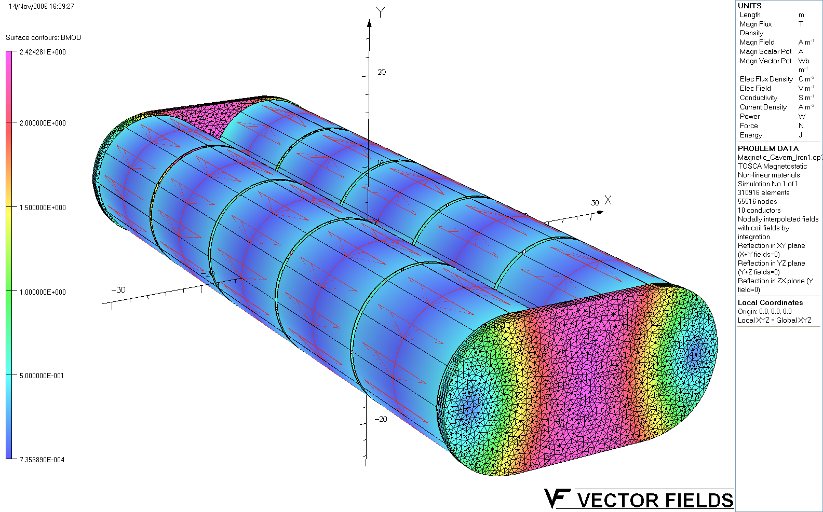
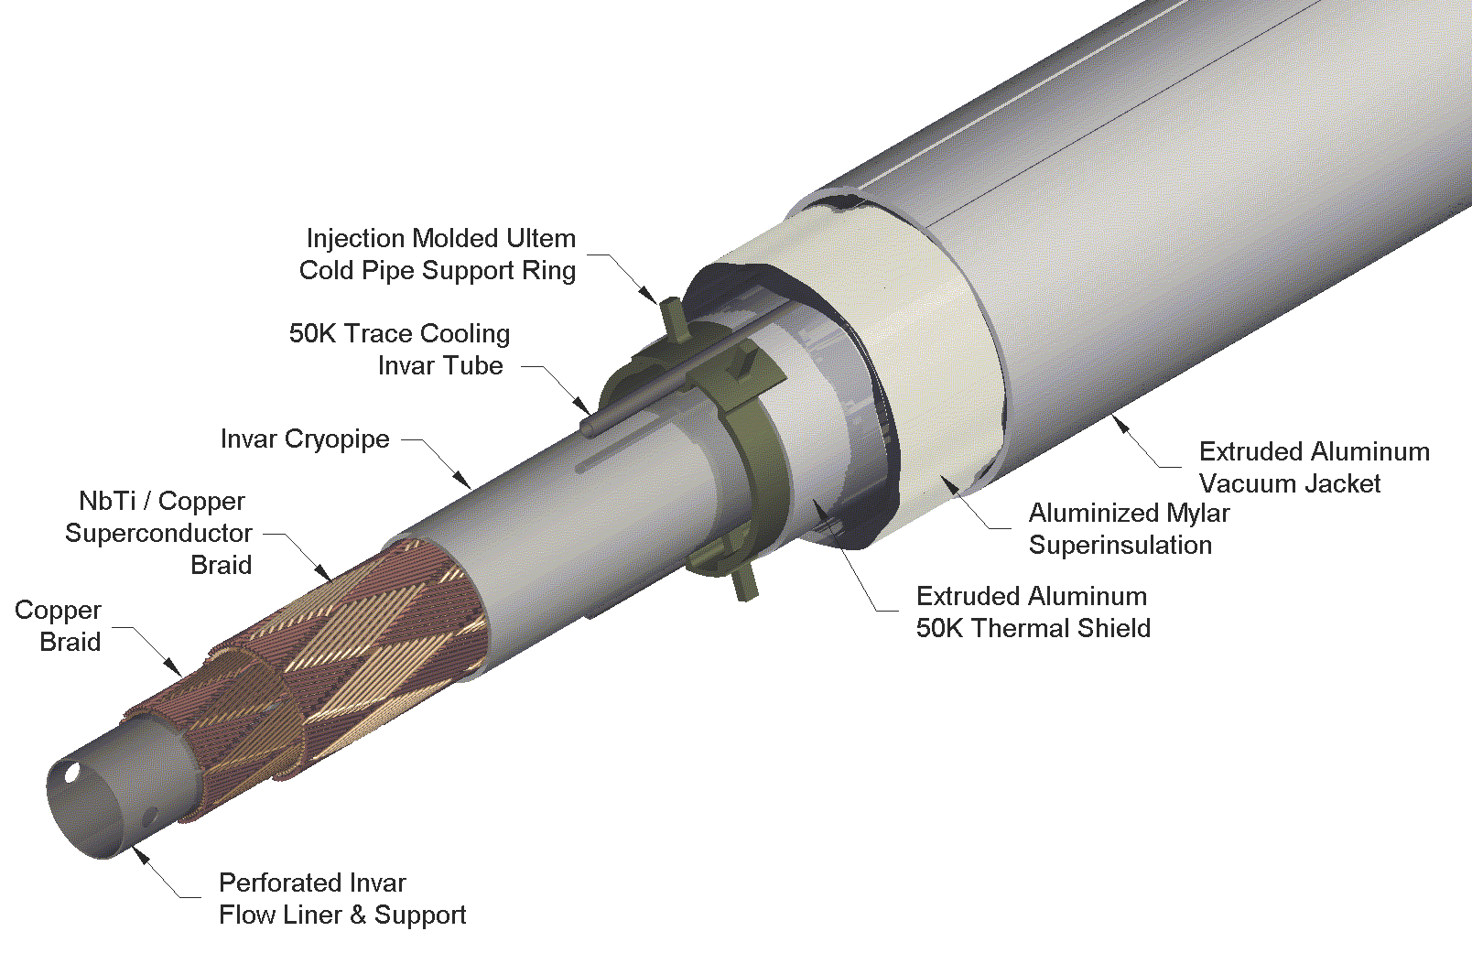
Magnet- Concept for IDS-NF
VLHC SC Transmission Line
Technically proven
Affordable
1 m iron wall thickness.
~2.4 T peak field in the iron.
Good field uniformity
R&D to support concept
Has not been funded

Slide 34
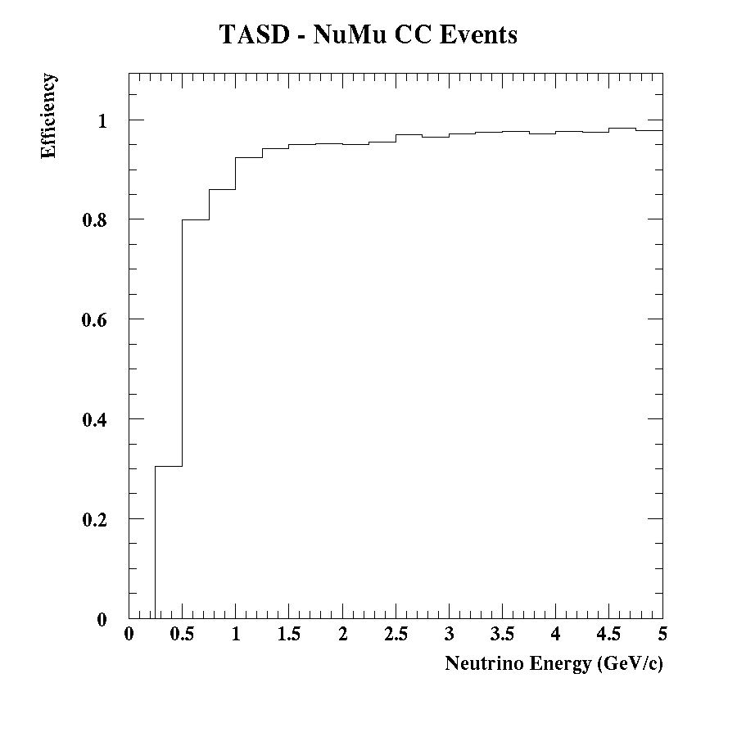
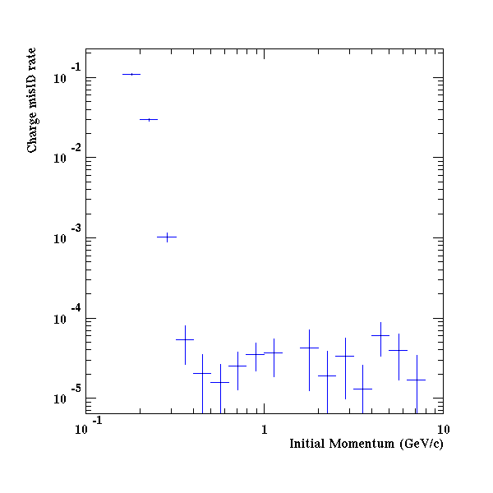
TASD Performance
ν Event Reconstruction ε
Muon charge mis-ID rate
Excellent σ_{E}

Slide 35
Detector Options
Technology check List
 | Fid Volume | B | Recon | Costing Model
SuperBIND | ☑ | ☑ | ☑ | ☑
Mag-TASD | ☑ | ☑ | ☑ | ☑
Mag-LAr | ☑ | ☑ | ☑ | ☑
☑ | Yes - OK
☑ | Maybe
☑ | Not Yet

Slide 36
Disappearance Experiments

Slide 37
Raw Event Rates
3+1
Assumption
Tremendous
Statistical
Significance
Appearance channels

Slide 38
Disappearance channels
But:
Need self-consistent two-detector simulation including (bin-to-bin) uncorrelated shape error ~ 10%
A challenge: there may be oscillations already in near detectors
Geometry important for Δm² ~ 10¹ – 10³ eV²
Suitability of SuperBIND for ν_{e} channels needs to be studied

Slide 39
Cross-Section Measurements & Disappearance Searches

Slide 40
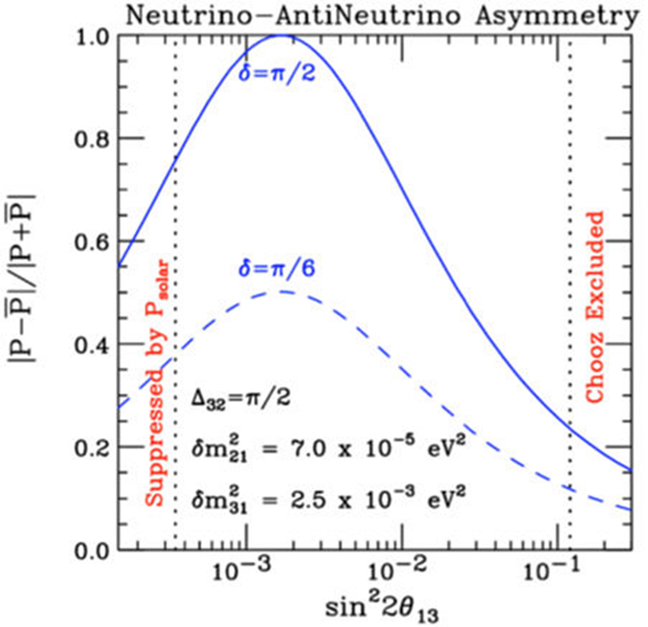
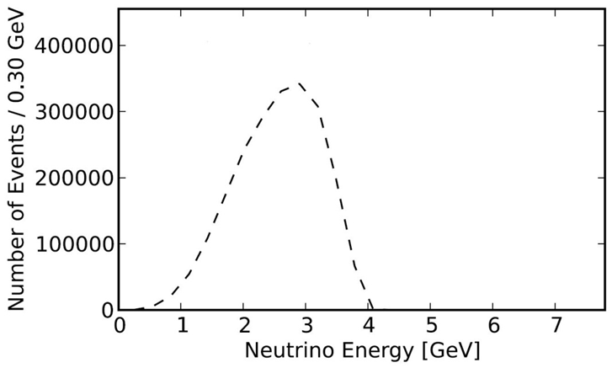
ν Cross-section measurements
Cross-section measurements
μ storage ring presents only way to measure ν_{μ} & ν_{e} & ( ) x-sections in same experiment
Supports future long-baseline experiments
E_{ν} matched well to needs of these experiments
ν_{μ}-bar

Slide 41
Outlook
Future Work:
Facility
Targeting, capture/transport & Injection
Need detailed design and simulation
Decay Ring optimization
Continued study of both RFFAG & FODO decay rings
Decay Ring Instrumentation
Define and simulate performance of BCT, polarimeter, Magnetic-spectrometer, etc.
Produce full G4Beamline simulation of all of the above to define ν flux
And verify the precision to which it can be determined.

Slide 42
Outlook II
Future Work:
Detector simulation
For oscillation studies, continue MC study of backgrounds & systematics
Also investigate disappearance channels
In particular the event classification in the reconstruction needs optimization.
Currently assumes "longest track" is interaction muon.
Plan to assign hits to and fit multiple tracks.
Vertex definition must also be improved.
For cross-section measurements need detector baseline design
Learn much from detector work for LBNE & IDS-NF
Increased emphasis on ν_{e} interactions, however
Near Detector hall could be envisioned as ν detector test facility
Produce Full Proposal

Slide 43
νSTORM: Conclusions
The Physics case:
Initial simulation work indicates that a L/E ≈ 1 oscillation experiment using a muon storage ring can confirm/exclude at 10σ (CPT invariant channel) the LSND/MiniBooNE result
ν_{μ} and (ν_{e} ) disappearance experiments delivering at the <1% level look to be doable
Systematics need careful analysis
Detailed simulation work on these channels has not yet started
Cross section measurements with near detector(s) offer a unique opportunity
The Facility:
Presents very manageable extrapolations from existing technology
But can explore new ideas regarding beam optics and instrumentation
Offers opportunities for extensions
Add RF for bunching/acceleration/phase space manipulation
Provide μ source for 6D cooling experiment with intense pulsed beam

Slide 44
νSTORM : Conclusions II
The Detector:
Is based on demonstrated technology and follows engineering principles from existing detectors
Technology extrapolations (scintillator readout) are perfectly aligned with development work within Fermilab’s existing program (μ2e)
Magnetization is based on technology that was fully vetted over 10 years ago
But has been in a dormant state
νSTORM :
Delivers on the physics for the study of sterile ν
Offering a new approach to the production of ν beams setting a 10 σ benchmark to confirm/exclude LSND/MiniBooNE ν-bar data
Can add significantly to our knowledge of ν cross-sections, particularly for ν_{e} interactions
Provides an accelerator technology test bed
Provides a powerful ν detector test facility

Slide 45
νSTORM : Sterile ν
Of the 30+ concepts that have recently been discussed in the literature to search for/study sterile neutrinos, νSTORM is the only one that can do all of:
Make a direct test of the LSND and MiniBooNE anomalies.
Provide stringent constraints for both ν_{e} and ν_{μ} disappearance to over constrain 3+N oscillation models and to test the Gallium and reactor anomalies directly.
Test the CP- and T-conjugated channels as well, in order to obtain the relevant clues for the underlying physics model, such as CP violation in 3 + 2 models.

Slide 46
END
Thank You

