Slide 1
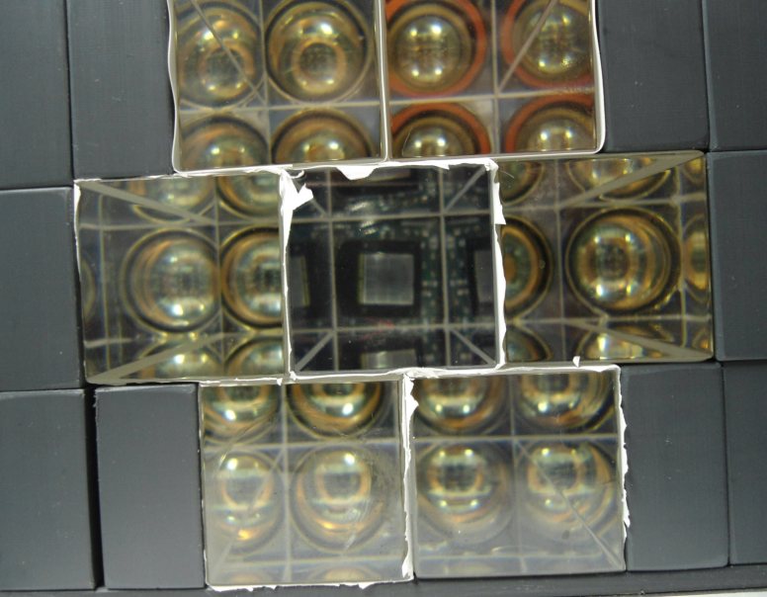
Fast calorimeter development for g-2
Peter Winter
University of Washington

Slide 2
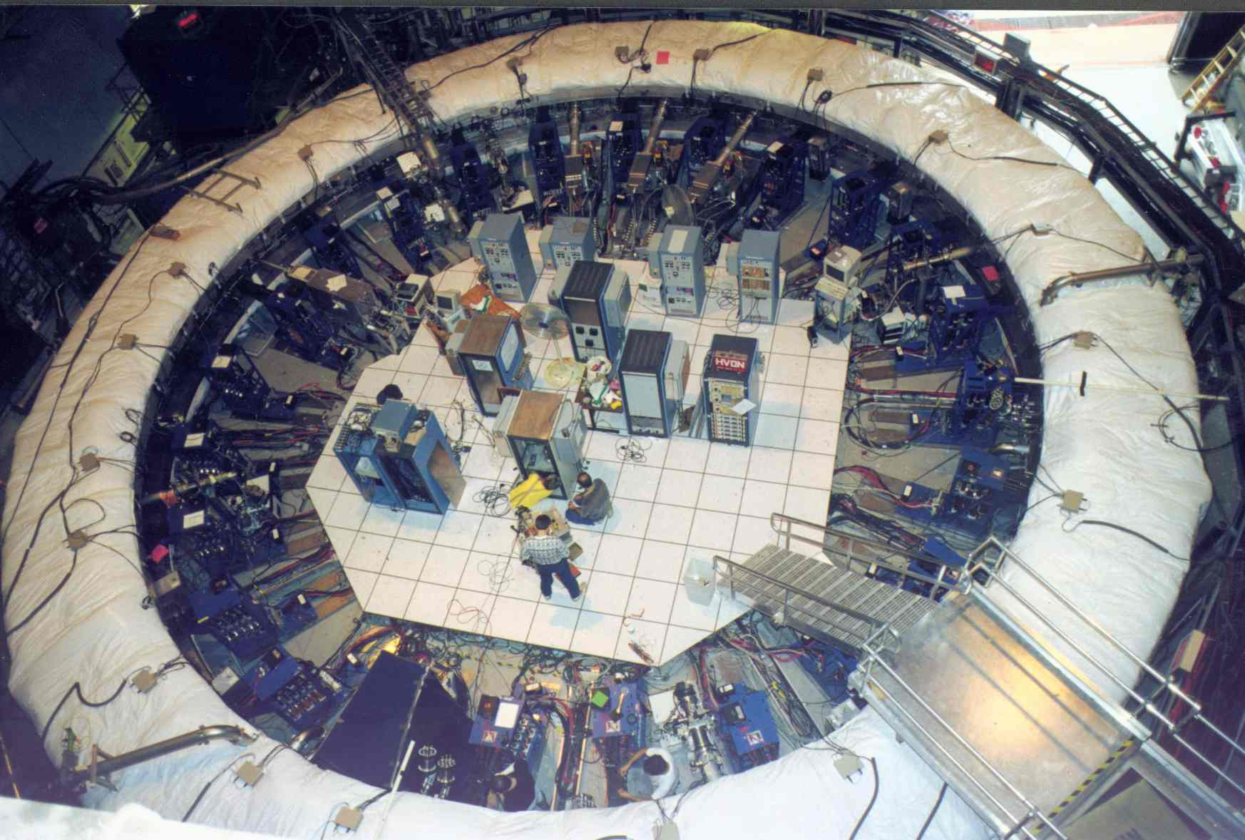
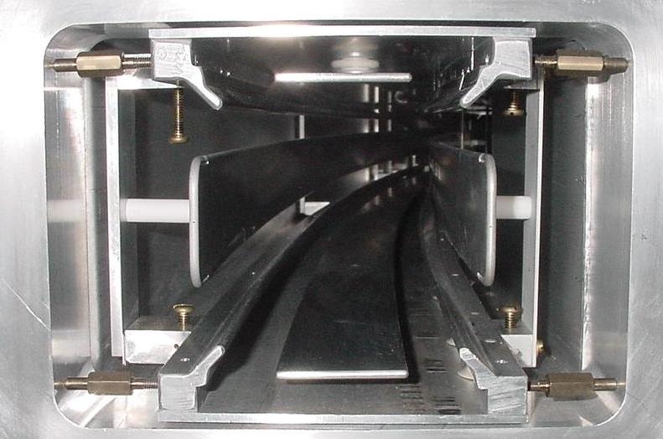
g-2 in a nutshell
ω_{a}
1 ppm contours

Slide 3
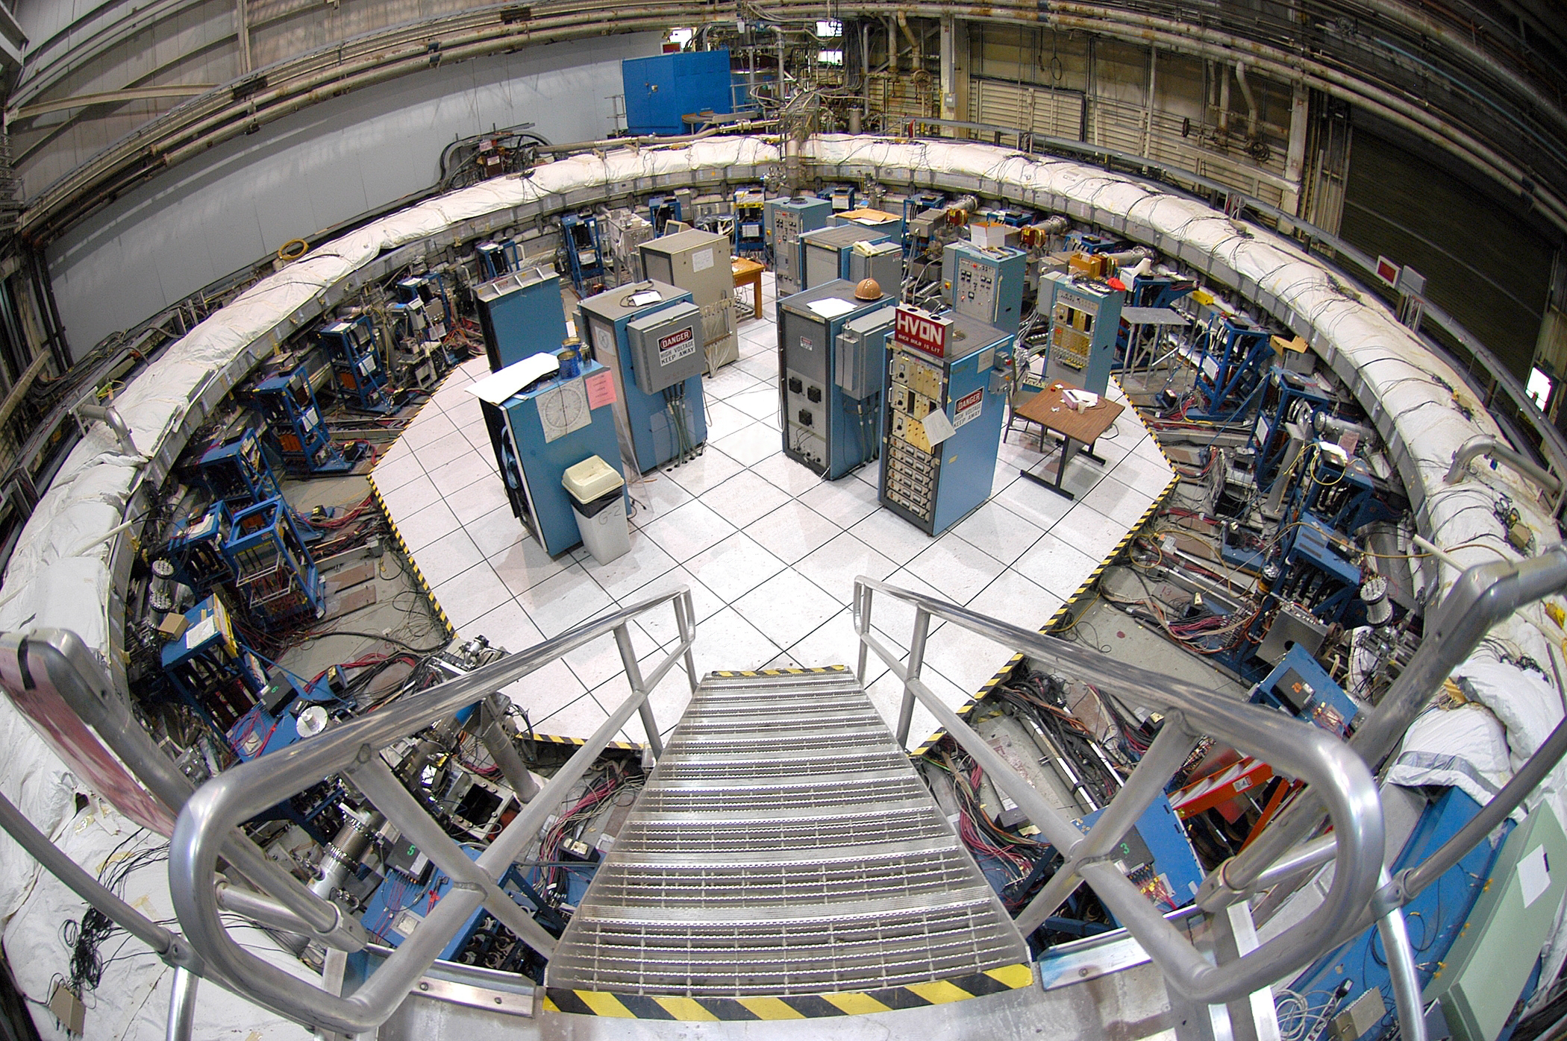
The storage ring

Slide 4
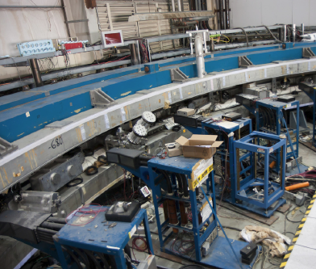
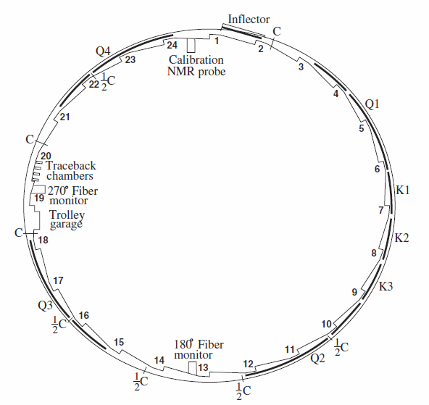
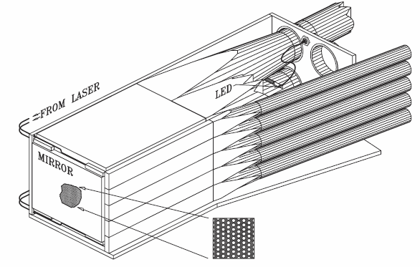
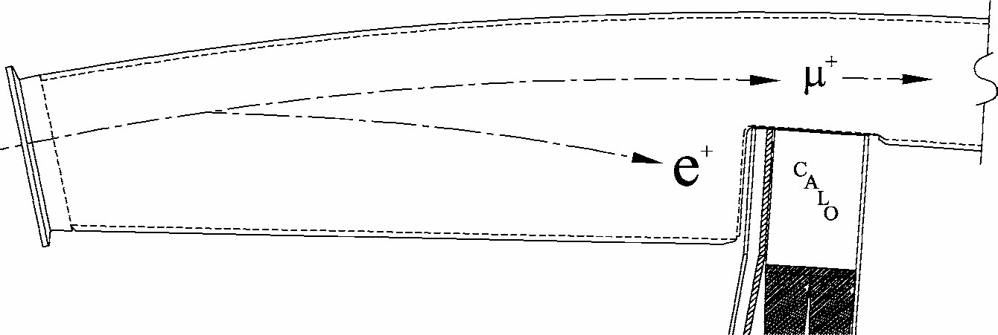
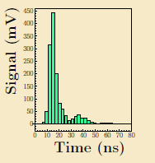

Measuring $ωa$
24 calorimeter stations
Scallop vacuum chamber
Lead scintillating fiber
calorimeter with PMTs
Full waveform digitized

Slide 5
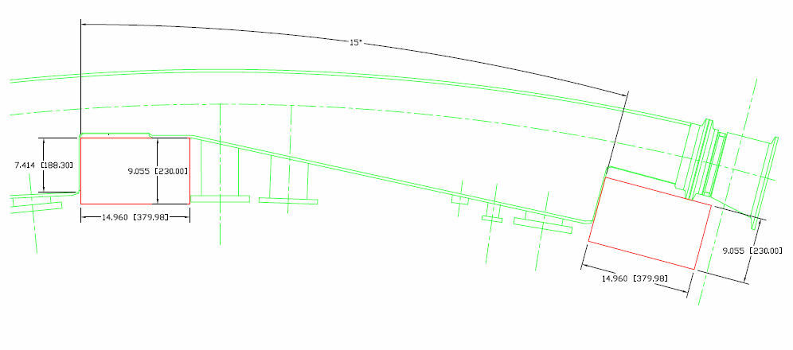
Space for calorimeter is limited and needs to be
shared with other detectors
38 cm

Slide 6
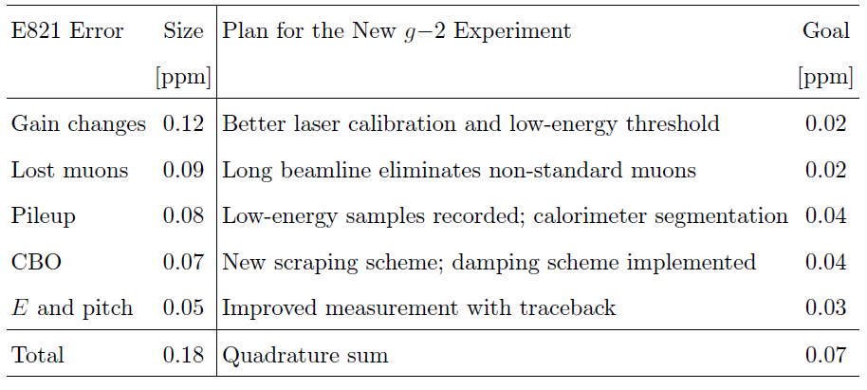

Improving on $ωa$
Electron calorimeter upgrade

Slide 7
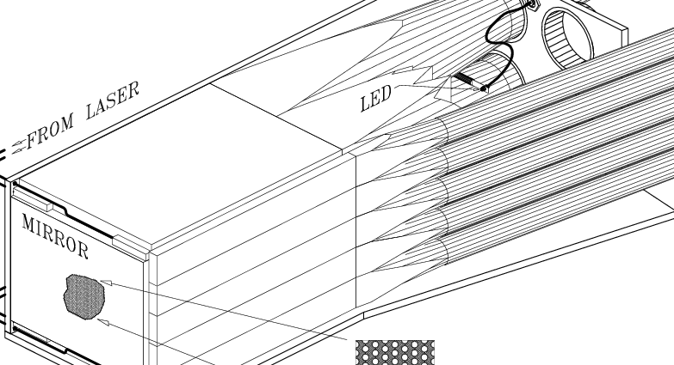
The high rate at injection and the flash-induced background were severe design constraints
Detector response: fast scint
  Pulse-to-pulse separation ~ 5 nsec
Gated off for ~10 μs was required
  Back on in 1 μs to 99.9% of gain
  Stability of gain a challenge (need <0.1%, full simulation required)
Pileup algorithms clever,
  But, 0.08 ppm systematic remained from percent-level pileup (see later)
CALO
_{X}
hodoscope
e⁺
E821 Instantaneous rates:
  At ~25 μs after injection, E > 1 GeV: Each calo sees up to 0.9 MHz
  With “no” threshold, the rate is up to 1.8 MHz
New Experiment Challenge:
  Determine average rate; it could be higher (up to 3x !)
  How to manage pileup and keep average rate on photo-detector “low”?

Slide 8
Calo detector: Parameters
Signal speed (fast), pulse shape
Higher light yield – better shower separ.
Segmentation for shower separation
Density (dense, compact): ~15X₀
Resolution (<10% / √E)
Non-magnetic
...

Slide 9
Considered calo materials
Material | PbF2 | PbWO4 (undoped) | W / SciFi
Type | Cerenkov | Cerenkov + Scintillation | Sampling
Radiation length | 0.93 cm | 0.89 cm | 0.69 cm
Moliere radius | 1.8 cm (Cerenkov) | 2.0 cm | 1.73 cm
Typical resolution | 3 – 5 % | 2 – 5 % | 12 %

Slide 10
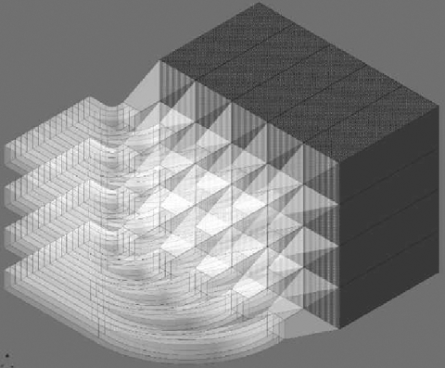
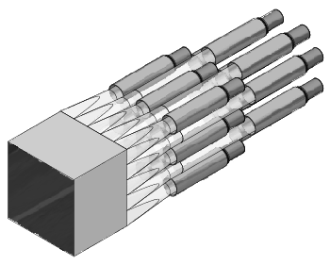
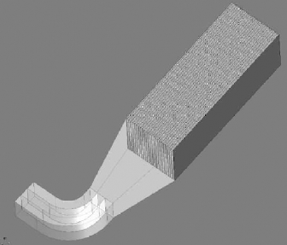
Option 1: W/SciFi
W/SciFi
Size | 21 cm × 15 cm
Thickness | 11 cm (> 15 X₀)
Transverse segm. | 4 × 5 or 5 × 7
Tungsten thickness | 0.5 mm
Fiber diameter | 0.5 mm
W/SciFi/glue ratio | 1:0.7:0.3
Radiation length | Calculated: 0.69 cm
W/SciFi
Concentrator
Lightguide

Slide 11
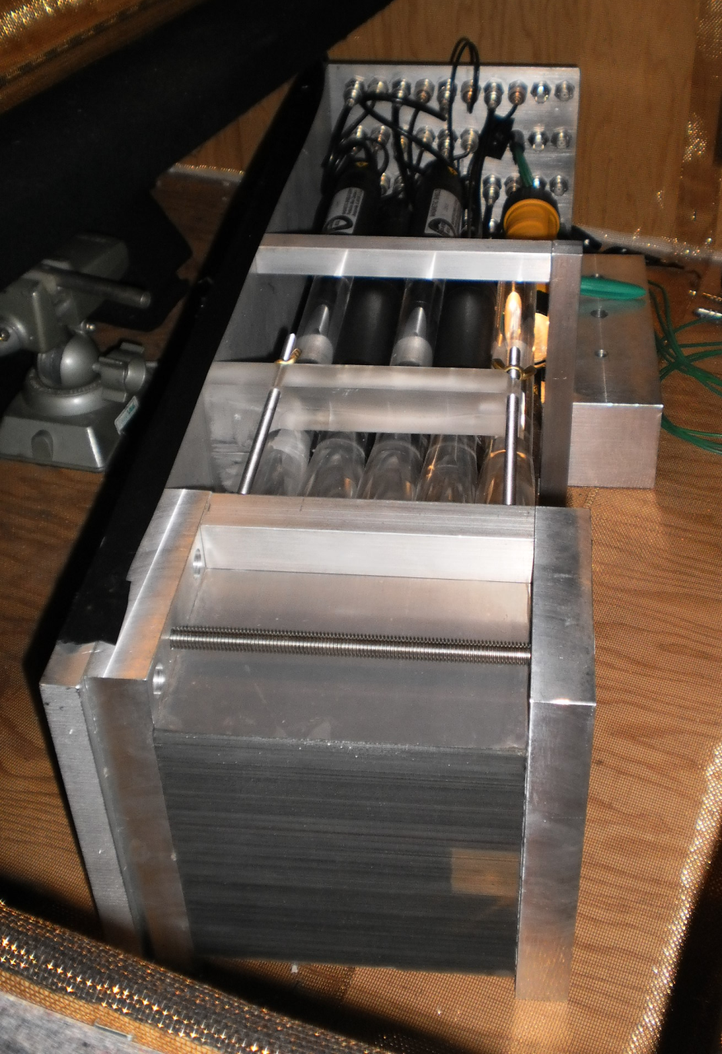
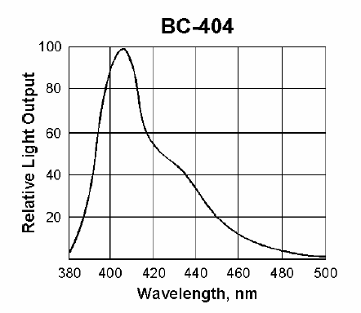
Option 1: W/SciFi
Bicron scintillator spectrum

Slide 12
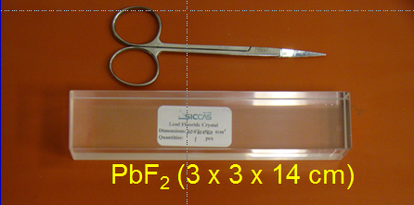
Option 2: Cerenkov PbF₂
Size | 3 x 3 cm
Thickness | 14 cm (> 15 X₀)
Transverse segm. | 5 × 7
E_{thr} (Cerenkov) | 102 keV

Slide 13
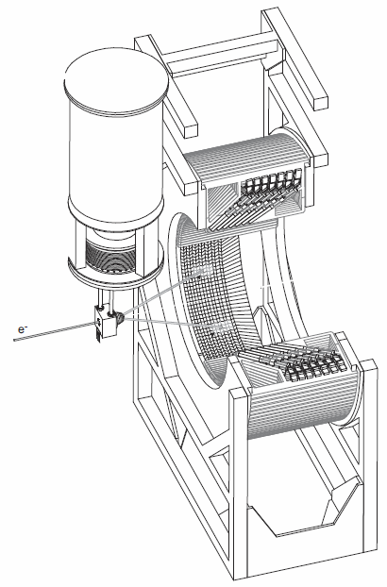

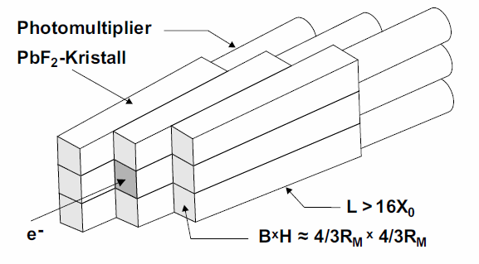
A4 calorimeter: PbF₂
- Effective light yield with 19mm HPMT:
~ 1.8 p.e. / MeV
- Brittle material required care for frame
- Good energy resolution:
1.9% @ 3.1 GeV
NIM A 465 (2001) 318

Slide 14
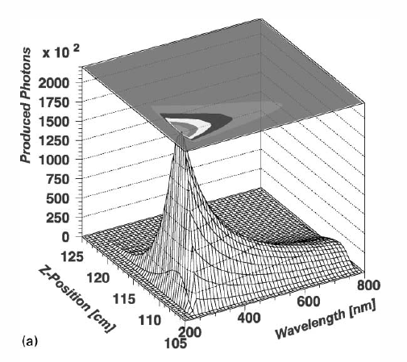
Cerenkov spectrum: PbF₂

Slide 15
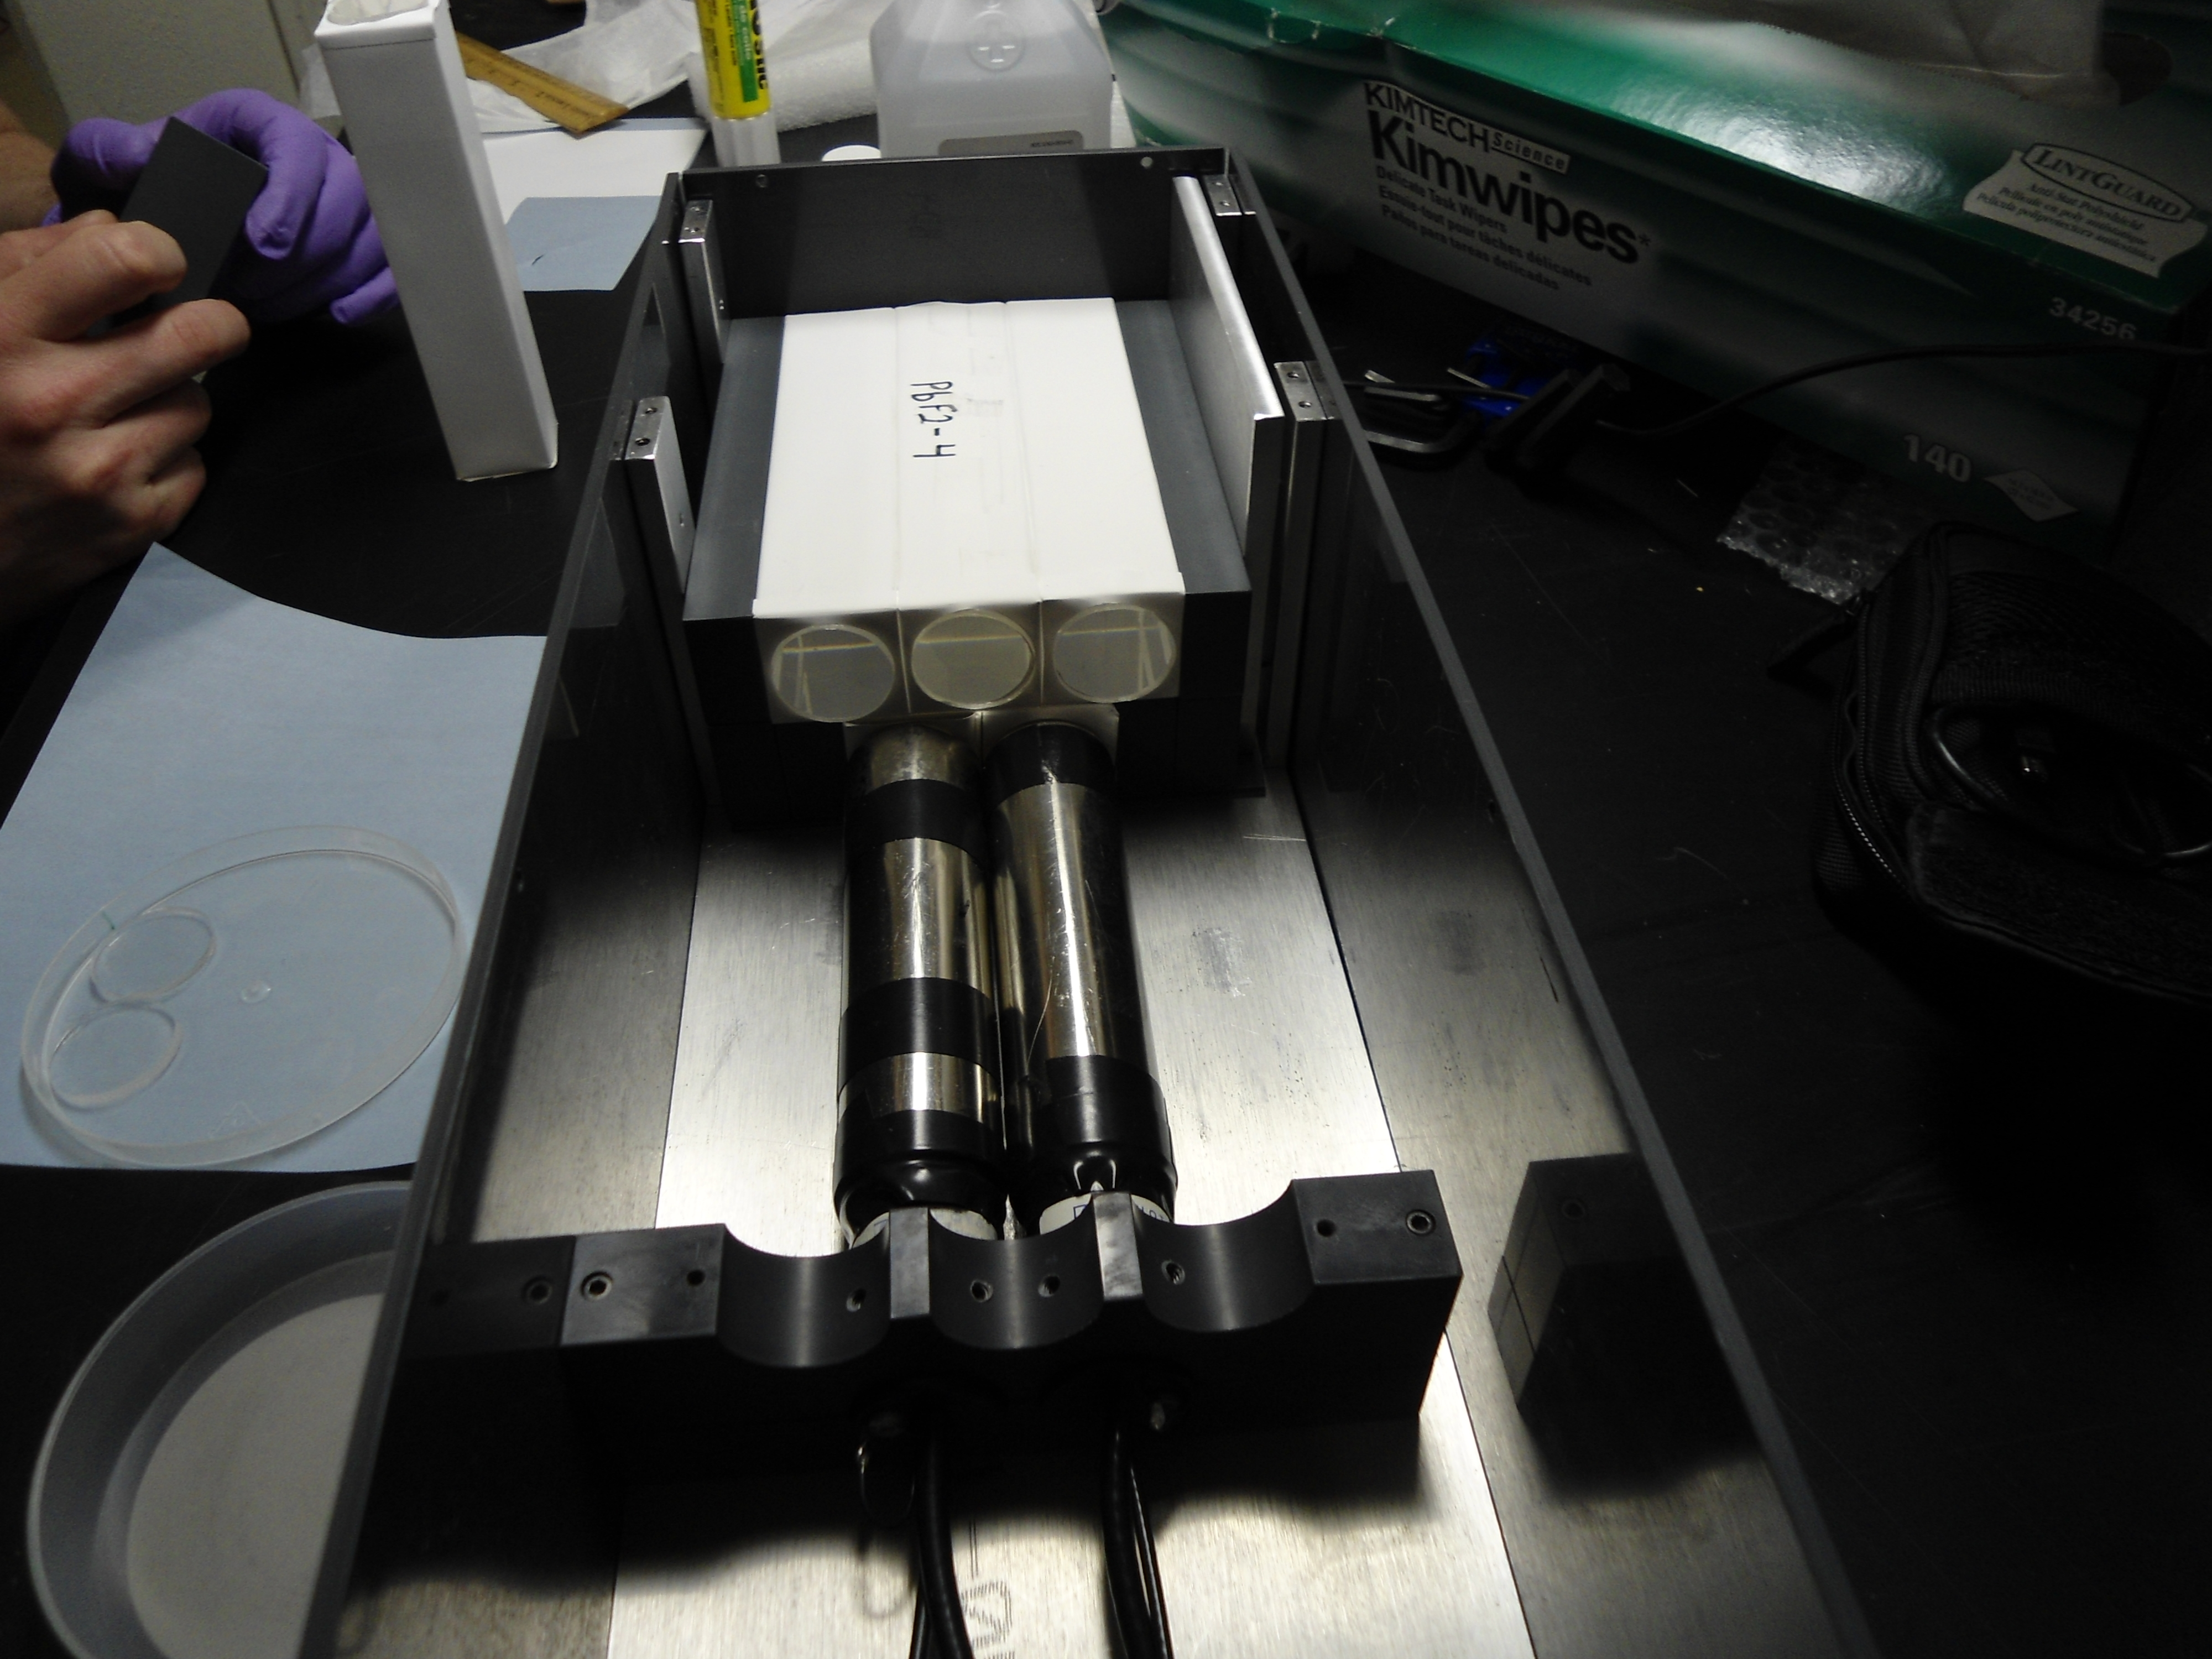
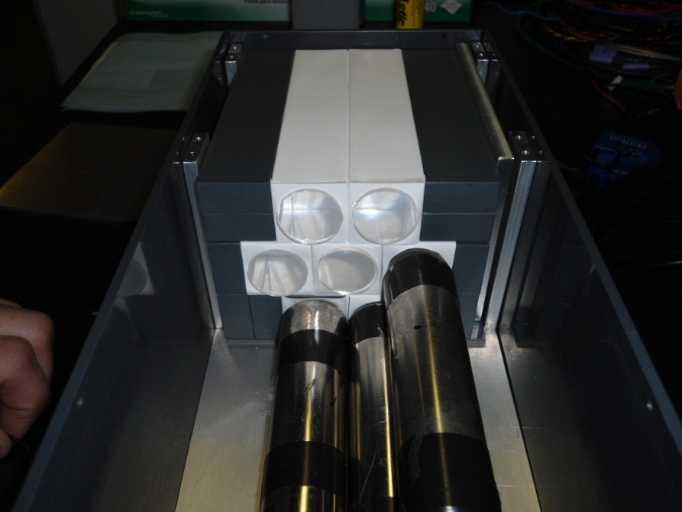
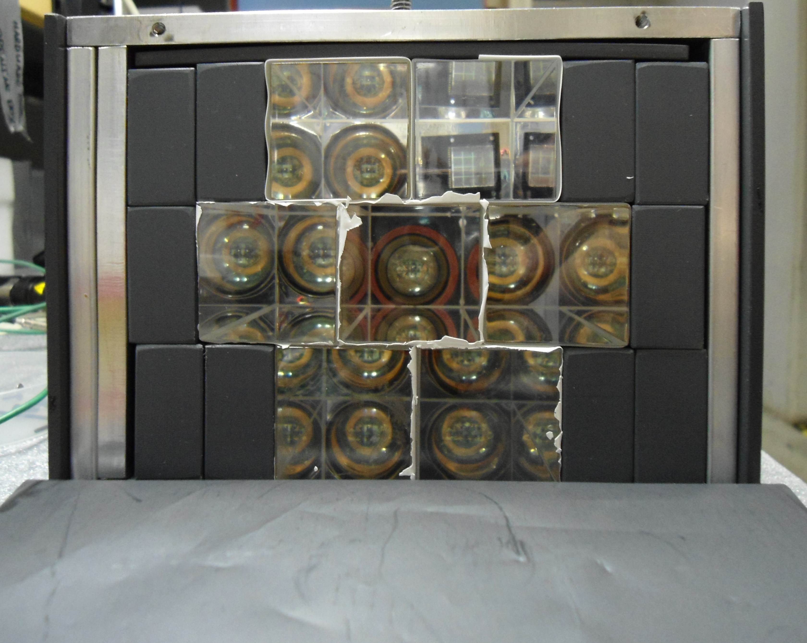
PbF₂ proto-type
Front face

Slide 16
Photo-detection: Parameters
Pulse shape, pileup resolution
Gain stability, rate dependence
Timing stability
Effective light collection
Non-magnetic
Gating (hadronic / proton flash)
...

Slide 17
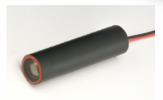
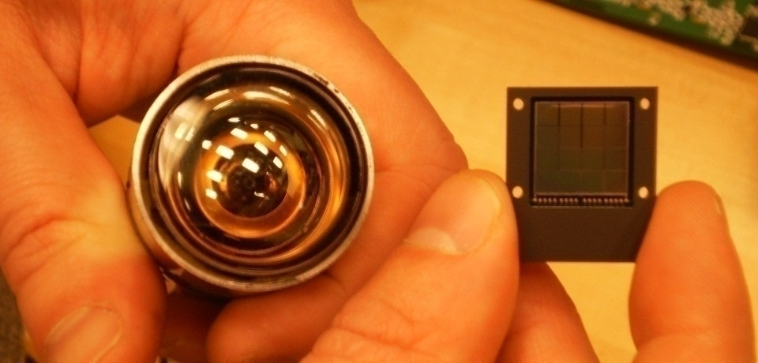
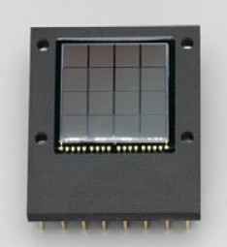
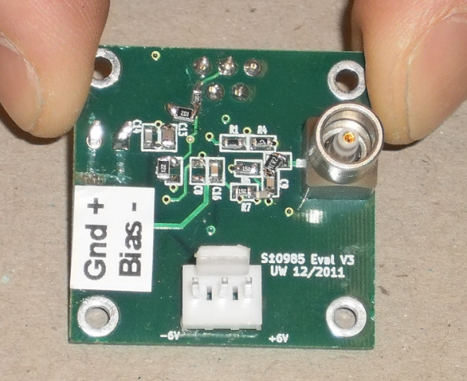
Optimize photo readout
Hamamatsu R9800 PMT
... and electronics for SiPM
Hamamatsu 16 channel SiPM

Slide 18
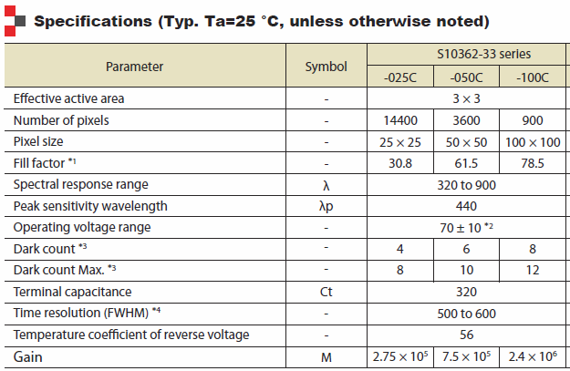
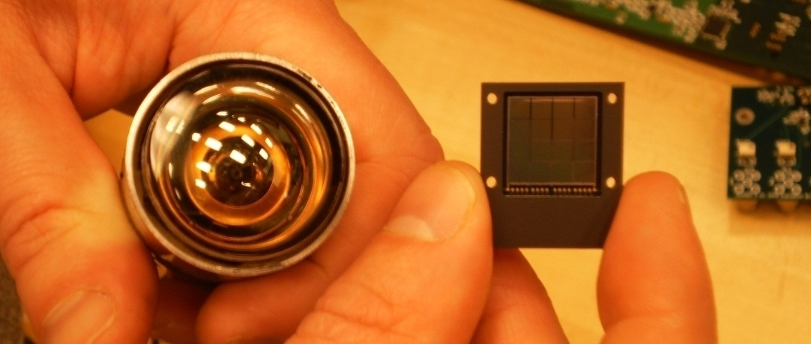
Photo-detection choice #1: SiPM

Slide 19
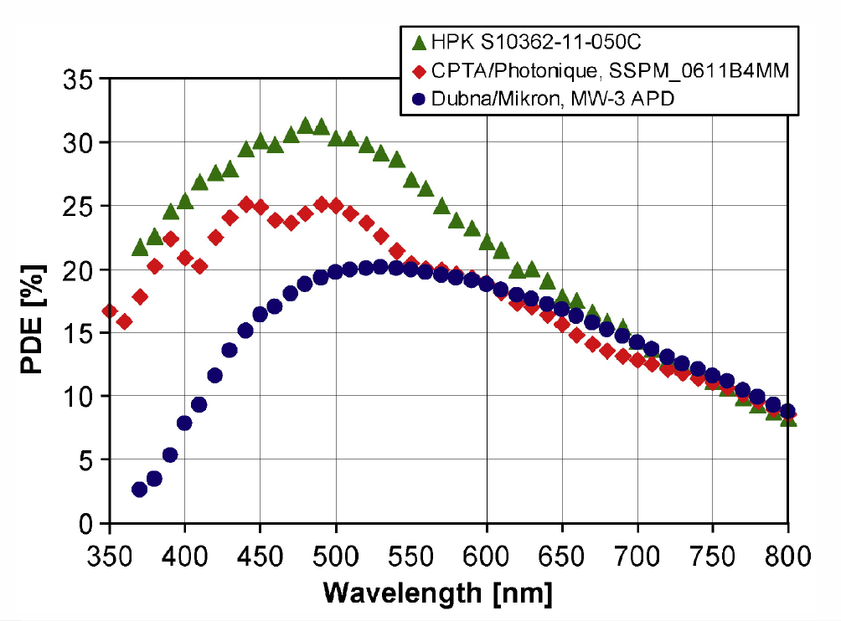
Quantum efficiency SiPM
PDE = QE × avalanche prob. × geometrical fill factor

Slide 20
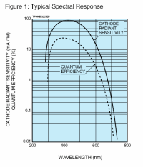
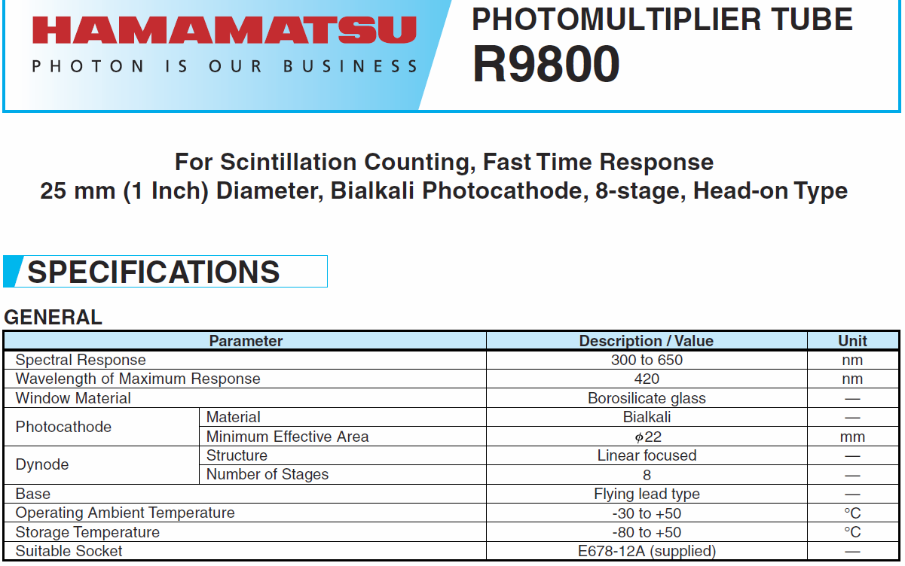
Photo-detection choice #2: R9800
Quantum efficiency

Slide 21
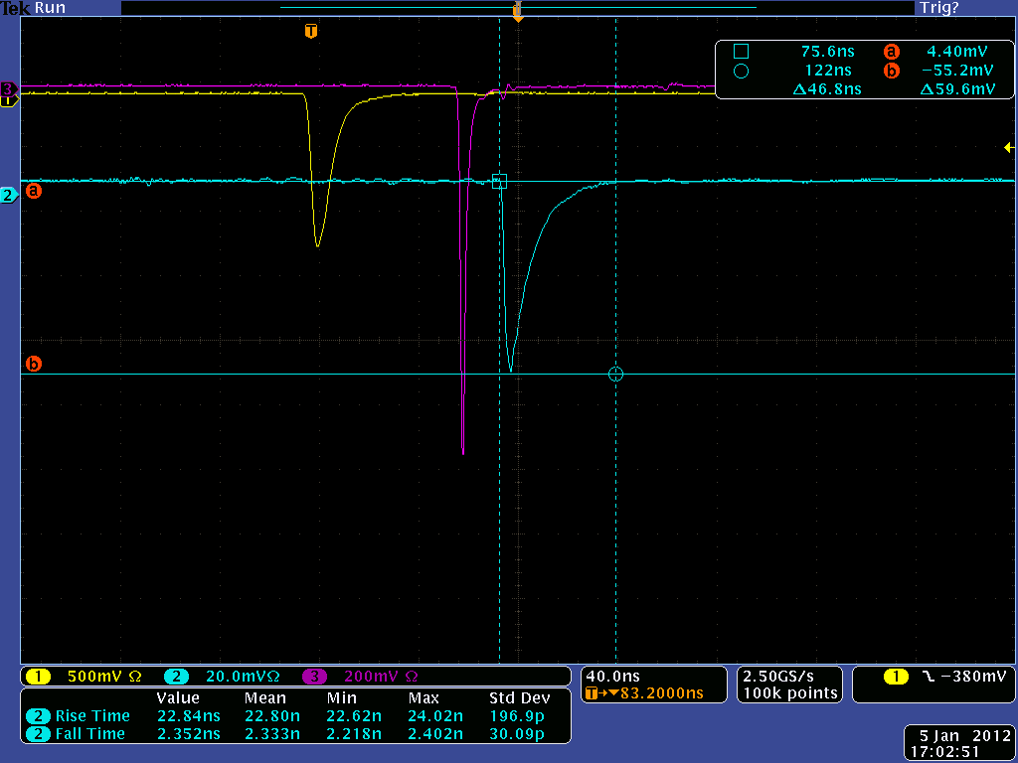
SiPM
τ = 10 ns
Light source: 600ps laser
R9800 PMT
τ = 3.6 ns
40 ns

Slide 22
Electronics readout: Parameters
Commercial vs custom made
Cost
Non-magnetic (current minimization)
Space limitation
Fast pulse shape
Bias voltage (SiPM)
...

Slide 23
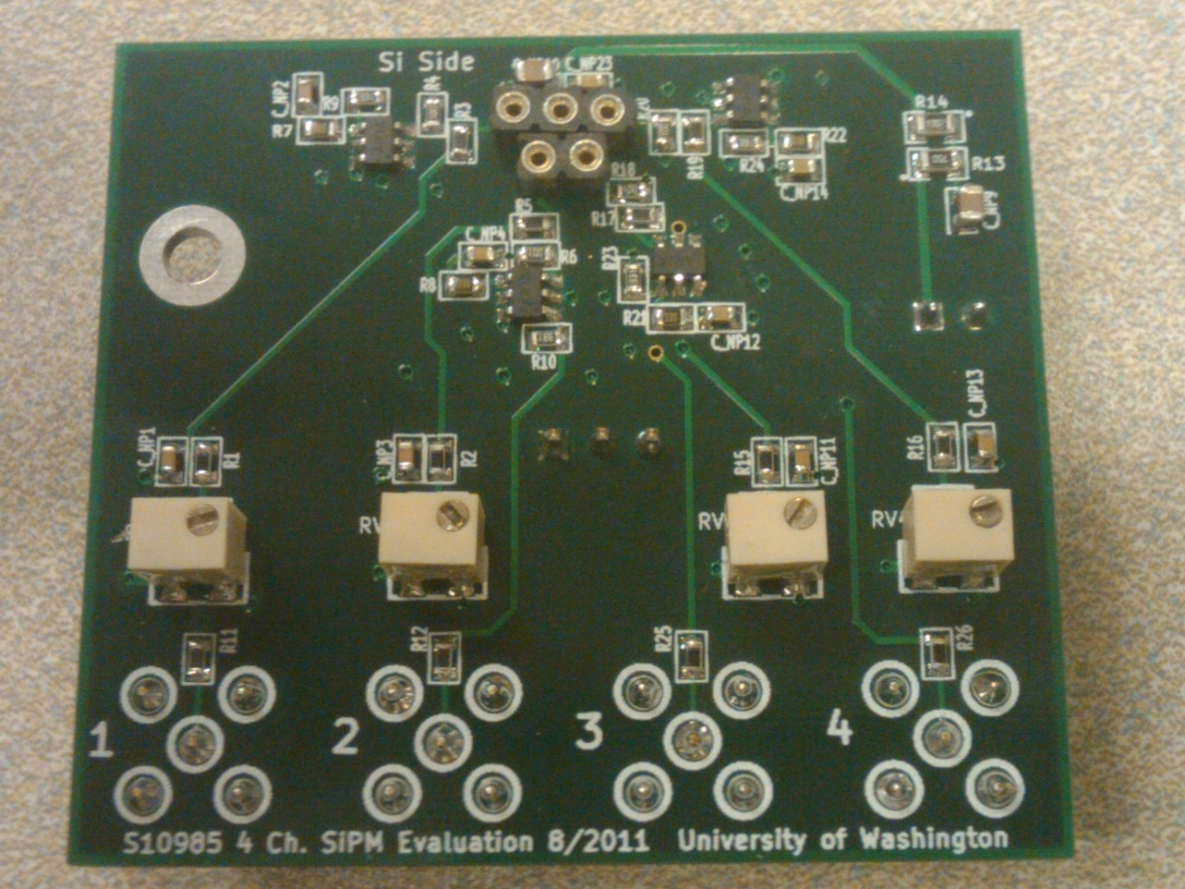
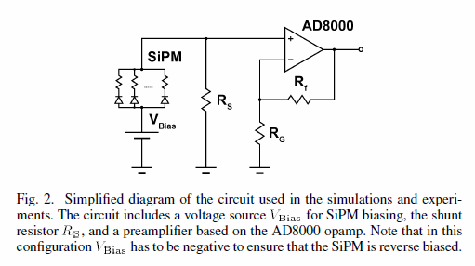
Voltage amplifier

Slide 24
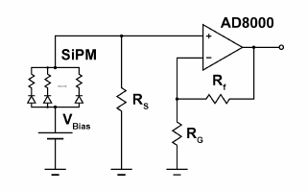
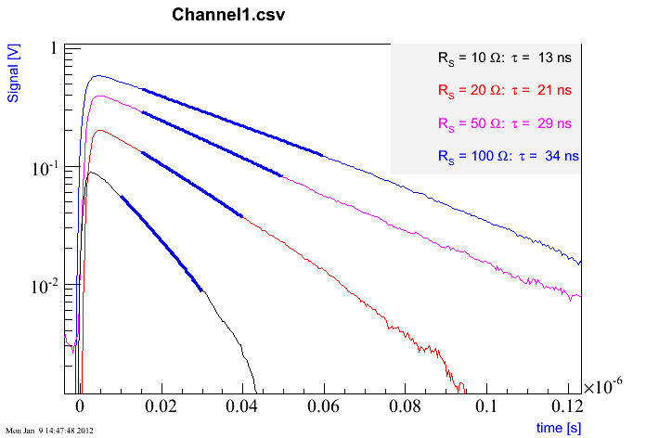
Signal shapes with voltage amp

Slide 25
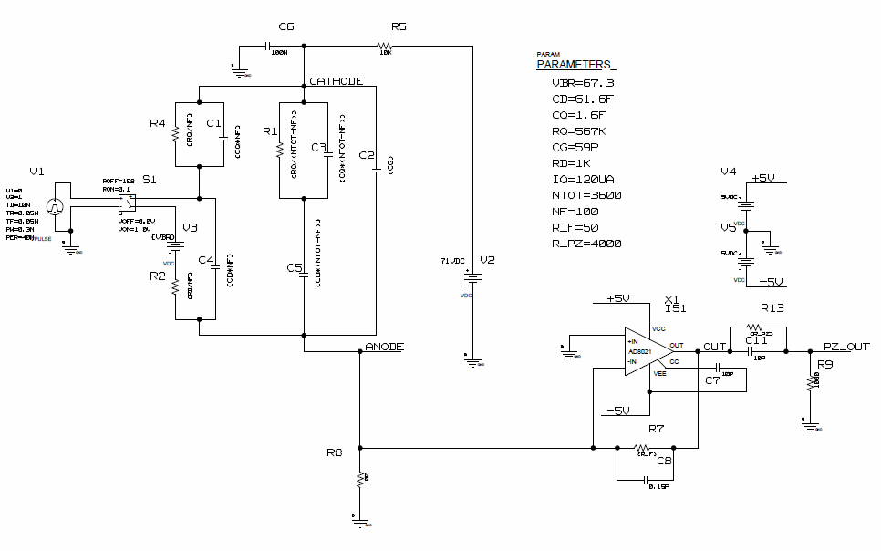
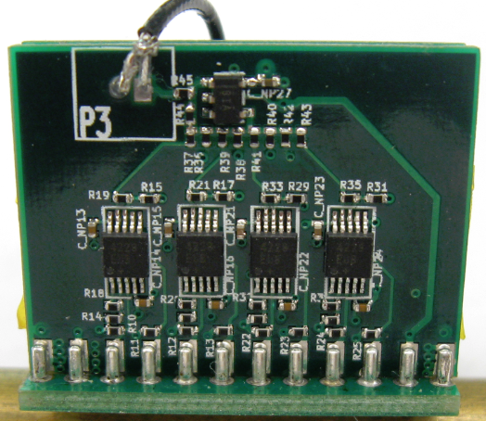
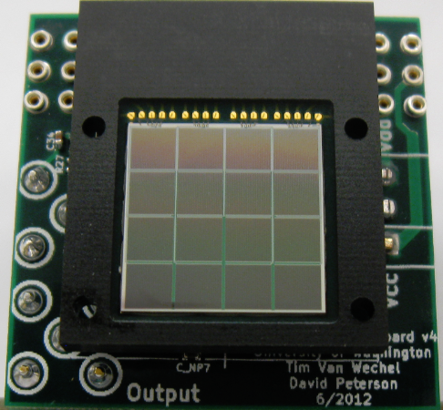
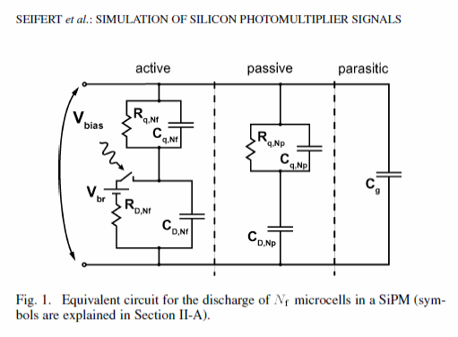
Current amplifier
UW CENPA electronics

Slide 26
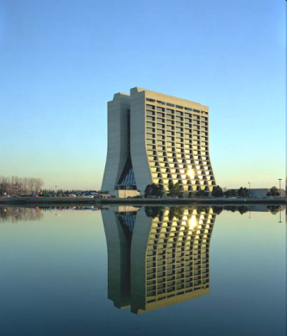
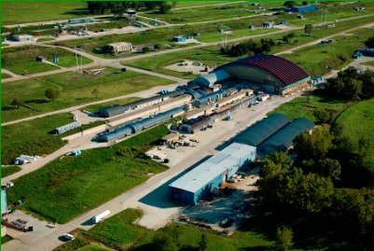
Calorimeter test @ FTBF
Electron beam 2 – 8 GeV

Slide 27
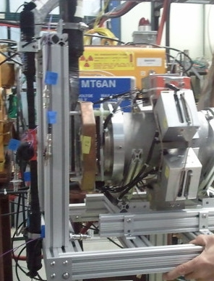
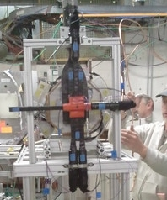
Test setup
S0
EMC preamps
UVA lattice
SC
S0 paddle upstream
SH
EMC
UVA lattice
SR
SL

Slide 28
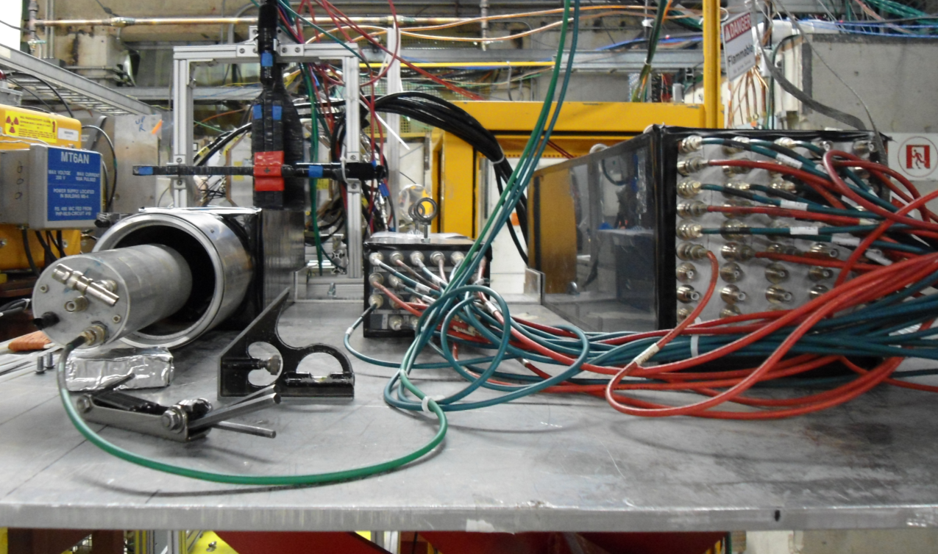
Calorimeters in the test
UVA lattice
Pb Glass
PbF2 array
W/SciFi

Slide 29
Crystal Configuration
W/SciFi
PbF2
W1
(661,40)
W2
(631,40)
W3 (601,40)
TL
(367,137)
TR (337,137)
W4
(661,70)
Center (W5) (631,70)
W6
(601,70)
ML
(382,167)
MC (352,167)
MR (322,167)
W7 (661,100)
W8 (367,100)
W9 (601,100)
BL (367,197)
BR (337,197)
Inactive
Crystal/Calo
Table position = (Horizontal, Vertical)
View of calorimeters looking downstream
(beam into page)

Slide 30
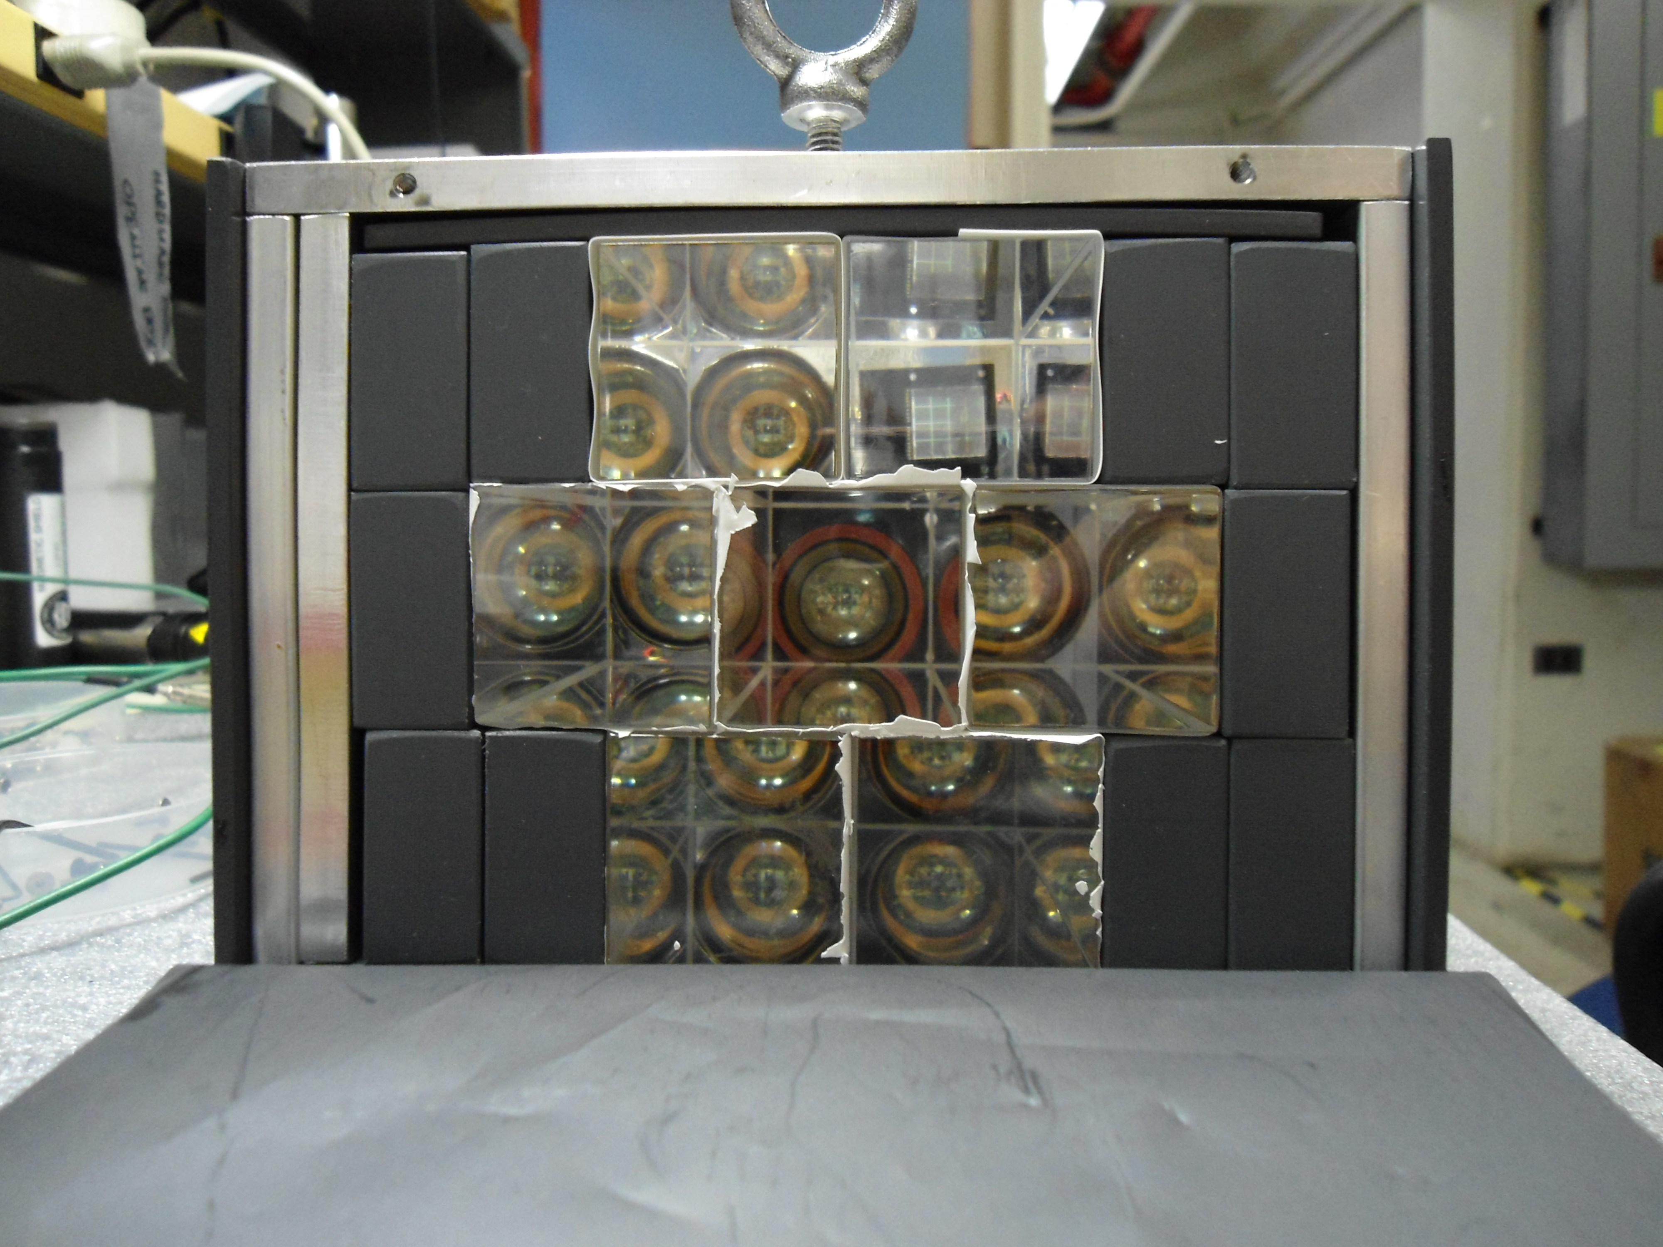

Slide 31
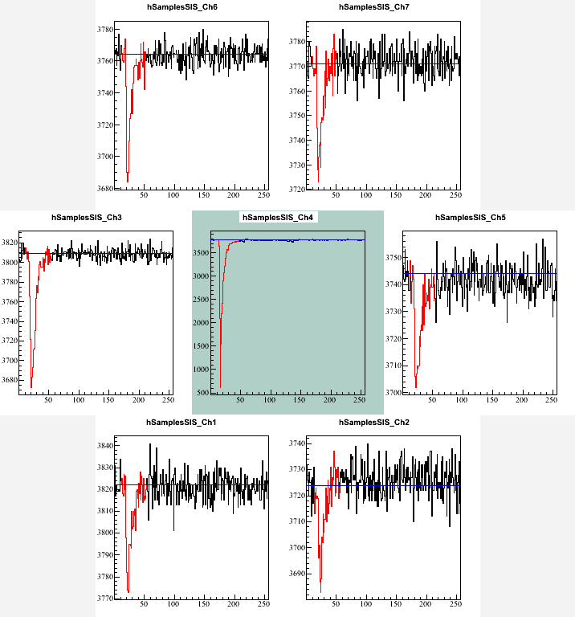
Struck digitizer: 500 MHz, 8bit

Slide 32
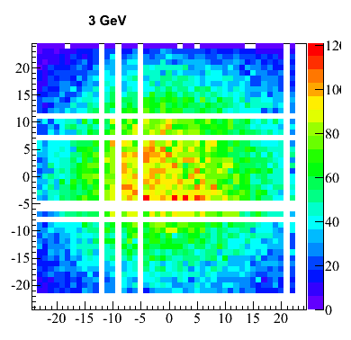



Preliminary analysis

Slide 33

Preliminary analysis
Mean(8 GeV) known to be too low because analysis not optimized yet

Slide 34
PbF2 with SiPM

Slide 35

SiPM and employed electronics not optimized for signal duration in this test!

Slide 36


Light yield: 4 GeV
Active area: 500 mm²
Active area: 90 mm²
σ / E (1GeV) ≈ 5 %
σ / E (1GeV) ≈ 9 %

Slide 37

Pulse shapes: Materials
FWHM:
15 ns
4 ns
6 ns
Peaks normalized to one for signal duration comparison

Slide 38

Light yields: PbF2 wrapping
Light yield comparison only approximate as better calibration required offline

Slide 39
Summary
Current best candidate: PbF2 + SiPM
Still need to evaluate all options
Ongoing GEANT4 simulation to support decision making
Beam test analysis will give us valuable input for calorimeter design

