Slide 1
Design considerations for the NNbarX source
G. Muhrer

Slide 2
Outline
Inverse geometry
Moderator materials in confined spaces

Slide 3
Inverse Geometry

Slide 4
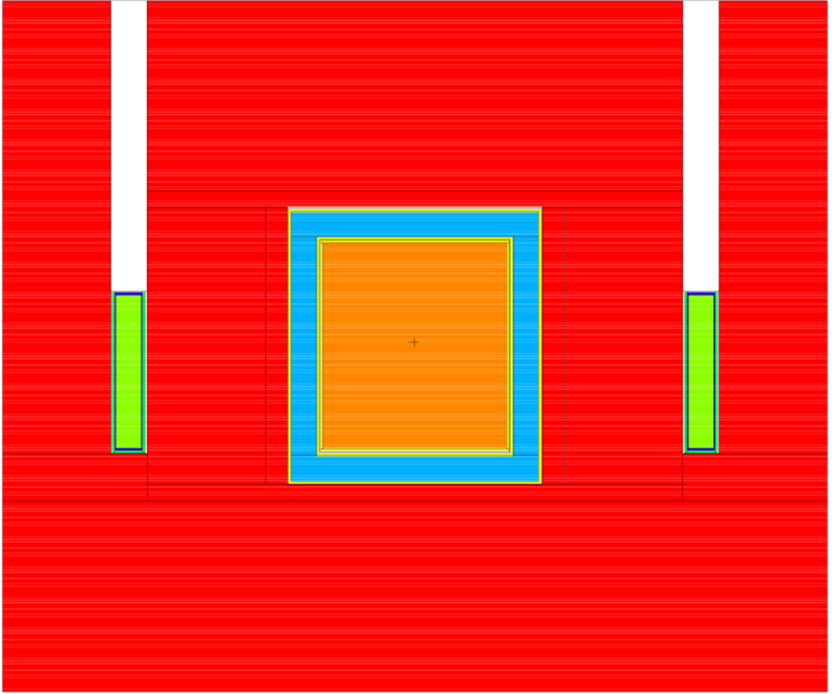
Inverse cylindrical geometry (1)
6.6*10⁷ UCN/s/100μA
Heat load @ 100μA ≡ 80KW
Total heat: 27.4 W
Neutron heat: 17.2 W
Photon heat: 9.6 W
Proton heat: 0.6 W
2.4*10⁸ UCN/s/100W (heat in the He)
800 MeV p+
800 MeV p+
53cm
40L-He
Al(20K)
W
W
H₂ (75% ortho, 20K)
Bi(300K)
Cylindrical proton target (beam rastered around circumference)

Slide 5
UCN production function

Slide 6
Inverse geometry (1): Neutron spectrum in He-4

Slide 7
ICG (2): Be canisters
9.5*10⁷ UCN/s/100μA
Heat load @ 100μA ≡ 80KW
Total heat: 23.6 W
Neutron heat: 15.5 W
Photon heat: 7.5 W
Proton heat: 0.6 W
4.0*10⁸ UCN/s/100W (heat in the He)
800 MeV p+
800 MeV p+
53cm
40L-He
Be(20K)
W
W
H₂ (75% ortho, 20K)
Bi(300K)

Slide 8
Inverse geometry (2): Neutron spectrum in He-4

Slide 9
ICG (3): D₂O pre-moderator
1.0*10⁸ UCN/s/100μA
Heat load @ 100μA ≡ 80KW
Total heat: 18.8 W
Neutron heat: 9.7 W
Photon heat: 8.4 W
Proton heat: 0.7 W
5.36*10⁸ UCN/s/100W (heat in the He)
800 MeV p+
800 MeV p+
53cm
40L-He
Be(20K)
W
W
D₂O (5cm)
H₂ (75% ortho, 20K)
Bi(300K)

Slide 10
Inverse geometry (3): Neutron spectrum in He-4

Slide 11
ICG (4): thick D₂O pre-moderator
9.9*10⁷ UCN/s/100μA
Heat load @ 100μA ≡ 80KW
Total heat: 17.5 W
Neutron heat: 8.0 W
Photon heat: 8.6 W
Proton heat: 0.9 W
5.64*10⁸ UCN/s/100W (heat in the He)
800 MeV p+
800 MeV p+
53cm
40L-He
Be(20K)
W
W
D₂O (9cm)
H₂ (75% ortho, 20K)
Bi(300K)

Slide 12
Inverse geometry (4): Neutron spectrum in He-4

Slide 13
ICG (5): D₂ moderator
1.0*10⁸ UCN/s/100μA
Heat load @ 100μA ≡ 80KW
Total heat: 13.9 W
Neutron heat: 10.8 W
Photon heat: 2.4 W
Proton heat: 0.7 W
7.14*10⁸ UCN/s/100W (heat in the He)
800 MeV p+
800 MeV p+
53cm
40L-He
Be(20K)
W
W
D₂O (5cm)
D₂ (70% ortho, 19K)
Bi(300K)

Slide 14
Inverse geometry (5): Neutron spectrum in He-4

Slide 15
Conclusions
Beryllium canister increase the UCN flux by 50%.
Beryllium canister decreases the heat load in the He by about 15%.
Heavy water pre-moderators decrease the heat load in the He by 20-25% (depending on the thickness).
No significant UCN flux increase has been observed from introducing a heavy water pre-moderator.
Liquid D₂ moderator lowers the gamma heating in the He significantly.

Slide 16
Moderator materials in confined spaces

Slide 17
Motivation
Reduction of radiation damage.
Recombination of radicals before they form gases.
Manipulation of the excitation spectrum.
More of the “right” neutrons.
Change of the solidification temperature (super cooling).
More predictable crystallization process.

Slide 18
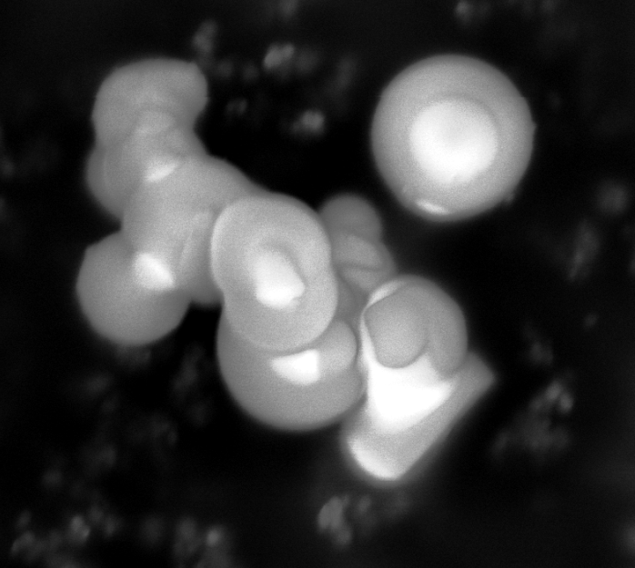
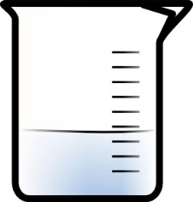
Water in Silica Microspheres
Silica is inert/ lightweight
TEOS + NaOH + H₂O/EtOH SiO₂ spheres
40 weight-% water in silica
Ultra sound
45 min
H₂O ?
SiO₂
1 μm
H₂O

Slide 19
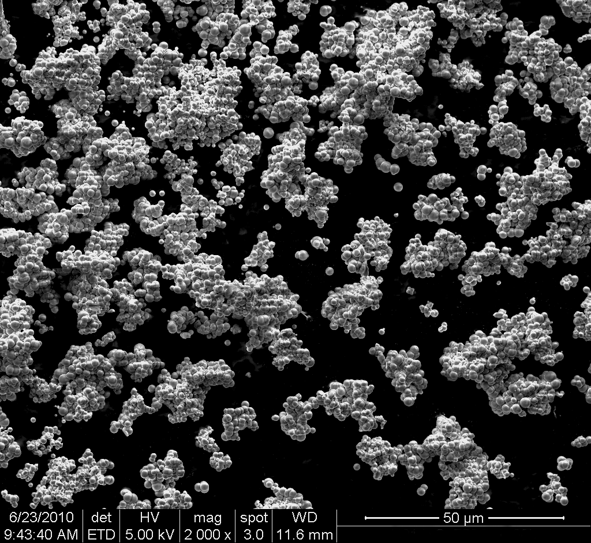
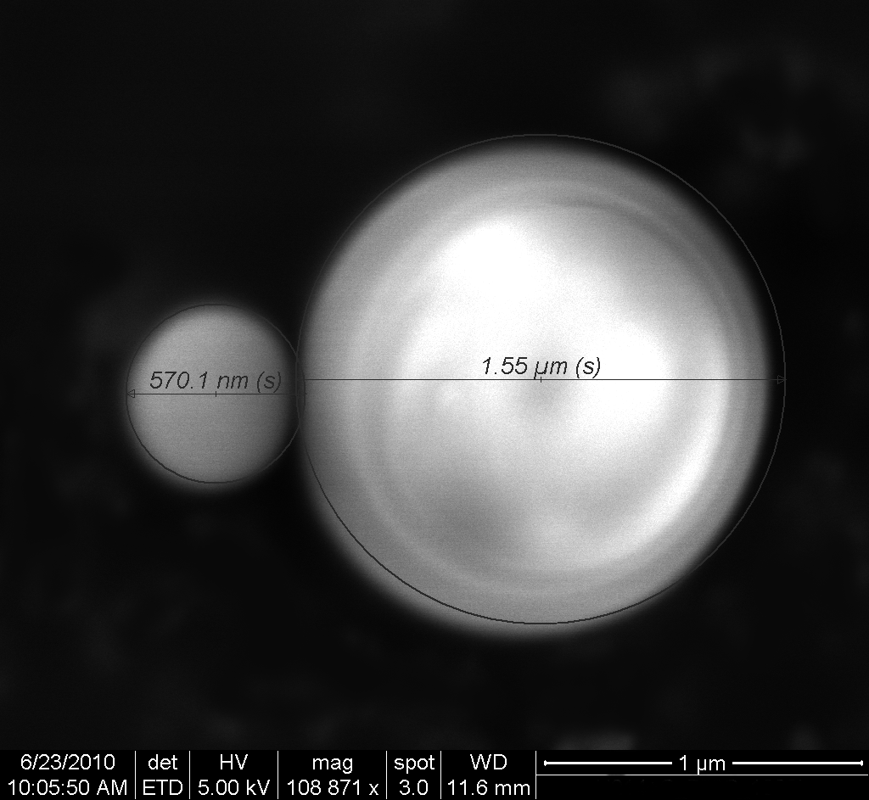
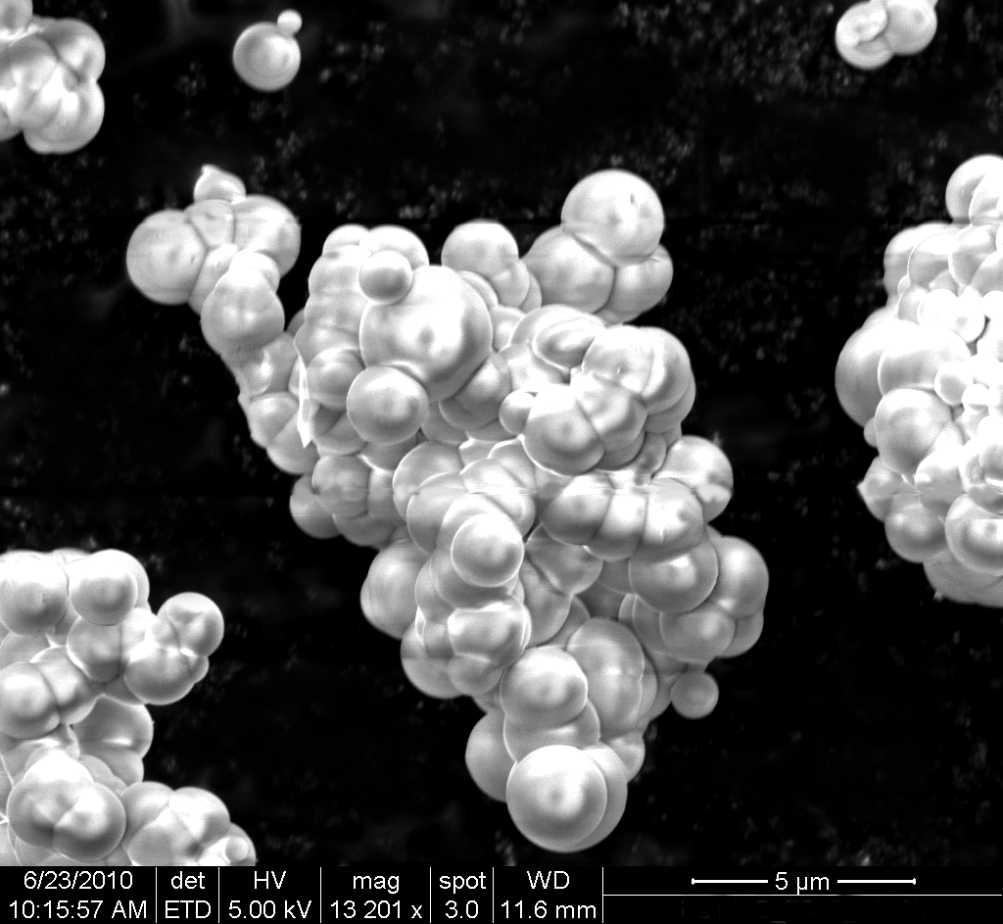
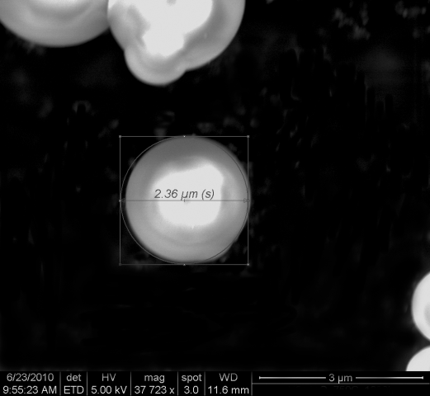
SEM of the silica spheres
Spheres are agglomerated
Room for water in the spaces between the spheres?
Three different sizes of spheres are present:
d = 2.4 μm
d = 1.5 μm
d = 600 nm

Slide 20
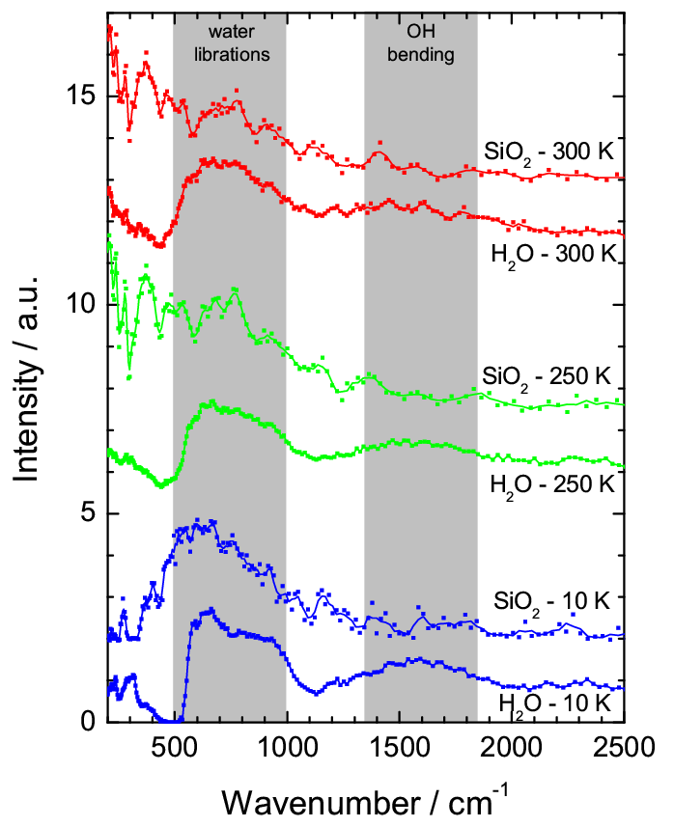
IINS Data of H₂O in Silica Spheres
IINS: Incoherent Inelastic Neutron Spectroscopy
Water at 250 K is still liquid
Modes for liquid H₂O:
Librational bands of “free” water: 550-1000 cm⁻¹
OH-bending: 1645 cm⁻¹
OH-stretch: 3280-3920 cm⁻¹

Slide 21
SANS Data of Silica Spheres with H₂O
BP: ξ=25.7Ǻ
m=2.0
Q₀=0.0215Ǻ⁻¹ (d=292Ǻ)
GP: R_{g}=25.0Ǻ (R=32.3Ǻ)
m=2.0
s=0

Slide 22
SANS: Fitting models
Broad Peak model:
Guinier-Porod model:

Slide 23
Total Cross Section of H₂O in Silica Spheres (1)
Notes:
Blue-green: transmission measurements: the experimental shows the total cross section for the water in SiO2 spheres. The contribution of the silica was subtracted from the measured cross section of the whole sample. Experimental measurements of the dry silica (same sample)
NJOY: Nuclear physics code for scattering kernel development. Blue is regular water according to MacFarlene‘s latest published scattering kernel for water. Black is generated by using the water model of MF by modifying. The weights of the different contributions of the excitation spectrum were adjusted to fit the data. (phonon spectrum and discrete oscillators (Einstein)´=excitation energies we
The shape of the phonon spectrum and the energies of the Einstein oscillators were kept the same but the weights of those excitations were changed from the standard water model to fit the experimental data.
Need more statistics at long wavelength (low energy)
Seems to be an acceptable –reasonable model at first approximation

Slide 24
Total Cross Section of H₂O in Silica Spheres (2)
Notes:
Blue-green: transmission measurements: the experimental shows the total cross section for the water in SiO2 spheres. The contribution of the silica was subtracted from the measured cross section of the whole sample. Experimental measurements of the dry silica (same sample)
NJOY: Nuclear physics code for scattering kernel development. Blue is regular water according to MacFarlene‘s latest published scattering kernel for water. Black is generated by using the water model of MF by modifying. The weights of the different contributions of the excitation spectrum were adjusted to fit the data. (phonon spectrum and discrete oscillators (Einstein)´=excitation energies we
The shape of the phonon spectrum and the energies of the Einstein oscillators were kept the same but the weights of those excitations were changed from the standard water model to fit the experimental data.
Need more statistics at long wavelength (low energy)
Seems to be an acceptable –reasonable model at first approximation

Slide 25
Total Cross Section of H₂O in Silica Spheres (3)
Notes:
Blue-green: transmission measurements: the experimental shows the total cross section for the water in SiO2 spheres. The contribution of the silica was subtracted from the measured cross section of the whole sample. Experimental measurements of the dry silica (same sample)
NJOY: Nuclear physics code for scattering kernel development. Blue is regular water according to MacFarlene‘s latest published scattering kernel for water. Black is generated by using the water model of MF by modifying. The weights of the different contributions of the excitation spectrum were adjusted to fit the data. (phonon spectrum and discrete oscillators (Einstein)´=excitation energies we
The shape of the phonon spectrum and the energies of the Einstein oscillators were kept the same but the weights of those excitations were changed from the standard water model to fit the experimental data.
Need more statistics at long wavelength (low energy)
Seems to be an acceptable –reasonable model at first approximation

Slide 26
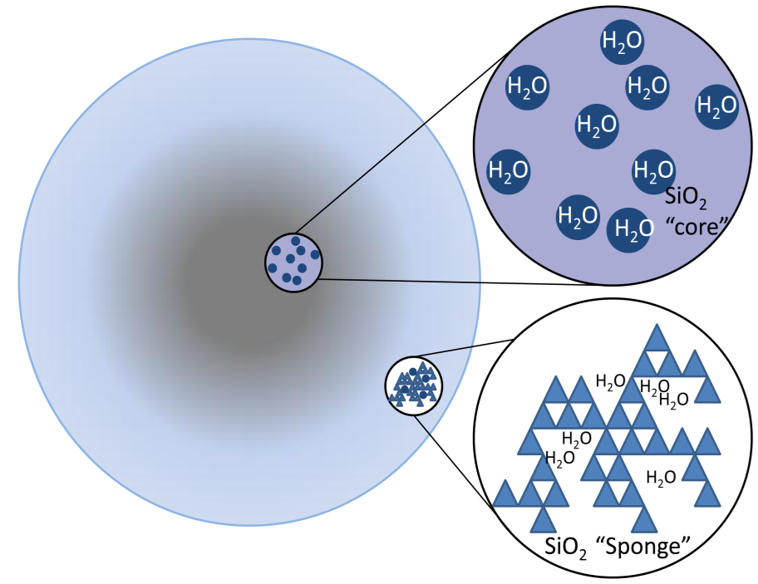
Placement of water in silica microspheres
Synthesis
Infrared spectroscopy (FTIR)
X-ray diffraction
Scanning electron microscopy (FEI)
Thermogravimetric -
BET (Brunauer-Emmet-Teller)
Incoherent Inelastic Neutron Scat.
Small Angle Neutron Scattering
Transmission measurement
Scattering kernel (not including SANS)
Notes:
Blue-green: transmission measurements: the experimental shows the total cross section for the water in SiO2 spheres. The contribution of the silica was subtracted from the measured cross section of the whole sample. Experimental measurements of the dry silica (same sample)
NJOY: Nuclear physics code for scattering kernel development. Blue is regular water according to MacFarlene‘s latest published scattering kernel for water. Black is generated by using the water model of MF by modifying. The weights of the different contributions of the excitation spectrum were adjusted to fit the data. (phonon spectrum and discrete oscillators (Einstein)´=excitation energies we
The shape of the phonon spectrum and the energies of the Einstein oscillators were kept the same but the weights of those excitations were changed from the standard water model to fit the experimental data.
Need more statistics at long wavelength (low energy)
Seems to be an acceptable –reasonable model at first approximation

Slide 27
Properties of H₂O in SiO₂
no OH-bending mode (E=208mV)
more phonon modes at low energies
solidification below 250K
water confined in spheres (R~30Ǻ)
spheres build Gaussian chains
correlation length of the chains is about 250Ǻ

