Slide 1
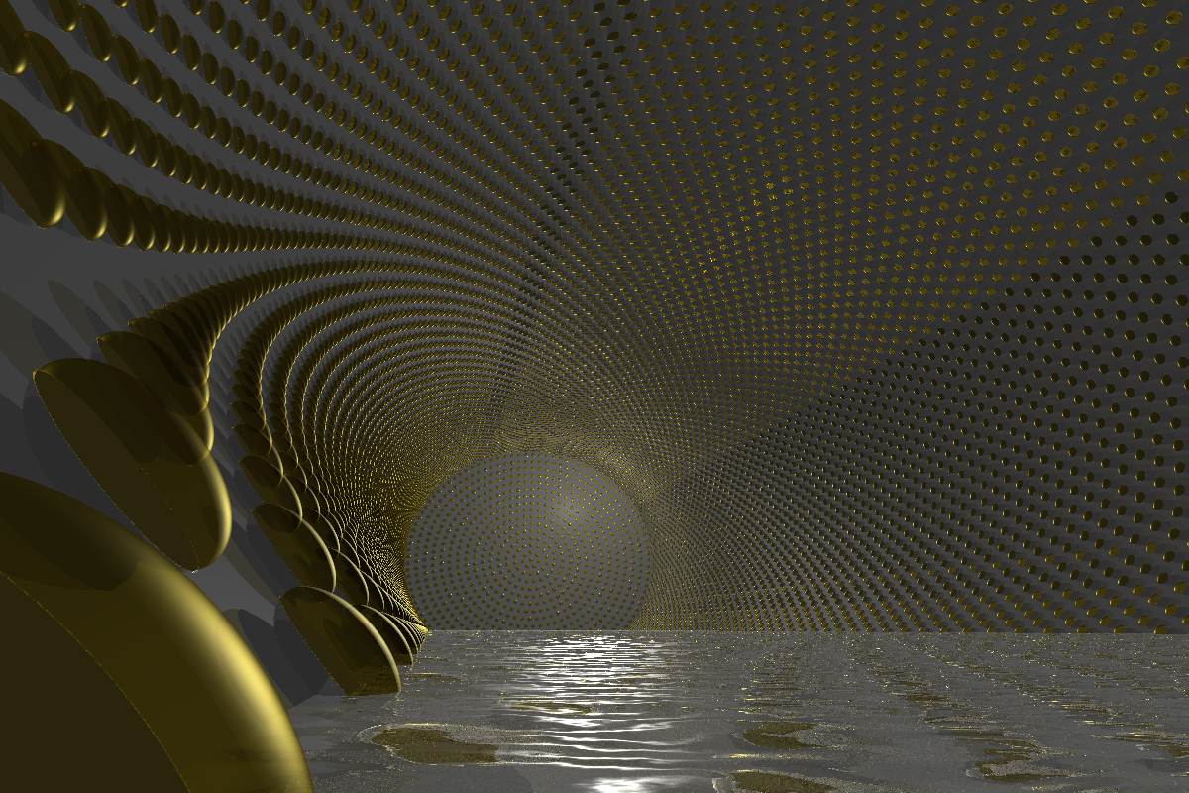
LENA with a focus on photosensor R&D
Marc Tippmann
for the LENA working group
Project X Physics Study 2012, Fermilab
2012/06/20
Notes:
shortoverview photodetection hardware, that is, the optical module for LENA project

Slide 2
Overview
Overview
Marc Tippmann
Technische Universität München
1/20
Low Energy Neutrino Astronomy
Detector layout
Photosensors
Requirements
Candidate photosensors
Measurement of sensor properties
Optical module for PMTs
Demands on the detector
Physics potential

Slide 3
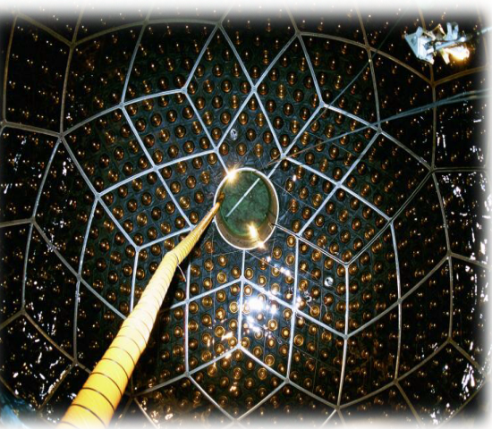
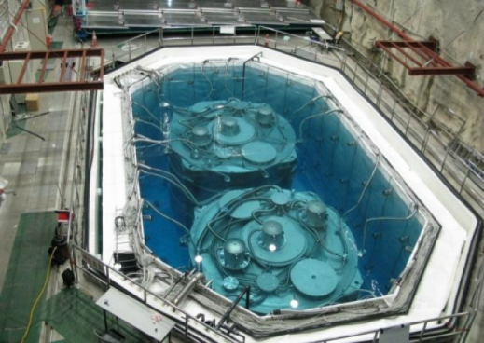
Neutrino physics: Status
Physics potential
Marc Tippmann
Technische Universität München
2/20
Particle physics
Neutrino properties
m₁
Δm₁₂²
Δm₂₃²
Mass hierarchy
Majorana / Dirac
ϑ₁₂
ϑ₂₃
ϑ₁₃
Sterile neutrinos
δ_{CP}
Astroparticle physics
Galactic supernova neutrinos
Diffuse supernova neutrinos
Solar neutrinos
High-energy neutrinos
Cosmological neutrinos
Atmospheric neutrinos
Dark Matter annihilation/decay
Baksan
SNO+
KamLAND
Borexino, SNO+
SNO+
Double Chooz, Daya Bay, RENO
Geophysics
Geoneutrinos
Borexino, KamLAND, SNO+
Liquid scintillator detectors so far have made great contributions already with relatively small target masses:
Baksan (330t), KamLAND (1kt), Borexino (280t), Double Chooz (8.3t), Daya Bay (20t), RENO (16t)
near future: SNO+ (780t)
What could we achieve with a 50kt detector?
Notes:
andere experimente
LSc: borexino + kamland very successful: theta12, dm12, solar nus geo nus, DC, dayabay, reno -> what can we do with a 50kt Lsc?
LSD thr lower +upper -> durchstreichen / x davor, haken, wo geht

Slide 4
Neutrino physics: Possible contributions from LENA
Physics potential
Marc Tippmann
Technische Universität München
2/20
Particle physics
Neutrino properties
m₁
Δm₁₂²
Δm₂₃²
Mass hierarchy
Majorana / Dirac
ϑ₁₂
ϑ₂₃
ϑ₁₃
Sterile neutrinos
δ_{CP}
Astroparticle physics
Galactic supernova neutrinos
Diffuse supernova neutrinos
Solar neutrinos
High-energy neutrinos
Cosmological neutrinos
Atmospheric neutrinos
Dark Matter annihilation/decay
Geophysics
Geoneutrinos
Artificial sources
Neutrino beam
Radioactive neutrino source
Pion decay-at-rest beam
Reactor neutrinos
Nucleon decay
LENA
Low
Energy
Neutrino
Astronomy
Notes:
andere experimente
LSc: borexino + kamland very successful: theta12, dm12, solar nus geo nus, DC, dayabay, reno -> what can we do with a 50kt Lsc?
LSD thr lower +upper -> durchstreichen / x davor, haken, wo geht

Slide 5
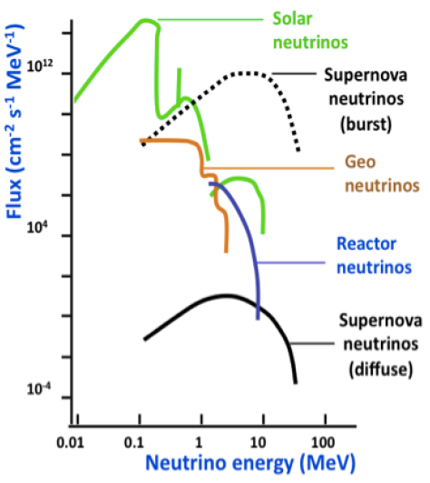
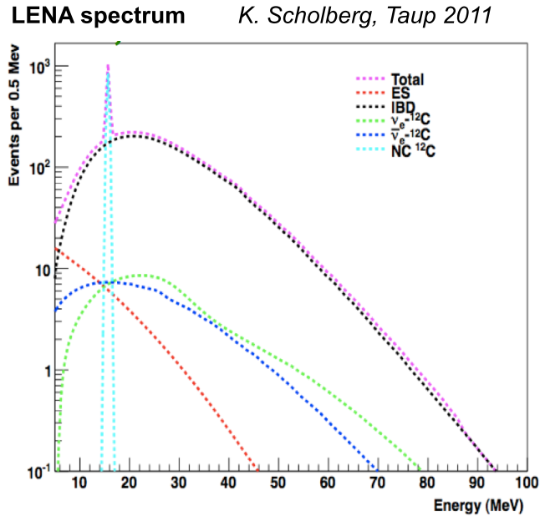
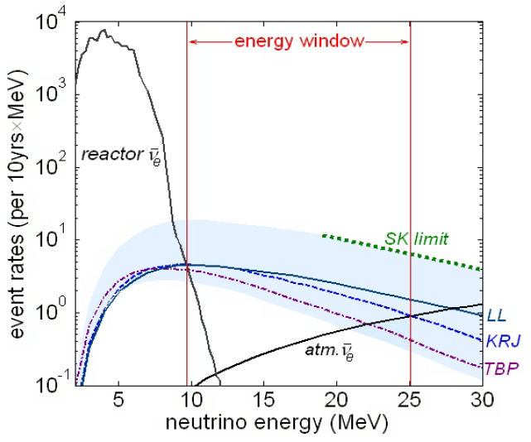
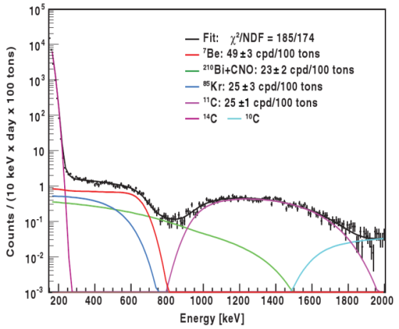
Physical goals: Natural sources
Physics potential
Marc Tippmann
Technische Universität München
3/20
Galactic supernova neutrinos: Observe neutronisation burst, time-resolved cooling phase, separation of core collapse supernova models, trigger for gravitational wave detectors, possibly mass hierarchy, θ₁₃
Diffuse supernova neutrinos: First detection, average SN neutrino spectrum
Solar neutrinos: ⁷Be precision measurement: 5400events/day → small time fluctuations, CNO + pep, MSW effect
Atmospheric neutrinos: Precise measurement of Δm₂₃², θ₂₃, potentially mass hierarchy
Indirect dark matter search: Via abundances in neutrino spectrum, sensitive to masses ≈10-100MeV
Diffuse SN ν
Galactic SN ν
Solar ν
Notes:
Use neutrinos to study sources

Slide 6
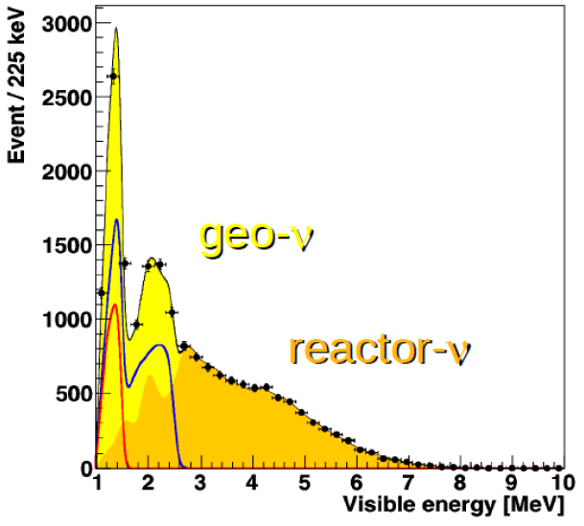
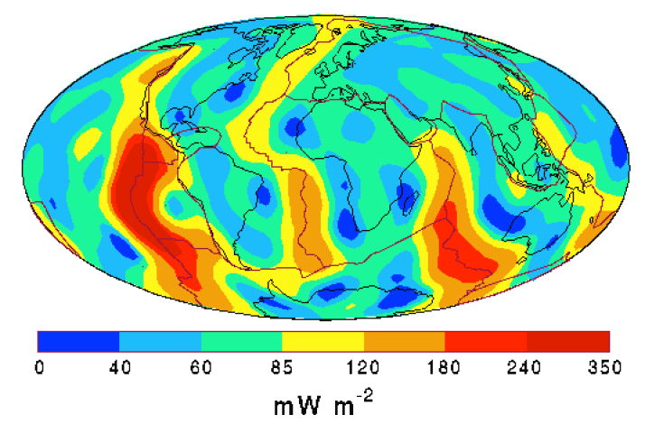
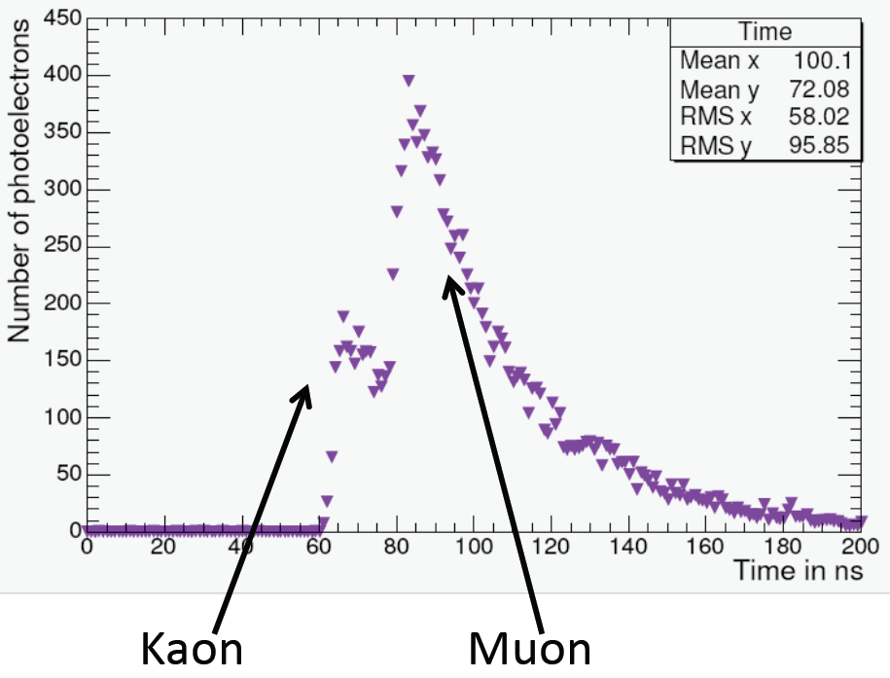
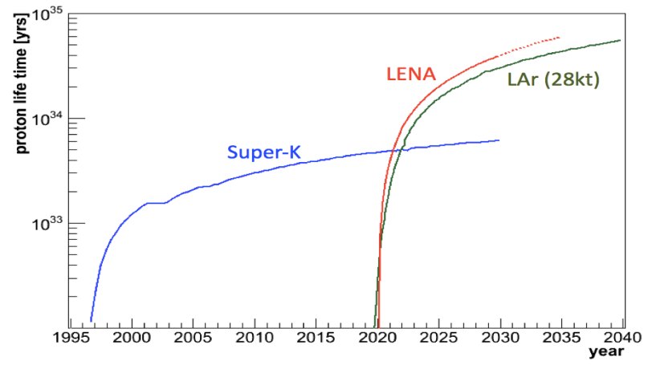
Physical goals: Natural sources
Physics potential
Marc Tippmann
Technische Universität München
4/20
Geoneutrinos: Determine U/Th decay contribution to earth heat production to 1%, ratio of U/Th contribution to 5%
Proton decay: High detection efficiency (≈68%) for p → K⁺ν decay channel → τ_{p,partial}> 4∙10³⁴ years (90% C.L.) for 10years no events observed
ˉ
proton decay
proton decay
Notes:
Use neutrinos to study sources
plan to increase bg free observation time by Pi0-e- discrimination algorithm using BDT -> maybe ~ 1*10^35yrs achievable

Slide 7
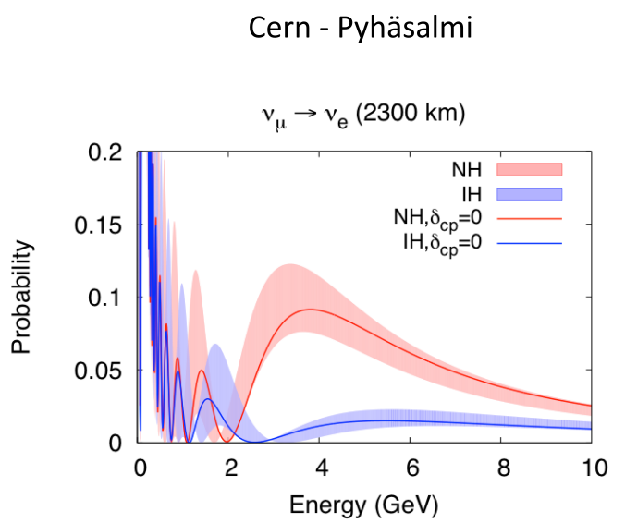
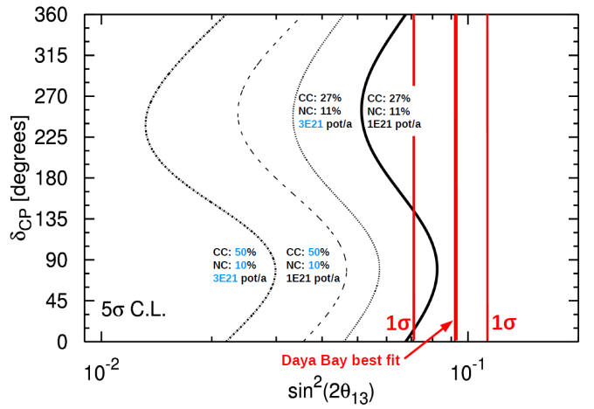
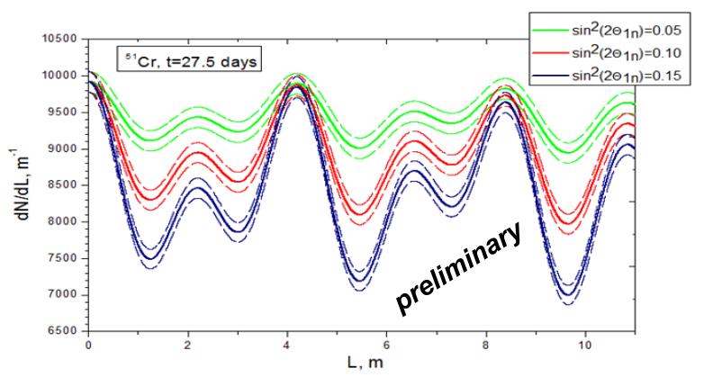
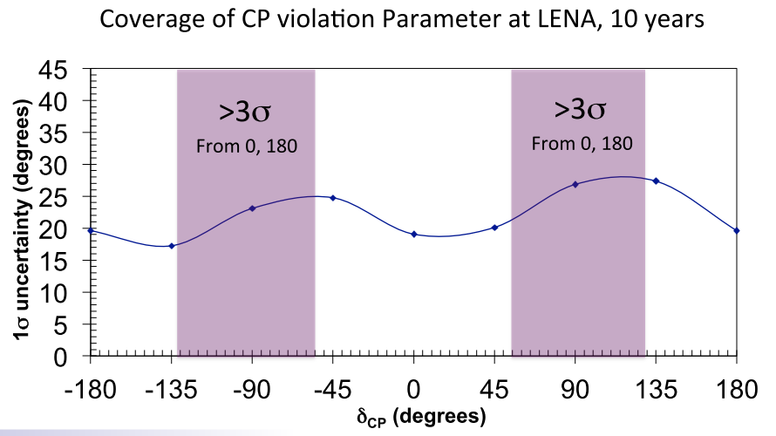
Physical goals: Artificial sources
Physics potential
Marc Tippmann
Technische Universität München
5/20
mass hierarchy
Conventional ν_{μ} beam CERN-Pyhäsalmi (2300km, maximum at 4-5GeV): Mass hierarchy with > 5σ in 10 years, precision measurement of θ₁₃+ θ₂₃, possibly δ_{CP}
Electron capture neutrino source: Sterile neutrinos:
⁵¹Cr 5MCi 55days → sin²(2θ₁₄) < 7∙10⁻³ with 90%C.L. 10∙55days → < 2.2∙10⁻³
θ₁₃
Pion decay-at-rest: δ_{CP}: 10 years → 42% coverage with > 3σ
Reactor antineutrinos (Fréjus site): Δm₁₂² ≈1%, θ₁₂≈10%
GeV
mass hierarchy
pion decay-at-rest
sterile ν
Notes:
Use sources to study neutrinos

Slide 8
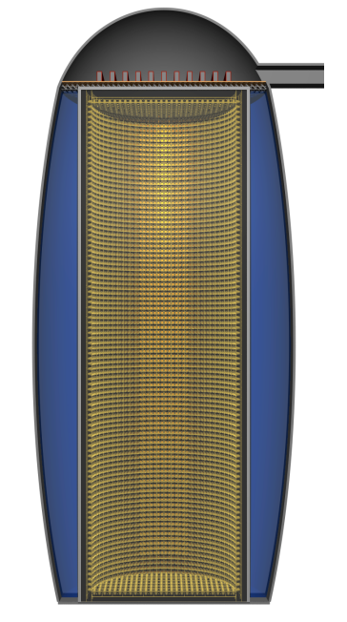
LENA detector layout
Detector layout
Marc Tippmann
Technische Universität München
6/20
Electronics hall
20m height
Liquid scintillator
LAB + 3g/l PPO + 20mg/l bis-MSB
Active volume: 50.8kt
Top muon veto
Vertical muon tracking
Concrete tank
Covered with steel sheets
r = 16m, h = 100m, wall thickness 60cm
Total mass: 69.1kt LAB
Water Cherenkov muon veto 133kt, min. thickness 2m
Fast neutron shield, inclined muons
2000 12“-PMTs (encaps.)
PMT support structure
Inner face at r = 14m, h = 96m
30,000 Optical Modules: Contains 12“-PMT, light concentrator, buffer liquid
30% optical coverage
Optical shielding from tank
Cavern
Elliptical cross-section from above
220,000m³
Rock overburden: 4000 mwe
Detector lifetime foreseen: > 30 years
Notes:
PSS: thickness 1m

Slide 9
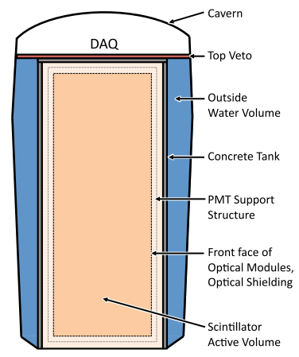
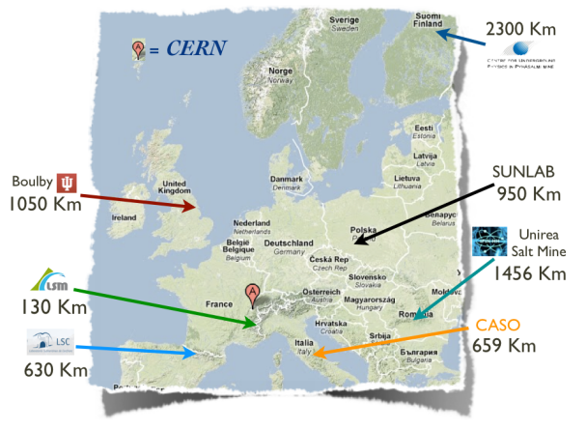
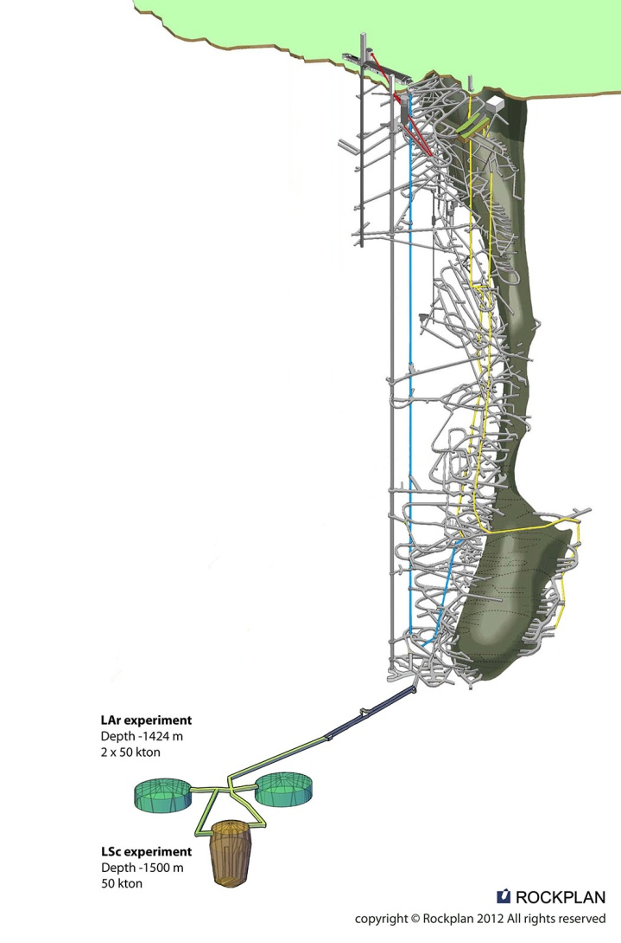
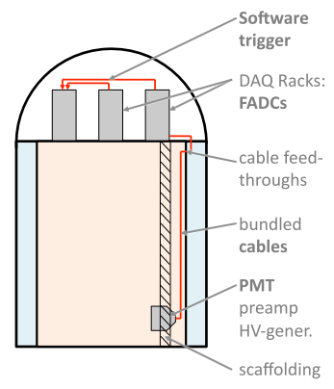
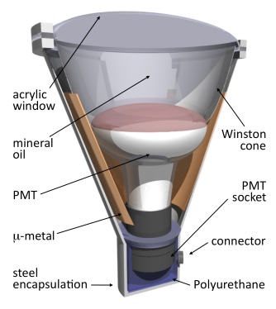
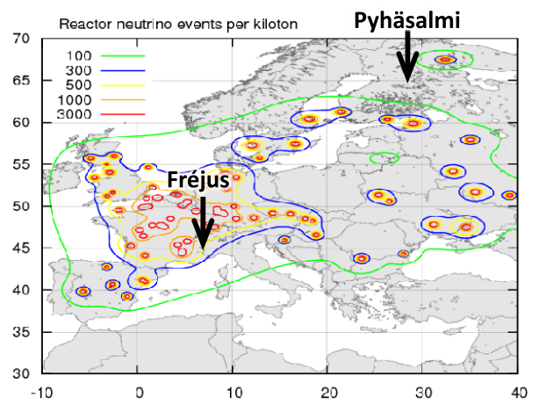
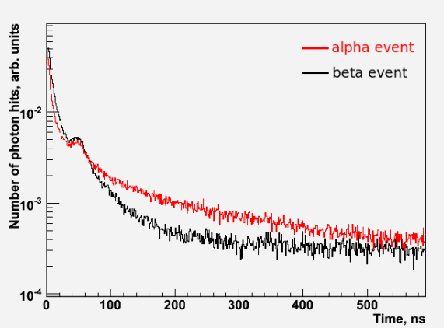
Technical demands
Physics potential
Marc Tippmann
Technische Universität München
7/20
Site: 4000mwe rock overburden, cavern excavation + stability, reactor neutrinos, neutrino beam → LAGUNA design study
Tank: Shape, water shielding, buffer, optical shielding, radiopurity, chemical compatibility, cost
Construction: Excavation, instrumentation, purification, filling + liquid handling
Scintillator: Light yield, scattering + absorption lengths, fast, particle identification, radiopurity, lifetime, toxicity, flammability
Photosensors: Optical coverage, detection properties, homogeneity of p.e. yield, low background materials, pressure, chemical compatibility, lifetime, cost
Electronics: Pulse shape, event rates, number of channels, cabling, sensor arrays, cost
Operation: Calibration, convection, cooling, N₂-buffering, maintenance
Most issues solved, necessary R&D under way No showstoppers

Slide 10
LENA White Paper published recently
Physics potential
Marc Tippmann
Technische Universität München
8/20
More information can be found in the LENA White Paper
Watch out, already some changes: e.g. physical goals (mass hierarchy, pion decay-at-rest), concrete tank, buffer within optical module, simulations of pressure encapsulation
→ Recent talks
e.g. Neutrino12, Lothar Oberauer, “Future liquid scintillator detectors“

Slide 11
Photosensors

Slide 12
Which demands result from our physics agenda?
Photosensors - Requirements
Marc Tippmann
Technische Universität München
9/20
Event detection in liquid scintillator detectors:
Neutrino scatters off electron
→ Electron freed
→ Loses kinetic energy via excitation of scintillator molecules
→ Emit light at deexcitation
ν_{e}
e⁻
96m
28m
Notes:
absorption
to give an idea: for PMTs covering 30% of area ~50 – 1*10^6 detected photons

Slide 13
Which demands result from our physics agenda?
Photosensors - Requirements
Marc Tippmann
Technische Universität München
9/20
Event detection in liquid scintillator detectors:
Neutrino scatters off electron
→ Electron freed
→ Loses kinetic energy via excitation of scintillator molecules
→ Emit light at deexcitation
Low interaction cross-section
→ Big active volume
→ Big surface (9700m²)
ν_{e}
Sensor requirements:
e⁻
sensitive around 420nm
pressure-withstanding,
long-term reliability
low price/detector area
96m
28m
Notes:
absorption
to give an idea: for PMTs covering 30% of area ~50 – 1*10^6 detected photons

Slide 14
Which demands result from our physics agenda?
Photosensors - Requirements
Marc Tippmann
Technische Universität München
9/20
Event detection in liquid scintillator detectors:
Neutrino scatters off electron
→ Electron freed
→ Loses kinetic energy via excitation of scintillator molecules
→ Emit light at deexcitation
Low interaction cross-section
→ Big active volume
→ Big surface (9700m²)
Deposited energies: 200keV - ≈20GeV
→ 700 - 60∙10⁶ photons arriving at photosensor surface
Low energies: Only energy of event available to distinguish neutrino sources
High energies (e.g. neutrino beam): Also directionality
ν_{e}
Sensor requirements:
e⁻
sensitive around 420nm
pressure-withstanding,
long-term reliability
low price/detector area
96m
single photon detection, high detection efficiency, large dynamic range
28m
good energy resolution
low fake detections: dark count, afterpulsing
good time resolution
Notes:
absorption
to give an idea: for PMTs covering 30% of area ~50 – 1*10^6 detected photons

Slide 15
Which demands result from our physics agenda?
Photosensors - Requirements
Marc Tippmann
Technische Universität München
9/20
Event detection in liquid scintillator detectors:
Neutrino scatters off electron
→ Electron freed
→ Loses kinetic energy via excitation of scintillator molecules
→ Emit light at deexcitation
Low interaction cross-section
→ Big active volume
→ Big surface (9700m²)
Deposited energies: 200keV - ≈20GeV
→ 700 - 60∙10⁶ photons arriving at photosensor surface
Low energies: Only energy of event available to distinguish neutrino sources
High energies (e.g. neutrino beam): Also directionality
Background (radioactivity inside + outside of detector, atmospheric muons, …); neutrino beam
→ Event reconstruction
ν_{e}
Sensor requirements:
e⁻
sensitive around 420nm
pressure-withstanding,
long-term reliability
low price/detector area
96m
single photon detection, high detection efficiency, large dynamic range
28m
good energy resolution
low fake detections: dark count, afterpulsing
good time resolution
low radioactivity
Notes:
absorption
to give an idea: for PMTs covering 30% of area ~50 – 1*10^6 detected photons

Slide 16
How can we obtain limits for the sensor requirements?
Photosensors - Requirements
Marc Tippmann
Technische Universität München
10/20
First estimate through comparison with previous liquid scintillator experiments (Borexino, KamLAND, DoubleChooz)
Improve values of limits via geant4 Monte Carlo simulations
Determine influence of sensor properties on overall detector behavior
If detector properties needed to achieve physics goals are known → can infer demands on sensor

Slide 17
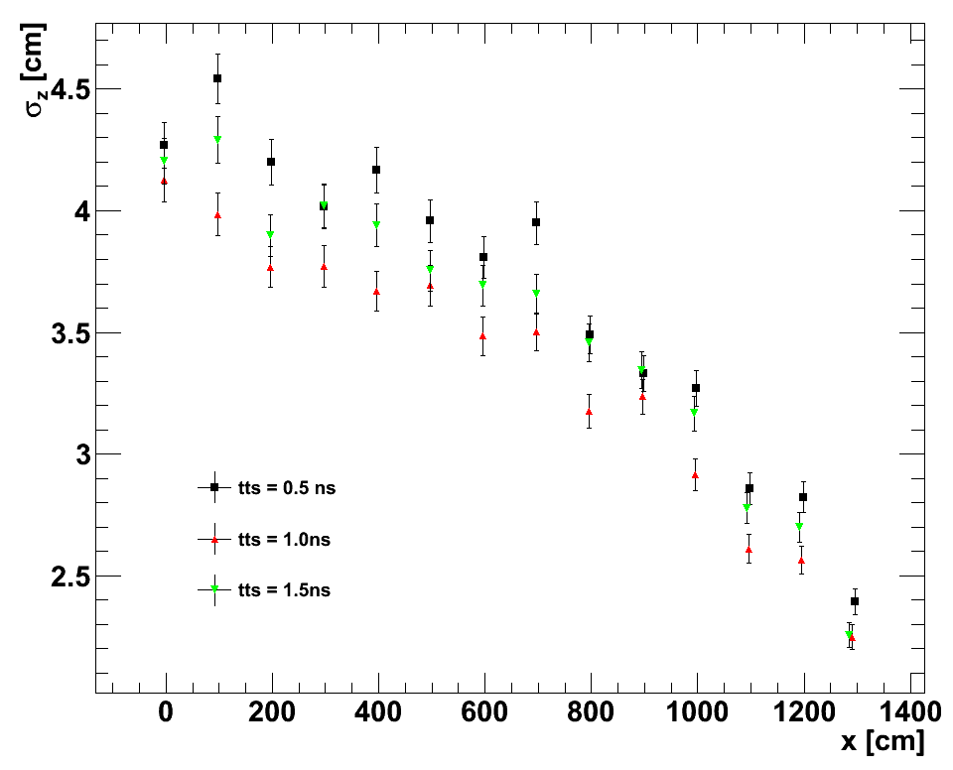
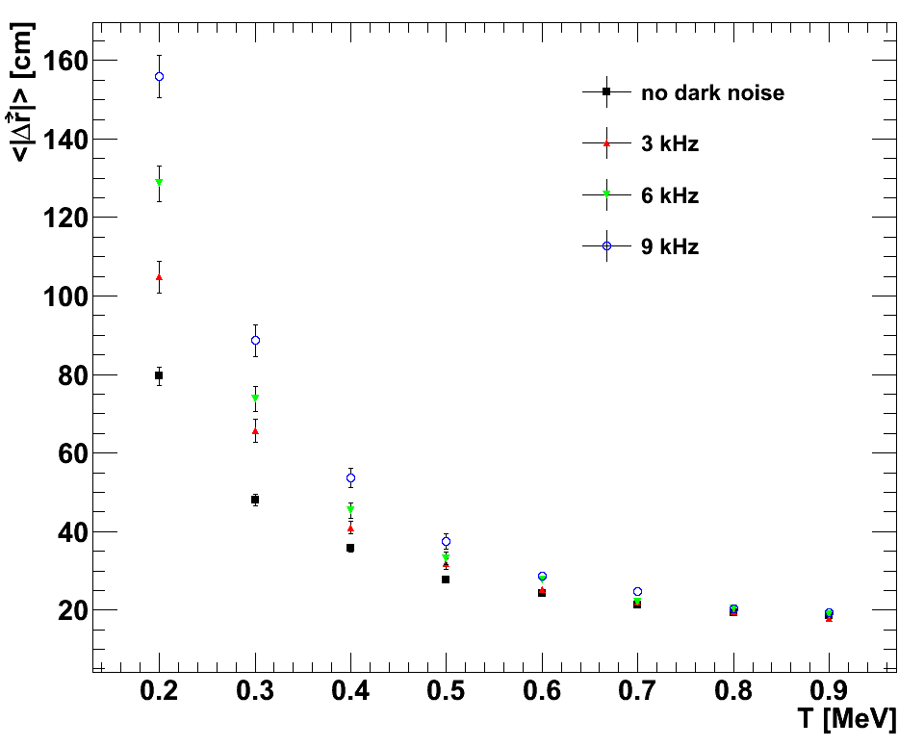
How can we obtain limits for the sensor requirements?
Photosensors - Requirements
Marc Tippmann
Technische Universität München
10/20
First estimate through comparison with previous liquid scintillator experiments (Borexino, KamLAND, DoubleChooz)
Improve values of limits via geant4 Monte Carlo simulations
Determine influence of sensor properties on overall detector behavior
If detector properties needed to achieve physics goals are known → can infer demands on sensor
MC studies in progress, first results:
Position and energy resolution (Dominikus Hellgartner)
Timing uncertainty:
First simulations, still fighting some problems with small timing uncertainties
First impression: no big influence
Dark Noise:
No big influence for energies around 1MeV or bigger
For 200keV position + energy resolution ≈30% worse
α/β-discrimination (Randolph Möllenberg)
Dark Noise:
Strong influence on efficiency
Late Pulses + Fast Afterpulses
Negligible effect
Winston Cones (50° opening angle)
Improve separation by a factor of two

Slide 18
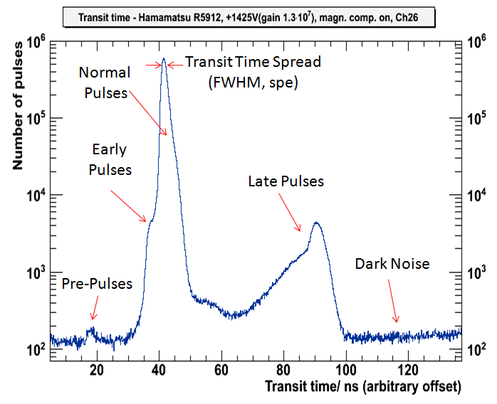
Photosensors - Requirements
Marc Tippmann
Technische Universität München
11/20
Property | Current limit
Timing uncertainty (single photoelectrons(spe), FWHM) | <3.0ns
Early pulses | <1%
Late pulses | <4%
Quantum efficiency @420nm | >21%
Optical coverage, using 1.75x light concentrators | 30%
Dynamic range | spe→0.3pe/cm²
Gain (PMTs) | >3∙10⁶
Peak-to-valley ratio (spe) | >2
Dark count | < 15Hz/cm²
Slow afterpulses (0.2-200µs) | <5%
Fast afterpulses (0-200ns) | <5%
Pressure resistance | >13bar
²³⁸U content | < 3∙10⁻⁸g/g
²³²Th content | < 1∙10⁻⁸g/g
^{nat}K content | < 2∙10⁻⁵g/g
Lifetime | >30y
First MC results:
possibly higher value allowed
probably needs to be increased
order of magnitude correct for big sensors; currently simulating with different trigger layout to establish value for SiPMs
can be increased

Slide 19
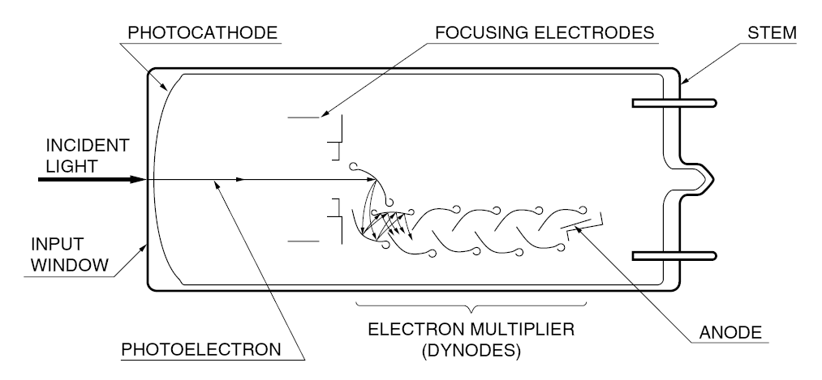
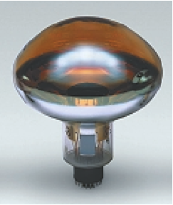
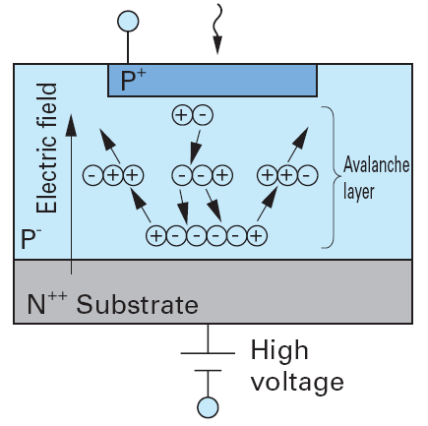
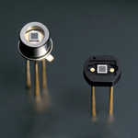
Photosensors - Candidate photosensors
Marc Tippmann
Technische Universität München
12/20
Which photosensors can fulfill the requirements?
Photomultipliers (PMTs)
Fulfill all requirements
→ Sensor of choice at the moment
Which sensors could fulfill them?
Si-Photomultipliers (SiPMs):
Better energy resolution, time resolution, detection efficiency
Dark count possibly too high
→ Study in detail
Hybrid detectors / New sensors
Crucial question: Available in high quantities in time for construction?
Possibly yes: QUASAR, X-HPD, HAPD, QUPID
Probably not: Abalone, LAPPD
Notes:
SiPMs DN -> need HE physics trigger logic

Slide 20
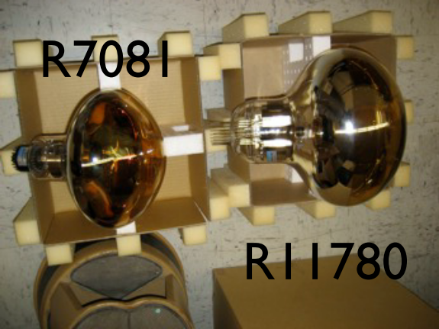
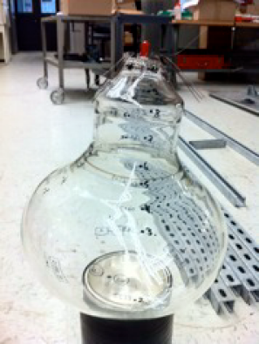
Which sensors could fulfill the requirements?
Photosensors - Candidate photosensors
Marc Tippmann
Technische Universität München
13/20
Favored sensor at the moment: PMTs
New models are most promising:
Hamamatsu R11780 (12“)
good transit time spread, by now high quantum efficiency, still high afterpulsing(?), high pressure tolerance; 100 prototypes built so far
Electron Tubes Enterprises D784 (11“)
designed from scratch for good performance + high pressure tolerance, so far only dummies for pressure tests
Existing models:
Hamamatsu R6594 (5“), R5912 (8“), R7081 (10“), R7250 (20“)
Electron Tubes Enterprises 9823 (5“), 9354 (8“)
Current design: Use either 11“/12“-PMTs (40k/31k PMTs in ID) or 8“ PMTs (68k PMTs in ID)
11-12“ should be at cost optimum, 8“ proven technology
Need to find out missing characteristics for all candidate sensor types + measure properties of candidate PMT series to select optimum sensor
D784
Notes:
11“ -> 40k PMTs in ID

Slide 21
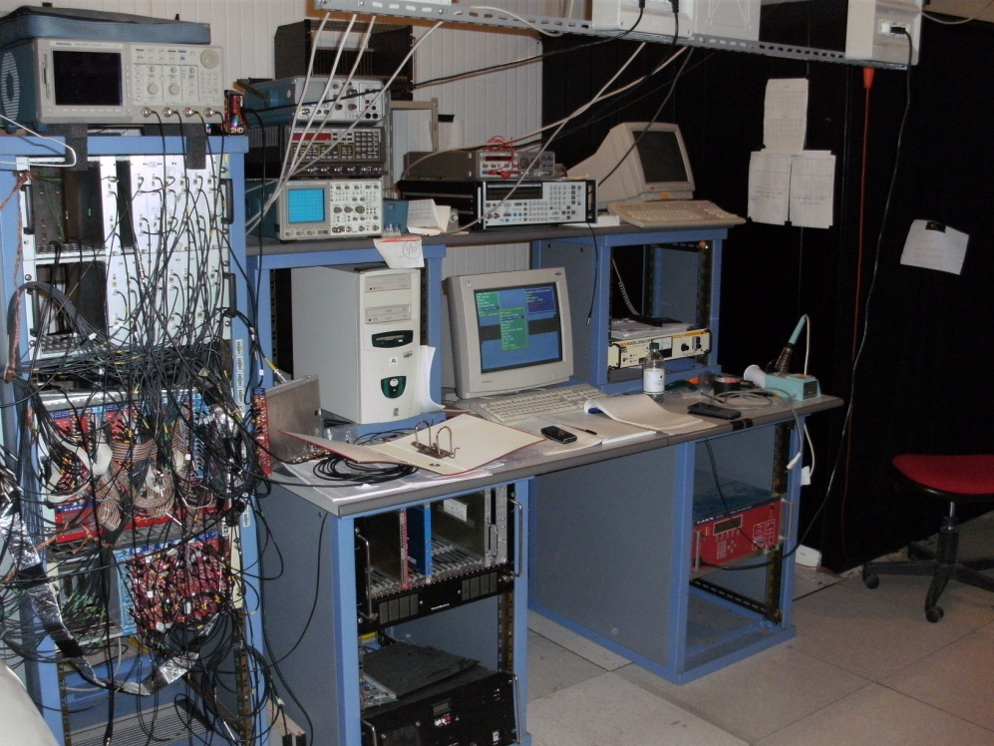
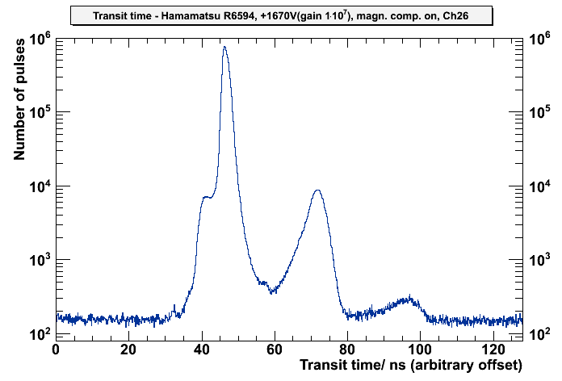
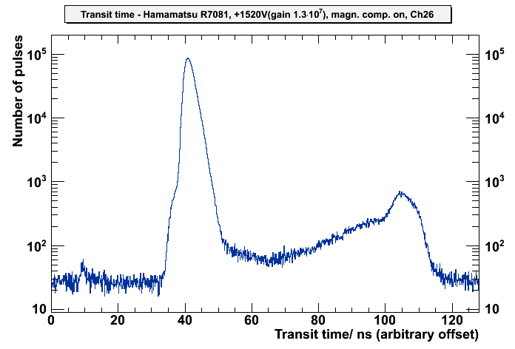
How can we determine the missing properties?
Photosensors - Measurement of sensor properties
Marc Tippmann
Technische Universität München
14/20
Measurements at the Borexino PMT testing facility (INFN LNGS, Italy)
Light source: 30ps diode laser (410nm), diffusor mounted at ceiling
Magnetic field compensation
Measure up to 64 PMTs simultaneously with NIM electronics
→ Transit time distribution, afterpulse time distribution, charge distribution, dark count
Measured until now 1 sample each of:
Hamamatsu: R6091(3“), R6594(5“), R5912(8“) and R7081(10“)
ETEL: 9351(8“)
R6594
R7081

Slide 22
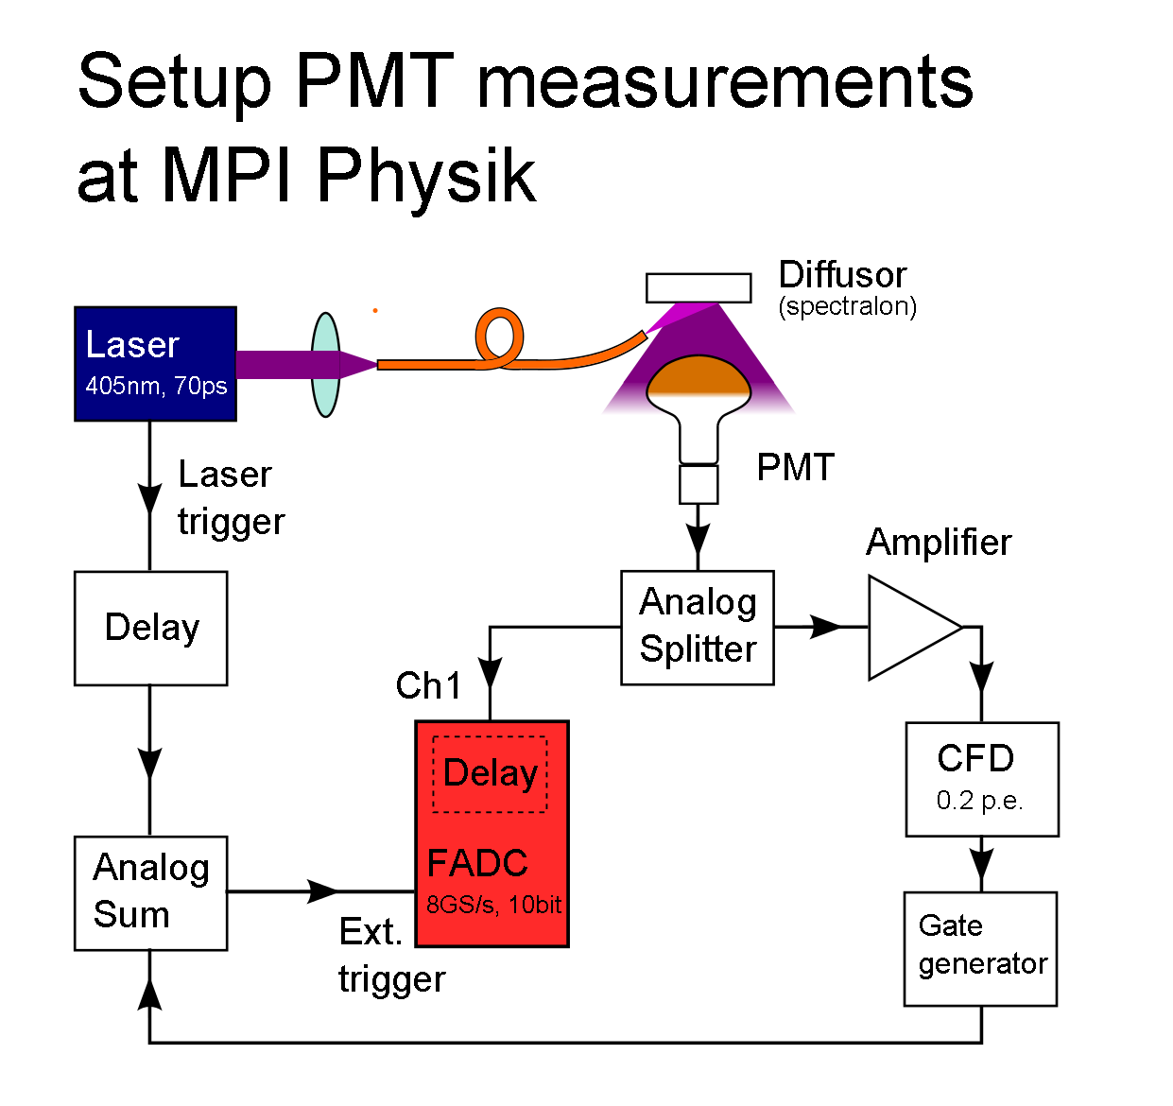
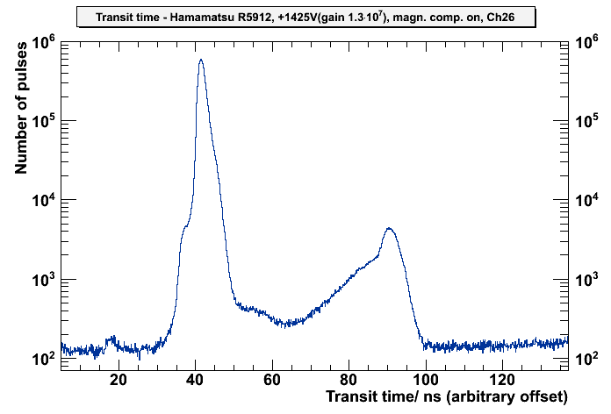
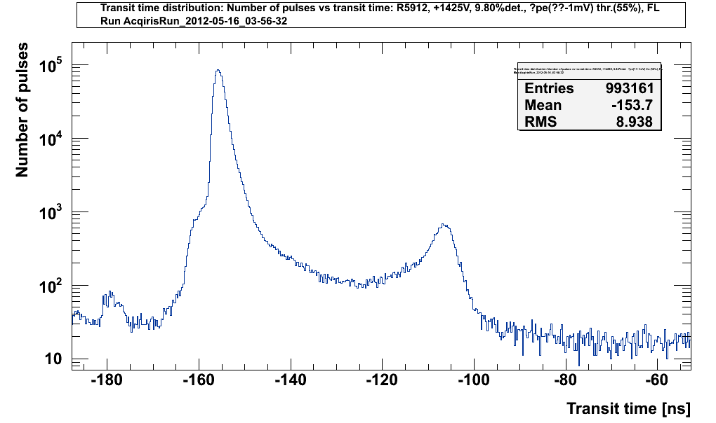
Photosensors - Measurement of sensor properties
Marc Tippmann
Technische Universität München
15/20
How can we determine the missing properties? Measurements at the Munich PMT testing facility
thr. 0.2pe CF, 2% det. prob.
thr. 0.1pe CF, ~11% det. prob.
preliminary
Comparison with same PMT:
Hamamatsu R5912, +1425V

Slide 23
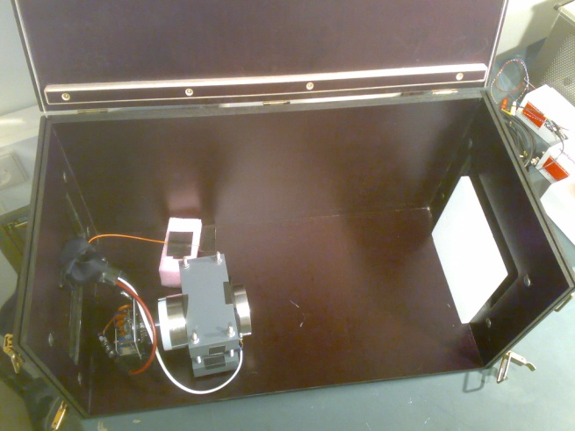
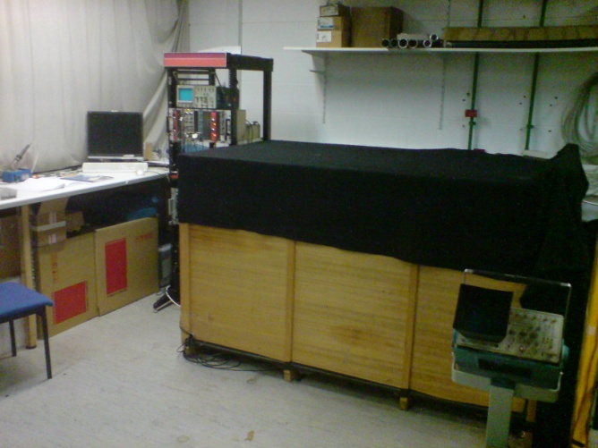
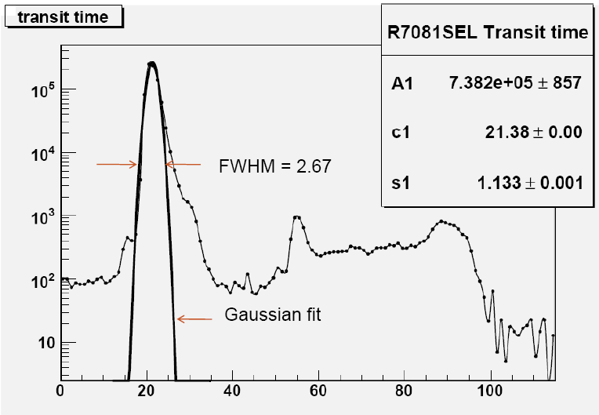
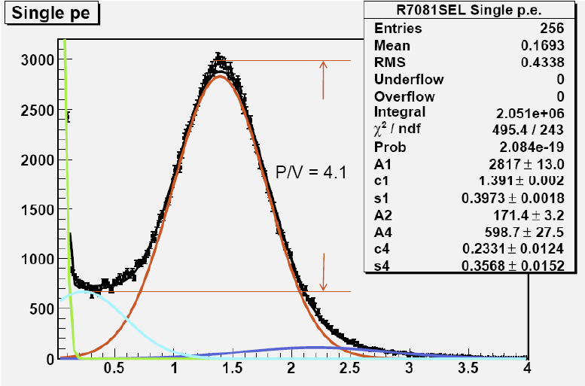
Photosensors - Measurement of sensor properties
Marc Tippmann
Technische Universität München
16/20
How can we determine the missing properties? Measurements at the Munich PMT testing facility
Key features:
Record waveform → greatest flexibility for measurements, offline analysis; waveform acquisiton rate up to 5kHz
Coincidence electronics → single photon measurements with virtually no 2-photon pulses in reasonable time + less data
So far can measure timing properties, dynamic range, dark count, afterpulsing + energy resolution
Electronics works
Next steps:
Migrate to larger dark box
Improve setup (fiber optics, transmissive diffusor, scanning, QE, more features in evaluation software…)
More extensive measurements of candidate sensors + light concentrators
…also:
measurements done by Paolo Lombardi at INFN Milano of 5-10“ Hamamatsu super-bialkali PMTs (same series as tested at LNGS)
Notes:
5kHz ->acquisiton of statistics not limitted by electronics

Slide 24
Photosensors - Optical module for PMTs
Marc Tippmann
Technische Universität München
17/20
Most probably PMTs will be the photosensor for LENA
→ What components do we need for optimum performance?
PMT
Increase active area + limit field of view
→ Light concentrator (Winston Cone)
Shield PMT from earth magnetic field
→ mu metal
Power supply
→ Voltage divider
Electronics? (Amplifier, signal processing)
Pressure
→ Encapsulation, acrylics glass window + stainless steel housing
During filling, tank is filled with water → conductive
→ Cast voltage divider into insulator compatible with ultrapure water + liquid scintillator: polyurethane
Notes:
WC : maybe can do measurements at MPI Physik

Slide 25
Photosensors - Optical module for PMTs
Marc Tippmann
Technische Universität München
17/20
Most probably PMTs will be the photosensor for LENA
→ What components do we need for optimum performance?
PMT
Increase active area + limit field of view
→ Light concentrator (Winston Cone)
Shield PMT from earth magnetic field
→ mu metal
Power supply
→ Voltage divider
Electronics? (Amplifier, signal processing)
Pressure
→ Encapsulation, acrylics glass window + stainless steel housing
During filling, tank is filled with water → conductive
→ Cast voltage divider into insulator compatible with ultrapure water + liquid scintillator: polyurethane
Need to shield scintillator from radioactive contamination contained in the PMT‘s glass → layer of inactive buffer liquid between scintillator and PMTs
New design: include buffer liquid into pressure encapsulation
→ Bigger active volume!
Optical Module
Notes:
WC : maybe can do measurements at MPI Physik

Slide 26
PMT optical module: Status of development
Photosensors - Optical module for PMTs
Marc Tippmann
Technische Universität München
18/20
PMT
Determine requirements → in progress
Measure properties → in progress
Selection of best series → to do
Modifications? → to do
Pressure encapsulation
Design (include design of OM) → in progress
Simulations → in progress
Build prototype → to do
Test: pressure tank, radiopurity, long term → to do
Light concentrator
Simulations → in progress
Build prototype → to do
Test:
Optical properties → to do
Material compatibility → in progress

Slide 27
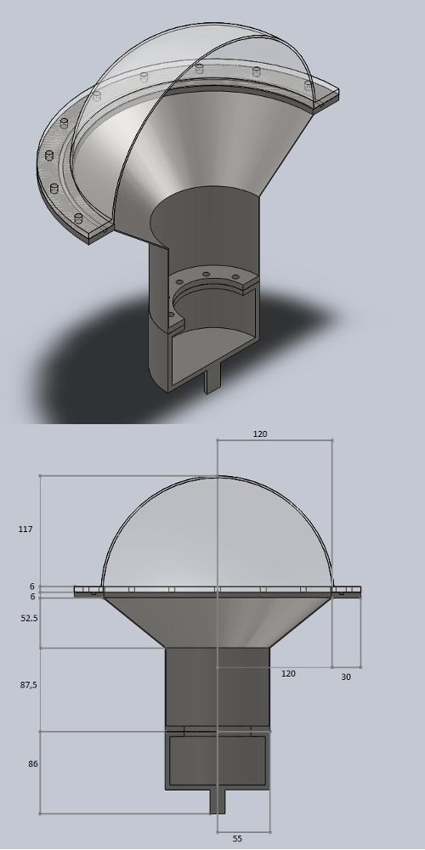
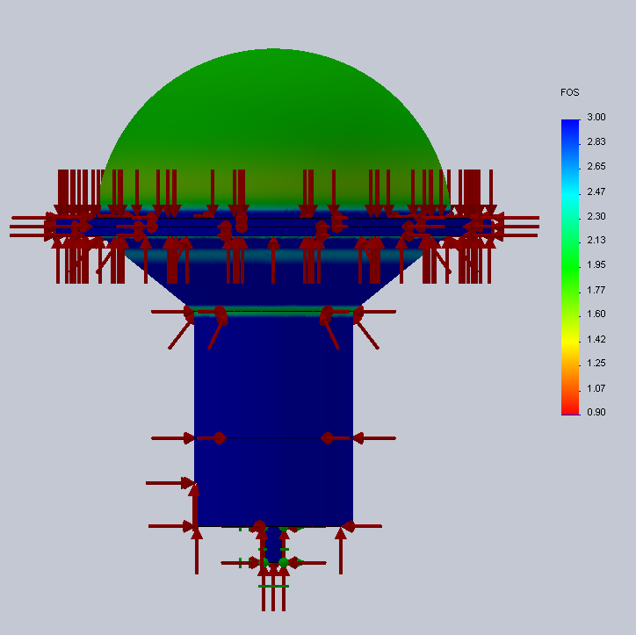
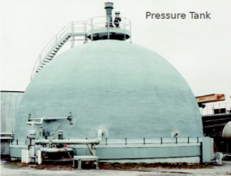
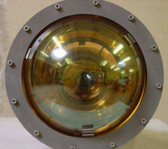
Pressure encapsulations
Photosensors - Optical module for PMTs
Marc Tippmann
Technische Universität München
19/20
How to develop an encapsulation?
Design, pressure simulations, build prototype, pressure tests

Slide 28
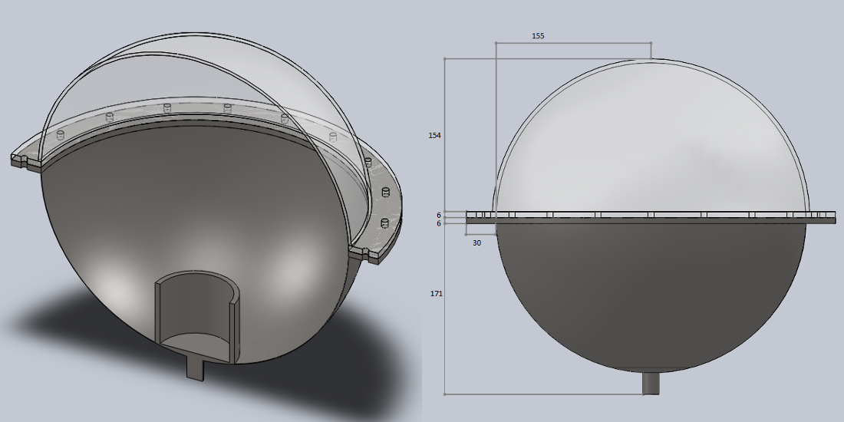
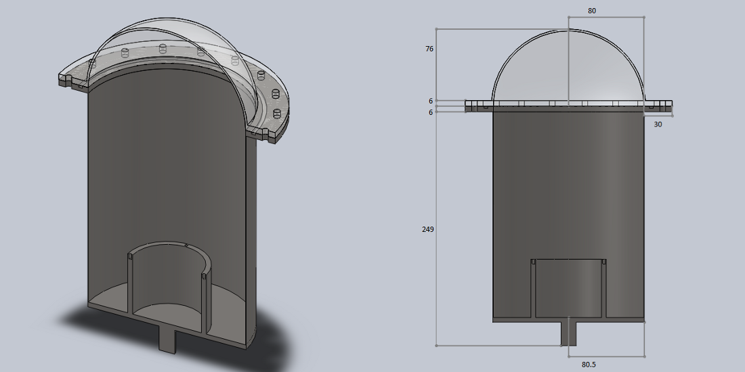
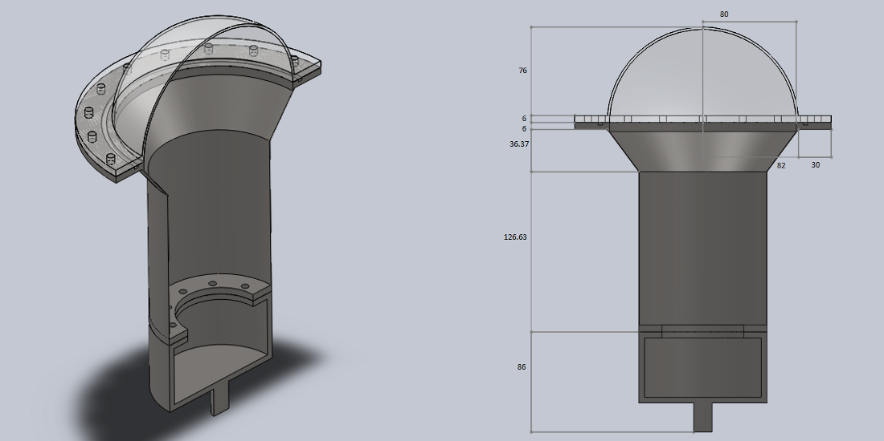
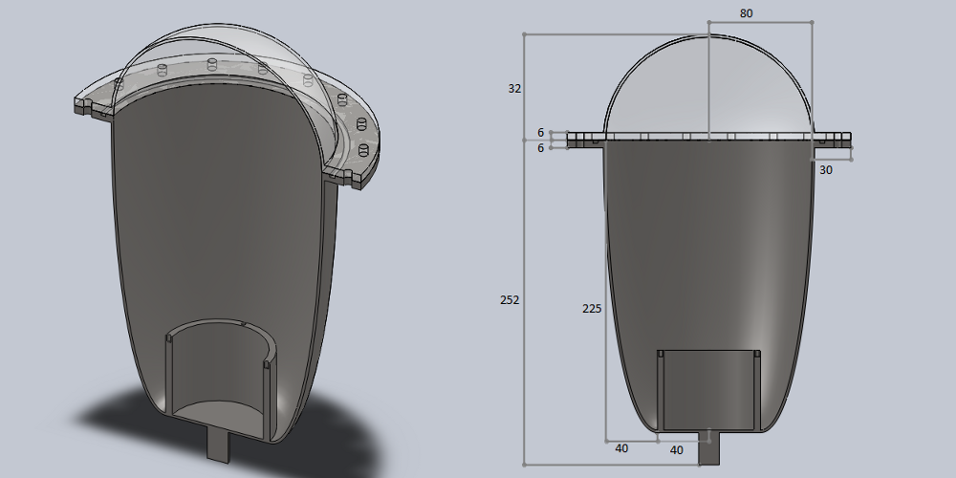
Pressure encapsulations
Photosensors - Optical module for PMTs
Marc Tippmann
Technische Universität München
19/20
How to develop an encapsulation?
Design, pressure simulations, build prototype, pressure tests
Was treated in Bachelor thesis + continuing work of German Beischler
Created engineering drawings
…for different designs (spherical, conical, cylindrical, elliptical, rotated spline)
…for 5-10“ PMTs of Hamamatsu + ETEL

Slide 29
Pressure encapsulations
Photosensors - Optical module for PMTs
Marc Tippmann
Technische Universität München
19/20
How to develop an encapsulation?
Design, pressure simulations, build prototype, pressure tests
Was treated in Bachelor thesis + continuing work of German Beischler
Created engineering drawings
…for different designs (spherical, conical, cylindrical, elliptical, rotated spline)
…for 5-10“ PMTs of Hamamatsu + ETEL
Did first Finite Element Analysis simulations with SolidWorks to determine necessary thicknesses + weight
Need encapsulations due to pressure, but weight = radioactivity → keep them as thin as safety allows

Slide 30
Pressure encapsulations
Photosensors - Optical module for PMTs
Marc Tippmann
Technische Universität München
19/20
How to develop an encapsulation?
Design, pressure simulations, build prototype, pressure tests
Was treated in Bachelor thesis + continuing work of German Beischler
Created engineering drawings
…for different designs (spherical, conical, cylindrical, elliptical, rotated spline)
…for 5-10“ PMTs of Hamamatsu + ETEL
Did first Finite Element Analysis simulations with SolidWorks to determine necessary thicknesses + weight
Need encapsulations due to pressure, but weight = radioactivity → keep them as thin as safety allows
Simulations so far were still for the old optical module without the buffer liquid → have to adapt design
Currently cross-checking results + dependence on simulation parameters and improving simulations
→ Switching from volume meshing to shell-meshing; are considering migrating from SolidWorks to ANSYS

Slide 31
Conclusions
LENA
… is a future 50kt liquid scintillator detector, which could provide valuable insights on neutrino properties, measure various neutrinos sources with unprecedented accuracy and set more stringent upper limits on proton decay
Detector layout in short:
Active mass 50kt, concrete tank, 32,000 12“ –PMTs, buffer inside optical module
Background → 133kt water cherenkov muon veto + top muon veto, 4000mwe rock overburden, favored site at the moment Pyhäsalmi, Finland
Physics highlights:
Galactic supernova neutrinos + diffuse supernova neutrino background, geoneutrinos
Proton decay via K⁺ ˉ : 10 years background-free → lifetime > 4∙10³⁴years (90% C.L.)
Mass hierarchy: 10²¹ POT → > 5σ significance
Sterile neutrinos: ⁵¹Cr 5MCi 550days → sin²(2θ₁₄) < 2.2∙10⁻³ with 90% C.L.
δ_{CP}: via 10 years pion decay-at-rest → 42% coverage with >3σ
Foreseen start of data taking in 2022
ν
Notes:
LENA is a future 50kt liquid scintillator detector, which could provide valuable insights on neutrino properties, measure various neutrinos sources with unprecedented accuracy and set more stringent upper limits on proton decay

Slide 32
Conclusions
Photosensors
Physics goals of LENA set demanding requirements for photosensors
Started to quantify limits with Geant4 Monte Carlo simulations
Measured properties for 5-10“ PMT series at LNGS + Milano
Constructing photosensor test facility in Munich to measure missing sensor properties, first test measurements in good agreement
So far PMTs favoured option:
Current standard option: Hamamatsu R11780 (12“)
Some other promising alternative sensors have to be tested
Designed an optical module for PMTs consisting of light concentrator, buffer liquid, mu metal, voltage divider, pressure encapsulation
Have completed first designs + FEA simulations of pressure encapsulations → optimize designs, cross-check simulation results
First prototype of complete optical module in ≈ 1 year
Notes:
LENA is a future 50kt liquid scintillator detector, which could provide valuable insights on neutrino properties, measure various neutrinos sources with unprecedented accuracy and set more stringent upper limits on proton decay

Slide 33
Backup slides

Slide 34
p→ K⁺ ˉ
ν
LHC won‘t exclude complete parameter space for SUSY SM extensions
K⁺ decay channel is favored due to R parity, which is part of all SUSY theories → parameter space left to be excluded
We plan to improve our background rejection capability (currently 0.6 events / 500 kt ∙yrs) by including the tracking capability of LENA → 20 yrs bg-free measurement time → exclude up to ≈ 1∙10³⁵ yrs → covers greatest part of SUSY extensions
Even without a viable theory, all channels must be examined - it could well be that all current theories are wrong. This channel combines quarks from first + second family → particularly interesting
LENA has the highest detection efficiency + mass of currently planned detectors for this channel
Nevertheless: will look at potential of K⁰ channels in near future

Slide 40
Which sensors could fulfill the requirements?
Hybrid detectors
Crucial question:
Available in high quantities in time for construction?
Possibly yes:
Layout: Photocathode, HV, scintillator crystal, PMT
QUASAR
better time resolution, lower dark count + afterpulsing
no manufacturer, dynamic range possibly too small
X-HPD
possibly too high dark count + too small dyn. range
Layout: Photocathode, HV, APD
HAPD
should be commercially available soon
dyn. range possibly too small
QUPID
small size, designed for LAr/LXe, dark count possibly too high, dyn. range poss. too low, detection efficiency not yet known
Notes:
SiPMs DN -> need HE physics trigger logic

Slide 41
Which sensors could fulfill the requirements?
Hybrid detectors
Crucial question:
Available in high quantities in time for construction?
Probably not:
Layout: Photocathode, HV, scintillator crystal, SiPM
Abalone
simple, robust + cheap design
Prototypes not yet stable under atmospheric pressure
Layout: Photocathode, 2 microchannel plates → anode striplines read out at both ends
LAPPD
ps time resolution, large area, position sensitive, cheap(?)
no complete prototype yet
Notes:
SiPMs DN -> need HE physics trigger logic

Slide 42
How can we determine the missing properties? Measurements at the Borexino PMT testing facility
Photosensors - Measurement of sensor properties
Marc Tippmann
Technische Universität München
15/20
 | R6091 (3“) with 1.8“ aperture | R6594 (5“) | R5912 (8“) | R7081 (10“) | ETL9351 (8“) no. 1732 | ETL9351 (8“) average
Voltage | +1760V | +1670V | +1425V | +1520V | +1500V | ≈+1450V
Gain | 1.0∙10⁷ | 1.0∙10⁷ | 1.3∙10⁷ | 1.3∙10⁷ | 1.0∙10⁷ | 1.0∙10⁷
pe/trigger (npe) | 2.21% | 5.53% | 1.83% | 2.91% | 4.78% | 5.19%
TTS (FWHM) (manufacturer) | 1.89ns (2.0ns) | 1.91ns (1.5ns) | 2.04ns (2.4ns) | 3.05ns (3.5ns) | 2.16ns | 2.76ns
EP (all non-gaussian) | 0.14% | 2.95% | 1.93% | 0.57% | 1.23% | 0.75%(3σ)
LP (all non-gaussian) | 27.29% | 34.16% | 55.01% | 42.90% | 8.70% | -
LP (after NP peak) | 6.26% | 3.13% | 2.88% | 3.09% | 4.08% | 7.90%(3σ)
DN | 0.192kHz | (5.23kHz) | 1.62kHz | 2.64kHz | 1.72kHz | 2.48kHz
DN/cm² | 12.1 Hz/cm²(eff.) | (46.3 Hz/cm²) | 5.1 Hz/cm² | 5.3 Hz/cm² | 5.3 Hz/cm² | 7.7 Hz/cm²
Ion AP | 0.14% | 0.94% | 6.62% | 5.12% | 2.57% | 4.9%
p/V | 2.04 | 3.88 | 2.99 | 3.09 | 2.25 | 2.10

Slide 44
Projects Paolo Lombardi
Study of HQE PMTs:
Measured Hamamatsu super-bialkali PMTs (≈34% peak-QE): R6594-SEL, R5912-SEL, R7081-SEL
→ Direct comparison with standard photocathode PMTs measured @ Borexino PMT testing facility or Garching setup possible
Next measurements:
Cathode uniformity scan
Magnetic field effect
Gain vs voltage response
Dark noise vs temperature
Long term stability
Paolo Lombardi, LENA Meeting 2010-07-05

Slide 45
Pressure encapsulations
New PMTs being developed for LBNE:
Designed for 11bar (81m tank height) + good performance, will have housing around pins (most sensitive area)
Hamamatsu R11780: 12“
Designed from scratch
Two independent simulations by Hamamatsu + LBNE → fulfills pressure requirements
≈100 prototypes build → sensor properties look mostly very good by now, will commence pressure tests soon
Did pressure tests for R7081 (10“): designed for 7bar, all survived until 10bar, some above 15bar
ETEL D784: 11“
Designed from scratch
Simulations → fulfills pressure requirements
Both manufacturers claim that designs for higher pressure should be possible, problem is not pressure but pressure + high purity water for several 10y
LENA: Do we need pressure encapsulations: for the ID? for the OD?
ID (100m height): LAB → ≈9.8bar
OD (100m height): water → ≈11bar + ultrapure water for 30y
Use encapsulations
Develop new PMT type which can withstand 13+bar
Decrease height

Slide 46
Pressure withstanding PMT encapsulations for LENA: Pressure simulations
Simulate behaviour under pressure with a Finite Elements Analysis (FEA) simulation software
Engineering drawings and FEA pressure simulations were done with same software
Software: SolidWorks Educational Edition Academic Year 2010-2011 SP4.0, Simulation Premium package
Settings: Linear static study, 12bar pressure, node distance 3mm ± 0.15mm
Materials: High impact resistant acrylic glass, 1,4404 stainless steel X2CrNiMo17-12-2
Computer: Intel i7-2600, 8GB DDR3-RAM, AMD Radeon HD 6450 1GB GDDR3, Win7 Prof. 64bit
So far designs + simulations for 5 candidate PMTs:
Hamamatsu: R7081 (10“), R5912 (8“), R6594 (5“)
Electron Tubes Enterprises Ltd.: 9354 (8“), 9823 (5“)
Was treated in a bachelor thesis by German Beischler
In consultance with Harald Hess (head of workshop + SolidWorks expert of our chair)
Continues these studies!
R6594 R5912 R7081
Notes:
SW contains CAD software for design
pressure resistance: 9.8bar needed -> 2.2bar margin, LBNE: ~8.8bar needed, design PMTs to withstand 11bar -> 2.2bar margin
meshing: acc. to our solidworks expert 3mm is sufficient
computer: important: too slow -> simulations unstable, varying results for same encapsulation
Mainboard: Asus P8H61-M LE

Slide 47
Pressure withstanding PMT encapsulations for LENA: Pressure simulations
Procedure:
Import PMT contour from engineering drawing in datasheet
Rotate to obtain model of PMT
Construct encapsulation based on PMT dimensions and experience from design of the Borexino + Double Chooz encapsulation
Simulate encapsulation with 12bar pressure applied
Apply forces → meshing → simulate to determine factor of safety
Vary thicknesses of acrylic glass + stainless steel to find minimum values
Compare results for different designs regarding weight (U, Th, K impurities in materials), surface (adsorbed Rn) and construction costs
Notes:
so far if engineering drawing + dimensions were contradictory width was kept length was adjusted in straight part -> not correct, will switch to „first stretch drawing dimensions accordingly, then read in“
Borexino +DC experience: taking into account construction procedure, sealing, attachment to tank, low radioactivity materials, material compatibility, (PMT properties,)… both encapsulations were not pressure withstanding, though
construction: draw, determine materials, assemble parts
simulation: static study, apply 12 bar pressure on all exterior surfaces, meshing, determine factor of safety
FoS: bearable pressure / applied pressure

Slide 48
Pressure withstanding PMT encapsulations for LENA Pressure simulation results: Hamamatsu R7081 (10“)
Conical encapsulation:
Steel: 2mm thickness, 4.38kg
Acrylic glass: 4mm thickness, 0.86kg
Total surface: 0.69m²
Spherical encapsulation:
Steel: 0.5mm thickness, 4.08kg
Acrylic glass: 5mm thickness, 1.48kg
Total surface: 1.01m²
Notes:
thickness quite hogh for conical steel due to kink

Slide 49
Pressure withstanding PMT encapsulations for LENA Pressure simulation results: Hamamatsu R5912 (8“)
Conical encapsulation:
Steel: 1mm thickness, 3.24kg
Acrylic glass: 3mm thickness, 0.50kg
Total surface: 0.53m²
Spherical encapsulation:
Steel: 0.5mm thickness, 4.66kg
Acrylic glass: 4mm thickness, 1.10kg
Total surface: 0.83m²

Slide 50
Pressure withstanding PMT encapsulations for LENA Pressure simulation results: Hamamatsu R6594 (5“)
TOO big for optical coverage of 30%
Conical encapsulation:
Steel: 1mm thickness, 2.77kg
Acrylic glass: 2mm thickness, 0.22kg
Total surface: 0.37m²
Spherical encapsulation:
Steel: 0.5mm thickness, 2.75kg
Acrylic glass: 4mm thickness, 0.94kg
Total surface: 0.78m²

Slide 51
Pressure withstanding PMT encapsulations for LENA Pressure simulation results: Hamamatsu R6594 (5“)
Elliptical encapsulation:
Steel: 2mm thickness, 3.06kg
Acrylic glass: 2mm thickness, 0.22kg
Total surface: 0.41m²
Cylindrical encapsulation:
Steel: 0.5mm thickness, 2.61kg
Acrylic glass: 2mm thickness, 0.22kg
Total surface: 0.46m²
51

Slide 52
Pressure withstanding PMT encapsulations for LENA Next steps:
Further crosschecks
More exact simulations: reduce node distance (locally or globally), use adaptive methods
Complete design (fixture for PMT inside encapsulation, filling valve) + create complete optical module: incorporate Mu-metal, Winston Cones, connections to other PMTs + wall
Optimize encapsulations for least weight + least production costs
Create + simulate designs for further PMTs (R6091, 9822, R11780, D784)
Distortion analysis
Aging simulation
Build prototype for PMT of choice
Test in pressure tank
Adapt design to meet requirements
Influence of PMT implosion on adjacent encapsulations
Design + simulations
Build + test Prototypes
52
Notes:
conical encaps.:
up to now surface minimized ideal length of conical part:
Rn probably not as critical as U, Th + K -> switch to weight minimization
first result: make conical section as long as possible: more stable -> thinner wall tickness suffices -> despite higher surface less weight
encapsulations might actually influence choice of PMT diameter: up to now (not optimized) least encapsulation mass / active area for highest PMT diameter

